Slide 1
NIRS
HIMAC
Present status of HIMAC ECR ion sources
M. Muramatsu¹, K. Takahashi², T. Suzuki², F. Ouchi²,
S. Hashizaki², M. Sei², T. Sasano², T. Shiraishi², T. Kondo²,
M. Kawashima², Y. Iwata¹, and A. Kitagawa¹
1 National Institutes for Quantum Radiological Science and Technology (QST-NIRS), Japan
2 Accelerator Engineering Corporation (AEC), Japan

Slide 2
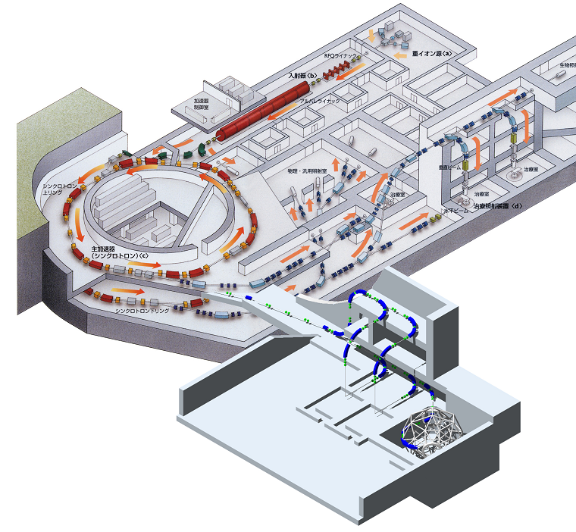
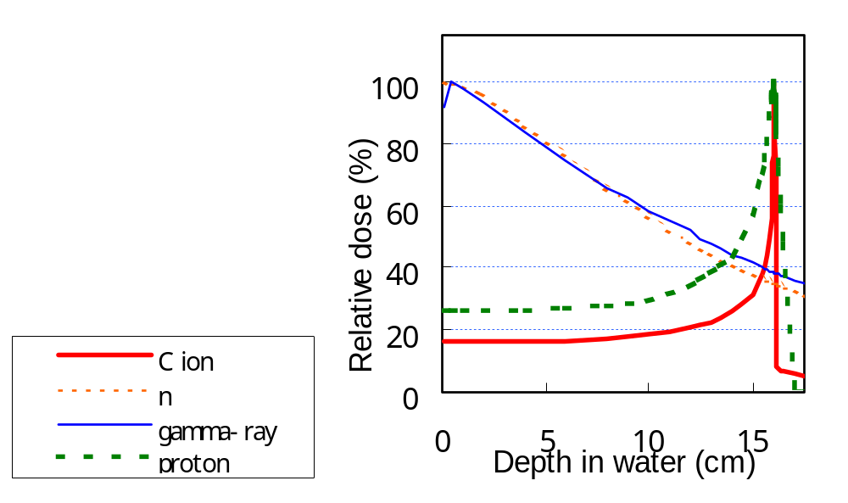
Heavy Ion Medical Accelerator in Chiba (HIMAC)
RFQ Linac
(800keV/n)
NIRS-HEC
NIRS-ECR
NIRS-PIG
Biology
Exp. room
Operation room
Alvarez Linac
(6MeV/n)
Kei3
Upper Synchrotron
(800MeV/n)
Kei2
Specifications
-Ion species He-Si
-Max. energy 800 MeV/n
-Size 70 m(W), 120 m(L), 30 m(H)
Therapy room
Lower Synchrotron
(800MeV/n)
High-Energy
Beam-Transport Line
Notes:
2

Slide 3
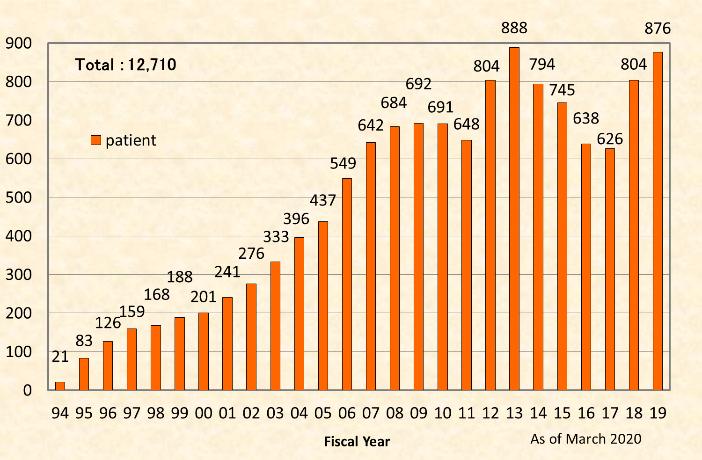
Patient Enrolled in Carbon Ion Therapy at QST
(June 1994～ March 2020)

Slide 4
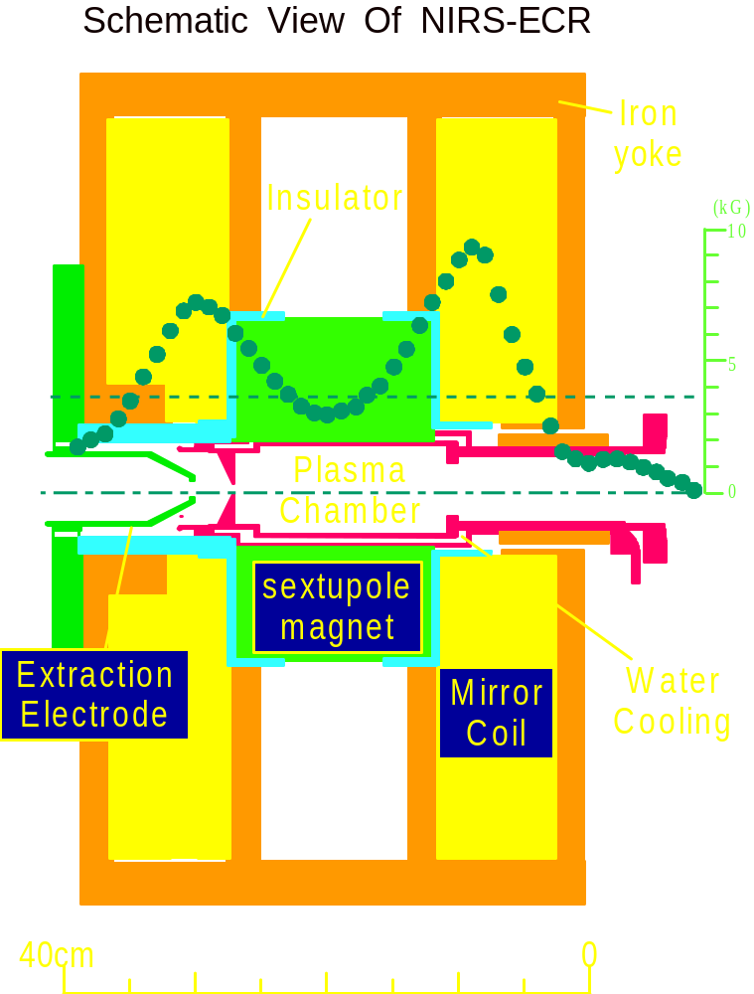
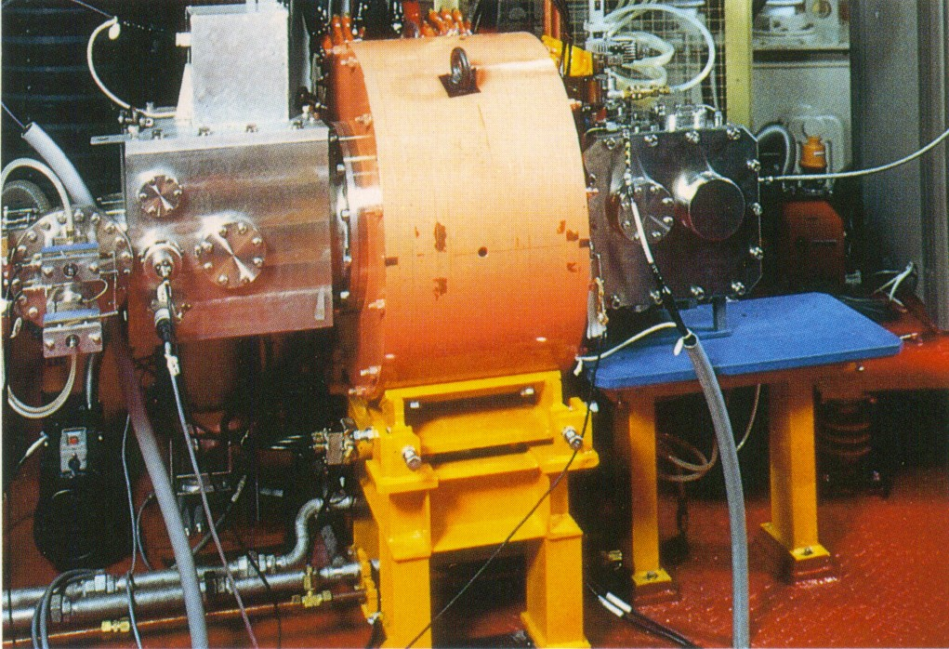
10 GHz NIRS-ECR ion source
  - TWT Amp., 9.75-10.25 GHz, 1 kW
  - Mirror field: 0.93 T / 0.76 T
  - Axial field: 0.8 T
  - Extraction voltage: 25kV max.
  - C⁴⁺: 430 μA (C²⁺: 200 μA for therapy)
  Production of C²⁺ ion for medical use

Slide 5
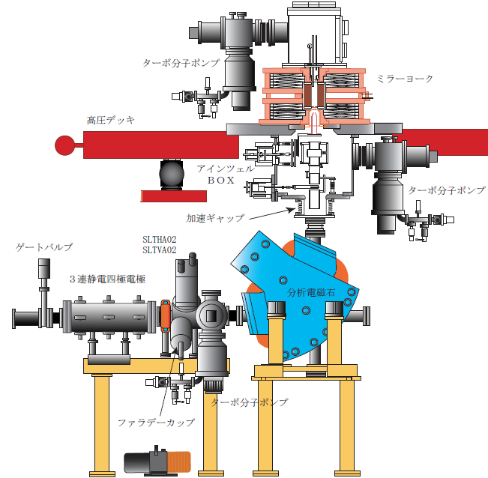
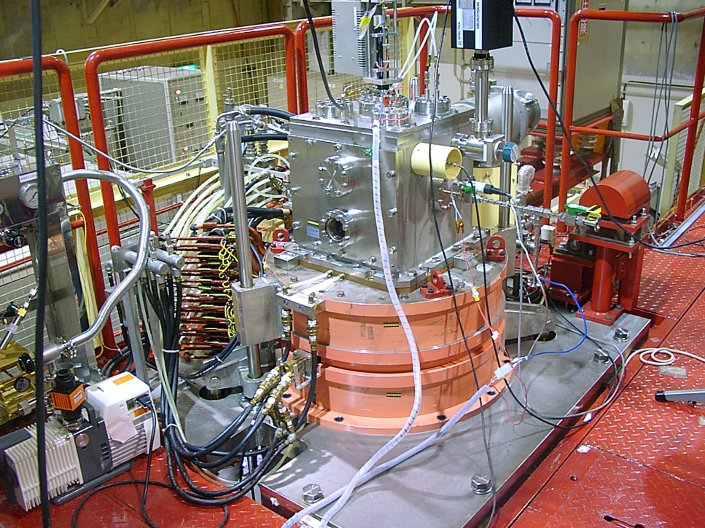
18 GHz NIRS-HEC source
TMP
Mirror coil
High voltage
Einzel
TMP
KLY: 18 GHz, 1400 W
TWTA: 17.10 – 18.55, 1200 W
Extraction voltage : 60 kV max.
FC
TMP
  Production of heavy ions (Ar, Fe, Kr, Xe)
  for biological and physical experiment

Slide 6
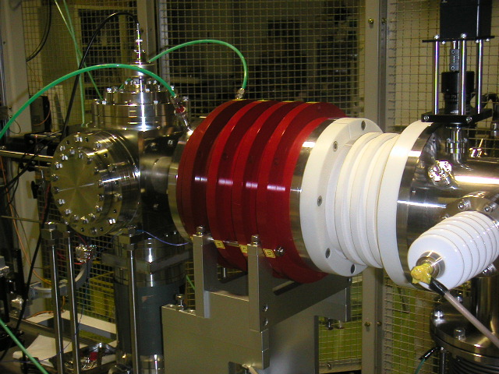
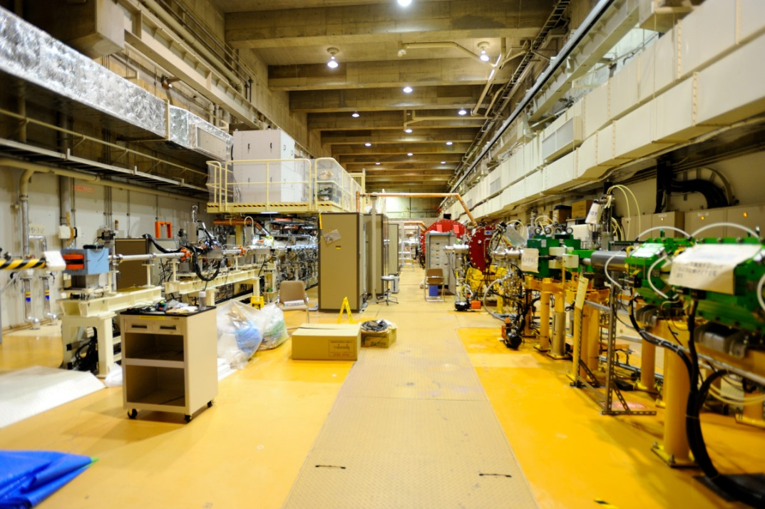
Prototype ion source for carbon ion radiotherapy (Kei2-source)
  All permanent magnet
    Mirror field: 0.84 T / 0.55 T
    Radial field: 0.75 T
  Extraction voltage: 30 kV max.
  Production of C⁴⁺ ion for biological experiment in HIMAC
  Commercial model (Kei series):Gunma, Saga, Kanagawa, Osaka, Yamagata -> under operating

Slide 7
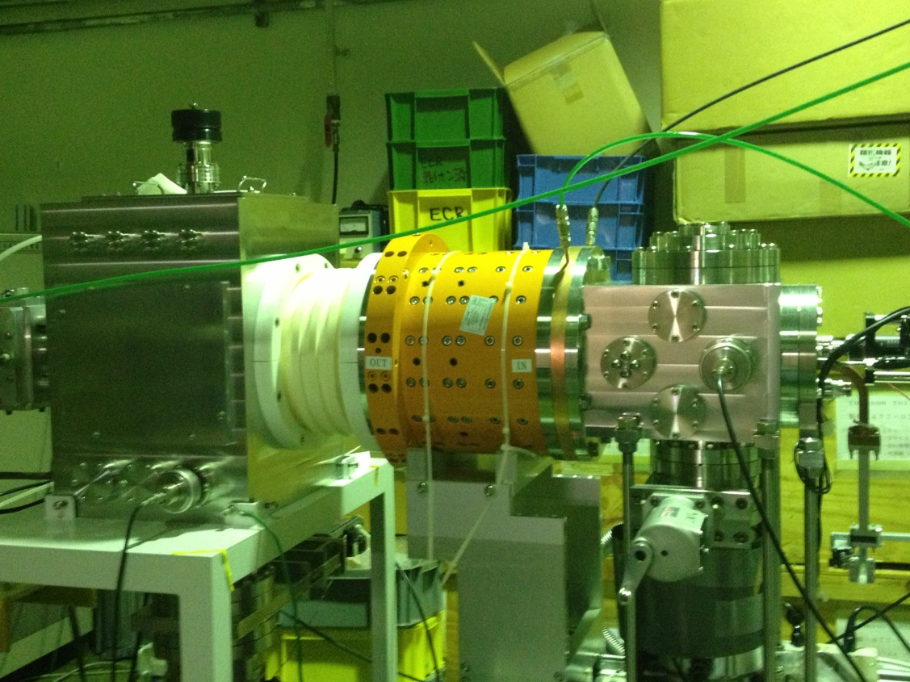
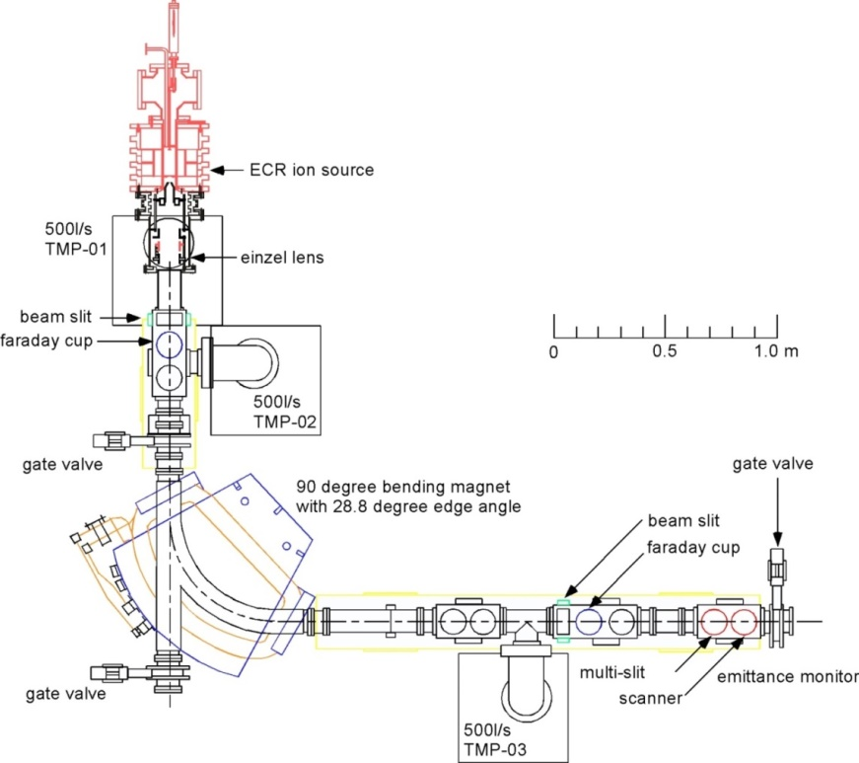
Prototype ion source for various ion production (Kei3-source)
  All permanent magnet
    Mirror field: 0.84 T / 0.55 T
    Radial field: 0.75 T
  Extraction voltage: 30 kV max.
  Development of ECR ion source (two frequency heating, gas mixing…)

Slide 8
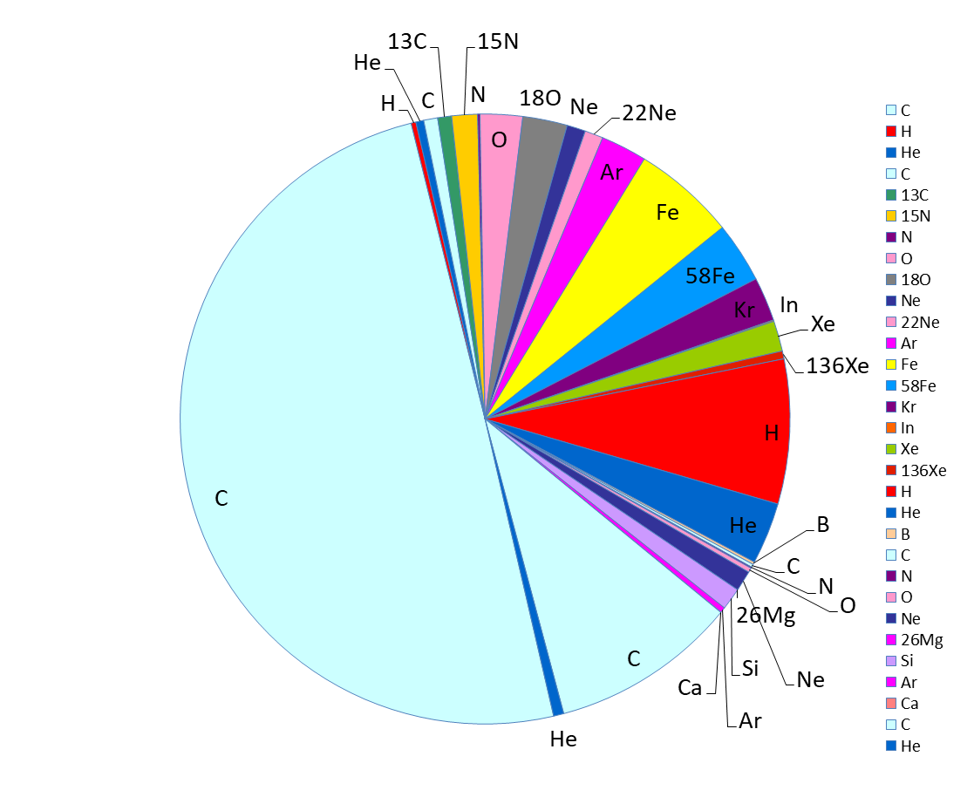
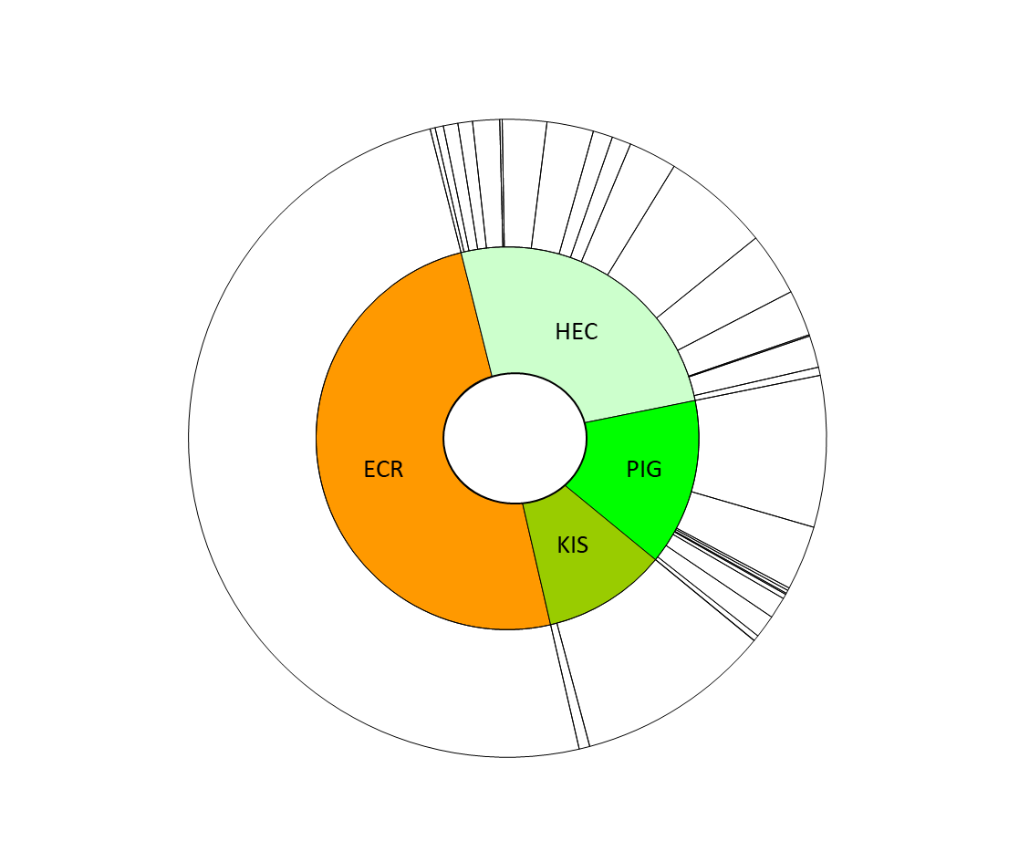
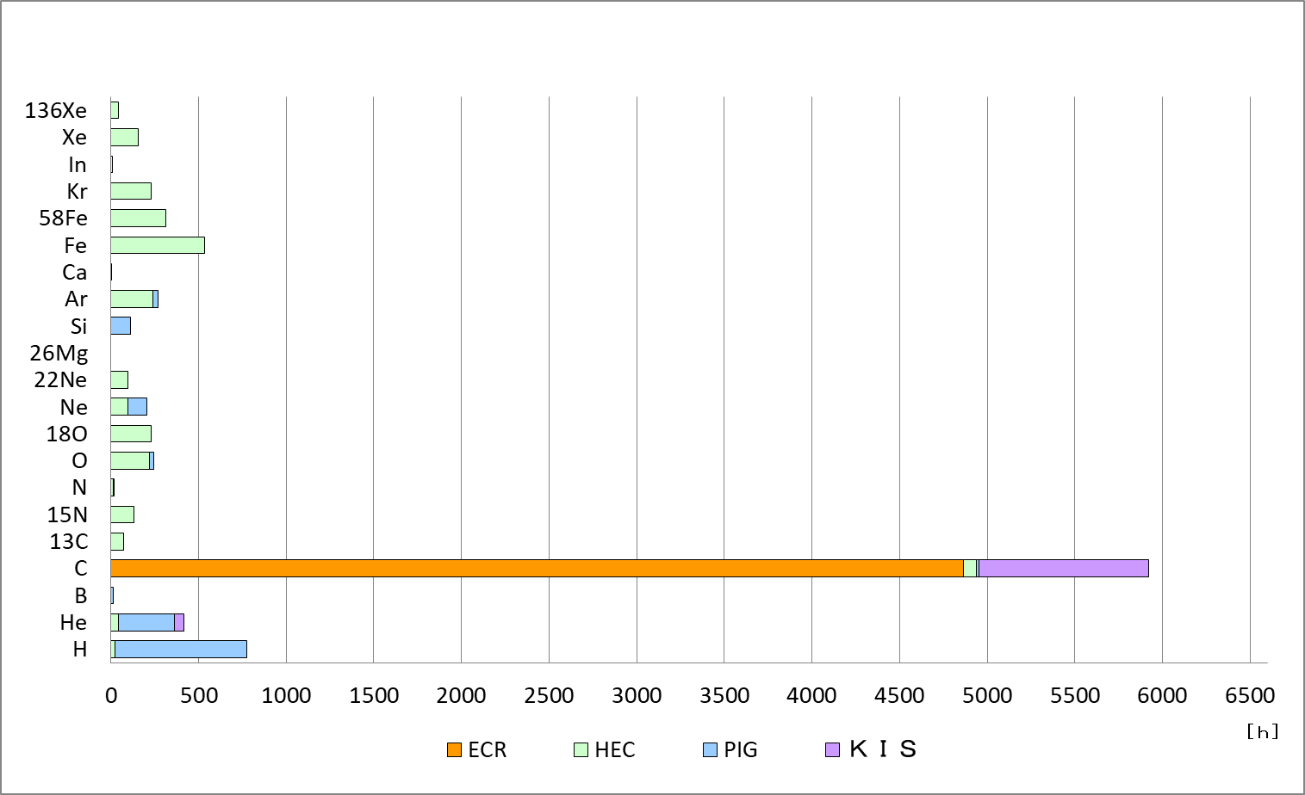
Operation of ion sources at HIMAC in 2019
  ECR: 10 GHz NIRS-ECR, HEC: 18 GHz NIRS-HEC
  PIG: NIRS-PIG, KIS: 10 GHz Kei2-source
25.7%
49.7%
14.1%
10.4%
  Ratio of operation time and ion species in 2019
  Operation time of various ion species in 2019
- Total operation time of ion sources were 9786.16hour in 2019.
- ECR produce C ion for medical use,
- HEC: Heavy ion, isotopic gas, PIG: light ion, spattering, KIS: carbon, He
- Operation time of carbon was 5923.04 hour (ECR: med., KIS, HEC, PIG: exp.)

Slide 9
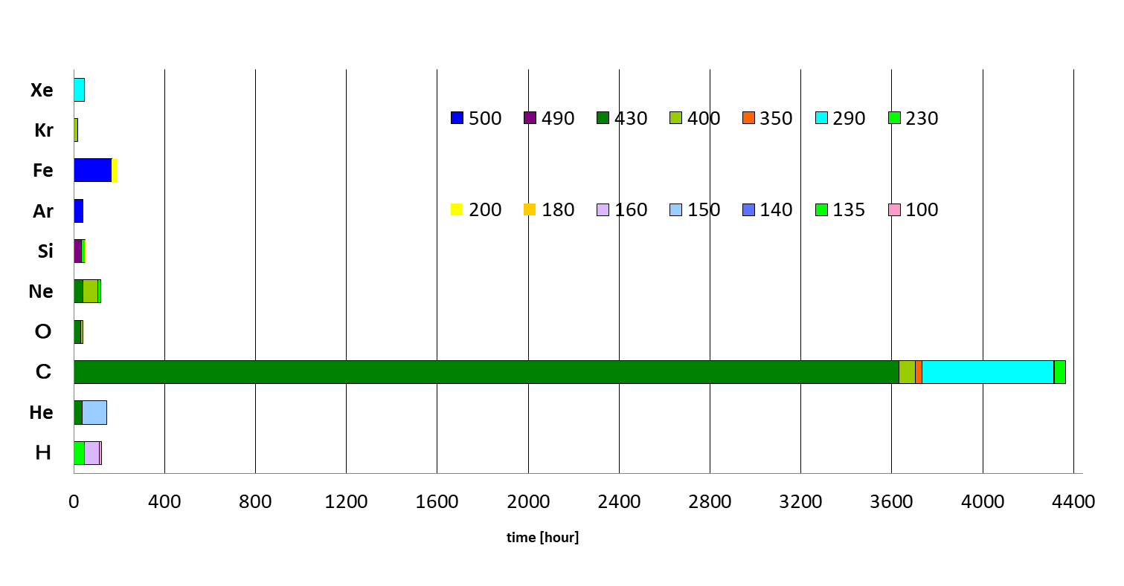
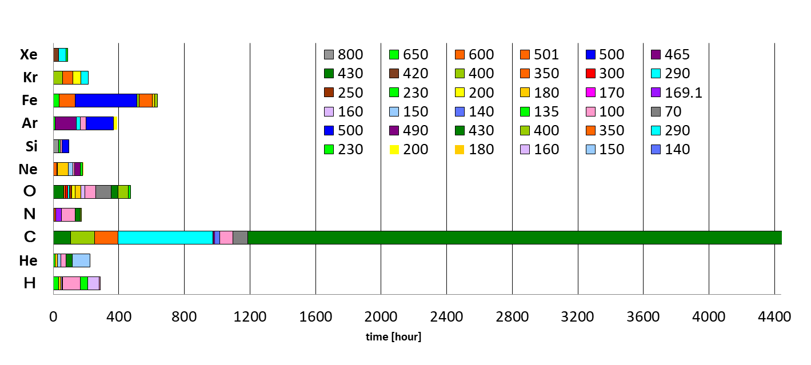
Operation time of HIMAC synchrotron
Upper synchrotron ring
- Carbon for medical use and few bio. Phys. experiment
- Beam energy for medical use is 56-430 MeV/n
- Other ion used for biological and physical experiment
Lower synchrotron ring
- Biological and physical experiment
- Iron and Oxygen are used a lot next to carbon

Slide 10
Development of 18 GHz NIRS-HEC
Gas switching at NIRS-HEC for multi-ion irradiation
- pulsed gas by solenoid valve
- production of He⁺, C²⁺, O³⁺, Ne⁴⁺
- beam switching
Production of Indium and Tin ion at 18 GHz NIRS-HEC
- In: In(C₅H₅)
- Sn: Sn(i-C₃H₇)₄

Slide 11
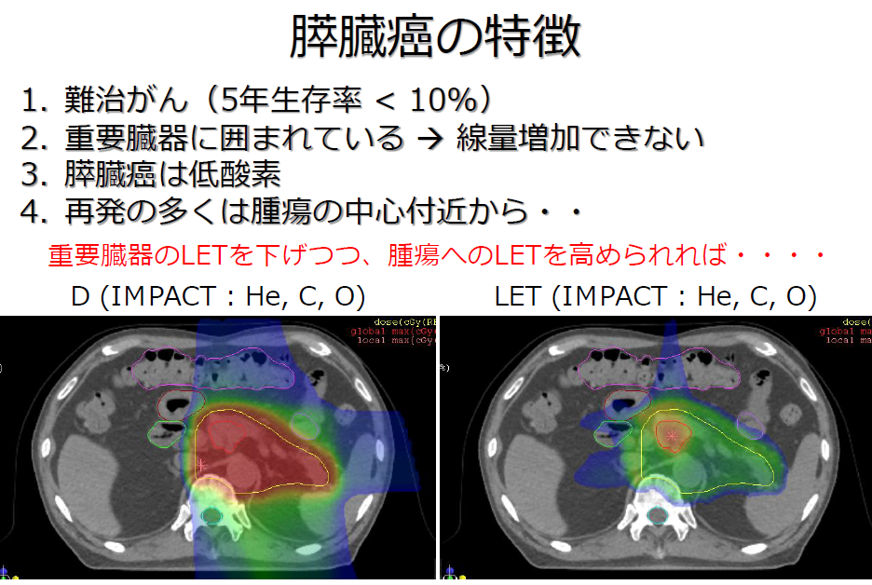
Multi-ion irradiation
Multi-ion irradiation: Optimization of ion species by irradiation area
  Center of tumor: Neon, Oxygen (higher biological effect than carbon)
  -> Suppression of cancer recurrence
  Around the center of the tumor: Carbon
  Near normal tissue: Helium (lower biological effect than carbon)
  -> Reducing side effects
Dose distribution with He, C, O at pancreas
Distribution of LET with He, C, O at pancreas
O
Irradiation area
O
He
He
C
C
Center of tumor
Ion source: production of He, C, O, and Ne ion
T. Inaniwa et al., Physics in Medicine and Biology, 62, p.5180 (2017).

Slide 12
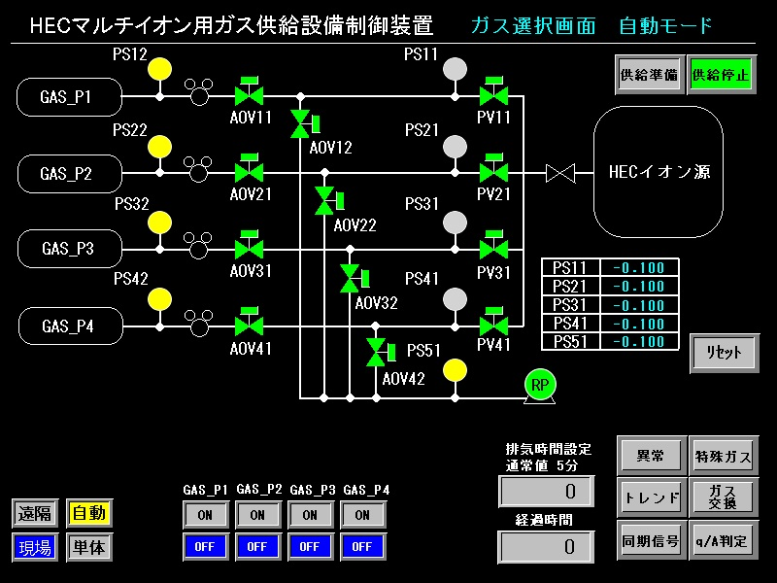
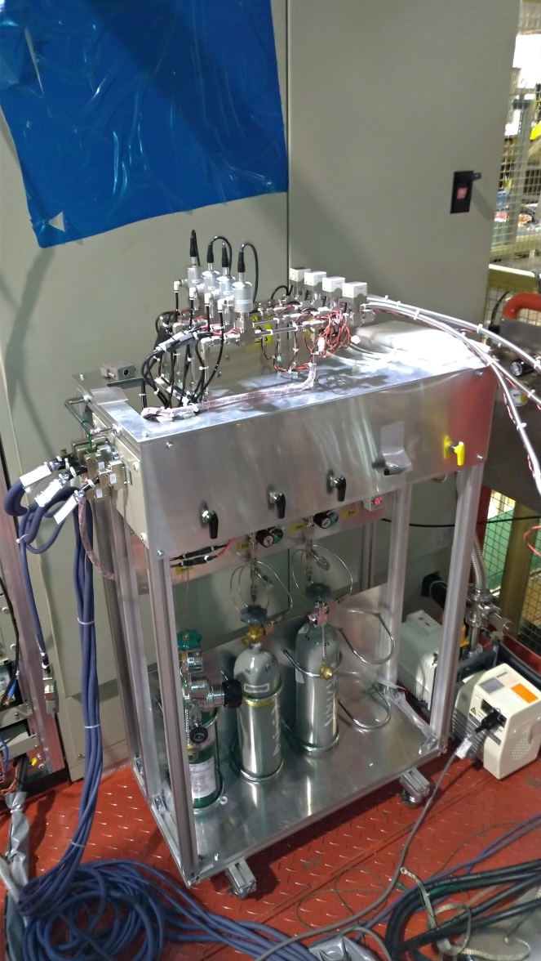
Gas switching system
Solenoid valve
NIRS-HEC
Material for ion production
He: He²⁺
CO₂: C²⁺, O³⁺
Ne: Ne⁴⁺
Ne
He
CO₂

Slide 13
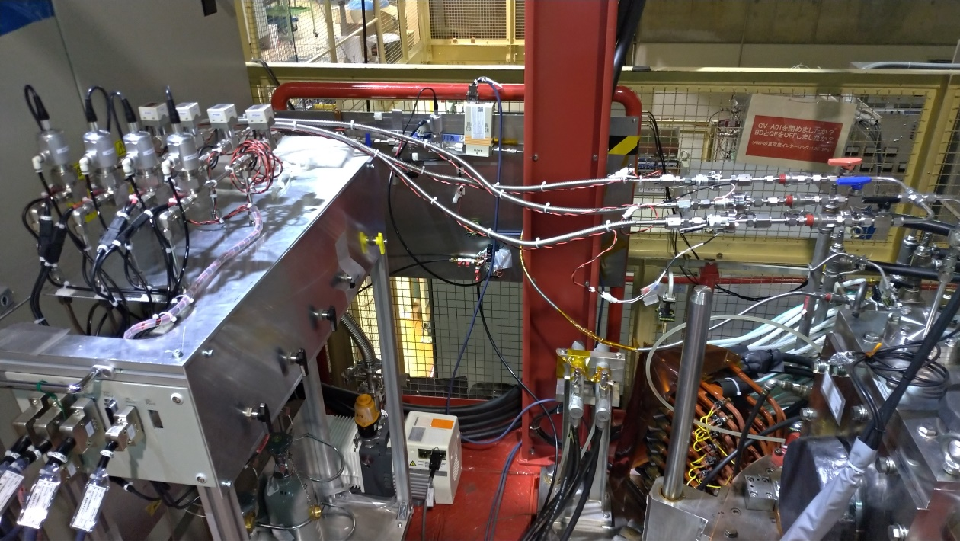
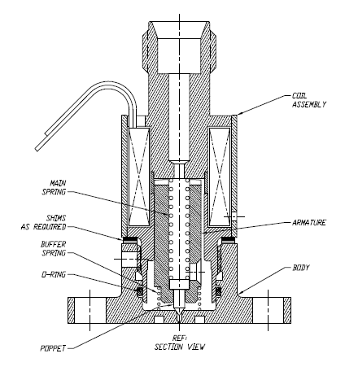
Gas switching system
NIRS-HEC
Material for ion production
He: He²⁺
CO₂: C²⁺, O³⁺
Ne: Ne⁴⁺
Ne
He

Slide 14
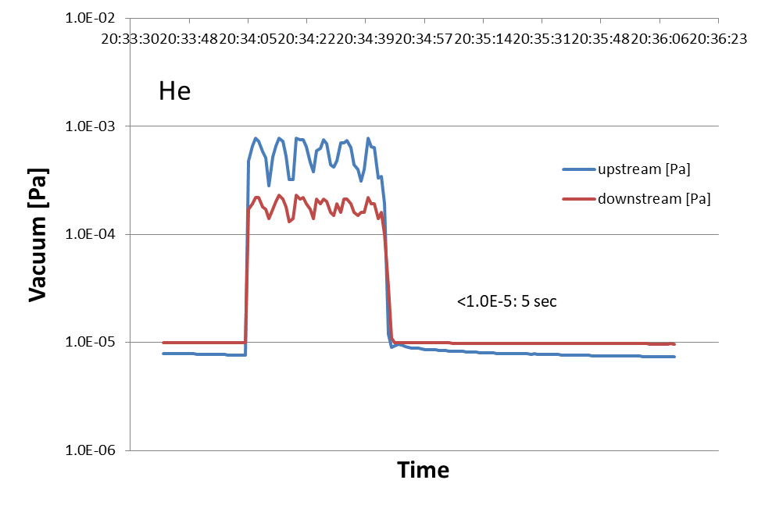
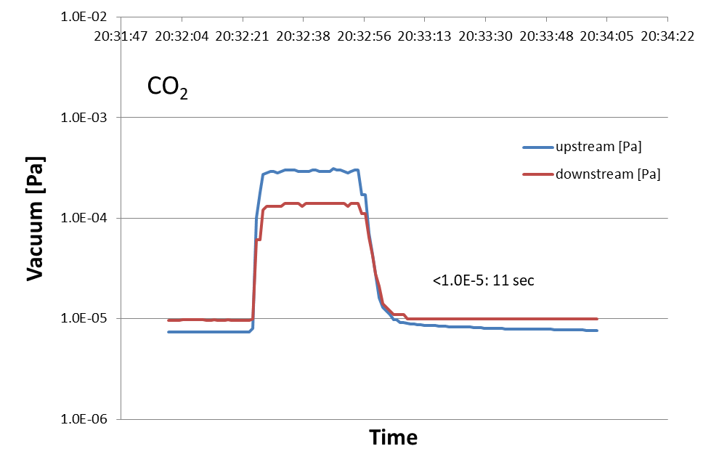
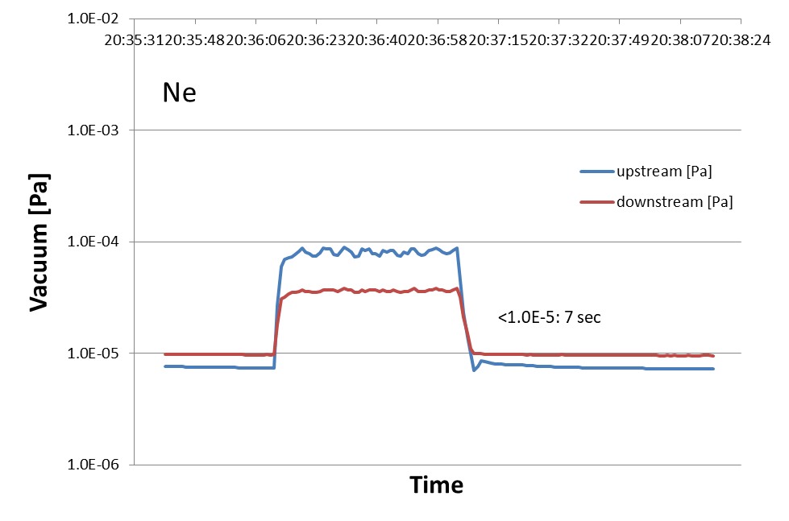
Exhaust time of gases
42 sec
27 sec
 | Pulse width [msec] | Repetition [Hz] | Pressure [MPa] | Time to 1.0E-5 Pa [sec]
He | 0.12 | 1.2 | 0.00 | 5
CO₂ | 0.3 | 1.2 | -0.05 | 11
Ne | 0.25 | 1.2 | 0.00 | 7
51 sec

Slide 15
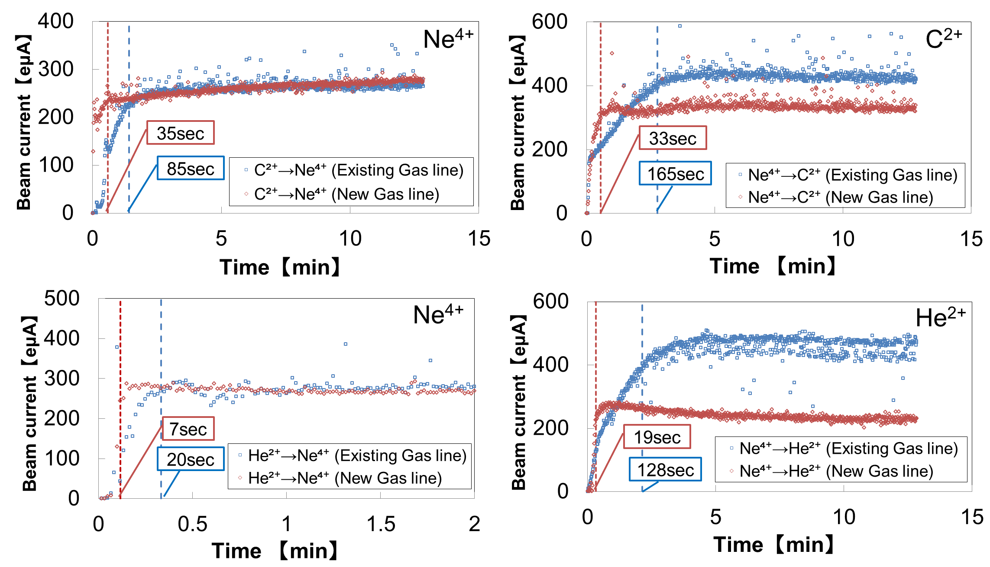
Beam switching time

Slide 16
Development of ECRIS
Gas switching at NIRS-HEC for multi-ion irradiation
- pulsed gas by solenoid valve
- production of He⁺, C²⁺, O³⁺, Ne⁴⁺
- beam switching
Production of Indium and Tin ion at NIRS-HEC
- In: In(C₅H₅)
- Sn: Sn(i-C₃H₇)₄

Slide 17
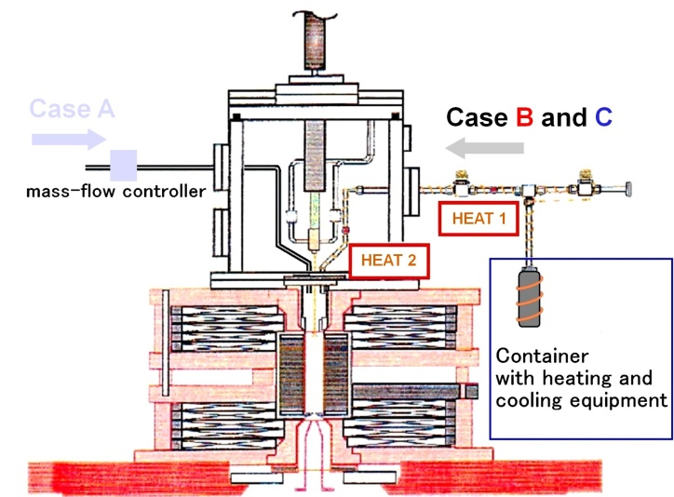
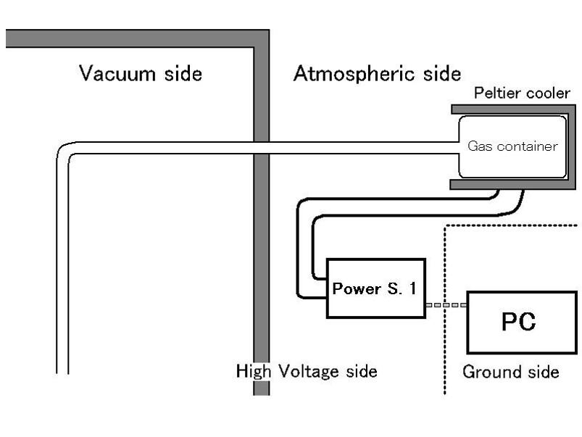
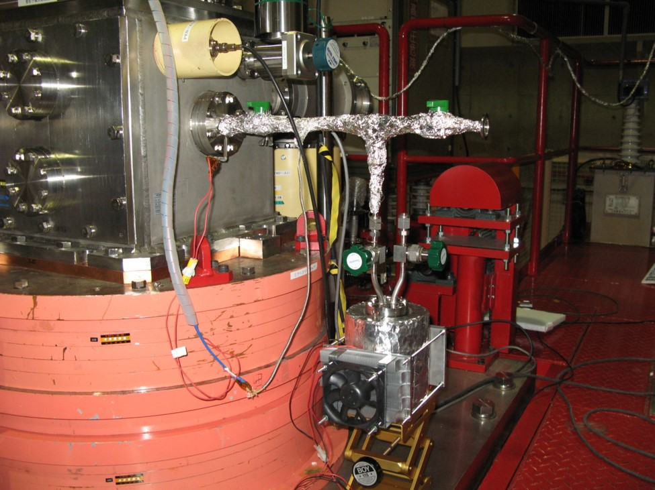
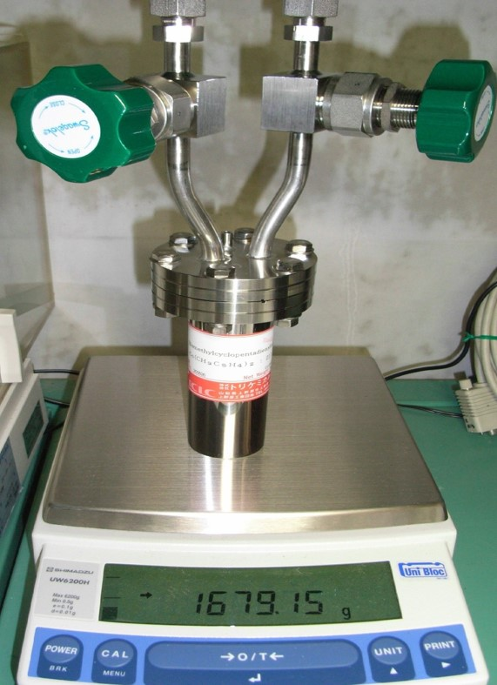
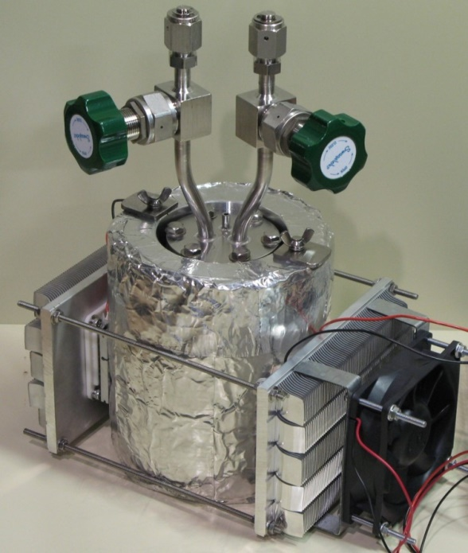
Production of Indium and Tin ion
Peltier cooler for MIVOC
0-room temperature
W. Takasugi RSI 81, 02A329 (2010)
Material
In: In(C₅H₅)
Sn: Sn(i-C₃H₇)₄

Slide 18
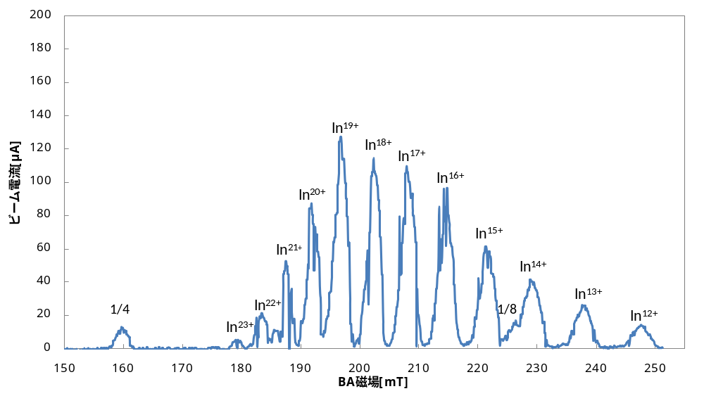
Production of Is ion from In(C₅H₅)
DEVICE | UNIT | PRESET
TG1_D | msec | 152.39
TG1_W | msec | 12
TG2_D | msec | 152.4
TG2_W | msec | 11.9
M_GFL | cc/min | 0.08 | O2
S_GFL | cc/min | 0
AMP1:F | W | 1200
AMP2:F | W | 600
LENS_D | kV | 7.2
MRR1 | A | 865
MRR2 | A | 570
EXT_D | kV | 31
AG_D | kV | 46
BD | V | 100
TEMP | Degree C | 6.2
BA | mT | 187.48
SLTA02 | mm | 10
SELF | sec | 0.412
Beam current [μA]
Magnetic field [mT]
Optimized for 20+
¹¹⁵In²⁰⁺: 90 μA

Slide 19
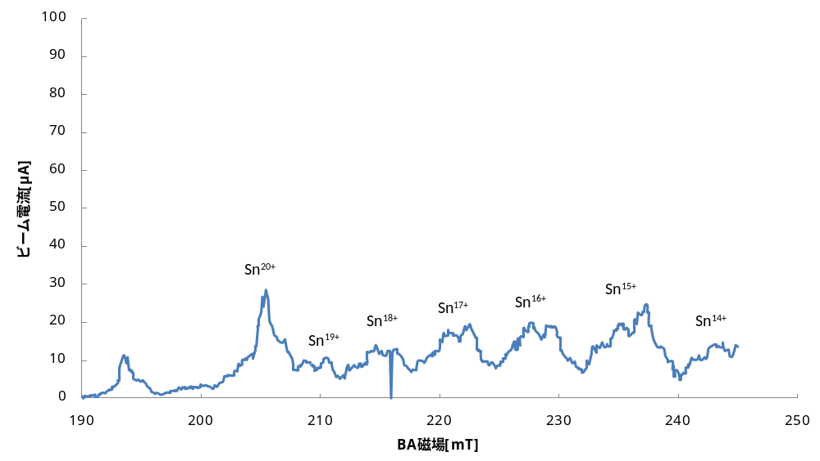
Production of Sn ion from Sn(i-C₃H₇)₄
DEVICE | UNIT | PRESET
TG1_D | msec | 0
TG1_W | msec | 75
TG2_D | msec | 0
TG2_W | msec | 75
M_GFL | cc/min | 0 | O2
S_GFL | cc/min | -
AMP1:F | W | 950
AMP2:F | W | 200
LENS_D | kV | 6
MRR1 | A | 865
MRR2 | A | 550
EXT_D | kV | 32
AG_D | kV | 53.333
BD | V | 100
TEMP | Degree C | 9.2
BA | mT | 215.71
SLTA02 | mm | 5
SELF | sec | 0.412
Beam current [μA]
Magnetic field [mT]
Optimized for 18+
¹²⁰Sn¹⁸⁺: 15 μA
not separation

Slide 20
Conclusion
Operation in 2019
- Total operation time: 9786hour
- Without big trouble (discharge, operation mistake)
Development of ECRIS
- Gas switching at NIRS-HEC for multi-ion irradiation
- production of He⁺, C²⁺, O³⁺, Ne⁴⁺
- switching time: 7-35 sec
- Production of Indium and Tin ion at NIRS-HEC
- ¹¹⁵In²⁰⁺: 90 μA
- ¹²⁰Sn¹⁸⁺: 15 μA (?)

Slide 21
Thank you

Slide 22
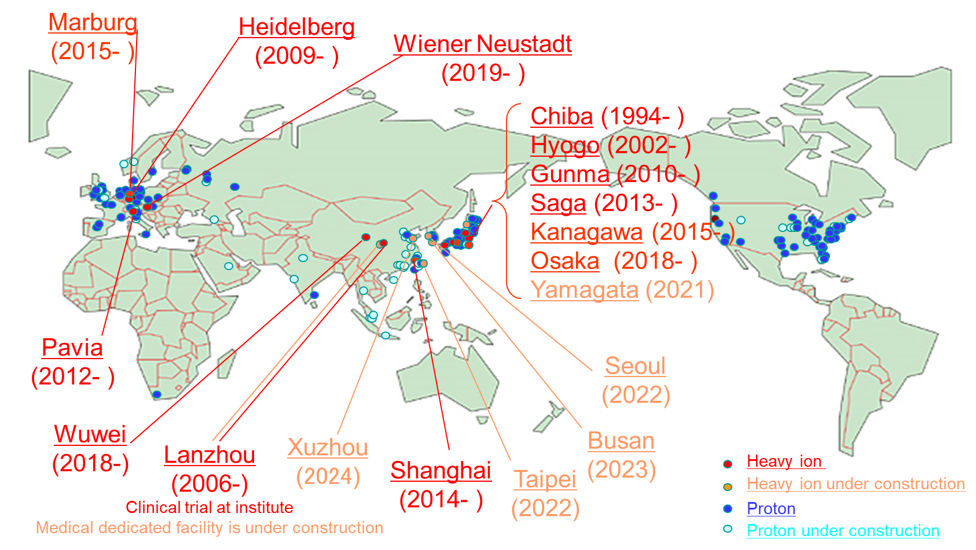
Heavy ion radiotherapy facilities worldwide

