Slide 1


The Institute of Nuclear Physics
Joint Institute for Nuclear Research, FLNR, Dubna, Russia
Production of metal ion beams from ECR ion source
А.E. Bondarchenko¹, S.L. Bogomolov¹, V.N. Loginov¹, A.N. Lebedev¹, V.E. Mironov¹, D.K. Pugachev¹, М.V. Zdorovets², I.А. Ivanov² ,Е.К. Sambayev², M. V. Koloberdin²,А.Е. Kurakhmedov², D.A. Mustafin², M.B. Abdigaliyev²
¹ Joint Institute for Nuclear Research, FLNR, Dubna, Russia
² Astana branch of Institute of Nuclear Physics, Astana, Kazakhstan
The report describes the production of metal ion beams from ECR ion sources by MIVOC (Metal Ions from Volatile Compounds) method. The method is based on the use of volatile metal compounds having high vapor pressure at room temperature: for example, Cr(C₅H₅)₂, (CH₃)₅C₅Ti(CH₃)₃ and several others. Using this method, intense beams of chromium, titanium, iron, and other ions were produced at the U-400 FLNR JINR and DC-60 cyclotrons (Astana branch of the INP, Alma-Ata, Kazakhstan Republic).

Slide 2
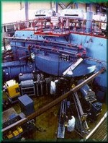
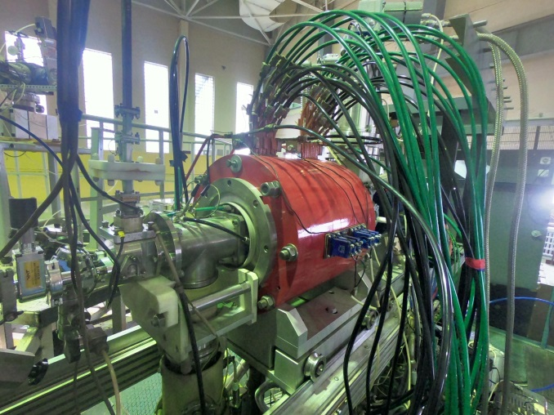
The cyclotron U-400 of Flerov laboratory nuclear reaction (JINR, Russia)
The main parameters of the beams
Atomic mass range (A) | 4 - 209
Accelerated ion energy | 3 – 29 MeV/nucleon
MAIN OBJECTIVES :
synthesis of superheavy elements
study of the chemical properties of superheavy elements
study of the structure of light nuclei at the nucleon stability boundary
study of the resonant structure of nuclear systems beyond neutron stability
study of fusion-fission mechanisms of nuclei
ECR4M ion source

Slide 3
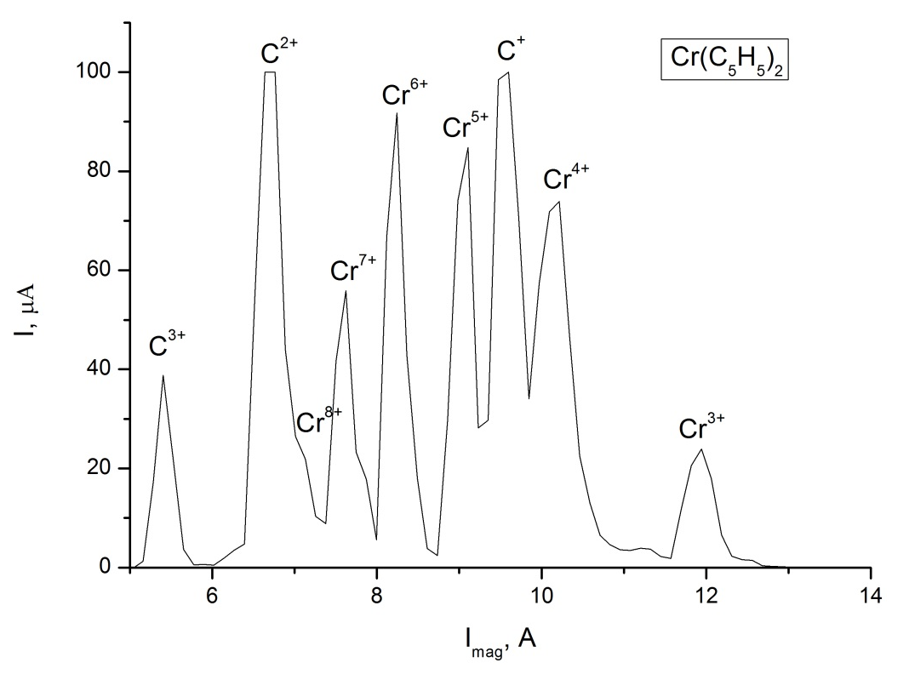
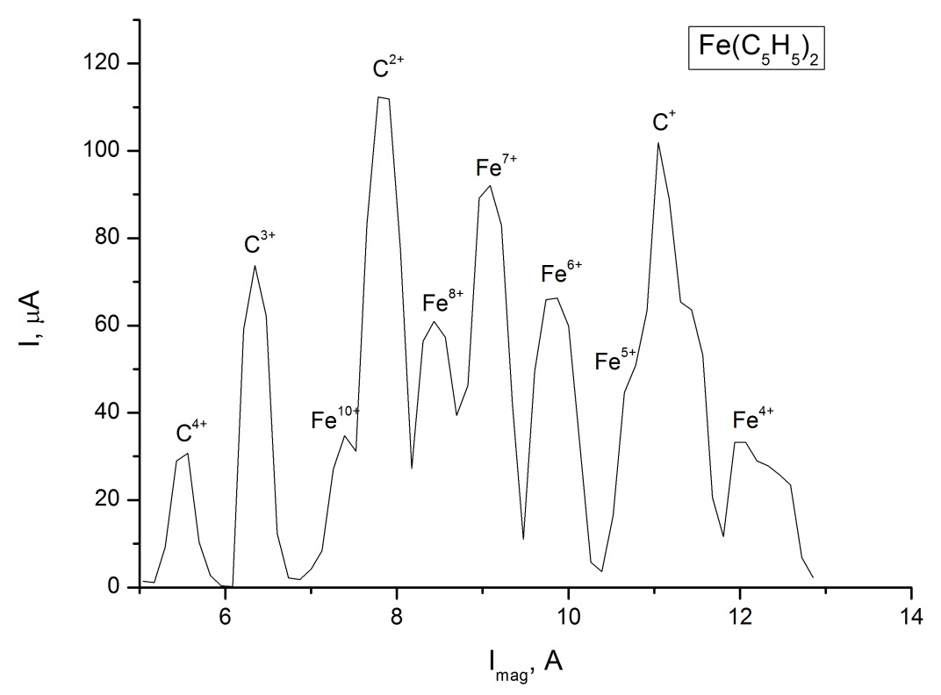
Beams of metal ions from ECR-4M ion source at the cyclotron U-400
At the U-400 cyclotron, stable beams of metal ions were obtained by the MIVOC method for various research areas:
⁵²Cr, ⁵⁶Fe – study of fusion-fission processes, quasi-fission and multi-nucleon transfer reactions
⁵⁴Cr, ⁵⁰Ti – alpha, beta and gamma spectroscopy of isotopes of heavy and superheavy elements
⁵⁶Fe – study of reactions with beams of stable and radioactive nuclides leading to the formation of exotic nuclei

Slide 4
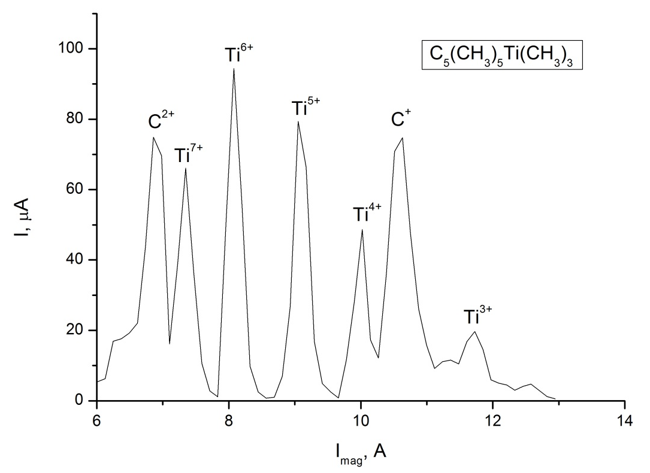
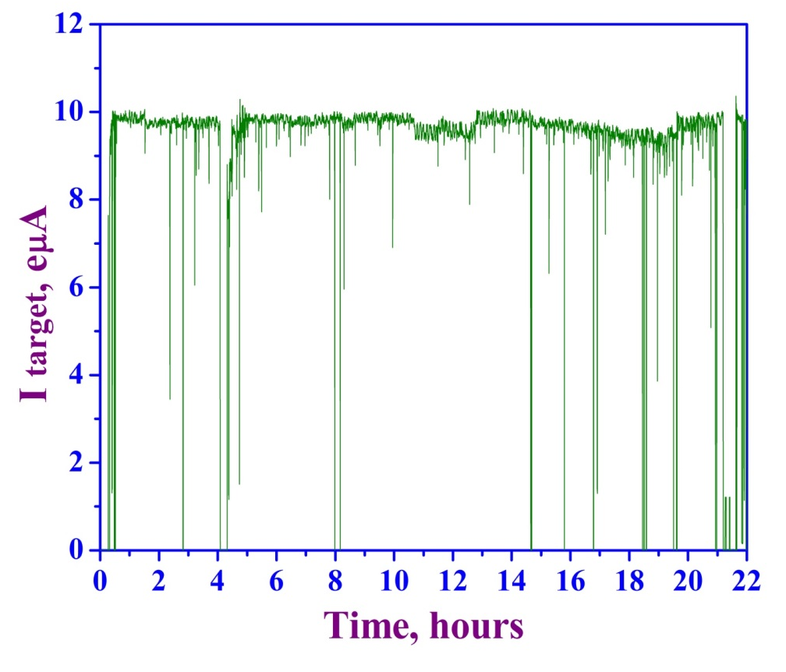
The spectrum of ⁵⁰Ti , the source settings are optimized for ⁵⁰Ti⁵⁺ – 78 μA. UHF power – 51 W.
Ti-50 current at the target
⁵⁰Ti runs:
Since October 2013 beam time of ⁵⁰Ti constitutes 46 weeks
One ampule with compound
(850 mg in average) –
≥ two weeks of non-stop operation

Slide 5
Table 2. The intensity (μA) of metal ion beams produced from the ECR ion sources of the FLNR JINR using the MIVOC method
Z | 5+ | 6+ | 7+ | 8+ | 9+ | 10+ | 11+ | 12+ | 14+ | 16+ | 17+ | 18+ | 19+
⁵⁶Fe* |  | 43 | 93* | 125 | 172 | 145 | 114 | 73
⁴⁶Ti* | 62* | 51 | 40
⁴⁸Ti* | 79* |  |  |  |  |  | 68
⁵⁰Ti* | 82* |  |  |  | 90 | 72 | 60 | 23
Ni |  | 45 | 43 | 48 | 53 |  | 30 | 10
Co |  | 57 | 80 | 86 | 98 |  | 82 | 25
Cr* | 50 | 74* | 68 | 42 | 17 | 8
Ge |  |  | 43 | 54 |  | 47
V | 75 | 54 | 41 | 54 | 55 | 43 | 34 | 19
Hf |  |  |  |  |  |  |  |  | 45 | 50 | 45 | 36 | 27
* – accelerated metal ion beams at the U-400 cyclotron, FLNR

Slide 6
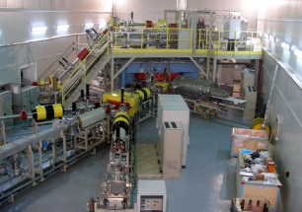
The accelerator complex DC-60 of Astana branch of the INP (Alma-Ata, Kazakhstan Republic)
The main parameters of the beams
Type of ions | Li - Xe
Mass to charge ratio (A/Z) | 6 - 12
Accelerated ion energy | 0,35 – 1,7 MeV/nucleon
MAIN OBJECTIVES :
Scientific research
Education
Production of track membranes with special properties
Creation of micro and nano structures
Surface modification of standard materials, creation of new materials with required properties
The cyclotron is equipped with the Electron Cyclotron Resonance (ECR) ion source DECRIS-3

Slide 7
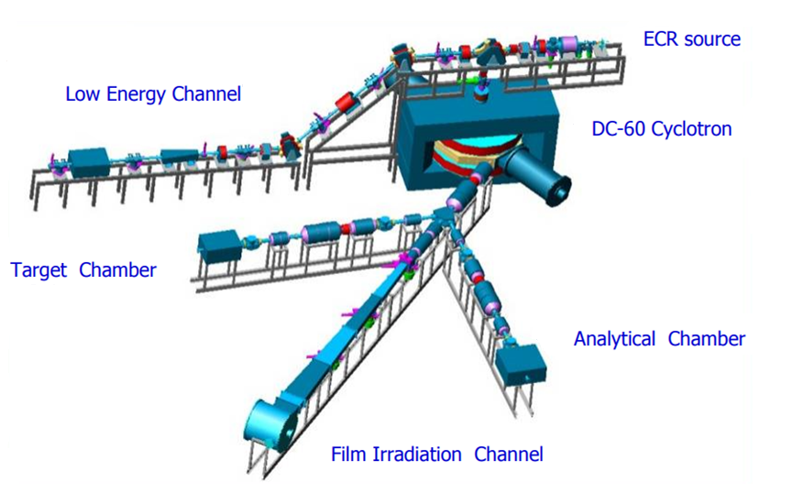
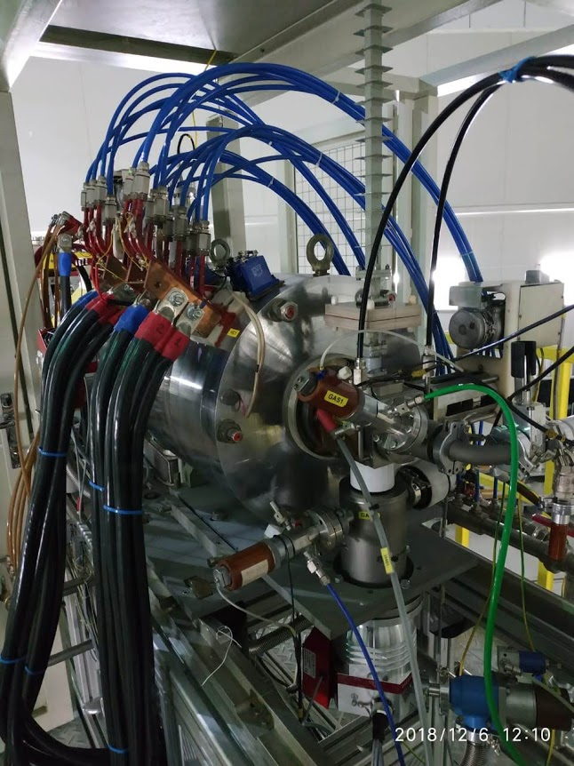
CYCLOTRON DC-60
DECRIS-3 ion source
The experience and knowledge on the production of metal ion beams from ECR ion sources in FLNR by the MIVOC method has been successfully transferred to the DC-60 cyclotron.

Slide 8
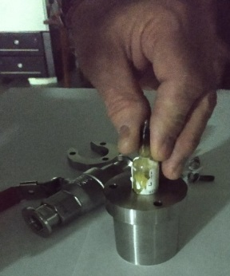
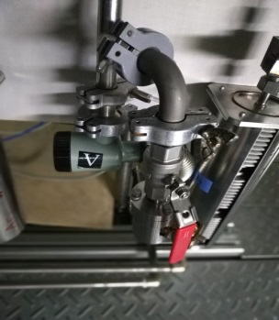
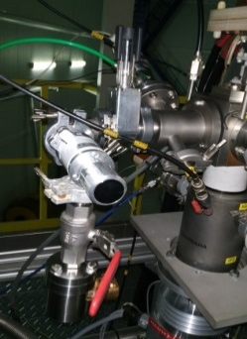
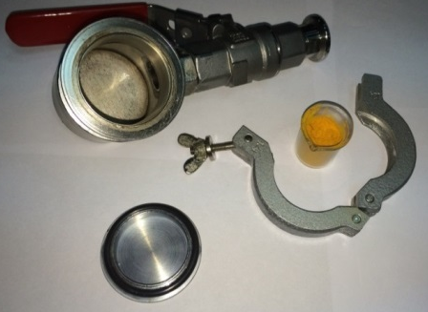
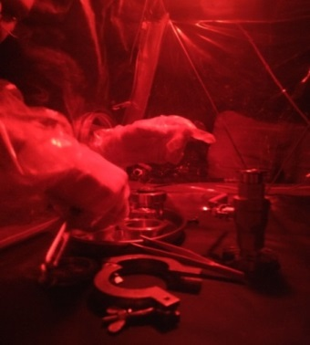
The preparation of the titanium compound.
Titanium ions beams were produced from the compound (CH₃)₅C₅Ti(CH₃)₃.
Preparation of the titanium compound (CH₃)₅C₅Ti(CH₃)₃ for operation. Left - an ampoule with a substance is placed in a container; in the center - the container with the substance is pumped to the forevacuum; on the right - the container with the working substance is connected to the ECR ion source through a mechanical regulating valve.
The preparation compounds ferrocene, cobalt, chrome, nickel, germanium and hafnium.
The organometallic compound Fe(C₅H₅)₂ hasn’t a chemical activity with oxygen and isn’t sensitive to visible light. Therefore, the preparation of the MIVOC chamber with the compound Fe(C₅H₅)₂ was carried without an argon box.
The compounds Cr(C₅H₅)₂, Co(C₅H₅)₂, Ge(CH₃)₄ and (C­₅H₅)₂Hf(CH₃)₂ has a chemical activity with oxygen. So, the preparation of the MIVOC chamber was carried out an argon box.
The compound Ni(C₅H₅)₂ has a high chemical activity with oxygen and is highly sensitive to visible light. Therefore, the preparation of the MIVOC chamber with the compound Ni(C₅H₅)₂ was carried out in an argon box under red light.
After preparation all containers with compounds are pumped to the forevacuum, and connected to the ECR ion source through a mechanical regulating valve.

Slide 9
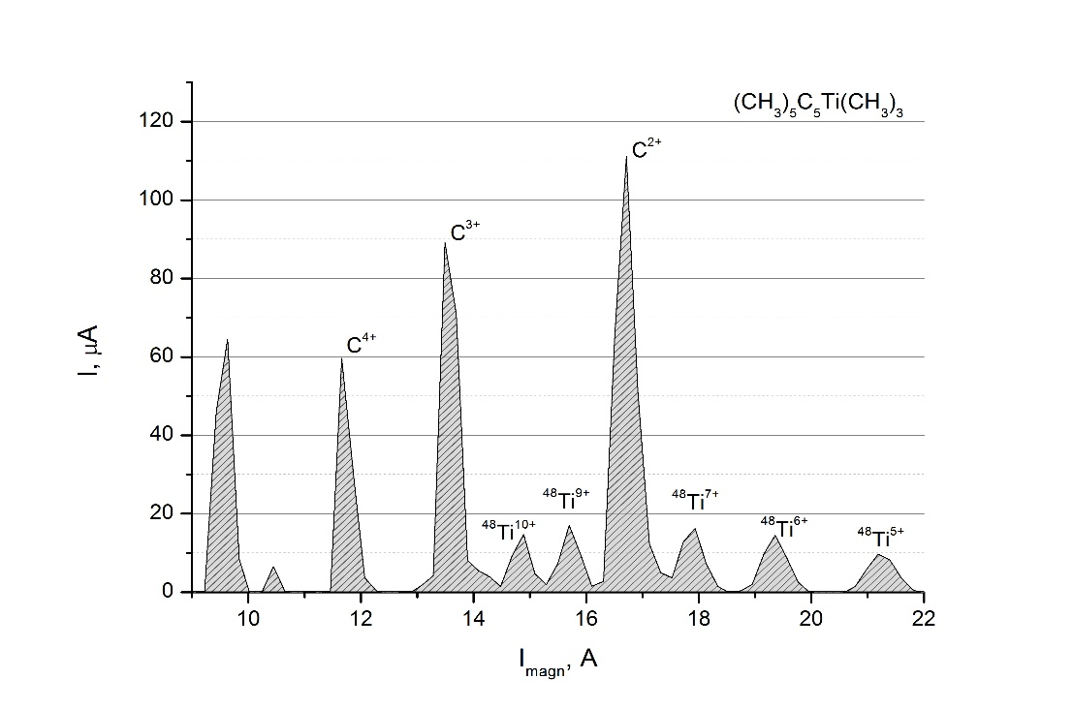
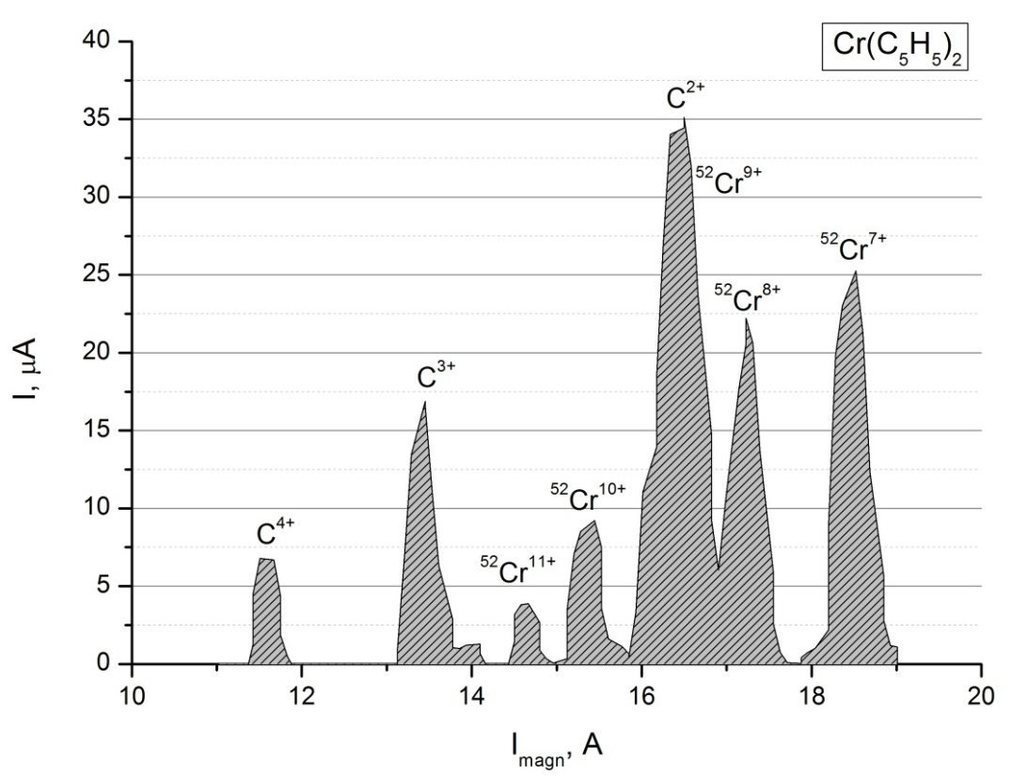
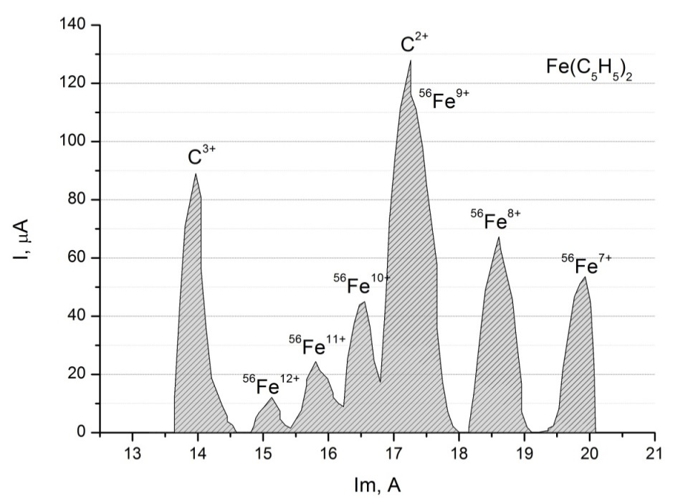
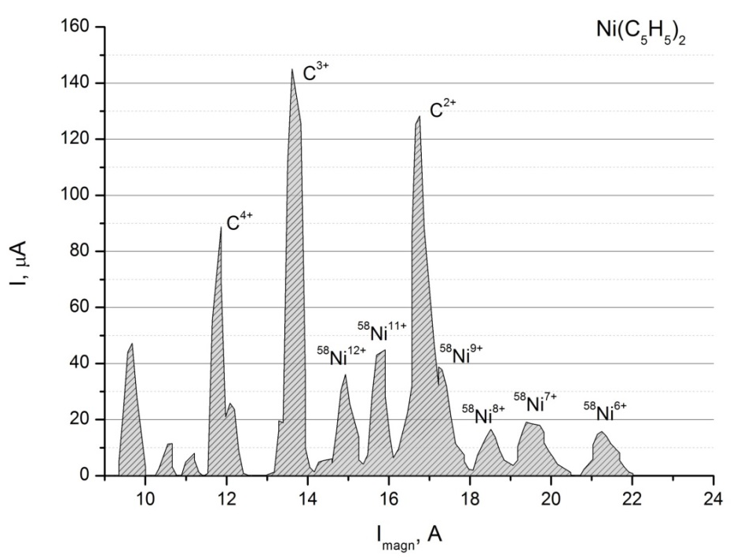

Slide 10
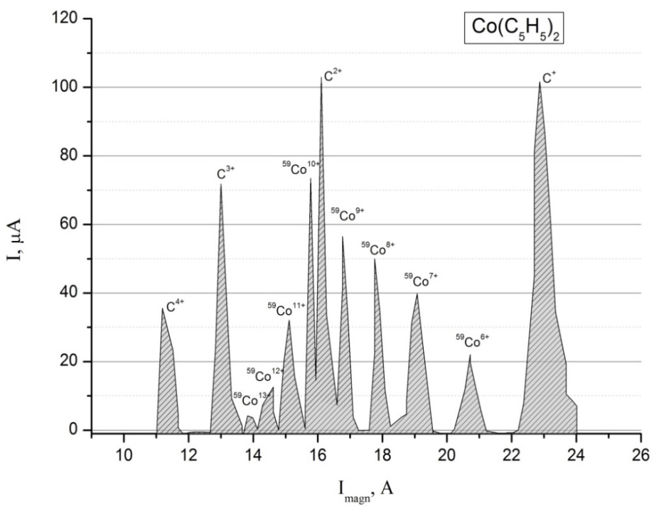
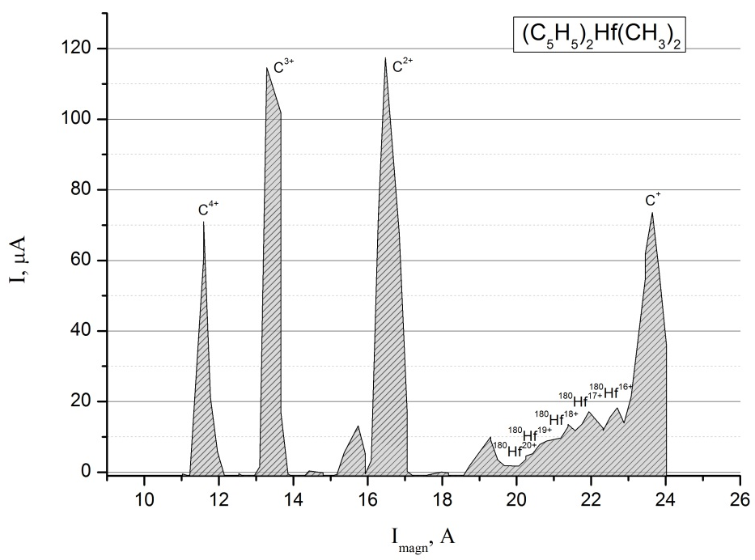
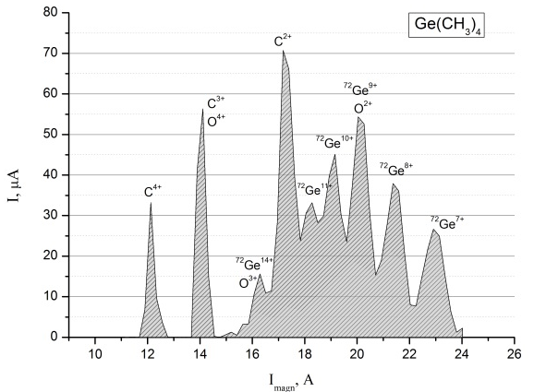
Table 1. The intensity (μA) of metal ion beams produced from the DECRIS-3 ECR ion source of the DC-60 cyclotron using the MIVOC method
Z | 8+ | 9+ | 10+ | 11+ | 12+ | 17+ | 18+ | 20+
⁴⁸Ti |  | 18* | 16
⁵⁸Ni |  | 39 |  | 43* | 37
⁵⁹Co |  | 57 | 73 | 36 | 12*
⁵²Cr | 22 |  | 9*
⁵⁶Fe | 68 |  | 44* | 25 | 12
⁷²Ge | 38 |  | 46* | 34
¹⁸⁰Hf |  |  |  |  |  | 19 | 15 | 5
* –metal ion beams accelerated at the DC-60 cyclotron

Slide 11
CONCLUSION
The main goal of this work was to employ the MIVOC method for production of ions of solid and extend the spectrum of accelerated ions at the FLNR cyclotrons and at the DC-60 cyclotron.
With the extention of the spectrum of accelerated elements, it becomes possible to set up new experiments in the field of experimental nuclear physics, radiation solid state physics, and various applied problems, which makes the research objective particularly relevant. As a result of the work done, for the first time at the DC-60 cyclotron, the ion beams of ⁴⁸Ti⁹⁺, ⁵⁸Ni¹¹⁺, ⁵⁹Co¹²⁺, ⁵²Cr¹⁰⁺, ⁷²Ge¹⁰⁺ and ¹⁸⁰Hf¹⁷⁺ were produced.

