Slide 1
Conceptual design of an electrostatic trap for high intensity pulsed beam
W. Huang, L. T. Sun, Y. G. Liu, H. W. Zhao
University of Chinese Academy of Sciences, Institute of Modern Physics (IMP), Chinese Academy of Sciences (CAS)
D. Z. Xie
Lawrence Berkeley National Lab (LBNL), USA
2020/9/30 ECRIS 2020, East Lansing 1

Slide 2
outline
Background
Principle of the ion trap
Design of the electron gun
Simulation of the ion trap
Summary
2020/9/30 ECRIS 2020, East Lansing 2

Slide 3
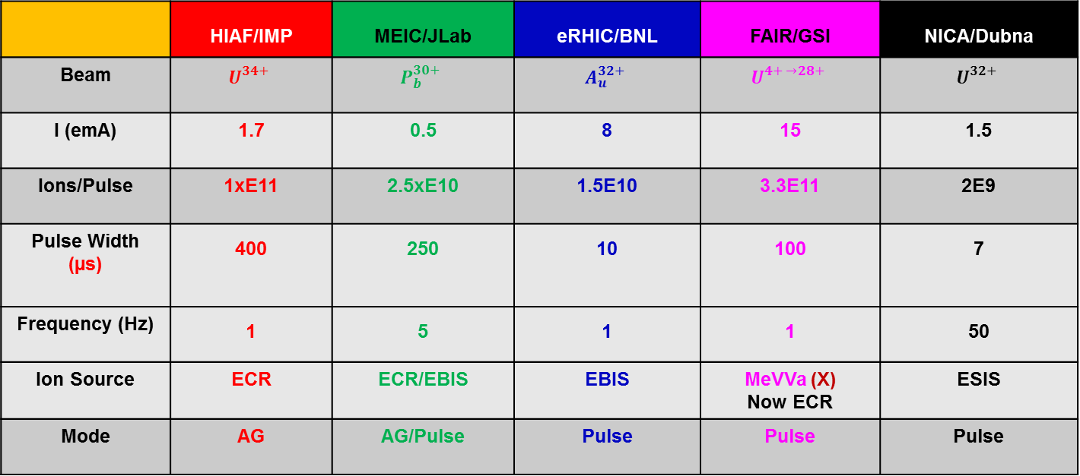
background
Heavy ion beam requirements for the next generation accelerators
 | HIAF/IMP | MEIC/JLab | FAIR/GSI | NICA/Dubna
Beam
I (emA) | 1.7 | 0.5 | 15 | 1.5
Ions/Pulse | 1xE11 | 2.5xE10 | 3.3E11 | 2E9
Pulse Width (µs) | 400 | 250 | 100 | 7
Frequency (Hz) | 1 | 5 | 1 | 50
Ion Source | ECR | ECR/EBIS | MeVVa (X) Now ECR | ESIS
Mode | AG | AG/Pulse | Pulse | Pulse
*AG: After Glow
Arguments on ion beam compressor, LBNL, USA, 2016
2020/9/30 ECRIS 2020, East Lansing 3

Slide 4
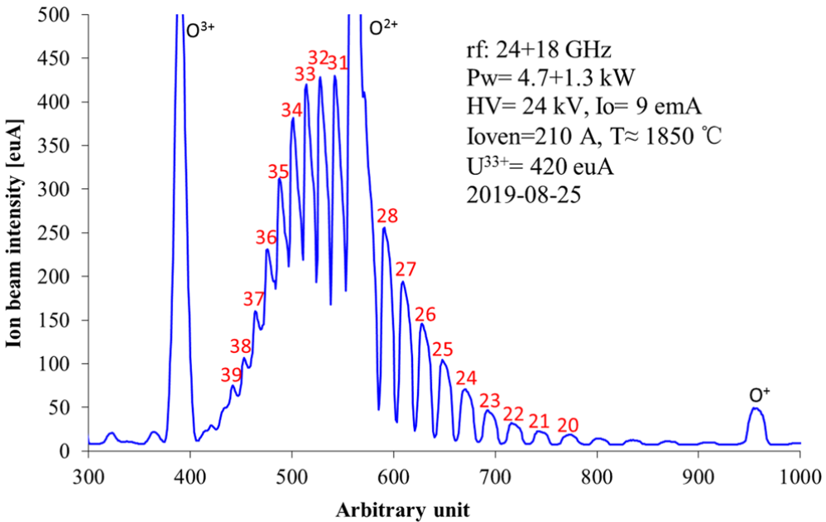
background
Present ECR performance on uranium beams in IMP
W. Lu et al., Rev. Sci. Instrum. 90, 113318 (2019).
The requirement of HIAF for U34+ is 4 times of this performance.
4th generation ECR ion sources.
Ion trap.
Solutions
2020/9/30 ECRIS 2020, East Lansing 4

Slide 5
Principle of the ion trap
EBIS?
≤ 20% in the desired charge state distribution.
ECR?
f=1 Hz, 10 ms
Ions in CW mode
Accelerator
99% of the ions are wasted
Ion trap
Ions in CW mode
accumulation
f=1 Hz
Ion trap
Accelerator
Most of the ions are used.
More ions are in the desired charge state.
2020/9/30 ECRIS 2020, East Lansing 5

Slide 6
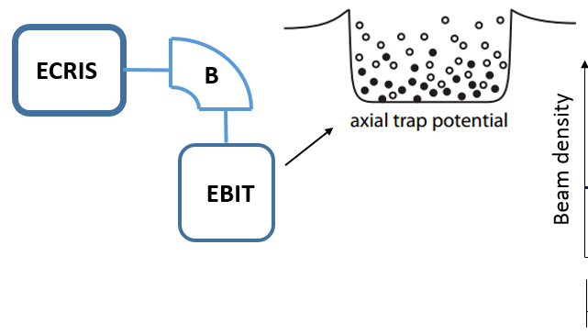
Principle of the ion trap
An electrically confined ion beam compressor
Gate
∆V(t-δ)
V_{bunch}(ƒ)
∆E
~ 5 qeV
U_{b}
Bunching Section
Trapping Section
L ~ 10 cm, Ø ~ 1.5 cm,
Bunching Efficiency ~ 0.5 - 0.6
U_{trap}
Z
L ~ 40 cm, Ø ~ 1.5 cm
Arguments on ion beam compressor, LBNL, USA, 2016
ITRIP
*ITRIP: Ion Trap for high Intensity Pulsed beams
2020/9/30 ECRIS 2020, East Lansing 6

Slide 7
Principle of the ion trap
features:
1. Extraction frequency ~ 1 Hz. (requirement of the HIAF)
2. No ionization of the desired charge state of ion.
3. Hollow structure of electron gun to extract the ions.
e.g. U³⁴⁺
Design parameters | value
Length | 0.5 m
Magnetic field | ~ 0.5 T
Ee | < 1.2 keV (ionization threshold of U³⁴⁺)
Ie | <1 A
Ion trapped (charges) | ~ 3E10
U³⁴⁺ ions | ~ 1.5E10
2020/9/30 ECRIS 2020, East Lansing 7

Slide 8
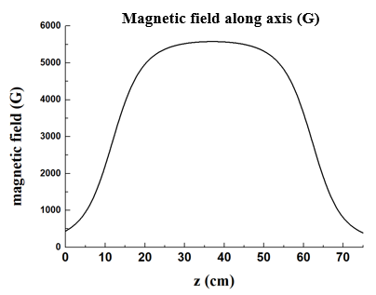
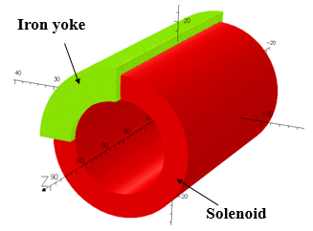
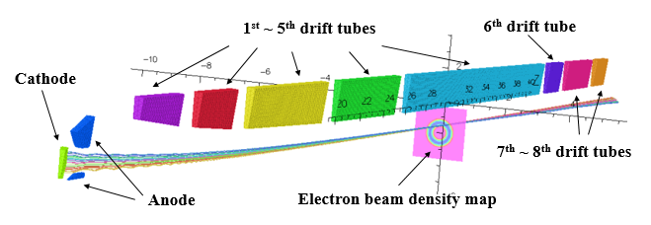
Design of the electron gun
Radius=15 cm
Bmax ~ 5500 G
Cathode position
Energy of electron ~ 1 keV, current ~ 440 mA.
2020/9/30 ECRIS 2020, East Lansing 8

Slide 9
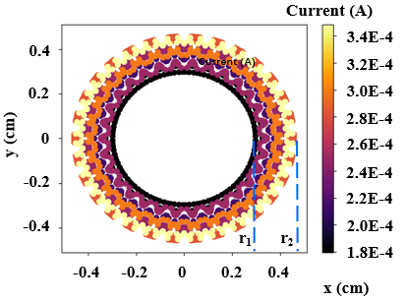
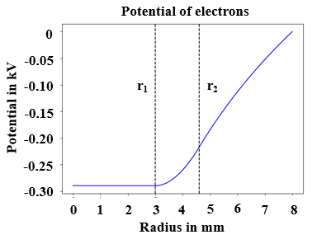
Design of the electron gun
Density distribution of electrons
r₁ ~ 3 mm, r₂ ~ 4.5 mm.
The depth of electron potential is ~ 0.3 kV.
2020/9/30 ECRIS 2020, East Lansing 9

Slide 10
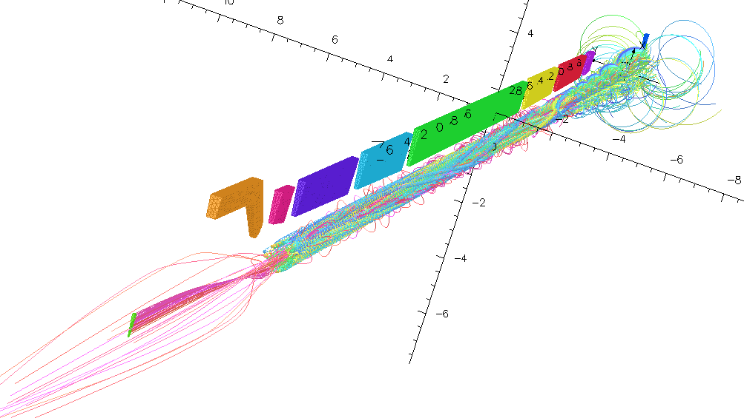
Simulation of the ion trap
Injection of ions
electrons
Reflecting electrode
U34+
Electrons move back and forth.
Ions parameters:
radius ~5 mm, 0.1 emA
Energy of ions in the trap: (20 ~ 50) *q eV
*q: charge state
2020/9/30 ECRIS 2020, East Lansing 10

Slide 11
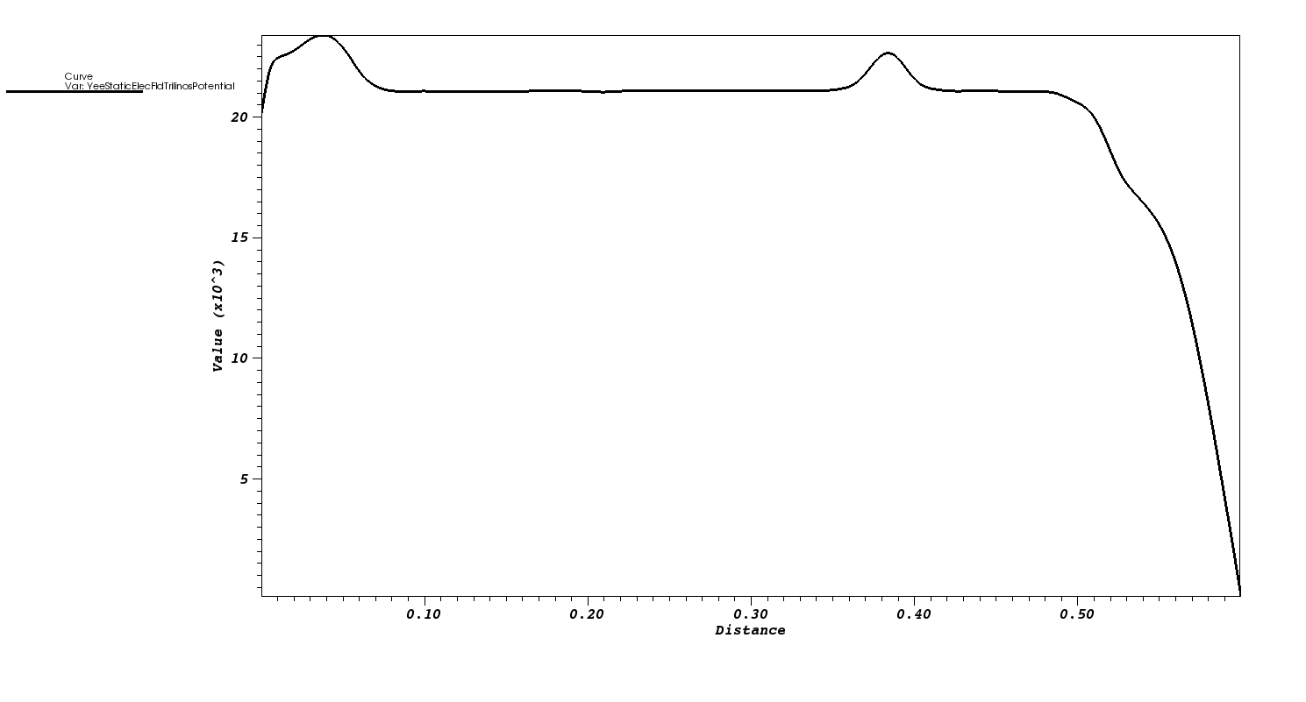
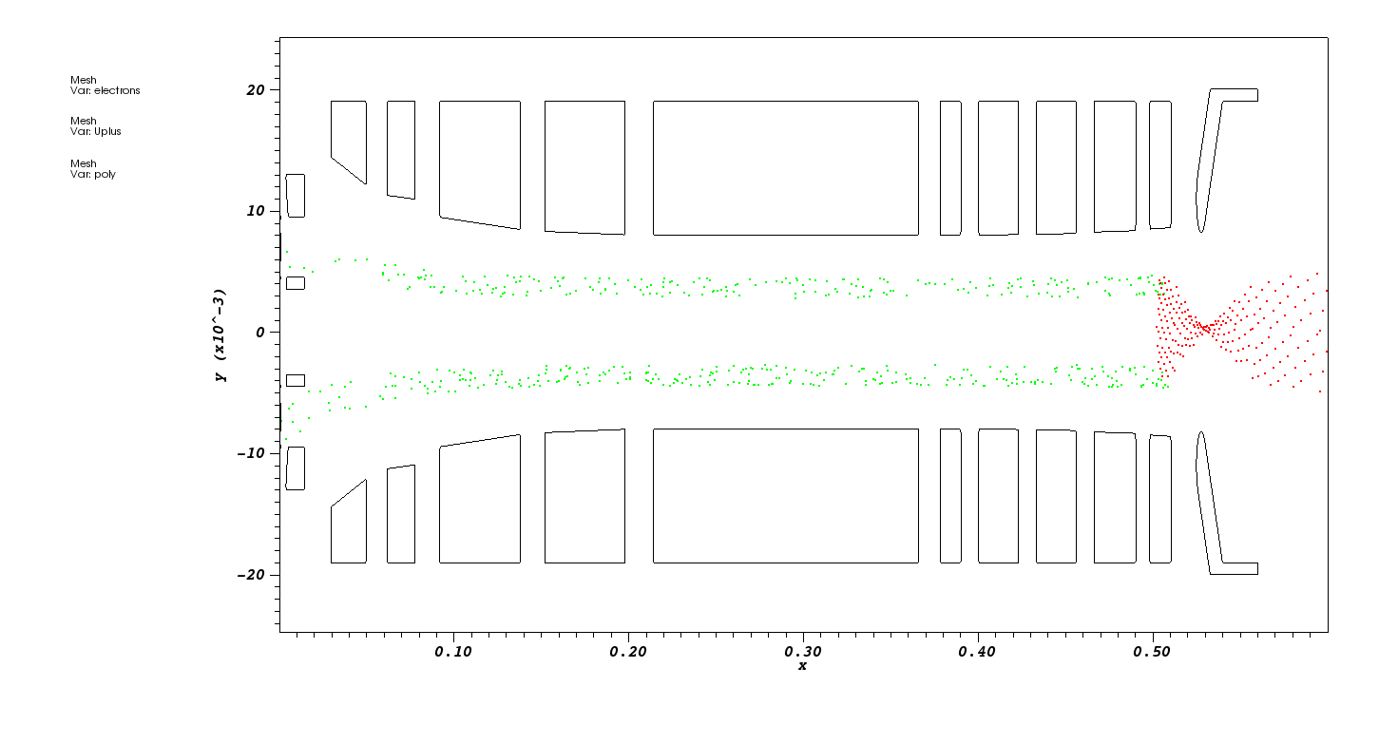
Simulation of the ion trap
Tracking without collisions.
Manipulation of potential
potential (kV)
mm
Drift tube
U34+
electrons
m
Ions can be trapped and accumulated in the trap.
2020/9/30 ECRIS 2020, East Lansing 11

Slide 12
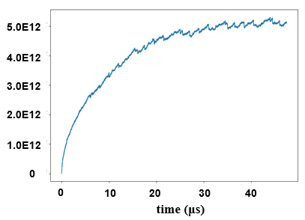
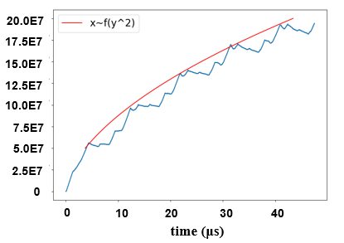
Simulation of the ion trap
Accumulation of electrons
Accumulation of ions
Capacity:
5.0E12 electrons ~ 1.4E11 U³⁴⁺
After 1 s:
In the trap
50% extraction efficiency
Intensity
3.4E10 U³⁴⁺
1.7E10 ions/pulse
Without collisions
2020/9/30 ECRIS 2020, East Lansing 12

Slide 13
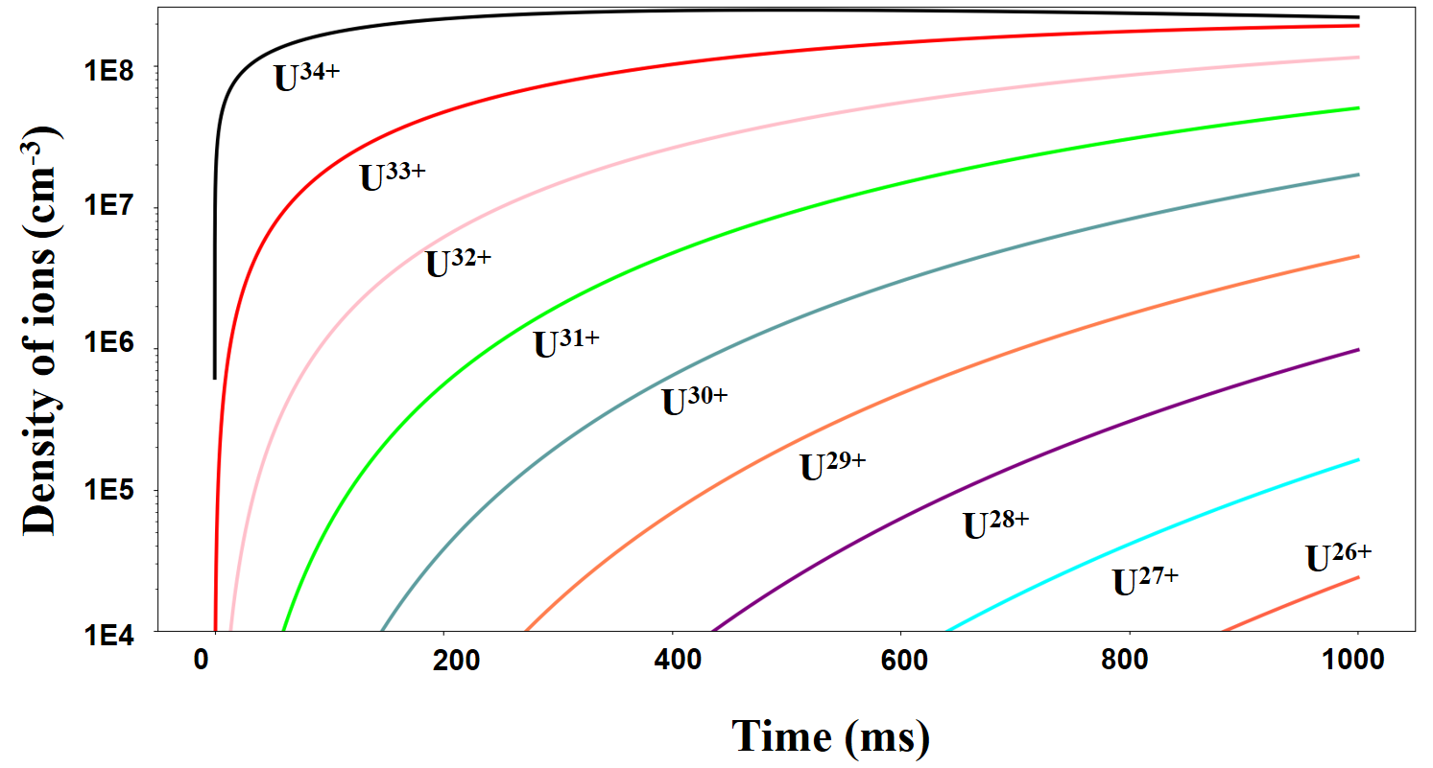
Simulation of the ion trap
Evolution of charge state of ions
Parameters: accumulation of U³⁴⁺ ions as fitting curve, vacuum 1E-10 Torr,
electron current is 440 mA with an energy of 1 keV.
Considering only charge exchange and radiative recombination processes.
After 1 s:
In the trap
Intensity
Need more effort!
50% extraction efficiency
1.24E10 U³⁴⁺
6.2E9 ions/pulse
2020/9/30 ECRIS 2020, East Lansing 13

Slide 14
summary
An ion trap based on ECRIS is proposed for high intensity highly charged ions.
The ion trap is a promising and economic device.
The above discussed design can be further refined for better efficiency but should be verified with experiments.
Thank you for your attention!
2020/9/30 ECRIS 2020, East Lansing 14

