Slide 1


High Intensity Ion Beam Extraction System
for FECR
Zhen Shen
L.T. Sun, X.Z. Zhang, W. Lu, Y. Yang, X. Fang, J.W. Guo, Z.H. Jia, Y.G. Liu, H.W. Zhao
Institute of Modern Physics (IMP), Chinese Academy of Sciences

Slide 2
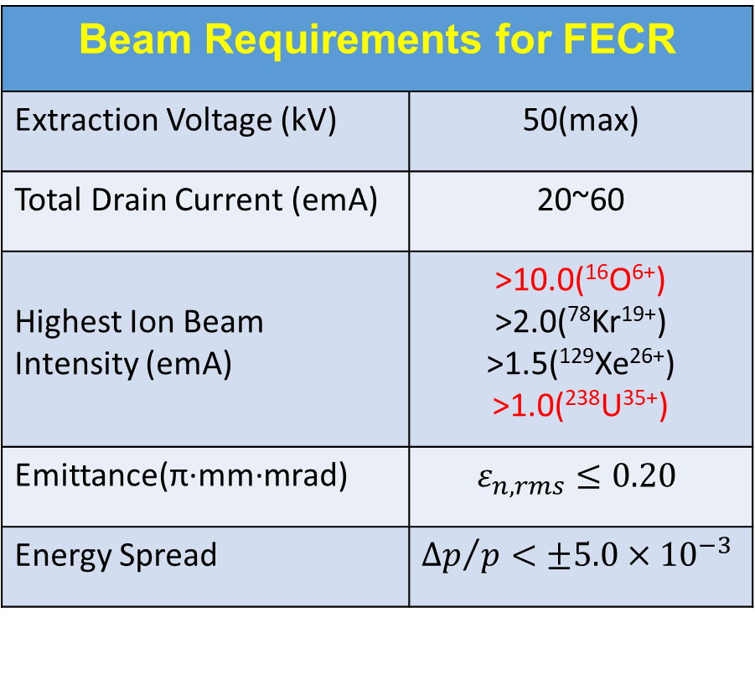
FECR: the 4th Gen ECRIS
Beam Distribution for Extraction Simulation
Beam Requirements for FECR
Extraction Voltage (kV) | 50(max)
Total Drain Current (emA) | 20~60
Highest Ion Beam Intensity (emA) | >10.0(¹⁶O⁶⁺) >2.0(⁷⁸Kr¹⁹⁺) >1.5(¹²⁹Xe²⁶⁺) >1.0(²³⁸U³⁵⁺)
Emittance(π·mm·mrad) | $$ε_{n, rms}≤0.20$$
Energy Spread | $${∆p}/p<±5.0×{10}^{−3}$$
20
emA
U
60
emA
O

Slide 3
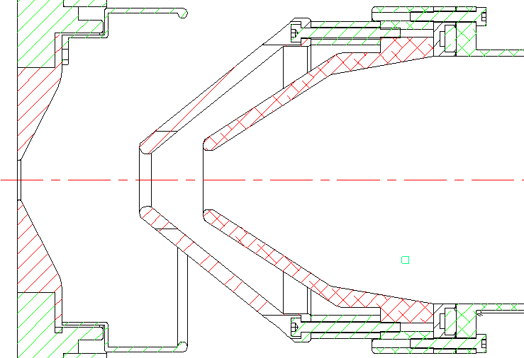
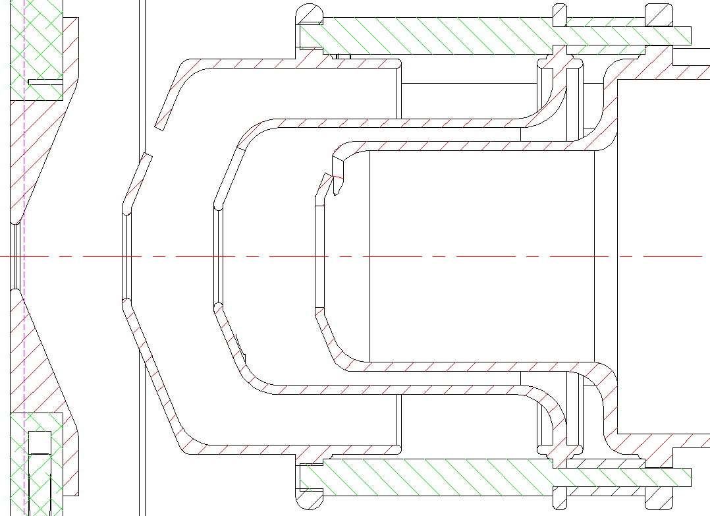
FECR: 4-electrode Extraction System
3-electrode Extraction for SECRAL 4-electrode Extraction for FECR
G1
G2
G3
Plasma Suppressor Ground
~20kV -1~-2kV 0
Plasma Middle Suppressor Ground
50kV V1 V2 0
Movable Electrodes

Slide 4
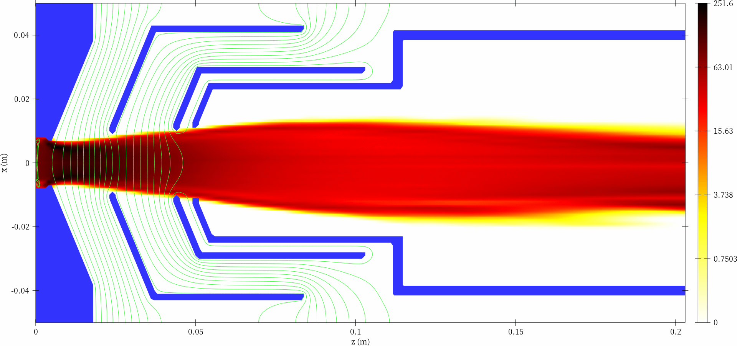
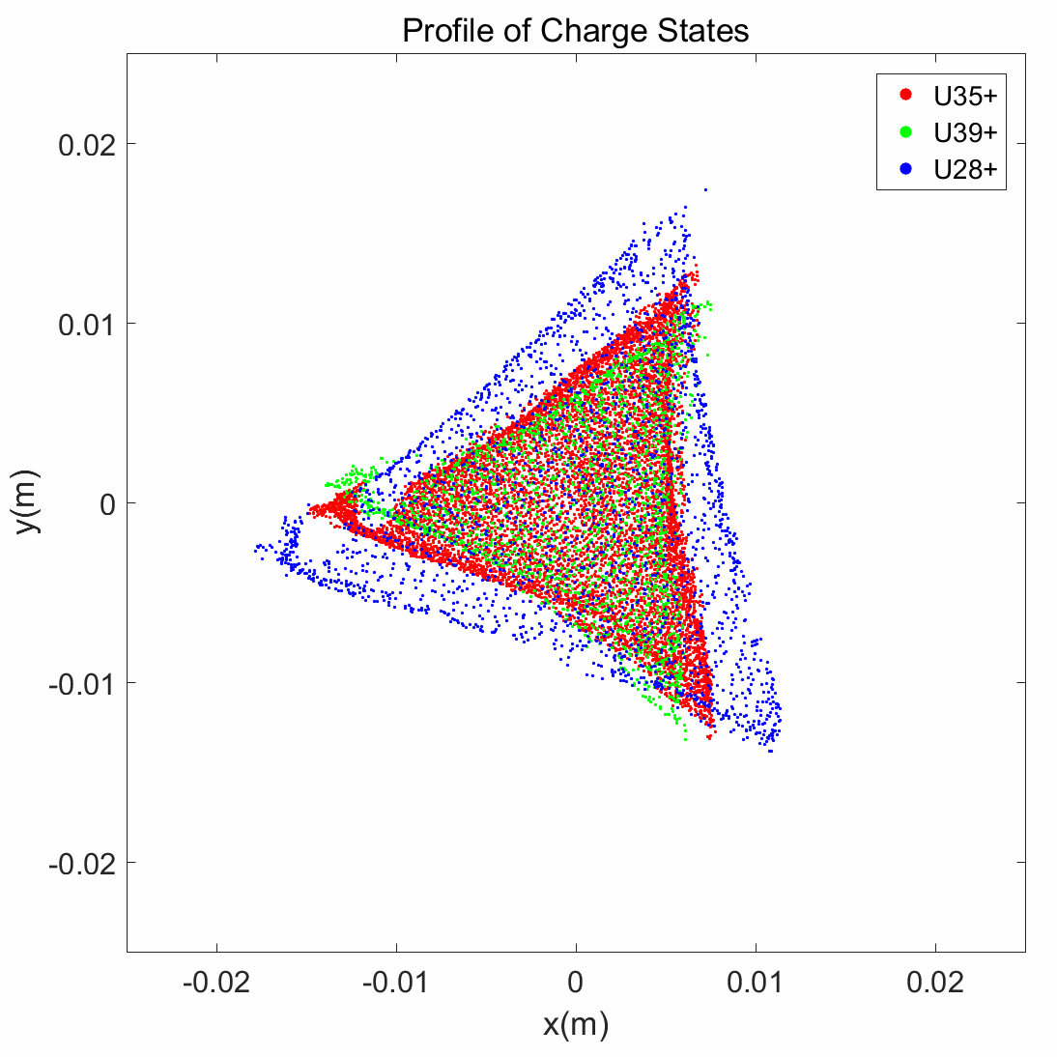
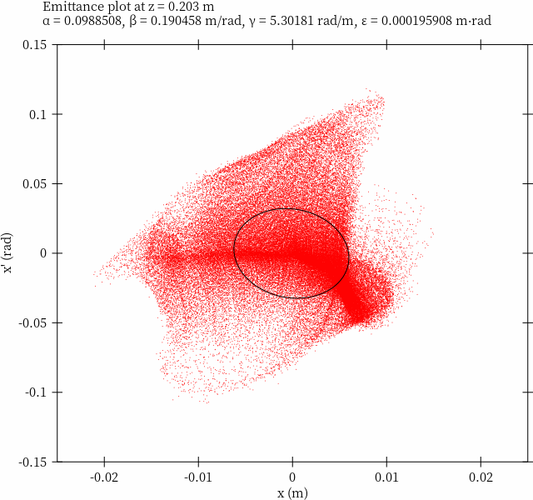
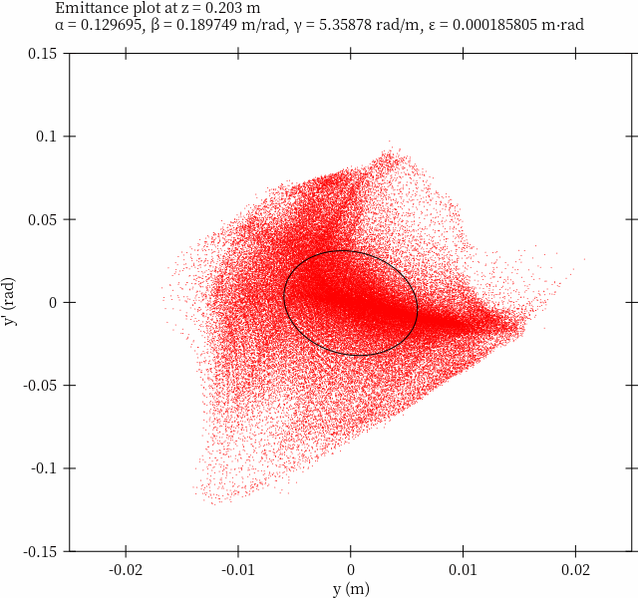
IBSIMU: G1= 20~47mm_V1= 23kV(U)
All Particles
X Emittance
All Particles
Y Emittance
U³⁵⁺ Beam Quality
at the End of Extraction
(200mm)

Slide 5
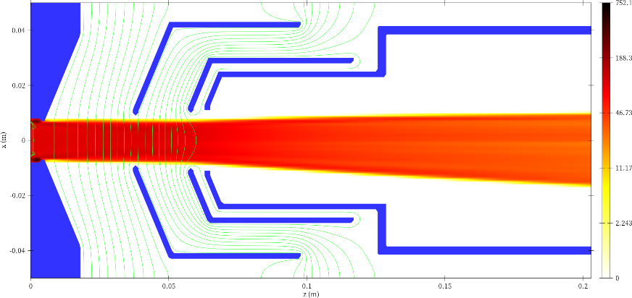





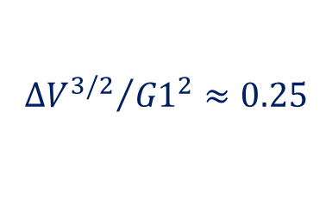
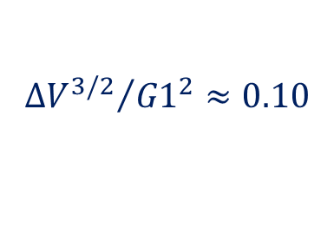



Optimizing G1&V1
$$U_{0}$$
$$d$$
$${{∆V}^{3/2}}/{{G1}^{2}}≈0.10$$
U³⁵⁺
$$0$$
$$k≈2.19×{10}^{−6}P$$
$$j=\frac{P_{0}}{9πd^{2}}{(\frac{Z}{A})}^{\frac{1}{2}}{U_{0}}^{3/2}$$
$$P_{0}=1.54×{10}^{−6}P$$
Exponential
$${{∆V}^{3/2}}/{{G1}^{2}}≈0.25$$
O⁶⁺
$$k≈2.14×{10}^{−6}P$$
$$j_{opt}=\frac{k}{{9πG1}^{2}}{(\frac{Z}{A})}^{\frac{1}{2}}{∆V1}^{3/2}$$
k: Optimal
Generalized
Perveance
k?

Slide 6
Optimizing G2
U³⁵⁺
O⁶⁺

Slide 7
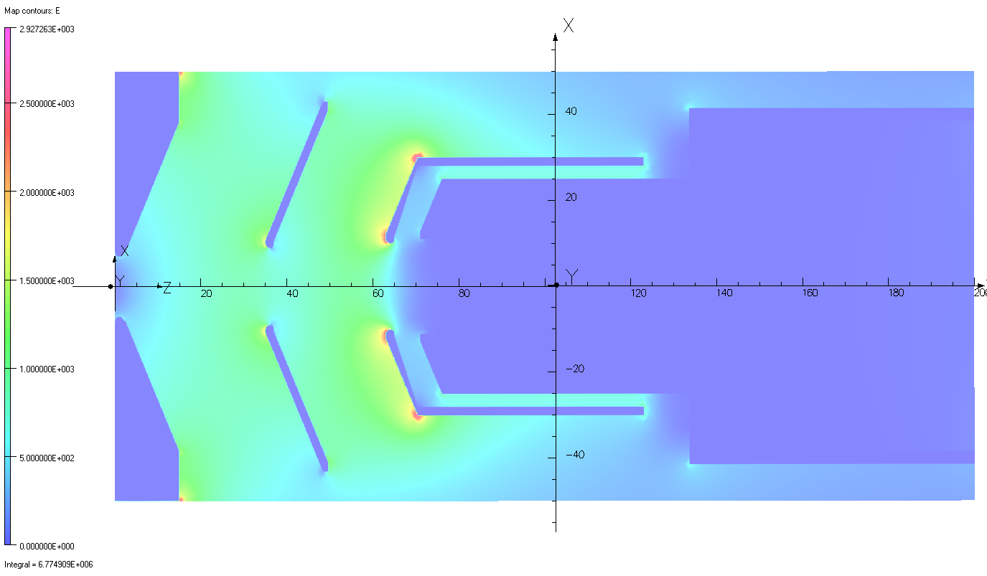
TOSCA: Electric Field Analysis
G1=35mm V1=25kV G2=25mm G3=6mm
G1=35mm V1=25kV G2=28mm G3=8mm
Emax≈5.0kV/mm
Emax≈2.9kV/mm

Slide 8
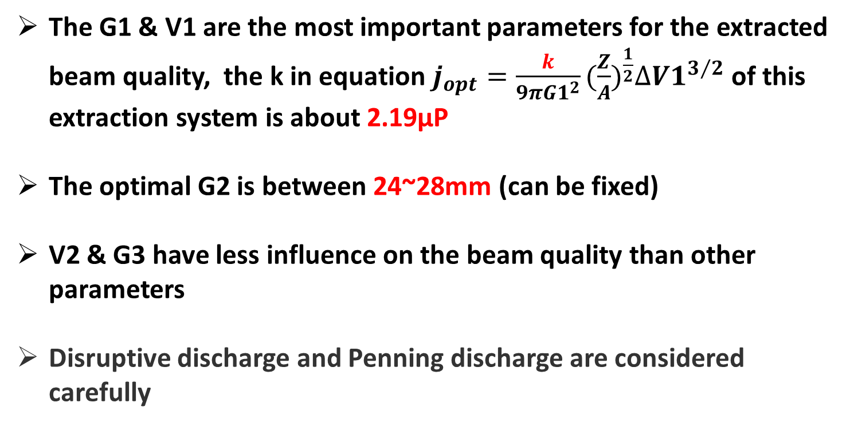
Conclusion
The G1 & V1 are the most important parameters for the extracted beam quality, the k in equation $j_{opt}=\frac{k}{{9πG1}^{2}}{(\frac{Z}{A})}^{\frac{1}{2}}{∆V1}^{3/2}$ of this extraction system is about 2.19μP
The optimal G2 is between 24~28mm (can be fixed)
V2 & G3 have less influence on the beam quality than other parameters
Disruptive discharge and Penning discharge are considered carefully

Slide 9
Appendix: U Beam V2&G3

Slide 10
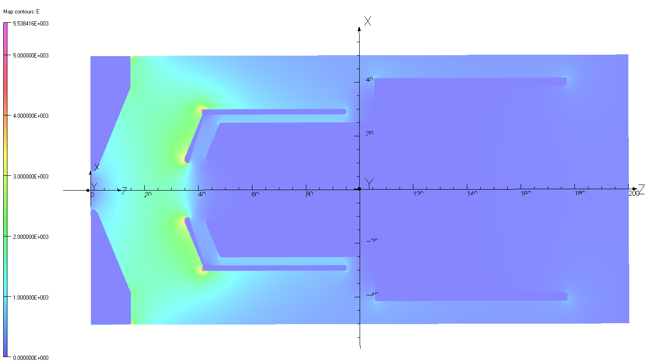
Appendix: 3-electrode for O Beam
G1=35mm
Emax≈5.5kV/mm

