Slide 1



IMP
Observation of Electron Cyclotron Instabilities in SECRAL-II Ion Source
Lixuan Li^{1,2}
J. B. Li¹, J. W. Guo¹, W. Lu¹, J. D. Ma¹, Y. C. Feng¹, W. H. Zhang¹, L. T. Sun^{1,2}, D. Hitz¹ and H. W. Zhao^{1,2}
¹Institute of Modern Physics, CAS, Lanzhou 730000, China
²School of Nuclear Science and Technology, University of Chinese Academy of Sciences, Beijing 100049,China
2020.9.30

Slide 2
Research aim
Experimental setup
Results
Discussion
Outline

Slide 3
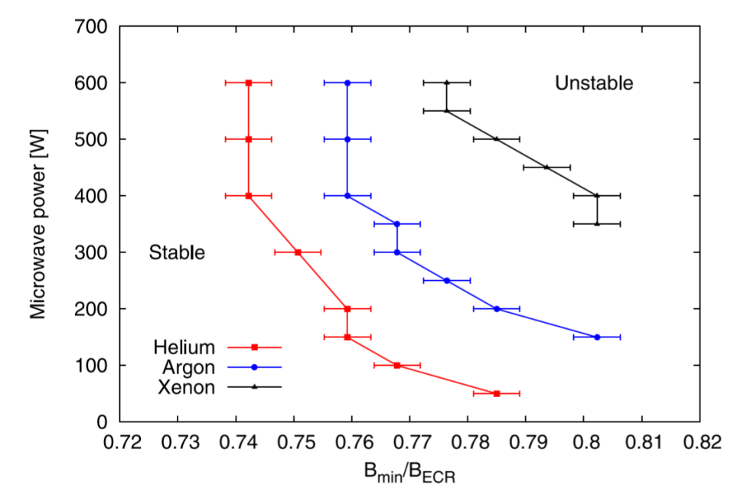
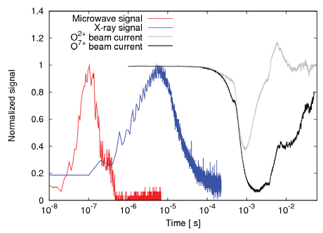
Research aim
Electron cyclotron instabilities threshold
Threshold between stable and unstable regimes
Diagnostic Signals
O. Tarvainen, et al., Rev. Sci. Instrum. 87 (2016)
Research aim of this study
Effects of other magnetic field parameters (mirror ratio、radial field ..) on electron cyclotron instabilities

Slide 4
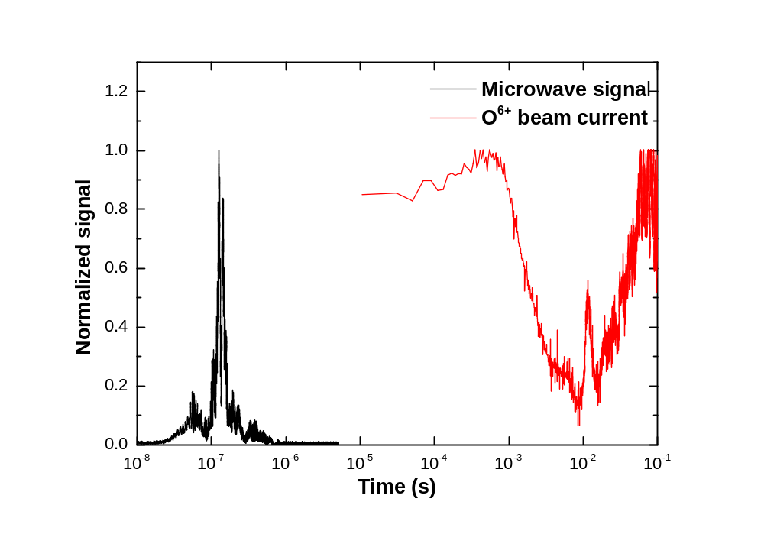
Experimental setup
Typical microwave emission and beam current signals on SECRAL-II when electron cyclotron instability is triggered
Source parameters
Beam | Oxygen
Frequency (GHz) | 18
Power (W) | 1000
Extraction Voltage (kV) | 15
Biased Disk Voltage (-V) | 10~60
Injection Pressure (mbar) | 1~2x10⁻⁷
Note: we do not optimize beam current at each data point, just tuning the gas injection and biased disk voltage to make ion source stable (long-term)
The microwave detection setup can been found in J. Li's presentation (1122)

Slide 5
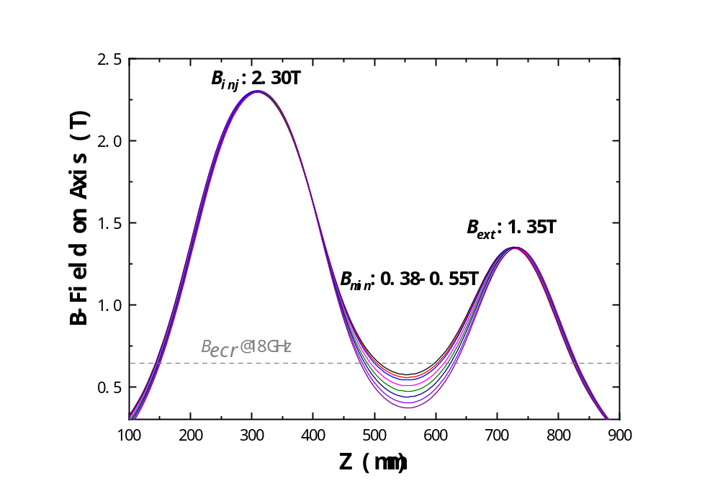
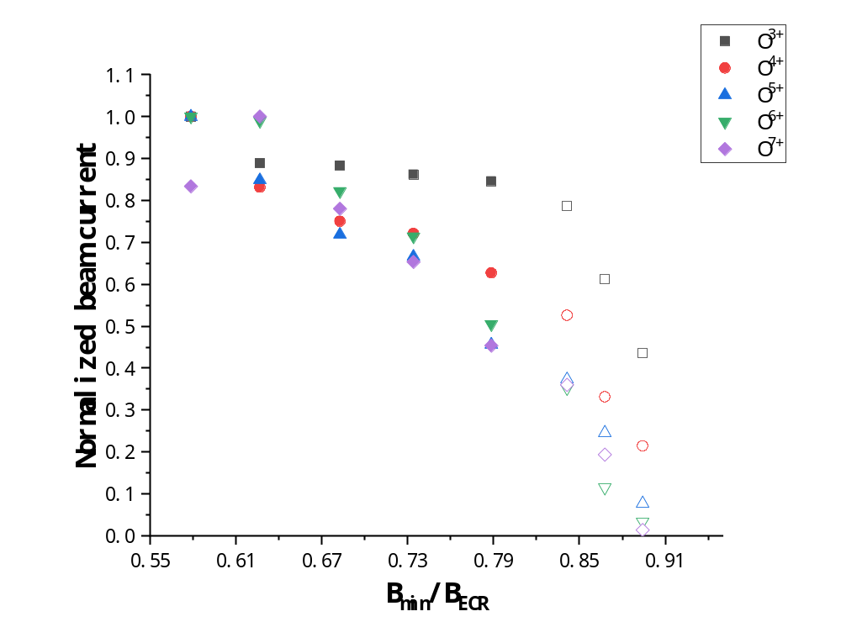
Experimental results
Part 1- constant B_{inj} , B_{ext} and B_{r} (1.1 T) while varying B_{min}
stable
unstable
Note: beam normalization is carried out independently for each charge state and
open symbols correspond to instability regime
0.38 | 0.41 | 0.44 | 0.47 | 0.50 | 0.52 | 0.54 | 0.55
B_{min} increases
: stable
: unstable

Slide 6
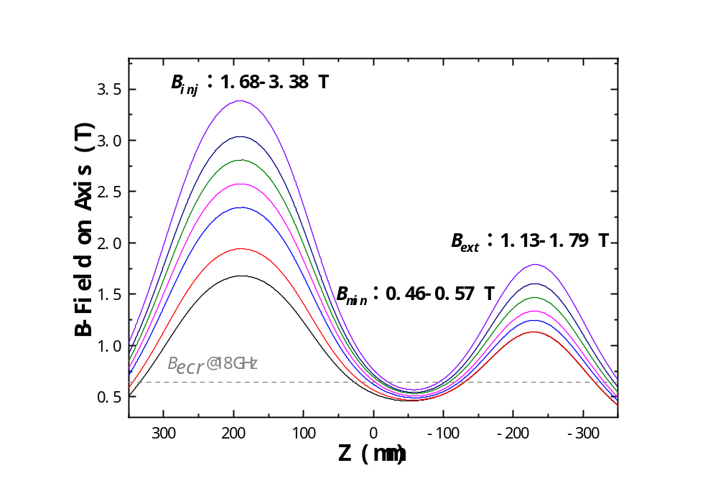
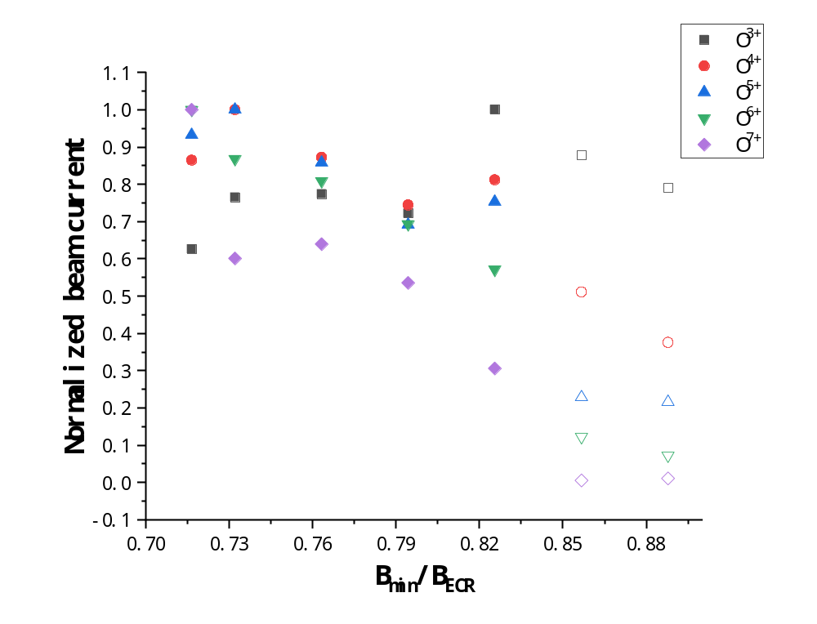
Experimental results
Part 2- constant on axis gradient (~4.5 T/m) and B_{r} (1.1 T) while varying B_{min}
stable
unstable
0.46 | 0.47 | 0.49 | 0.51 | 0.53 | 0.55 | 0.57
B_{min} increases

Slide 7
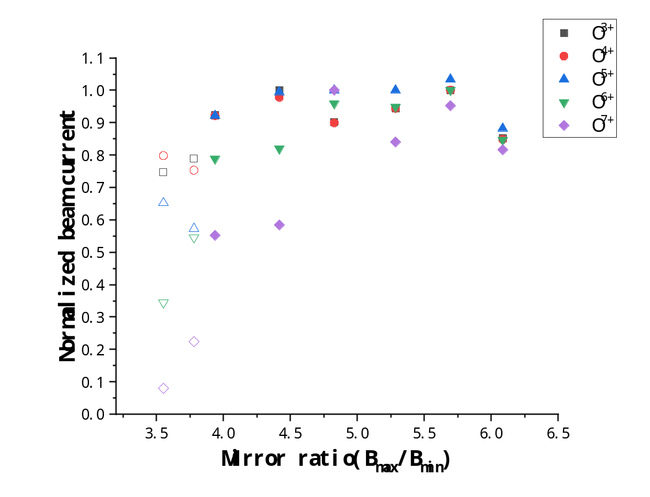
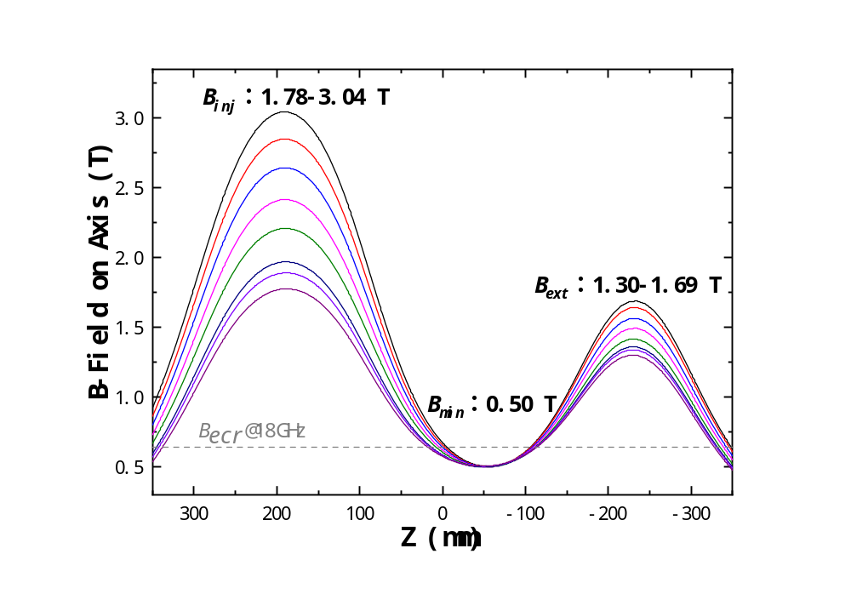
Experimental results
Part 3- constant B_{min} (0.50 T) and B_{r} (1.1 T) while varying mirror ratio (i.e. B_{inj} and B_{ext})
unstable
stable
3.56 | 3.78 | 3.94 | 4.42 | 4.83 | 5.29 | 5.70 | 6.08
Mirror ratio (B_{max}/B_{min}) increases

Slide 8
Experimental results
Summary: constant B_{min} and B_{r} while varying mirror ratio (i.e. B_{inj} and B_{ext})
0.55
0.52
0.50
0.48
B_{min} increases
3.31
Mirror ratio (B_{max}/B_{min}) increases
6.25

Slide 9
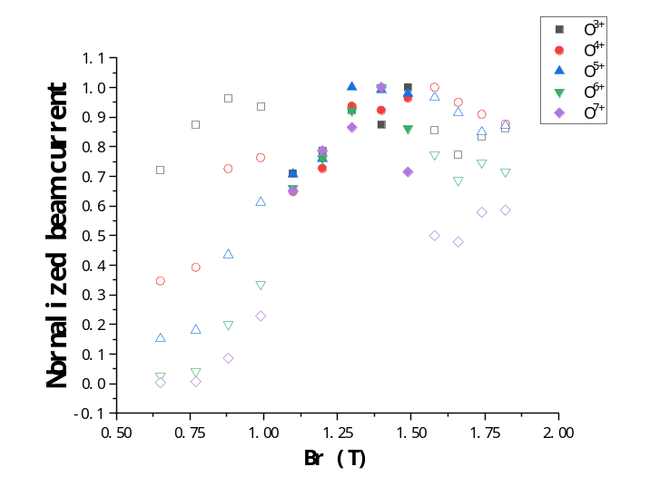
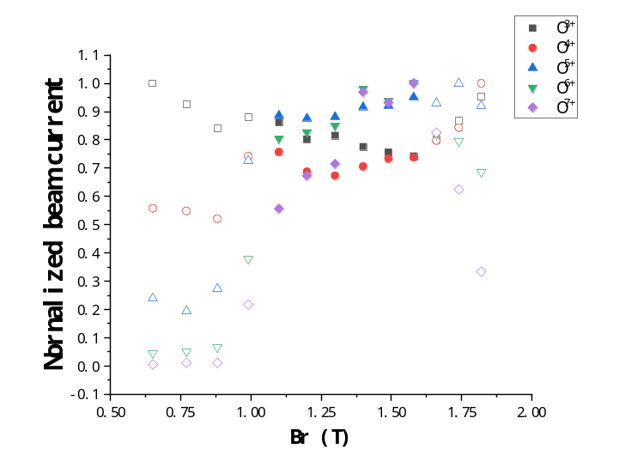
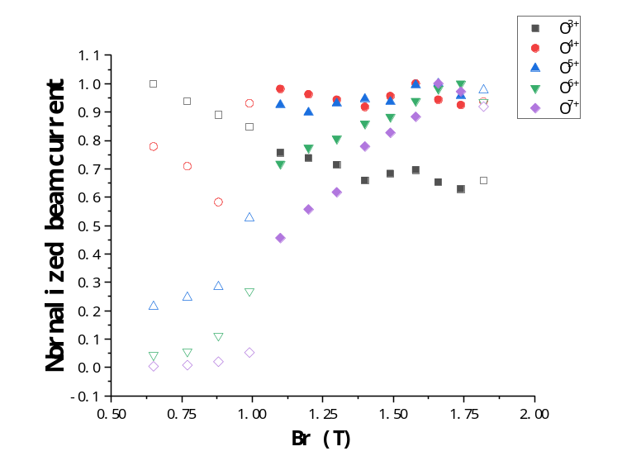
Experimental results
B_{min}：0.50 T
Part 4 - constant axial magnetic fields while varying B_{r}
B_{inj} : 1.78 T
B_{ext}: 1.30 T
B_{inj} : 2.41 T
B_{ext}: 1.49 T
B_{inj} : 3.04 T
B_{ext}: 1.69 T
a. Low mirror ratio
b. Medial mirror ratio
c. High mirror ratio
0.65 | 0.77 | 0.88 | 0.99 | 1.10 | 1.20 | 1.30 | 1.40 | 1.49 | 1.58 | 1.66 | 1.74 | 1.82
High mirror ratio
Medial mirror ratio
Low mirror ratio
B_{r} increases

Slide 10
Experimental results
Summary: constant axial magnetic fields while varying B_{r}
a. Low mirror ratio
0.65 | 0.77 | 0.88 | 0.99 | 1.10 | 1.20 | 1.30 | 1.40 | 1.49 | 1.58 | 1.66 | 1.74 | 1.82
0.55
0.52
0.50
0.48
B_{min} increases
b. Medial mirror ratio
0.55
0.52
0.50
0.48
0.65 | 0.77 | 0.88 | 0.99 | 1.10 | 1.20 | 1.30 | 1.40 | 1.49 | 1.58 | 1.66 | 1.74 | 1.82
B_{min} increases
c. High mirror ratio
0.65 | 0.77 | 0.88 | 0.99 | 1.10 | 1.20 | 1.30 | 1.40 | 1.49 | 1.58 | 1.66 | 1.74 | 1.82
0.55
0.52
0.50
0.48
B_{min} increases
B_{r} increases

Slide 11
B_{min} is the primary magnetic field parameter affecting the appearance of cyclotron instability, but not the only one; mirror ratio and radial field also
affect the appearance of cyclotron instability;
Effects of magnetic configuration on electron cyclotron instability may provide a physical explanation for the semiempirical magnetic field scaling laws of ECRIS;
The trigger of cyclotron instability maybe a combined effect of many magnetic field parameters, further analyses are needed to reveal the inherent link between these parameters and plasma heating (<∇B_{ecr} >) as well as confinement.
Discussion

Slide 12

Thanks for
your attention！

