Slide 1


Beam Profile Measurements of Decelerated Multicharged
Xe Ions from ECRIS for Estimating Low Energy
Damage on Satellites Components
Koichi Sato, Kazuki Okumura, Shuhei Harisaki,
Wataru Kubo, Issei Owada, Kazuki Tsuda, and Yushi Kato
Division of Electrical, Electronic and Inforcommunications Engineering,
Graduate School of Engineering, Osaka University
24th International Workshop on ECR Ion Sources

Slide 2

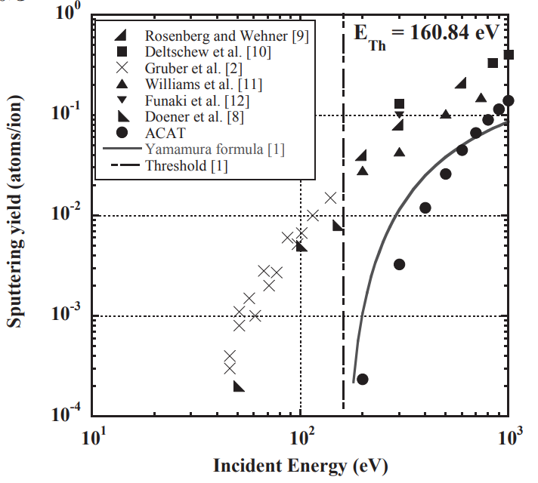

Background
[1]JAXA–RR–09–004, pp.26--31 ,2010
Low-Energy Sputtering
$$Xe^{+}→C$$
・Xe⁺：80%
・Dependence of incidence angle
Theory
Experimental data
☞ In designing satellites for 10-15 years of operation, low
energy sputtering cannot be ignored.
☞Low energy sputtering yield has some different results in experimental data and theory.
The irradiation experiment is carried out using
a device that simulates an ion engine.
1

Slide 3
Background
～ In our laboratory ～
Our goal is measurement of sputtering yield by irradiating satellite components with low energy Xe ion beam.
Beam Deceleration
The amount of beam currents is not enough for irradiation
when the extraction voltage is 1kV and Xe is extracted.
We extract the ion beams from high voltage 10 kV and transported
into the ion beam irradiation system (IBIS) where we constructed.
And we decelerate and irradiate ion beams to the materials.
Previous studies
・ Experimental setup using an existing ECRIS for decelerated ion beams
・ Improvement of beam line to increase current
2

Slide 4
Objective
Construction of equipment for irradiation experiment
・ Problem: Uniformity of beam profile on the sample about 1cm²
⇒We measure the two dimensional profiles of the decelerated beam
・ Xe, Ar Deceleration Experiments
→Measurements of beam current in the low energy region
・Measurements of beam profiles in the low energy region
・ Calculations of the current density ＆ Evaluating of the dose amount
→ Estimation of irradiation time
3

Slide 5
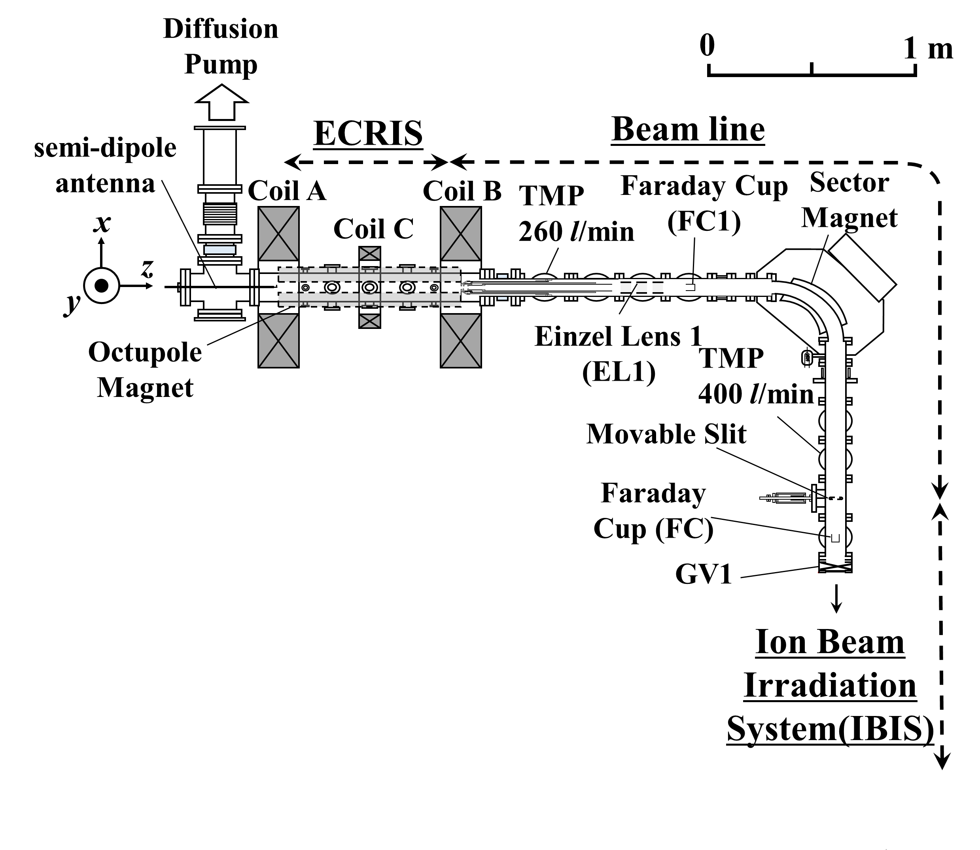
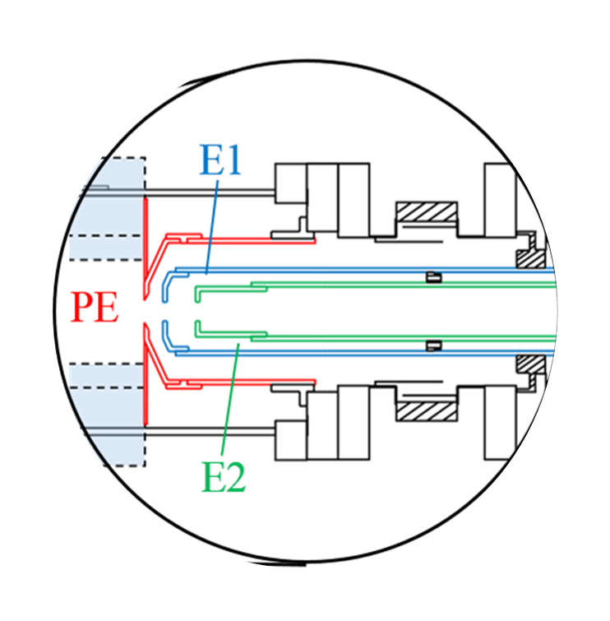
ECRIS ＆ Beam line
Steering Coil 1
Steering Coil 2
4

Slide 6
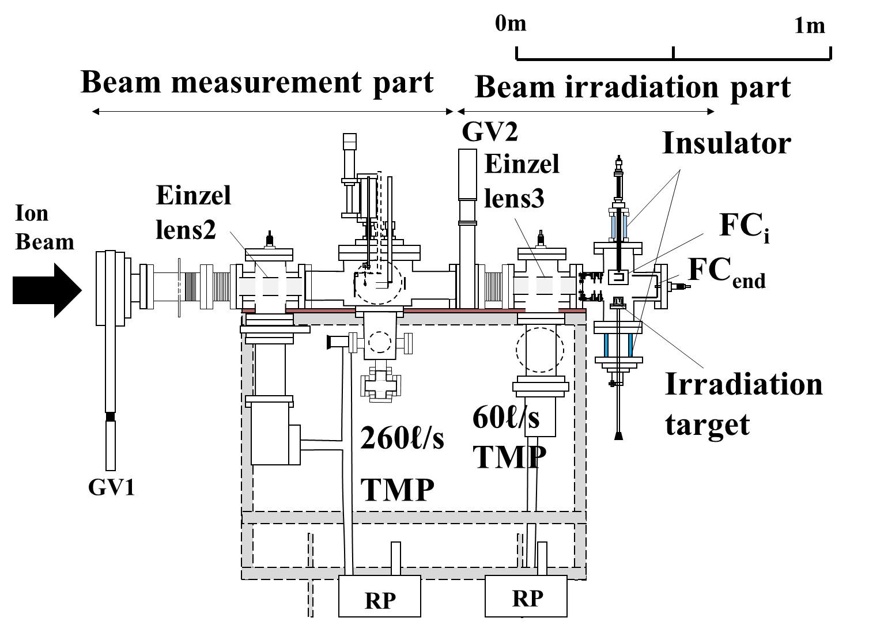
Ion Beam Irradiation System (IBIS)
Insulator
X-Y Wire Probe
FC_{i}
Casing
Insulator
300
Irradiation
target
5

Slide 7
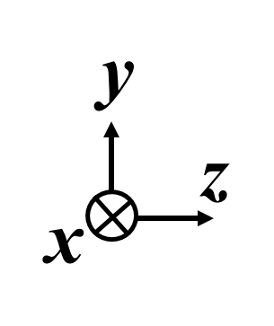
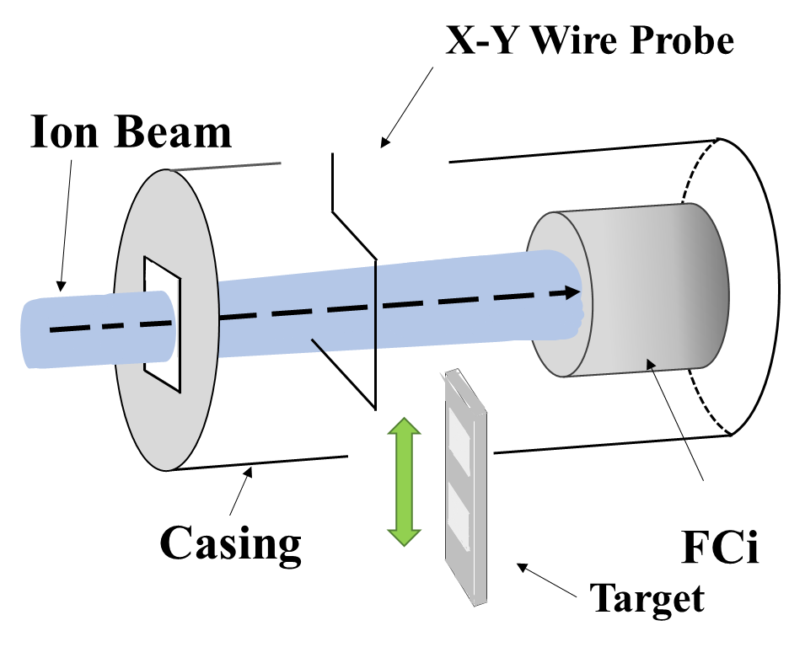
Construction of equipment for irradiation experiment
Beam irradiation part
X-Y Probe and FCi
with casing in detail
X-Y Wire
Probe
Insulator
beam
FC_{i}
Deceleration electrodes
Casing
Irradiation
target
6

Slide 8
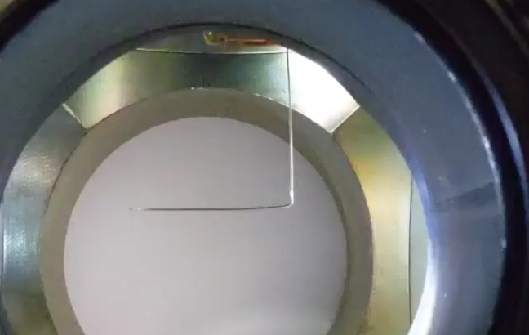
Construction of equipment for irradiation experiment
Beam irradiation part
Movement of the X-Y wire probe during
measurements of two dimensional profiles
Insulator
X-Y
Wire Probe
FC_{i}
beam
Casing
Deceleration electrodes
Irradiation
target
7

Slide 9
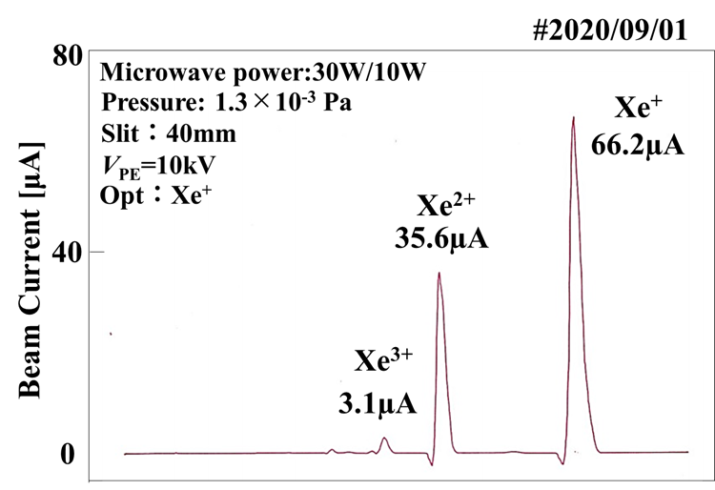
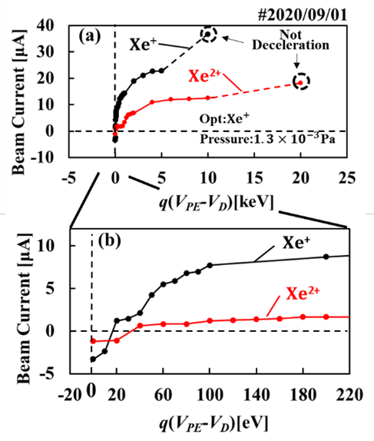

Experimental Results
Xe Deceleration Experiment
FCi Beam Current [µA]
FC Beam Current [µA]
$$B∝\sqrt{m/q}$$
FCi Beam Current [µA]
We found that there was
sufficient current to conduct
irradiation experiments in the
low energy region (100～200eV).
8

Slide 10
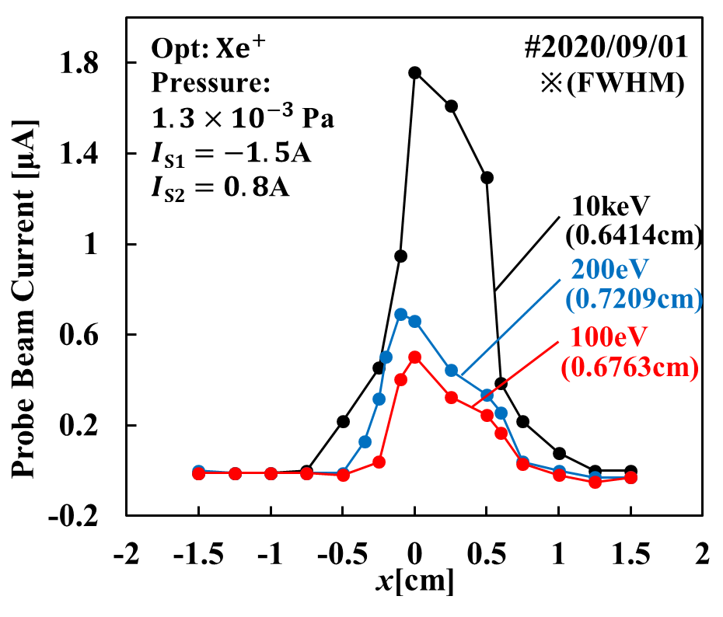
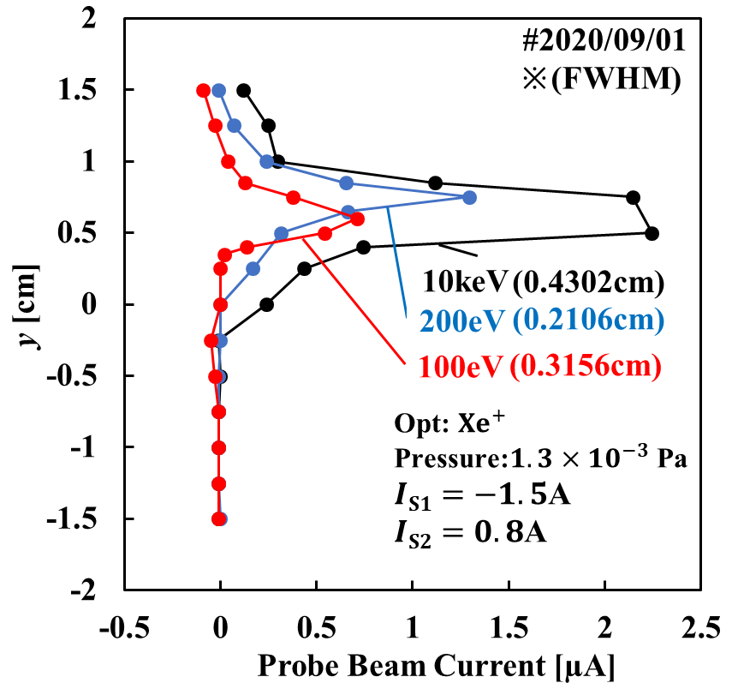
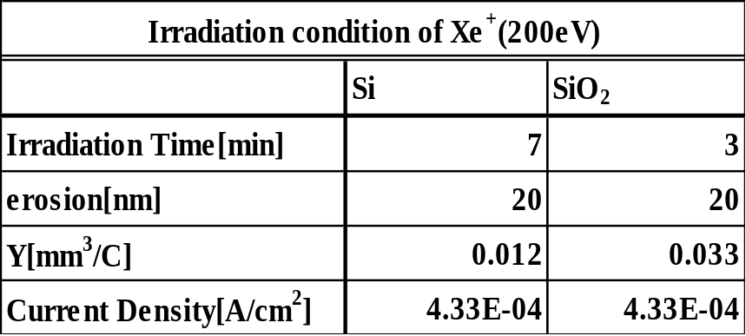
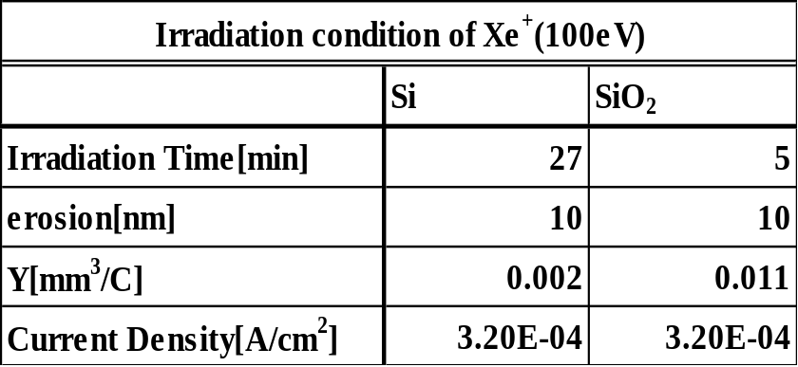
Experimental Results
Measurements of Decelerated Xe⁺ Ion Beam Profiles
9

Slide 11
Summary and Future Plan
Summary
☞ Sufficient beam current in the low energy region (about 100eV
to 500eV) for irradiation experiments
☞ We succeeded in acquiring the profile of decelerated beam.
☞ Evaluation of high precision dose amount and irradiation time
Future Plan
☞ Further improvement of deceleration electrode and irradiation
system to shorten irradiation time
☞ Irradiation experiments for various materials
10

Slide 12
Construction of equipment for irradiation experiment
Beam irradiation part
X-Y Wire Probe
Insulator
y[cm]
Beam Current[µA]
X-Y
Wire Probe
Beam Current[µA]
Ion Beam
x [cm]
FC_{i}
beam
Casing
Deceleration electrodes
FCi
Casing
Target
Irradiation
target
6

Slide 13
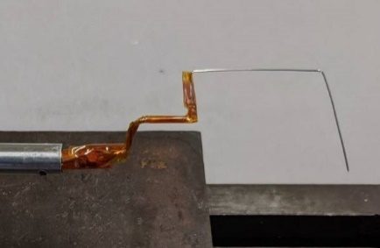
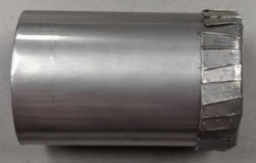
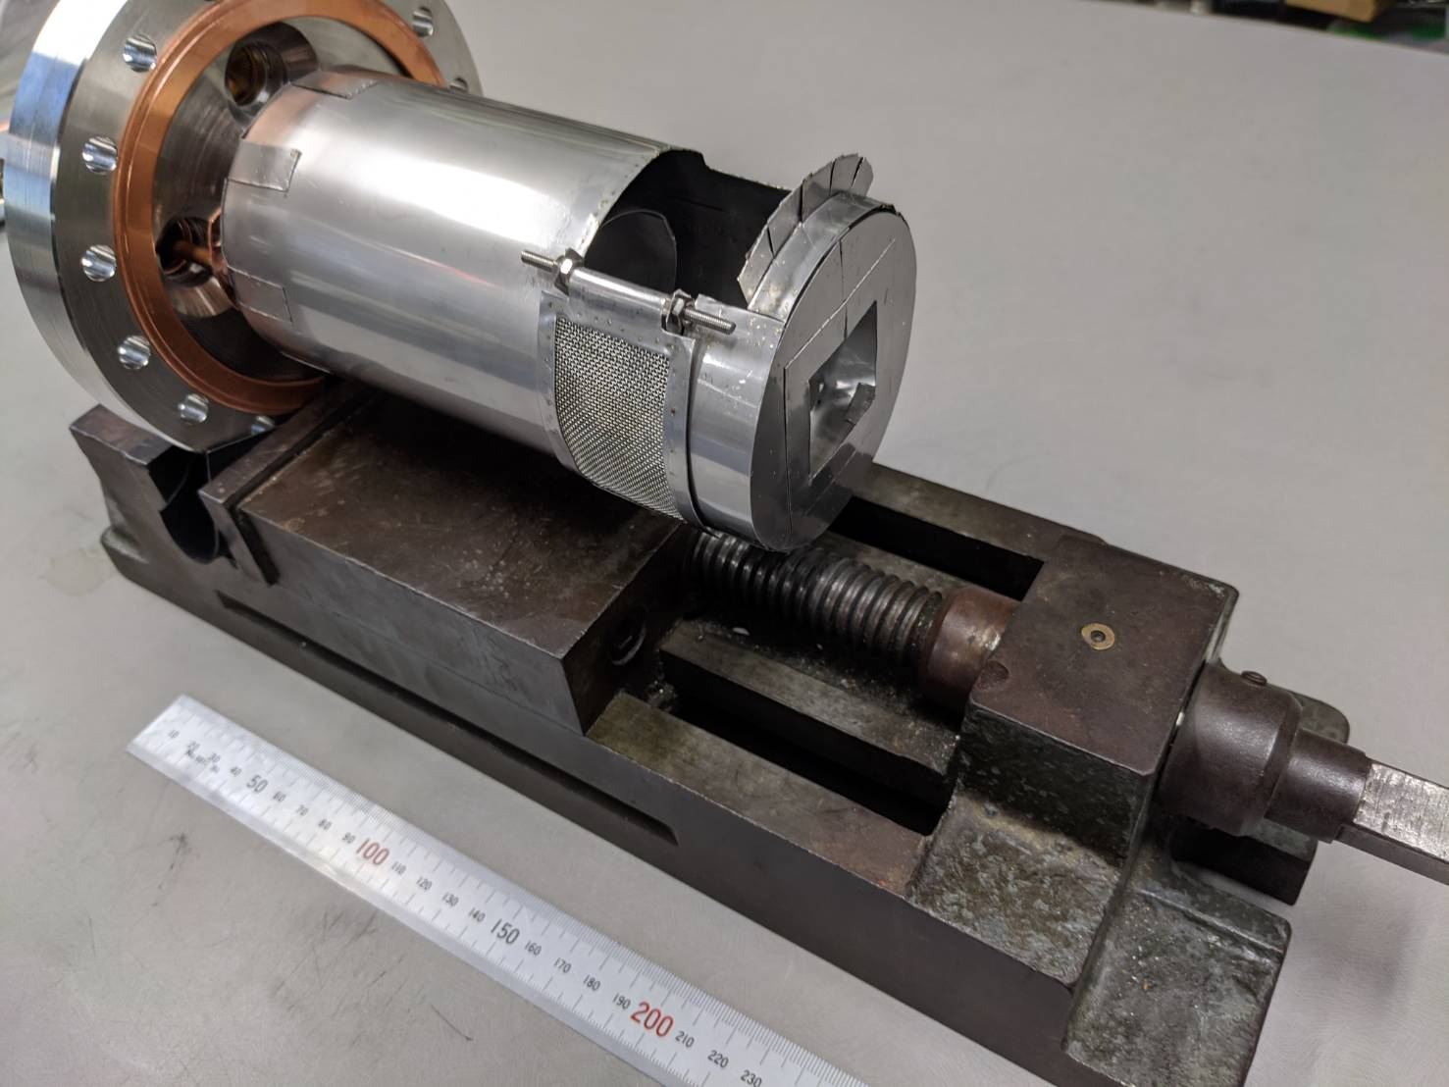
Construction of equipment for irradiation experiment
Beam irradiation part
FC_{i} (φ50)
XY-Probe
(Mo φ0.5)
Insulator
X-Y
Wire Probe
FC_{i}
beam
Casing
Casing
Deceleration electrodes
Target
outlet
Irradiation
target
7

Slide 14
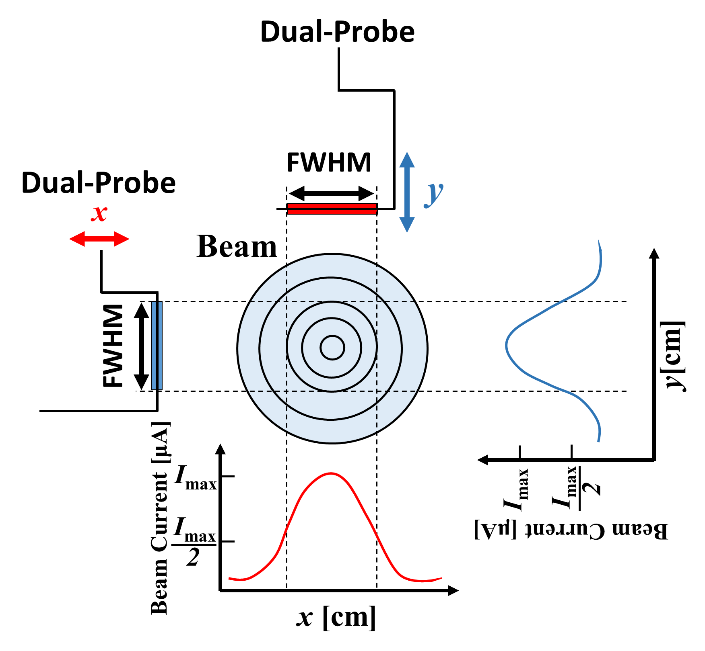
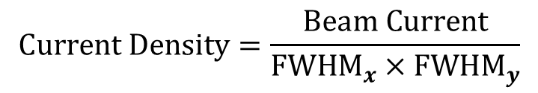
Construction of equipment for irradiation experiment
Current density calculation procedure
Beam irradiation part
X-Y Wire Probe
re Probe
Insulator
X-Y
Wire Probe
X-Y Wire Probe
FC_{i}
beam
Casing
Deceleration electrodes
We calculate the beam area using the full width at
half maximum (FWHM) in the X and y directions.
$$Current Density=\frac{Beam Current}{{FWHM}_{x}×{FWHM}_{y}}$$
Irradiation
target
7

Slide 15
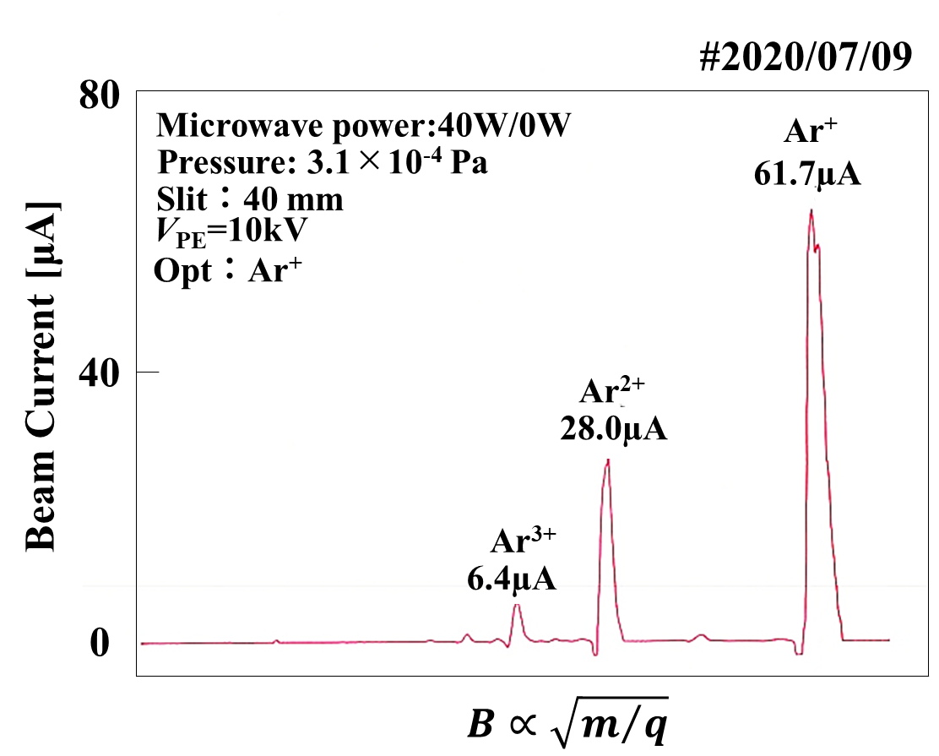
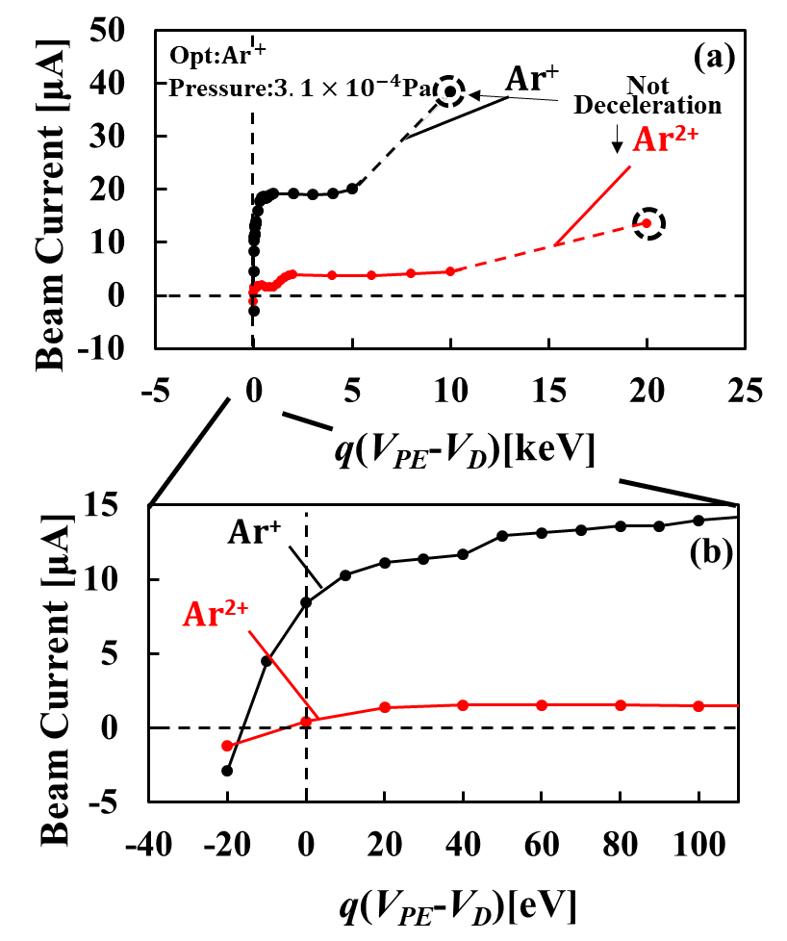
Experimental Results
1.1 Ar Deceleration Experiment
#2020/07/09
We found that there was
sufficient current to conduct
irradiation experiments in the
low energy region (100～200eV).
8

Slide 16
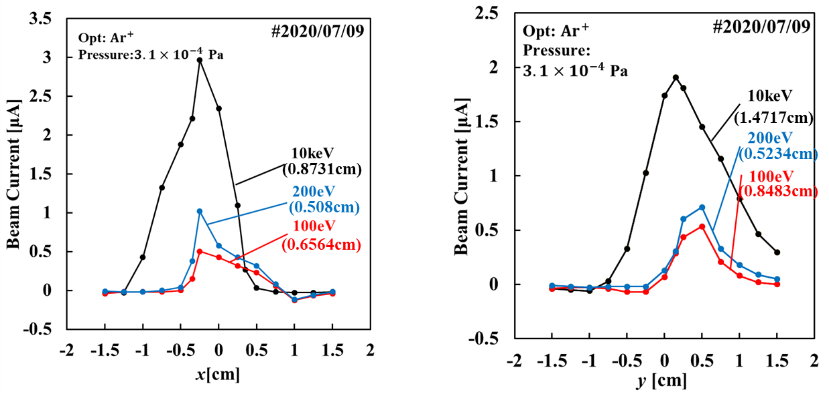
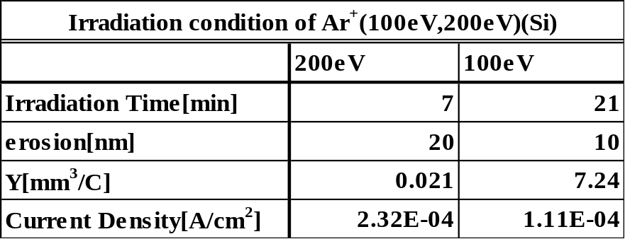
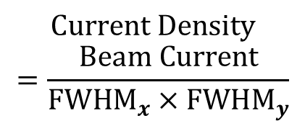
Experimental Results
1.2 Measurements of Decelerated Ar⁺ Ion Beam Profiles
※(FWHM)
※(FWHM)
$$Current Density$$
$$=\frac{Beam Current}{{FWHM}_{x}×{FWHM}_{y}}$$
9

Slide 17
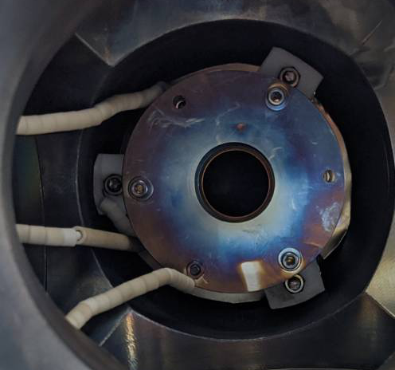
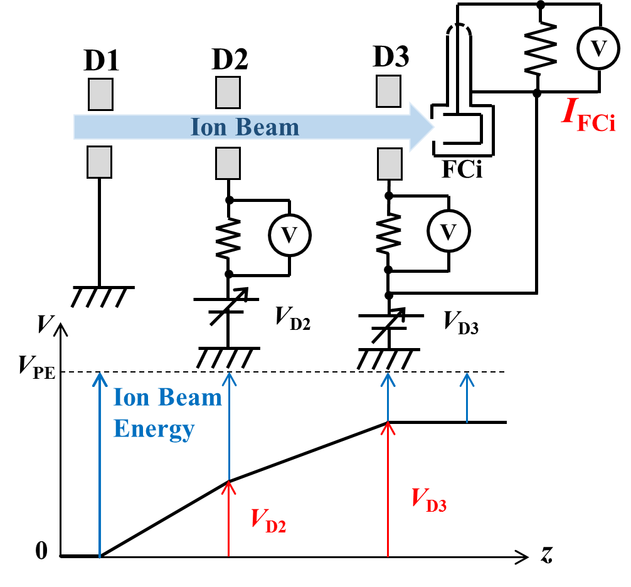
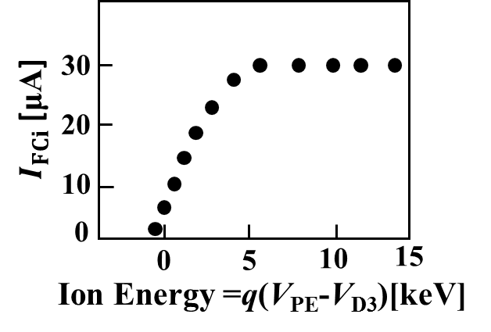
照射部
Decelerating electrodes
D1
D2
D3
D3
0
100mm
配線
Experiment method of beam deceleration
FCi
Decelerating
electrodes
Casing

Slide 18

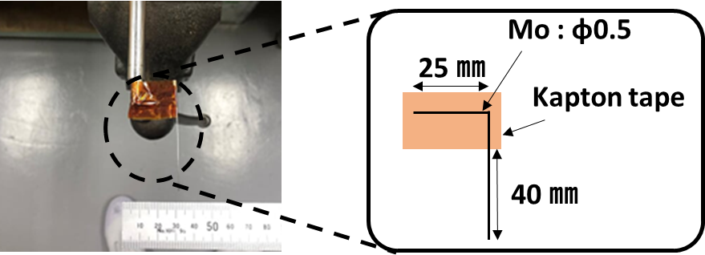
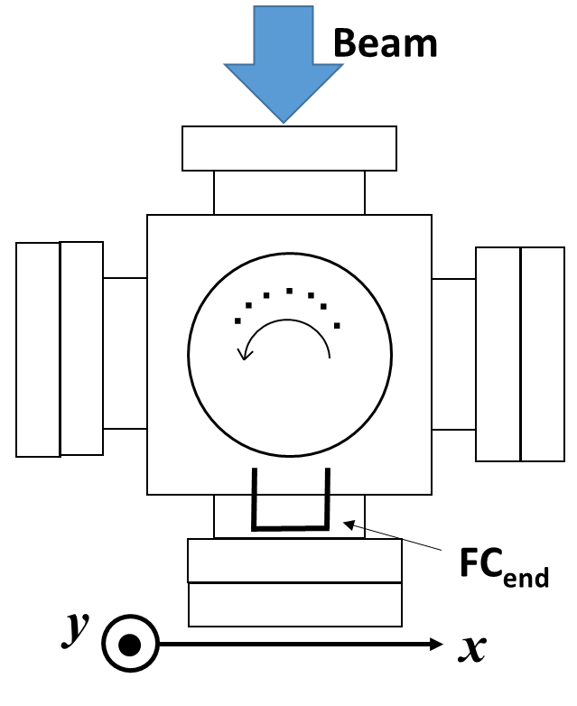
2．Construction of equipment for irradiation experiment
Setup of preliminary experiment for design of equipment
Beam irradiation part
X-probe (wire probe)
Insulator
X-probe
FC_{end}
Experiment method of beam deceleration
beam
・X-probe can be rotated to
measure the x direction.
Casing
X-probe
Casing
Deceleration electrodes
・The probe and the casing can be floated to GND by the insulator, and these can be applied with a deceleration voltage V_{D3}.
Irradiation
target

Slide 19
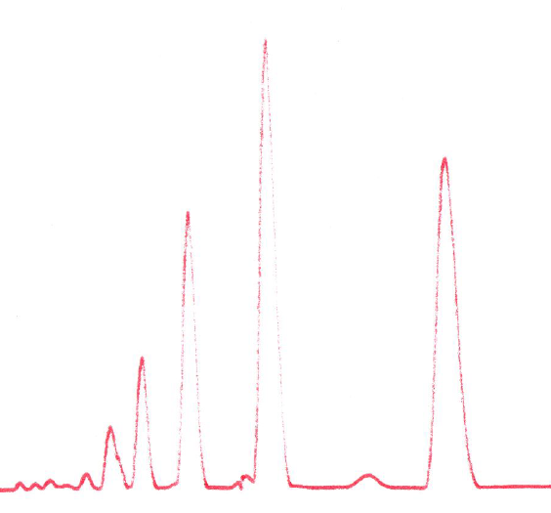
2．Construction of equipment for irradiation experiment
The beam profile in the x direction from 100eV to 10keV
#2019/11/08
#2019/11/08
Microwave power:140W/130W
V_{el2}=7.66 kV
Xe⁺
70
measurement: FC(50 mmφ)
Pressure: 4.0×10⁻⁴ Pa
V_{el3}=6.6 kV
60
V_{PE}=10kV
Xe²⁺
Slit：40 mm
Xe⁺
50
10 keV
1 keV
Beam Current [μA]
Xe³⁺
Beam current [µA]
40
30
20
100 eV
10
0
B∝m/q
x [cm]
☞ We obtained the beam profile in the x direction from 100eV to 10keV.
☞ It was found that the beam trajectory shifted when beam was decelerated.

Slide 20
3．Construction of equipment for irradiation experiment
Calculation method of current density
Beam irradiation part
Insulator
Dual-Probe
FC_{i}
beam
Casing
Deceleration electrodes
Step.1 Dual-Probe can be rotated to measure the x direction
And be pulled out to measure the y direction.
Irradiation
target
Step.2 Even when the target is inserted, it does not come into contact with the probe.

Slide 21
2．Production of equipment for irradiation experiment
Operation check of the manufactured device
Ar⁺
Ar⁺
10 keV
10 keV
500 eV
Beam current [µA]
500 eV
Beam current [µA]
y [cm]
x [cm]
Calculating the current density using the full width at half maximum(FWHM)…
Ar⁺
10 keV
Ar⁺
10 keV
500 eV
500 eV
current density[µA/cm²]
current density[µA/cm²]
y [cm]
x [cm]
☞ In the FCi, the current density using these FWHM were 79.6 µA/cm²(1keV) and 85.2µA/cm²(500eV). When performing the irradiation experiment on Si with Ar+ using this current density, it can be performed in about several tens of minutes.

Slide 22
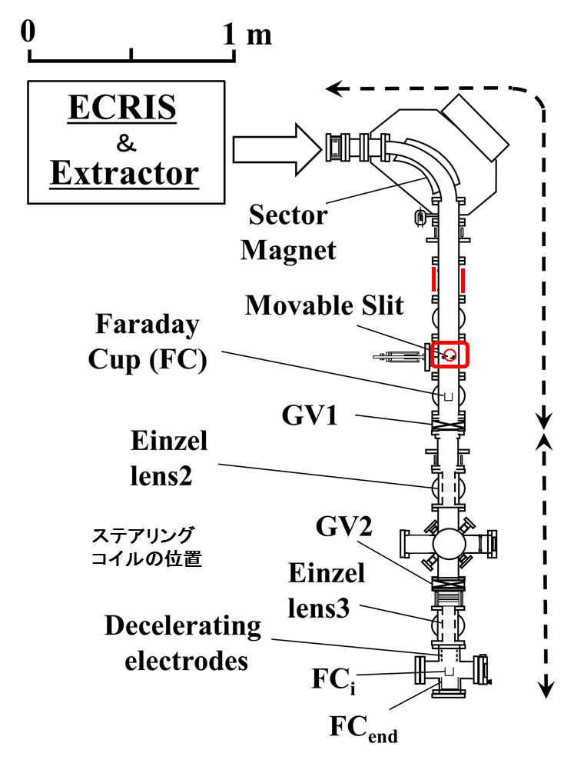
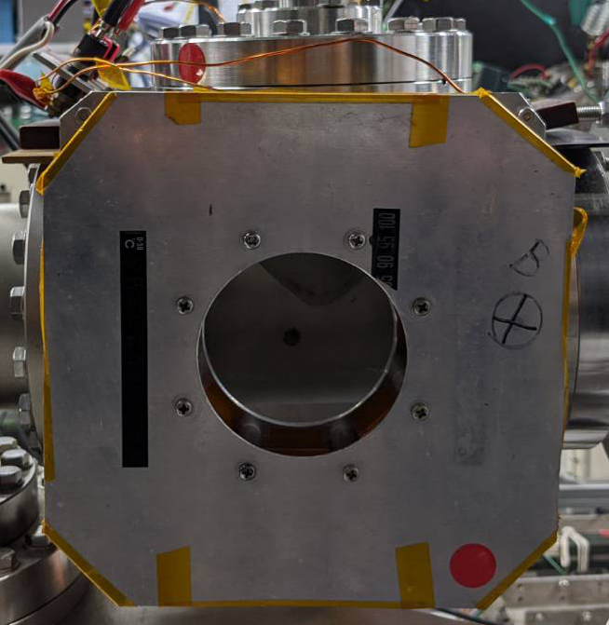
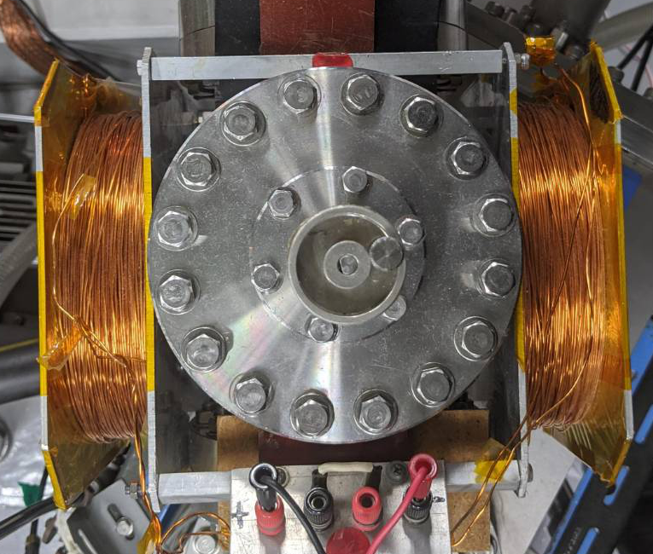
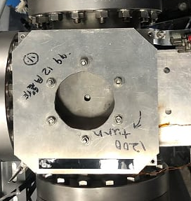
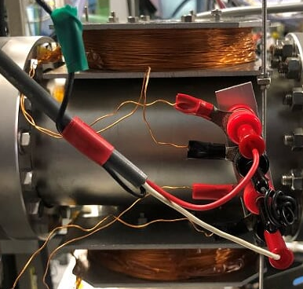
減速時にビーム偏向する理由
Setup and method of irradiation experiment
Steering Coil 1
電流の向き
I_{s1}
上面図
側面図
Steering Coil 2
I_{s2}
上面図
側面図

Slide 23
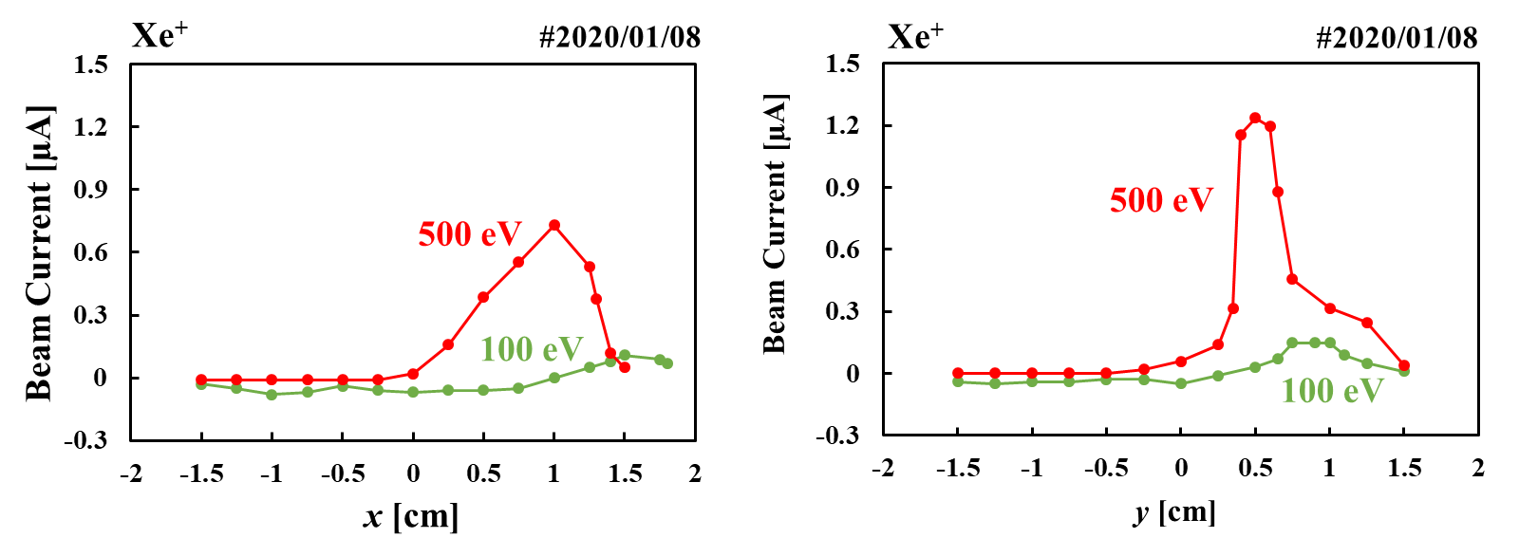
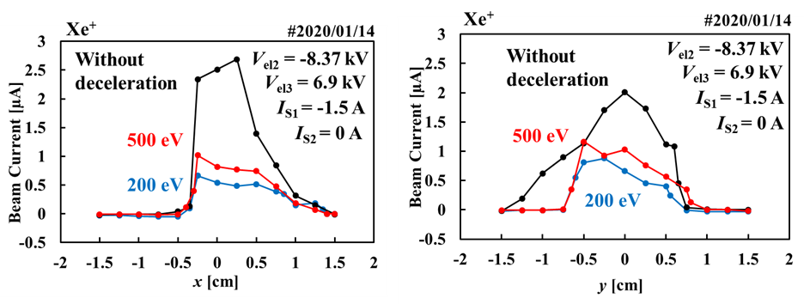
減速時にビーム偏向する理由

Slide 24
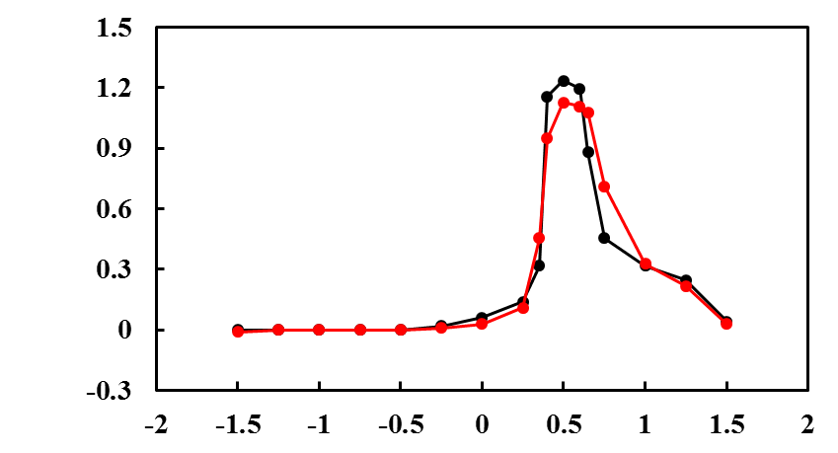
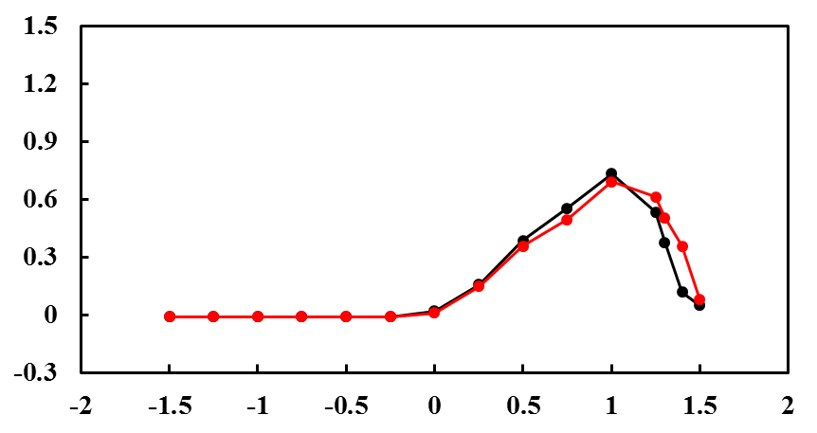
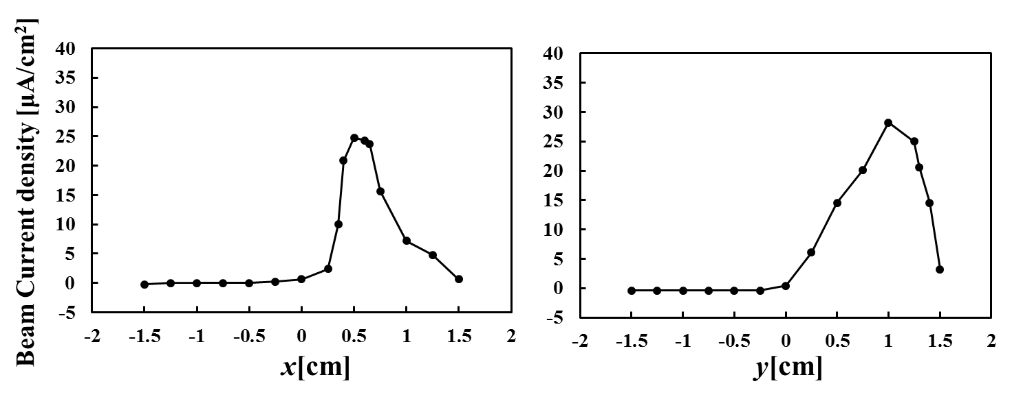
照射実験
ビームプロファイル測定結果
2020/01/08
Xe+(500eV)
Xe+(500eV)→Si
Beam Current [μA]
Xe+(500eV)
Xe+(500eV)→Si
x[cm]
y[cm]

Slide 25
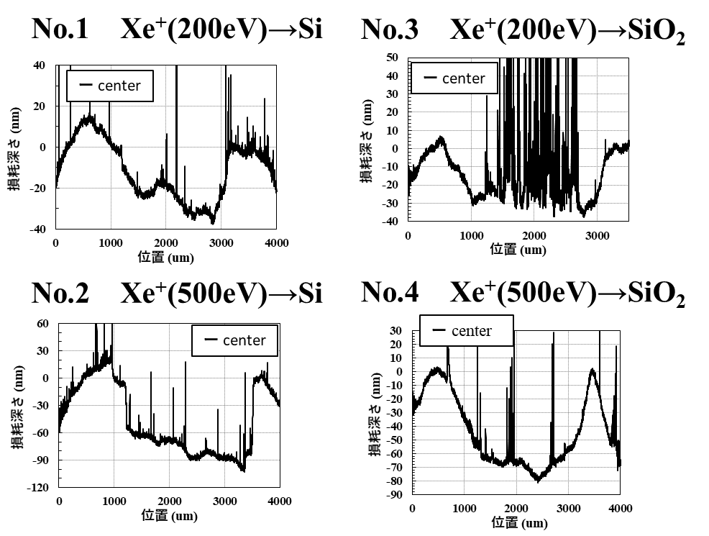
3. 照射実験
段差測定結果
マスク部分
center
Right
Left
ターゲット材料

