Slide 1

Producing Multicharged Ions
by Pulse Modulated Microwaves
at Mixing Low Z Gases on ECRIS
Shuhei Harisaki, Wataru Kubo, Issei Owada, Koichi Sato, Kazuki Tsuda, and Yushi Kato
Division of Electrical, Electronic and Inforcommunications Engineering, Graduate School of Engineering, Osaka Univ.
24th International Workshop on ECR Ion Sources

Slide 2
Introduction
Background
In the previous study, we succeeded in increasing the multicharged ion yield of Xe in UHR heating experiment using 4-6GHz X-mode microwaves (※).
We are now exploring the feasibility of selectively heating specific ions by launching a frequency band much lower than conventional ECR.
⇒e. g., ion cyclotron resonance (ICR), lower hybrid resonance (LHR)
As a preliminary step, we try to enhance the ion cooling effect by heating low Z ions by pulsing microwaves under gas mixing.
Objective
We conduct the experiment to generate ECR plasma with pulse-modulated microwaves under gas mixing.
By changing the pulse period, the optimum period for extracting Xe⁷⁺ ion beams is investigated.
(※)Y. Kato, et al., Rev. Sci. Instrum., 2020, 91, 013315

Slide 3
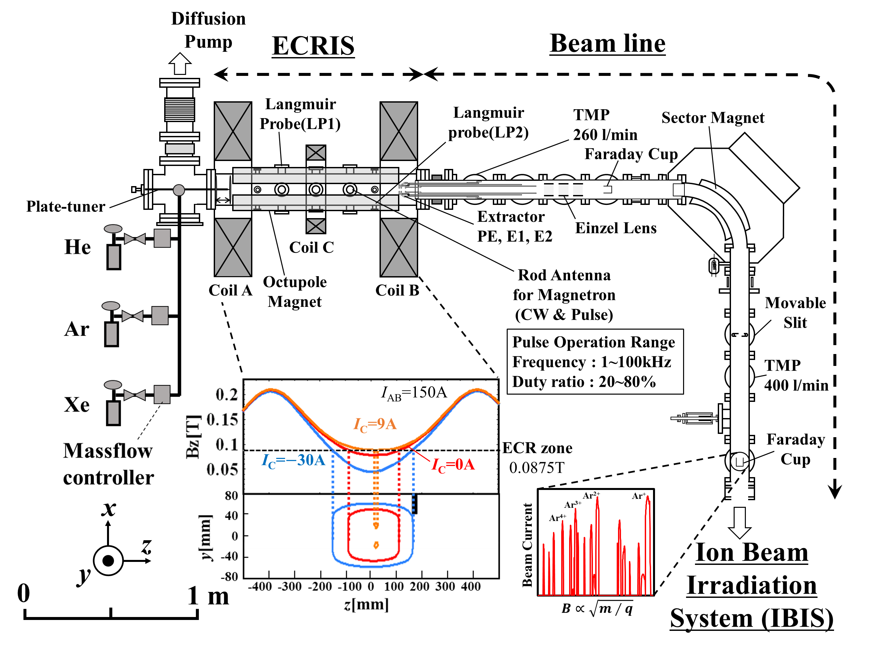
Experimental setup
These experimental conditions
Pressure : 7.0×10⁻⁴Pa
I_{AB} : 150A
P_{in}/P_{ref} : 100W/opt
V_{PE} : 10kV

Slide 4
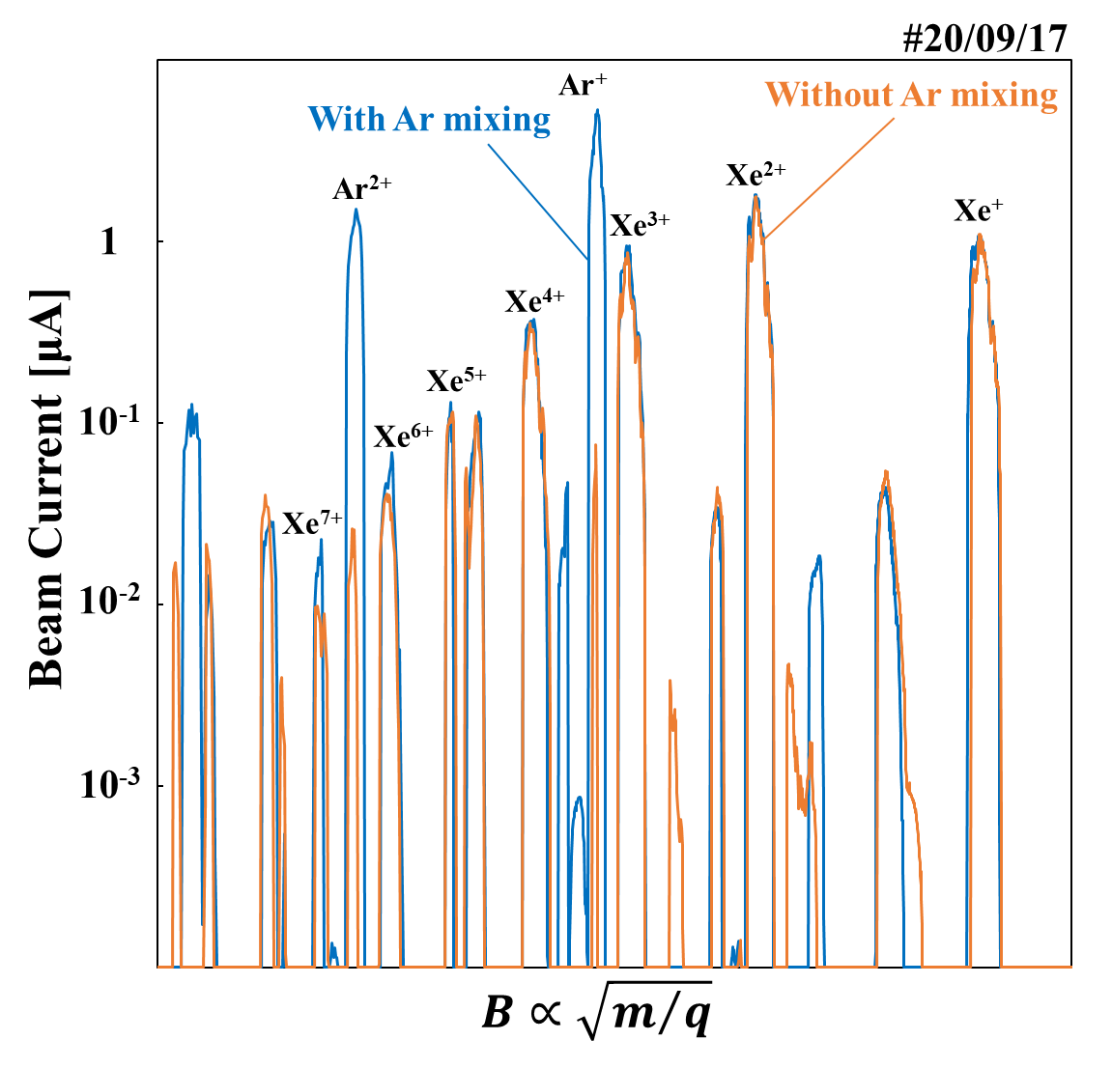
Typical CSD’s of gas mixing application
CW operation
Experimental condition
Pressure : 7.0×10⁻⁴Pa
I_{AB} : 150A
P_{in}/P_{ref} : 100W/10W
V_{PE} : 10kV
I_{C}, V_{E1}, V_{el1} : Opt Xe⁷⁺
Without Ar mixing
Xe : Ar = 100 : 0 [%]
With Ar mixing
Xe : Ar = 50 : 50 [%]
Increased Xe⁷⁺ ion beam current by introducing Ar gas

Slide 5
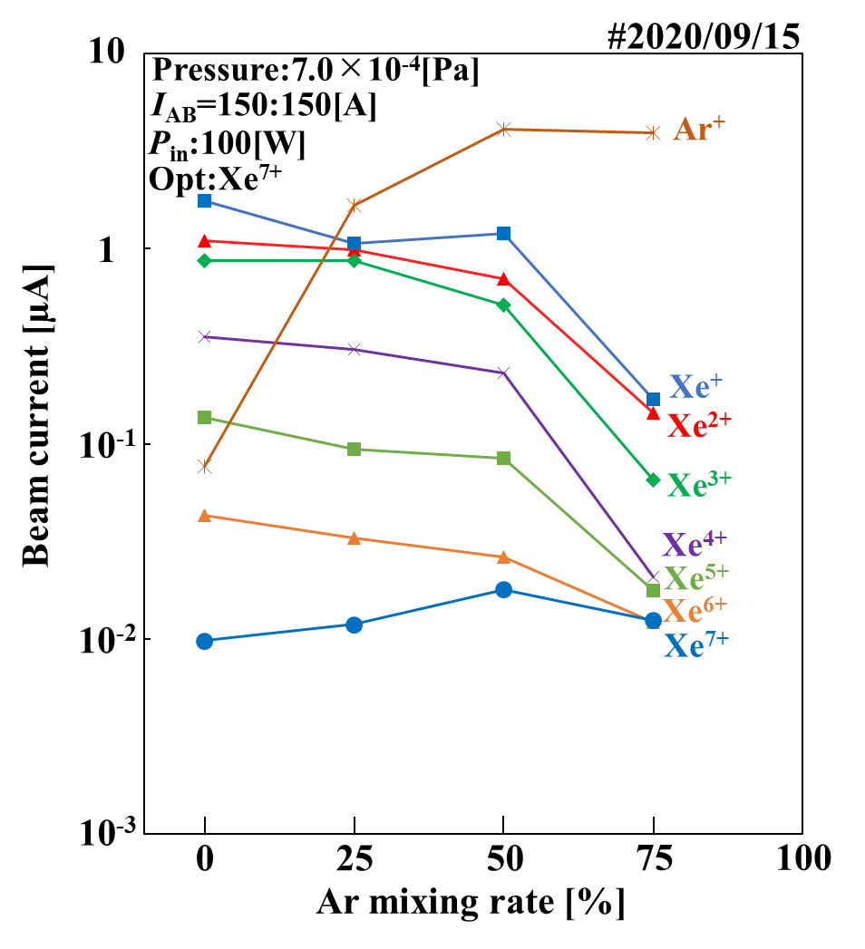
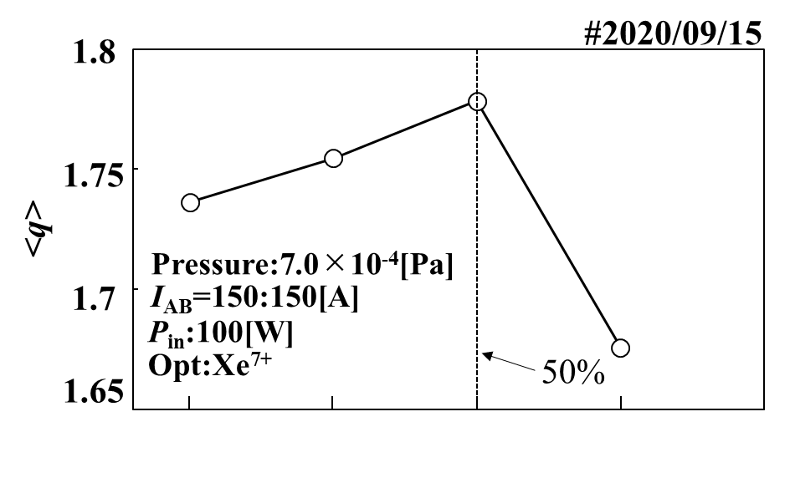
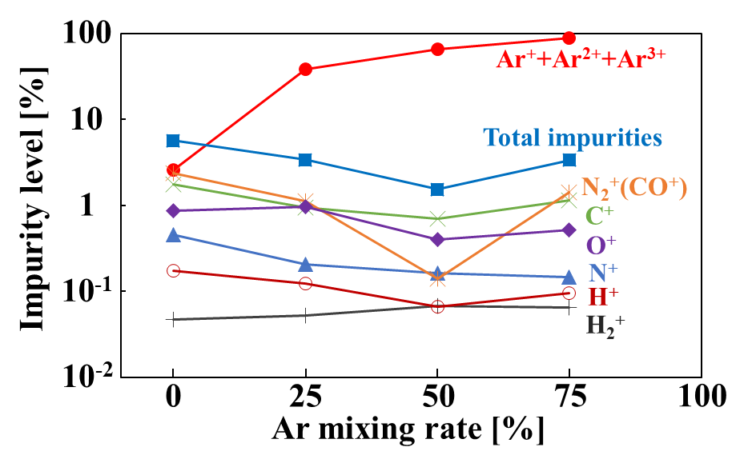

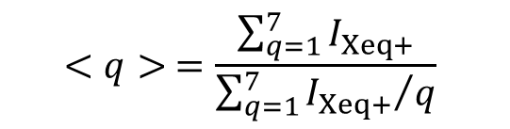
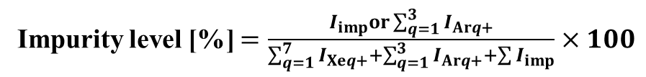
The dependence of Xe^{q+} on Ar mixing ratio
Average charge state $<q>$
$$<q> =\frac{\sum_{q=1}^{7}{I_{Xeq+}}}{\sum_{q=1}^{7}{{I_{Xeq+}}/q}}$$
Impurity level [%] $=\frac{I_{imp}or\sum_{q=1}^{3}{I_{Arq+}}}{\sum_{q=1}^{7}{I_{Xeq+}}+\sum_{q=1}^{3}{I_{Arq+}}+\sum{I_{imp}}}×100$

Slide 6
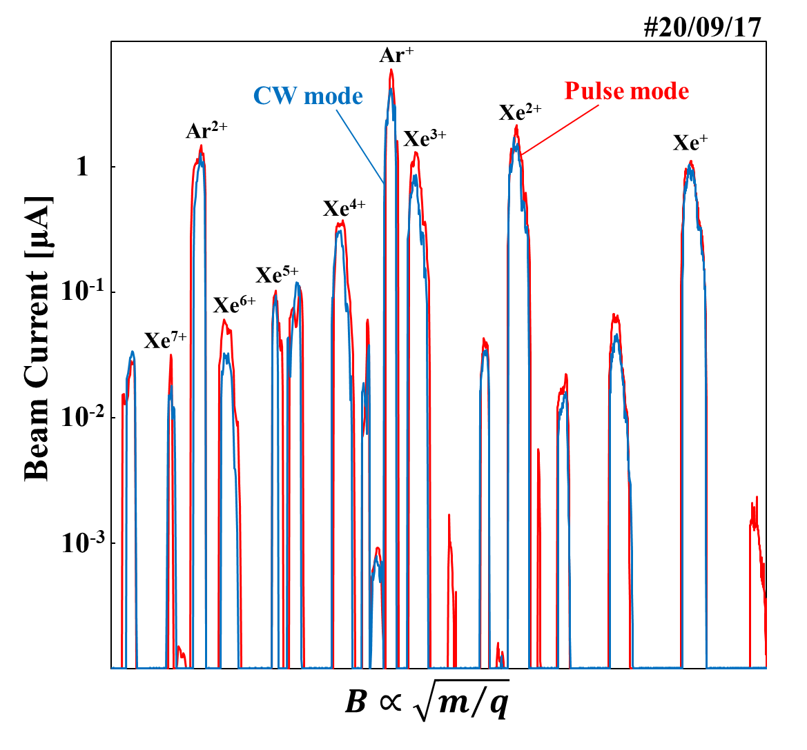
Typical CSD’s of pulse application
Under Ar gas mixing operation
Experimental condition
Pressure : 7.0×10⁻⁴Pa
I_{AB} : 150A
V_{PE} : 10kV
I_{C}, V_{E1}, V_{el1} : Opt Xe⁷⁺
Xe : Ar = 50 : 50 [%]
CW mode
P_{in}/P_{ref} : 100W/10W
Pulse mode
P_{in}/P_{ref} : 100W(ave.)/10~20W
Duty ratio : 50%
Increased Xe⁷⁺ ion beam current by launching pulsed microwaves

Slide 7
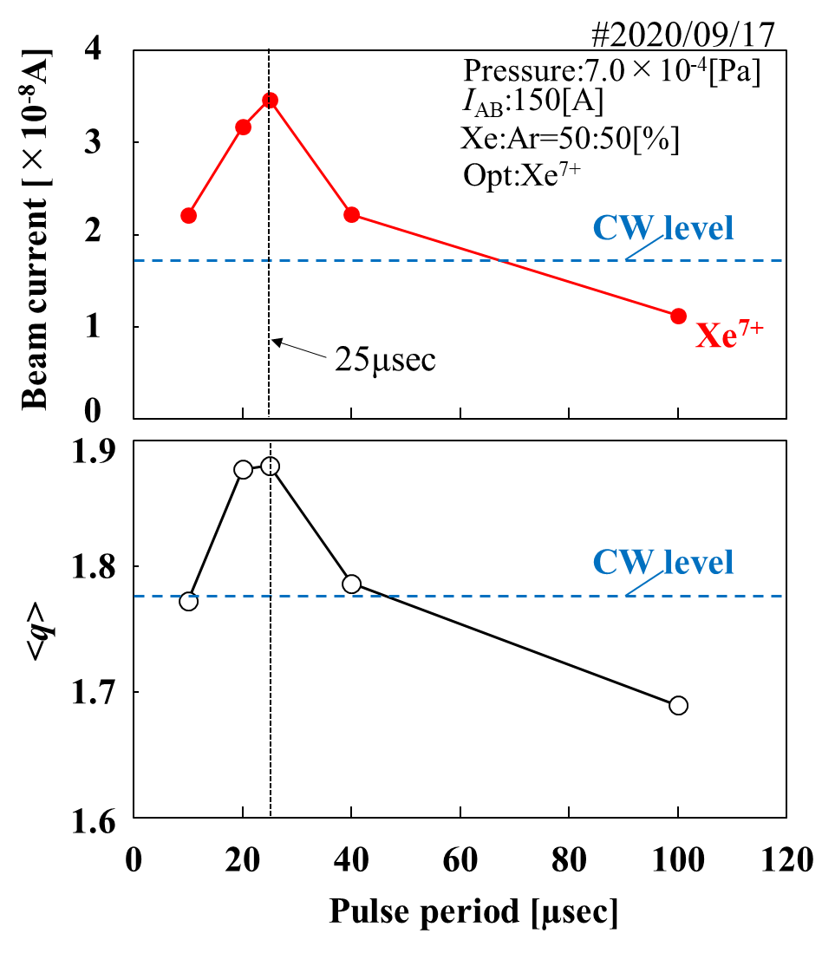
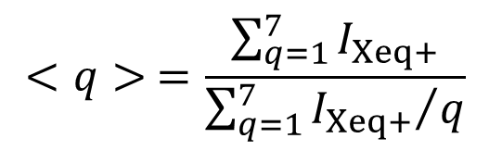
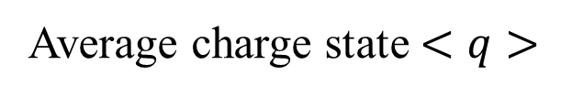
The dependence of Xe⁷⁺ on pulse period
Average charge state $<q>$
$$<q> =\frac{\sum_{q=1}^{7}{I_{Xeq+}}}{\sum_{q=1}^{7}{{I_{Xeq+}}/q}}$$
Microwaves operation
CW mode
P_{in}/P_{ref} : 100W/10W
Pulse mode
P_{in}/P_{ref} : 100W(ave.)/10~20W
Duty ratio : 50%

Slide 8
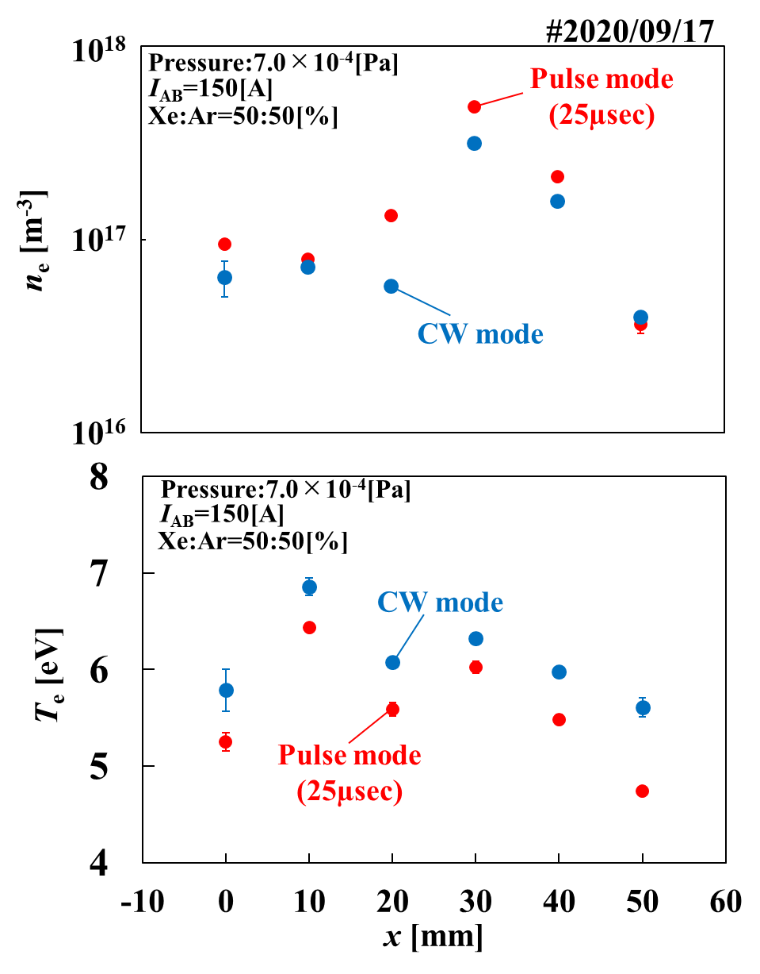

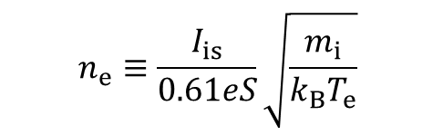
Comparison of the n_{e} and the T_{e}
Langmuir probe method
$$n_{e}≡\frac{I_{is}}{0.61eS}\sqrt{\frac{m_{i}}{k_{B}T_{e}}}$$
$$T_{e}≡\frac{k_{B}}{e}\frac{d ln I_{e}}{d V_{p}}$$
Microwaves operation
CW mode
P_{in}/P_{ref} : 100W/10W
Pulse mode
P_{in}/P_{ref} : 100W(ave.)/10~20W
Duty ratio : 50%

Slide 9
Conclusion
Summary
We increased the beam current of Xe⁷⁺ by pulsed microwave launching under gas mixing.
The T_{e} decreases when the pulsed microwave is applied, so the increase in the average charge state <q> is not due to it.
The increase in Xe⁷⁺ seems to be due to the selective heating of ions,
but another possibility is the effect of the afterglow (※).
Future plan
We will estimate the ion temperature T_{i} and obtain confirmation of the cooling effect of the ions.
⇒Conducting emittance measurements
We will conduct the experiments to generate ICR and LHR to selectively heat low Z ions.
⇒Injection of RF waves (typically 13.56MHz) into ECR plasma under gas mixing
(※)Y. Kato, et al., Rev. Sci. Instrum., 2000, 71, 657

