Slide 1




A Guiding Centre Approximation Approach for the Simulation of Electron Trajectories in ECR and Microwave Ion Sources
Antonio MENDEZ¹, Thomas THUILLIER¹, Tiberiu MINEA²
¹Université Grenoble-Alpes, CNRS-IN2P3, Grenoble Institute of Engineering (INP), LPSC, 38000 Grenoble, France
²Université Paris-Saclay, CNRS-IN2P3, LPGP, 91405 Orsay, Île de France, France
ECRIS Workshop, Michigan, September 28th-30th 2020

Slide 2
Introduction
Objective: Investigation of the validity and stability of
the Guiding Centre (GC) algorithm to speed up particle propagation in magnetised plasma simulation.
2 ion sources to consider:
  ECRIS (Phoenix V2) confinement up to ~1ms.
  Microwave discharge (MDIS) ion source (SILHI@GANIL) confinement ~1µs.
Methodology:
  Implementation of two, otherwise identical, algorithms in c to simulate electron trajectories by Boris and the GC approximation.
  Consistency check and computation time measurement of trajectories for equivalent initial conditions with different time-steps (dt).
  Identify a range of validity for dt.
Notes:
-I’m talking some more about these two ion sources later in this presentation

Slide 3
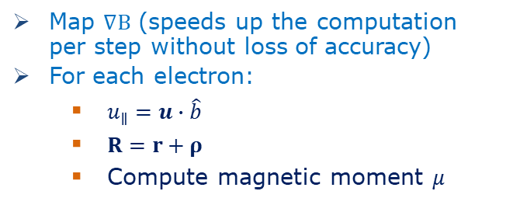



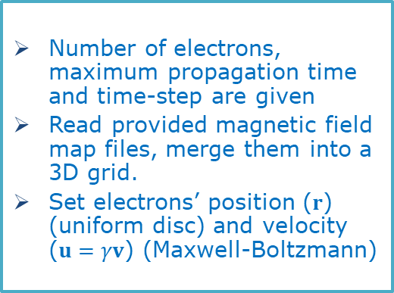
Implementation
General initialization
Number of electrons, maximum propagation time and time-step are given
Read provided magnetic field map files, merge them into a 3D grid.
Set electrons’ position ($r$) (uniform disc) and velocity ($u=γv$) (Maxwell-Boltzmann)
GC initialization
Map $∇B$ (speeds up the computation per step without loss of accuracy)
For each electron:
  $u_{∥}=u∙\hat{b}$
  $R=r+ρ$
  Compute magnetic moment $μ$
Boris Algorithm
GC Approximation
$$dt$$
$$dt$$
$\frac{dR}{dt}$ and $\frac{{du}_{∥}}{dt}$ integrated concurrently by RK4
Output
Track file (r, u, µ (GC), n_{e}, ε, t, t_{cpu})
Notes:
-Magneto-static (low current, we keep the strong applied field constant)
-

Slide 4
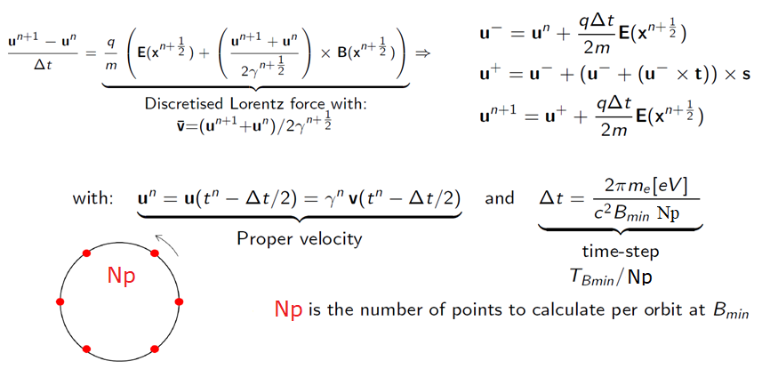
Boris algorithm
The standard for magnetised plasma simulations.
Second order, explicit method. Energy conserving while only a magnetic field is present.
For B= 1T, T_{B}=1/ω_{B}~35ps → dt~3ps.

Slide 5
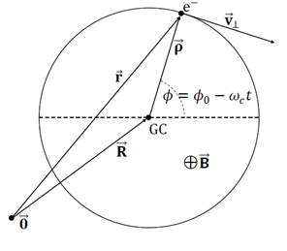
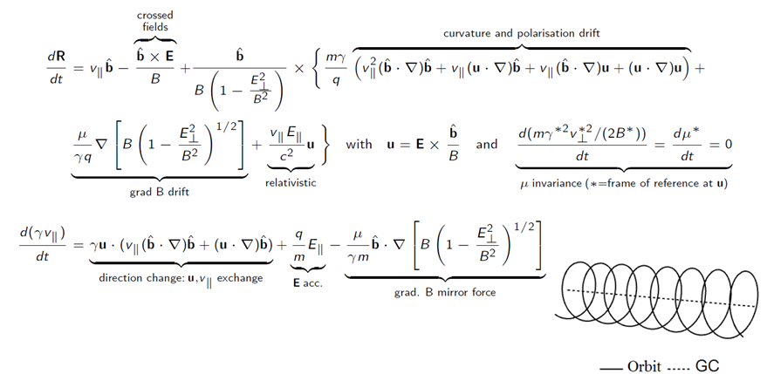
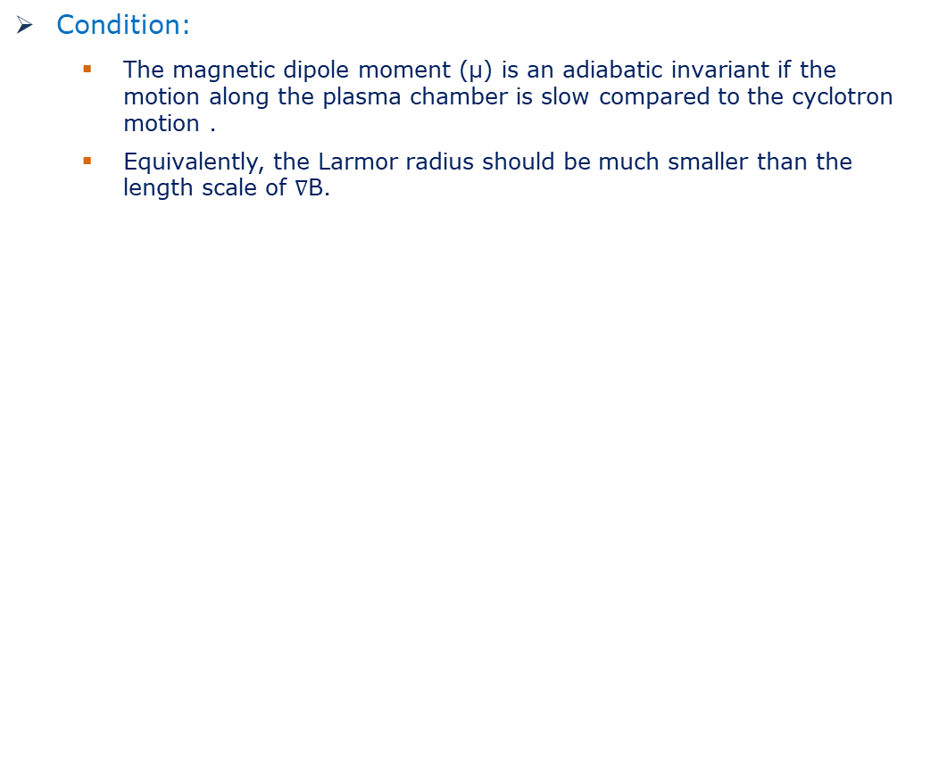

Guiding Centre (GC) approximation
Condition:
  The magnetic dipole moment (µ) is an adiabatic invariant if the motion along the plasma chamber is slow compared to the cyclotron motion .
  Equivalently, the Larmor radius should be much smaller than the length scale of $∇$B.
$$ρL≪\frac{B}{\left|∇B\right|}$$

Slide 6
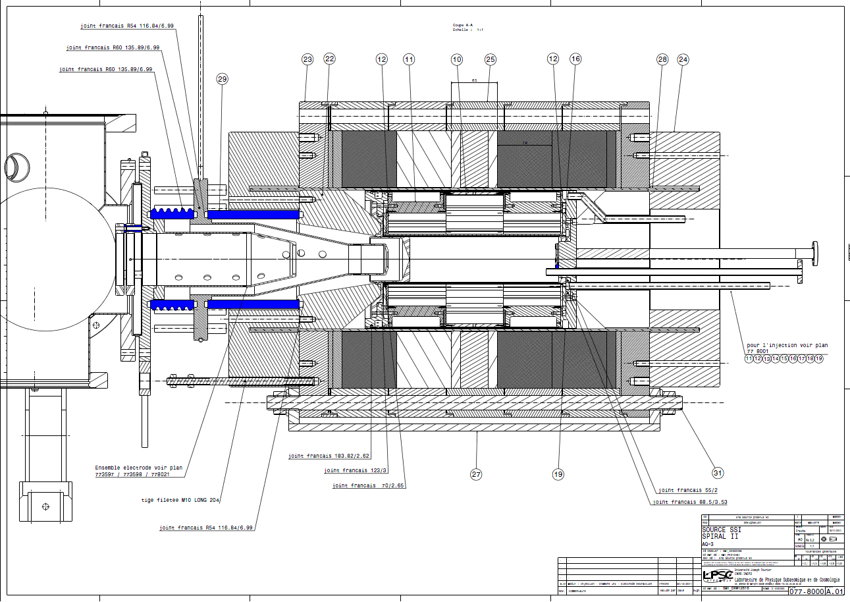
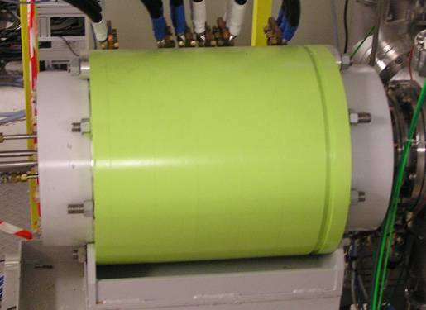
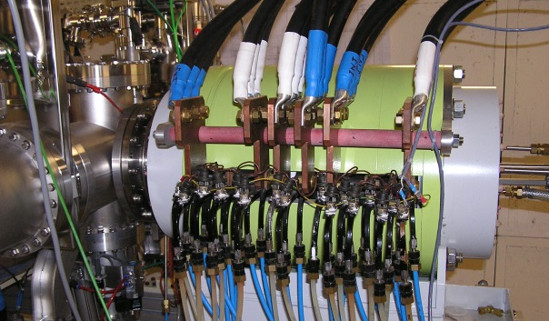
Phoenix V2 ECRIS
Compact ECRIS commissioned for the SPIRAL 2 accelerator.
0.6L plasma chamber volume (L204mm , Ø63mm)
Operation frequency of 18GHz
1.3-0.4-2.1 T B_{z} Axial Mirror
60 kV core
Hexapole B_{r}~1.35 T at wall

Slide 7
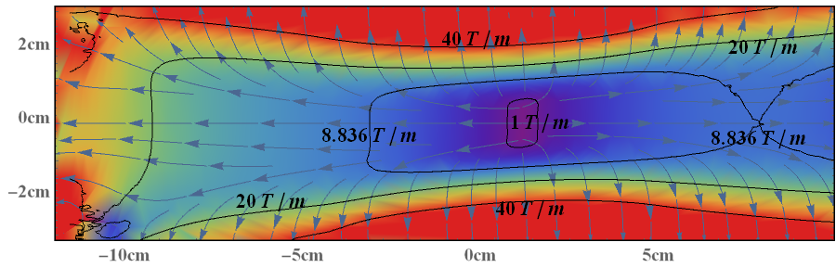
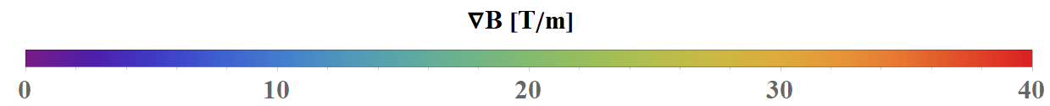
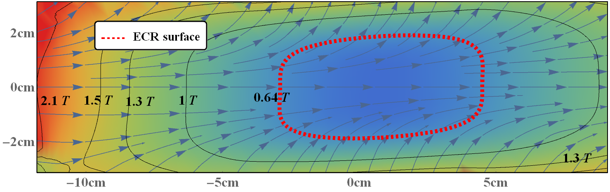
Phoenix V2 min-B field
Map files provided to simulation
  2D for axisymmetric solenoidal fields
  3D for hexapolar fields
Figure: Phoenix V2 magnetic field and it’s gradient, longitudinal cross section map

Slide 8
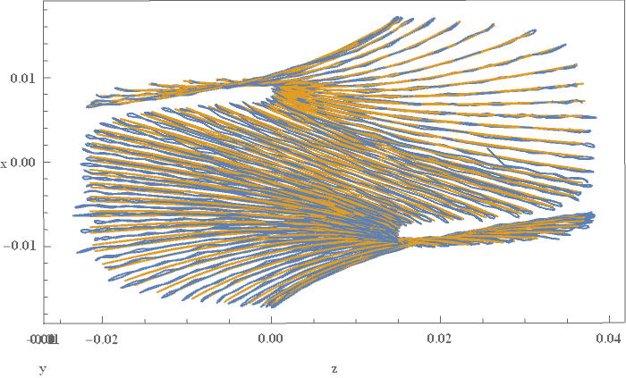
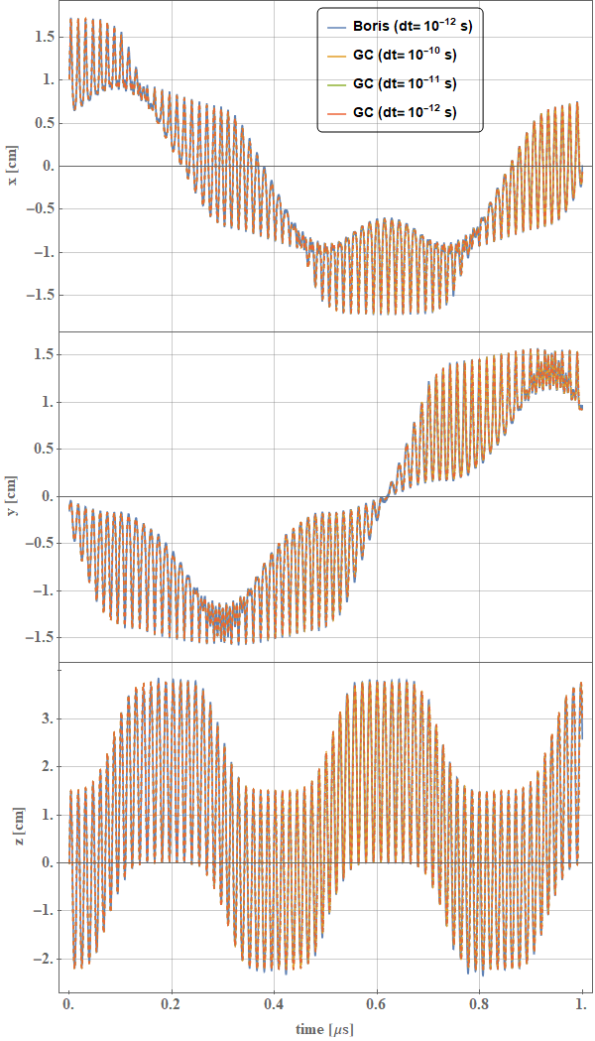
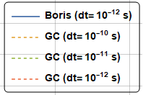
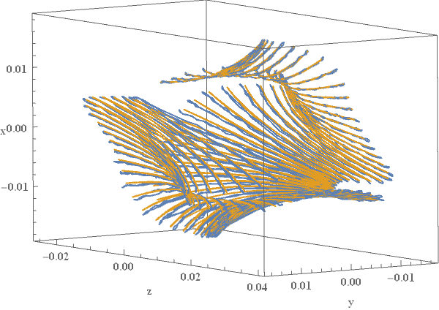
ECR orbit Far From Axis (FFA)
X
x[cm]
Z
y[cm]
X
Z
Y
z[cm]
Figure: Confined electron orbit 3D plot
Good agreement between Boris and GC with ~1µs of propagation.
time[µs]
Figure: Confined electron orbit components

Slide 9
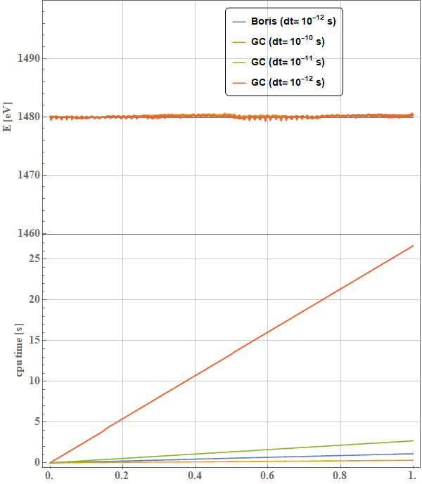
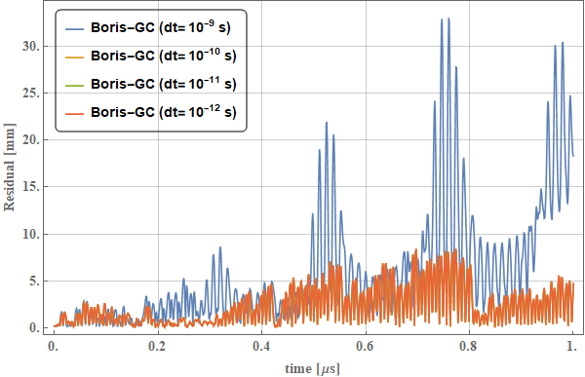
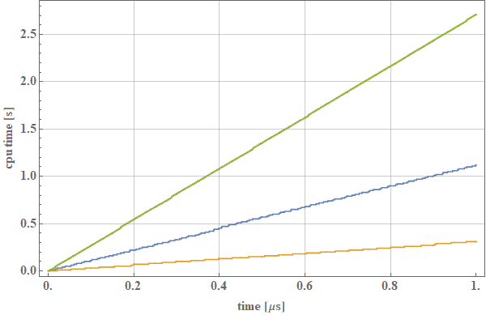
ECR orbit analysis (FFA)
GC algorithm ~20 times more computationally expensive per step.
  ~100 times larger timestep rends it faster.
The GC trajectories are stable up to a 100ps time-step, broken at a 1000ps.
T_{boris} = Boris computation time
24.5 T_{Boris}
2.4 T_{Boris}
T_{Boris}
Figure: Boris-GC orbit residual at corresponding propagation times.
0.2 T_{Boris}
Notes:
1 ev energy variation 1 turn
1 mus is typical for the electron free flight

Slide 10
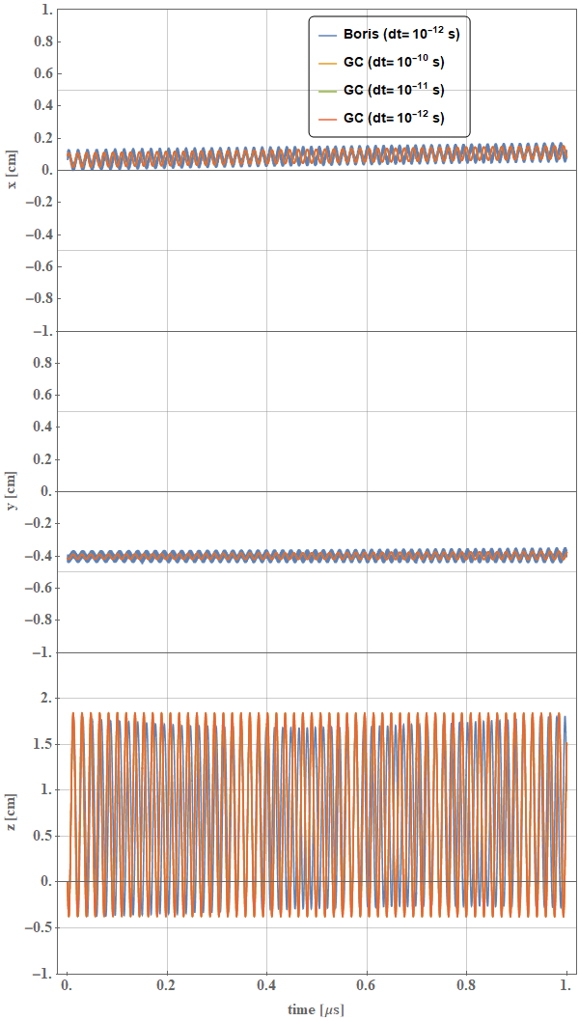
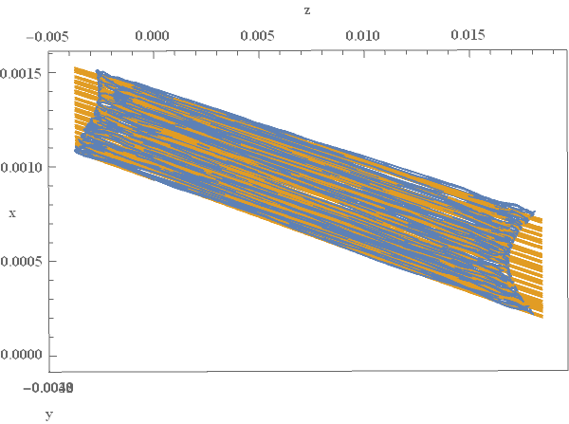
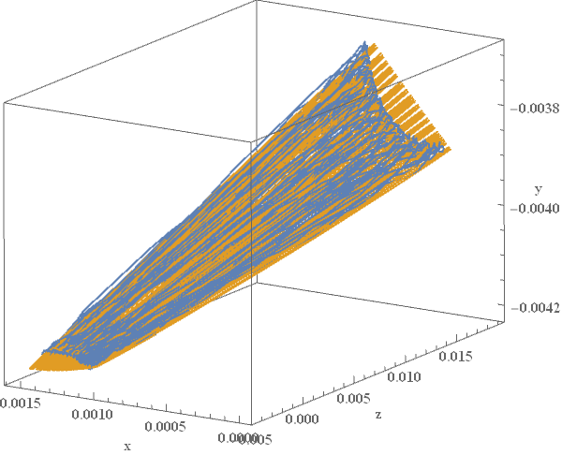
ECR orbit Close To Axis (CTA)
Disphasement observed between the GC and Boris orbits
Spatial envelopes are consistent.
x[cm]
Z
X
y[cm]
Y
z[cm]
X
Z
time[µs]
Figure: Confined electron orbit 3D plot
Figure: Confined electron orbit components

Slide 11
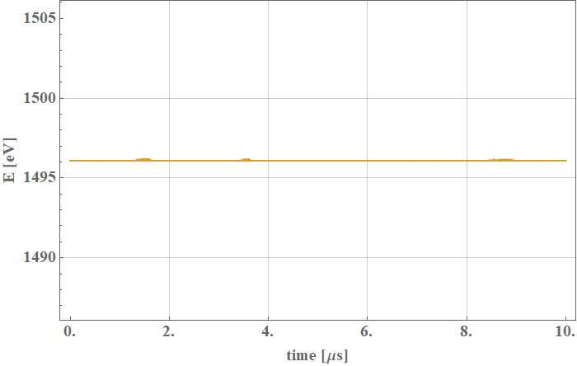
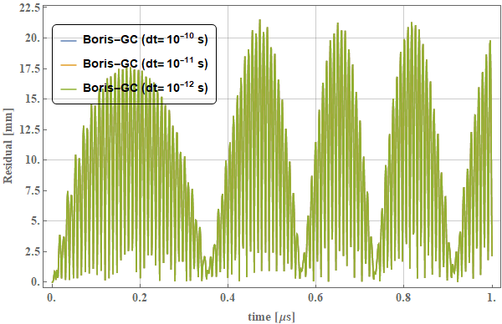
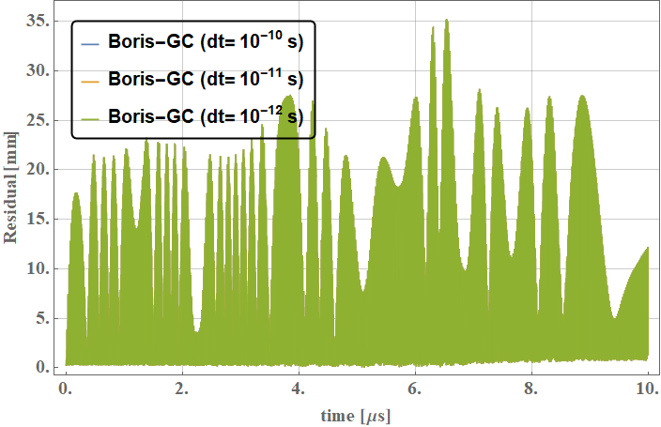
ECR orbit analysis (CTA)
The observed disphasement is evident
Good agreement between Boris and GC
This orbit is one of the hardest for GC, (high axial oscillation frequency)
Stable at this time-scale
Figure: Boris-GC orbit residual at corresponding propagation times.
Figure: Boris-GC orbit residual at corresponding propagation times.
Energy conserved with both methods
Notes:
Reasonably good energy conservation in the GC approach
Good spatial agreement between trajectories

Slide 12
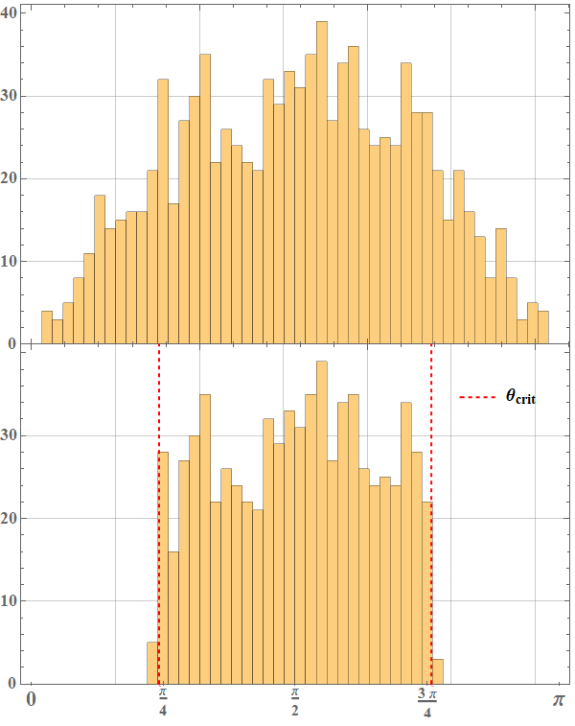






ECR confinement
Good agreement for the confined electron distribution with both propagation methods
  Sample size 1000, largest valid dt (10⁻¹⁰s for GC and 10⁻¹²s for Boris)
Boris propagated e⁻
GC propagated e⁻
$$\tan{{(θ}_{pitch})}=\frac{v_{⊥}}{v_{∥}}$$
$$\frac{1}{ℛ}=\frac{B_{0}}{B_{max}}$$
$$\sin{{(θ}_{crit})}=\frac{1}{\sqrt{ℛ}}$$
$$θ_{pitch}$$
$$θ_{pitch}$$

Slide 13
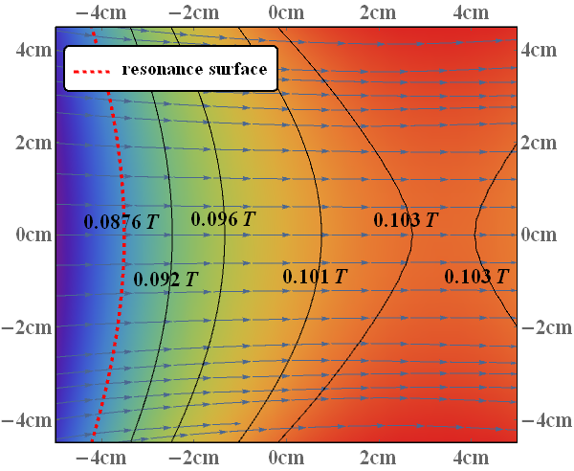
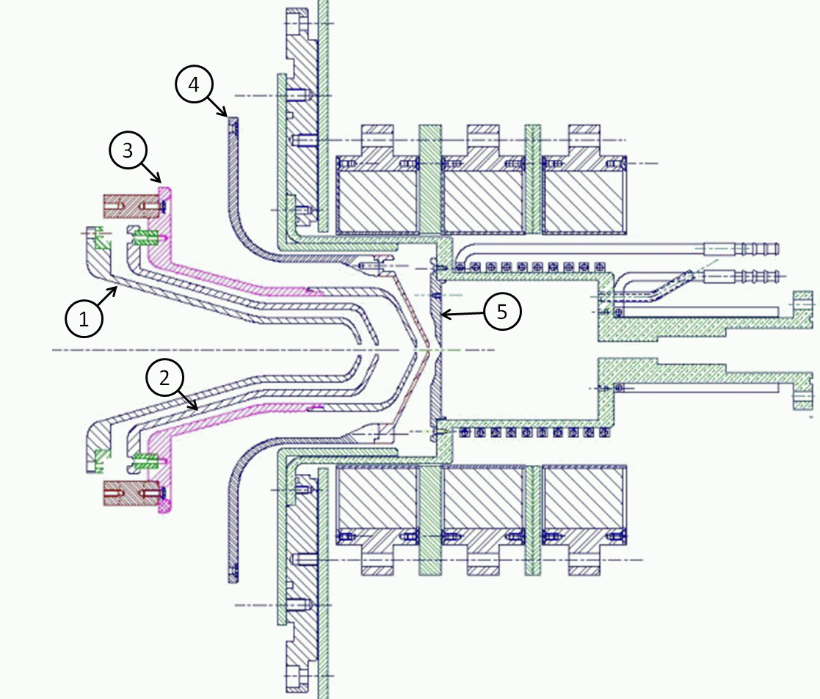
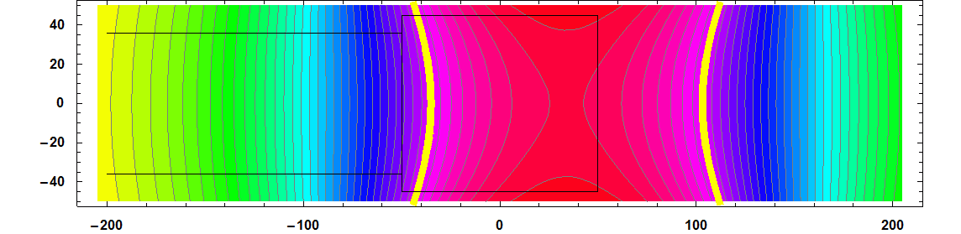
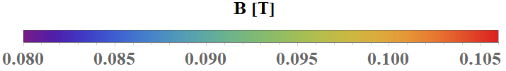
SILHI@GANIL ion source
2.45GHz operation frequency
Microwave discharge ion source (MW)
~0.1T maximum solenoidal magnetic field. (2D map given)
No magnetic confinement, one magnetic mirror towards extraction
Resonance surface
Gas
RF/Gas injection wall
Extraction wall
RF
Figure: SILHI source with permanent magnets (CEA/IRFU/GANIL)

Slide 14
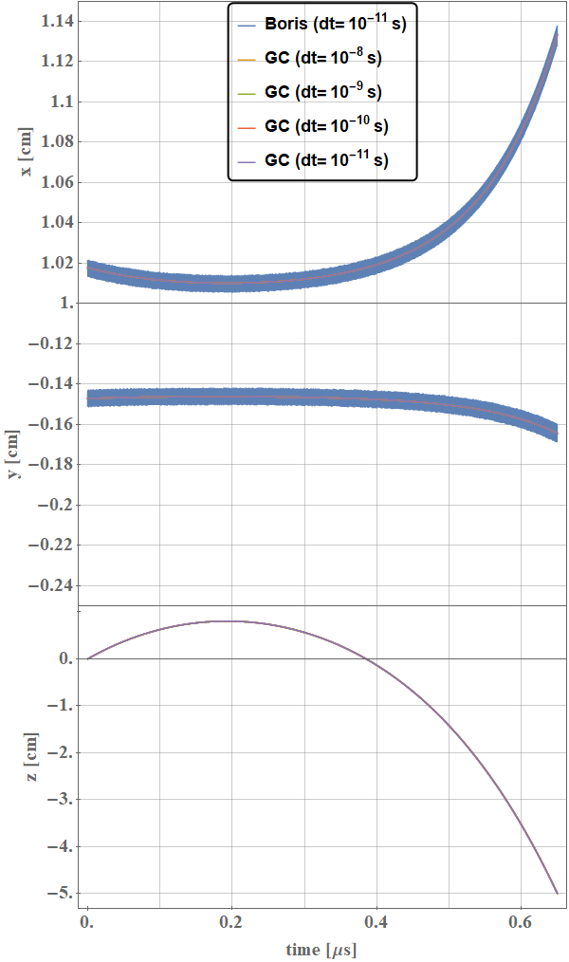
Trapped orbit in SILHI
(one bounce)
Very good qualitative agreement.
A one bounce orbit chosen as it is one of the most challenging examples.
A typical energy electron of ~1eV is confined for ~1µs. In the absence of interaction
Figure: One bounce electron orbit components

Slide 15
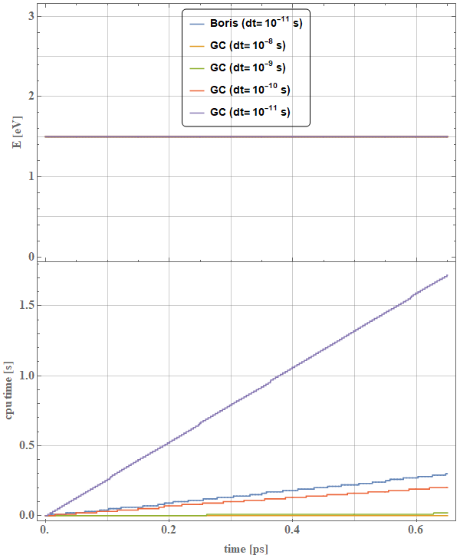
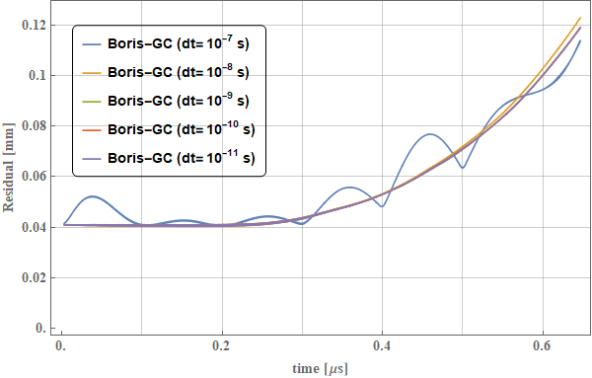
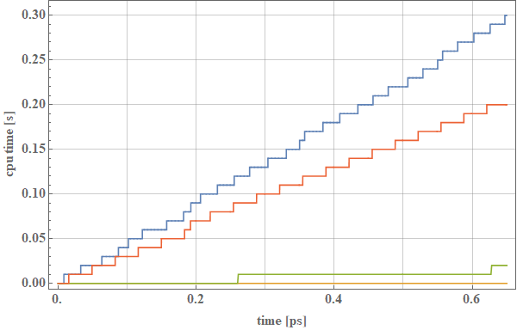
Trapped orbit analysis
GC algorithm ~5.7 times more computationally expensive per step.
10 times larger timestep rends it faster.
The GC trajectories stable up to a 1000ps time-step, broken at a 10⁴ps.
  GC up to ~10 times faster when compared to Boris.
5.7 T_{Boris}
2/3 T_{Boris}
2/30 T_{Boris}
Figure: Boris-GC orbit residual at corresponding propagation times.
Notes:
Size of the field map
Mesh array size varies

Slide 16
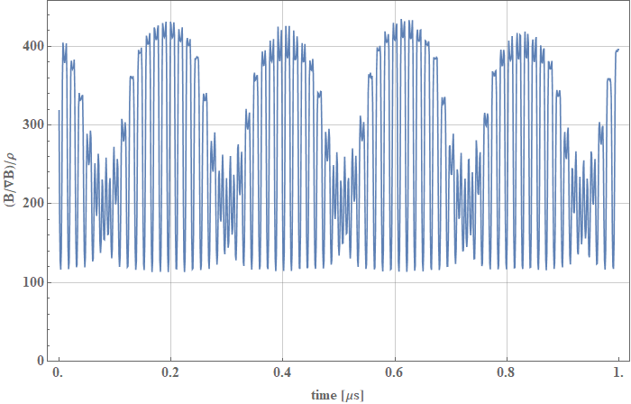
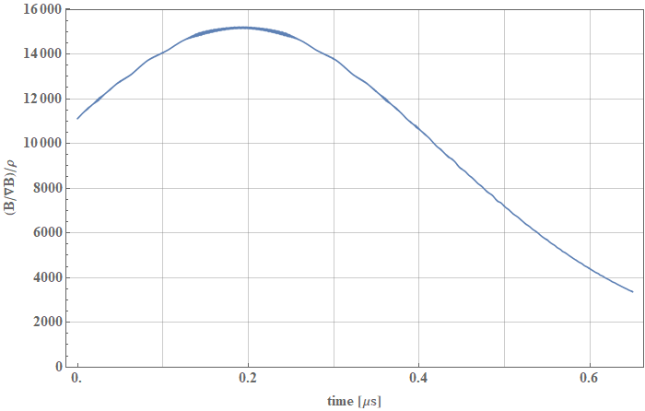


GC algorithm validity
$$ρL≪\frac{B}{\left|∇B\right|}$$
$$\frac{\left(B/{\left|∇B\right|}\right)}{ρL}≫1$$
ECRIS (Phoenix V2)
MDIS (SILHI)
Figure: Validity condition for the GC algorithm for ECRIS and MDIS typical orbit
The GC algorithm is more suitable for a MDIS (SILHI type) source than for an ECRIS

Slide 17
Conclusions and prospects
The GC algorithm can accurately reproduce electron trajectories in the domain of both studied ion sources
  PHOENIX V2 ECRIS: B=1T, T_{e}~1keV, volume=0.6L
  SILHI@GANIL: B=0.1T, T_{e}~1eV, volume=0.6L
The GC algorithm can provide an advantage in terms of computation time for particle plasma simulations.
  This advantage is greater in a flat field, as observed for SILHI. The time step can be increased by a factor of 10³ with a computation time two orders of magnitude smaller with respect to Boris.
  For the Phoenix V2 ECRIS the gains are more modest, with a time-step increased by a factor of 10² and one order of magnitude gain in computation time.
A smart switcher for orbit integration could be implemented, where the GC approximation is used with a large time-step when valid and a high time resolution isn’t required.

Slide 18
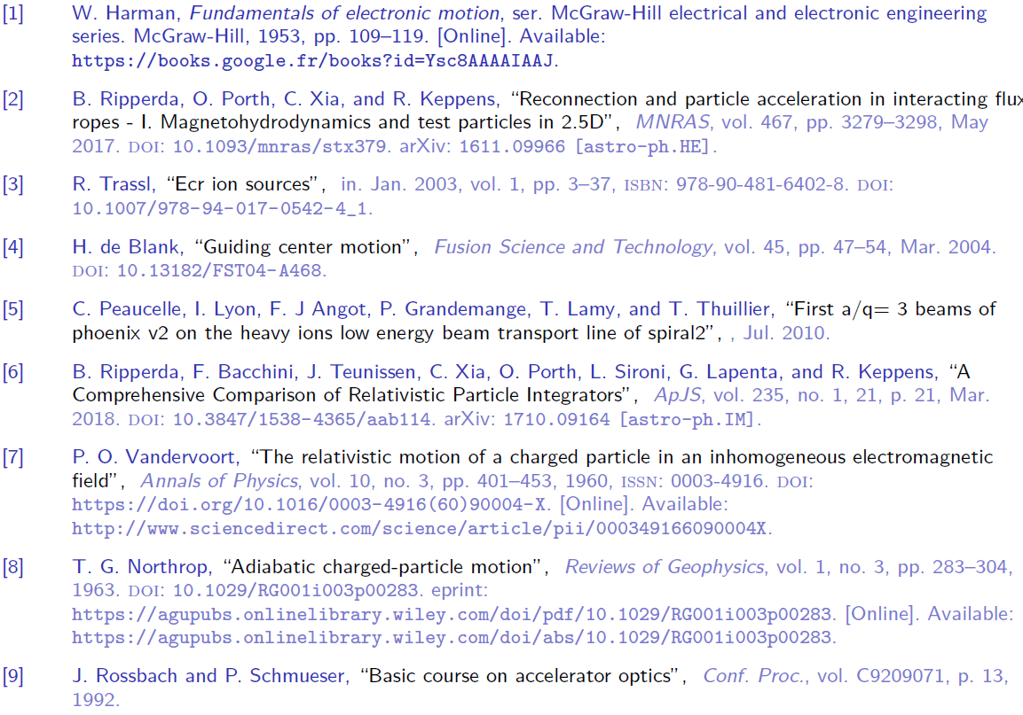
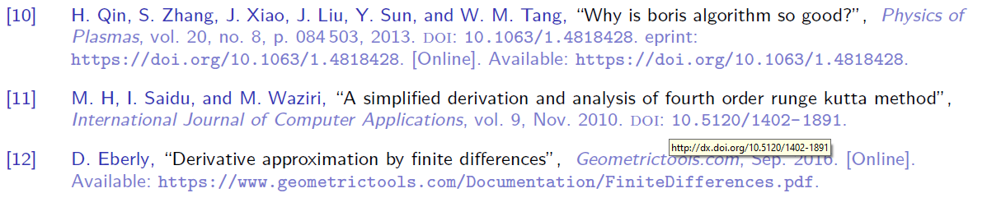
References

Slide 19
Appendix

Slide 20
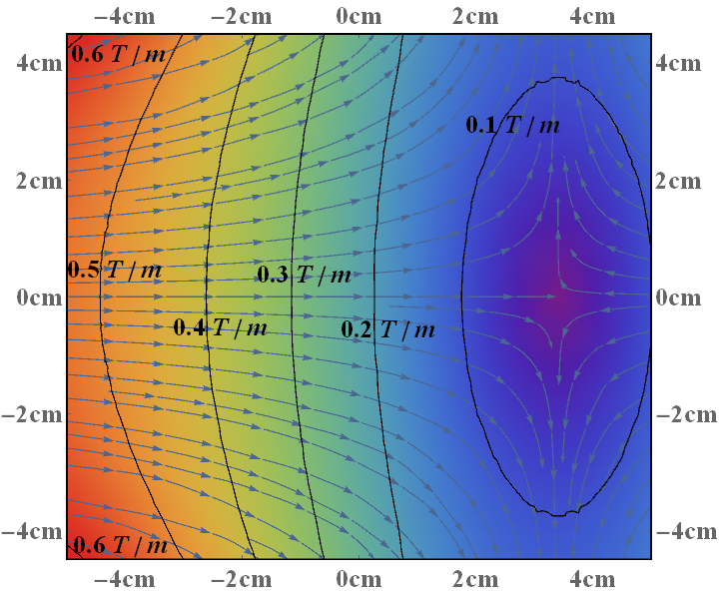
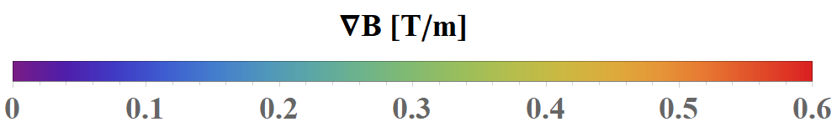
SILHI@GANIL B field and gradient

Slide 21
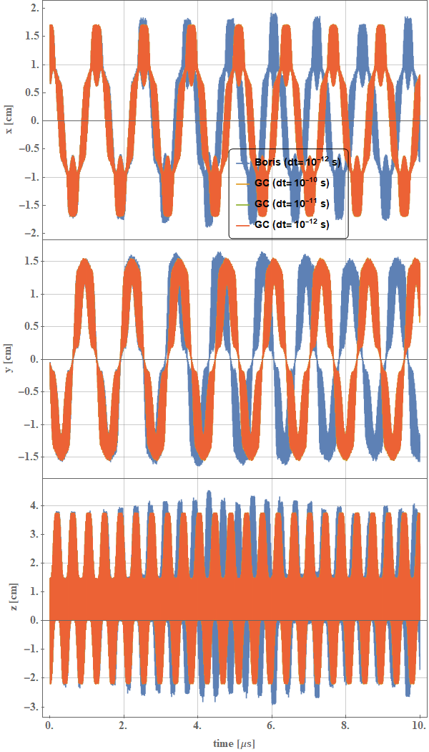
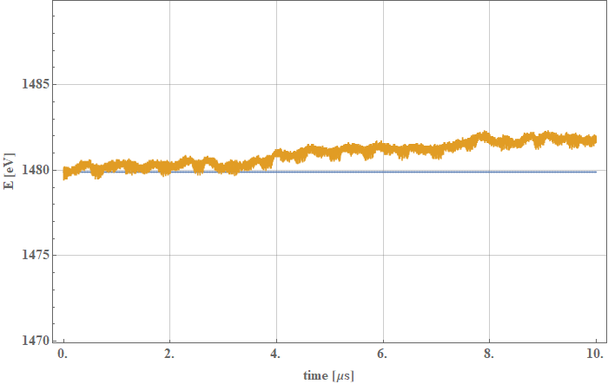
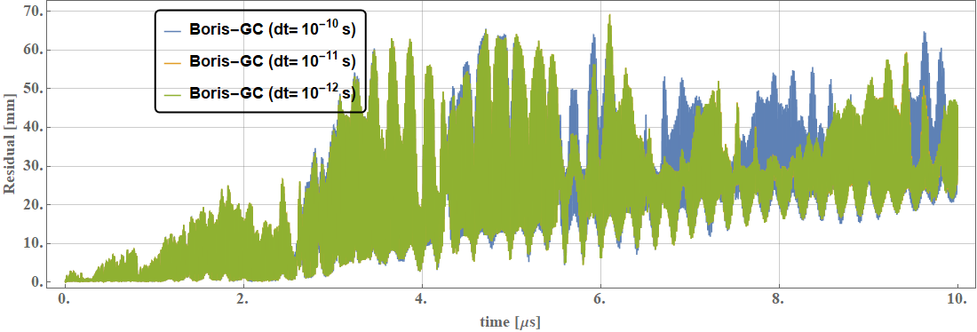
Disphasement FFA

Slide 22
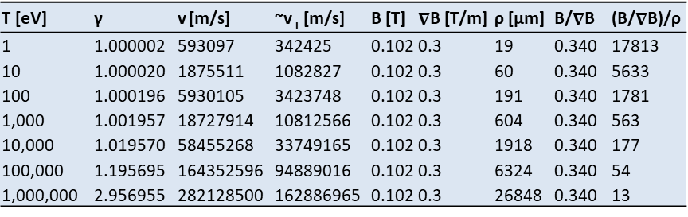
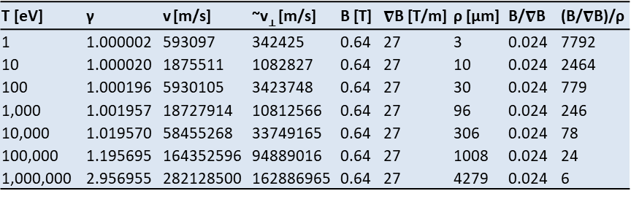
GC approximation validity by electron’s kinetic energy
T [eV] | γ | v [m/s] | ~v⊥ [m/s] | B [T] | $∇$B [T/m] | ρ [µm] | B/$∇$B | (B/$∇$B)/ρ
1 | 1.000002 | 593097 | 342425 | 0.64 | 27 | 3 | 0.024 | 7792
10 | 1.000020 | 1875511 | 1082827 | 0.64 | 27 | 10 | 0.024 | 2464
100 | 1.000196 | 5930105 | 3423748 | 0.64 | 27 | 30 | 0.024 | 779
1,000 | 1.001957 | 18727914 | 10812566 | 0.64 | 27 | 96 | 0.024 | 246
10,000 | 1.019570 | 58455268 | 33749165 | 0.64 | 27 | 306 | 0.024 | 78
100,000 | 1.195695 | 164352596 | 94889016 | 0.64 | 27 | 1008 | 0.024 | 24
1,000,000 | 2.956955 | 282128500 | 162886965 | 0.64 | 27 | 4279 | 0.024 | 6
Table: ECRIS near ECR region
T [eV] | γ | v [m/s] | ~v⊥ [m/s] | B [T] | $∇$B [T/m] | ρ [µm] | B/$∇$B | (B/$∇$B)/ρ
1 | 1.000002 | 593097 | 342425 | 0.102 | 0.3 | 19 | 0.340 | 17813
10 | 1.000020 | 1875511 | 1082827 | 0.102 | 0.3 | 60 | 0.340 | 5633
100 | 1.000196 | 5930105 | 3423748 | 0.102 | 0.3 | 191 | 0.340 | 1781
1,000 | 1.001957 | 18727914 | 10812566 | 0.102 | 0.3 | 604 | 0.340 | 563
10,000 | 1.019570 | 58455268 | 33749165 | 0.102 | 0.3 | 1918 | 0.340 | 177
100,000 | 1.195695 | 164352596 | 94889016 | 0.102 | 0.3 | 6324 | 0.340 | 54
1,000,000 | 2.956955 | 282128500 | 162886965 | 0.102 | 0.3 | 26848 | 0.340 | 13
Table: MDIS near plasma chamber centre

