Slide 1



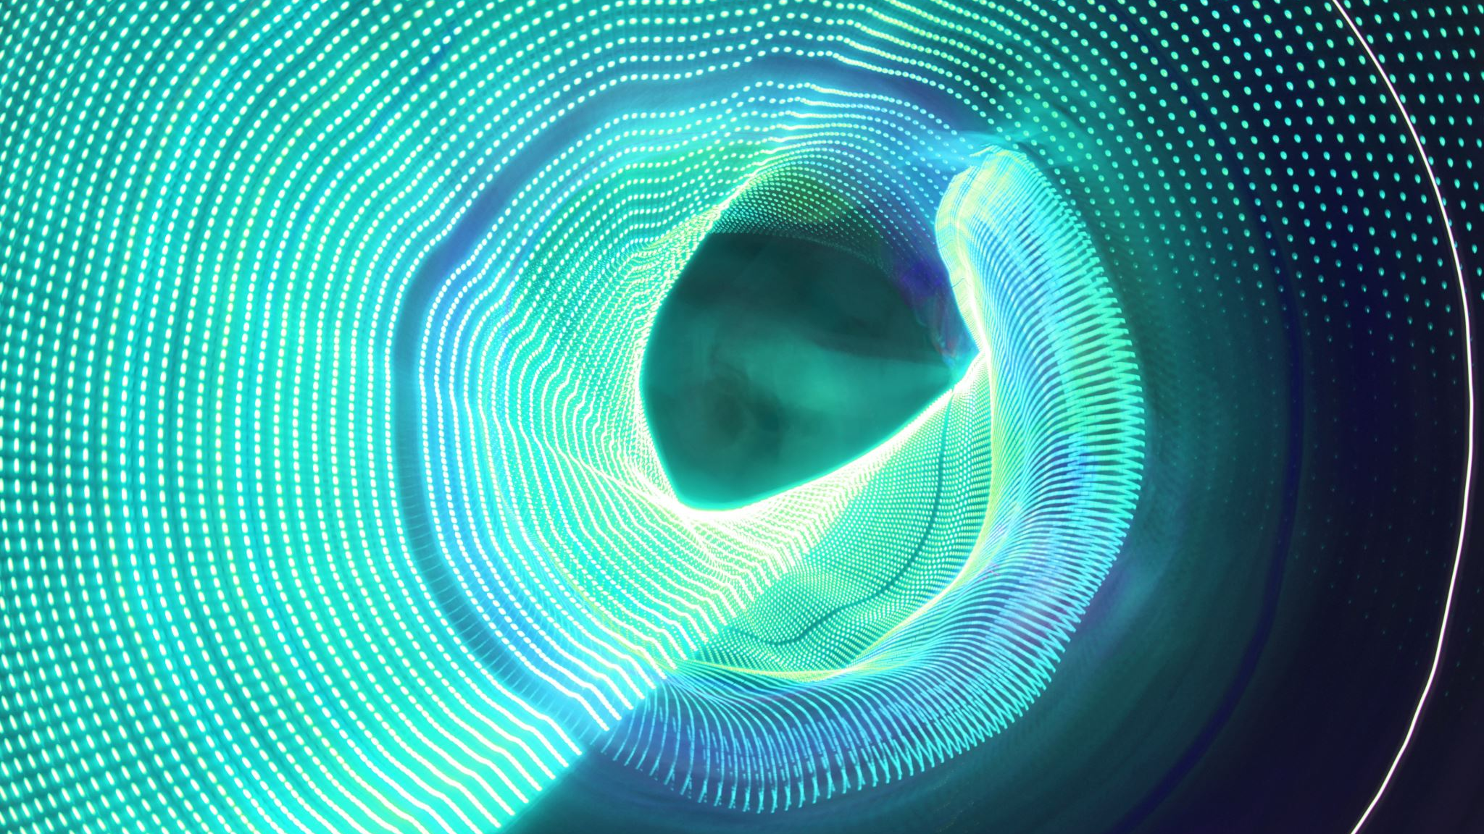

ADVANCEMENTS IN SELF-CONSISTENT MODELING OF TIME- AND SPACE-DEPENDENT PHENOMENA IN ECRIS PLASMA
Angelo Pidatella, David Mascali, Bharat Mishra, Eugenia Naselli, Giuseppe Torrisi, INFN-LNS, Catania, Italy
Alessio Galatà, INFN-LNL, Legnaro, Italy

Slide 2
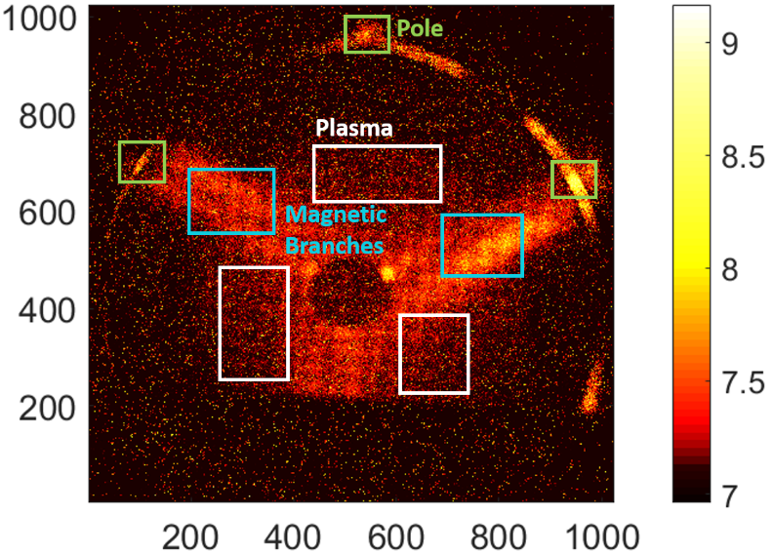
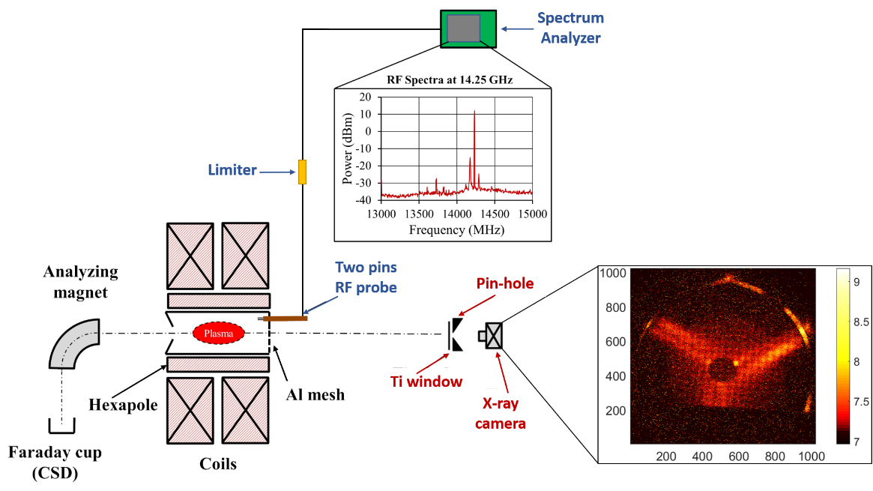
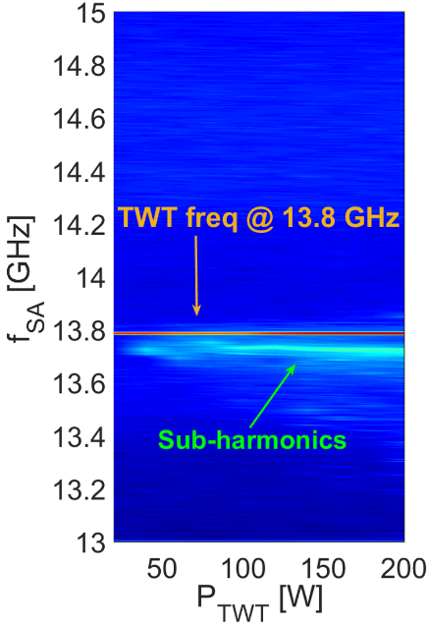
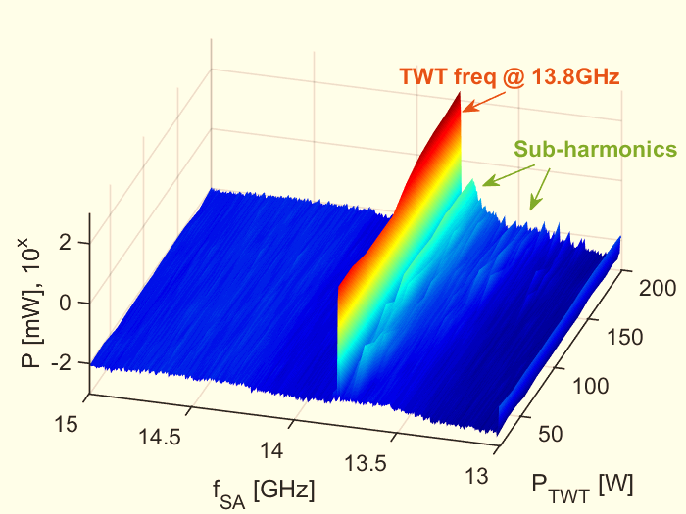
INTRODUCTION
GOAL: Bridge the gap between theoretical and experimental study of space-dependent and time-dependent electron/ion properties/phenomena in ECR plasmas
Examples:
SPACE: particles confinement dynamics, reaction rates for electromagnetic emissions, ion CSD
TIME: kinetic instabilities, plasma turbulences, fast transients, EC MASER instability
THE EXPERIMENTAL SURVEY
SPACE-RESOLVED PLASMA STUDY
TIME-RESOLVED PLASMA STUDY
Space-resolved soft X-Ray imaging: monitoring confinement dynamics and plasma structure
Time-averaged single-frequency spectral evolution of the RF-probe detected signal vs. pumping wave power, with sub-harmonics generation already evident at around 40 W
E. Naselli et al. (2019), 10.1088/1748-0221/14/10/C10008
See talk from (September 28):
R. Ràcz: Imaging in X-ray Ranges to Locally Investigate the Effect of the Two-Close-Frequency Heating in ECRIS Plasmas
E. Naselli: High Resolution X-ray Imaging as a Powerful Diagnostics Tool to Investigate ECRIS Plasma Structure and Confinement Dynamics
E. Naselli et al., PSST 28 (2019) 085021

Slide 3
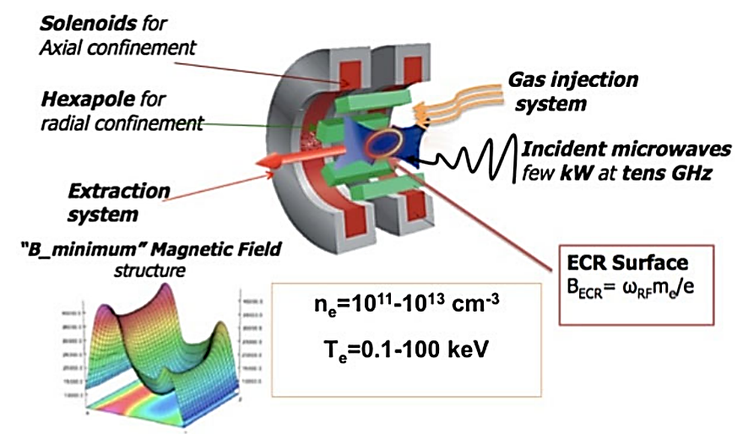
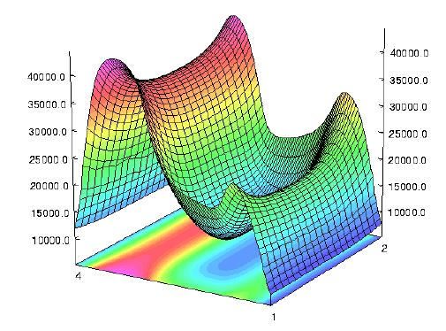
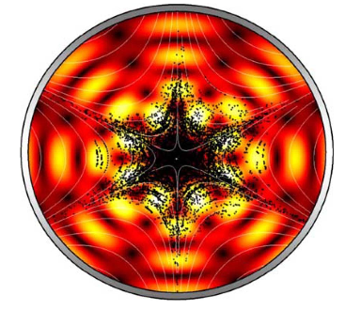


ECR PLASMA ANISOTROPICITY
Wave-to-particle coupling: heating process via electron cyclotron resonance (ECR)
  RF guided wave + multimodal structure: highly inhomogeneous, space-dependent electric field
Space-dependent and highly-inhomogenous magnetic field profile: plasma trapping + electron gyration
$$ω=ω_{c}=\frac{eB(r)}{m}$$
RESULTS: closed ECR surface for wave-particle coupling and heating
RESULTS : space-dependent power transfer depending on electric field profile
$$P∝{E(r)}^{2}$$
INHOMOGENEOUS SYSTEM WITH ANISOTROPIC ENERGY DISTRIBUTION
B-field profile as superposition of min-B and hexapole structures
Electromagnetic field pattern in the midplane for f ~14 GHz
D. Mascali, et al., Eur. Phys. J. A 53, 145 (2017).
S. Gammino, et al., IEEE transactions on plasma science 36, 4 (2008).

Slide 4
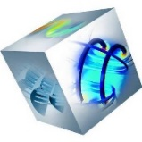


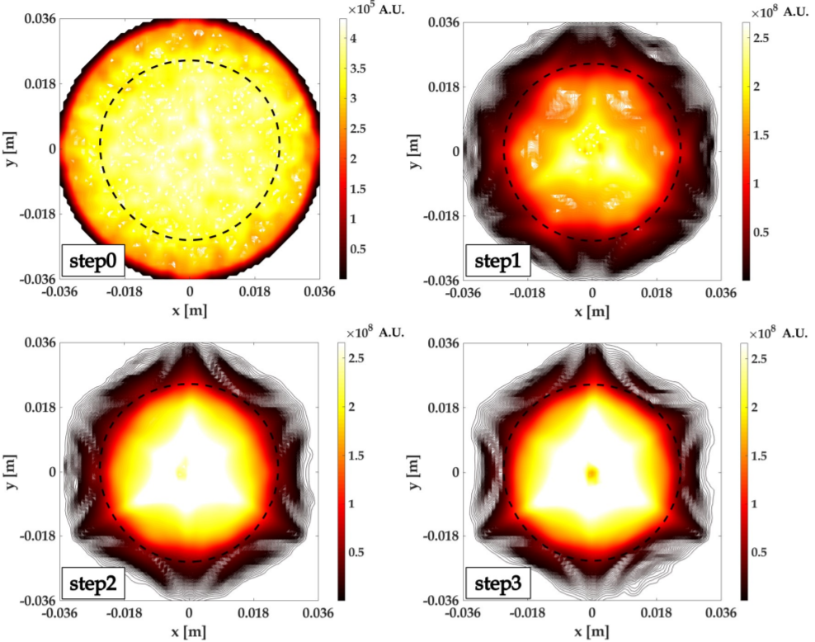
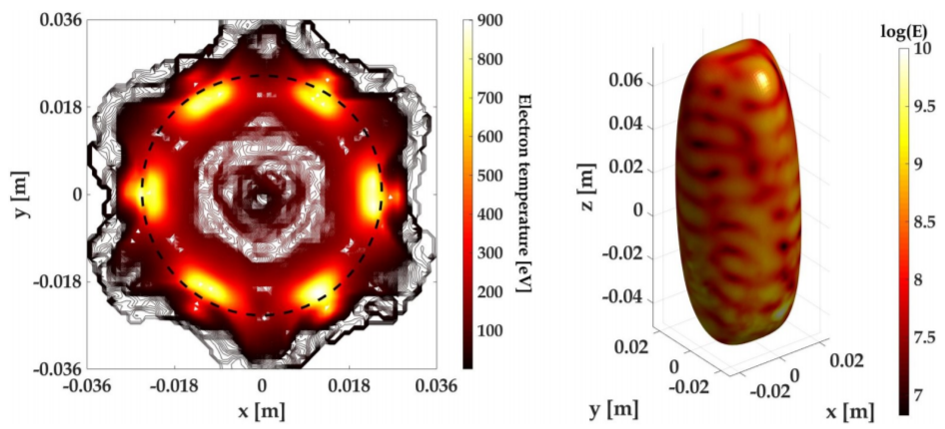
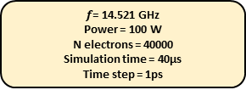
3D MODELING OF ELECTRON KINETICS
EM field calculated for the empty chamber
Tracking electrons uniformely distributed inside the chamber
Density map
Approach to self-consistency: 3D particle mover + 3D FEM Electromagnetic solver (INFN-LNL + INFN-LNS code)
The EM field distribution and the plasma medium influence each other in a closed loop:
  Plasma concentrates in near resonance region: dense plasmoid egg surrounded by rarefied halo
  Resonant cavity and mode structures modify plasma density distribution
  Electrons at different energies distribute differently in the space: cold in the core, hot close to ECR boundaries
EM field calculated considering plasma
Tracking electrons distributed according to the density map
Temperature and density maps
Tracking electrons including collisions
Density map
(1)
(2)
Self-consistent loop
$f$= 14.521 GHz
Power = 100 W
N electrons = 40000
Simulation time = 40µs
Time step = 1ps
(1) z-axis projection of density maps during the calculation steps (ECR zone black dotted). (2-Left) Distribution of electron temperature in the midplane. (2-Right) Distribution of the EM field on the resonance surface.
A. Galatà, et al., arXiv:1912.01988
D. Mascali, Eur. Phys. J. D (2015) 69: 27

Slide 5
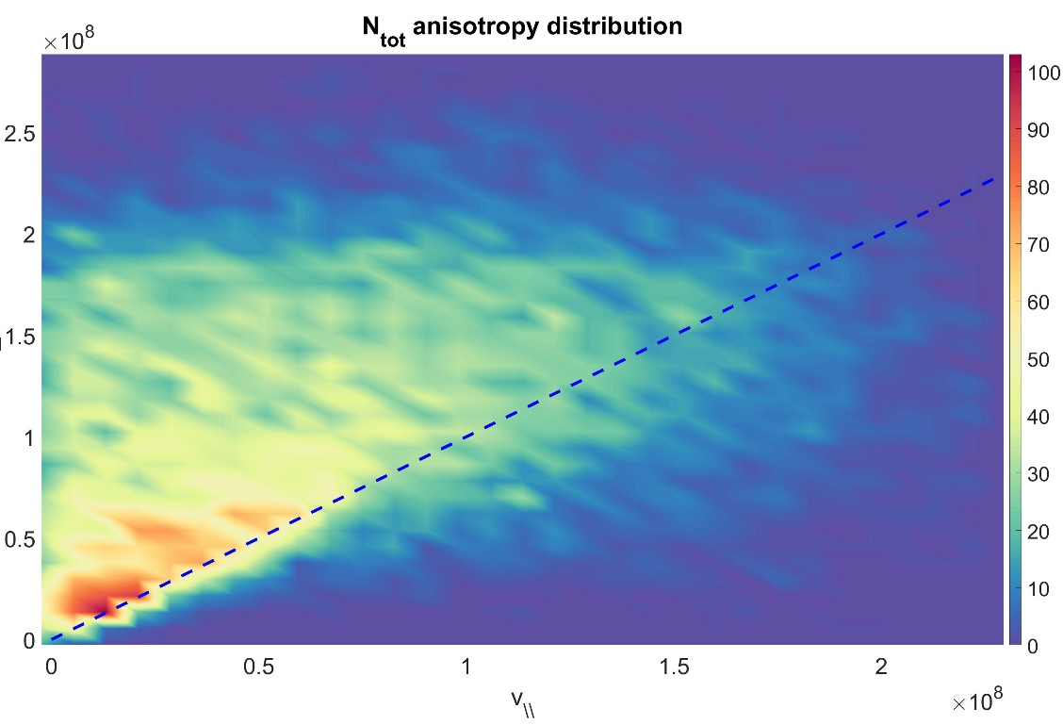
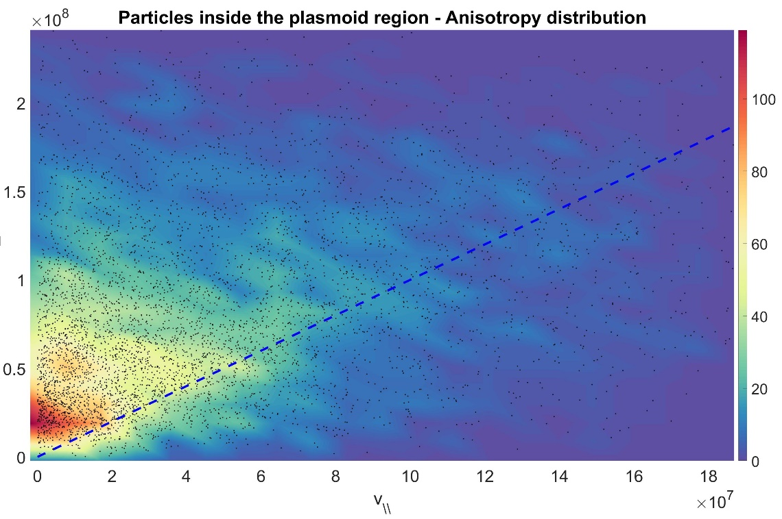
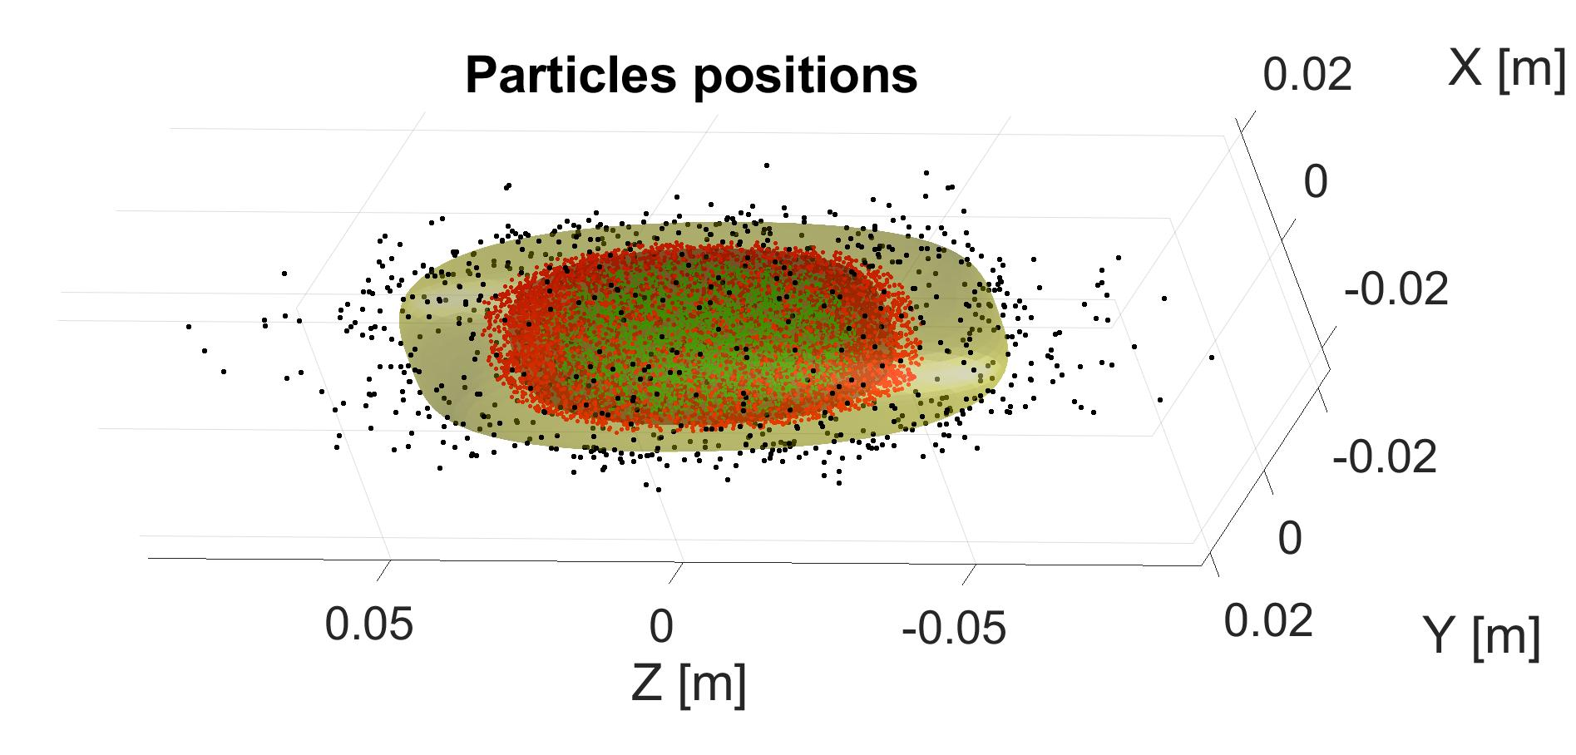
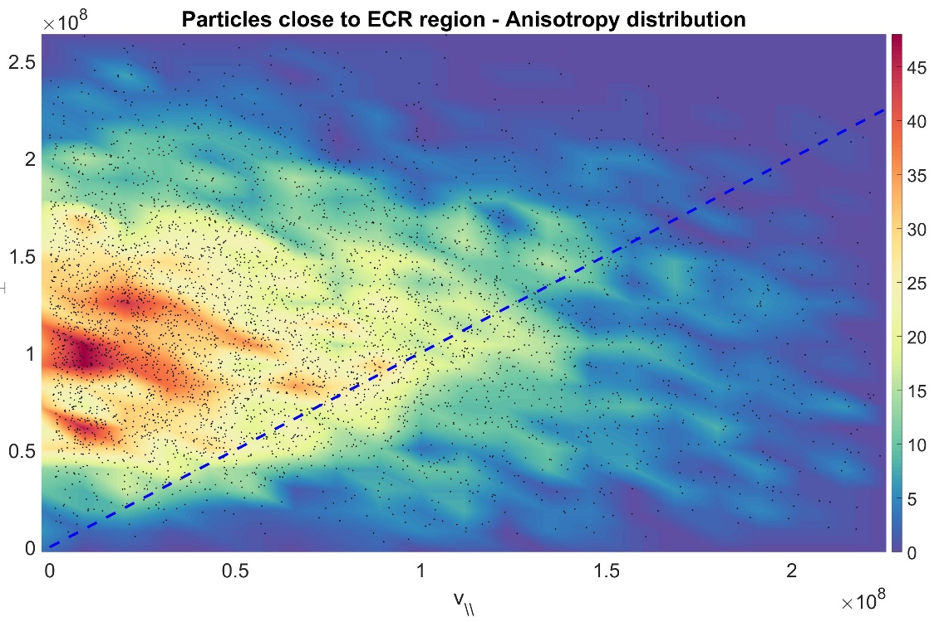
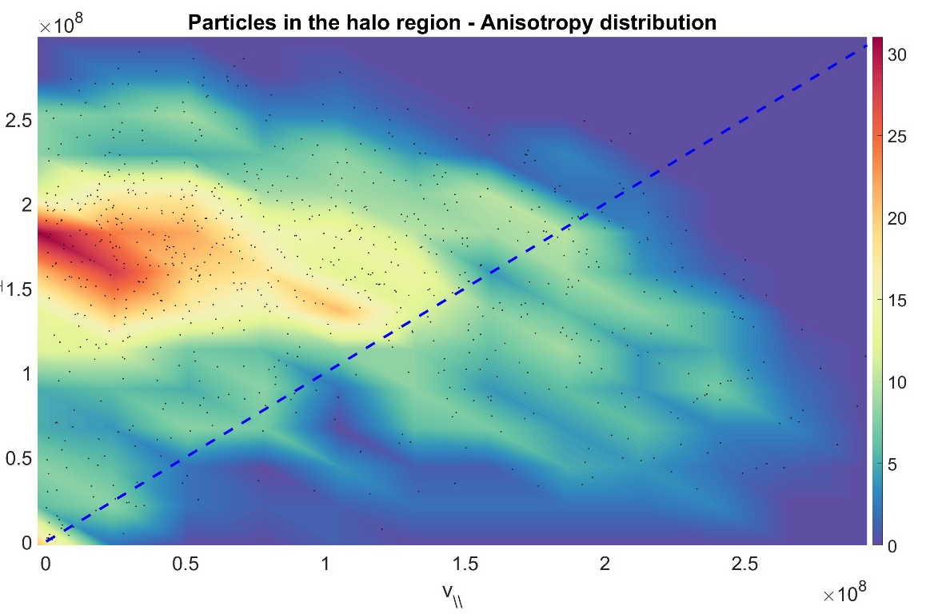
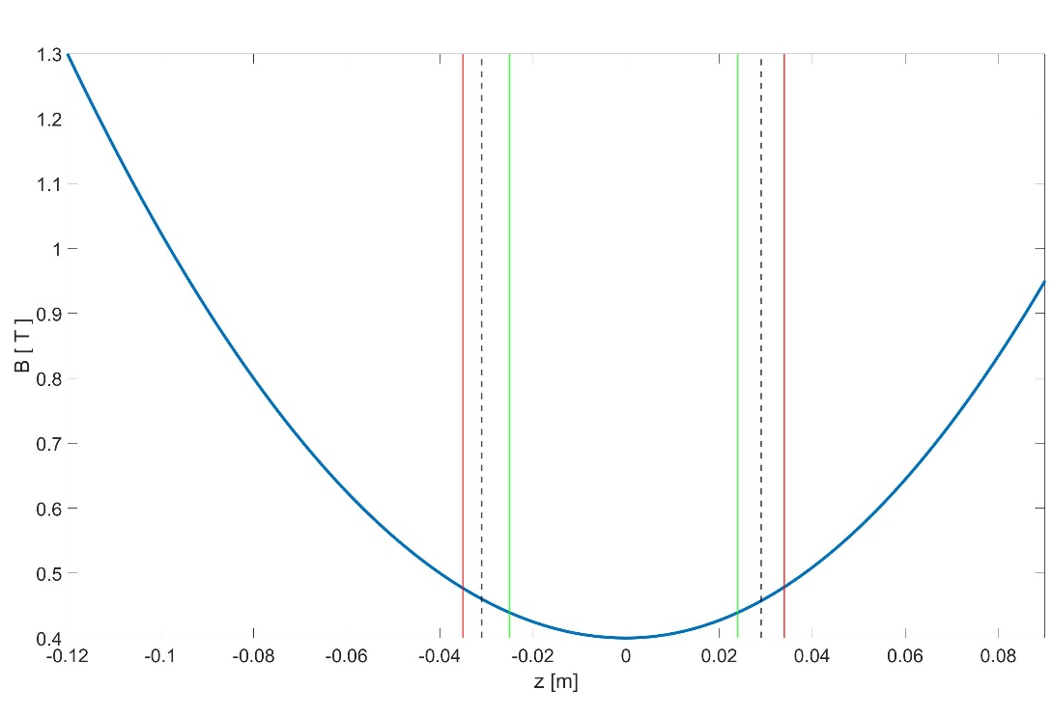

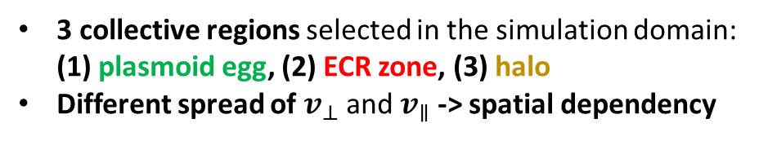







VELOCITY-SPACE ANISOTROPY DISTRIBUTION $v_{⊥}/v_{∥}$
$$v_{⊥}$$
$$v_{⊥}$$
# particles in chamber after t=250 µs ~ 15k
B_{min}/B_{ECR} = 0.87
𝒇= 12.84 GHz
RF power = 400 W
All particles distribution
Particles inside the plasmoid
ISOTROPIC LINE
ISOTROPIC LINE
$$v_{∥}$$
$$v_{∥}$$
B = B_ECR
B < 0.9 B_ECR
$$v_{⊥}$$
Particles around the ECR region
$$v_{⊥}$$
Particles in the halo region
ISOTROPIC LINE
ISOTROPIC LINE
B > 1.2 B_ECR
B=B_ECR
B=B_ECR
$$v_{∥}$$
$$v_{∥}$$
3 collective regions selected in the simulation domain: (1) plasmoid egg, (2) ECR zone, (3) halo
Different spread of $v_{⊥}$ and $v_{∥}$ -> spatial dependency
B field – profile along z-axis

Slide 6
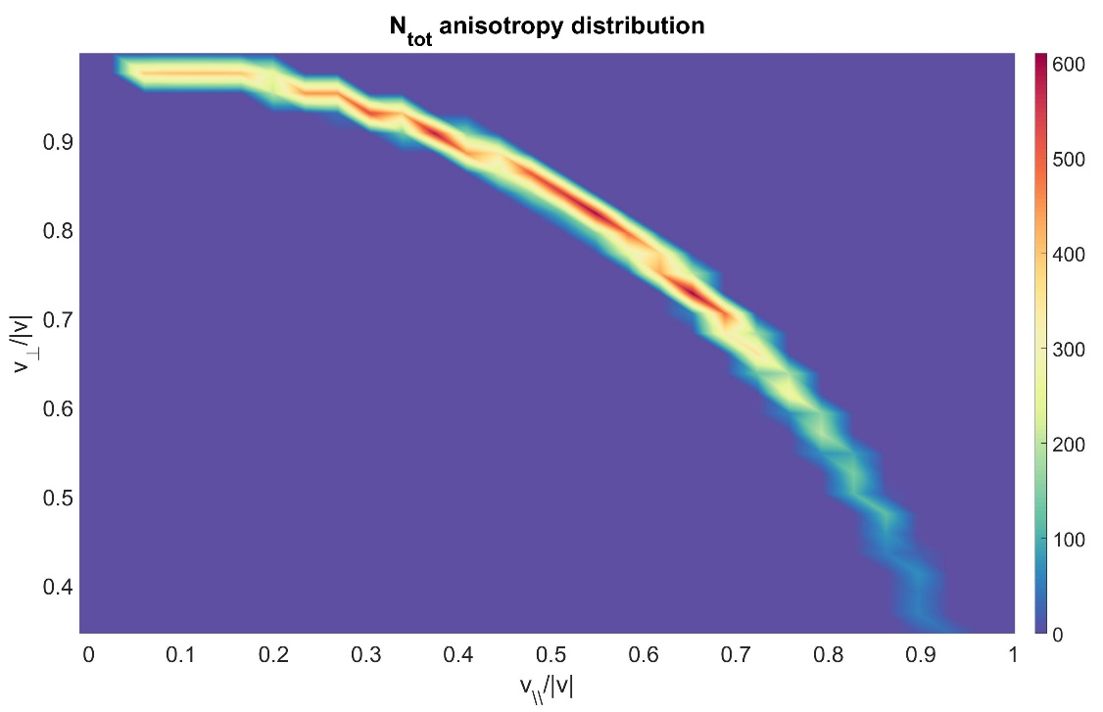
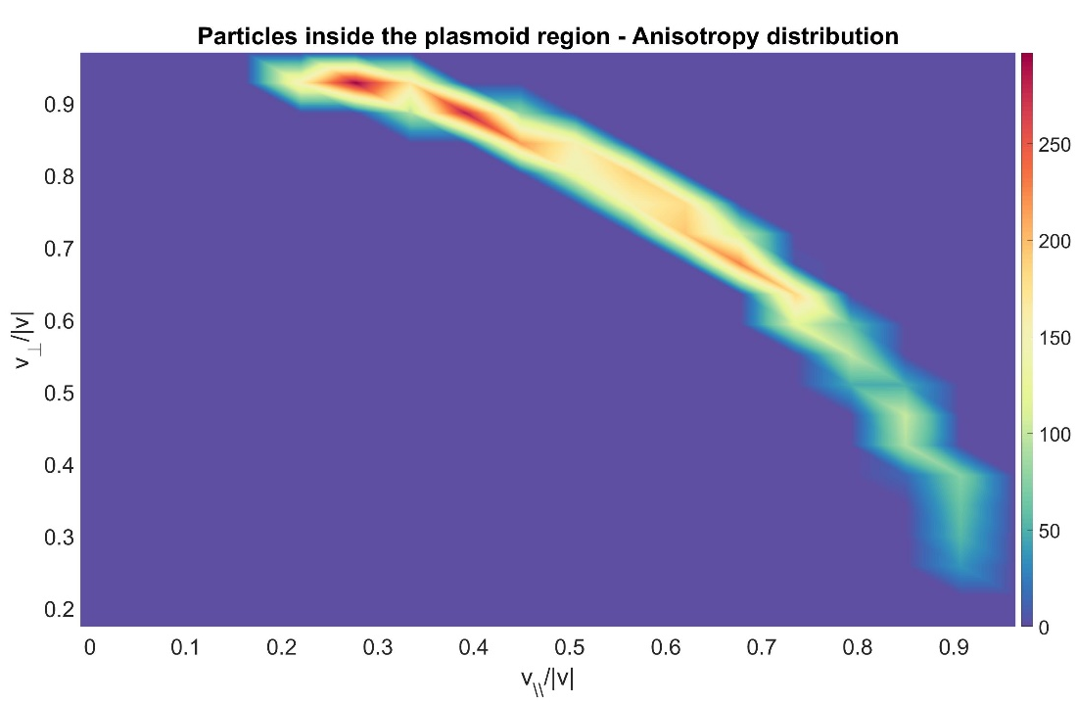
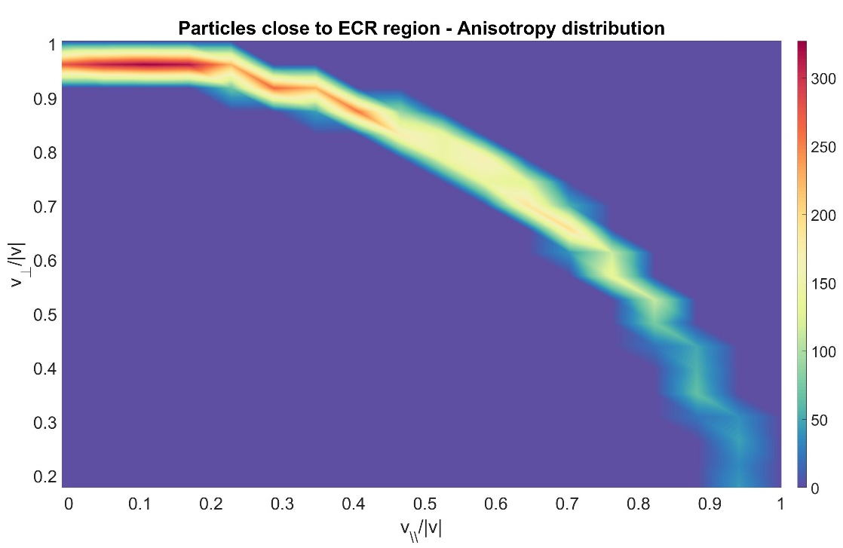
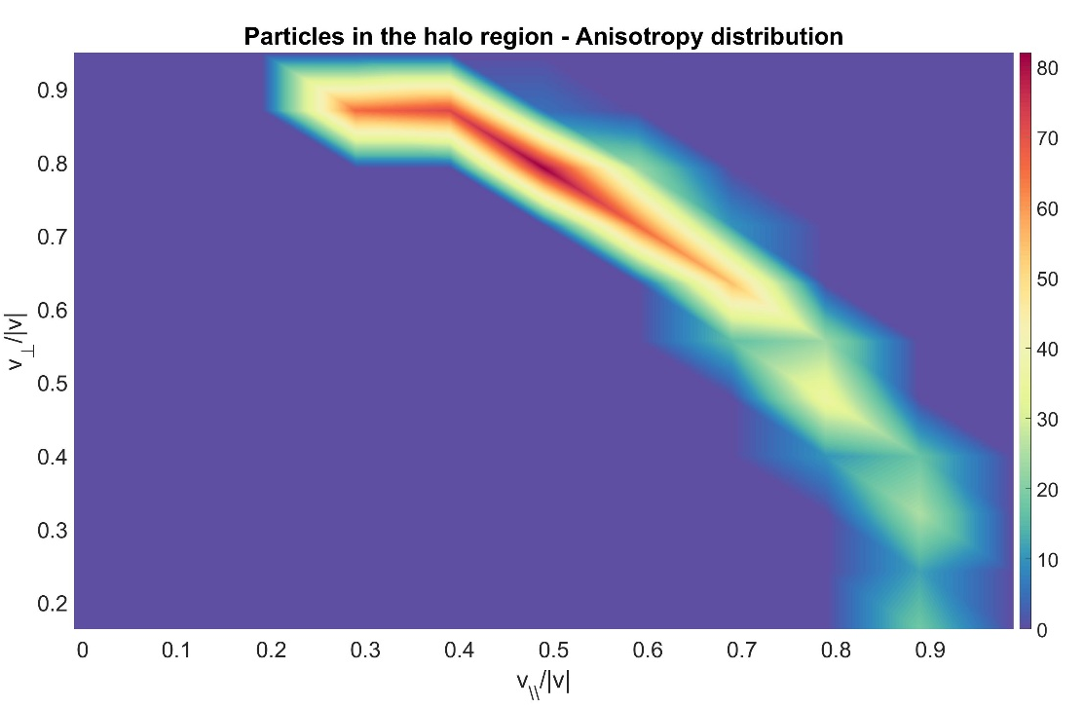
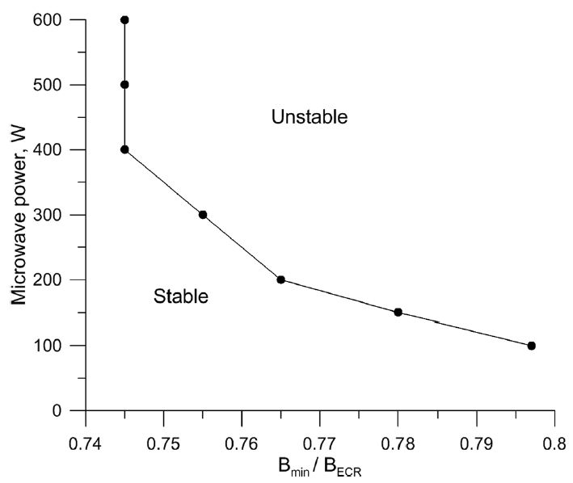
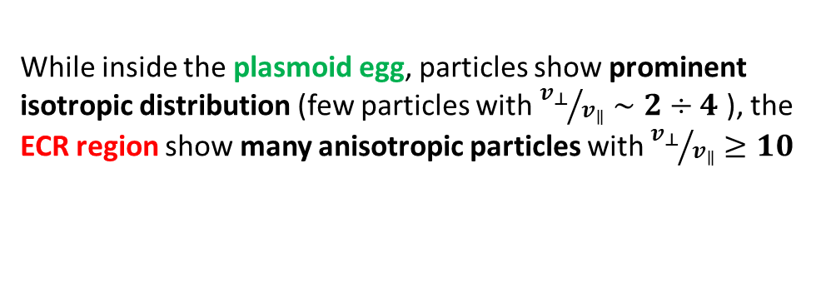




VELOCITY-SPACE ANISOTROPY DISTRIBUTION $v_{⊥}/v_{∥}$
$${v_{⊥ }}/{|v|}$$
$${v_{⊥ }}/{|v|}$$
$${v_{∥ }}/{|v|}$$
$${v_{∥ }}/{|v|}$$
NUMERICAL TOOL ABLE TO STUDY TIME-DEPENDENT PHENOMENA DEPENDING ON THE PARTICLES’ ANISOTROPY: PLASMA TURBULENCES, INSTABILITIES
B = B_ECR
B < 0.9 B_ECR
$${v_{⊥ }}/{|v|}$$
$${v_{⊥ }}/{|v|}$$
B > 1.2 B_ECR
$${v_{∥ }}/{|v|}$$
$${v_{∥ }}/{|v|}$$
B_{min}/B_{ECR} = 0.87
Power = 400 W
While inside the plasmoid egg, particles show prominent isotropic distribution (few particles with ${v_{⊥}}/{v_{∥}}∼2÷4$ ), the ECR region show many anisotropic particles with ${v_{⊥}}/{v_{∥}}≥10$
V. Skalyga, et al., Physics of Plasma 22, 083509 (2015)

Slide 7
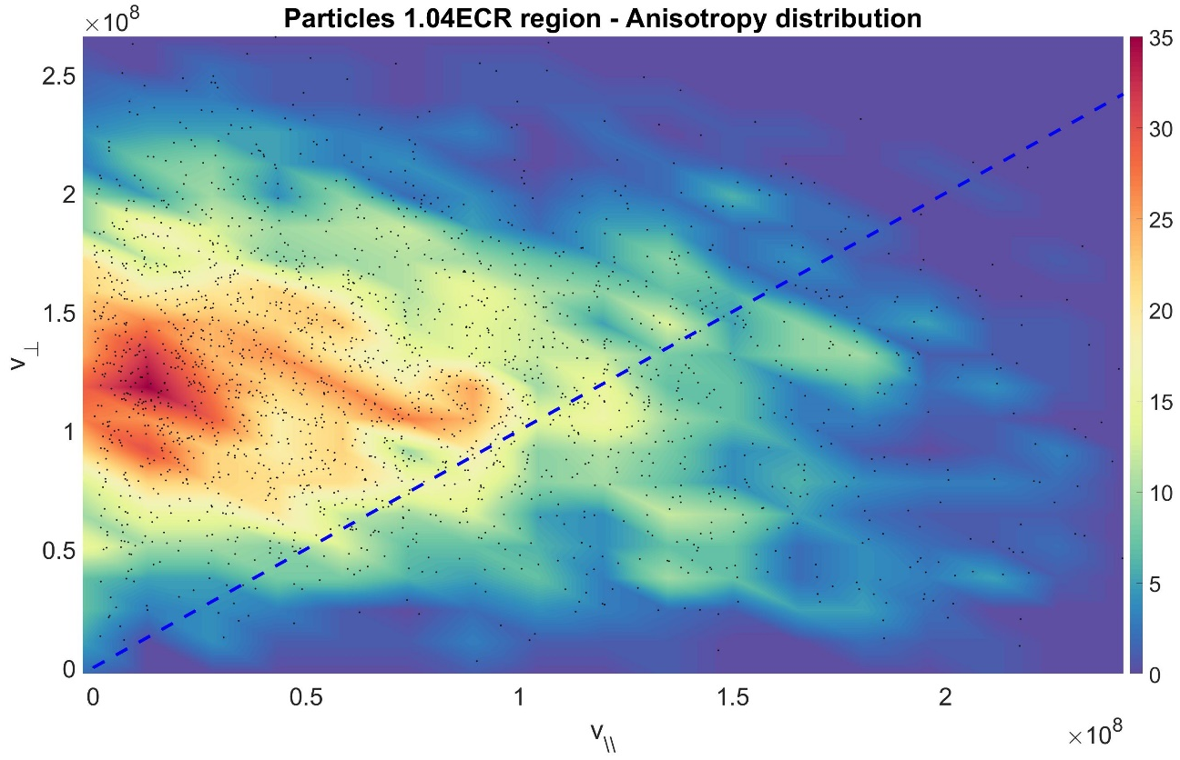
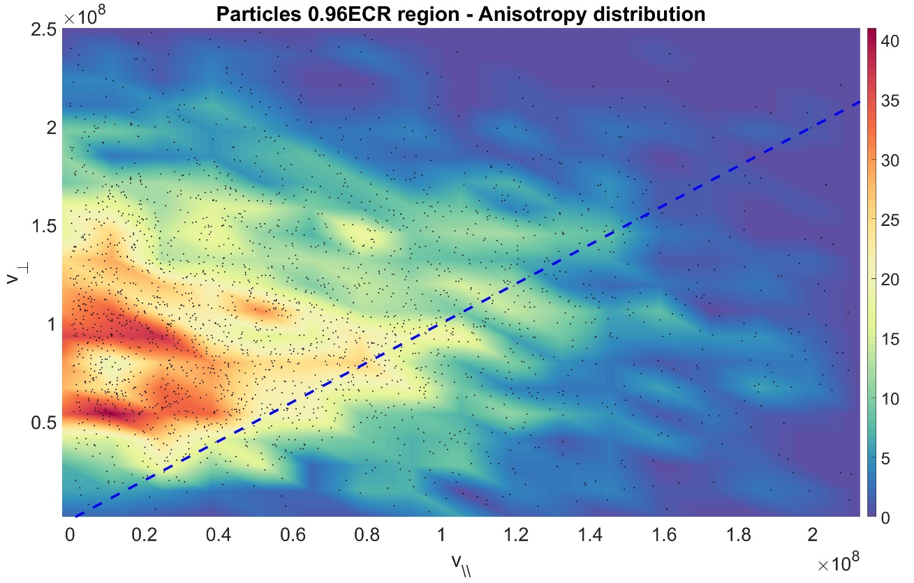
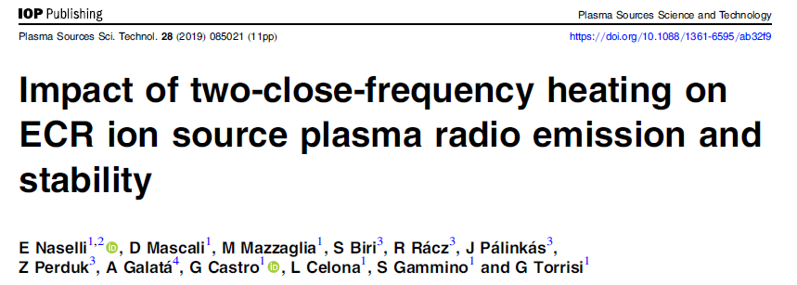
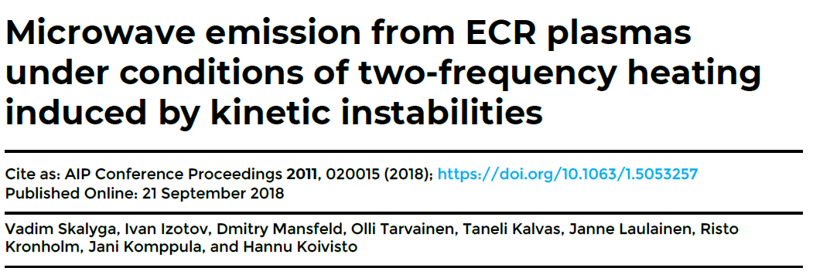
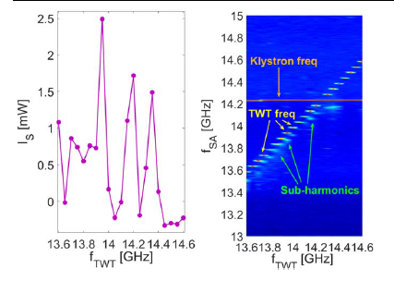
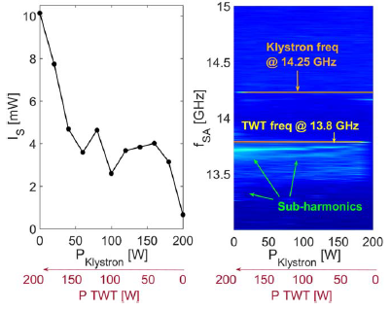
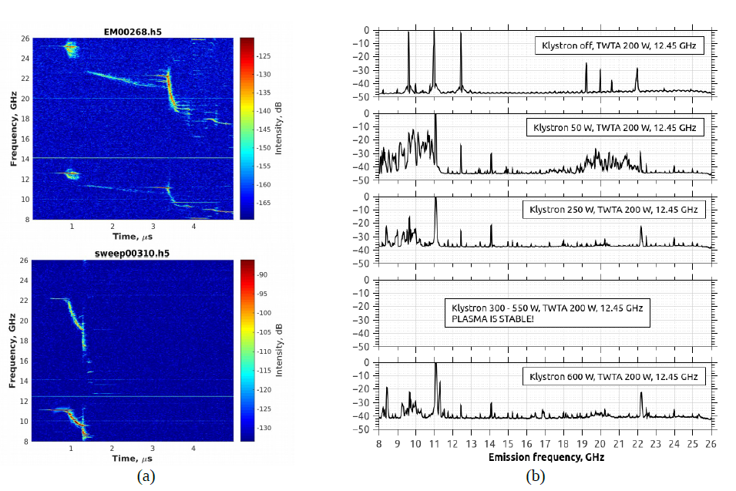
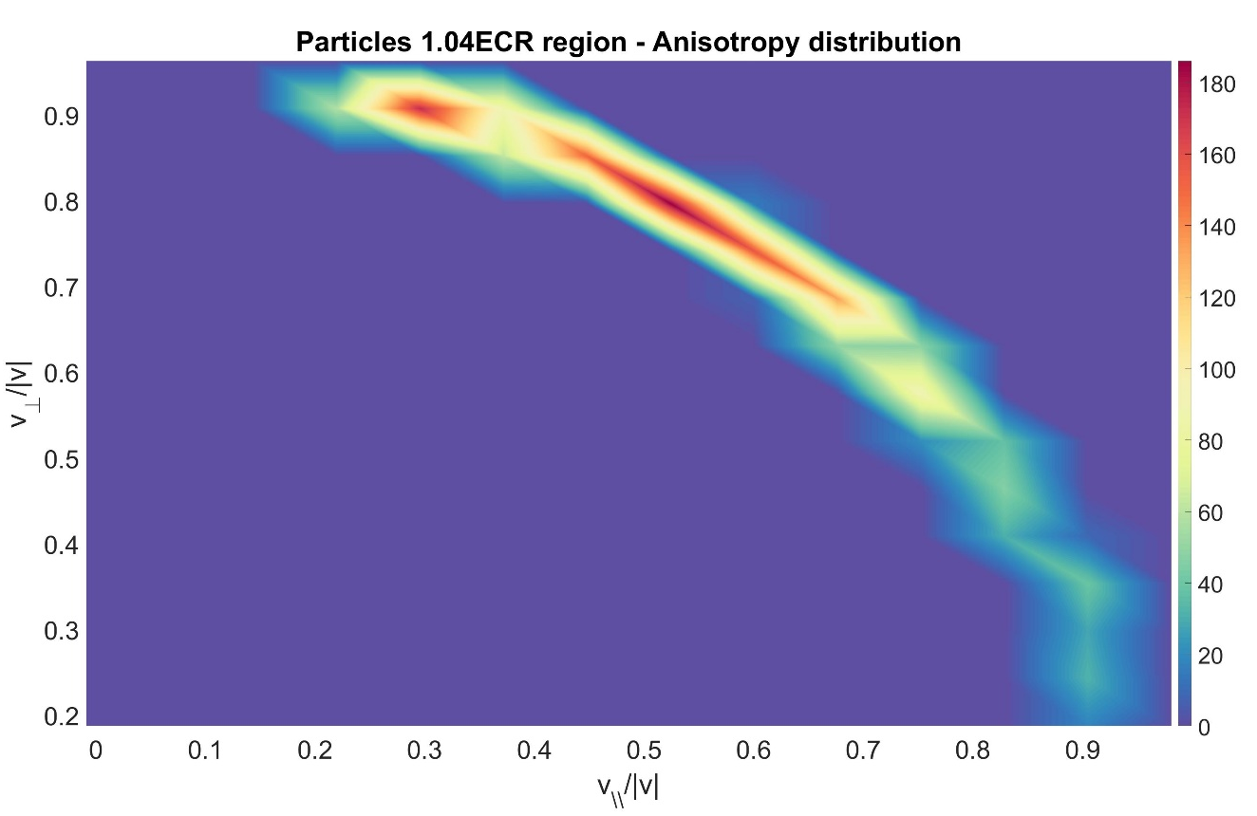
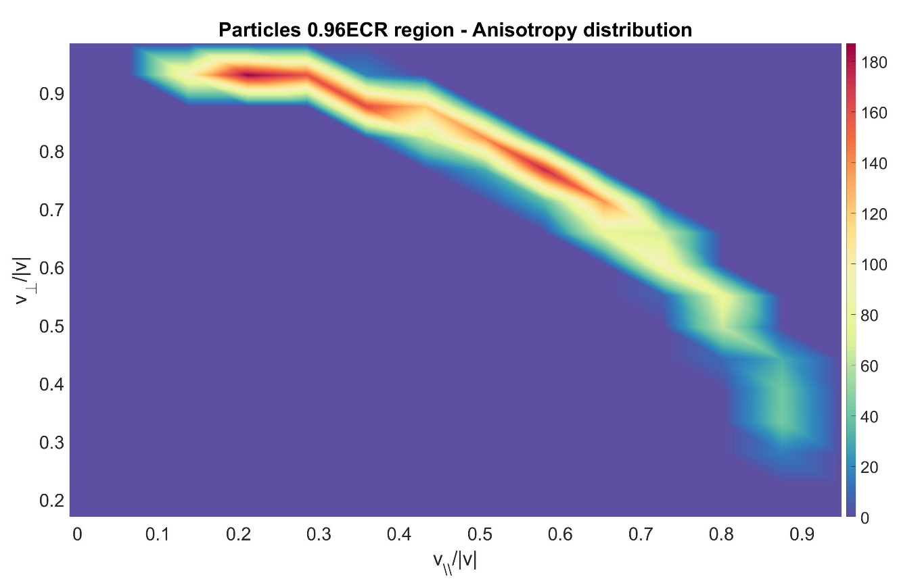








ECR REGION ANISOTROPY DISTRIBUTION $v_{⊥}/v_{∥}$
$$v_{⊥}$$
$$v_{⊥}$$
$$v_{∥}$$
$$v_{∥}$$
B = B_ECR
$${v_{⊥ }}/{|v|}$$
$${v_{⊥ }}/{|v|}$$
1.04 B_ECR> B > B_ECR
B=B_ECR
B=B_ECR
$$v_{∥}$$
B_ECR >B > 0.96 B_ECR
$${v_{∥ }}/{|v|}$$
$${v_{∥ }}/{|v|}$$
Around the ECR isosurface: inner particles slightly more anisotropic than the outer ones
B field – profile along z-axis

Slide 8
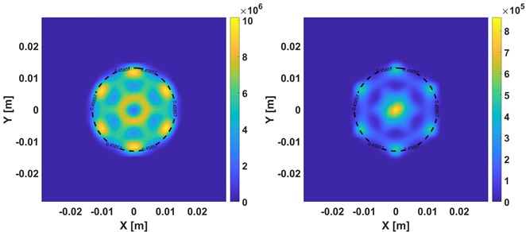

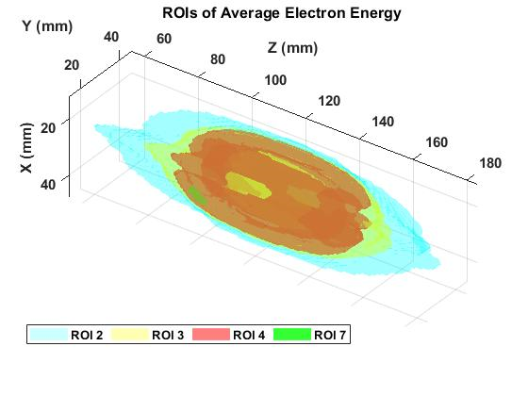
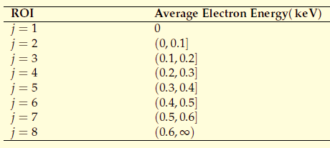

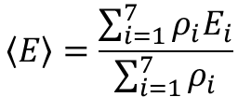
SPACE-RESOLVED ELECTRON ENERGY DISTRIBUTION FUNCTION (EEDF)
(Submission paper in progress)
Simulation data:
𝒇= 12.84 GHz
RF power = 30 W
XY-projections of electron occupation maps in 2-4 (left) and 6-8 keV (right), and ECR surface contour
1° Step: division of plasma regions in electron energy intervals-> 7 intervals [0-2], [2-4] … [12-∞] keV
2° Step: separate plasma into different electron average-energy-based regions of interest (ROIs), assuming each ROI as containing independent electron populations.
$$\left\langle E\right\rangle =\frac{\sum_{i=1}^{7}{ρ_{i}E_{i}}}{\sum_{i=1}^{7}{ρ_{i}}}$$
AVERAGE ELECTRON ENERGY
GOAL: study the nature of local EEDF in each of these ROIs; continuous EEDF from discrete electron data.

Slide 9
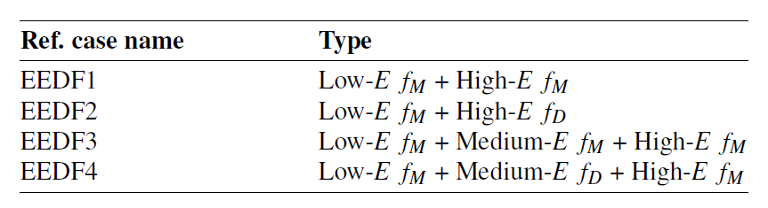
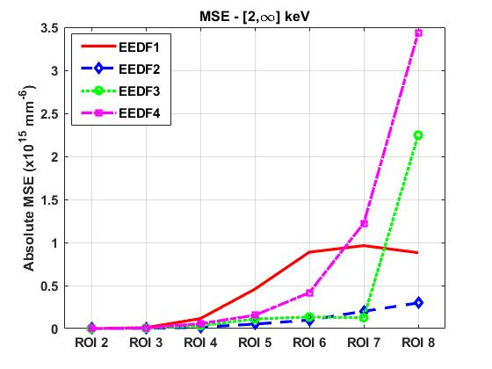
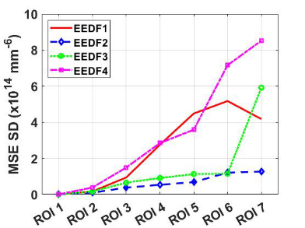
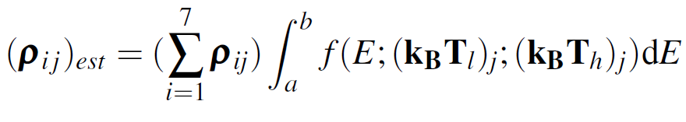
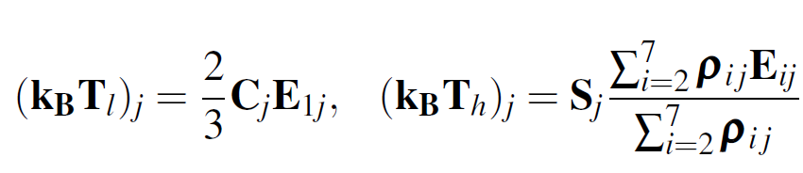
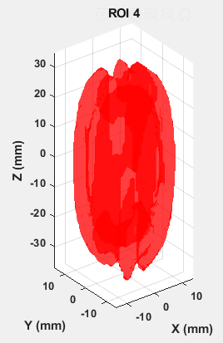
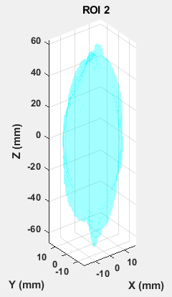
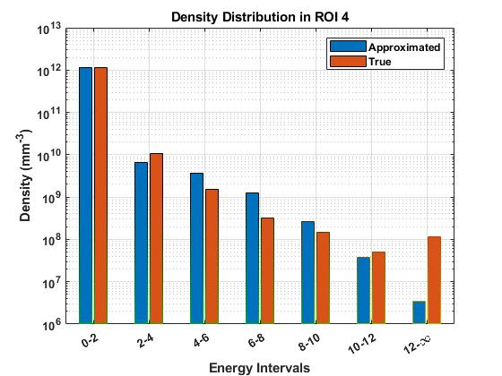
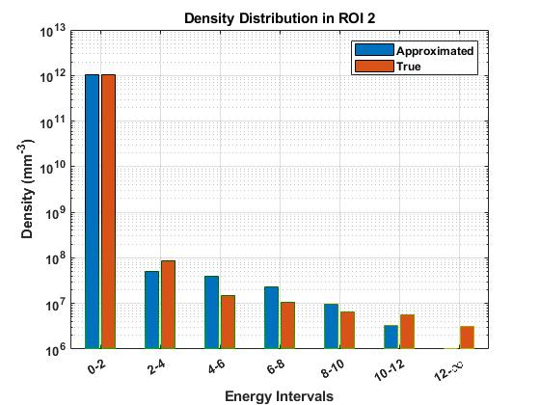
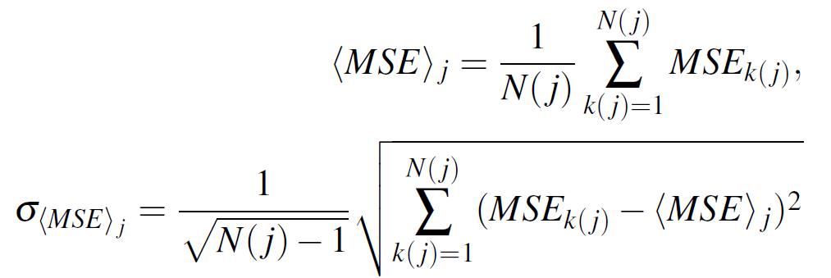
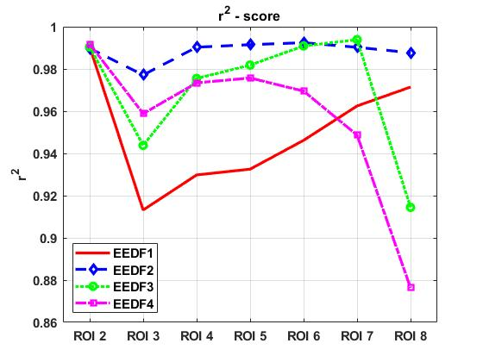
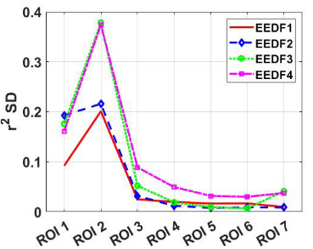




SPACE-RESOLVED ELECTRON ENERGY DISTRIBUTION FUNCTION (EEDF)
(Submission paper in progress)
2-components test EEDFs: capturing low-T and high-T properties (EEDF1 and EEDF2)
3-components test EEDFs: low-T + mid-T + high-T properties (EEDF3 and EEDF 4)
BEST EEDF2: LOW-MAXWELLIAN + HIGH-DRUYVESTEYN
$$f\left(E,kT_{1},kT_{2}\right)=N_{1}\left(\frac{2}{\sqrt{π}}\frac{\sqrt{E}}{\sqrt{{\left(kT_{1}\right)}^{3}}}e^{−E/kT_{1}}\right)+N_{2}\left(1.04\frac{\sqrt{E}}{\sqrt{{\left(kT_{2}\right)}^{3}}}e^{−0.55E^{2}/{\left(kT_{2}\right)}^{2}}\right)$$
Quantitative analysis cell-by-cell
Qualitative analysis on j-th ROI-aggregated collective data for the i-th energy interval
Fit parameters
Density Comparison (ROI 4)
Fit analysis
Density Comparison (ROI 2)
Energy Density Comparison (ROI 2)
Energy Density Comparison (ROI 4)
Mean Squared Error and r² Values for different EEDFs in each ROI

Slide 10





1st EEDF TEST BENCH: ESTIMATE OF Ar FLUORESCENCE K-α EMISSION
Argon plasma emission rate for the K-shell X-ray fluorescence at 2.96 keV supporting the experimental campaign carried out jointly by the ATOMKI (Debrecen) and INFN-LNS/LNL groups in 2017 on space-resolved X-ray spectroscopy
EXPERIMENTAL SETUP
Electron data from simulations used to evaluate a 3D K-α emission rate map : using the analytical EEDF
Geometrical efficiency of detecting system, quantum efficiency of CCD camera and exposure time considered for the emission map
Numerical emission map not too far from capturing the true physical experimental emission image: robustness of the evaluated EEDF
Longitudinally integrated estimated K-α map at the CCD, considering Total Emission, LGE and Quantum Efficiency
Plot of experimental photon counted images
R. Ràcz et al., PSST 26 (2017) 075011
B. Mishra, Master Thesis work (2020)

Slide 11



2nd EEDF TEST BENCH: ESTIMATE OF ION CHARGE STATE DISTRIBUTION
Ion CSD calculated in spatially-aggregated ROI cells treated as 0D plasma cell: 0D code suite FLYCHK*
Data input: plasma density + EEDF
*H.K. Chung, R.W. Lee,M.H. Chen and Y. Ralchenko, The How To For FLYCHK @ NIST (2008).
Higher electron energy content shifts the ion CSD to higher charge states
Possibility to use the 0D CSD for 3D modeling ion-electron dynamics
B. Mishra, Master Thesis work (2020)

Slide 12

CONCLUSION
Self-consistent numerical modeling of ECRIS plasma to study space-resolved and time-resolved phenomena
Space-resolved particles’ anisotropy in the the velocity space reflects the inhomogenous and space-dependent properties of ECRIS plasma
Space-resolved EEDF provides a local information on the electron distribution
2 test bench for the analytical EEDF: 3D map of the fluorescence X-ray emission rate compared with experimental results, evaluation of local ion charge state distribution
ACKNOWLEDGMENTS
David Mascali
Bharat Mishra
Eugenia Naselli
Giuseppe Torrisi
Alessio Galatà
THANK YOU ALL !

