Slide 1

Influences of Magnetic Field Parameters on ECRIS Plasma Characteristics
J. Li¹
L. X. Li^{1,2}, B. S. Bhaskar^{3,4}, V. Toivanen³, O. Tarvainen^{3,5}, D. Hitz¹, L. B. Li¹, W. Lu¹, H. Koivisto³,
T. Thuillier⁴, J. W. Guo¹, X. Z. Zhang^{1,2}, H. Y. Zhao^{1,2}, L. T. Sun^{1,2} and H. W. Zhao^{1,2}
¹Institute of Modern Physics (IMP), Chinese Academy of Sciences, Lanzhou 730000, China
²School of Nuclear Science and Technology, University of Chinese Academy of Sciences, Beijing 100049, China
³University of Jyväskylä, Department of Physics (JYFL), 40500 Jyväskylä, Finland
⁴Laboratoire de Physique Subatomique et de Cosmologie, 53 avenue des Martyrs, 38026 Grenoble Cedex, France
⁵STFC ISIS Pulsed Spallation Neutron and Muon Facility, Rutherford Appleton Laboratory, Harwell, OX110QX, UK
The 24th International Workshop on ECR Ion Source
East Lansing, USA, September 28th, 2020

Slide 2
Outline
Quick overview
Experimental setup
Investigation and results
Discussion and conclusion

Slide 3
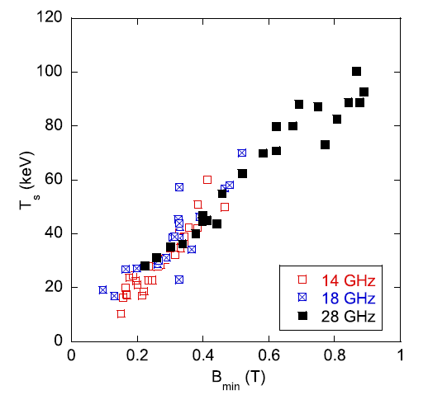
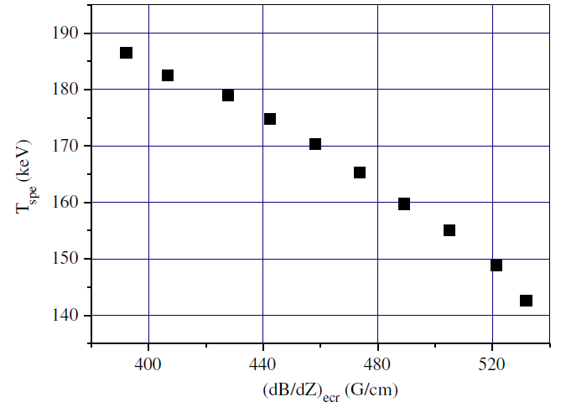
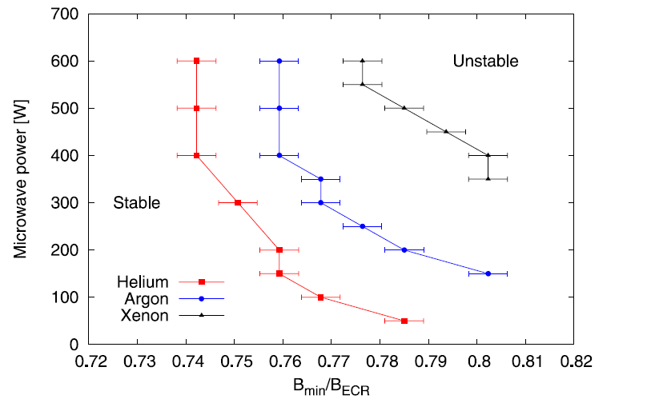
Quick overview
Correlation of magnetic field parameters to bremsstrahlung spectral temperature T_{s}
is not yet clear
minimum magnetic field B_{min} and gradient at resonance zone ∇B_{ecr} are key parameters on T_{s}
Benitez J et al 2017 IEEE Trans. Plasma Sci. 45 1746–54
Zhao H Y et al 2009 Plasma Sources Sci. Technol. 18 025021
Possible correlation between bremsstrahlung spectra and the appearance of
electron cyclotron instabilities are still unknown
Tarvainen O et al 2016 Rev. Sci. Instrum. 87 02A703

Slide 4
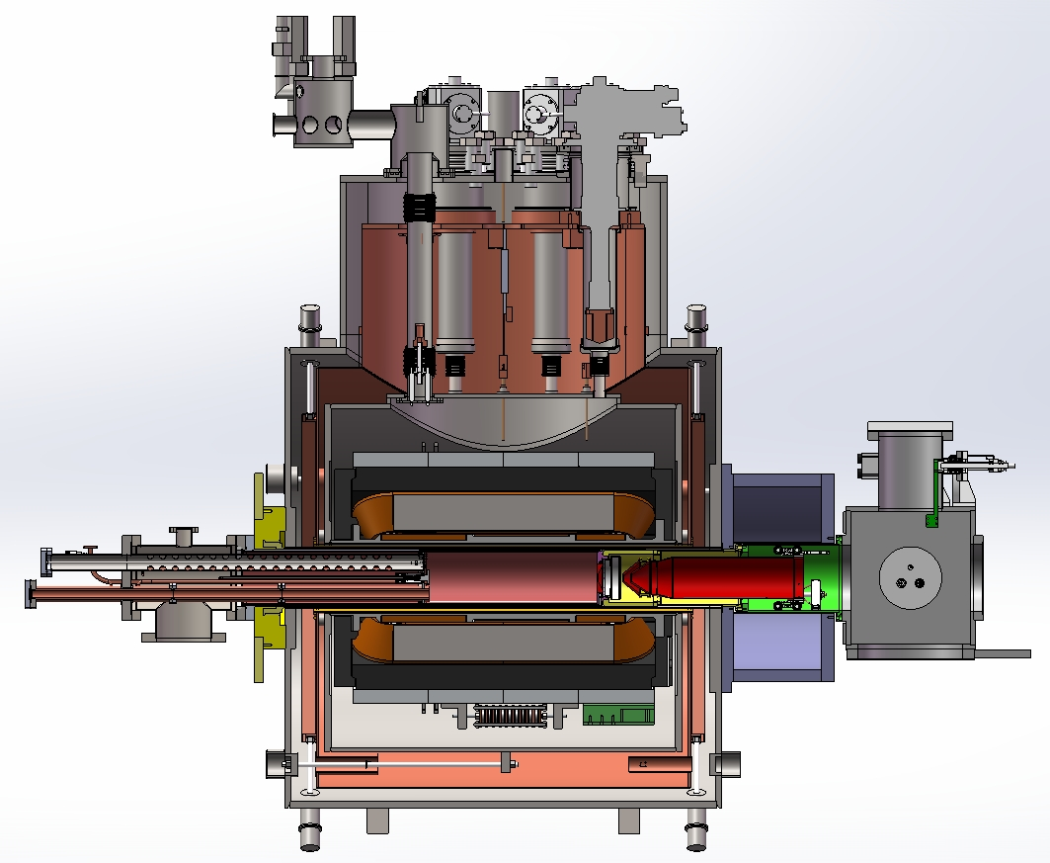
SECRAL-II ion source
GM cooler
Key parameters
SECRAL-II
ω_{rf} (GHz) | 18-28
Axial Field Peaks (T) | 3.7 (Inj.), 2.2 (Ext.)
Mirror Length (mm) | 420
No. of Axial SNs | 3
B_{r} at Chamber Inner Wall (T) | 2.0
Magnet Cooling | LHe bathing
Chamber ID (mm) | 125.0
Dynamic cooling power (W) | ~6
He recondenser
Sextupole
LHe reservoir
Solenoids
Extraction
Plasma chamber

Slide 5
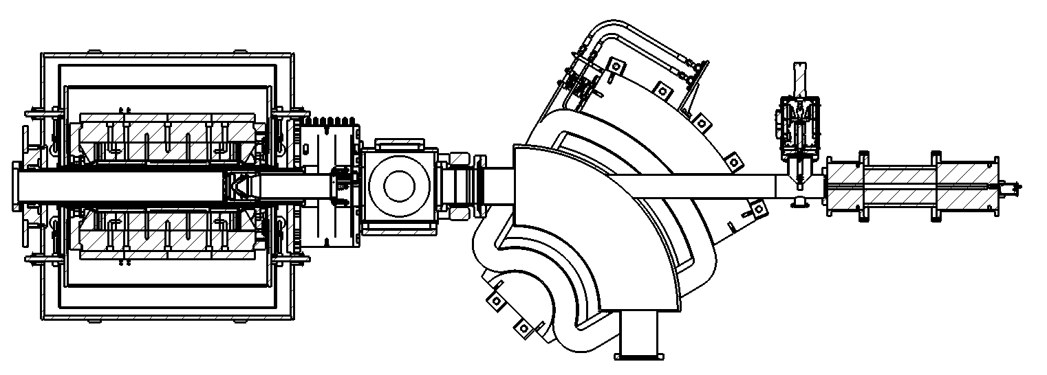
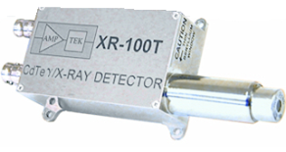
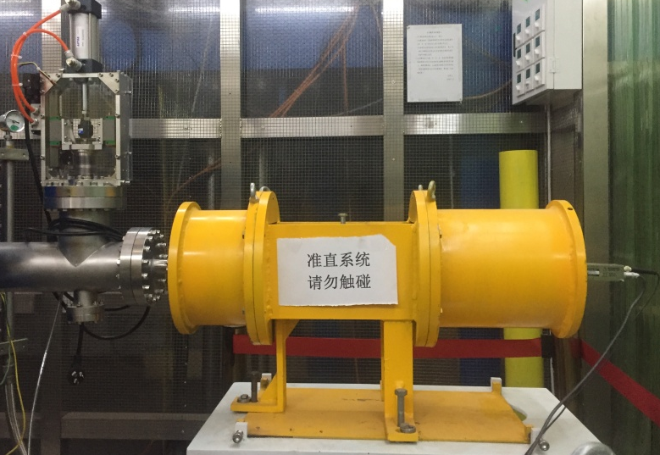
Bremsstrahlung detection system
EXT
2558.7mm
Part 2
L:300mm ID:20mm OD:220mm
X-ray blocking
SECRAL-II
Pb collimator
XR-100-CdTe detector
Analyzing
magnet
Part 1
L:150mm ID:2.5mm OD:200mm
10mm diameter
extraction aperture
16mm diameter
puller aperture
Part 3
L:210mm ID:1mm OD:200mm
X-ray Blocking
Designed using MCNP code to avoid
  Thick target bremsstrahlung
  Secondary radiation
Collimating System

Slide 6
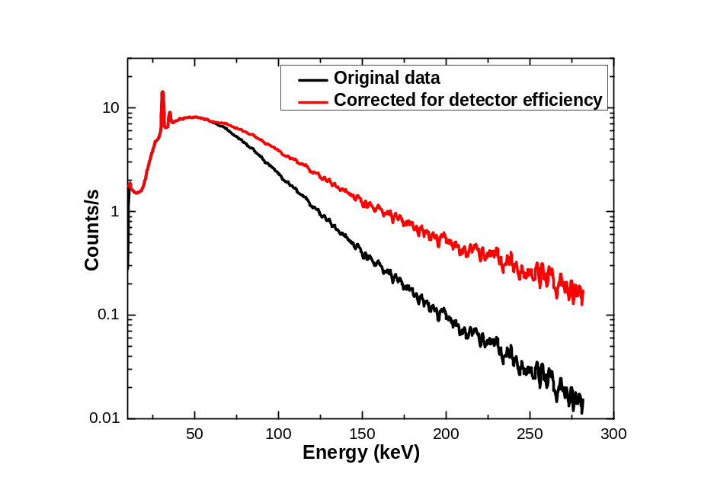
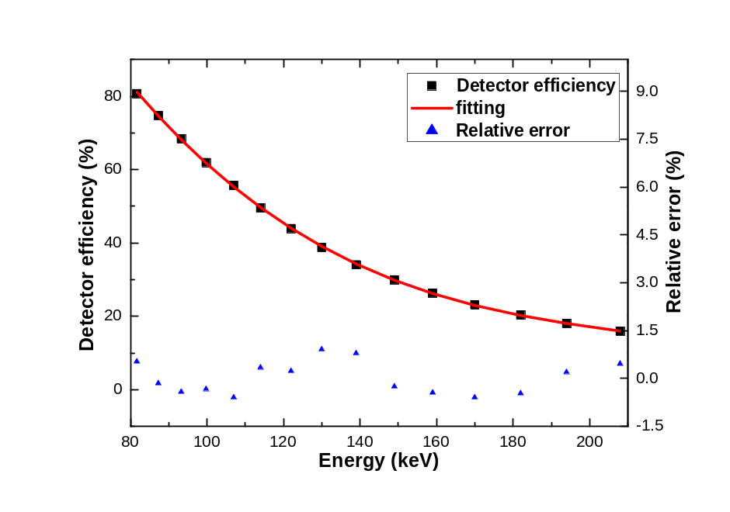
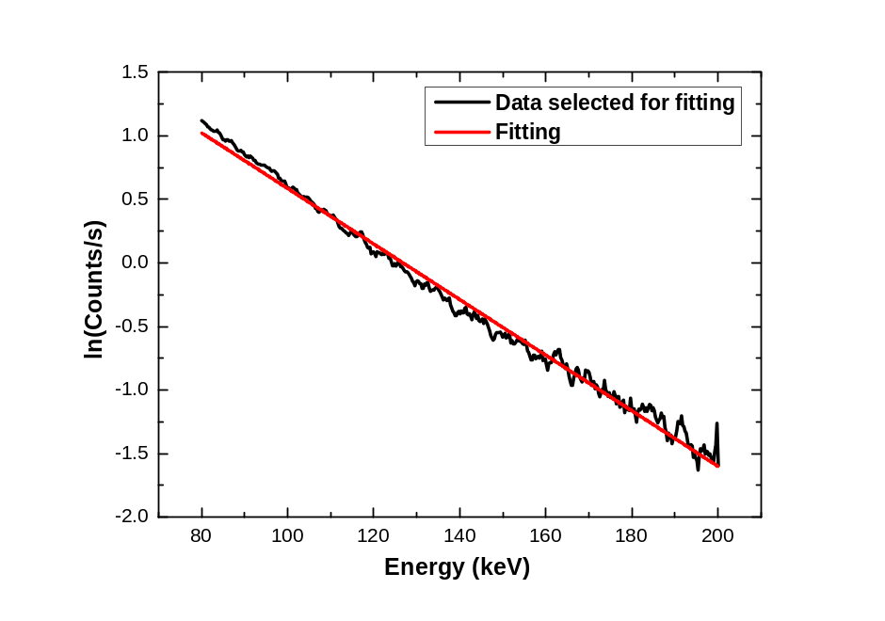
Spectral temperature T_{s} determination
I. Calibration applied
II. Spectra corrected for detector efficiency
III. Linear fit applied
In semi-log plot
T_{s}=-1/slope
Fitting range: 80-200 keV

Slide 7
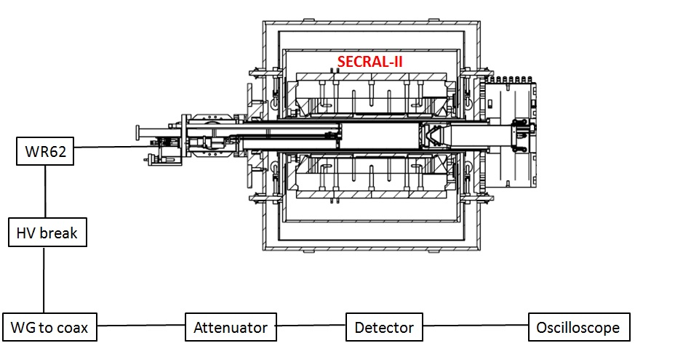
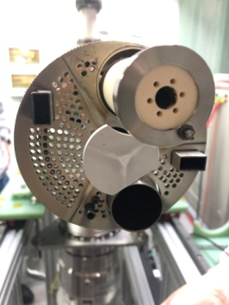
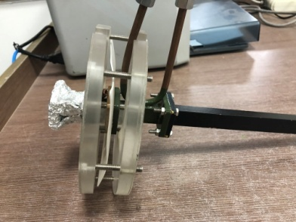
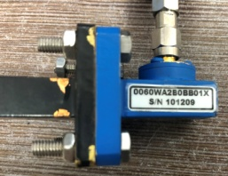
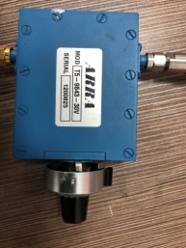
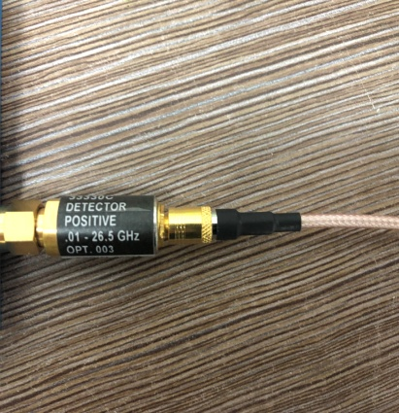
Microwave signal measurement system
18GHz injection
24GHz injection
0.01-26.5 GHz
Schottky Diode Detector

Slide 8
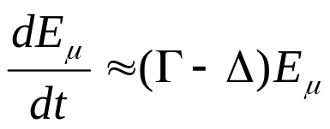
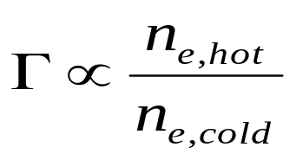
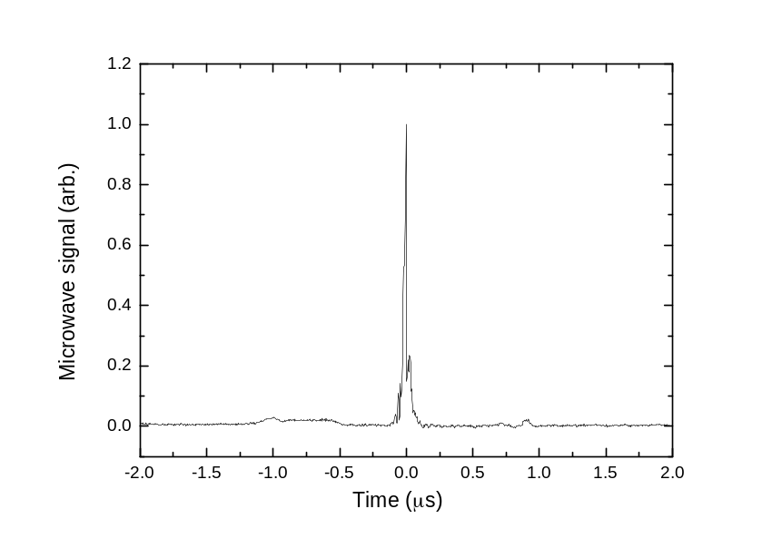
Electron cyclotron instabilities
Driven by hot electrons interacting resonantly with electromagnetic plasma waves
A characteristic feature (independent on the mode) is emission of microwaves
Energy of microwave emission, E_{µ}, is described by growth and damping rates, Γ and Δ
Γ is proportional to the anisotropy of the EVDF
Exponential growth of instability amplitude when Γ > Δ
Example of microwave signal associated with electron cyclotron instability on SECRAL-II

Slide 9
Source parameters
Beam | Xe
Frequency (GHz) | 18、24
Power (w) | 1500
Extraction Voltage (kV) | 20
Biased Disk Voltage (-V) | 40-50
Injection Pressure (mbar) | 1~2x10⁻⁷

Slide 10
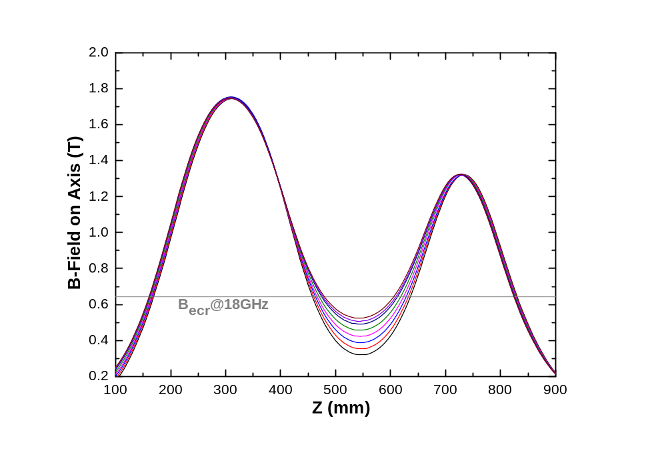
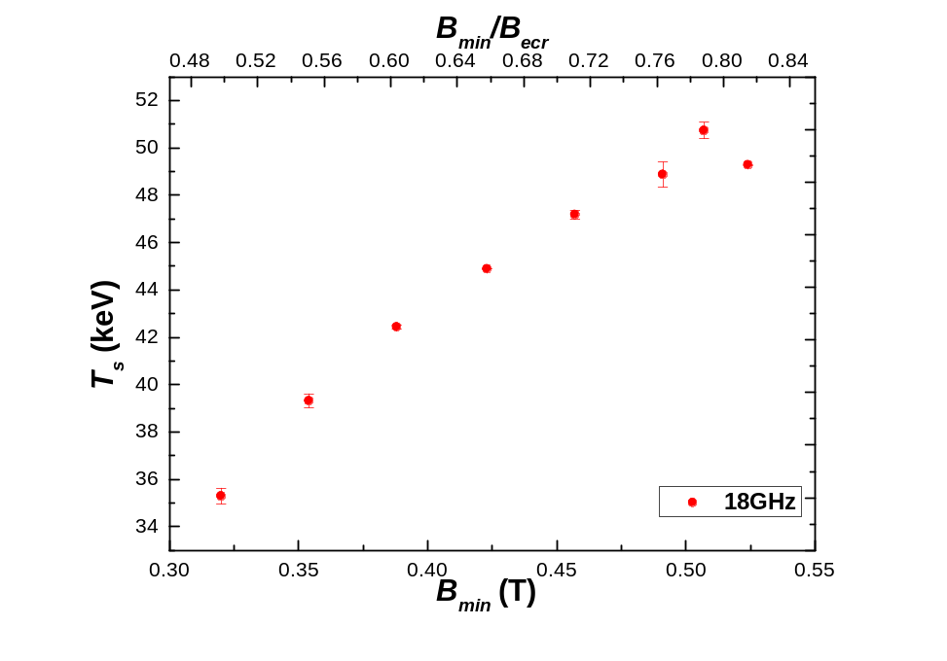
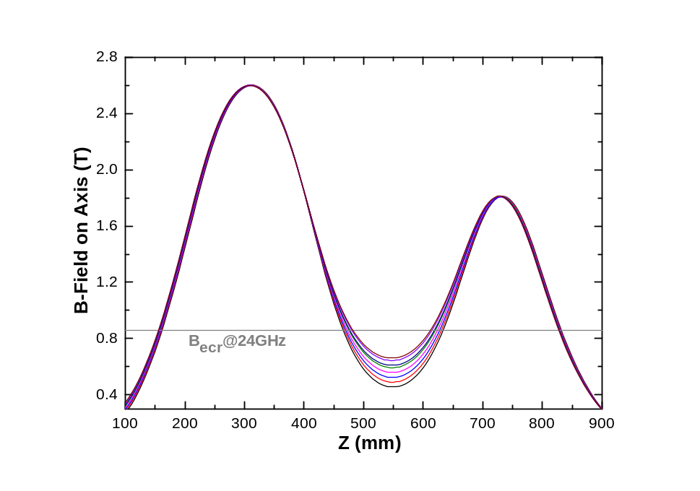
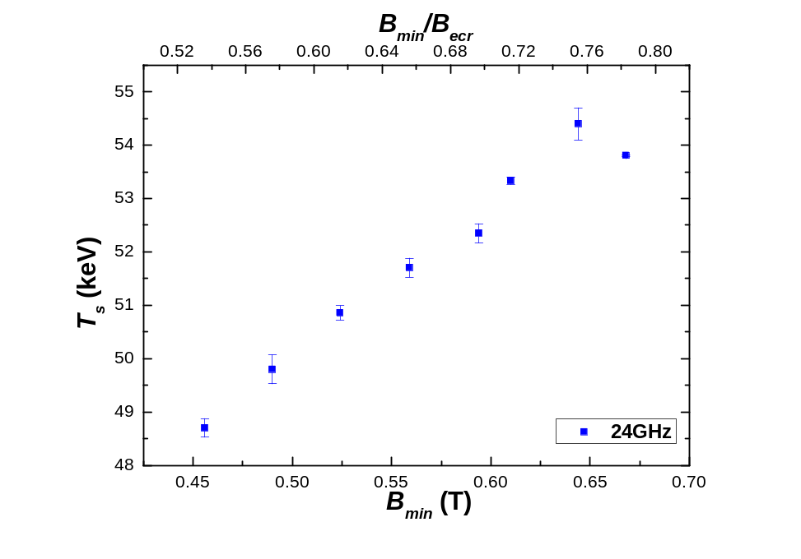
Experimental results- part 1
Constant B_{inj} , B_{ext} and B_{r} while varying B_{min}
B_{inj}: 1.75 T
B_{ext}: 1.32 T
B_{r}: 1.20 T
B_{min}: 0.32-0.52 T
B_{min}/B_{ecr}: 0.50-0.81
Electron cyclotron instability
Note: on-axis ∇B_{ecr} is also changed when B_{min} is changed
B_{inj}: 2.60 T
B_{ext}: 1.81 T
B_{r}: 1.66 T
B_{min}: 0.45-0.66 T
B_{min}/B_{ecr}: 0.53-0.78

Slide 11
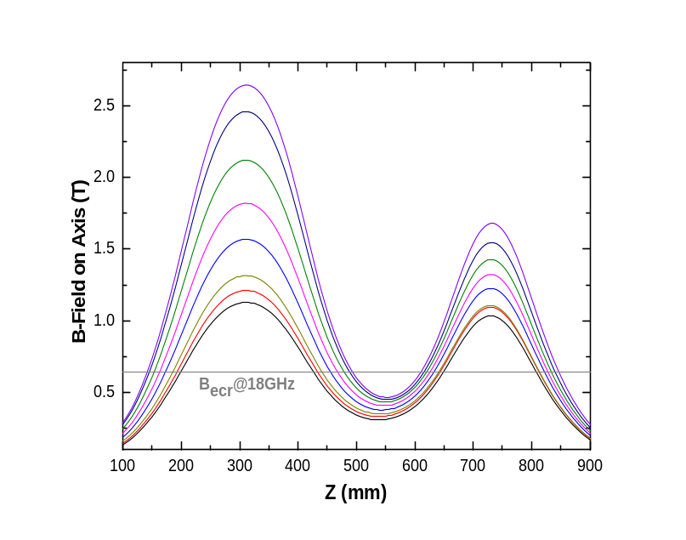
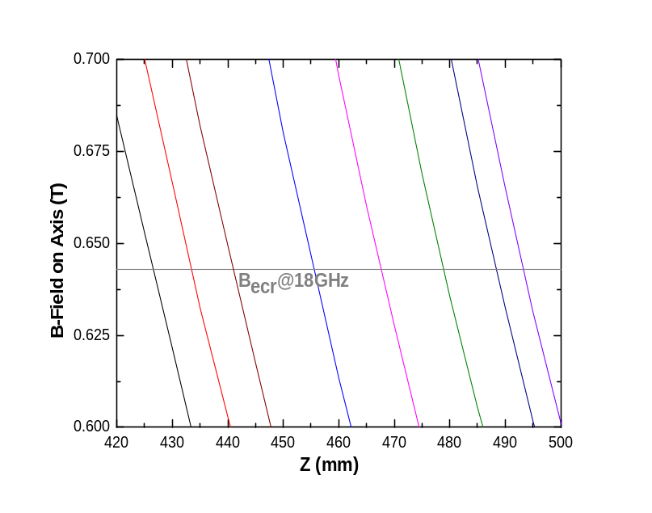
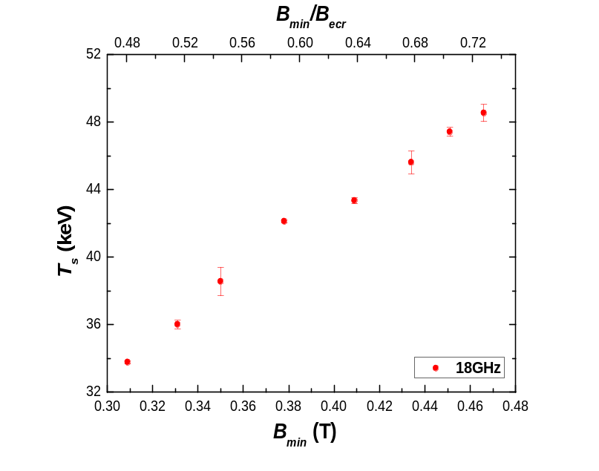
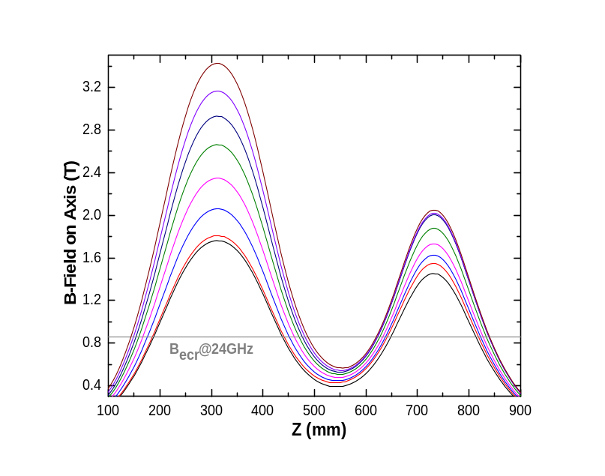
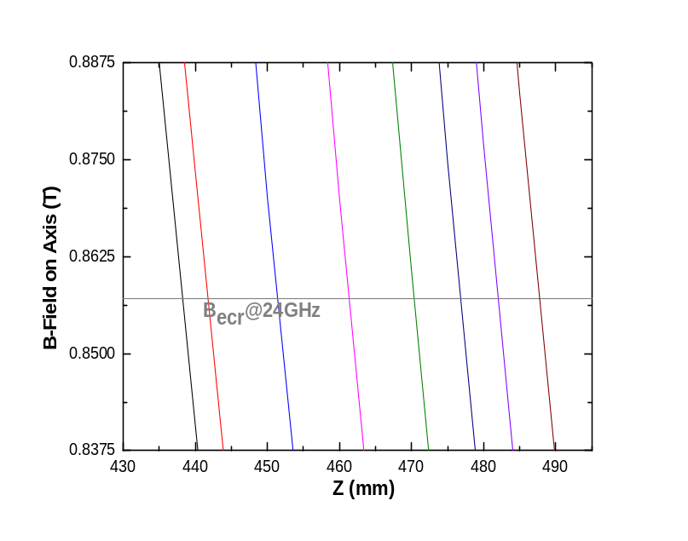
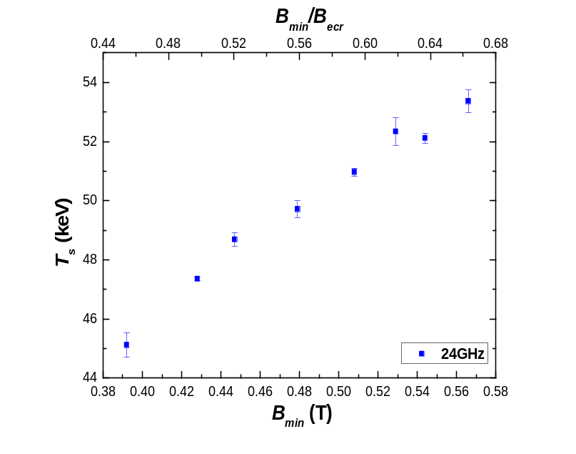
Experimental results- part 2
Constant on-axis ∇B_{ecr} and B_{r} while varying B_{min}
B_{inj}: 1.13-2.65 T
B_{ext}: 1.03-1.68 T
B_{r}: 1.02 T
B_{min}: 0.31-0.47 T
B_{min}/B_{ecr}: 0.48-0.73
Enlarged
on-axis ∇B_{ecr} ~6.3 T/m
B_{inj}: 1.76-3.43 T
B_{ext}: 1.45-2.05 T
B_{r}: 1.44 T
B_{min}: 0.39-0.57 T
B_{min}/B_{ecr}: 0.46-0.67
Enlarged
on-axis ∇B_{ecr} ~9.2 T/m

Slide 12
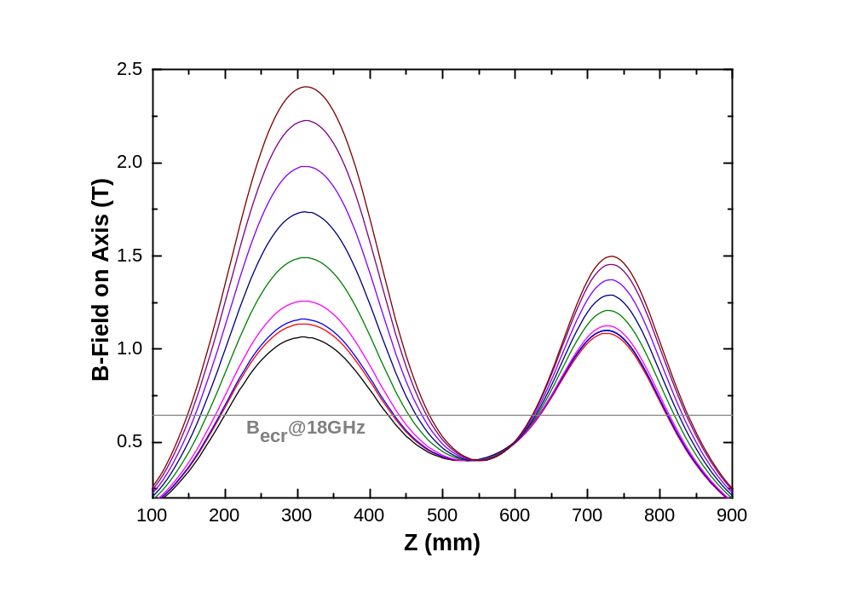
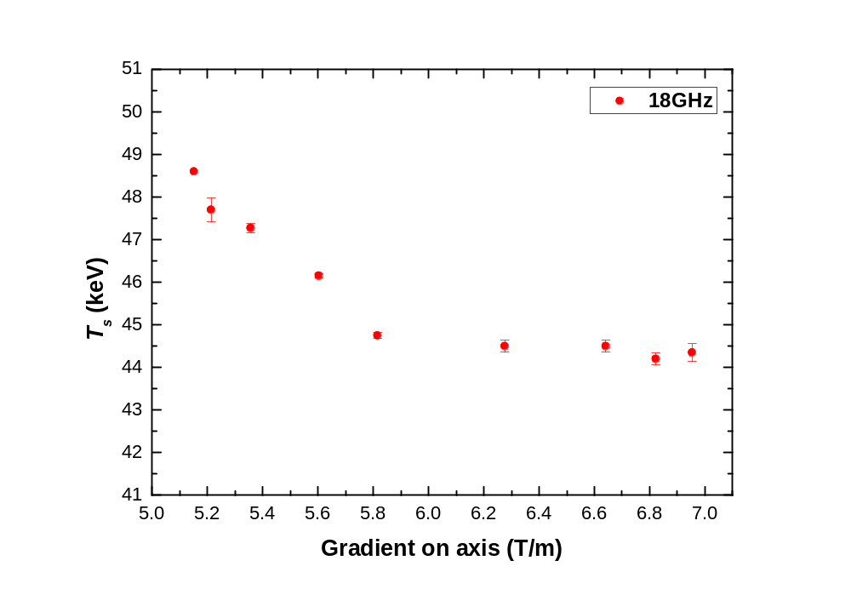
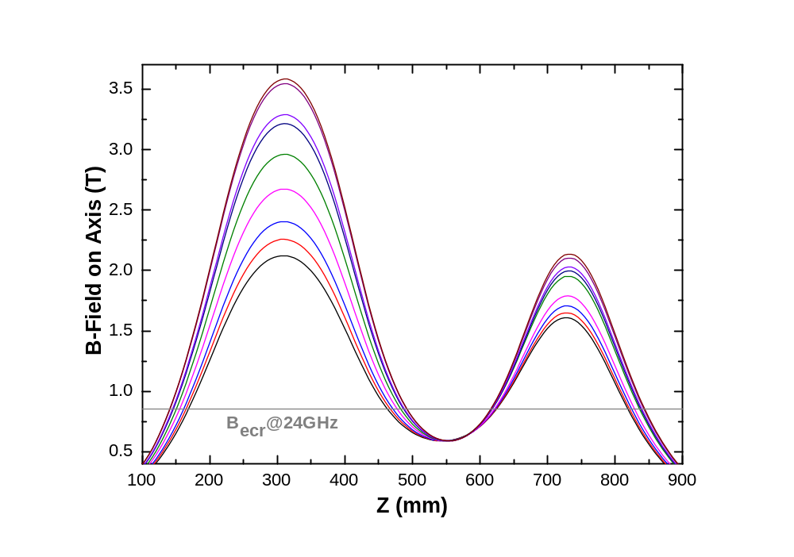
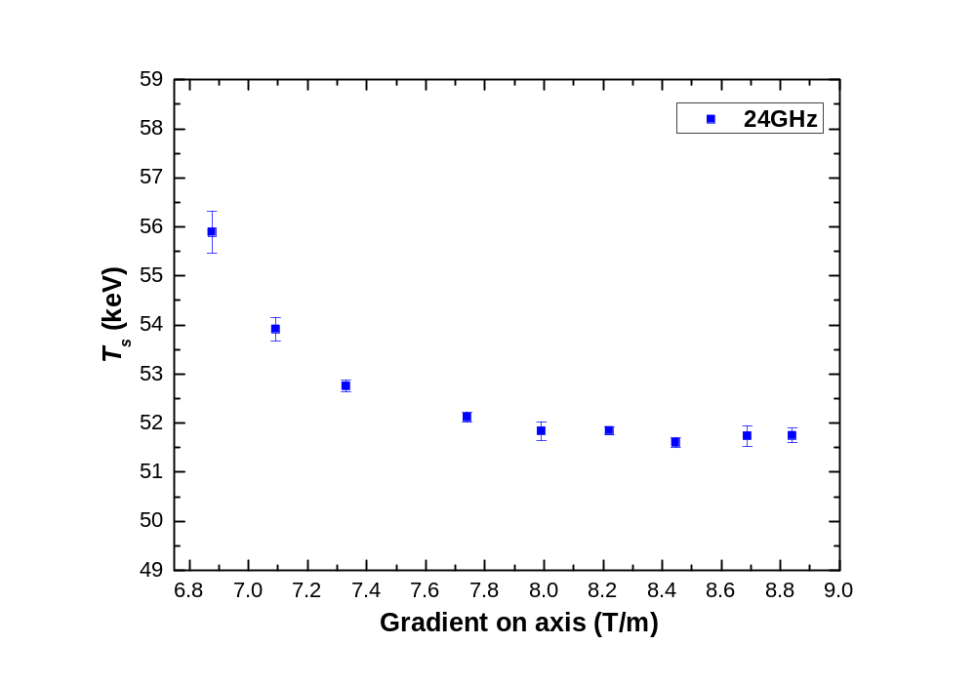
Experimental results- part 3
Constant B_{min} and B_{r} while varying on-axis ∇B_{ecr}
B_{inj}: 1.06-2.41 T
B_{ext}: 1.10-1.50 T
B_{r}: 1.05 T
B_{min}: 0.40 T
B_{inj}: 2.12-3.58 T
B_{ext}: 1.61-2.14 T
B_{r}: 1.53 T
B_{min}: 0.59 T

Slide 13
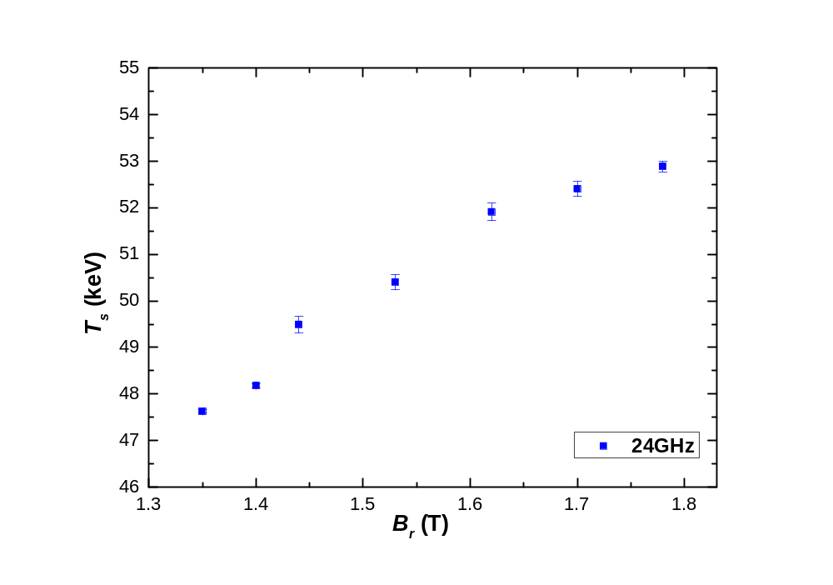
Experimental results- part 4
Constant B_{inj} , B_{ext} and B_{min} while varying B_{r}
B_{inj}: 3.00 T
B_{ext}: 1.98 T
B_{min}: 0.60 T

Slide 14
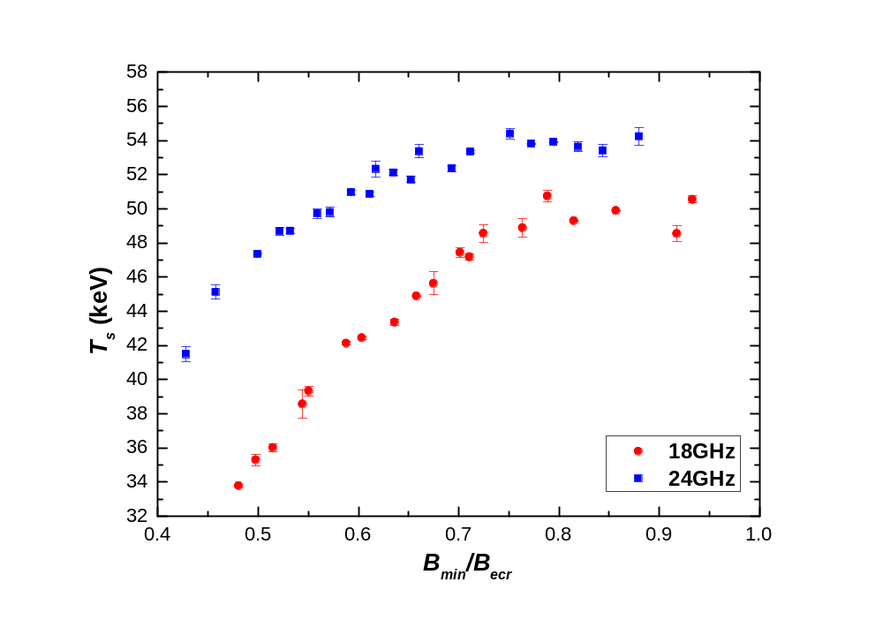
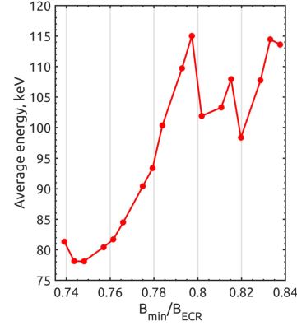
Discussion
-Correlation between T_{s} and electron cyclotron instabilities
Summary of T_{s} versus B_{min}/B_{ecr}
Electron cyclotron instability
Izotov I et al 2018 Plasma Sources Sci. Technol. 27 025012

Slide 15
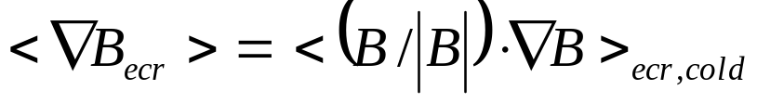
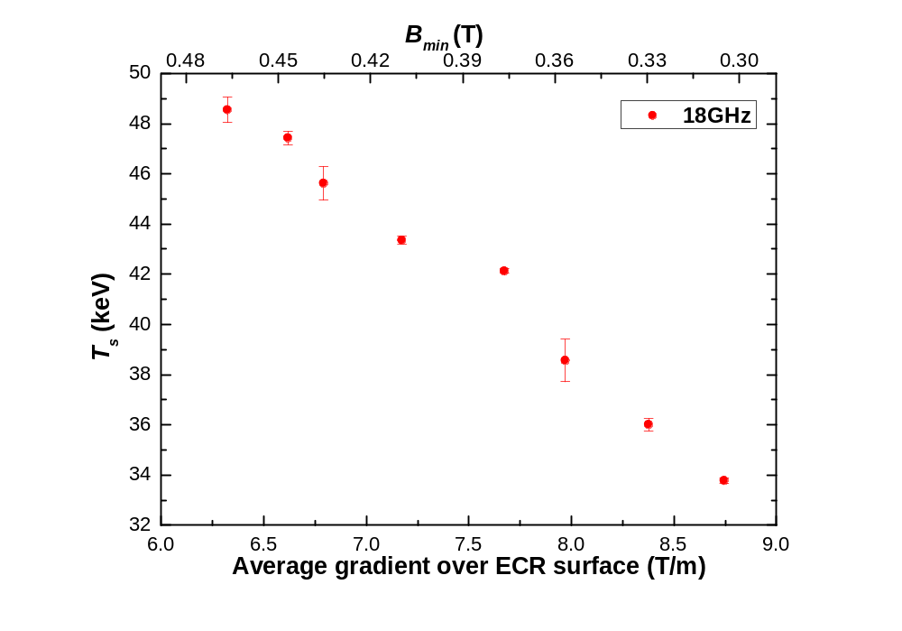
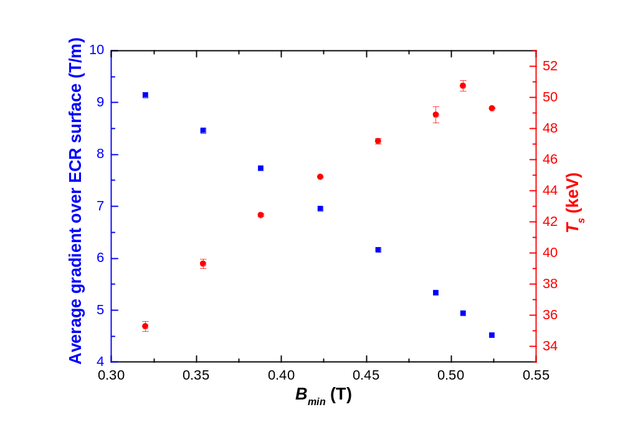
Discussion
-How to understand apparent linear B_{min} dependence on T_{s}
Electron energy gain in single resonance crossing
Effective resonance width
depend strongly on ∇B_{ecr}
rather than B_{min}
Average gradient over ECR surface：
Constant on-axis ∇B_{ecr} and B_{r} while varying B_{min}
Constant B_{inj} , B_{ext} and B_{r} while varying B_{min}

Slide 16
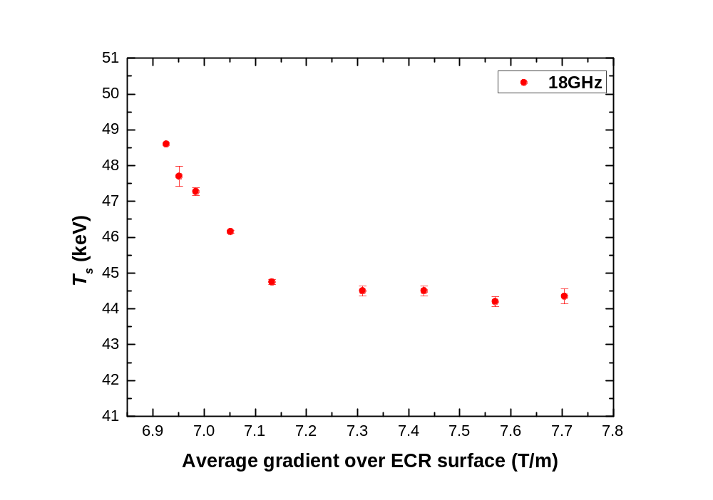
Discussion
-Plasma confinement
Constant B_{min} and B_{r} while varying on-axis ∇B_{ecr}
B_{r} (T) | B_{min} (T) | B_{inj} (T) | B_{ext} (T) | <∇B_{ecr} > (T/m)
1.05 | 0.40 | 1.06 | 1.10 | 6.92
 |  | 1.14 | 1.11 | 6.95
 |  | 1.16 | 1.12 | 6.98
 |  | 1.26 | 1.13 | 7.05
 |  | 1.49 | 1.21 | 7.13
 |  | 1.74 | 1.29 | 7.31
 |  | 1.98 | 1.37 | 7.43
 |  | 2.23 | 1.45 | 7.57
 |  | 2.41 | 1.50 | 7.70
Mirror ratio (B_{max}/B_{min}): 2.65-6.03

Slide 17
Discussion
-Plasma confinement
Constant B_{inj} , B_{ext} and B_{min} while varying B_{r}
B_{last} defines overall magnetic confinement
f (GHz) | B_{inj} (T) | B_{min} (T) | B_{ext} (T) | B_{r} (T) | <∇B_{ecr} > (T/m) | B_{last} (T)
24 | 3.00 | 0.60 | 1.98 | 1.35 | 9.09 | 1.05
 |  |  |  | 1.40 | 9.13 | 1.09
 |  |  |  | 1.44 | 9.18 | 1.13
 |  |  |  | 1.53 | 9.29 | 1.21
 |  |  |  | 1.62 | 9.39 | 1.29
 |  |  |  | 1.70 | 9.50 | 1.37
 |  |  |  | 1.78 | 9.61 | 1.45
Weak effect of <∇B_{ecr} >

Slide 18
Conclusion
Bremsstrahlung spectral temperature T_{s} increases approximately linearly with the increase of B_{min}/B_{ecr} up to ~ 0.8 and then saturates with the appearance of electron cyclotron instabilities, which suggests that periodic bursts of energetic electrons escaping the magnetic confinement will limit the increase of the energy content carried by the hot electron population and eventually lead to a saturation of T_{s};
Increasing B_{min} corresponds to decreasing <∇B_{ecr} > although the on-axis ∇B_{ecr} remains constant, which shows the inherent link between B_{min} and <∇B_{ecr} > , and thus provides a viewpoint that is more coincident with theoretical studies to understand the apparent linear B_{min} dependence and the appearance of electron cyclotron instabilities;
T_{s} decreases with the increasing of gradient (on-axis ∇B_{ecr} and <∇B_{ecr}>) at relatively low mirror ratio and is insensitive to the gradient at high mirror ratio when B_{min} is constant, which indicates that T_{s} depends on not only electron heating, but also depends on electron confinement. This view is supported by the dependence of T_{s} on the radial confinement.

Slide 19
Acknowledgement
J. Benitez, LBNL
D. Xie, LBNL

Slide 20

Thanks for
your attention！

Slide 21
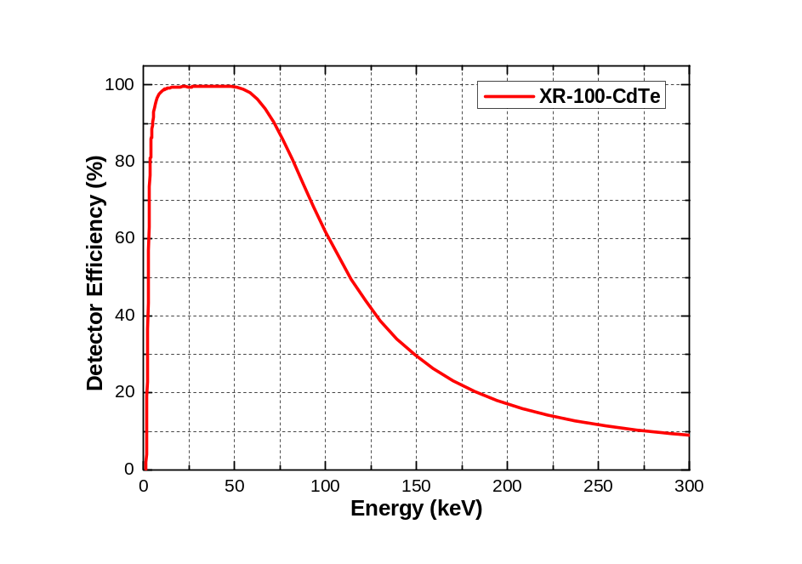
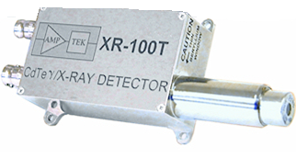
Appendix
XR-100-CdTe Detector
Detector type | Cadmium Telluride (CdTe) Diode
Detector areas | 5 x 5 mm (25 mm²)
Detector thickness | 1 mm
Energy resolution @ 122 keV, ⁵⁷Co | <1.5 keV FWHM, typical
Detector window | Be: 4 mil thick (100 µm)
Energy range | 10 – 300 keV
Detector efficiency | See below

Slide 22
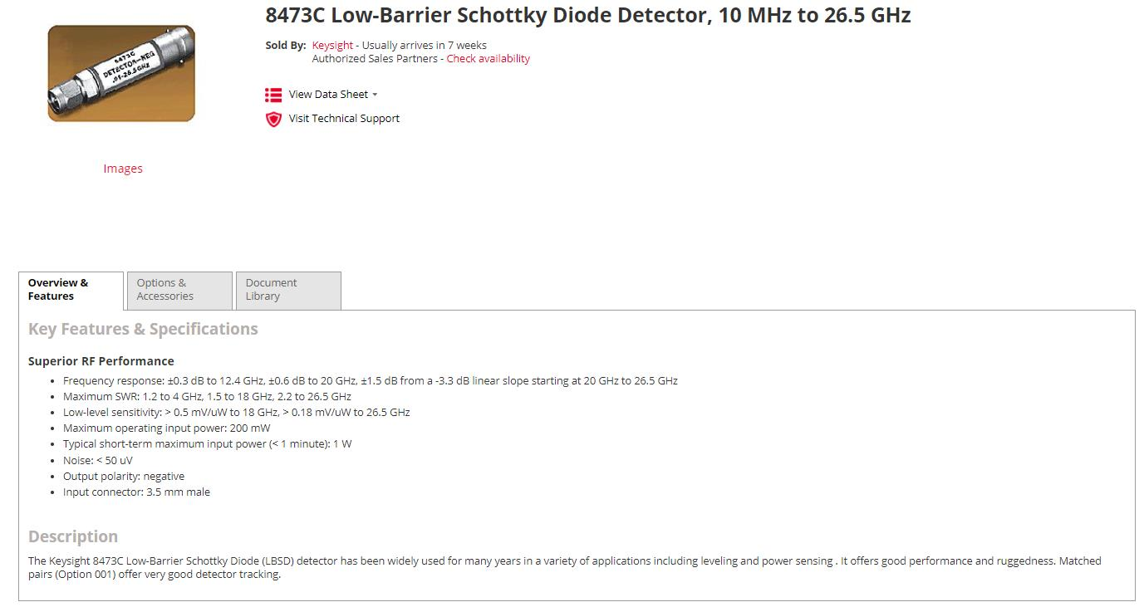
Appendix

Slide 23
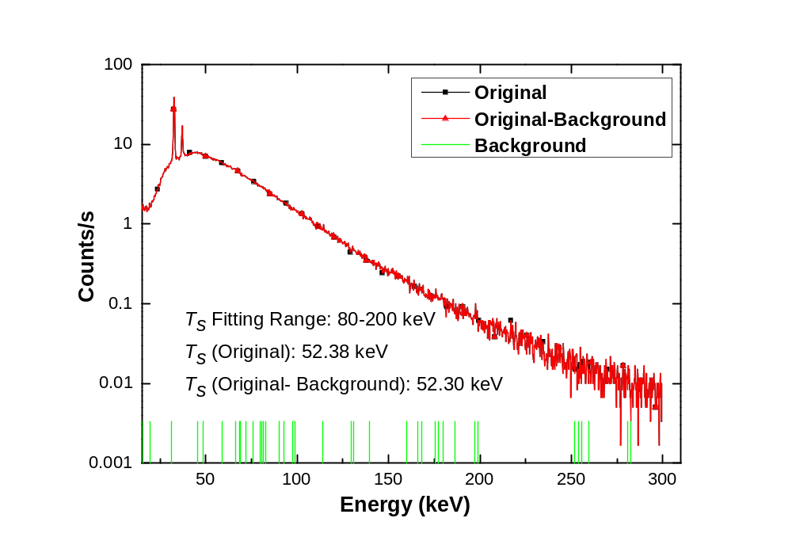
Appendix
Efficiency of Collimating System
Difference (with or without background subtraction) of T_{S} is less than 0.16%
All data presented in this talk are spectra without background subtraction

Slide 24
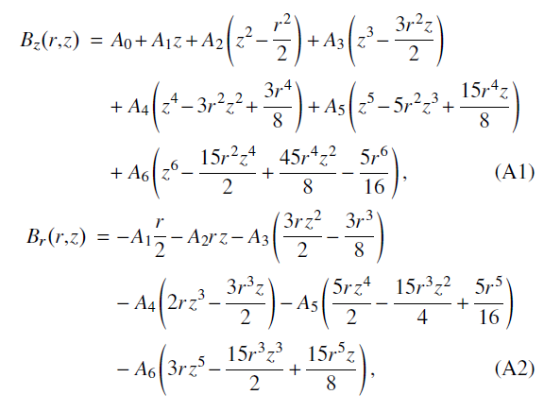
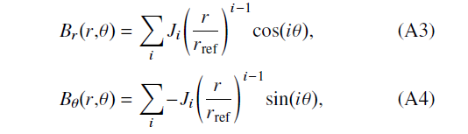
Appendix
The solenoid field model is constructed by fitting a sixth order polynomial Bz(z) to on axis magnetic field
The off-axis solenoid field is evaluated with a standard expansion
The sextupole field model is constructed by fitting a linear combination of cylindrical multipoles

