Slide 1
Production of metallic ion beams with inductive heating oven at IMP
W. Lu, L. T. Sun, C. Qian, W. Huang, L. X. Li, J. W. Guo,
X. Z. Zhang and H. W. Zhao
Institute of Modern Physics (IMP), CAS
Lanzhou, 730000, China
E-mail: luwang@impcas.ac.cn
Notes:
Thanks for you introduction, chairman. Hello everyone.
My presentation is “production of metallic ion beams with inductive heating ovens at IMP.

Slide 2
OUTLINE
Background
Standard-Inductive Oven-2019
Uranium ion beams production with UO2
Aluminum & Iron beams routine operation
Mini-Inductive Oven-2020
Calcium ion beams production with CaO
Summary
Notes:
At the beginning, I’d like to introduce the background. And then… then…, and finally..

Slide 3
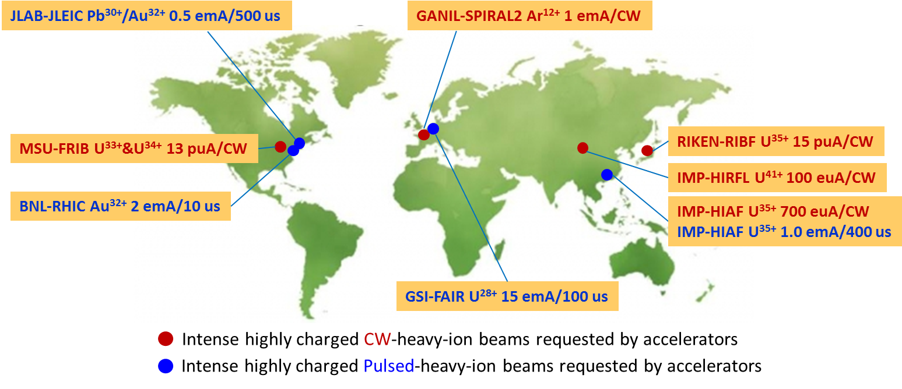
Background
Typical ion beams requirement for heavy ion accelerators in the world
Notes:
This slide shows the… and we can see that most of the advanced accelerators need intense metallic ion beams, like FAIR at GSI need U28+, FRIB at MSU needs U33+ and U34+, RIBF at RIKEN need U35+,

Slide 4
Background
Methods to produce metal vapor in ECRIS
→ Plasma Heating
MIVOC
Sputtering
RIKEN, MSU, IMP
Metal oven (Resistance oven, Inductive oven, etc)
LBNL, MSU, RIKEN, GSI, IMP, JYFL…
→ Laser Ablation
…
Notes:
In order to meet these requirements, our colleagues in ECR community have developed different methods to produce…

Slide 5
Background-Sputtering
Ion Species | Source | Rf Power (kW) | Sputtering Voltage (kV) | Ion Beam intensity (euA)
²³⁸U³³⁺ | RIKEN-28 | 4.0 | -5.5 | 225 ^{[1]}
²³⁸U³⁵⁺ | RIKEN-28 | 4.0 | -5.5 | 180 ^{[1]}
²³⁸U³³⁺ | SECRAL | 3.8 | -3.1 | 202 ^{[2]}
²³⁸U³³⁺ | SuSI | 2.9 | -3.9 | 85 ^{[3]}
...
Pros | Simple Structure; Suitable for long-time operation;
Cons | Need a lot of supporting gas; Difficult to get very high charge state;
At present, metal oven is still the best way to produce intense highly charged metallic ion beams.
[1]. Y. Higurashi, et al. Recent development of RIKEN 28 GHz SC-ECRIS, ICIS2013, Chiba, Japan, 2013.
[2]. W. Lu, et al. SECRAL commissioning report, 2013;
[3]. L. T. Sun, et al. Intense ion beam production with SuSI., ECRIS2010, LPSC-Grenoble, France, 2010.
Notes:
For sputtering method, it has the advantages of … Any way. At present, metal oven is …

Slide 6
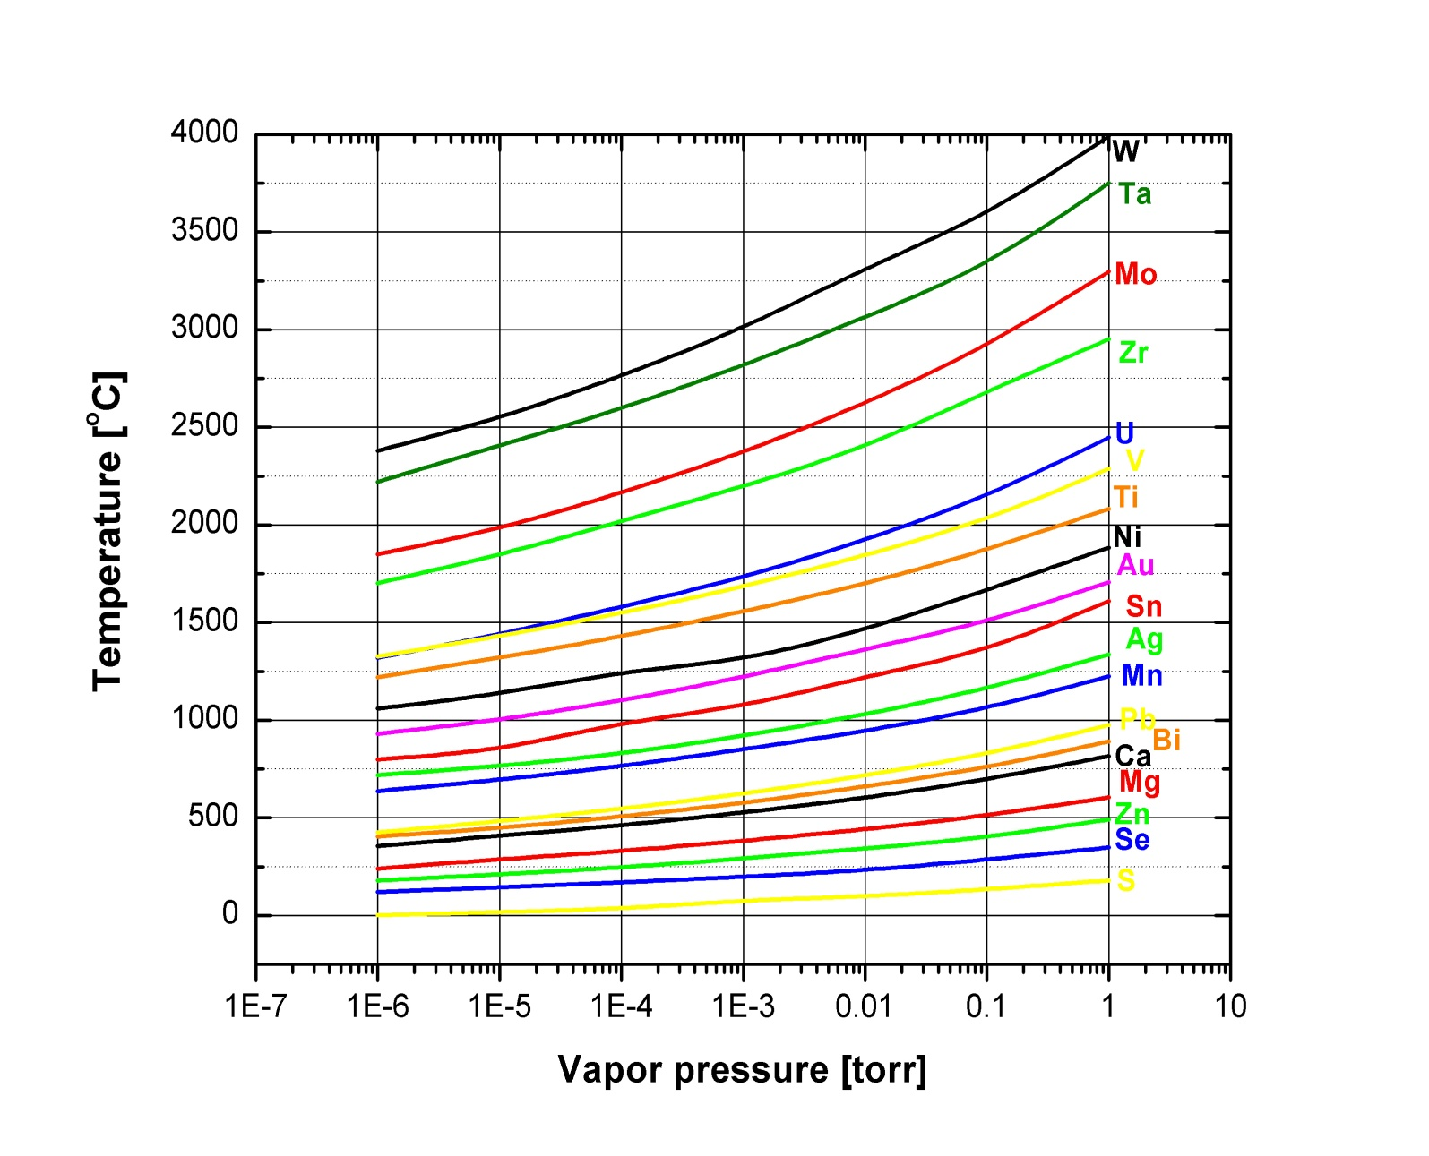
Background-Metal Oven
Vapor pressure vs crucible temperature
HTO
For refractory metals, the typical temperature to produce enough vapor (0.01-0.1 torr) in ECR ions source is 1600~2000 degree C.
Notes:
From this slide we can see that… for refractory metals, the typical…

Slide 7
Background-Resistive Heating Oven
Vapor pressure vs crucible temperature
Ion Species | Source | Rf Power (kW) | Operation Time | Ion Beam Intensity (euA)
²³⁸U³³⁺ | VENUS | 6.5+1.8 | ~10 hours | 440 ^{[4]}
²³⁸U³⁵⁺ | VENUS | 6.5+1.8 | ~10 hours | 300 ^{[4]}
²³⁸U³³⁺ | RIKEN-28 | 2.2-2.6 | - | ~225 ^{[5]}
²³⁸U³⁵⁺ | RIKEN-28 | 2.2-2.6 | - | ~200 ^{[5]}
²³⁸U³⁵⁺ | RIKEN-28 | - | ~1 month | 100-120 ^{[6]}
…
Pros | Temperature up to 2000 ℃； Large capacity;
Challenges | Strong Lorenz force; Crucible deformation; Especially used in the next generation ECR ion source (B_{inj}~6 T)
Inductive heating might be another choice
[4]. J. Y. Benitez, et al. Current developments of the VENUS ion source in research and operations, ECRIS2012, Sydney, Australia, 2012.
[5]. T. Nakagawa, et al. Production of intense metal ion beam with RIKEN 28 GHz SC-ECRIS, in this conference.
[6]. J. Ohnishi, et al. Practice use of high-temperature oven for 28 GHz superconducting ECR ion source at RIKEN., ECRIS2018, Catania, Italy, 2018.
Notes:
As all we know that, resistive heating high temperature ovens have been developed in ecr community for more than ten years, and some good results have also been produced, as shown in this table. But, the challenge of resistive heating oven is also obvious, like,… and this could be more difficult in the next generation ECR ion source. Because the maximum field at the injection side might be around 6 T.

Slide 8
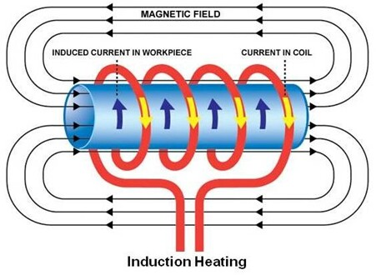
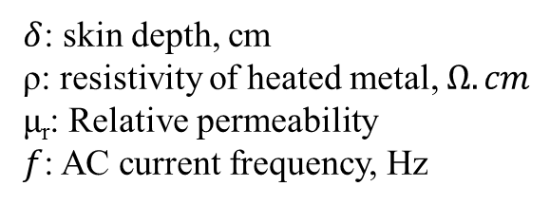
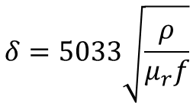
Background-Inductive Oven
Principle of inductive heating and its features
$$δ=5033\sqrt{\frac{ρ}{μ_{r}f}}$$
$δ$: skin depth, cm
ρ: resistivity of heated metal, $Ω. cm$
μ_{r}: Relative permeability
$f$: AC current frequency, Hz
Pros:
Challenges:
Lorenz force free when work in high magnetic field environment (B>3-6 T);
Fast temperature respond to the heating power;
Material compatibility under high temperature;
Thermal radiation and thermal conduction shielding;
With inductive heating oven, MSU got ~200 euA of U³³⁺ in 2012. But the performance of oven degrades quickly!
Notes:
This slide shows…

Slide 9
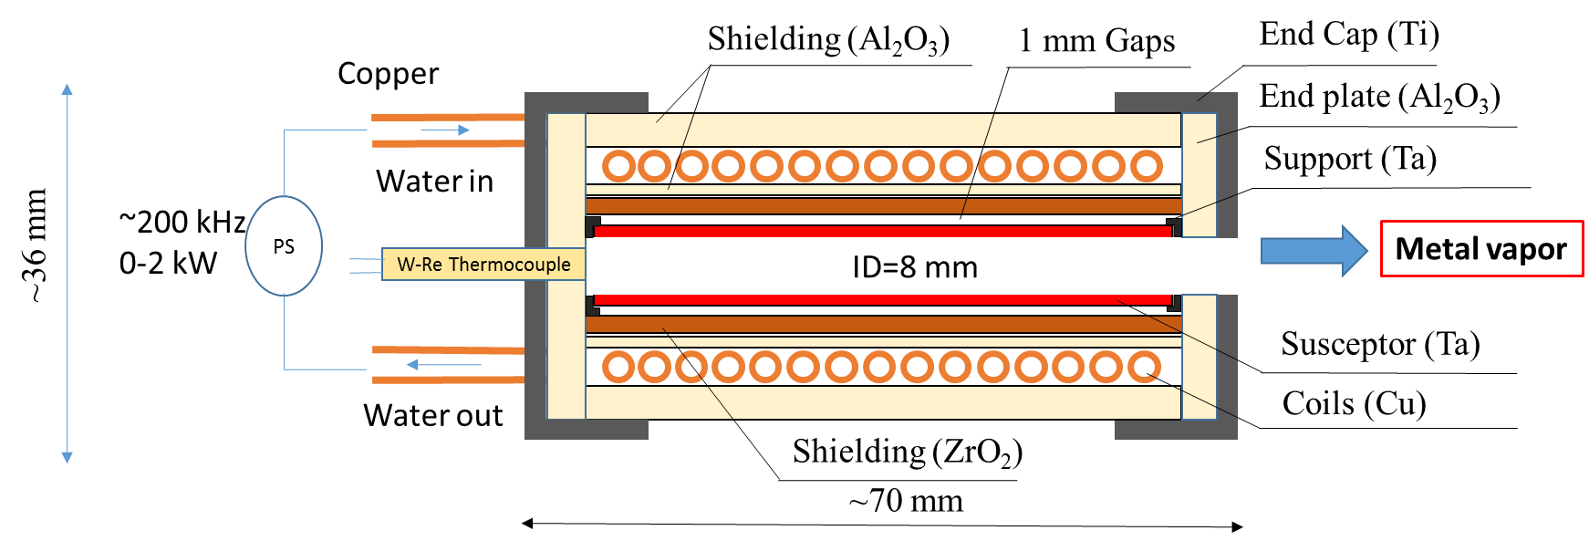
Standard Inductive Oven-2019
The layout of inductive oven at IMP (2019)
Design temperature: 1800 -2100 ⁰C ;
Design working life: >200 hours;
Control mode: Close loop (open loop at the first step);
Capacity: Ø 8 mm×50 mm crucible;
Main features: Add gap between crucible and ZrO₂;
Idea from MSU
Notes:
So how to solve this issue? This slide shows…from the figure above, we can see that the most important feature of this oven is that we add a gap between the crucible and ceramic. This gap is very important. With this gap, the crucible can avoid to touch the ceramic in high temperature region. As a result, to decrease the risk of reaction and degradation.

Slide 10
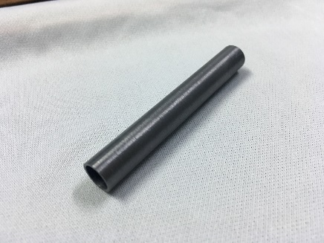
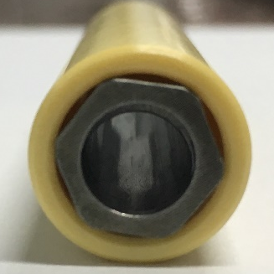
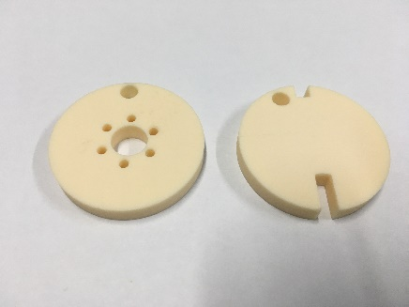
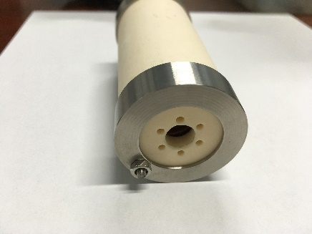
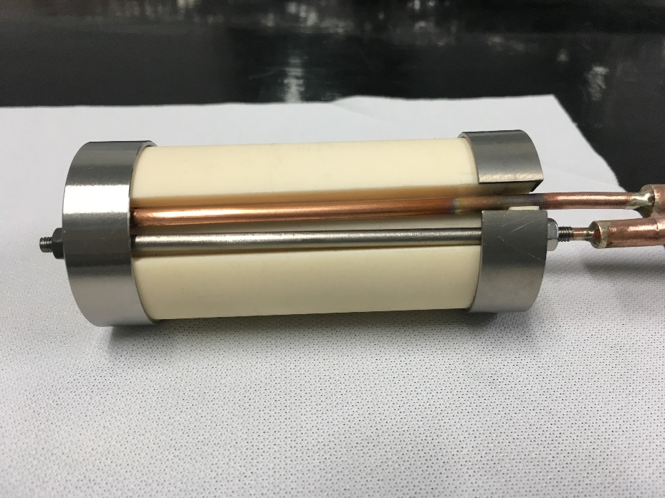
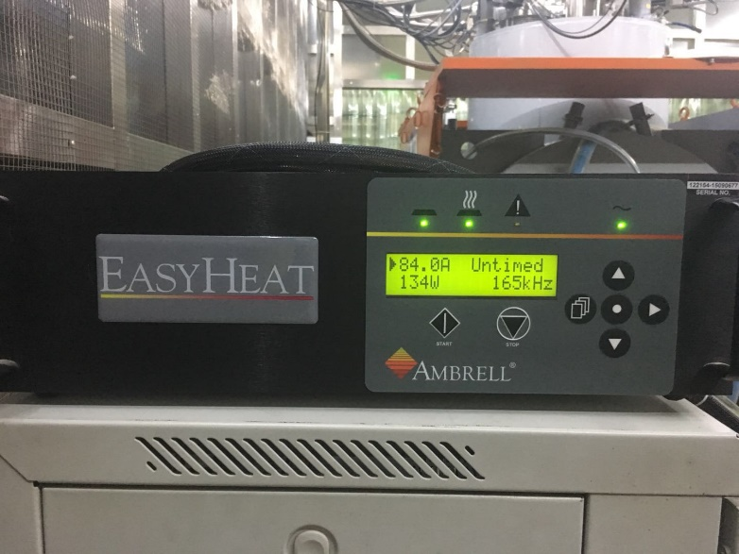
Standard Inductive Oven-2019
Inductive oven assembling
Ta support
For pumping
1 mm of Susceptor (Ta)
2 mm of ZrO2
Al₂O₃ End plate
Inductive oven-2019
End cape and rod
Inductive oven after assembling
RF power generator (0-2 kW, 200 kHz)
Notes:
This slide shows the inductive oven at IMP before and after assembling. We use a RF power generator to provide the heating energy. The maximum power is ~2 kW and frequency about 200 kHz.

Slide 11
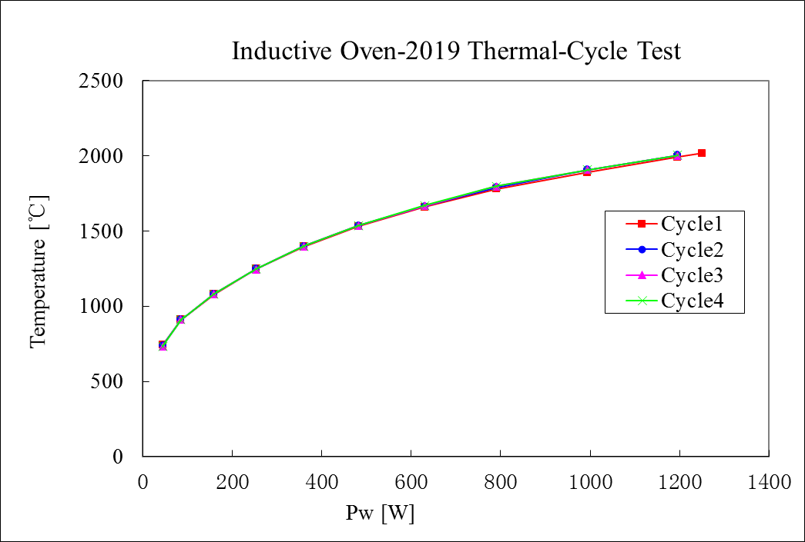
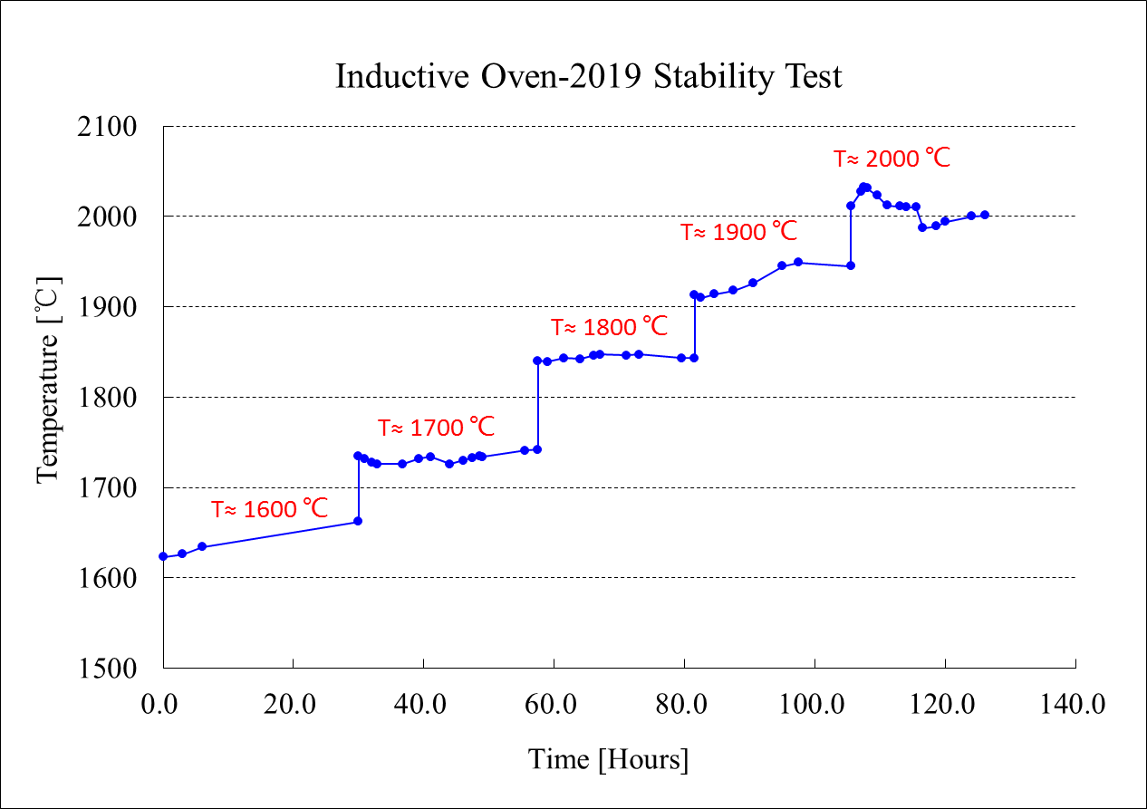
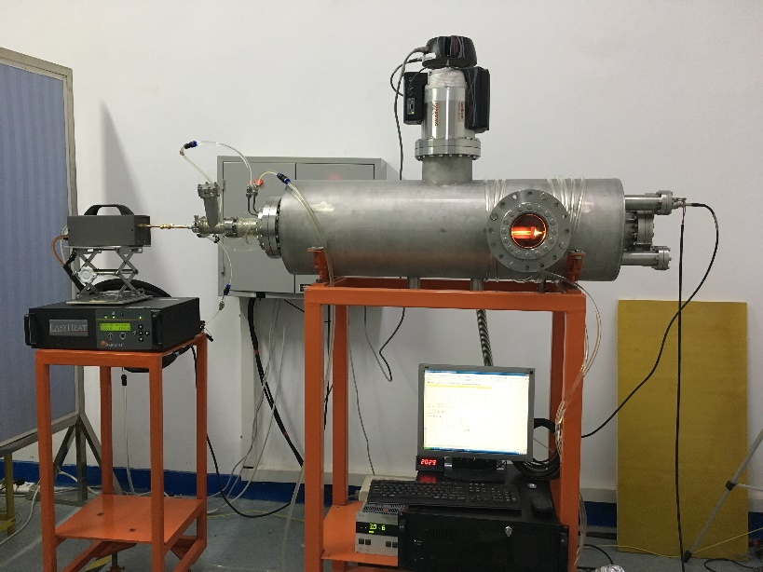
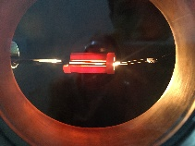
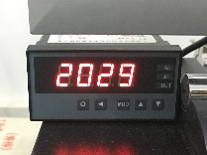
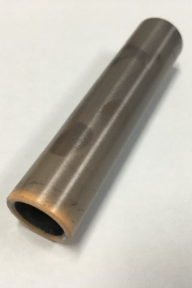
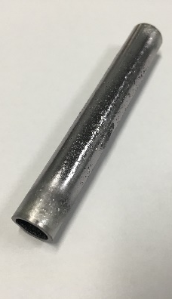
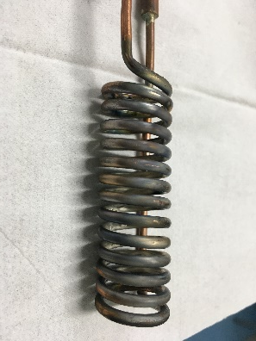
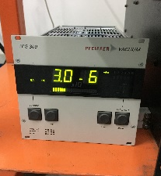
Standard Inductive Oven-2019
Off-line test
5 days continuous running
Heat station
Coil
ZrO₂
Ta crucible
ZrO2 and Ta crucible survived;
Similar performance in thermal-cycle test
Notes:
From the off-line test results we can see that, the performance of this oven is almost the same after 4 thermal-cycle tests. And after about 5 days continuous test, both the susceptor and zirconia survived. That means this oven can operate at high temperature for a long time without damage.

Slide 12
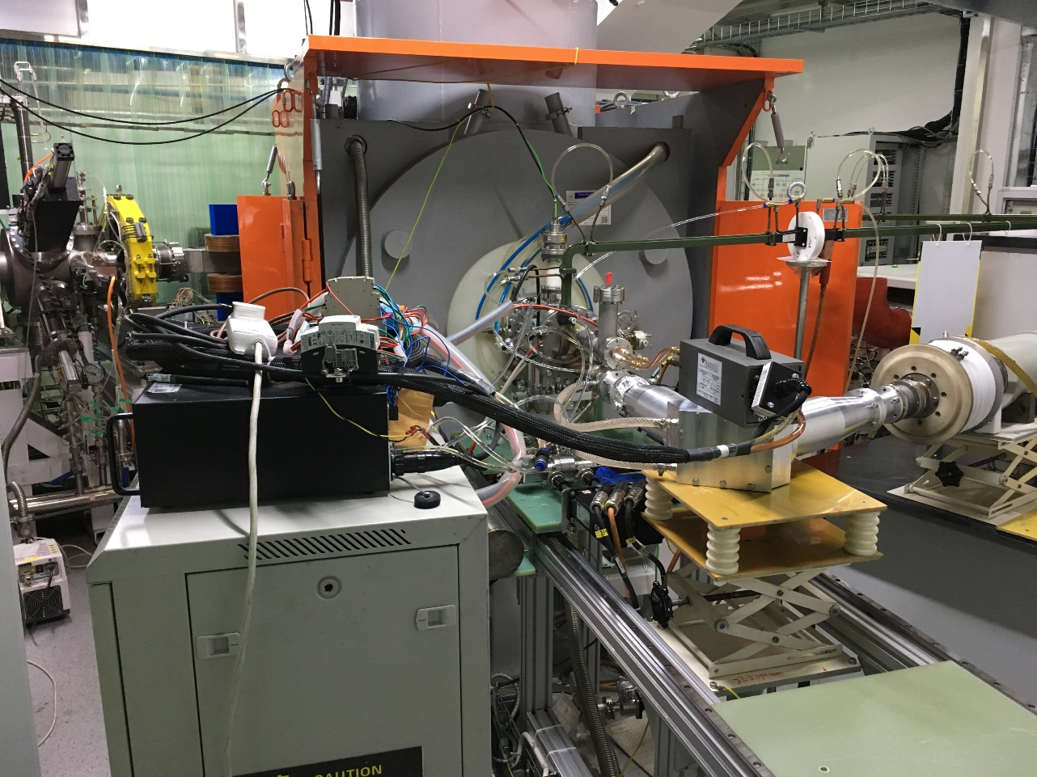
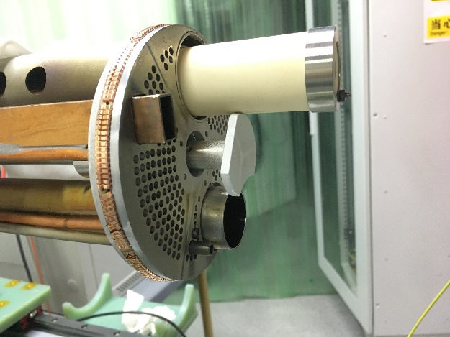
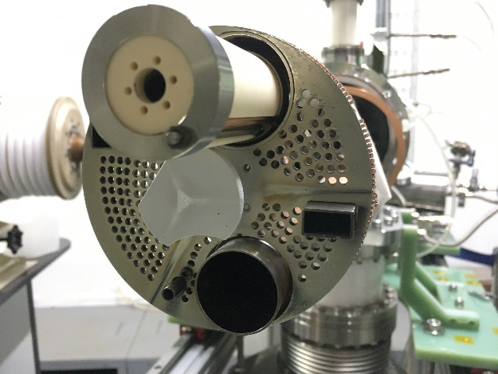
Standard Inductive Oven-2019
The On-line Test on SECRAL-II platform
SECRAL-II
Power supply
Heat station
SECRAL-II platform
Injection component
(SECRAL-II)
Notes:
After off-line test, we install the oven on SECRAL-II superconducting ECR ion source, to test the production of intense uranium beams.

Slide 13
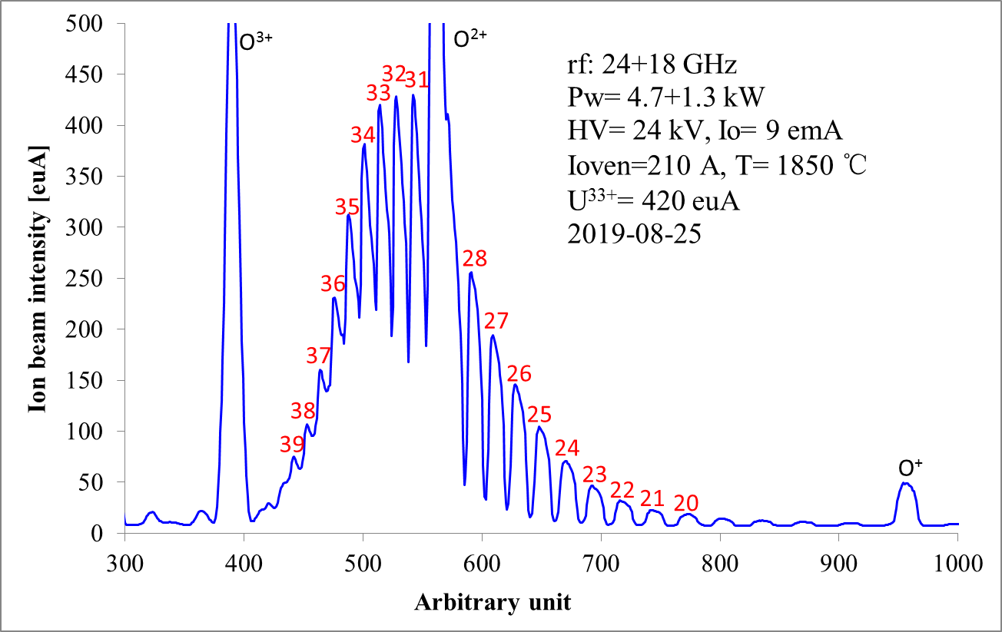
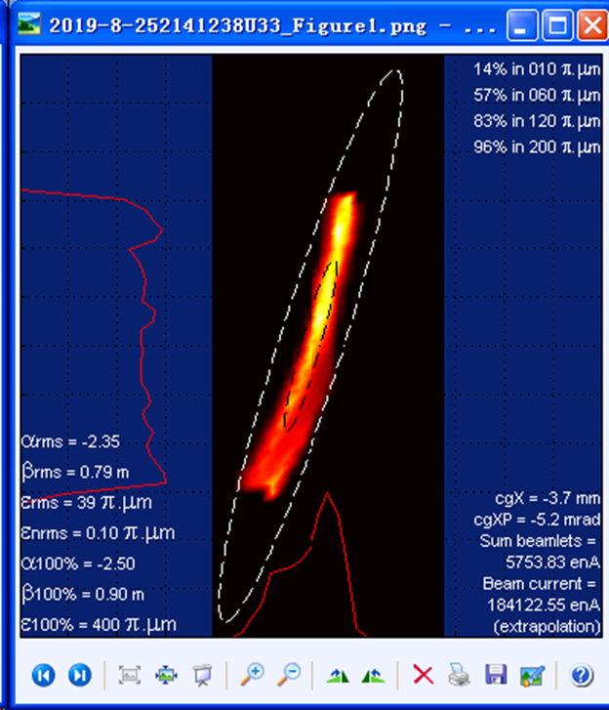
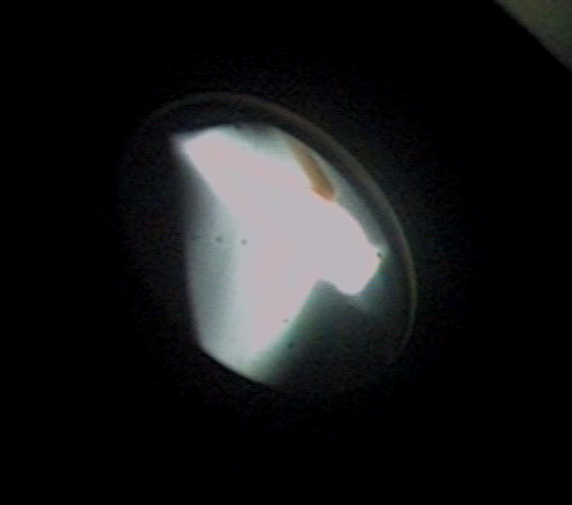
Production of intense uranium beams
Standard Inductive Oven-2019
Normalized RMS emittance:
Ɛx≈0.1 π. mm. mrad
Total maximum rf power ~6.0 kW, some preliminary but very promising intense uranium ions were produced, such as:
450 euA of U³³⁺, 380 euA of U³⁴⁺, 310 euA of U³⁵⁺, etc
Notes:
In about one week’s tuning…

Slide 14
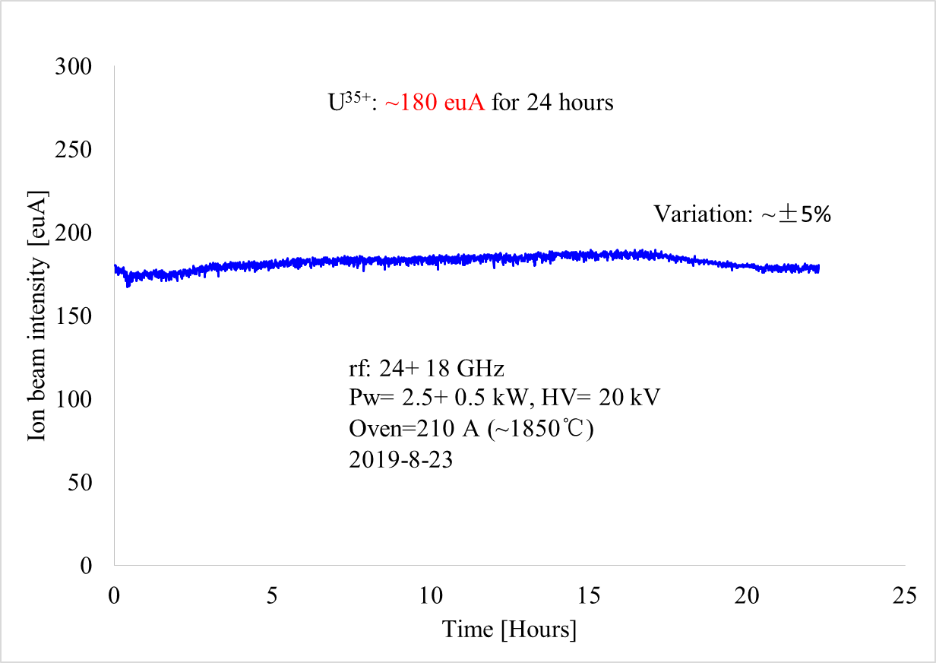
²³⁸U³⁵⁺ stability test
Standard Inductive Oven-2019

Slide 15
Uranium beam latest results
Standard Inductive Oven-2019
Ion Species | Source | Rf Power (kW) | Ion Beam Intensity (euA)
²³⁸U³³⁺ | SuSI | 3.4 | 180
²³⁸U³⁵⁺ | SuSI | 3.4 | 135
²³⁸U³³⁺ | SECRAL-II | 6.0 | 450
²³⁸U³⁵⁺ | SECRAL-II | 5.8 | 310
²³⁸U⁴²⁺ | SECRAL-II | 5.8 | 60
²³⁸U⁴⁶⁺ | SECRAL-II | 5.8 | 26
²³⁸U⁵⁰⁺ | SECRAL-II | 5.8 | 9
²³⁸U⁵⁴⁺ | SECRAL-II | 5.8 | 2.6
²³⁸U⁵⁶⁺ | SECRAL-II | 5.8 | 0.9
Average consumption rate in a week: ~4.5 mg/h

Slide 16
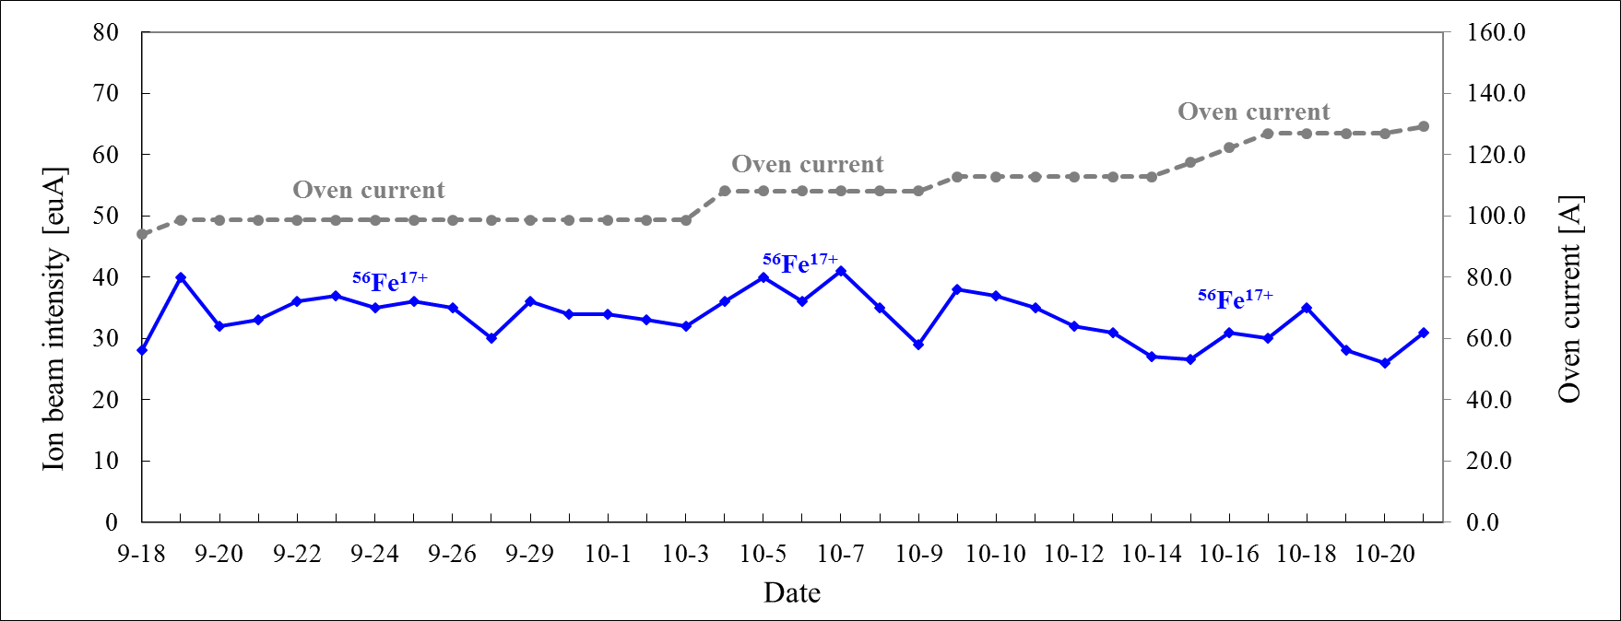
Al⁸⁺ & Fe¹⁷⁺ Routine Operation for HIRFL-CSR
Standard Inductive Oven-2019
 | IHO temperature (℃) | Beam current (euA) | Continuous operation time (days)
²⁷Al⁸⁺ | 1300-1400 | 20-30 | 7
⁵⁶Fe¹⁷⁺ | 1400-1500 | 30-40 | 32
⁵⁶Fe¹⁷⁺: 30~ 40 euA in one month
optimize
optimize
Long-term reliability of standard inductive oven-2019 is reasonable!

Slide 17
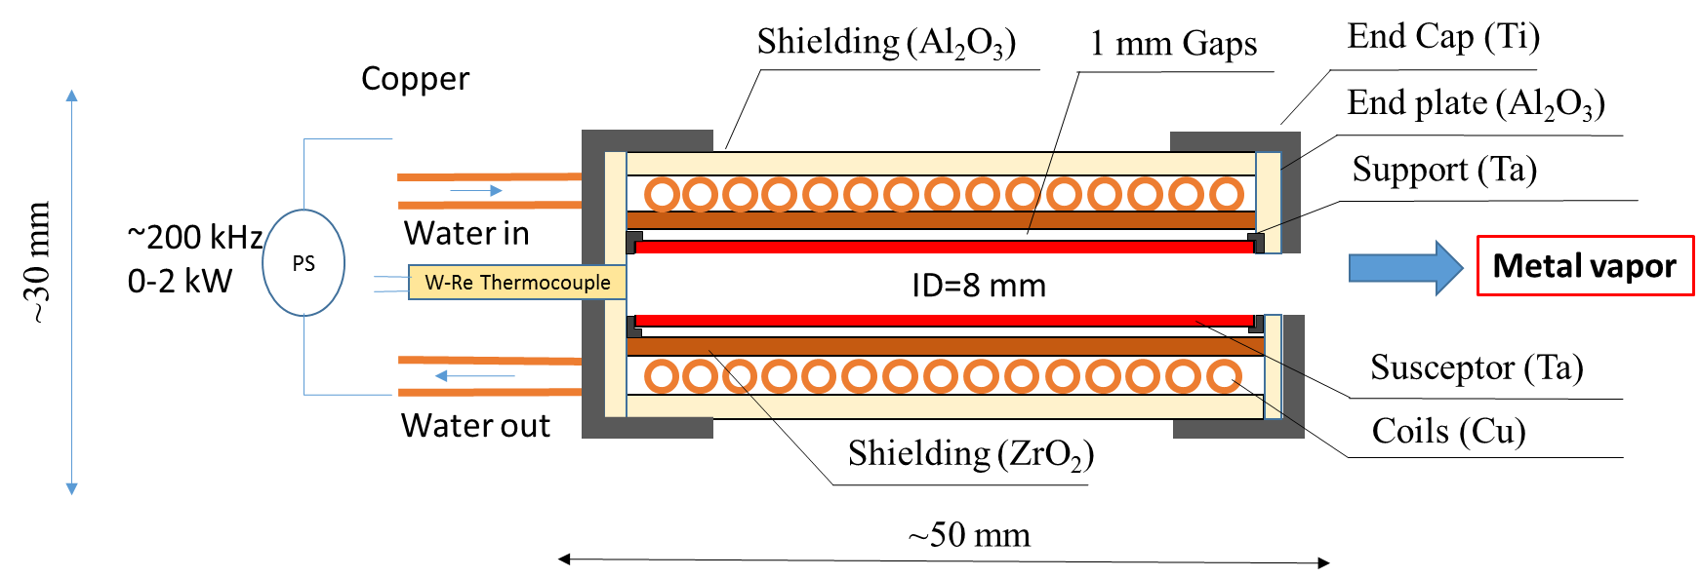
Mini-Inductive Oven-2020
The layout of Mini-Inductive Oven (2020)
Design temperature: 1800 -2100 ⁰C ;
Design working life: >200 hours;
Control mode: Close loop (open loop at the first step);
Capacity: Ø 8 mm×40 mm crucible;
Main features: Smaller & Shorter, but similar crucible diameter;

Slide 18
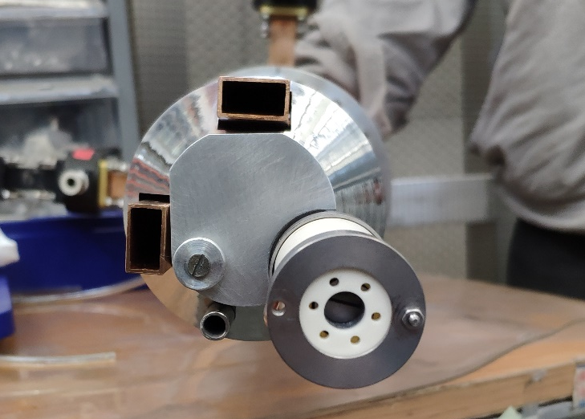
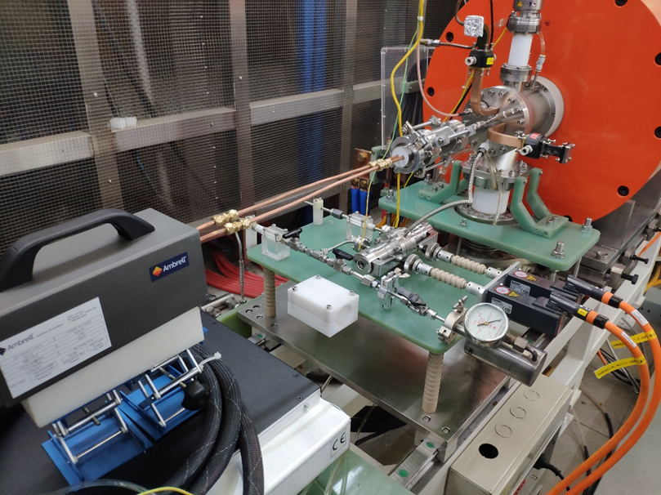
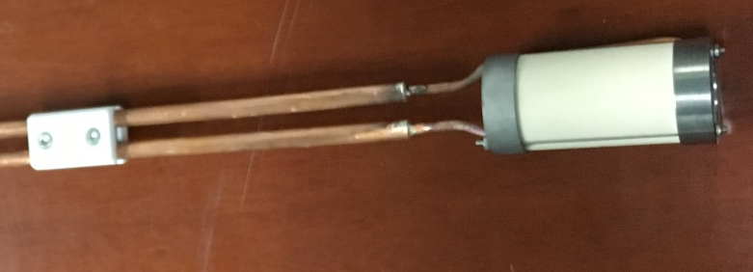
Mini-Inductive Oven-2020
The On-line Test on LECR5 platform
18+14.5 GHz
LECR5
Bias disk
Heat station
Injection component (LECR5)
Power supply
Supporting ceramic
LECR5 platform
Mini-Inductive Oven-2020
To produce calcium beams with CaO & Mini-Inductive Oven-2020
Ion source group at RIKEN has produced ~50 euA of ⁴⁰Ca¹¹⁺ with CaO & high temperature oven in 2019*
* Private communication

Slide 19
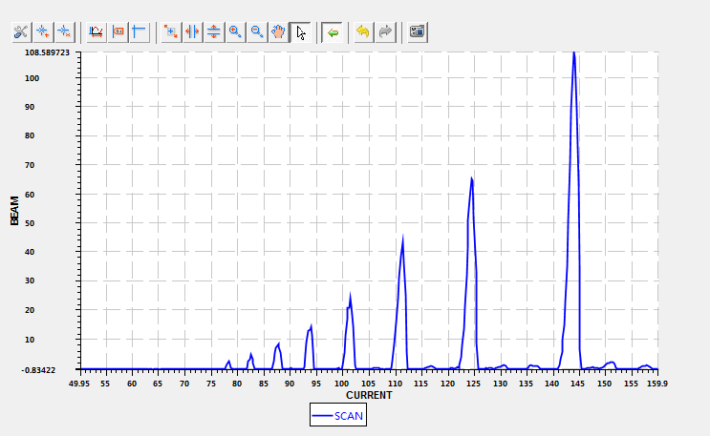
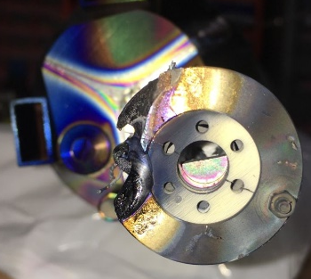
Production of calcium beams with CaO-1st test
Mini-Inductive Oven-2020
18 GHz
3
Plasma
Oven
40 mm
4
5/O²⁺
rf: 18 GHz
Pw= 0.4 kW, HV= 15 kV
Io= 1.4 emA, ⁴⁰Ca³⁺= 110 euA
OVEN: 195 A (1800 ℃)
Pinj= 3.8×10⁻⁷ mbar
Pext= 1.0×10⁻⁷ mbar
2020-7-27
6
7
9
8
10/O⁴⁺
Plasma heating contributes too much, that leads to serious outgassing and instability. Only low charge state ion beams produced, like:
110 euA of Ca³⁺, 60 euA of Ca⁴⁺, etc

Slide 20
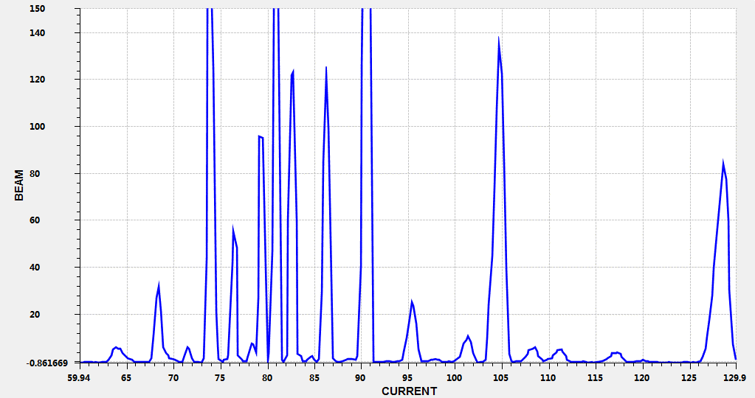
Mini-Inductive Oven-2020
Production of calcium beams with CaO-2nd test
O⁶⁺
O⁵⁺
10/O⁴⁺
O³⁺
18 GHz
12
11
Plasma
13
Oven
O²⁺
60 mm
14
rf: 18 GHz
Pw= 1.0+0.2 kW, HV= 20 kV
Io= 2.0 emA, ⁴⁰Ca¹²⁺= 120 euA
OVEN: 180 A (1700 ℃)
Pinj= 3.6×10⁻⁷ mbar
Pext= 9.2×10⁻⁸ mbar
2020-8-4
O⁷⁺
9
8
Plasma heating influence still obvious, but much lower, some medium charge state ion beams can been produced:
120 euA of Ca¹²⁺, 50 euA of Ca¹⁴⁺, etc

Slide 21
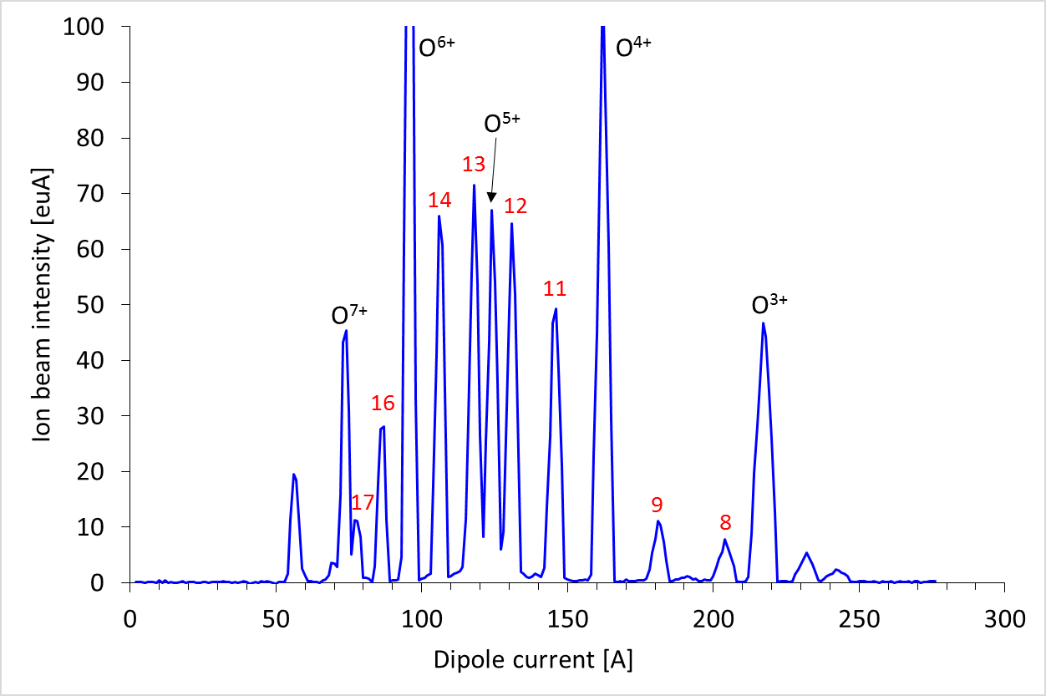
Mini-Inductive Oven-2020
Production of calcium beams with CaO-3rd test
18 GHz
Plasma
Oven
100 mm
rf: 18 GHz
Pw= 1.02+0.18 kW, HV= 20 kV
Io= 1.1 emA, ⁴⁰Ca¹⁶⁺= 28 euA
OVEN: 170 A (1600 ℃)
Pinj= 2.5×10⁻⁷ mbar
Pext= 5.4×10⁻⁸ mbar
2020-9-27
Plasma heating influence can be well controlled, and very high charge state ion beams produced:
30 euA of Ca¹⁶⁺, 10 euA of Ca¹⁷⁺, etc

Slide 22
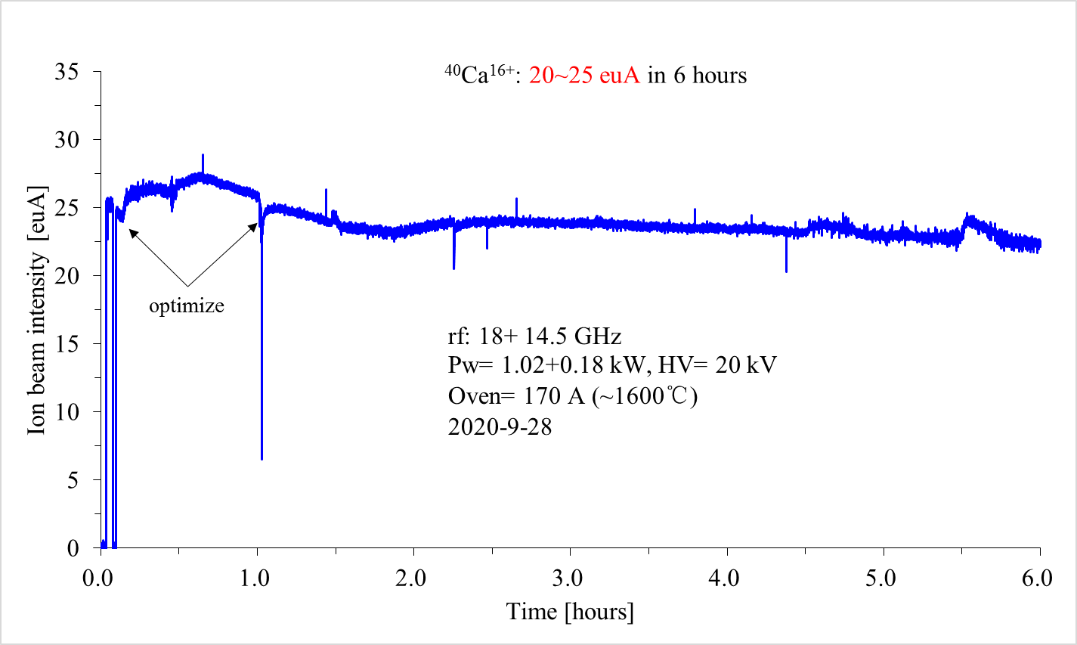
⁴⁰Ca¹⁶⁺ stability test
Mini-Inductive Oven-2020
Variation : ~±10%

Slide 23
Summary
Standard and Mini inductive heating ovens have been developed at IMP and they can reach up to 2000 ℃ with 1.2 kW of AC power.
Some good results of uranium beams have been achieved on SECRAL-II superconducting ECR ion source platform with about 6 kW of rf power, like 450 euA of U³³⁺, 310 euA of U³⁵⁺, 60 euA of U⁴²⁺, and so on.
Intense high-charge-state calcium ion beams can be produced on LECR5 room temperature ECR ion source with CaO and inductive heating oven.

Slide 24
Acknowledgement
Thanks for you attention!

