Slide 1
A new solution to plasma chamber cooling for high power ECR ion source operation
The 24th International Workshop on ECR Ion Source
East Lansing, USA, September 28th-30th 2020
J. W. Guo
L. B. Li, J. D. Ma, L. X. Li, Y. C. Feng, W. Lu, W. H. Zhang, X. Fang, X. Z. Zhang, Y. Y. Yang, Y. J. Zhai, W. Huang, D. Hitz, L. T. Sun and H. W. Zhao
Institute of Modern Physics (IMP), Chinese Academy of Sciences
Lanzhou, 730000, China

Slide 2
Outline
Introduction
Analysis of microchannel cooling for plasma chamber
On-line high power test
Summary

Slide 3
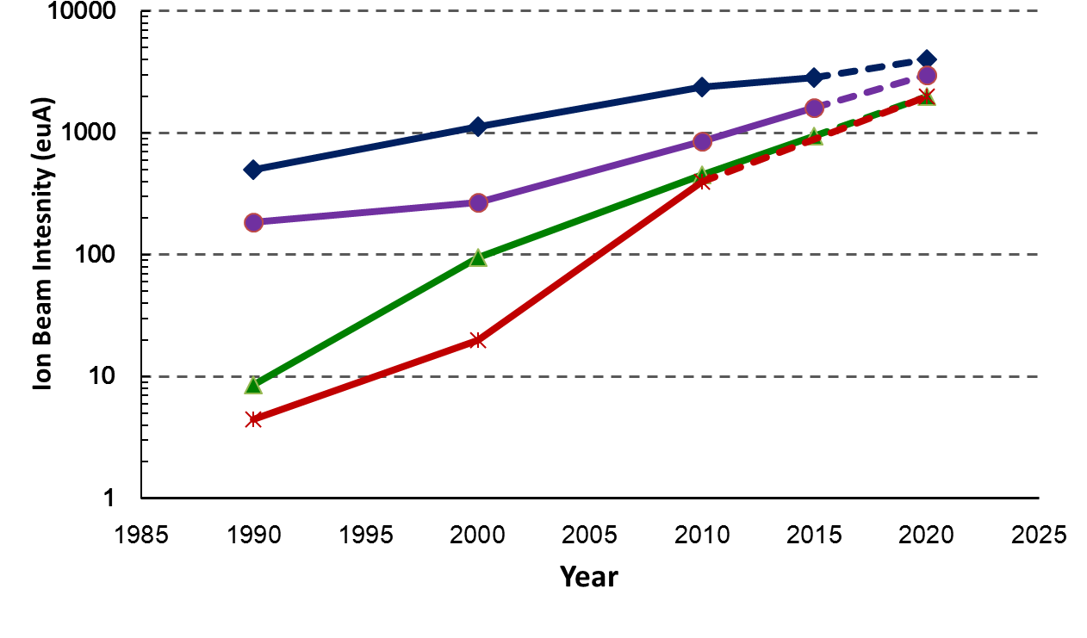
Evolution of ECRIS Generations
2nd G.
3rd G.
O⁶⁺
Ar¹²⁺
Caprice
ECR4
AECR-U
SERSE
GTS
LECR3
…
VENUS
SECRAL
SECRAL-II
SuSI
SCECR
…
Xe²⁷⁺
U³⁴⁺
4th G.
Frequency
6.4~18 GHz
24~28 GHz
40~60 GHz
Power 0.5-2 kW 5-12 kW 15-30 kW

Slide 4
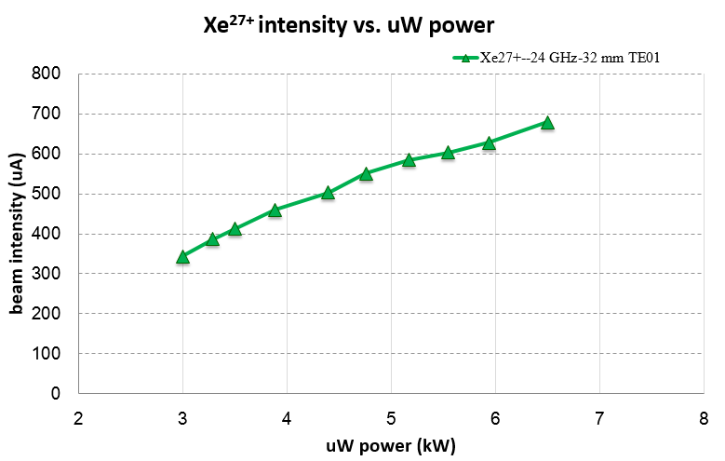
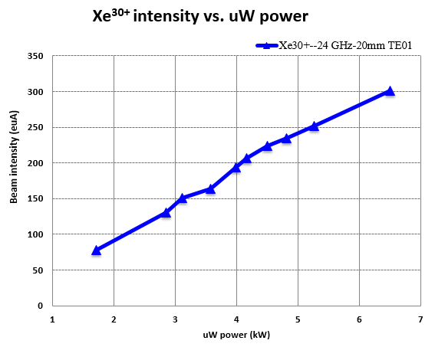
Power Scaling Laws
SECRAL Xe²⁷⁺ and Xe³⁰⁺ scale linearly with power
TE₀₁ , ∅ waveguide 32mm
TE₀₁ , ∅ waveguide 20 mm

Slide 5
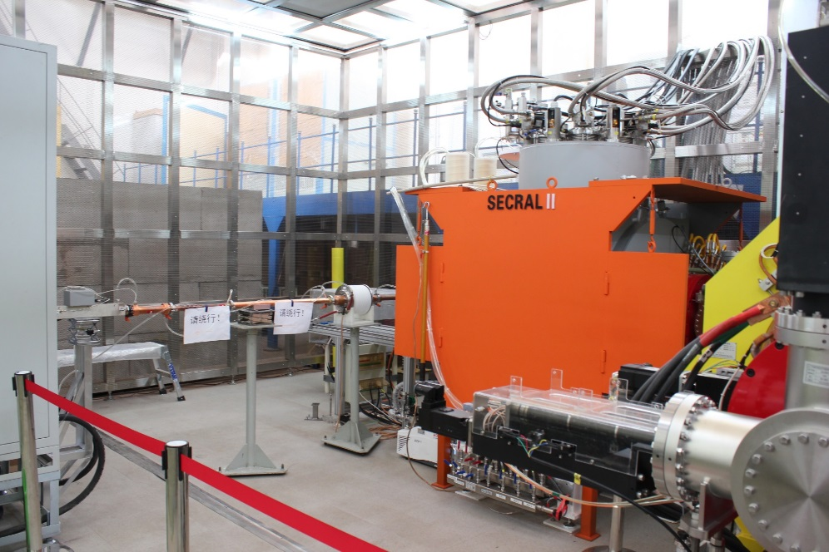
SECRAL-II
28 GHz Superconducting ECR Ion Source
High power operation
 | SECRAL-II（eμA）
Ar¹⁶⁺ | 620
Ar¹⁷⁺ | 130
Xe³⁰⁺ | 365
Xe³⁴⁺ | 110
Frequency ： 28 + 18 GHz
Max. Power ：10 + 2 kW
Parameters | SECRAL-II
ω_{rf} (GHz) | 18-28
Axial Field Peaks (T) | 3.7 (Inj.), 2.2 (Ext.)
Mirror Length (mm) | 420
B_{r} at r=63 mm (T) | 2.06
Magnet Cooling | LHe bathing
Dynamic cooling power (W) | ~6
Warm bore ID (mm) | 142 .0
Chamber ID (mm) | 125.0（B_{r}=1.96T）

Slide 6
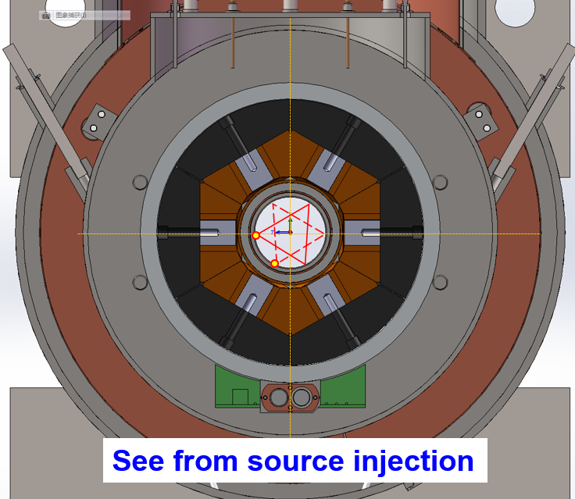
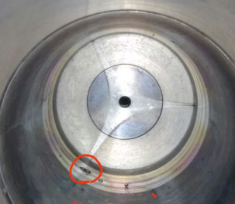
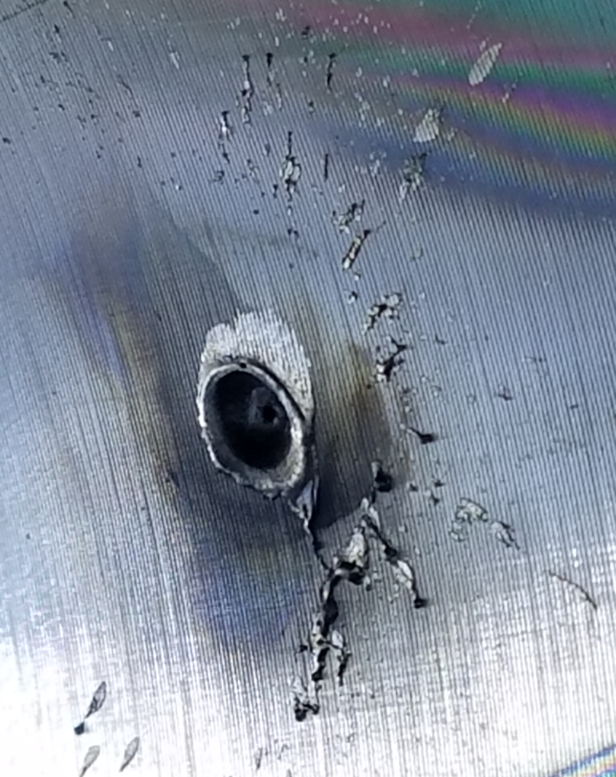
Plasma chamber burnout
The plasma chamber cooling has become a serious obstacle for high power operation
SECRAL-II (2019) 6.5kW (24GHz)+1.7kW (18GHz)
Injection: 2 times
Extraction: 7 times
VENUS chamber was burned out twice
（D. Z. Xie, ECRIS2016）

Slide 7
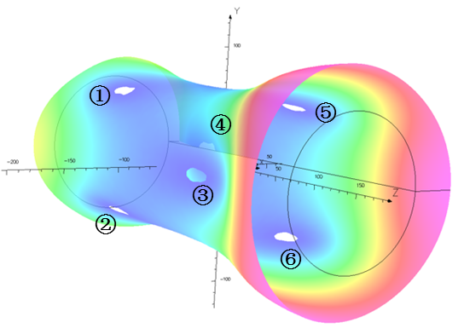
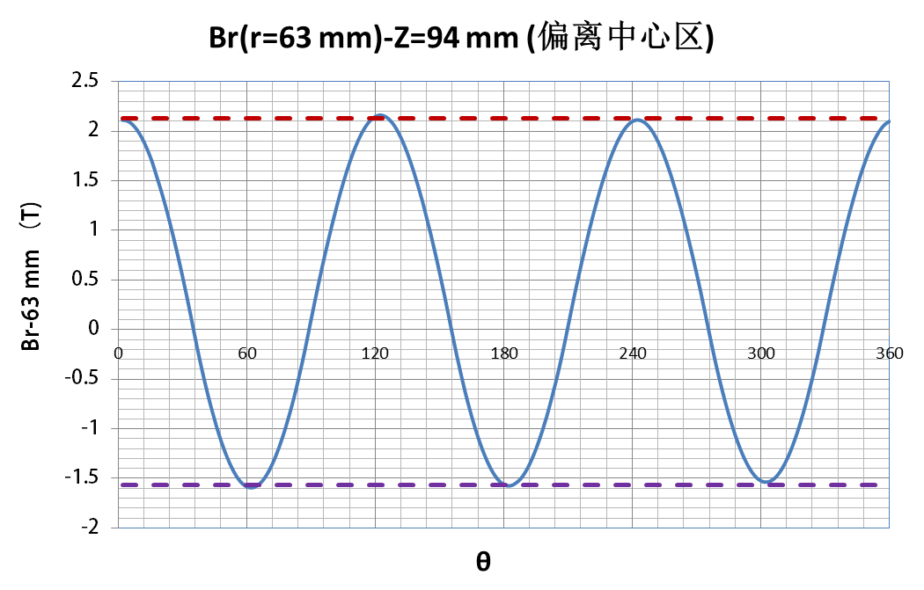
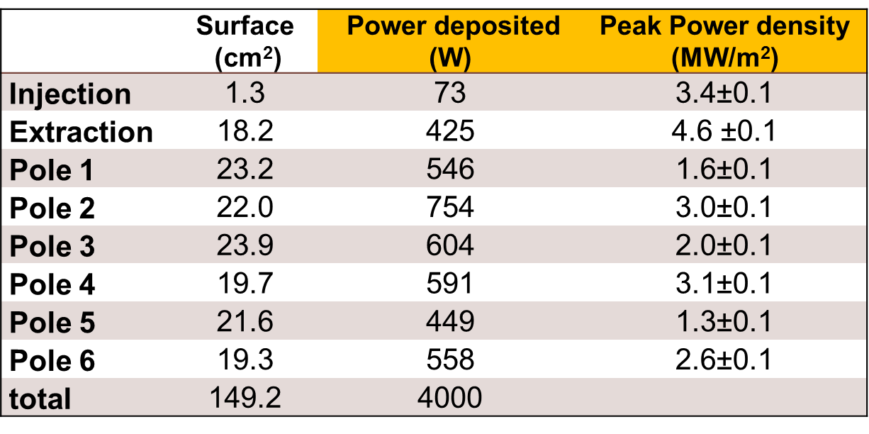
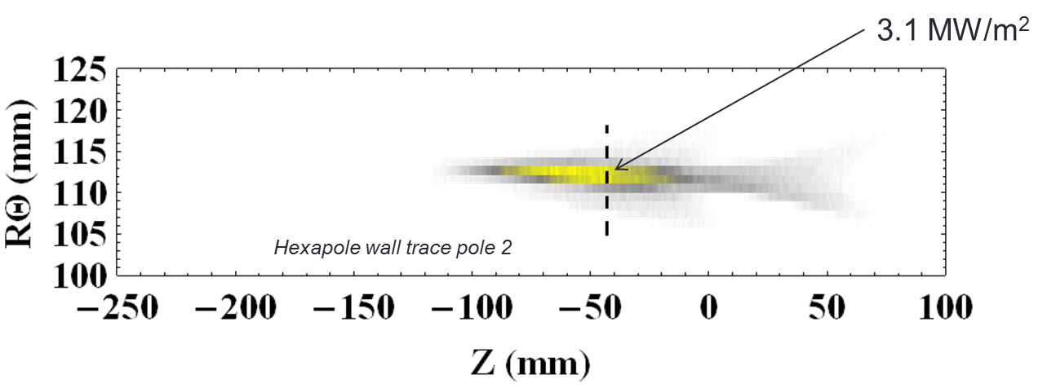
Origin of plasma chamber burnout
6 points where the magnetic field is weakest
SECRAL-II (machining error during wire winding)
Minimum B field
Ave.
Extraction: -2.0%
P=4 kW，1x1 mm² pixel
T. Thuillier, et al., Rev. Sci. Instrum. 87, 02A736 (2016)

Slide 8
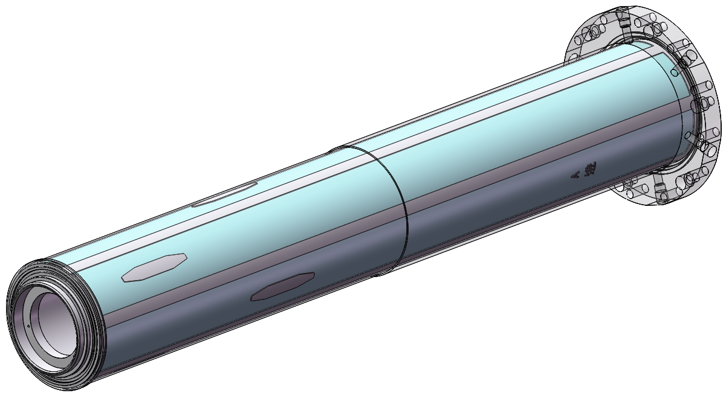
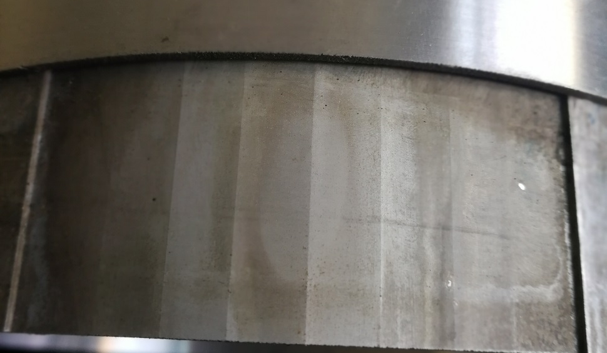
Main reason of plasma chamber burnout
Very high heat flux
Power density：≈ 1 kW/cm² Very high heat flux !!!
Power ：12 kW
The overall cooling capacity is sufficient to remove much more than 12 kW power. (Total flow rate:15 L/m, ΔT=11.4 ℃）
Water flow
>160℃
θR=8 mm
Z=20 mm
Water pressure：6 bar
Boiling point：≈150 ℃
Obvious over heating mark in at the surface of cooling water channel.
Size of overheating area ＜ 8 * 20 mm

Slide 9
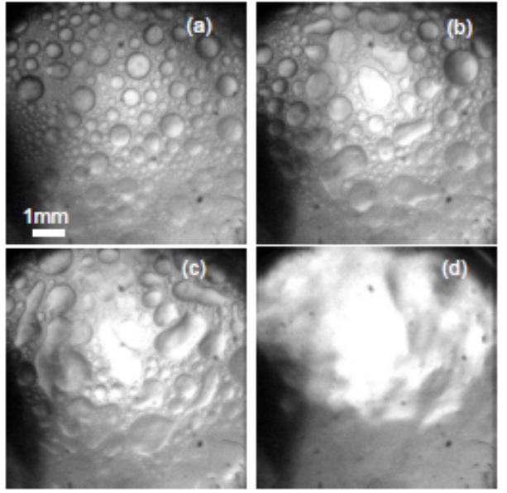
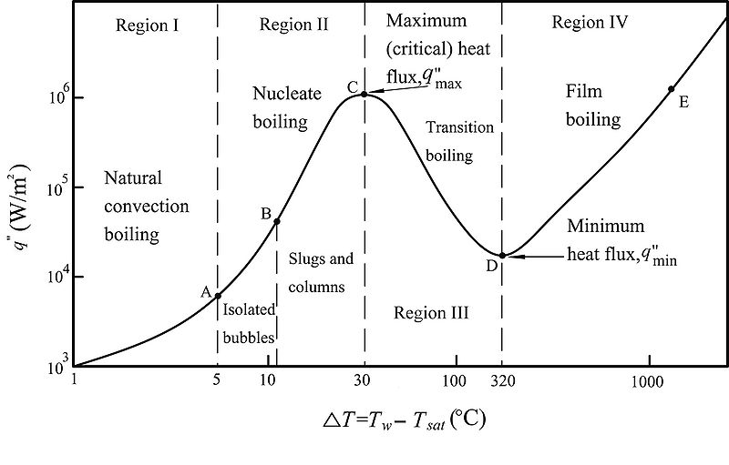
Origin of wall destruction
Transition from nucleate boiling to film boiling
Nucleate boiling
film boiling
Bubbles coalescence→ surface dryout →
Rapid surface temperature increase
Nukiyama curve for Pool boiling
CHF (Critical heat flux) point at Twall ≈ 30 + 150 = 180 ℃

Slide 10
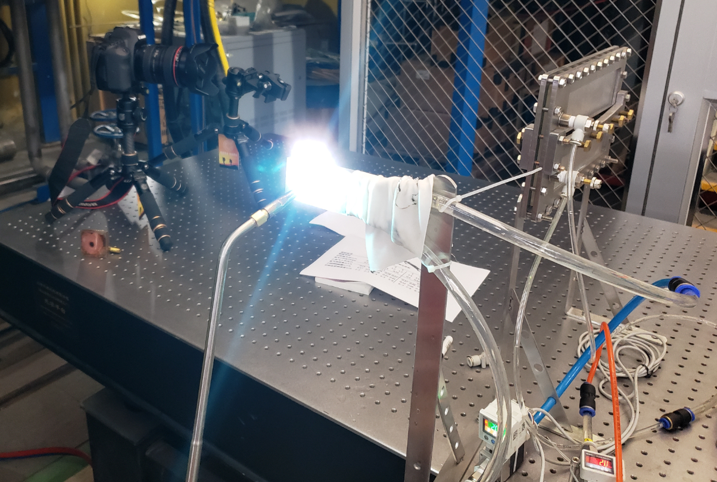
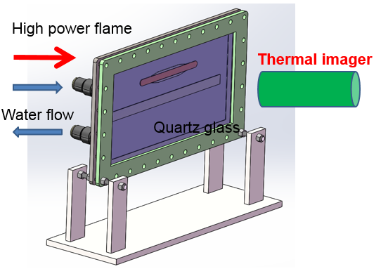
Thermal testing platform
oxy-acetylene flame

Slide 11

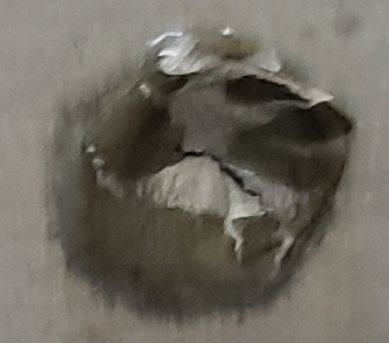
The burnout process of plasma chamber
Transition from nucleate boiling to film boiling
As the heat flux is too high, the local water boils completely.
The heat exchange decreases and the aluminum temperature rises rapidly，then burnout.

Slide 12
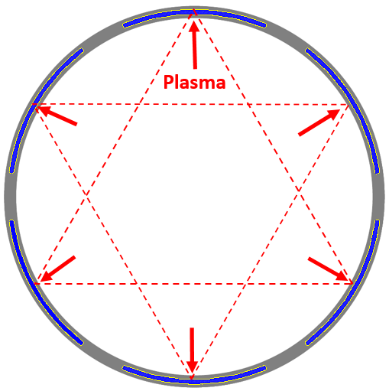
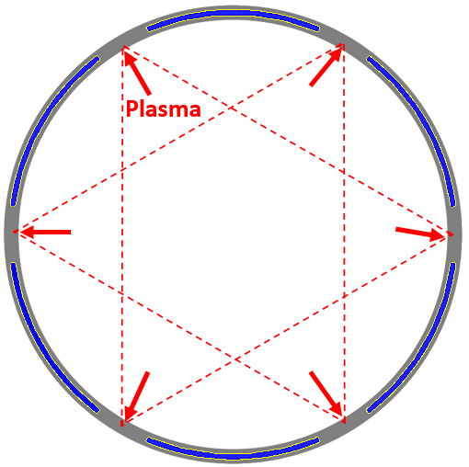
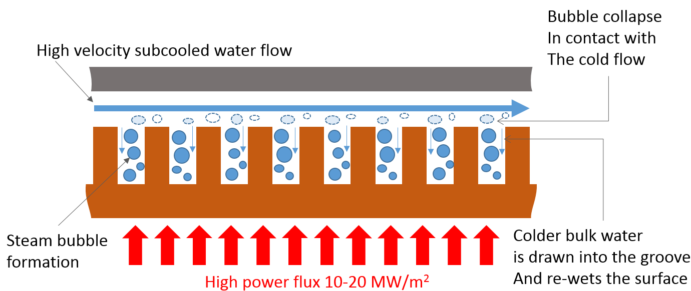
Cooling & Structure Optimization
Goal : to enhance heat transfer
Plasma flux to the water channel
Plasma flux to the solid aluminum (rotating 30°of the chamber)
Plasma flux to the Additional bar
Water flow
Plasma flux
Additional aluminum bar
c
a
b
Thuillier Proposed an hyper-vapotron cooling schemes ，but it requires a total thickness for the plasma chamber of ~20 mm.
T. Thuillier, et al., Rev. Sci. Instrum. 87, 02A736 (2016)
Notes:
Need more efficient cooling solutions to deal with high heat flux！！！

Slide 13
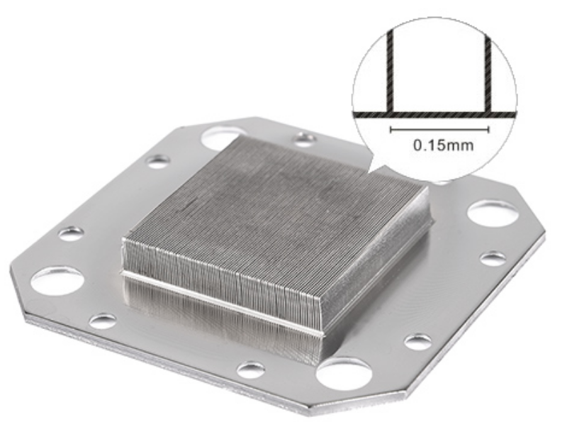

Microchannel cooling
Technically it means using a micro-fluidics device as heat exchanger for the thermal management of a heat source
Microchannel：D< 1 mm
Power
Surface ↑
$$P=h\left(T\right)×S×∆T$$
Temperature difference
Between water and metal
Heat exchange
coefficient ↑
Features:
Very thin thickness
High power flux (0.5-2 kW/cm²)
Acceptable pressure drop
D.B. Tuckerman, R.F.W. Pease, High performance heat sink for VLSI,IEEE Electron Dev.Lett.EDL-2(5)(1981)126-129.
Micro Channel Cooling seems to be an excellent solution

Slide 14
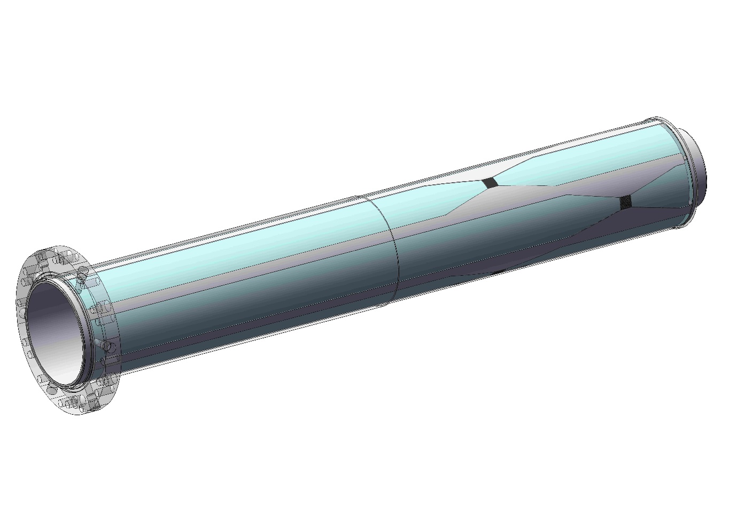
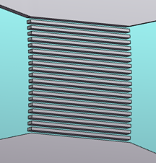
Plasma chamber with microchannel cooling
The microchannel structure is set up in the 6 high heat flux poles
52 mm
Water flow
Parameters that need to be optimized
Water channel thickness
Chamber wall thickness
Pressure loss and flow velocity
Water flow rate
15.6 * 15 mm
Fins: 0.4 mm*19
Channel: 0.4 mm *20

Slide 15
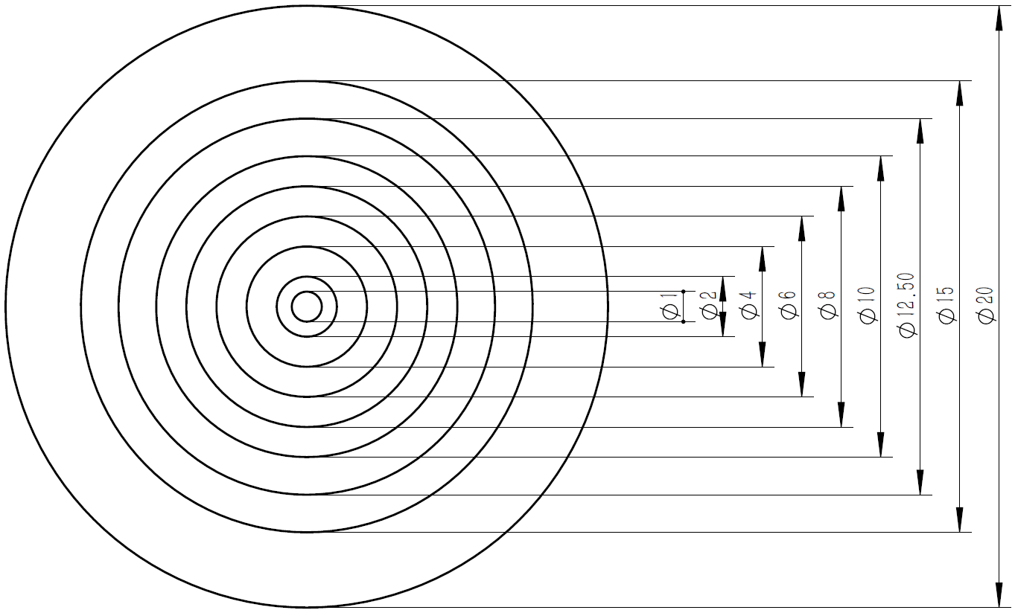

Simulation conditions
Total power at each pole:≈ 1 kW Max. power density：≈ 1 kW/cm²
Uniform power density distribution
Power density：1 kW/cm²，Surface: 100 mm²（φ11.28 mm），Power : 1 KW
Gaussian power density distribution
Max. power density：1 kW/cm² ，Surface: 314 mm²（φ20 mm）, Power : 1 KW
 | Surface (cm2) | Power (W) | Power density (MW/m²)
φ1 | 0.79 | 8.14 | 10.3038
Φ2-φ1 | 2.36 | 24.04 | 10.1864
Φ4-φ2 | 9.42 | 90.72 | 9.63057
Φ6-φ4 | 15.71 | 133.52 | 8.49905
Φ8-φ6 | 21.99 | 155.12 | 7.05412
Φ10-φ8 | 28.27 | 155.53 | 5.50159
Φ12.5-φ10 | 44.18 | 170.29 | 3.85446
Φ15-φ12.5 | 54 | 128.24 | 2.37481
Φ20-φ15 | 137.45 | 134.39 | 0.97774
total | 314 | 1000

Slide 16
Water channel thickness
Uniform power density distribution
Al 6061-T6, Flow rate: 7 L/min, Chamber wall thickness: 1.5 mm, Channel height：1 mm

Slide 17
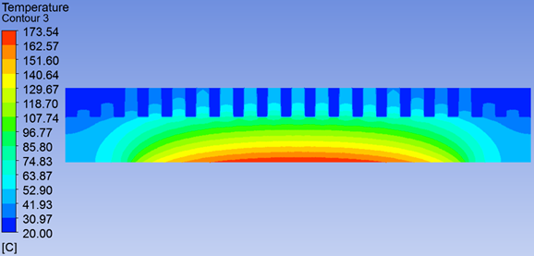
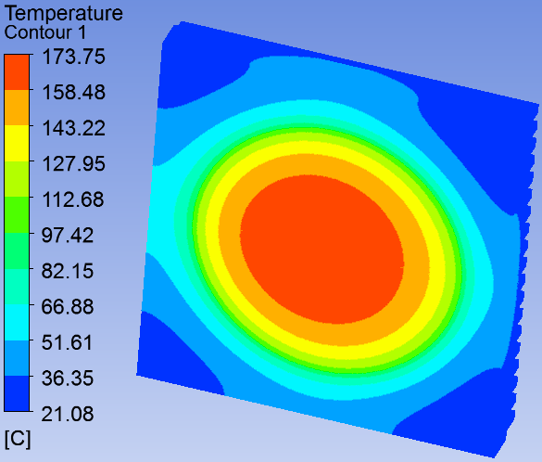
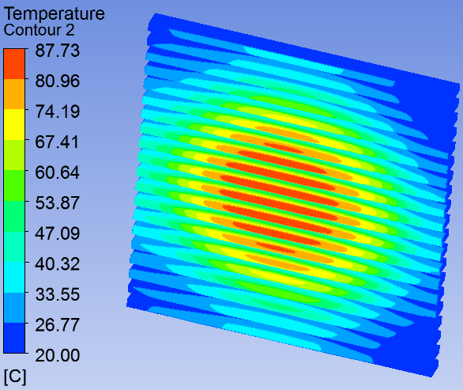
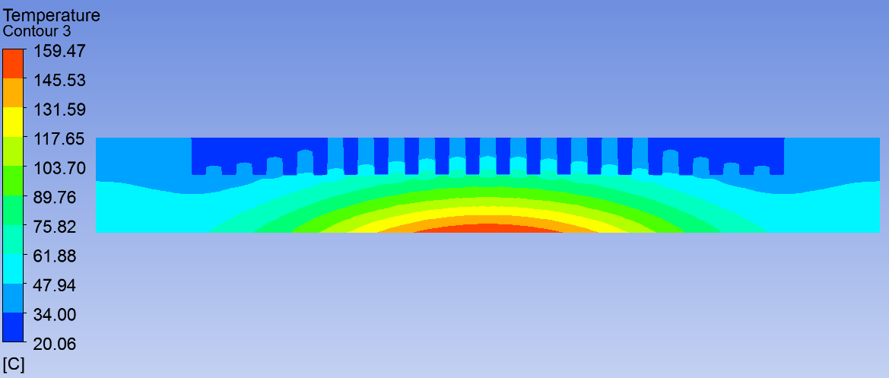
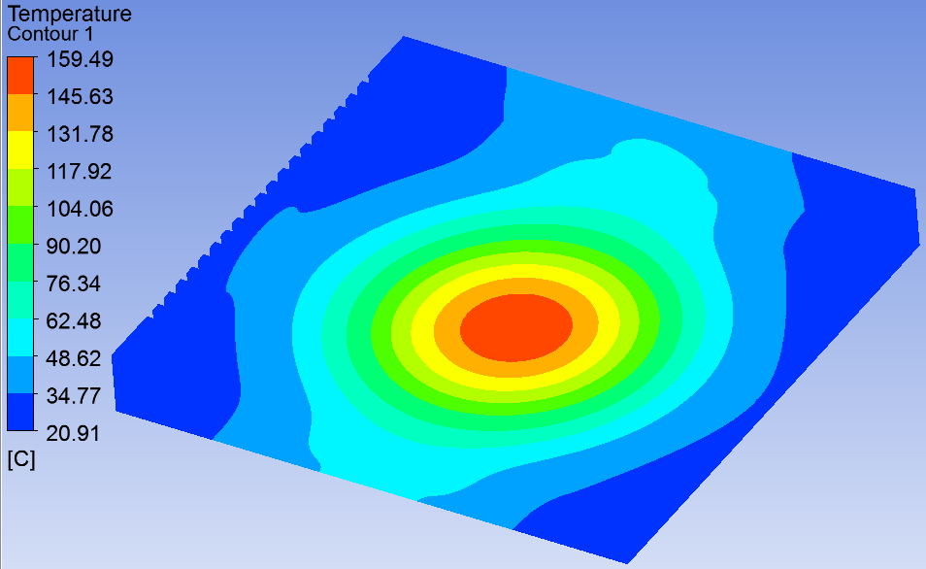
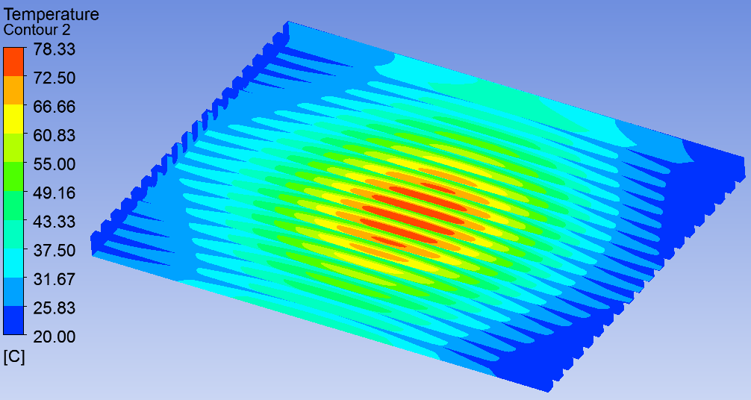
Temperature distribution
Al 6061-T6, Flow rate: 7 L/min, Chamber wall thickness: 1.5mm
Microchannel: 0.4 mm *20, Channel height：1 mm
 | Power density distribution | T _{max} chamber | T _{max} water
1 | Uniform (φ11.28 mm) - 1 kW/cm2 | 174℃ | 88℃
2 | Gaussian (φ20mm)- 1 kW/cm2 | 159℃ | 78℃
1
1
1
Plasma
2
2
2
Plasma
Cross section
Inside-wall
Water

Slide 18
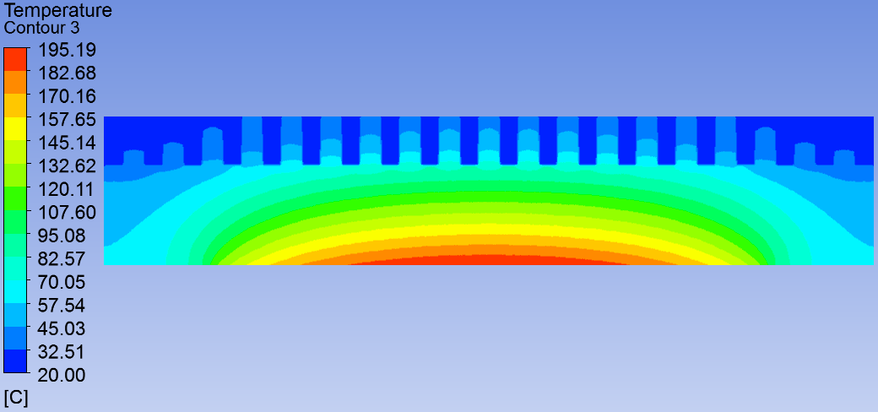

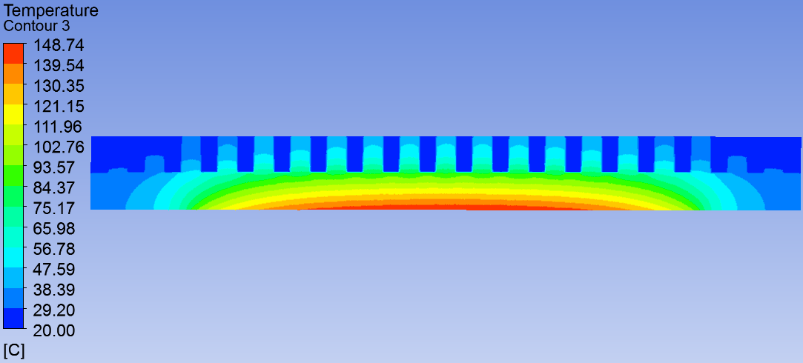
Chamber wall thickness
Uniform power density distribution
Al 6061-T6, Flow rate: 7 L/min,
Microchannel: 0.4 mm *20, Channel height：1 mm
Plasma
Plasma
2.0
1.5
Plasma

Slide 19
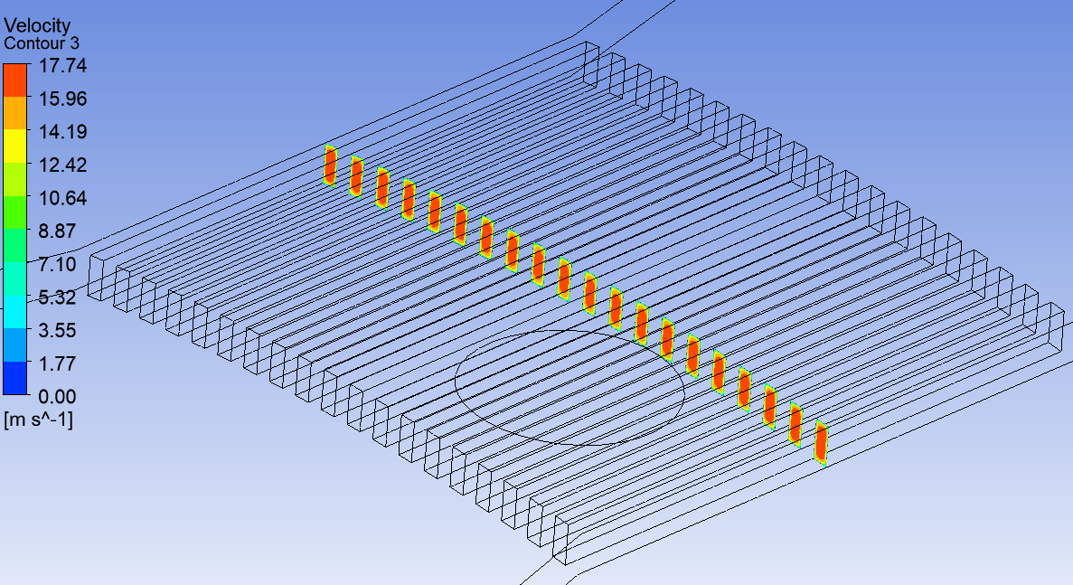
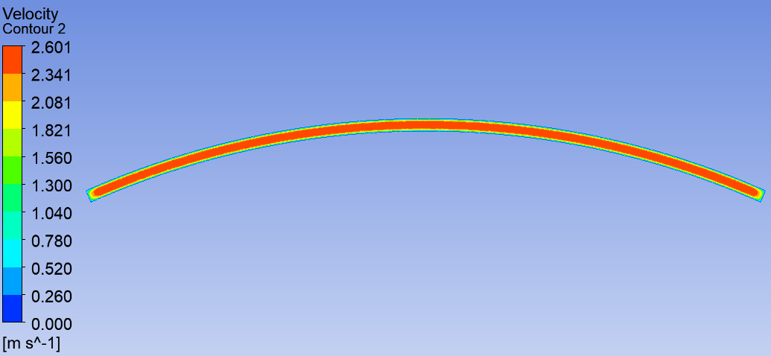
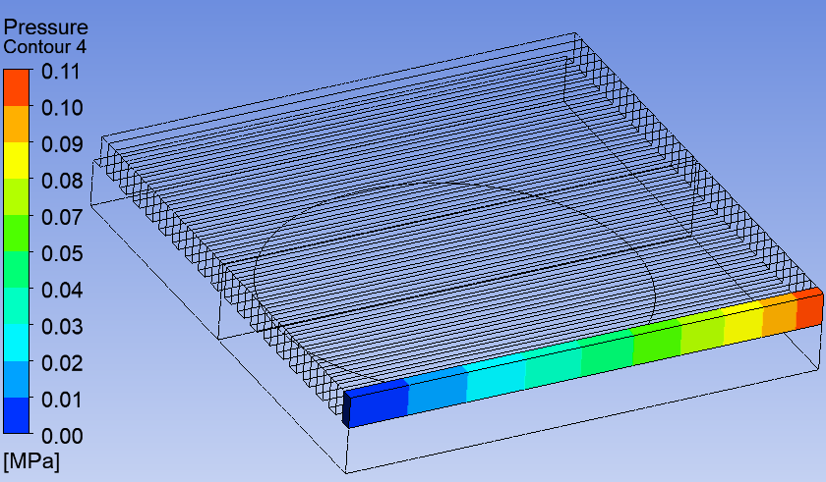
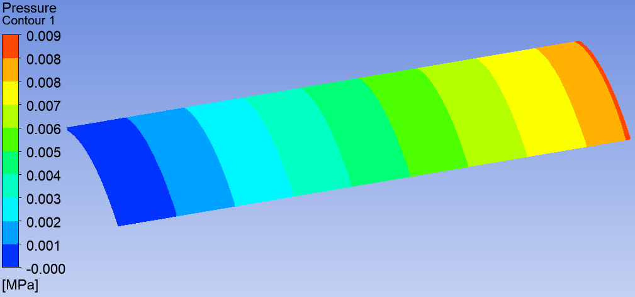
Water pressure drop & flow velocity
Microchannel: 0.4 mm *20, Channel height：1 mm, Flow rate: 7 L/min
Maximum flow velocity: 18 m/s
Maximum flow velocity: 2.6 m/s
Usual channel
Pressure drop: 0.11 Mpa
Pressure drop: 0.009 Mpa
(52*1*150mm)

Slide 20
Water flow rate
Uniform power density distribution
Microchannel: 0.4 mm *20, Channel height：1 mm, Chamber wall thickness: 1.5 mm

Slide 21
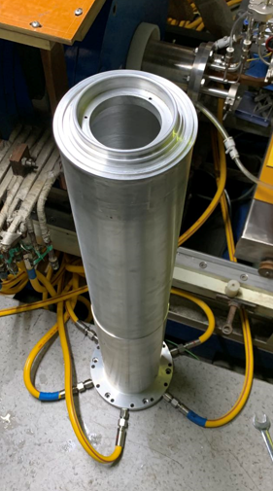
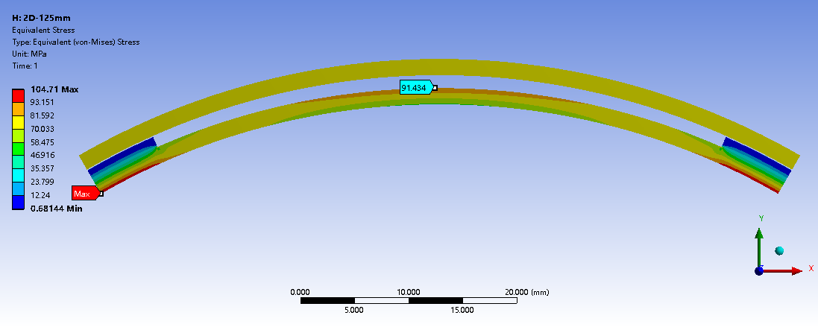
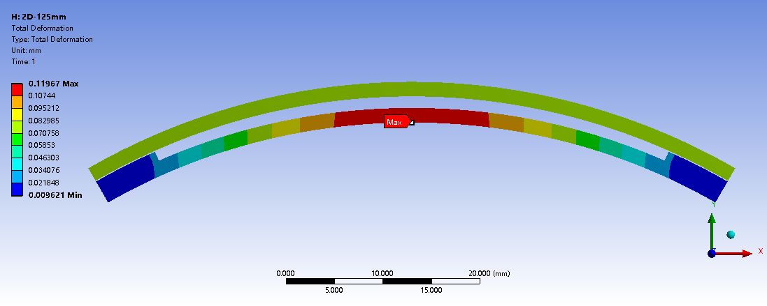
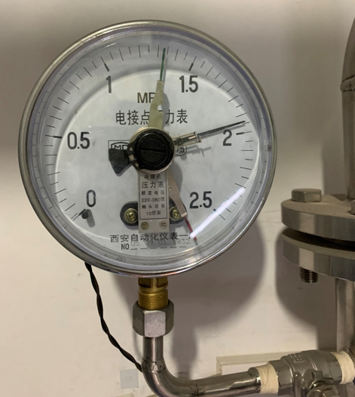
Strength analysis
Maximum pressure：2.0 MPa
Al 6061-T6 Yield strength: 100 MPa (@200 ℃);
Maximum yield strength:104 Mpa
Maximum deformation: 0.12 mm

Slide 22
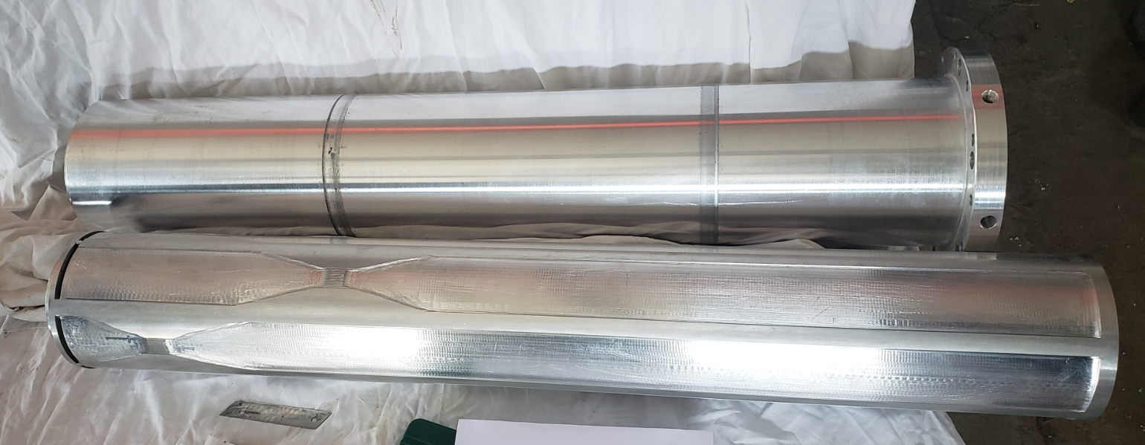
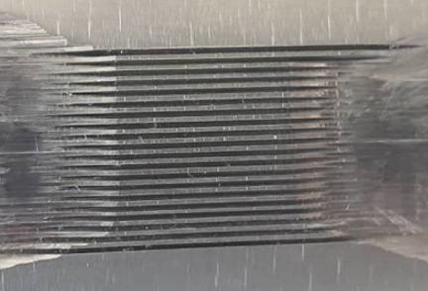
Plasma chamber with microchannel cooling
Water pressure (Bar) | Flow rate Channel A (L/m) | Flow rate Channel B (L/m) | Flow rate Channel C (L/m)
8.9 | 4.3 | 4.2 | 4.6

Slide 23
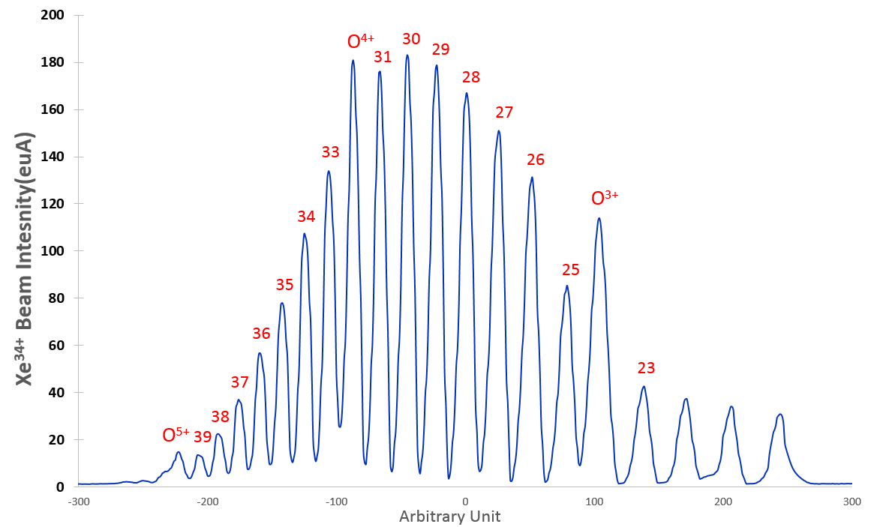
High power operation
SECRAL-II operate at the maximum power of the microwave system
ω_{rf}: 24 +18 GHz
Pw= 9.3 + 1.7 kW
Xe³⁴⁺=106 eμA Io= 2.7 emA
HV= 20 kV, Slit-x= 20 mm
B: 3.41 T, 0.6 T, 1.8 T, 1.87 T
2020/09/18

Slide 24
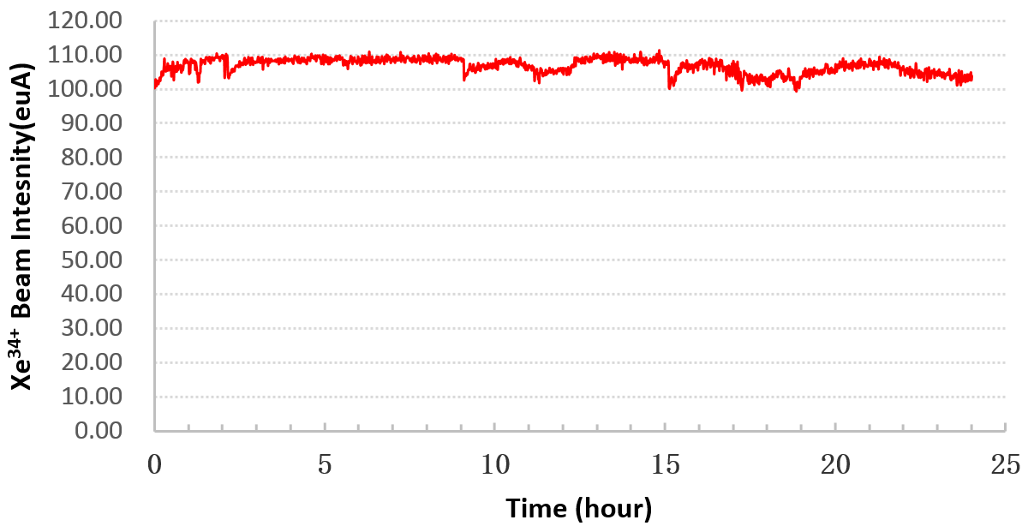
High power operation
Reliable operation at total power 11 kW for more than 48 hours, including 24 hours for Xe³⁴⁺

Slide 25
Summary
The efficiency of microchannel cooling embedded in plasma chamber of ECRIS at high power operation is demonstrated at IMP
The breakthrough of plasma chamber cooling can make high power (>10 kW) operation reliable
Microchannel cooling technology is the promising solution for chamber cooling of the fourth-generation ECR ion source with power of 20 kW

Slide 26
Thanks for your attention!

