Slide 1


Study on correlation between Energy Distribution of Electrons Lost from the Confinement and Plasma Bremsstrahlung on a min-B ECR Plasma
Bichu Bhaskar, Hannu Koivisto, Olli Tarvainen, Thomas Thuillier, Ville Toivanen, Taneli Kalvas, Ivan Izotov, Vadim Skalyga, Risto Kronholm, Miha Marttinen

Slide 2
Aim and motivation
To gain a better understanding of electron population dynamics in ECR plasmas by combining multiple diagnostics methods.
  Bremsstrahlung (Radial and axial)
  Lost electron energy distribution (LEED)
To find the evolution of the spectra as a function of ECR operational parameters – here we focus on microwave power and magnetic field strength.
To find the effect of instability on the spectra.

Slide 3
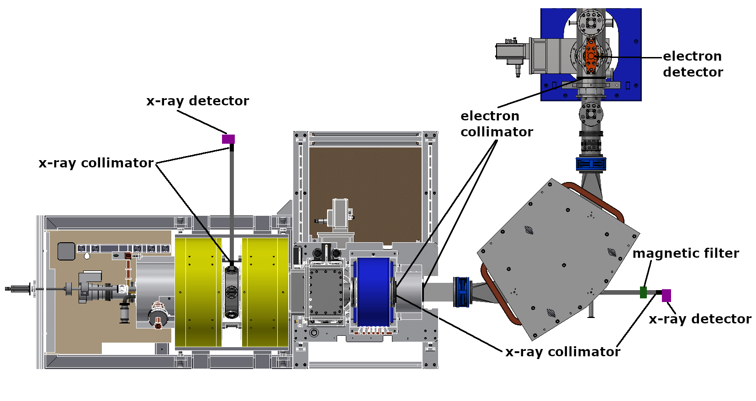
Experimental setup and procedure
Installed X-ray detector.
Installed electron detector detector.
Dipole polarity was reversed w.r.t normal operation and ramped to obtain energy distribution lost electrons.
JYFL 14 GHz ECR-2
Min-B confinement topology with 2 solenoids and hexapole

Slide 4
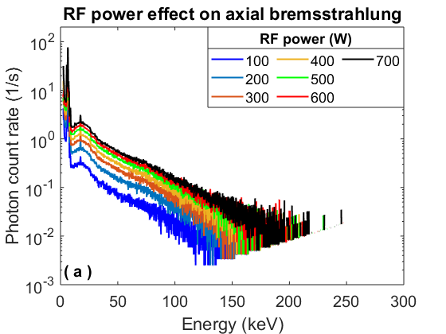
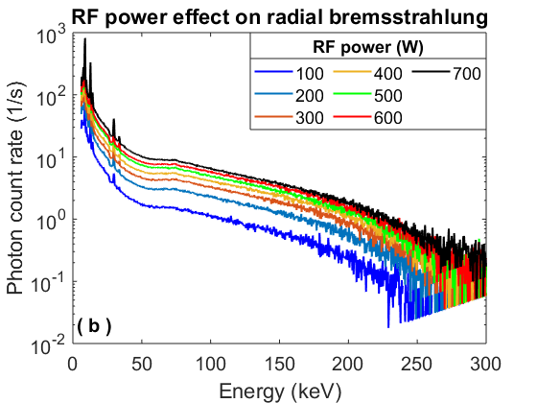
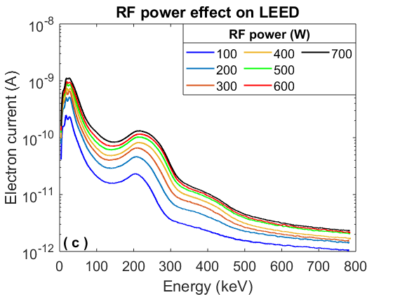
Influence of microwave power
Varied microwave power alone, keeping all other parameters constant
The shape of the spectra is not changing and only the total signal level changes, which suggests that the microwave power affects the plasma density and not EED.

Slide 5
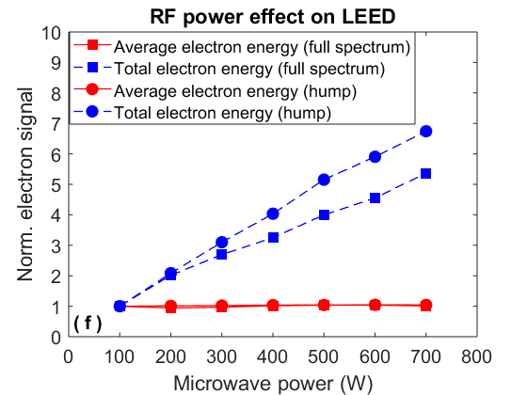
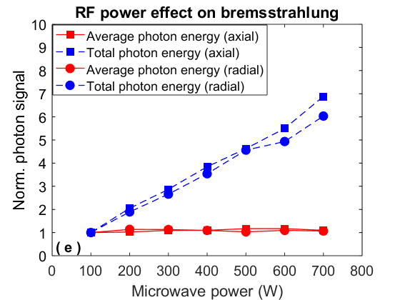
Influence of microwave power
The LEED and bremsstrahlung shows a prominent correlation in case of the effect of microwave power .
Effect of increased plasma density increases plasma bremsstrahlung and thus increases coulomb and RF scattering as observed in LEED.
Microwave power shows no effect on electron energy distribution.
a
b
LEED
Bremsstrahlung

Slide 6
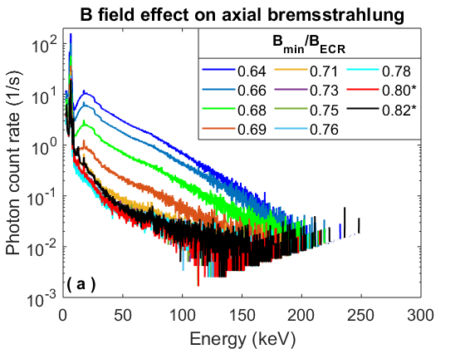
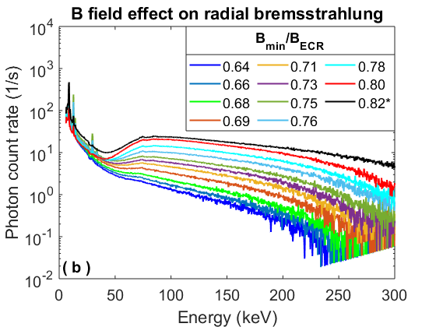
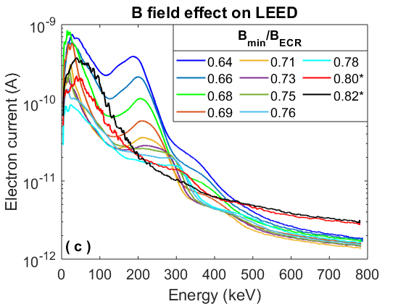
Influence of magnetic field
Varied injection and extraction magnetic field symmetrically, keeping all other parameters constant
The intensity of axial bremsstrahlung spectra decreases whereas its vice versa for radial bremsstrahlung spectra.
The high energy hump in LEED is observed to be the most influenced parameter in the LEED.
Instability was observed to happen at very high magnetic field strength.

Slide 7
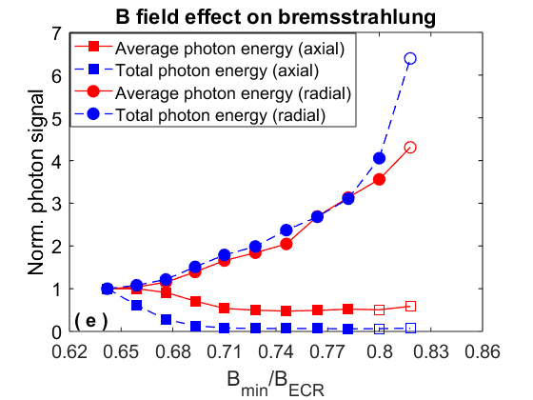
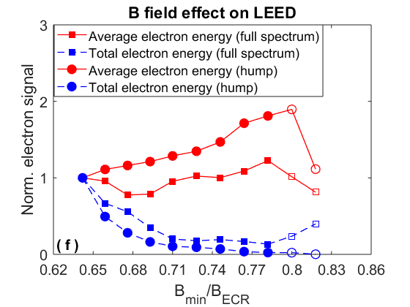
Influence of magnetic field
Total photon energy in the radial bremsstrahlung spectra increases with magnetic field and vice versa in case of axial bremsstrahlung .
It can be correlated with anisotropy of EED since increase in B-field decreases average magnetic field gradient of ECR surface , thus increases energy density and transverse velocity ( v⏊ ) of electrons.
Thus increases bremsstrahlung energy in the radial direction since increase in electron energy favors bremsstrahlung in forward direction (relativistic effect).
The decrease in electron signal LEED also suggests redistribution of electron losses towards radial direction which is also supported by single electron tracking simulation.
Instability is found to have a prominent effect on high energy hump in LEED, however there is no prominent effect in the bremsstrahlung spectra.

Slide 8
Thank you for your attention.

