Slide 1
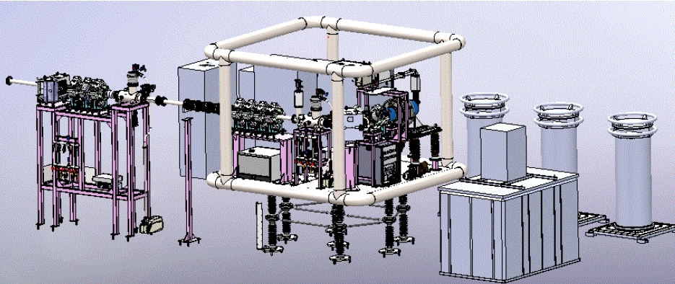


Characterization of 2.45 GHz ECR Ion Source Bench for Accelerator-Based 14-MeV Neutron Generator
SUDHIRSINH VALA
INSTITUTE FOR PLASMA RESERCH
GANDHINAGAR-GUJARAT, INDIA

Slide 2
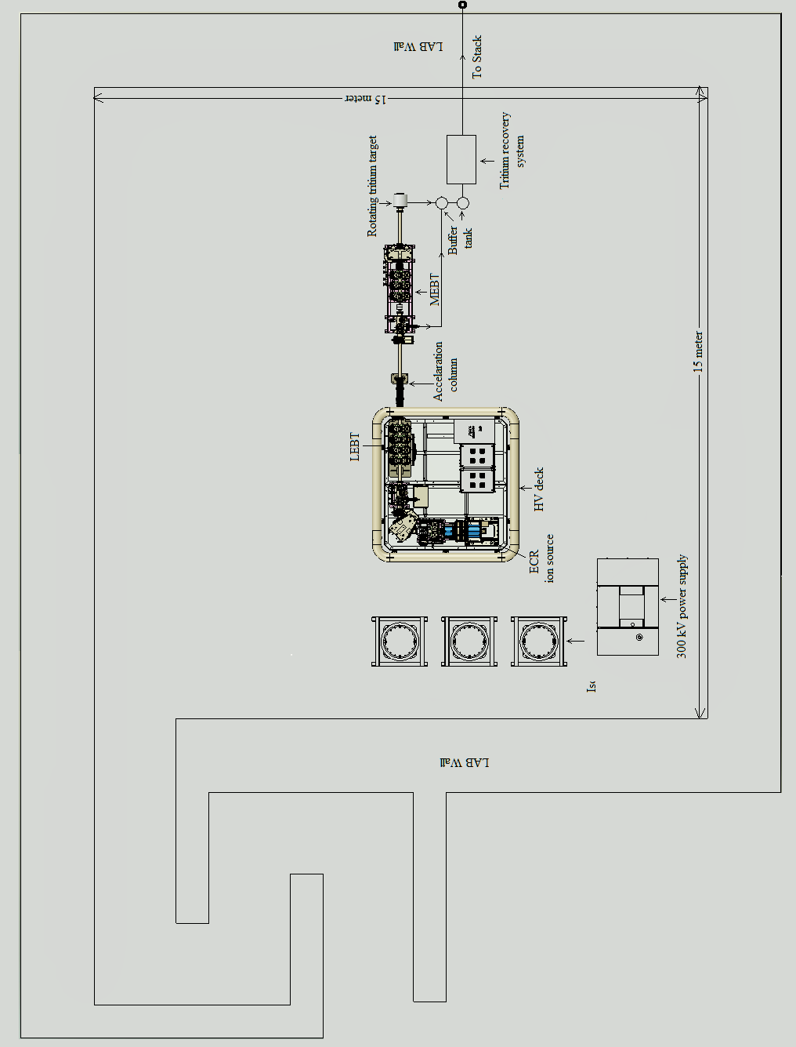
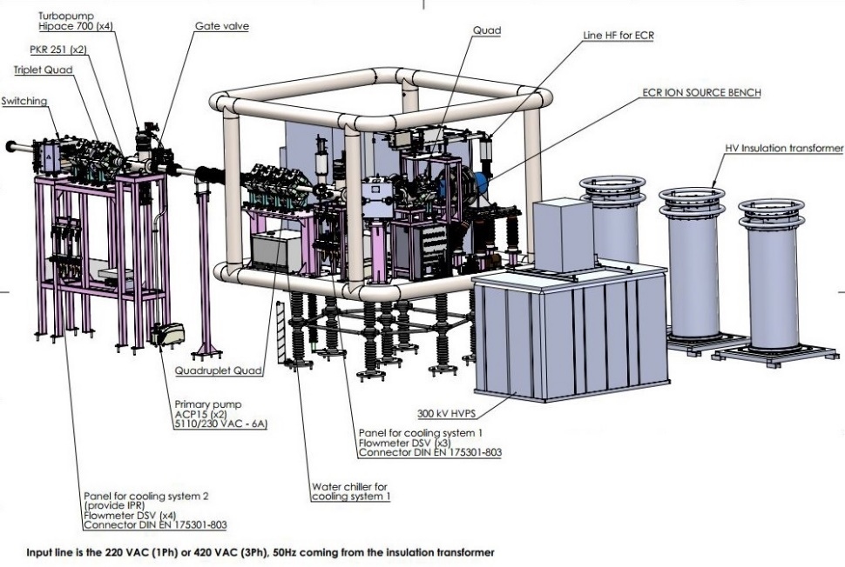
Upcoming 14-MeV neutron Facility at IPR
Parameter of 14-MeV Neutron Generator
Type of Machine | DC Electrostatic Accelerator
Max Acceleration Voltage | 300 kV
Type of Beams | D⁺ Ion
D+ Ion Current | 20 mA
Vacuum Pressure | 1 x 10⁻⁷ mbar
Target | Tritium, 140 Ci
Estimated Neutron Yield | ~ 1 -5 x 10¹² n/s
3D view of the 14-MeV neutron Generator

Slide 3
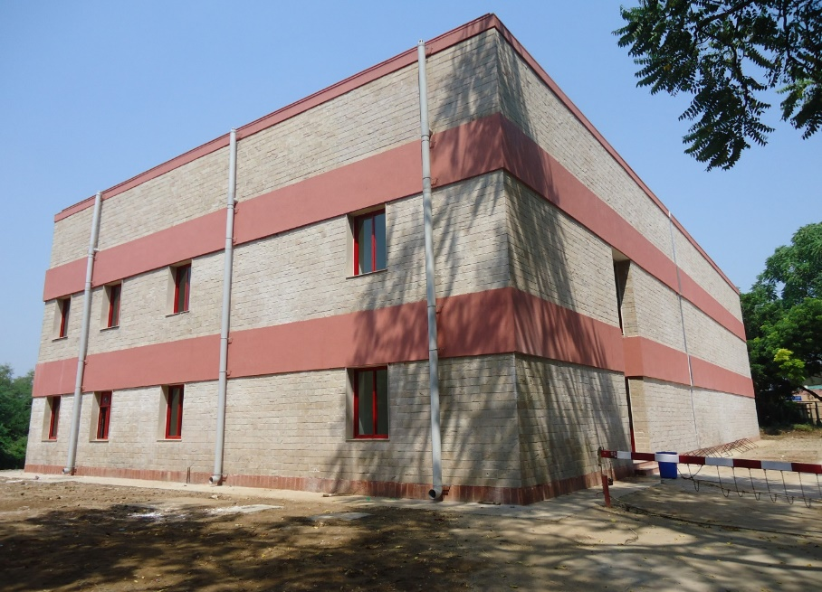
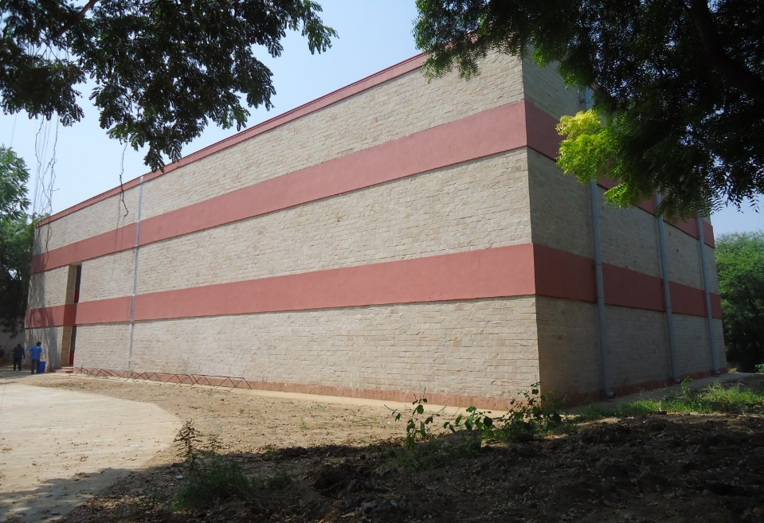
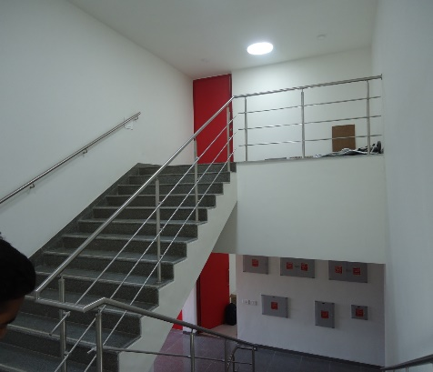
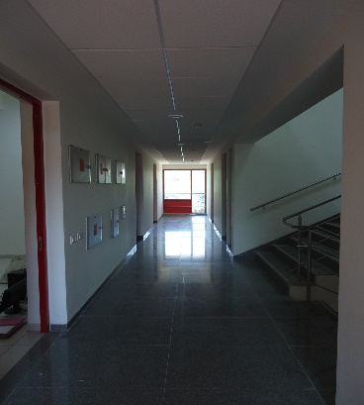
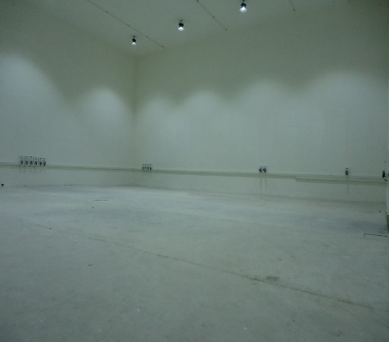
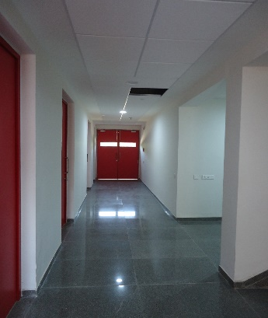
Neutron & Ion Irradiation Laboratory
Neutronics Laboratory Building South - East side view
Neutronics Laboratory Building East - North side view
Inside view of Neutronic Laboratory

Slide 4
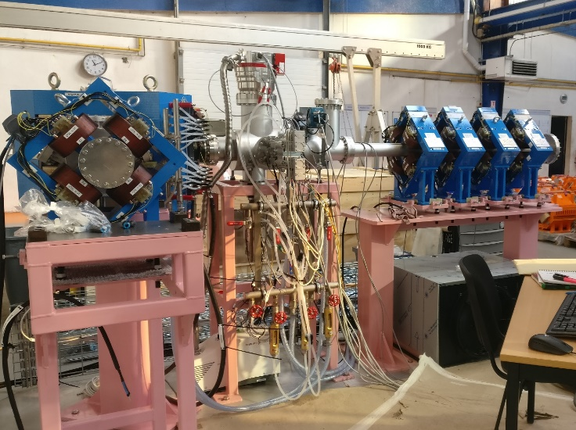
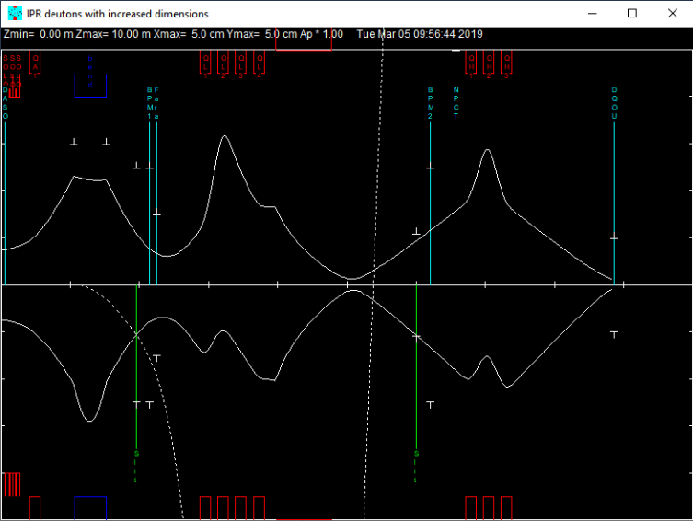
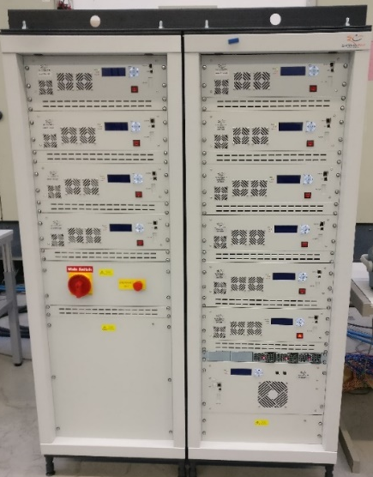
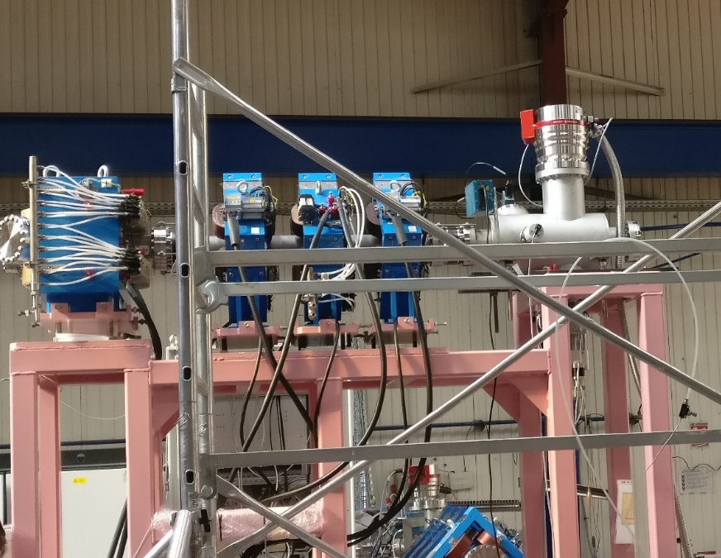
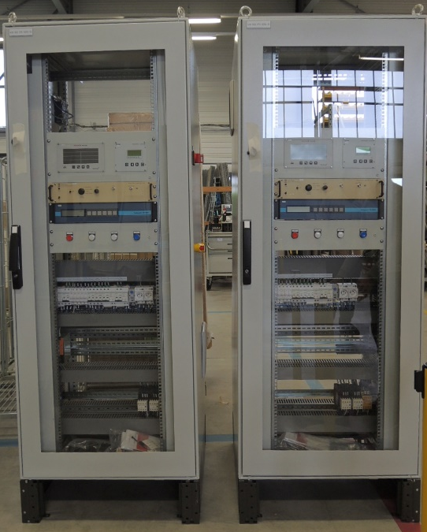
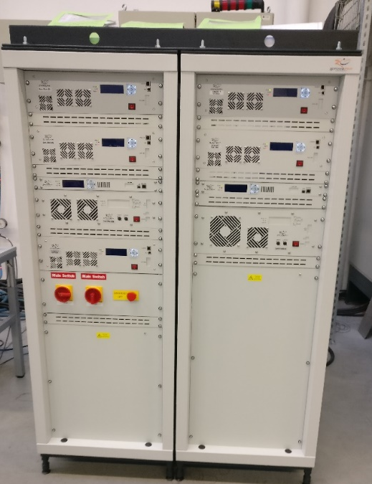
40 keV, Low Energy Beam line
Results of beam optics simulations
Magnet Power supplies for Beam line
340 keV, Medium Energy Beam line
Command & Control System
Magnet Power supplies for Beam line

Slide 5
2.45 GHz High Current Source
Parameter | GANIL FRANCE | SILHI (SPIRAL -2) FRANCE | CEA/Saclay (IFMIF) FRANCE | PKUNIFTY CHINA | LBNL USA
Microwave Power | 1200 Watt, 2.45GHz, | 1200 Watt, 2.45GHz | 2000 Watt, 2.45 GHz | 800 Watt, 2.45GHz | 700 Watt, 2.45GHz
Magnet System | Two Coaxial NdFeB permanent magnet Ring | Three Coaxial NdFeB permanent magnet Ring | Two solenoid configuration | Three Coaxial NdFeB permanent magnet Ring | Two solenoid configuration
Plasma Chamber | 90mm diameter, Water cooled | 90mm diameter, Water cooled | 90mm diameter, Water cooled | 40/50 mm diameter, OFHC Copper, with Al liner | 92mm diameter, Water cooled
Beam Optics | 4 electrode extraction system with 40 kV max, | 5 electrode extraction system with 50 kV max, | 5 electrode extraction system with 55 kV max, | 3 electrode extraction system with 50 kV max, | 3 electrode extraction system with 60 kV max,
Extraction aperture | 7mm | 3 mm | 9mm | 5mm | 3mm
Beam Emittance (π mm mrad) | 0.2 | < 0.1 | 0.25 | 0.2 | 0.04
Max Beam Current | 40 (P) | 10 (D) | 140(D) | 100(D) | 44(D)

Slide 6
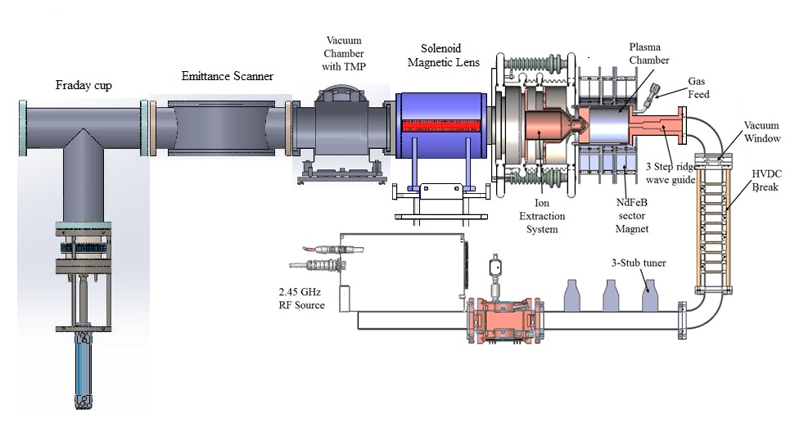
Schematic diagram of 2.45 GHz ECR ion Source bench

Slide 7
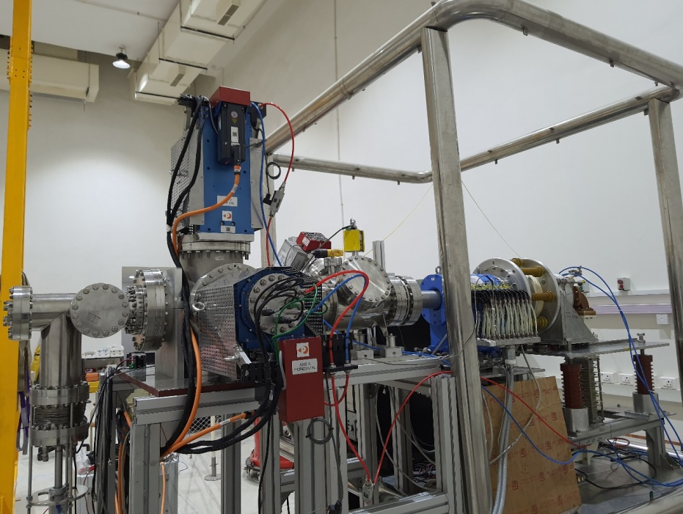
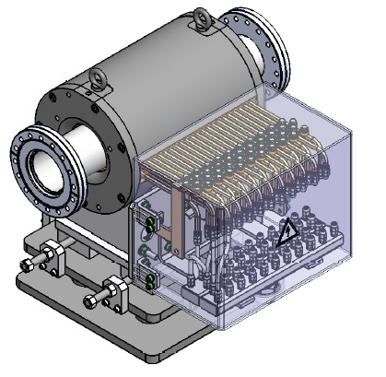
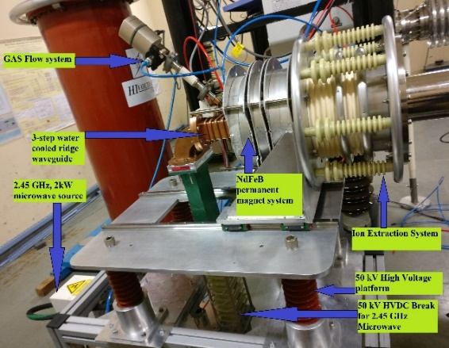
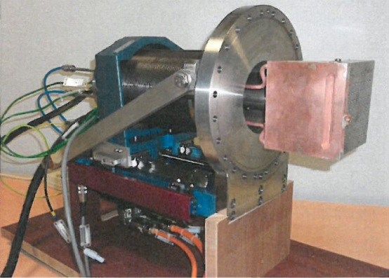
2.45 GHz ECR ion source bench at IPR
Magnetic lens, 0.350 T, 255mm, 40 mm half aperture
Allison scanner
2.45 GHz ECR Ion Source

Slide 8
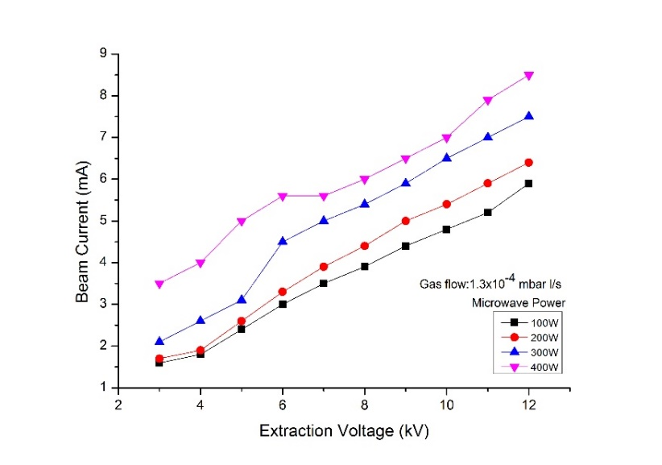
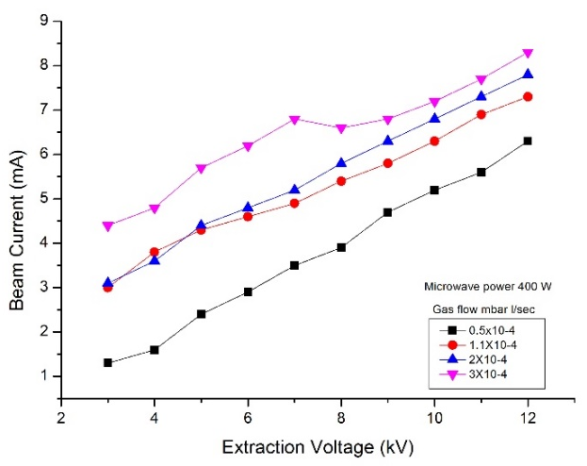
Results of ion beam Extraction
Measurement deuterium beam current as function extraction voltage & pressure (mass flow rate) with fix microwave power 400 W
Measurement deuterium beam current as function extraction voltage & microwave power

Slide 9
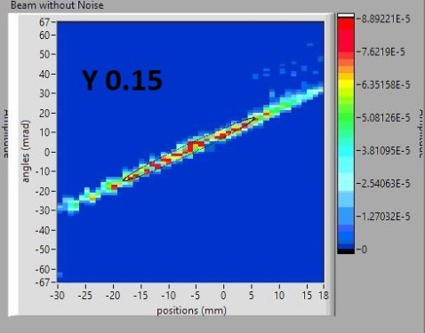
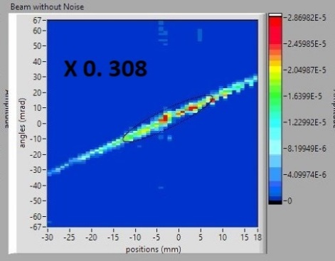
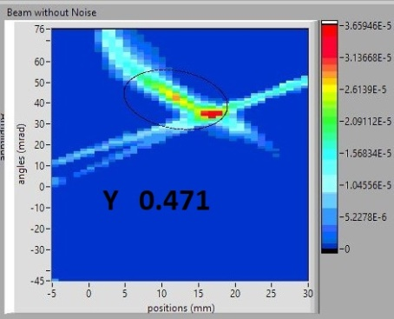
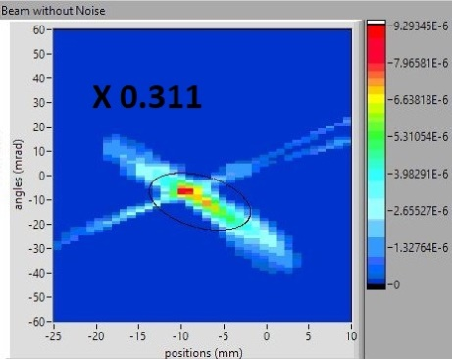
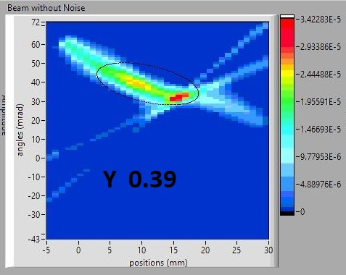
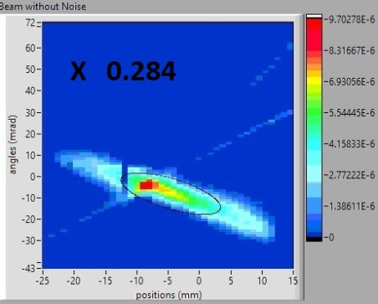
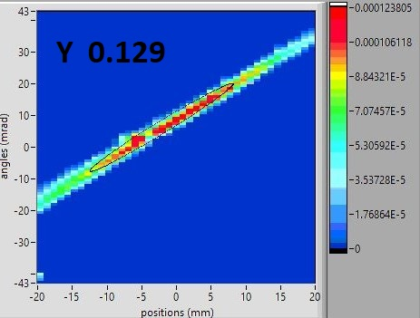
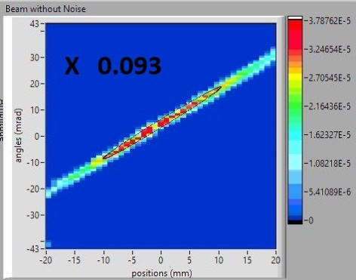
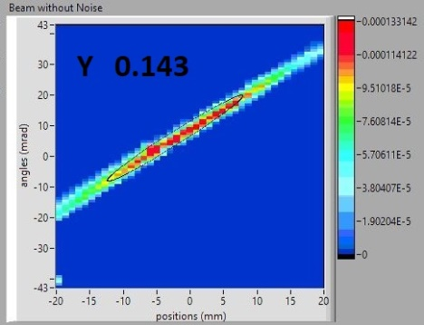
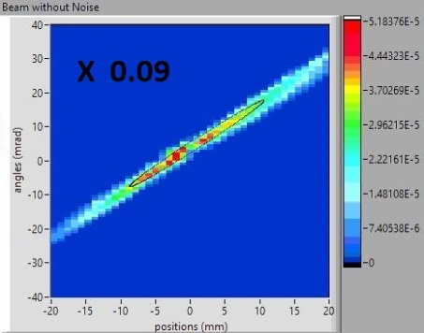
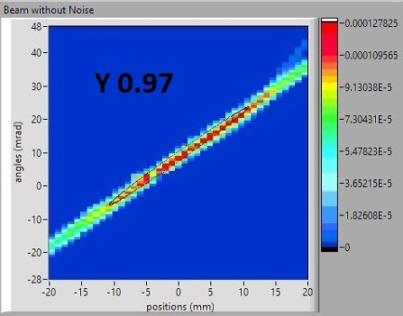
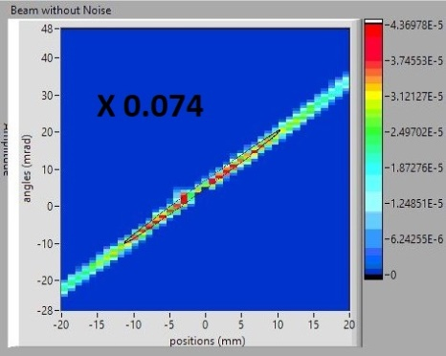
Results of Emittance measurements

Slide 10
Summary
For the better focusing of the ion beam into the LEBT, the Einzel lens has been replaced with the magnetic lens (Solenoid)
To measure the beam emittance dual Allison emittance scanner has been integrated into the test bench.
The beam characterization experiments have been successfully performed.
The beam emittance, as well as beam profile, have been measured as a function of solenoid current.
The normalized emittance is < 0.2 pi.mm.mrad
The beam diameter is < 20 mm

Slide 11


