Slide 1
… Stuff to do before…
²²⁹Pa-EDM
Prajwal T. MohanMurthy
Massachusetts Institute of Technology
PM@LECM,2025

Slide 2
Overview
Motivation
“Why look for CP violating EDMs? & the role of deformation”
Choice of Isotopes
“Which isotopes should we really focus on?”
Measurement of Deformation
“What are the shapes of these isotopes?”
Source of ²²⁹Pa
“How to get years of atoms?”
Summary

Slide 3
Motivation
§1
“Why look for CP violating EDMs?
& the role of deformation”

Slide 4
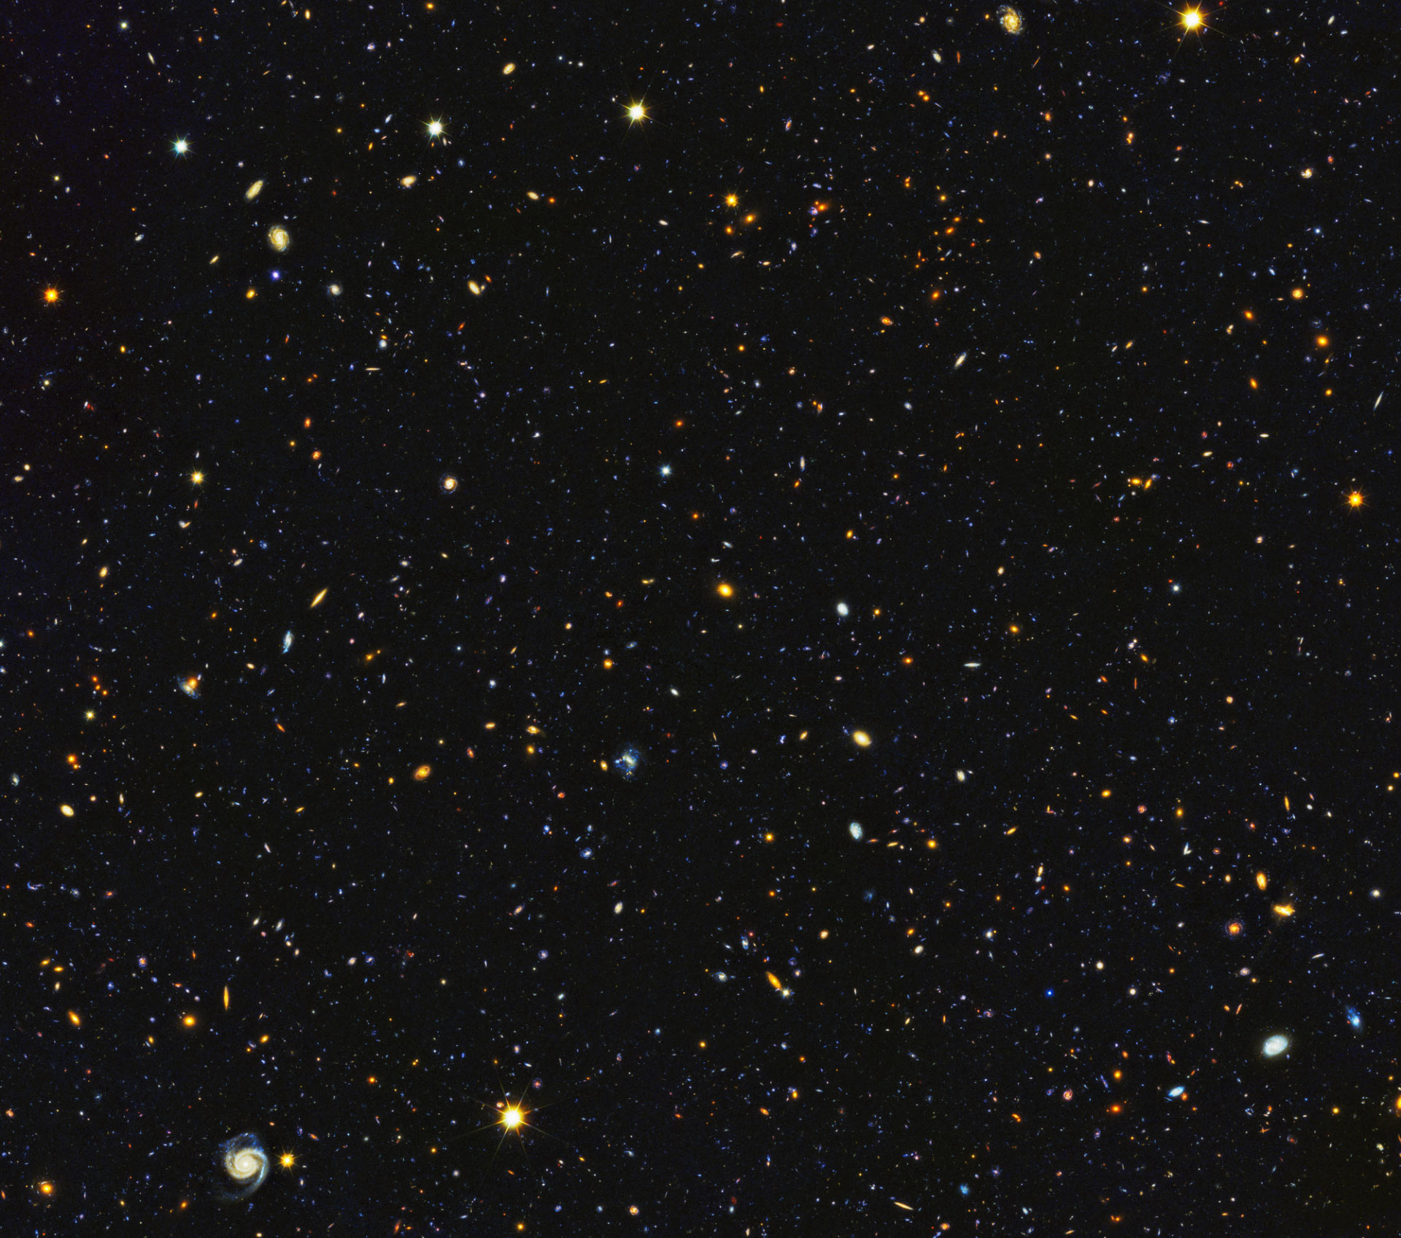
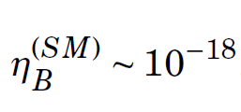
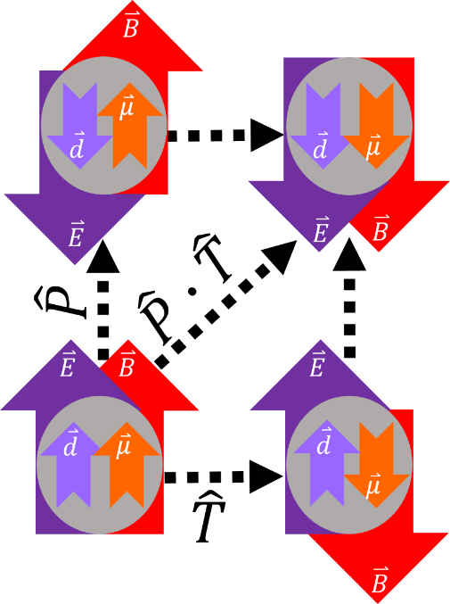
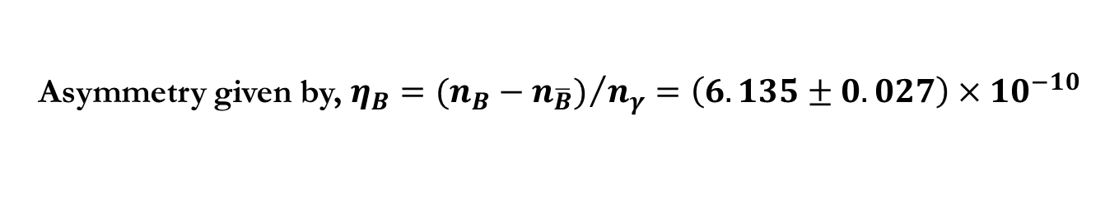
BAU
§1
Naively, equal amounts of matter and antimatter; but, most of this is matter…
Asymmetry given by, $η_{B}={(n_{B}−n_{\overline{B}})}/{n_{γ}=\left(6.135±0.027\right)×{10}^{−10}}$
Sakharov Conditions
Baryon # violation
C & CP violation
Out of thermodynamic equilibrium
CKM
An EDM is a signature of P, T, CP, CT violation
→ measure EDM to see if there are new sources of CPV
Plank Collaboration, arXiv: 1807.06209

Slide 5
Schiff Moment
§1
Net~ 0
In an atom…
EDM
Nucleus
e-cloud
EDM’
Exceptions:
Relativistic electrons in high-z atoms (Eg.: ²¹⁰Fr)
Deformed nuclei (Eg.: ²²⁵Ra)
CPV interaction between nucleus & electrons

Slide 6
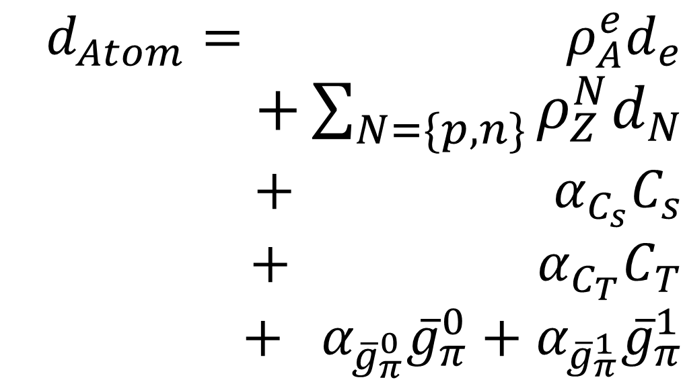
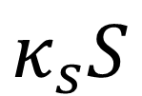
Atomic EDM: Low Energy Param.
§1
Electron
Neutrons & Protons
Scalar eN coupling
Tensor eN coupling
Nuclear Structure dependent
πNN interactions
Schiff moment
Enhanced by deformation
T. Chupp and M. Ramsey-Musolf, Phys. Rev. C 91, 035502 (2015).

Slide 7
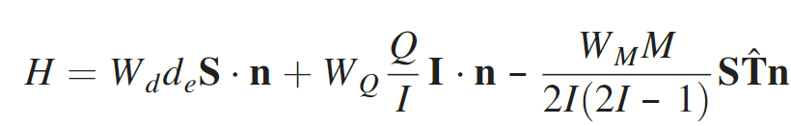
Molecules
§1
When nuclei with MQM, NSM is put in an mol. → Large (x10⁵) CPV EDM
Nuclear Structure dependent
e-EDM
Nuclear Schiff Moment
MQM
e-EDM
e-spin
Nuclear Schiff moment
Nuclear-spin
Mol.’s symmetry axis
Nuclear MQM
MQM contribution can be ~ order of magnitude higher than NSM
B. G. C. Lackenby and V. V. Flambaum, Phys. Rev. D 98, 115019 (2018).

Slide 8
Choice of Isotopes
§2
“Which isotopes should we really focus on?””

Slide 9
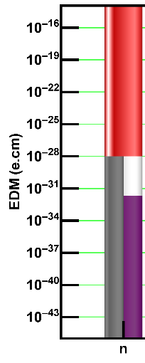


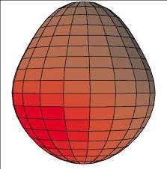
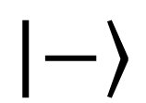
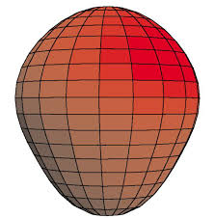

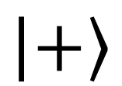
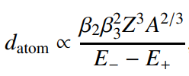
Ground State Parity Doublets (β₃)
§2
Octupole Deformed Nuclei
Spin
Spin
Isotope | ΔE (keV)
²²⁷Fr | 62.97(7)
²²³Ra | 50.128(9)
²²⁷Ac | 27.369(11)
²²⁹Pa | 0.06(5)?!
P. Mohanmurthy and J. A. Winger, PoS (ICHEP2020) 390, 265 (2020)

Slide 10
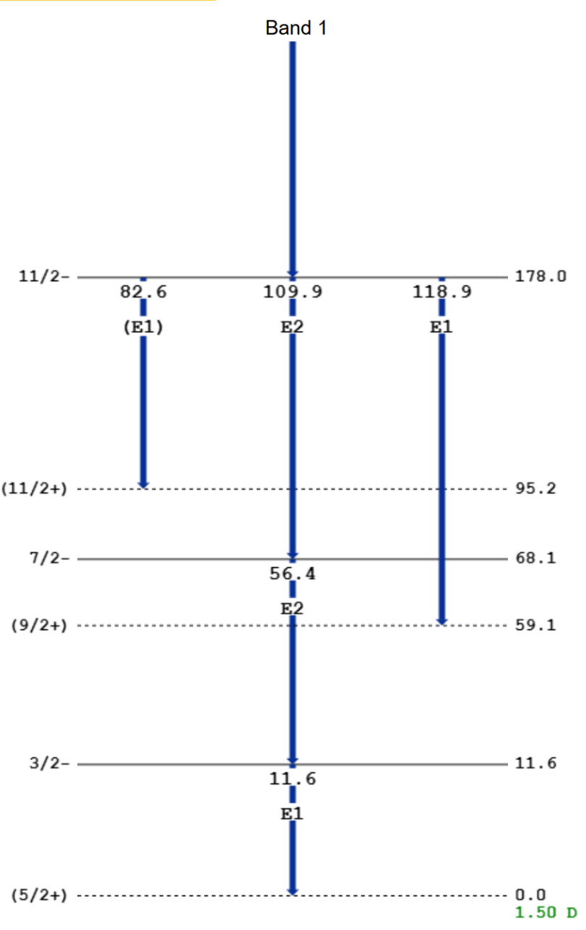
Confirm ΔE in ²²⁹Pa
§A
High res. Conversion e-Spectroscopy
@ decay- station
FRIB LOI: #23086
Spin
Spin
Isotope | ΔE (keV)
²²⁷Fr | 62.97(7)
²²³Ra | 50.128(9)
²²⁷Ac | 27.369(11)
²²⁹Pa | 0.06(5)?!
?

Slide 11
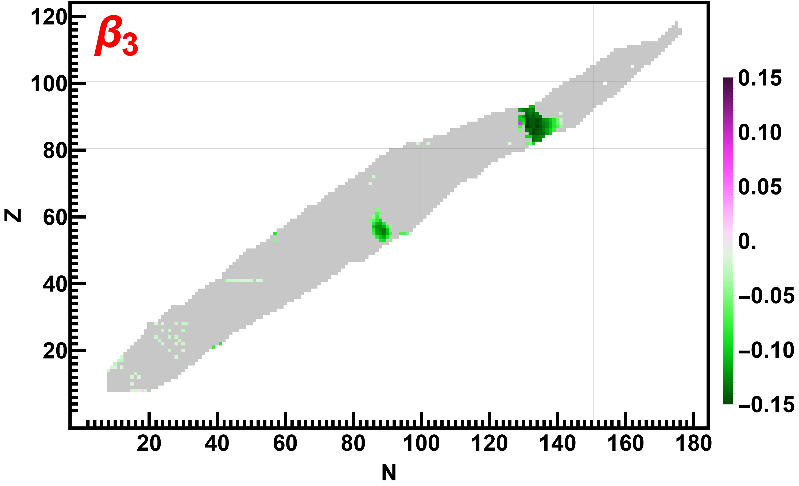
Schiff Moment
§2
Yields: ...^{223,225}Fr, ²²³Ra, ^{223,225,227}Ac, … ²²⁹Pa
P. MohanMurthy et al., Interactions 245, 64 (2024)
P. Mohanmurthy et al., AIP Conf. Proc. 2249, 030046 (2020)

Slide 12
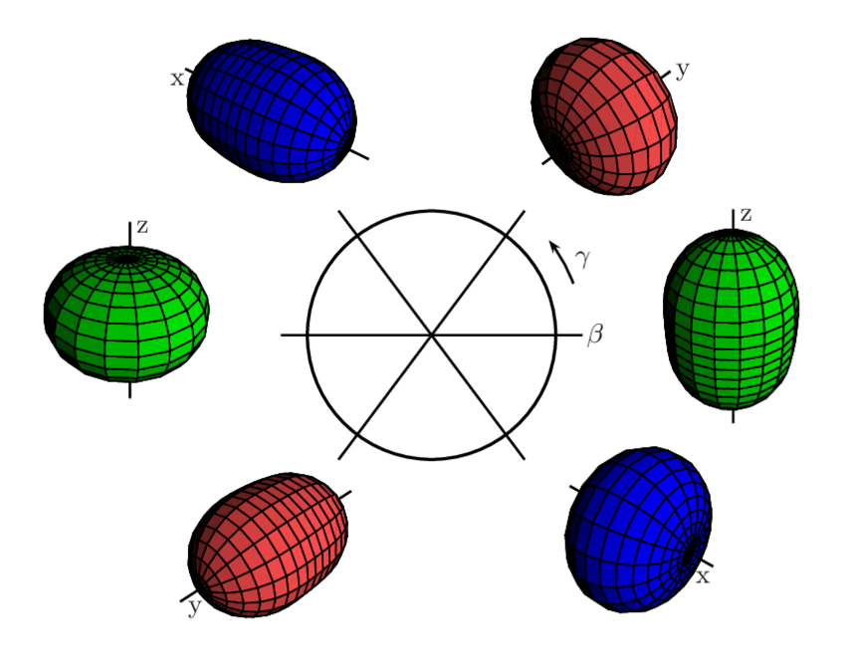
MQM – Quad. Deform. (β₂)
§2
But need quadrupole deformation too!
+ nuclear MQM is another source of EDMs in molecules
L. Fortunato, Eur. Phys. J. A 26, 1–30 (2005).

Slide 13
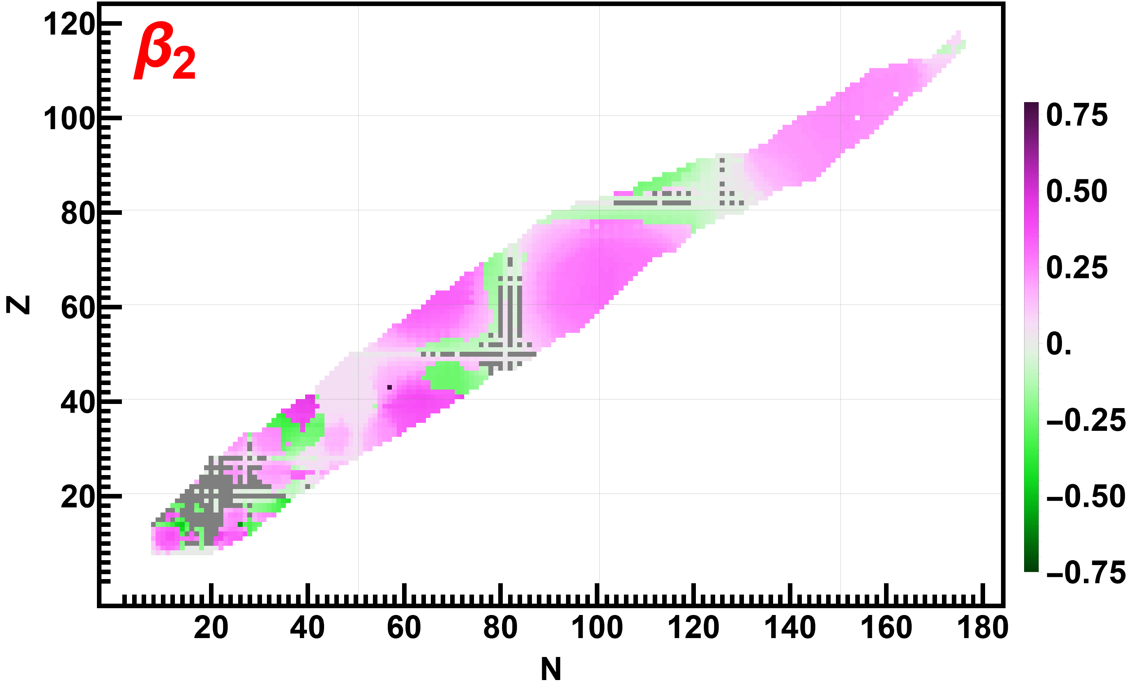
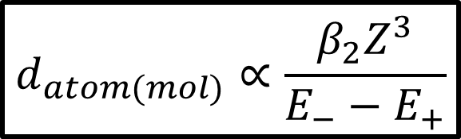
MQM (Preliminary)
§2
Relevant for NSM molecules: FrAg, RaCd…
$$d_{atom(mol)}∝\frac{β_{2}Z^{3}}{E_{−}−E_{+}}$$
Yields: ...^{163,165}Er, ^{161,168}Tm, ¹⁶⁷Yb, ¹⁶⁹Hf, … ^{223,225}Fr, ^{223,227,229,231}Ra, ^{223,225,227,229}Ac, … ^{229,231,233,235}Pa, … ^{239,241,242,243,245}Am
P. MohanMurthy et al., Interactions 245, 64 (2024)

Slide 14
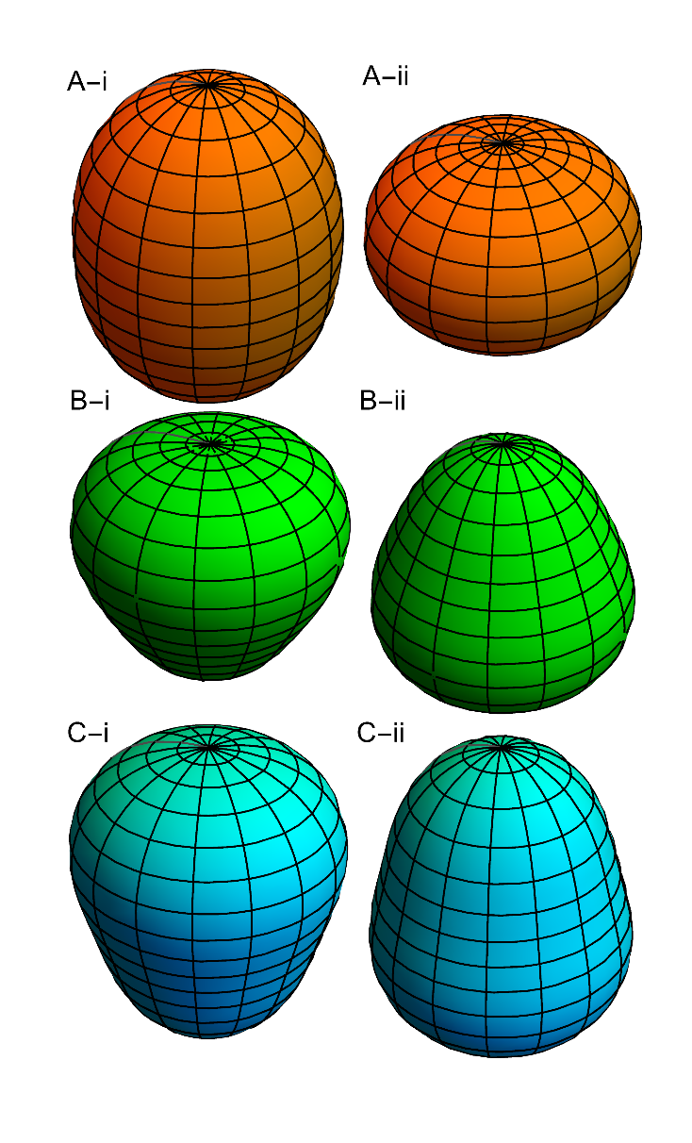
Need: β₂ + β₃ (& ΔE)
§2
Yields: ...^{163,165}Er, ^{161,168}Tm, ¹⁶⁷Yb, ¹⁶⁹Hf, … ^{223,225}Fr, ^{223,227,229,231}Ra, ^{223,225,227,229}Ac, … ^{229,231,233,235}Pa, … ^{239,241,242,243,245}Am
β₂
β₃
Yields: ...^{223,225}Fr, ²²³Ra, ^{223,225,227}Ac, … ²²⁹Pa
ΔE
Yields: ...²²⁷Fr, ²²³Ra, ²²⁷Ac, … ²²⁹Pa
Ultimately the nuclei need to look like
Pa’s got it all… But so do Fr, Ra…
P. MohanMurthy et al., Interactions 245, 64 (2024)

Slide 15
Measurement of Deformation
§3
“What are the shapes of these isotopes?”

Slide 16

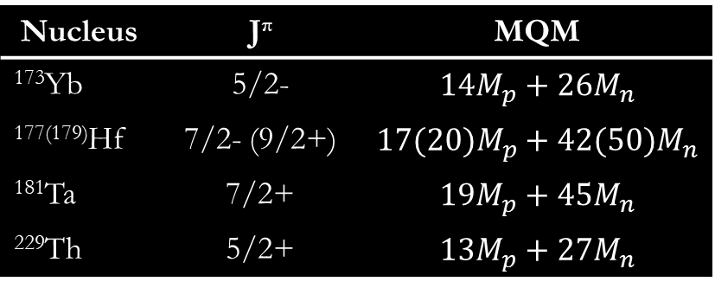

Nucleon EDM & MQM
§3
Breaking down Atomic EDM & Nuclear MQM to
constituent nucleon EDM via Nuclear Schiff Moment
is nuclear structure dependent
EDM
MQM
S | d_{n} | d_{p}
¹⁹⁹Hg | 0.200 fm² | 1.895 fm²
¹²⁹Xe | 0.63 fm² | 0.123 fm²
Nucleus | J^{π} | MQM
¹⁷³Yb | 5/2-
¹⁷⁷⁽¹⁷⁹⁾Hf | 7/2- (9/2+)
¹⁸¹Ta | 7/2+
²²⁹Th | 5/2+
$$d_{Hg}=−2.4×{10}^{−4} {fm}^{−2}S$$
$$d_{Xe}=−3.2×{10}^{−5} {fm}^{−2}S$$
¹⁹⁹Hg-EDM: $d_{Hg}<6.2×{10}^{−30}\text{e}\text{.}\text{cm}$ ${⇒ d}_{p}<1.7×{10}^{−25}$e.cm & ${ d}_{n}<1.3×{10}^{−26}$e.cm
Better than direct UCN: $d_{n}<1.8×{10}^{−26}\text{e}\text{.}\text{cm}$ [C. Abel et al., Phys. Rev. Lett. 124, 081803 (2020)]
B Graner et al, Phys. Rev. Lett. 116, 161601 (2016).
J Engel et al., Prog. Part. Nucl. Phys. 71 (2013), pp. 21–74.
B. G. C. Lackenby and V. V. Flambaum, Phys. Rev. D 98, 115019 (2018)
V. V. Flambaum, Phys. Lett. B 320, 211 (1994)

Slide 17
Quadrupole Deformation
§3
Quadrupole Deformation in (i) FRDM & (ii) DFT:
Have significant variation → Needs measurements
FRDM
β₂ | FRDM | DFT-PC1
²²⁶Ra | 0.164 | 0.196
²³⁰Th | 0.195 | 0.224
β₃ | FRDM | DFT-PC1
²²⁶Ra | -0.112 | 0.133
²³⁰Th | 0?! | 0.152
P. Möller, A. J. Sierk, T. Ichikawa, and H. Sagawa, At. Data Nucl. Data Tables 109-110, 1 (2016)
S. E. Agbemava, A. V. Afanasjev, and P. Ring, Phys. Rev. C 93, 044304 (2016)

Slide 18
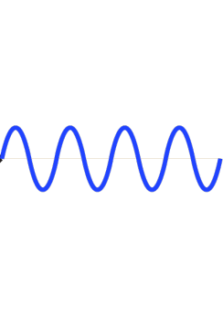
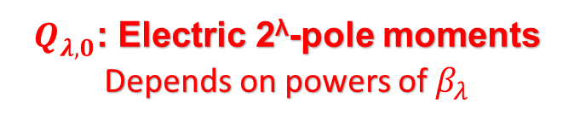

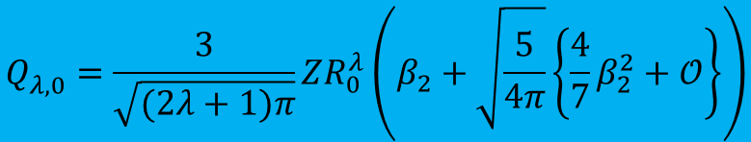

β from Nuclear Spectroscopy
§3
E2 (Coulex)
Measure: B(E2)
β₂
γ
2⁺
0⁺
$$B\left(E2\right)=\frac{5}{16π}Q_{2,0}^{2}{\left|\left\langle J_{i},m,2,0 | J_{f},m\right\rangle \right|}^{2}$$
EDM species: $J_{i}$> 0
Need to incorporate Clebsch Gordon Coefficients
$$Q_{λ,0}^{}=\frac{3}{\sqrt{(2λ+1)π}}ZR_{0}^{λ}\left(β_{2}+\sqrt{\frac{5}{4π}}\left\{\frac{4}{7}β_{2}^{2}+𝒪\right\}\right)$$
$Q_{λ,0}^{}$: Electric 2^{λ}-pole moments
Depends on powers of $β_{λ}$
E3 (Coulex)
Measure: B(E3)
β₃
G. A. Leander and Y. S. Chen, Phys. Rev. C 37, 2744 (1988)

Slide 19
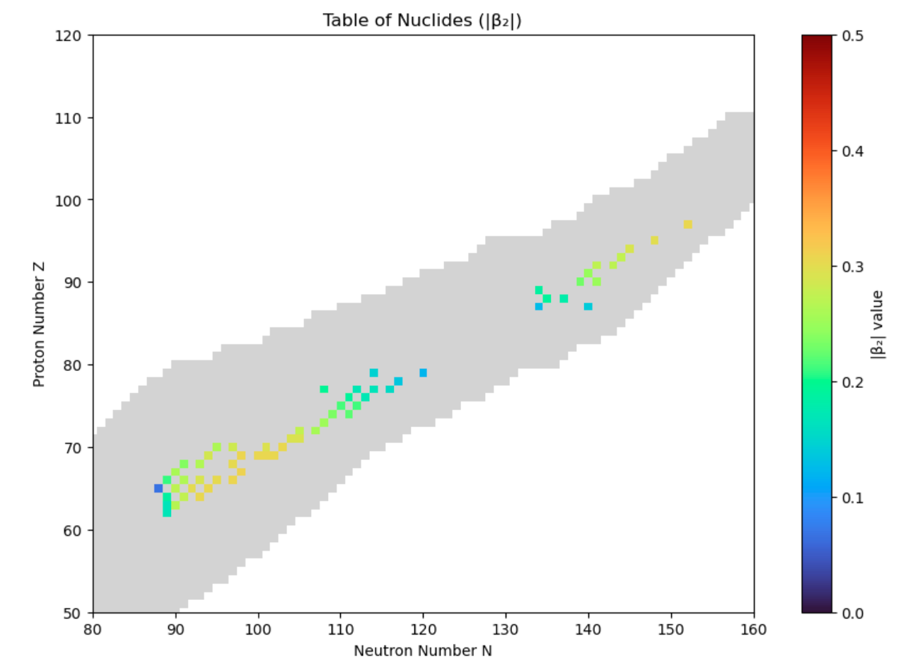

β₂ from E2, E2+M1
§3
Existing Measurements
^{OK:}
^{221,227}Fr,
^{223,225}Ra
E2
M1+E2
L. Qin
CEU Poster, Abstract - G00.00011 (L. Qin) @ APS DNP 2024:
Measurement of Quadrupole Deformations from E2 and E2+M1 Transitions*
P. Mohanmurthy et al., PoS (QNP 2024) 465, 176 (2025)

Slide 20
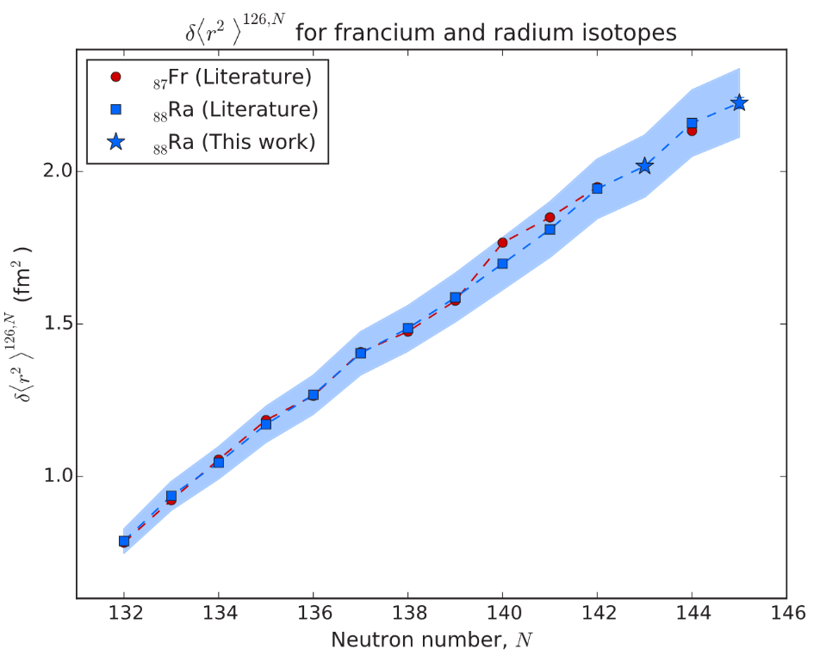
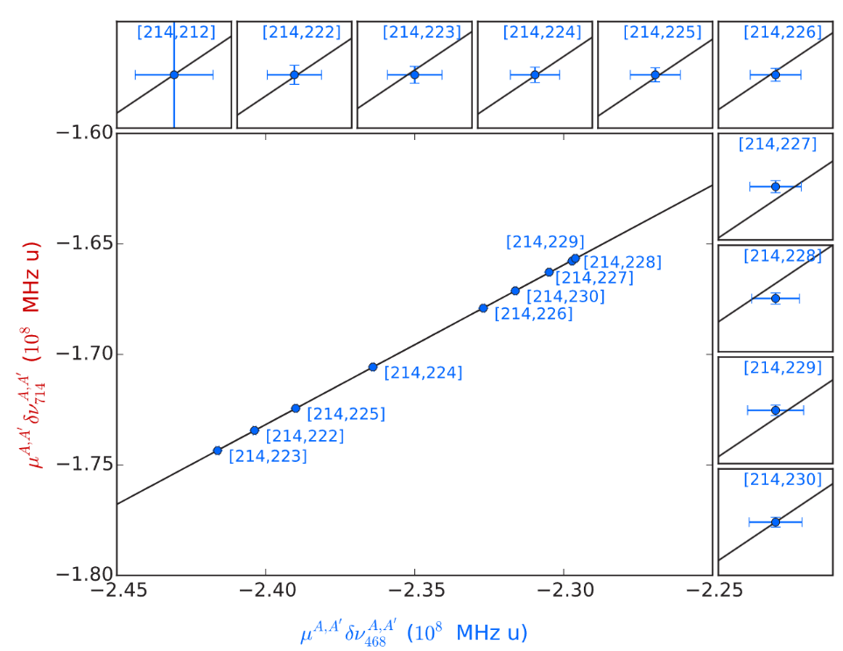

β from Atomic Spectroscopy
§3
Available for some Fr, Ra isotopes…
β₂: E2 (Coulex)
Use Hyperfine
$${δν}_{A,A_{0}}=F_{A,A_{0}}\left\{{δ\left\langle r^{2}\right\rangle }_{A,A_{0}}\right\}+M_{A,A_{0}}\left(\frac{A−A_{0}}{AA_{0}}\right)$$
King Plots:
$${δ\left\langle r^{2}\right\rangle }_{A,A_{0}}={\left\langle r^{2}\right\rangle }_{A_{0}}\left\{1+\frac{5}{4π}{δ\left\langle β_{2}^{2}\right\rangle }_{A_{0}}+…\right\}$$
K. M. Lynch et al., Phys. Rev. C 97, 024309 (2018)

Slide 21
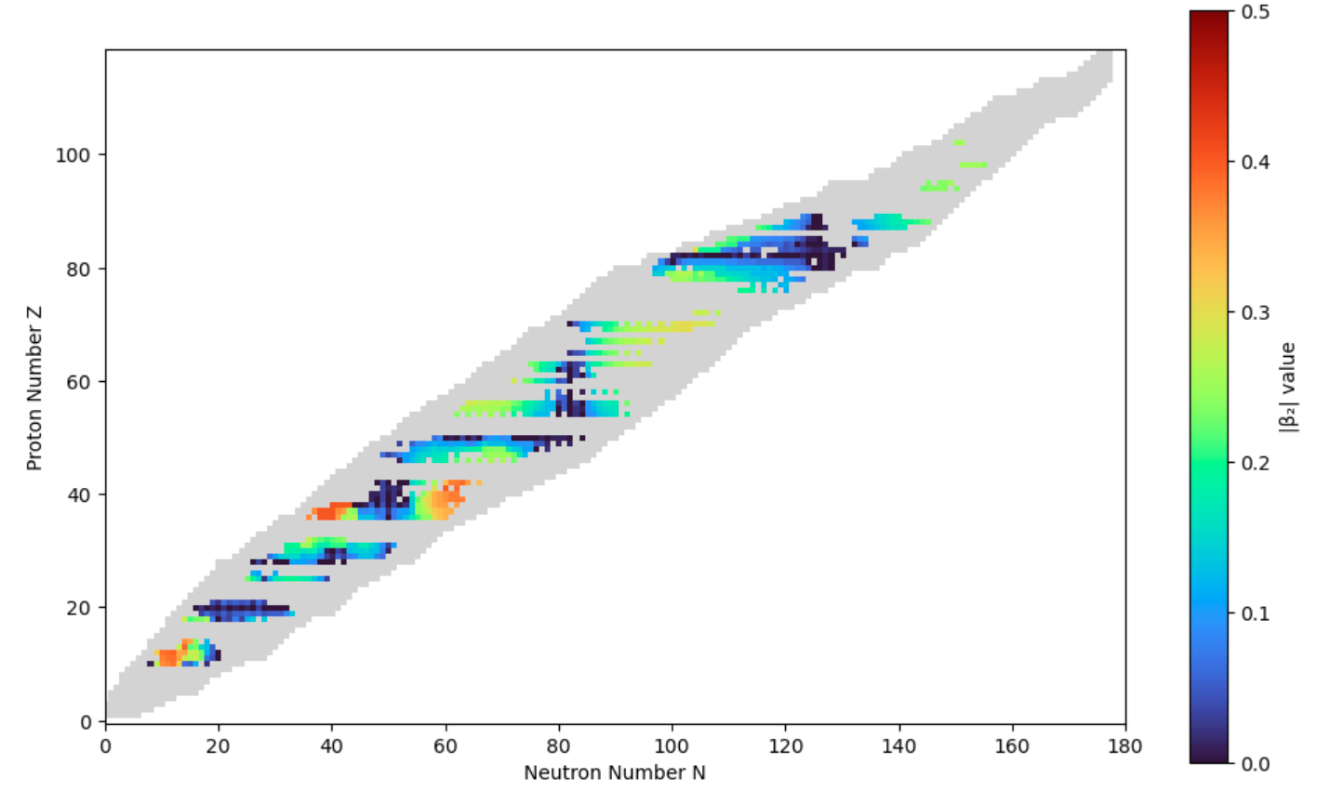

β from Atomic HF Spectroscopy
§3
Existing <r²> Measurements
^{OK:}
^{225, 227, 229}Ac
^{221, 223, 225, 227, 229}Ra
^{221,223,225,227}Fr
HF
!!!Not really sensitive to β₃
I. Lam
Abstract - G00.00011 @ APS DNP 2024:
Using Hyperfine Spectroscopy to Measure Nuclear Deformation*
P. MohanMurthy et al., tbp (2025)

Slide 22
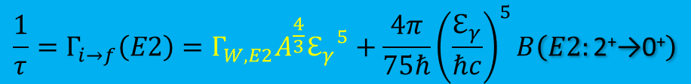
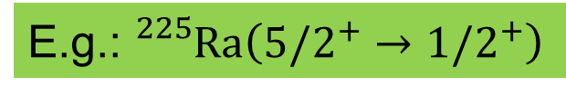
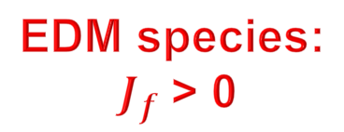

β₃ from E{2,3}, but not 0⁺
§3
Measure: B(E{2,3})
Measure in {A,Z}-1
β_{{2,3}}
Spectator “single particle” nucleon on a collectively deformed shell
1/2
γ
1/2
E.g.: ${}_{}^{225}{Ra}\left({5/2}^{+}→{1/2}^{+}\right)$
2⁺
0⁺
EDM species:
$J_{f}$> 0
$$\frac{1}{τ}=Γ_{i→f}\left(E2\right)=Γ_{W,E2}A^{\frac{4}{3}}{ℇ_{γ}}^{5}+\frac{4π}{75ℏ}{\left(\frac{ℇ_{γ}}{ℏc}\right)}^{5}B\left(E2:\text{2}\text{+}\text{→0}\text{+}\right)$$
$$≪$$
Typically orders of magnitude smaller than deformation component,
so only important in minimally deformed systems
C. Morse et al., Phys. Rev. C 102, 054328 (2020)

Slide 23
Stuck with: β₃ from E3
§3
Measure: B(E3)
Measure in {A,Z}-1
β₃
Radon | 218Rn | 0+ | 33.75 ms | 0.079 | -0.139 | N/A
 | 220Rn | 0+ | 55.6 s | 0.11 | -0.125 | E3: Q3=2180 e.fm3
 | 222Rn | 0+ | 3.82 d | 0.11 | -0.125 | E3: Q3=2360 e.fm3
 | 224Rn | 0+ | 114 m | 0.142 | -0.112 | E3: B(E3)=42(3) W.u.
 | 226Rn | 0+ | 7.4 m | 0.163 | -0.056 | Upcoming…
…Fr
isotopes
…Ra, Ac
isotopes
Radium | 218Ra | 0+ | 25.91 µs | 0.078 | -0.125 | N/A
 | 220Ra | 0+ | 18 ms | 0.111 | -0.127 | N/A
 | 222Ra | 0+ | 33.6 s | 0.122 | -0.141 | E3: Q3=3030 e.fm3
 | 224Ra | 0+ | 3.63 d | 0.143 | -0.139 | E3: Q3=2520 e.fm3
 | 226Ra | 0+ | 1600 y | 0.164 | -0.112 | E3: Q3=2890 e.fm3
 | 228Ra | 0+ | 5.75 y | 0.174 | -0.083 | E3: Q3=2300 e.fm3
…Pa
Isotopes
No direct E3
Thorium | 220Th | 0+ | 10.2 µs | 0.09 | -0.139 | N/A
 | 222Th | 0+ | 1.97 ms | 0.111 | -0.14 | N/A
 | 224Th | 0+ | 1.04 s | 0.144 | -0.153 | ?
 | 226Th | 0+ | 30.69 m | 0.154 | -0.139 | ?
 | 228Th | 0+ | 1.91 y | 0.174 | -0.111 | E1: Q3=2520 e.fm3
 | 230Th | 0+ | 7540 y | 0.195 | 0 | 3-: Q3=2140 e.fm3
 | 232Th | 0+ | 1.41E10 y | 0.205 | 0 | 3-: Q3=1970 e.fm3
Only >80 ms available at REA6 → Coulomb safe energies

Slide 24
Source of ²²⁹Pa
§4
“How to get years of atoms?”

Slide 25
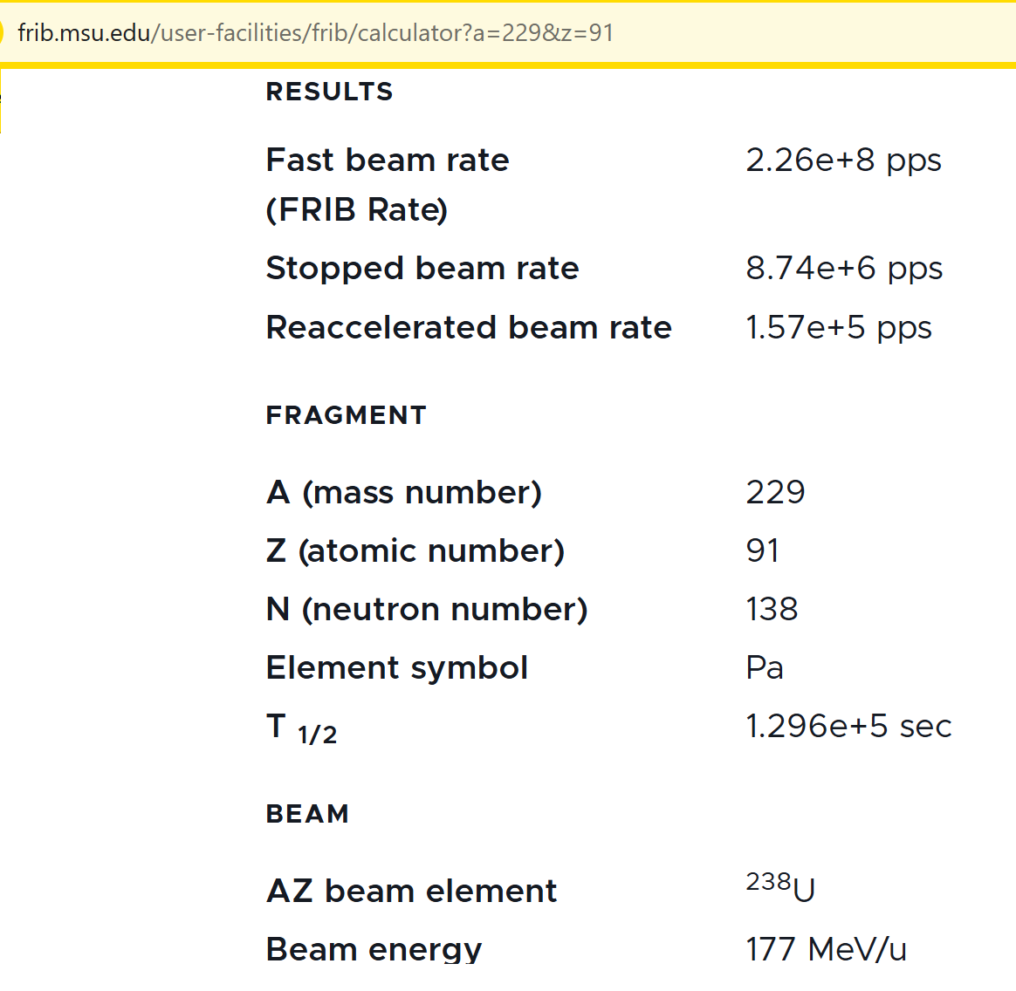
²²⁹Pa beam?!
§4
²²⁹Pa could become available at REA site

Slide 26
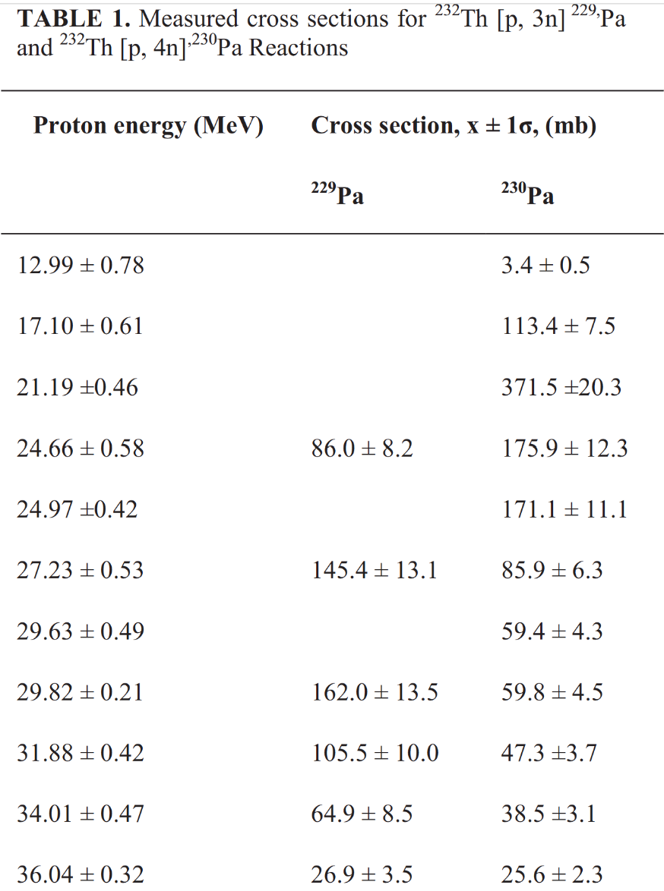
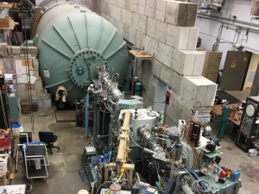
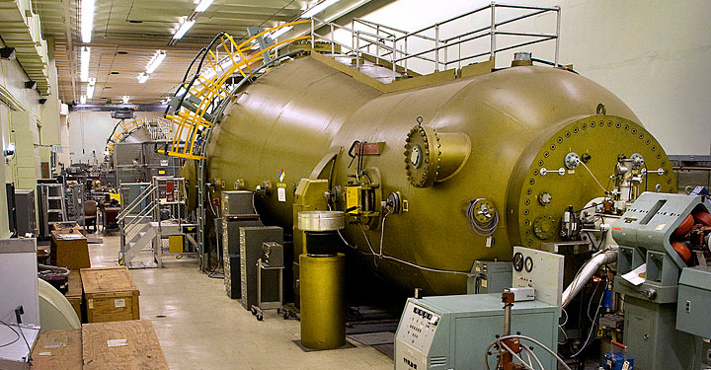
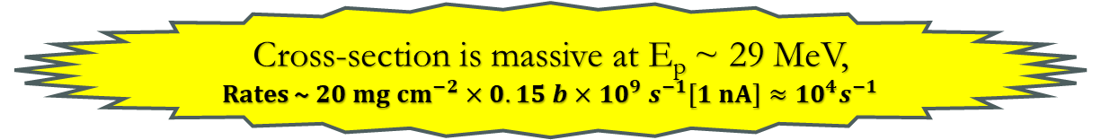
Dedicated ²²⁹Pa source
§4
²³²Th (p,4n) ²²⁹Pa
Ni-foil coated with ²³²Th
²²⁹Pa
1000ºC
Duke>
<BNL
p@Tandem
~10 mA
Cross-section is massive at E_{p} ~ 29 MeV, Rates ~ ${20 mg cm}^{−2}×0.15 b×{10}^{9}$ $s^{−1}[1 nA]≈{{10}^{4}s}^{−1}$
  C. U. Jost et al., AIP Conf. Proc. 1525, 520 -524 (2013)

Slide 27
Summary
§5
✔
β₂ :existing E2,E2+M1 transition measurements
^{221,227}Fr, ^{223,225}Ra
✔
β₂ : existing HF atomic spectroscopy measurements
^{225, 227, 229}Ac, ^{221, 223, 225, 227, 229}Ra, ^{221,223,225,227}Fr
✔
β₃: existing E3 measurements with {A,Z}-1
^{221, 223, 225, 227}Fr, ^{223, 225, 227, 229}Ra/Ac, ^{231,233}Pa
!
β₃: Need dedicated conv. e-spect. & E{2,3}: ^{224,226,228}Th
.
Tandem accelerators can be a long-term source of ²²⁹Pa

Slide 28








Acknowledgements
§5
Current
DE-SC0018229, DE-SC0024846
BNL-460913
UROP, MISTI, LNS
Fellowship
Past
DE-SC0014448, DE-SC0019768, DE-FG02-94ER40818
PHY-1822502
ORED-110
Fellowship
G2017100190747806, G2019100190747806
F-19124368008
Thanks: A. Afanasjev, J. Winger

Slide 29
Backup

Slide 30
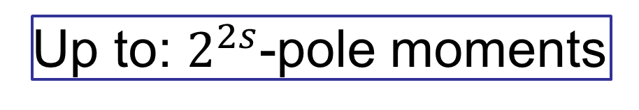
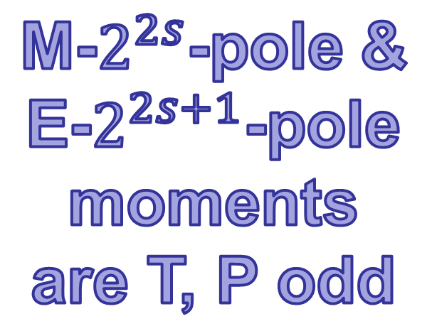
E & M Moments
§1
Wigner-Eckart Theorem
CPV
(E)lectric
moments
(M)agnetic moments
Spin ‘s’
0 | Charge | - (Anapole)
1/2 | …EDM | …MDM
1 | …EQM | …MQM
K. T. Hecht, Quantum Mechanics (Springer, NY), (2002): pp. 299-302.

Slide 31
MQM
§1
Quadrupole Deformed Nuclei
While nuclear EDM is screened by an atom, nuclear MQM is not!
B. G. C. Lackenby and V. V. Flambaum, Phys. Rev. D 98, 115019 (2018).

Slide 32
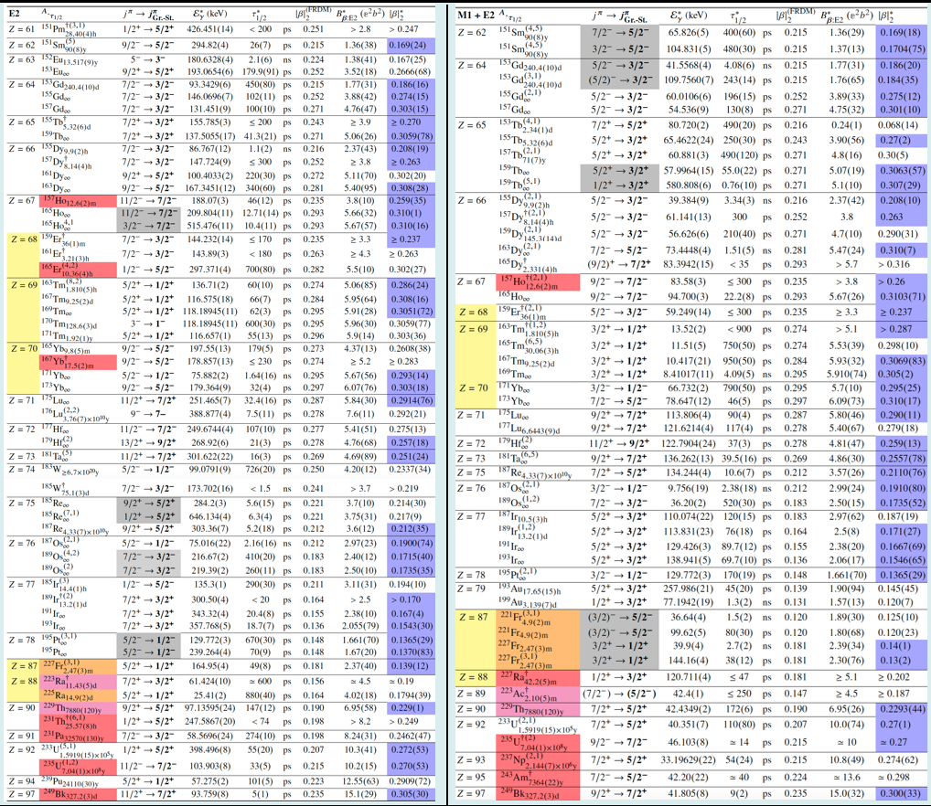
β₂ from E2, E2+M1
§3
E2
M1+E2
#67 ¹⁵¹Pm – ²⁴⁹Bk:
^{171,173}Yb, ^{221,227}Fr,^{223,225}Ra
CEU Poster, Abstract - G00.00011 (L. Qin) Tue @ 4PM:
Measurement of Quadrupole Deformations from E2 and E2+M1 Transitions*

Slide 33
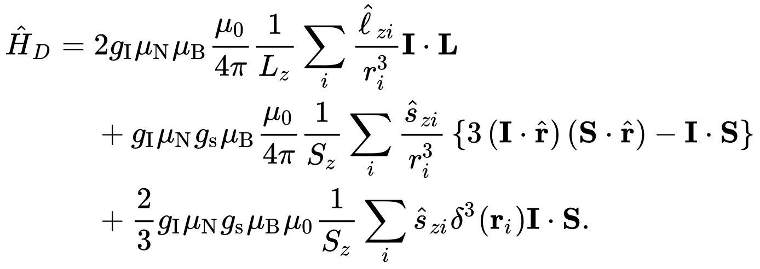
Hyperfine Interaction
§3
Due to nuclear spin
7s7p ³P₁
7s² ¹S₀
γ
1/2⁺
1/2⁺
Nuclear Spin
Nuclear-Electron Cross talk
Electron Spin
K. M. Lynch et al., Phys. Rev. C 97, 024309 (2018)

Slide 34
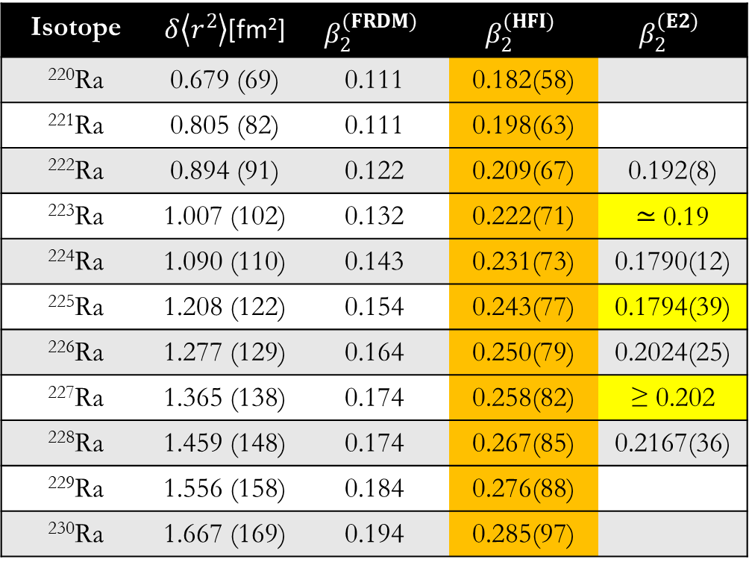

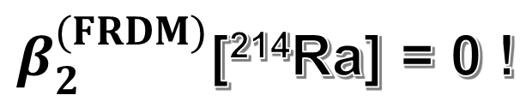
β from Atomic Spectroscopy
§3
$β_{2}^{(FRDM)}$[²¹⁴Ra] = 0 !
β₂: E2 (Coulex)
Use Hyperfine
Isotope | $δ\left\langle r^{2}\right\rangle$[fm²] | $$β_{2}^{(FRDM)}$$ | $$β_{2}^{(HFI)}$$ | $$β_{2}^{(E2)}$$
²²⁰Ra | 0.679 (69) | 0.111 | 0.182(58)
²²¹Ra | 0.805 (82) | 0.111 | 0.198(63)
²²²Ra | 0.894 (91) | 0.122 | 0.209(67) | 0.192(8)
²²³Ra | 1.007 (102) | 0.132 | 0.222(71) | ≃ 0.19
²²⁴Ra | 1.090 (110) | 0.143 | 0.231(73) | 0.1790(12)
²²⁵Ra | 1.208 (122) | 0.154 | 0.243(77) | 0.1794(39)
²²⁶Ra | 1.277 (129) | 0.164 | 0.250(79) | 0.2024(25)
²²⁷Ra | 1.365 (138) | 0.174 | 0.258(82) | ≥ 0.202
²²⁸Ra | 1.459 (148) | 0.174 | 0.267(85) | 0.2167(36)
²²⁹Ra | 1.556 (158) | 0.184 | 0.276(88)
²³⁰Ra | 1.667 (169) | 0.194 | 0.285(97)
✔
✔
✔
✔
✔
✔
✔
$${δν}_{A,A_{0}}=F_{A,A_{0}}\left\{{δ\left\langle r^{2}\right\rangle }_{A,A_{0}}\right\}+M_{A,A_{0}}\left(\frac{A−A_{0}}{AA_{0}}\right)$$
King Plots:
$${δ\left\langle r^{2}\right\rangle }_{A,A_{0}}={\left\langle r^{2}\right\rangle }_{A_{0}}\left\{1+\frac{5}{4π}{δ\left\langle β_{2}^{2}\right\rangle }_{A_{0}}+…\right\}$$
S. A. Ahmad et al., Nucl. Phys. A 483, 244 (1988)
P. Möller et al, At. Data Nucl. Data Tables 109-110, 1 (2016)

