Slide 1
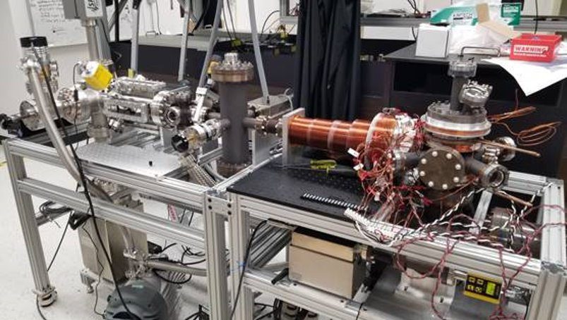

Update on the Ra-225 EDM Experiment
Aug. 11th, 2025
erhtjhtyhy
Peter Mueller
Project funding:
Principal Physicist
Interim Group Leader Fundamental Symmetries
Nuclear Physics – Fundamental Symmetries

Slide 2







Radium EDM Team
@ANL
@MSU
@UKentucky
REU Students
Harvey Campos-Chavez
David Vera
Wolfgang Korsch
Michael Bishof
Peter Mueller
Jaideep Singh
Graduate Students
Gordon Arrowsmith-Kron
Aiden Boyer
Kevin Bailey
Tom O’Connor
David Peana

Slide 3
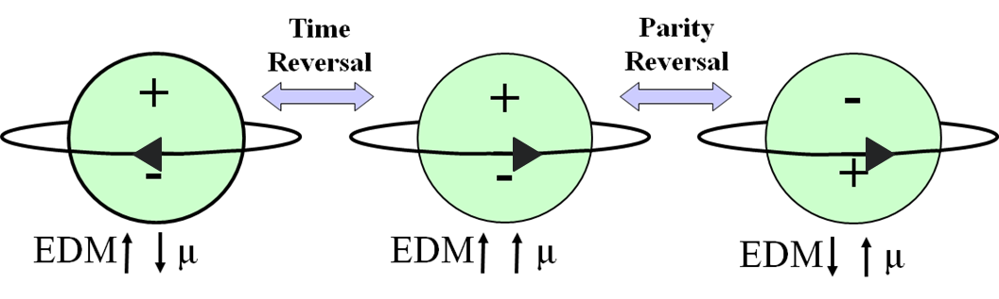
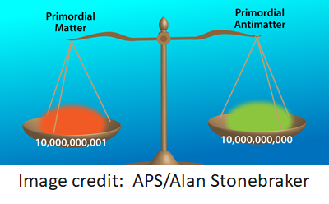
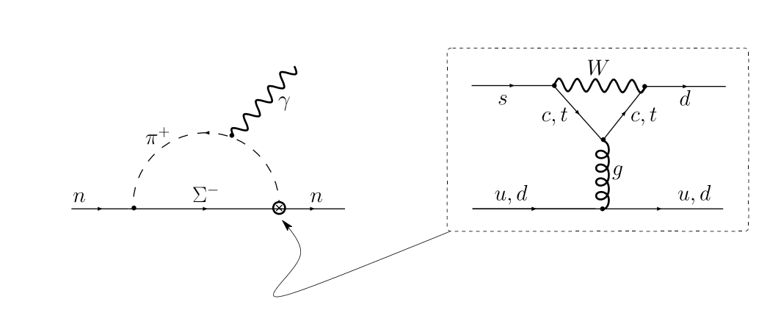
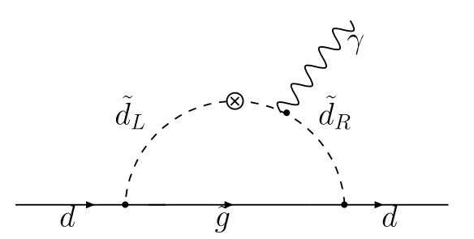

Why look for electric dipole moments?
T-violation implies CP violation via CPT symmetry
Additional CP violation needed to explain matter—antimatter asymmetry
No Standard Model EDM near experimental limits.
BSM theories naturally include additional CP violation
$$d_{n}^{CKM}≅ {10}^{−32}e cm$$
M. Pospelov, A. Ritz, Annals of Physics 318, 119–169 (2005).

Slide 4
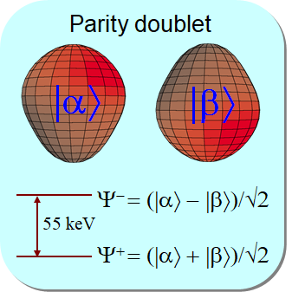
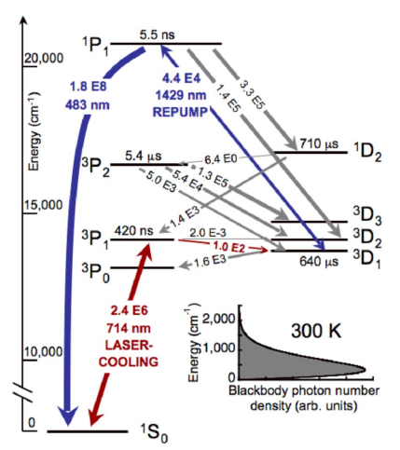
Why radium?
Laser Cooling
No accelerator needed
Strong Octupole Deformation
²³³U
159 kyr
α
²²⁹Th
7.3 kyr
α
²²⁵Ra
15 d

Slide 5
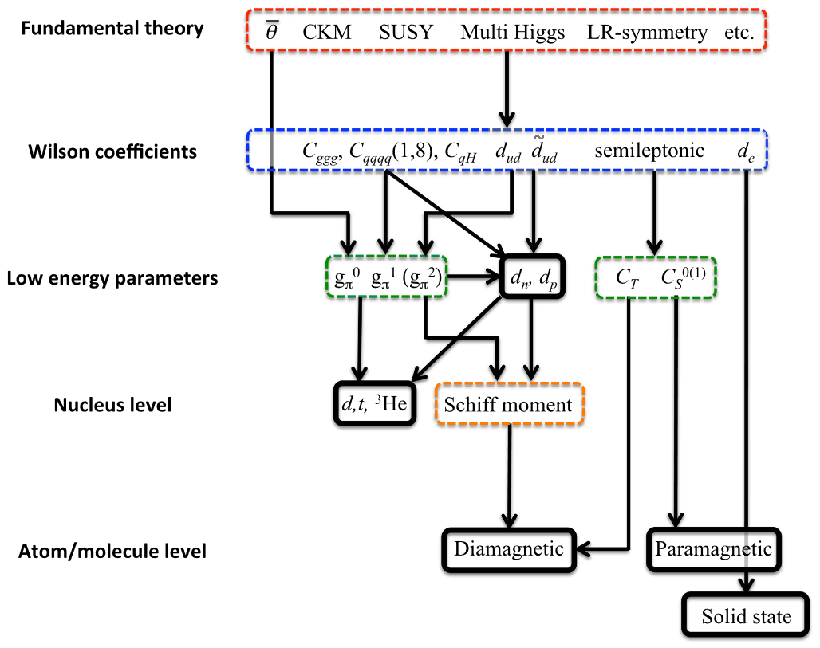
Where to look for an EDM?
Several stones to uncover
“Origin” of an EDM explained by low energy EFT parameters
Diamagnetic systems sensitive to many parameters
Every system has different sensitivities
Many systems contribute to current limits
(Cs, Tl, ThO, YbF, HfF+)
(Hg, Xe, Ra, Yb, Rn, TlF)
T. E. Chupp et al., Rev. Mod. Phys. 91 (2019)

Slide 6
Current limits on Diamagnetic systems
New limits on Ra can have a big impact
Experiment | ¹⁹⁹Hg | ¹²⁹Xe | TlF | n | ²²⁵Ra | ¹⁷¹Yb
Current limit, e-cm (95% CL)​​ | 7.4×10⁻³⁰ | 1.4×10⁻²⁷ | 6.5×10⁻²³ | 3.6×10⁻²⁶ | 1.4×10⁻²³ | 1.5×10⁻²⁶
T. E. Chupp et al., Rev. Mod. Phys. 91 (2019);N. Sachdeva et al., Phys. Rev. Lett. 123, 143003(2019);T. A. Zhang et al., Phys. Rev. Lett. 129, 083001 (2022).
BSM parameter​​ | C_{T}​​ | g_{π}⁽⁰⁾​​ | g_{π}⁽¹⁾​​ | đ_{n} (e cm)​​
Current limits (95% CL)​​ | 2×10⁻⁶​​ | 8×10⁻⁹​​ | 1.2×10⁻⁹​​ | 1.2×10⁻²²​​
Improvement Factor (over current limit)​​
Current + ²²⁵Ra [10⁻²⁵ e cm]​​ | 40​​ | 2​​ | 1.2​​ | 20​​
Current + ²²⁵Ra [10⁻²⁶ e cm]​​ | 200​​ | 8​​ | 4​​ | 60​​

Slide 7
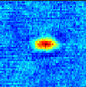
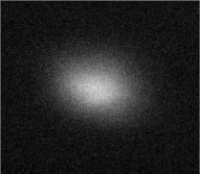
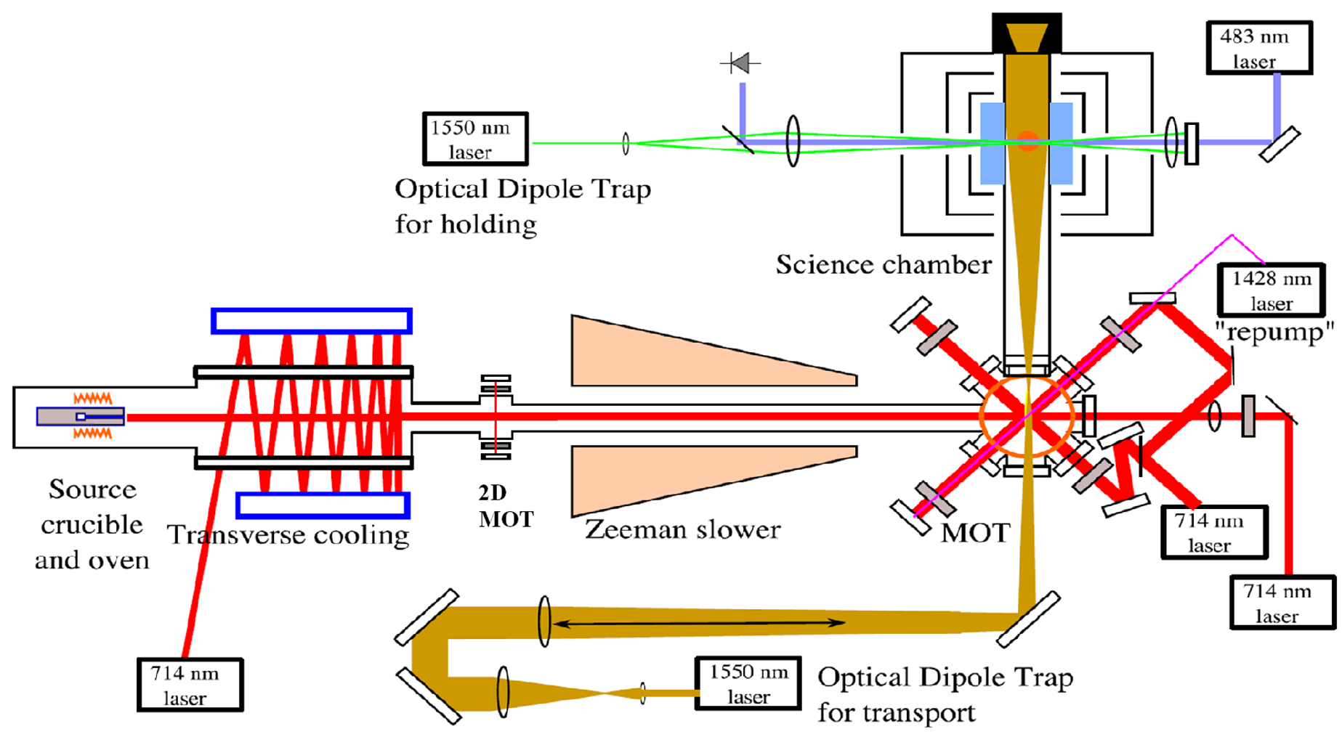
Ra-EDM Apparatus at ANL
0.5 mm
²²⁶Ra MOT
200,000 atoms
40 μK
0.6 mm
700 atoms
Ra-225
Absorption
image
Ra(NO₃)₂+Ba

Slide 8
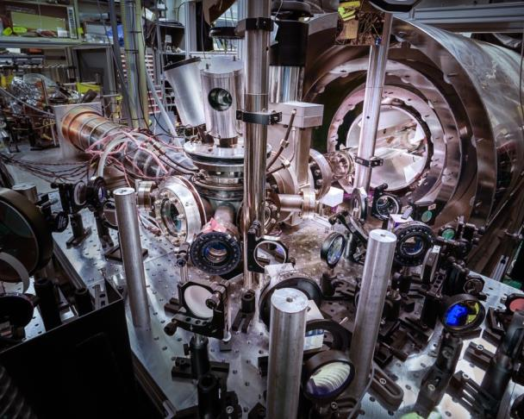

Slide 9
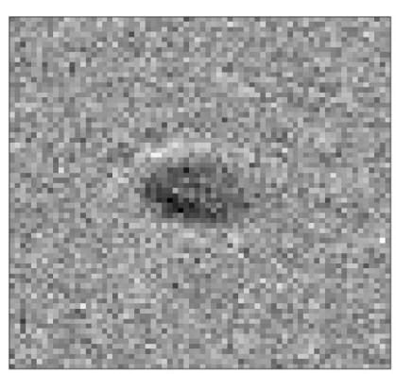
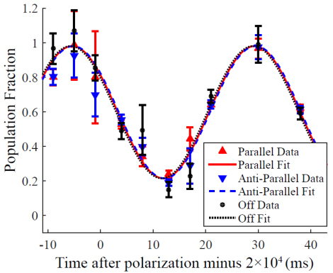
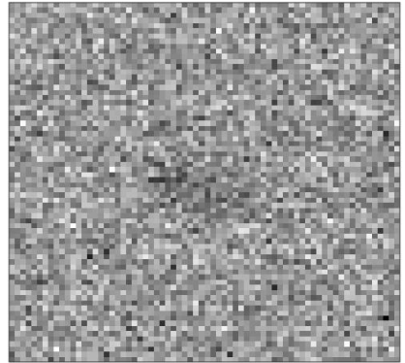
Most recent EDM result
d_{Ra-225} = (4± 6_{stat} ± 0.2_{syst}) × 10⁻²⁴
e-cm
d_{Ra-225} < 1.4 × 10⁻²³ e-cm 95% C.L.
M. Bishof et al. PRC 94, 025501 (2016)

Slide 10
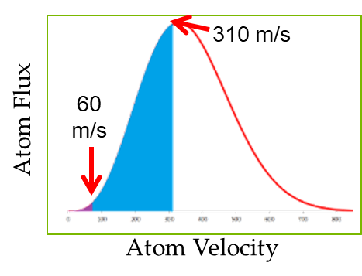
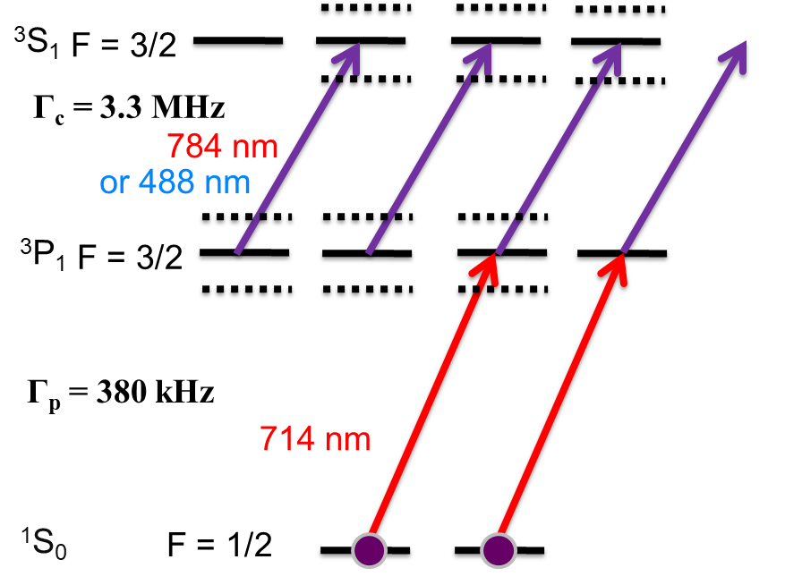
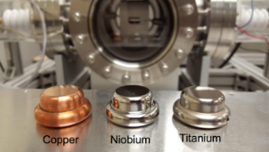
Experimental Improvements
Blue Light Upgrade
(improved laser cooling and trapping)
Improved Spin Detection
Improved Electrodes

Slide 11
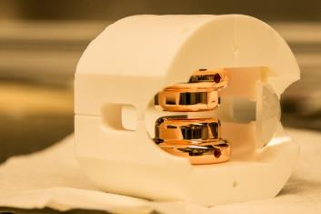
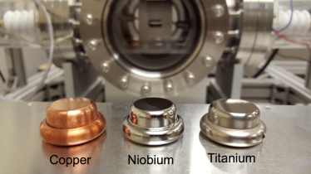
Improving the electric field
Previously: Copper Electrodes, E = 65 kV/cm
Niobium electrodes completed:
300 kV/cm demonstrated
(J. Singh/MSU, M. Kelly, T. Reid/ANL, M. Poelker/Jlab)
R. A. Ready et al., Nucl. Instrum. Methods Phys. Res., Sect. A 1014, 165738 (2021).
4x increase in EDM Sensitivity

Slide 12
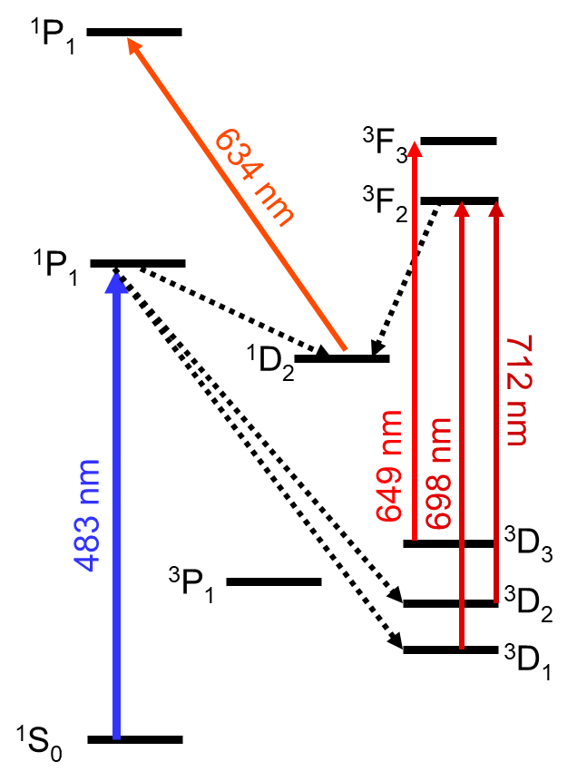
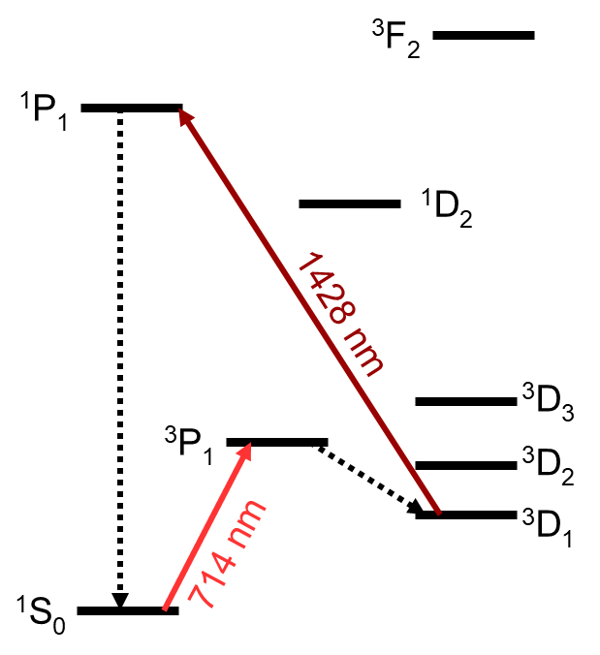
Blue light upgrade
100x more atoms and only 2x more lasers
Previous 714 nm laser cooling weaker but simple
483 nm cooling requires more repumps but traps 100x more atoms

Slide 13
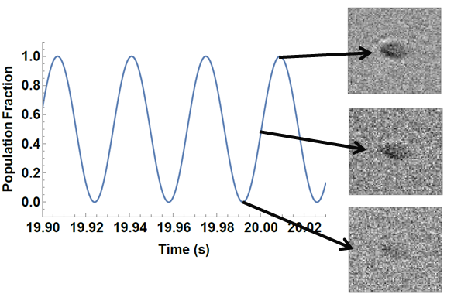
Improving spin detection
Current absorption imaging
F = 3/2
¹P₁
F = 1/2
483 nm
³D₁
¹S₀
F = 1/2
Only 2.1 photons/atom on average

Slide 14
Improved spin detection in ²²⁵Ra
QND spin detection
³S₁
F = 3/2
Γ_{c} = 3.3 MHz
AC Stark shift of ±Ω_{c}/2
  (Autler-Townes splitting)
Scattering reduced by Ω_{c}²/(Γ_{c}×Γ_{p})
¹⁷¹Yb demonstrated 19 dB reduction in optical noise
Expect very similar performance in ²²⁵Ra
784 nm
(or 488 nm)
³P₁
F = 3/2
Γ_{p} = 380 kHz
714 nm
T. A. Zhang et al., Phys. Rev. Lett. 129, 083001 (2022).
Y. Yang, et al. Phys. Rev. Applied 19, 054015 (2023).
¹S₀
F = 1/2

Slide 15
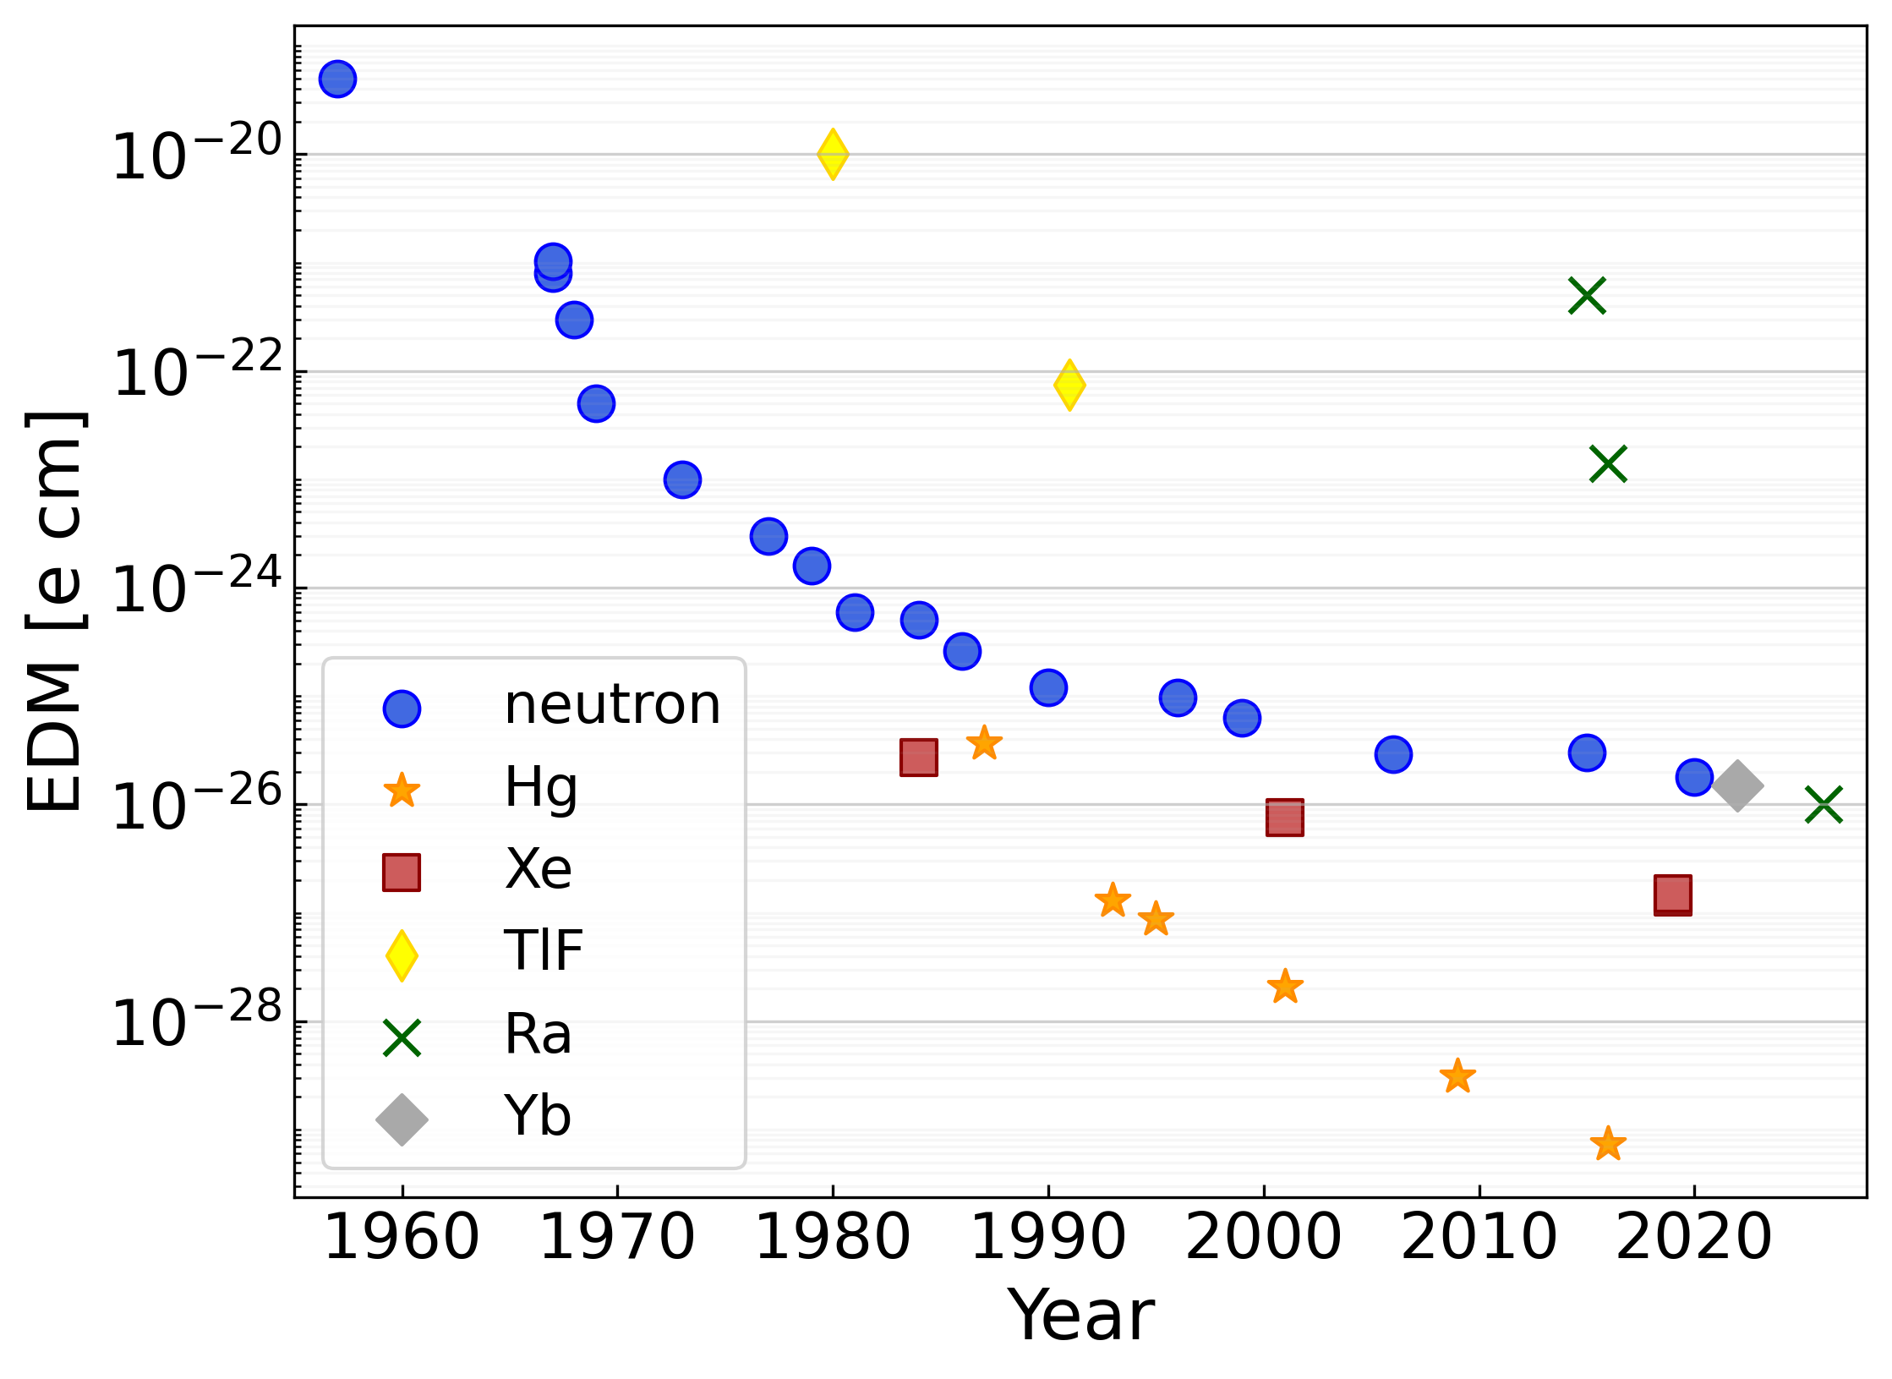
Putting it all together—expected sensitivity
Raw EDM sensitivity
Upgrade | Sensitivity Gain
Blue Light | 100
QND Detection | 4
Electrodes | 4
Total (not a product) | 1000
M. Bishof, et al. Phys. Rev. C 94, 025501 (2016).
Y. Yang, et al. Phys. Rev. Applied 19, 054015 (2023).
https://github.com/Jayich-Lab/EDM-Limits

Slide 16
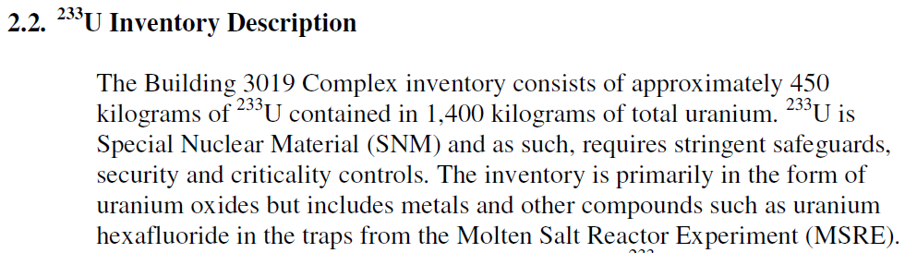
²²⁹Th → ²²⁵Ra: a straightforward source of ²²⁵Ra
DOE has ~20 Ci of unused ²²⁹Th… but there’s a catch
The ²²⁹Th is contained in 1,400 kg of uranium
Enriched ²³³U was created in the 50’s and 60’s as potential nuclear fuel
450 kg of ²³³U decaying for ~60 years produces ~117 g (23 Ci) of ²²⁹Th
This amount of ²²⁹Th dwarfs the current global supply (~0.1 Ci¹)
¹https://www.isotopes.gov/sites/default/files/2020-08/Ac-225 User Group Presentation – Final (002).pdf

Slide 17
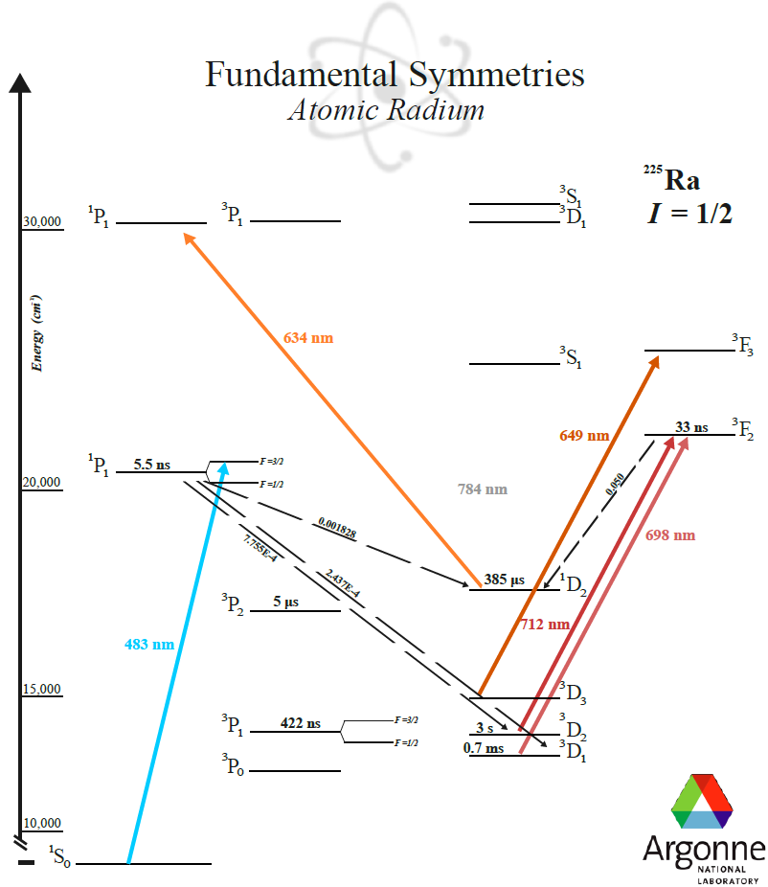
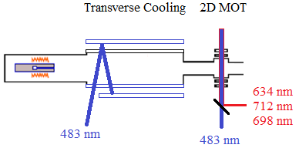
Blue Light Upgrade
Repump Spectroscopy

Slide 18
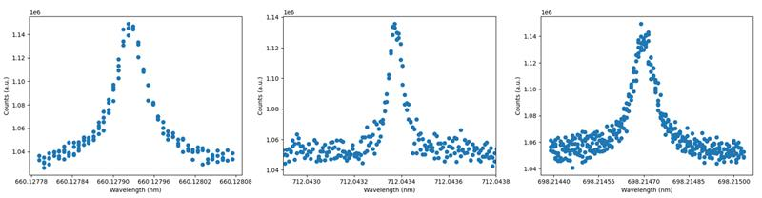
Blue Light Upgrade
712 nm
Repump Spectroscopy
698 nm

Slide 19
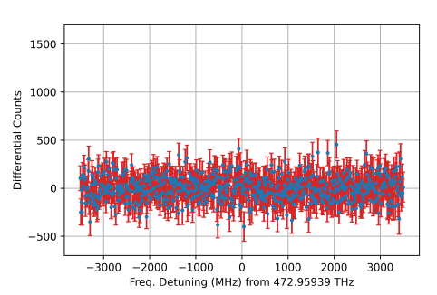
Blue Light Upgrade
712 nm
Repump Spectroscopy
634 nm
698 nm

Slide 20
Blue Light Upgrade
712 nm
Repump Spectroscopy
?
x
660 nm
698 nm

Slide 21
Ra-225 EDM Status
Solution to Ra-225 supply issues identified
  20 mCi of ²²⁹Th produces 10 mCi of ²²⁵Ra every 2 weeks
  Approach tested with Th-230 -> Ra-226 observed
Blue light upgrade is progressing
  Beamline assembled, loaded with Ra-226
  Repump transitions (finally) observed
  Next step: Blue MOT
Join “science” apparatus with BLU once 482 nm MOT works
Aim for <10⁻²⁵ e cm EDM measurement within 2 years

Slide 22
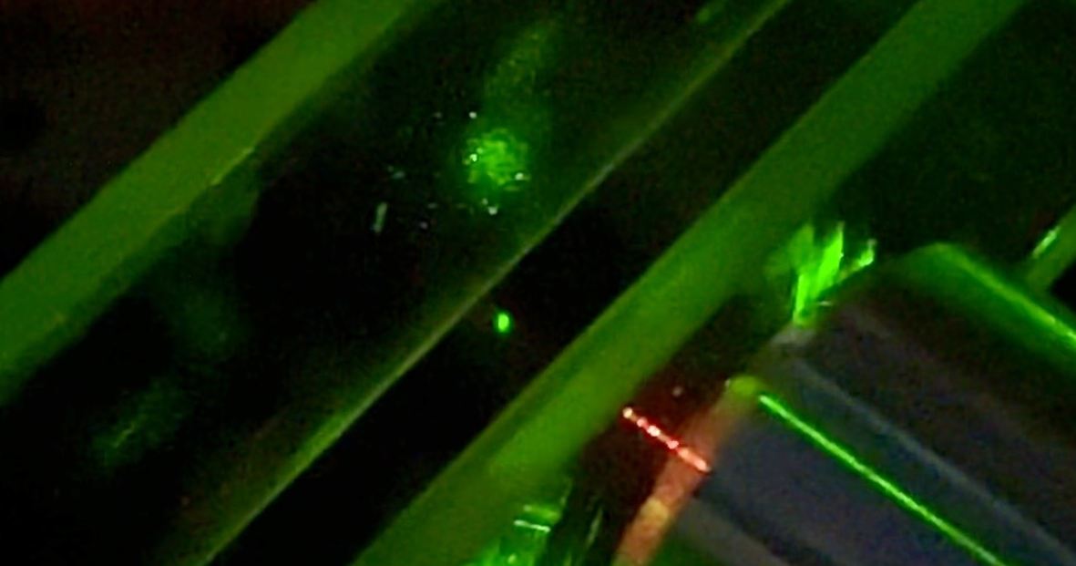
Development of Yb tweezer arrays for quantum simulation of nuclear physics

Slide 23






The Yb team
PI
Postdocs
Grad Student
Michael
Bishof
Francesco
Granato
Varun
Jorapur
Zeyu
Ye
Collaborators
REU Student
Mouhamed Mbengue
Wanda Lindquist
Kevin
Bailey
Tom
O’Connor
Peter
Mueller
Ian
Cloet
Anna
McCoy
10/9/2024 | DNP 2024

Slide 24
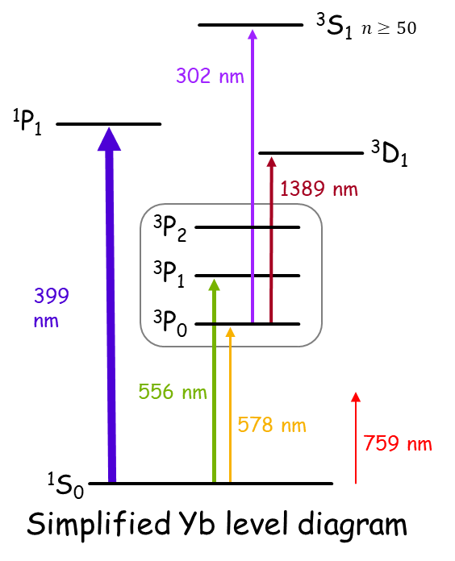


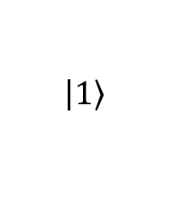

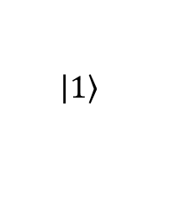

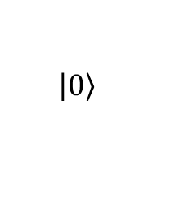
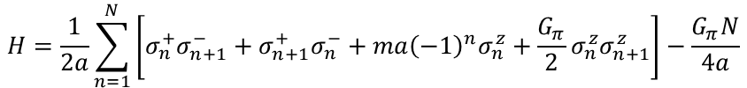
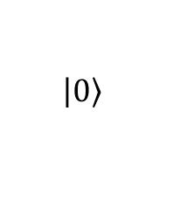
A Neutral atom quantum simulator for nuclear physics
Perform simulations of strongly-interacting fermion systems relevant to nuclear physics.
Yb atoms offer unique tools to cool, trap, and manipulate atoms held in tweezer arrays with long coherence times.
Effective field theories for QCD with short-range interactions can be implemented naturally in Yb arrays
Hamiltonians in spin operator basis translate directly to arrays of interacting atom qubits
$$H_{±}$$
$$H_{m}$$
$$H_{I}$$
$$H=\frac{1}{2a}\sum_{n=1}^{N}{\left[σ_{n}^{+}σ_{n+1}^{−}+σ_{n+1}^{+}σ_{n}^{−}+ma{\left(−1\right)}^{n}σ_{n}^{z}+\frac{G_{π}}{2}σ_{n}^{z}σ_{n+1}^{z}\right]−\frac{G_{π}N}{4a}}$$
$$\left|\left.1\right\rangle \right.$$
$$\left|\left.0\right\rangle \right.$$
$$\left|\left.0\right\rangle \right.$$
$$\left|\left.1\right\rangle \right.$$

Slide 25

Why ytterbium?
³S₁ $n≥50$
Powerful tools provided the two electrons
302 nm
Preferable for laser cooling
  Broad cooling (~mK)
  Narrow cooling and imaging (~μK)
“Clock” transition to long-lived metastable states protected from environmental effects
Single-photon excitation to Rydberg states trapped by the same tweezers ^{[1]}
¹P₁
³D₁
1389 nm
³P₂
³P₁
399 nm
³P₀
556 nm
578 nm
¹S₀
[1] J. T. Wilson, et al. Phys. Rev. Lett. 128, 033201 (2022).
10/9/2024 | DNP 2024

Slide 26
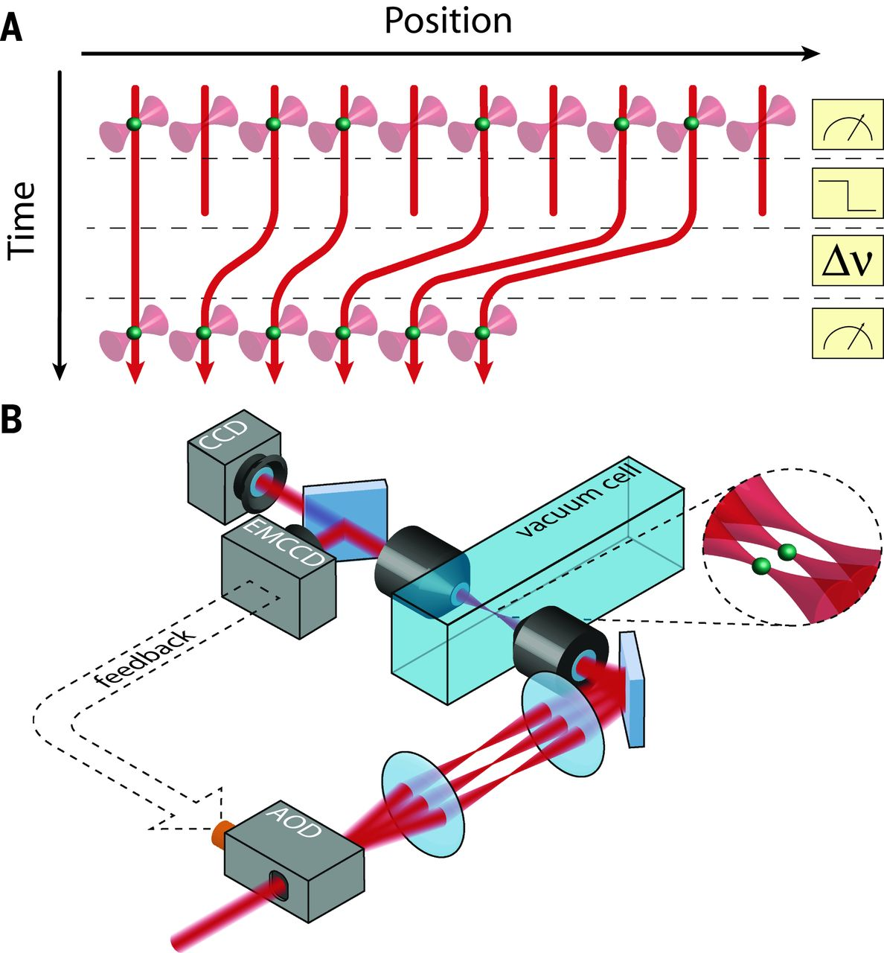
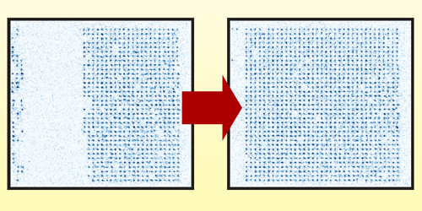
Neutral atoms in Tweezers
A bottom-up approach
Re-configurable to arbitrary patterns
Scalable to large systems
Flexible connectivity
M. A. Norcia, et al. PRX Quantum 5, 030316 (2024).
M. Endres, et al. Science 354, 1024-1027 (2016).
10/9/2024 | DNP 2024

Slide 27
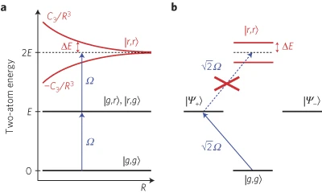
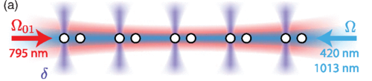
Rydberg atoms in tweezers
Tunable strong interactions
Rydberg blockade mechanism provides strong interaction between atoms
High fidelity (>99.5%) entanglement can be realized ^{[1]}
Interaction strength can be tuned by using different Rydberg states or variable lattice spacings ^{[2]}
A. Gaëtan, et al. Nat. Phys. 5, 115–118 (2009).
E. Urban, et al. Nat. Phys. 5, 110–114 (2009).
[1] P. Scholl, et al. Nature 622, 273-278 (2023).
[2] H. Bernien, et al. Nature 551, 579–584 (2017).
H. Levine, et al. Phys. Rev. Lett. 123, 170503 (2019).
10/9/2024 | DNP 2024

Slide 28
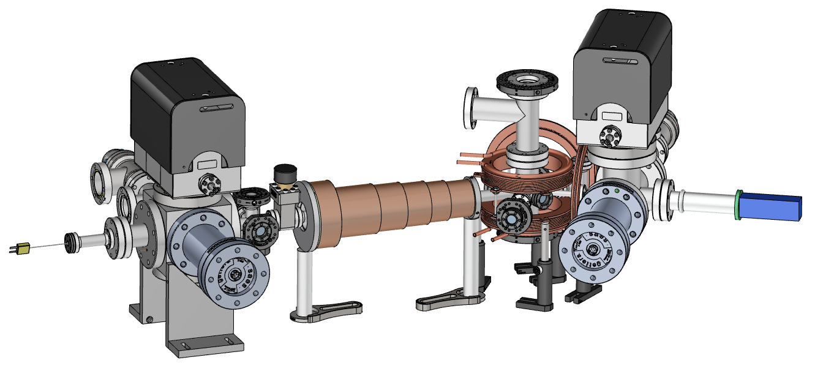


Vacuum design
Load atoms in UHV from a cold beam source
Maintains <10⁻¹¹ Torr vacuum in the glass cell
Bending MOT Chamber
Trapping Region
¹P₁
³P₁
399 nm
556 nm
¹S₀
¹S₀
Oven
$Γ/(2π)$ = 29.1 MHz
$Γ/(2π)$ = 182.4 kHz
Transverse Cooling
Zeeman Slower
10/9/2024 | DNP 2024

Slide 29
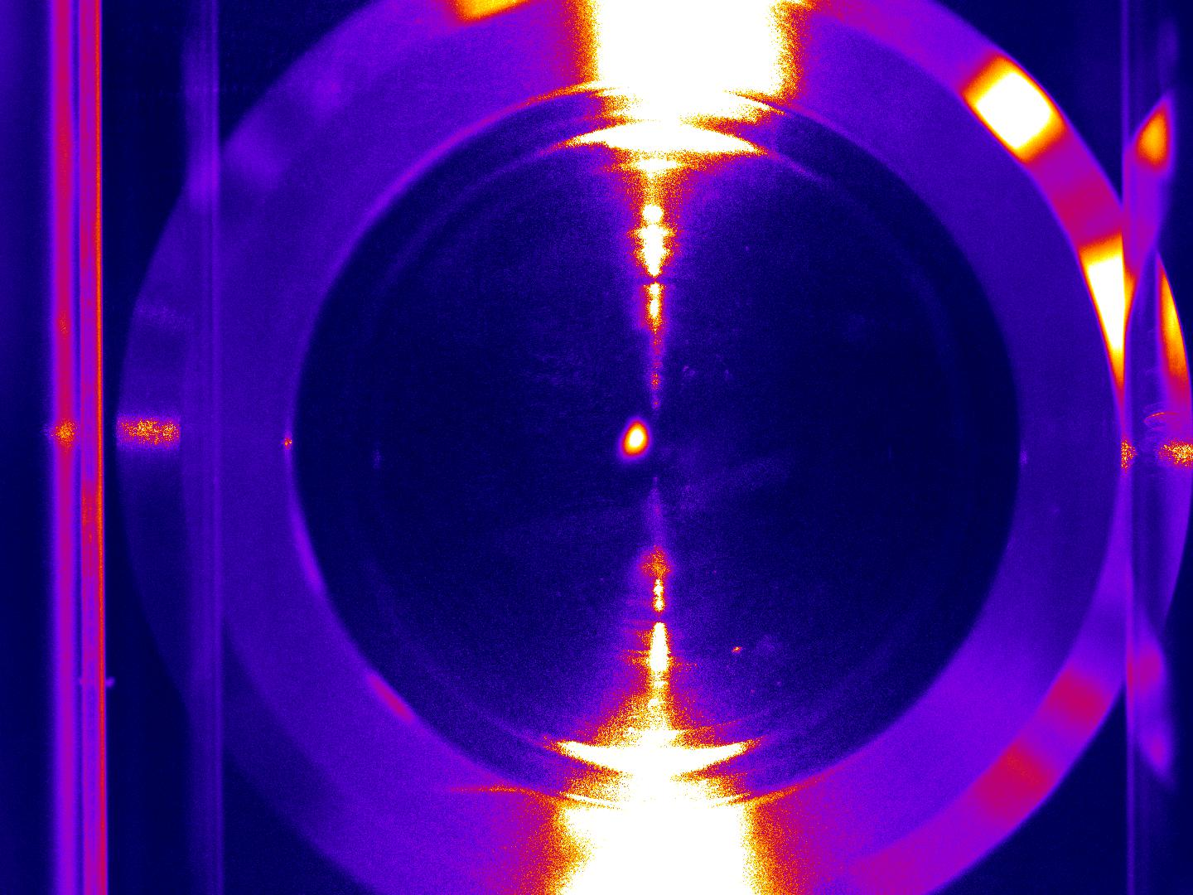
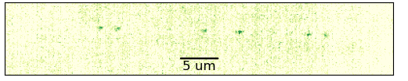
1D ytterbium arrays
Cooling and imaging
Atoms loaded into individual dipole traps
Fluorescence from single atoms can be imaged by sCMOS
10/9/2024 | DNP 2024

Slide 30
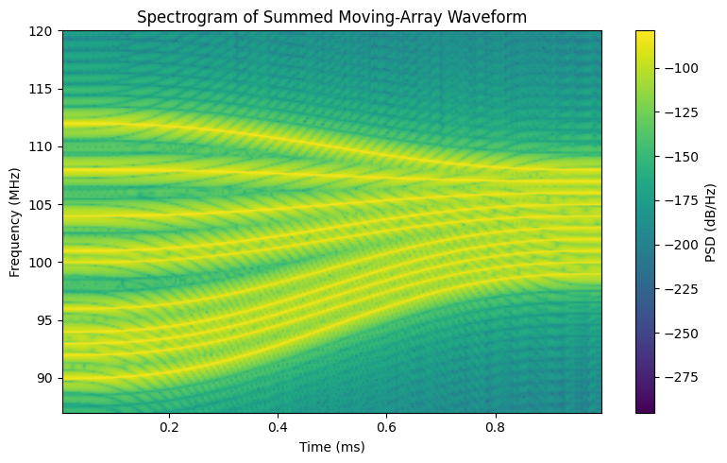
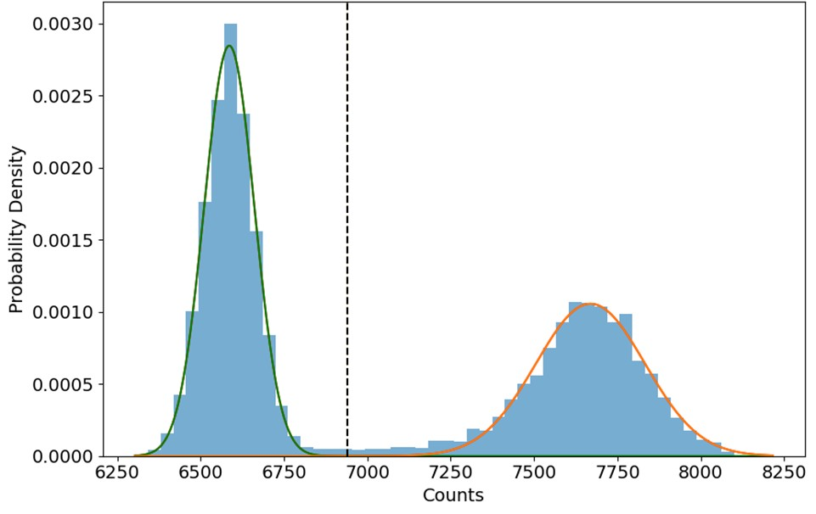
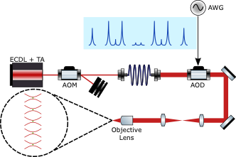


Atom Rearrangement (preliminary)
Defect-free arrays: a pre-requisite for simulations
Image determines site occupancy with high fidelity
Determine occupancy with camera image
Calculate waveform using GPU in 20 ms (Typ.)
Move atoms in 1 ms
First image: before rearrangement
……
Second Image: confirms successful rearrangment
Typical attempt for 10-site defect-free array

Slide 31
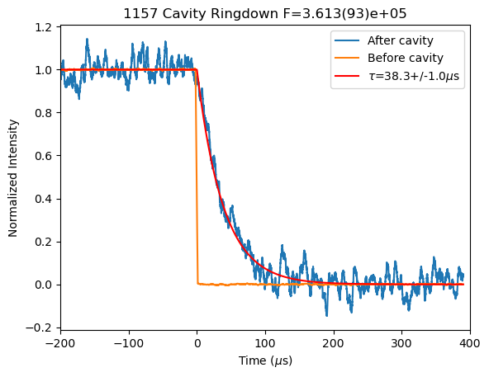
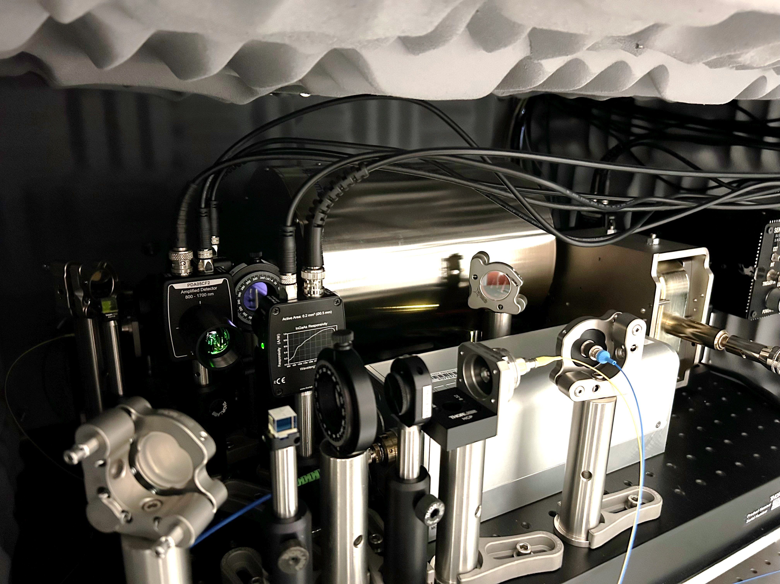
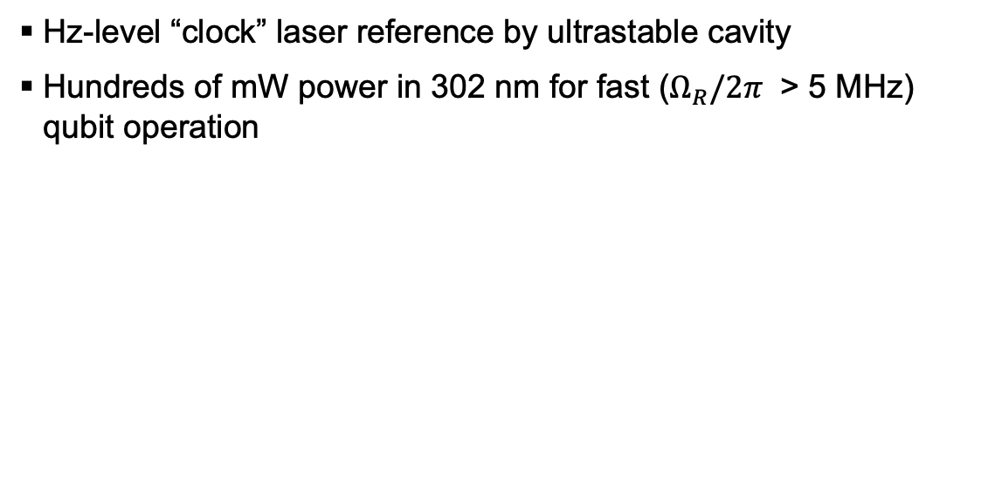

Local Entanglement
³S₁ $n≥50$
Long-coherence qubit operations
Hz-level “clock” laser reference by ultrastable cavity
Hundreds of mW power in 302 nm for fast ($Ω_{R}/2π$ > 5 MHz) qubit operation
302 nm
³P₀
578 nm
¹S₀
10/9/2024 | DNP 2024

Slide 32
The Yb team
PI
Postdoc
Grad Student
Michael
Bishof
Francesco
Granato
Varun
Jorapur
Zeyu
Ye
Collaborator
REU Student
Mouhamed Mbengue
Kevin
Bailey
Tom
O’Connor
Peter
Mueller
Ian
Cloet
Anna
McCoy
10/9/2024 | DNP 2024

Slide 33
Thank you!

Slide 34
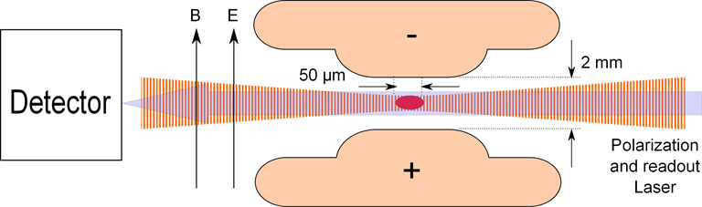





EDM measurement in Radium
¹P₁
F = 1/2
$$\vec{B}$$
483 nm
$$\vec{μ}$$
¹S₀
F = 1/2

Slide 35



EDM measurement in Radium
¹P₁
F = 1/2
$$\vec{B}$$
483 nm
$$\vec{μ}$$
¹S₀
F = 1/2

Slide 36


Ra-EDM Apparatus at ANL
Ra(NO₃)₂+Ba
Oven
Transverse Cooling
HV Electrodes
Magnetic Shielding
& Magnet Coils
Zeeman
Slower
η ~ 1.6*10⁻⁶
²²⁶Ra MOT
200,000 atoms
40 μK
0.6 mm
36
J. R. Guest et al., PRL 98 093001 (2007)

Slide 37



Latest Ra-EDM Measurement
d_{Ra-225} = (4± 6_{stat} ± 0.2_{syst}) × 10⁻²⁴
e-cm
d_{Ra-225} < 1.4 × 10⁻²³ e-cm 95% C.L.
M. Bishof et al. PRC 94, 025501 (2016)
Atom cloud absorption images

Slide 38




Improvements toward 10⁻²⁶ e cm measurement
"QND" spin detection
T. A. Zhang et al., Phys. Rev. Lett. 129, 083001 (2022).
Improved Electrodes
R. A. Ready et al., Nucl. Instrum. Methods Phys. Res., Sect. A 1014, 165738 (2021).
310 m/s
Blue Light Upgrade (BLU)
improved laser cooling and trapping
60
m/s
Atom Flux
D. Booth et al. Spec. Acta B 172, 105967 (2020)
Atom Velocity

Slide 39

Blue Light Upgrade details
¹P₁
All lasers installed at Argonne
100x increase in trapping efficiency
Will enable a sensitivity in the low 10⁻²⁶ e cm
³F₂
633 nm
¹P₁
712 nm
1D2
698 nm
³D₃
483 nm
63%
³D₂
~1%
³D₁
¹S₀

Slide 40

Radium vs. other octupole deformed nuclei
Largest experientially confirmed Schiff moment
Observable EDM
Octupole Moment
Jacek Dobaczewski, Jonathan Engel, Markus Kortelainen, and Pierre Becker, Phys. Rev. Lett. 121, 232501 (2018).

Slide 41
Radium vs. other octupole deformed nuclei
Largest experientially confirmed Schiff moment
*
*
Observable EDM
Octupole Moment
*220eV parity doublet needs to be confirmed
Jacek Dobaczewski, Jonathan Engel, Markus Kortelainen, and Pierre Becker, Phys. Rev. Lett. 121, 232501 (2018).

Slide 42






Simulating nuclear physics
Possibilities with neutral atoms
1 flavor Nambu–Jona-Lasinio model start with 1+1D ^{[1]}
  Interesting to study $\left\langle \overline{ψ}ψ\right\rangle$ with different parameters
  e.g. Dynamic chiral symmetry breaking
  Out-of-equilibrium dynamics can be probed
Application of three-body forces in EFT for halo nuclei and collective effects ^{[2]}
$$H_{±}$$
$$H_{m}$$
$$H_{I}$$
$$H=\frac{1}{2a}\sum_{n=1}^{N}{\left[σ_{n}^{+}σ_{n+1}^{−}+σ_{n+1}^{+}σ_{n}^{−}+ma{\left(−1\right)}^{n}σ_{n}^{z}+\frac{G_{π}}{2}σ_{n}^{z}σ_{n+1}^{z}\right]−\frac{G_{π}N}{4a}}$$
[1] I.C. Cloët, private communication.
[2] H.-W. Hammer, et al. Rev. Mod. Phys. 85, 197 (2013).
10/9/2024 | DNP 2024

Slide 43


EDM of ²²⁵Ra enhanced
Closely spaced parity doublet – Haxton & Henley (1983)
Large intrinsic Schiff moment due to octupole deformation
    – Auerbach, Flambaum & Spevak (1996)
Relativistic atomic structure (²²⁵Ra / ¹⁹⁹Hg ~ 3)
– Dzuba, Flambaum, Ginges, Kozlov (2002)
²²⁵Ra:
I = ½
t_{1/2} = 15 d
Parity doublet
|α⟩
|β⟩
Enhancement Factor: EDM (²²⁵Ra) / EDM (¹⁹⁹Hg)
Skyrme Model | Isoscalar | Isovector
SIII | 300 | 4000
SkM* | 300 | 2000
SLy4 | 700 | 8000
Ψ⁻ = (|α⟩ − |β⟩)/√2
Ψ⁺ = (|α⟩ + |β⟩)/√2
55 keV
Schiff moment of ²²⁵Ra, Dobaczewski, Engel (2005)
Schiff moment of ¹⁹⁹Hg, Ban, Dobaczewski, Engel, Shukla (2010)
Notes:
43

Slide 44
EDM of ²²⁵Ra enhanced
Closely spaced parity doublet – Haxton & Henley (1983)
Large intrinsic Schiff moment due to octupole deformation
    – Auerbach, Flambaum & Spevak (1996)
Relativistic atomic structure (²²⁵Ra / ¹⁹⁹Hg ~ 3)
– Dzuba, Flambaum, Ginges, Kozlov (2002)
²²⁵Ra:
I = ½
t_{1/2} = 15 d
Parity doublet
|α⟩
|β⟩
Enhancement Factor: EDM (²²⁵Ra) / EDM (¹⁹⁹Hg)
Skyrme Model | Isoscalar | Isovector
SIII | 300 | 4000
SkM* | 300 | 2000
SLy4 | 700 | 8000
Ψ⁻ = (|α⟩ − |β⟩)/√2
Ψ⁺ = (|α⟩ + |β⟩)/√2
55 keV
Schiff moment of ²²⁵Ra, Dobaczewski, Engel (2005)
Schiff moment of ¹⁹⁹Hg, Ban, Dobaczewski, Engel, Shukla (2010)
Notes:
44

