Slide 1



Investigating weak decays with nuclear density functional theory
Ante Ravlić (ravlic@frib.msu.edu)
Facility for Rare Isotope Beams, Michigan State University
East Lansing, US
FRIB-TA: Future directions in nuclear beta decay at FRIB, Sep 19th 2025

Slide 2



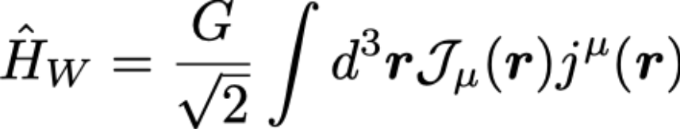



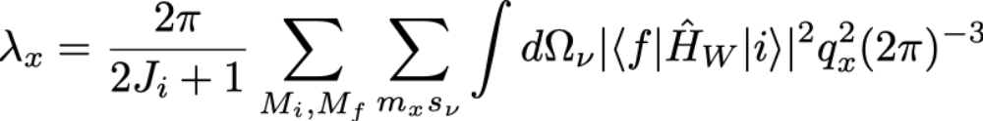



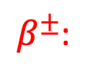
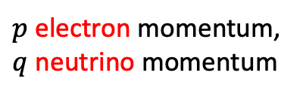
Current-current form of weak-interaction Hamiltonian:
β-decay:
First-order time-dependent perturbation theory (Fermi rule):
Electron capture:
EC:
$β^{±}$:
$p$ electron momentum, $q$ neutrino momentum
Depends on kinematics
[W. Bambynek, H. Behrens, et al., Rev. Mod. Phys. 49, 77 (1977). ]

Slide 3

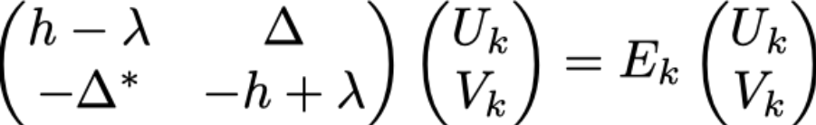
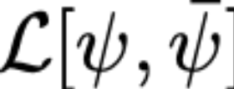

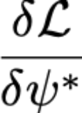

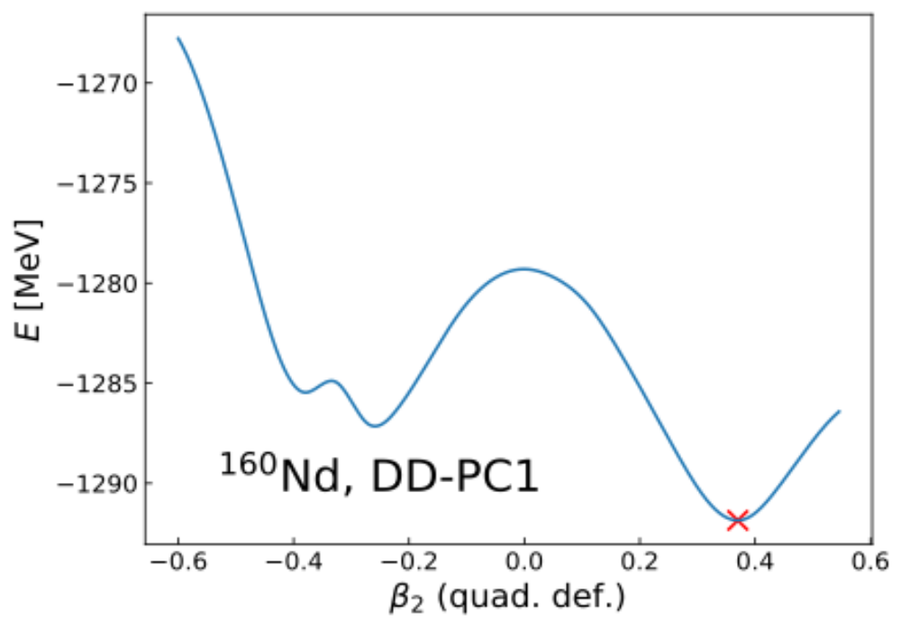
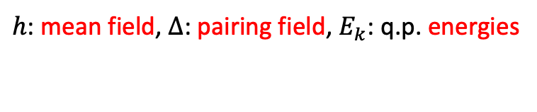
[J. Meng, Relativistic density functional for nuclear structure. Vol. 10.
World Scientific (2016).]
Ground state
Solve relativistic Hartree-Bogoliubov equation:
$h$: mean field, $Δ$: pairing field, $E_{k}$: q.p. energies
Quadrupole constraint ($β_{2}$) potential energy curve (PEC):
Density Functional Theory

Slide 4









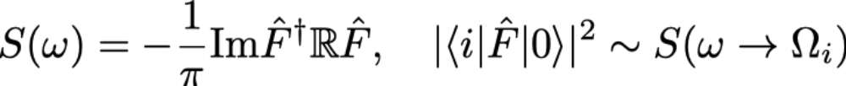






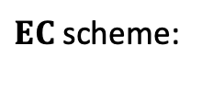


Excited states
Strength
Quasiparticle Random-Phase Approximation (QRPA)
$EC$scheme:
[A. Ravlić, Y.F. Niu et al., PRC 104, 064302 (2021).]
[A. Ravlić, T. Niksic et al., PRC 110, 024323, (2024).]

Slide 5

What about leptons?
Single-particle orbital
Multiple electrons in the cloud

Slide 6
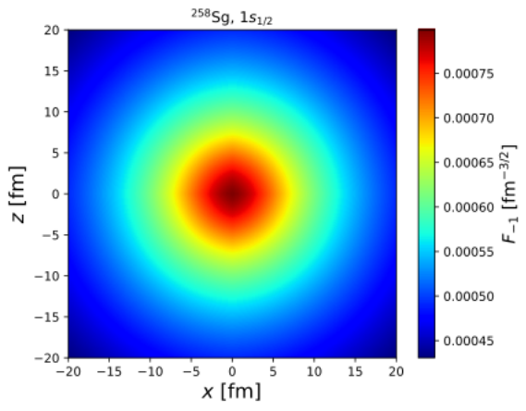
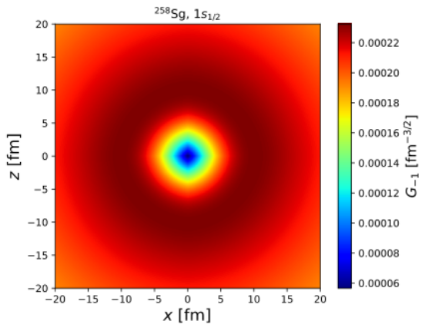
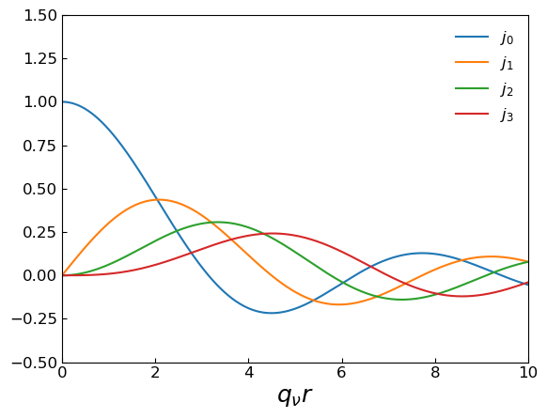
What about leptons?
For electron: Solve the Dirac equation with nuclear charge distribution
For neutrino: expand into multipoles, spherical Bessel functions
Single-particle orbital

Slide 7
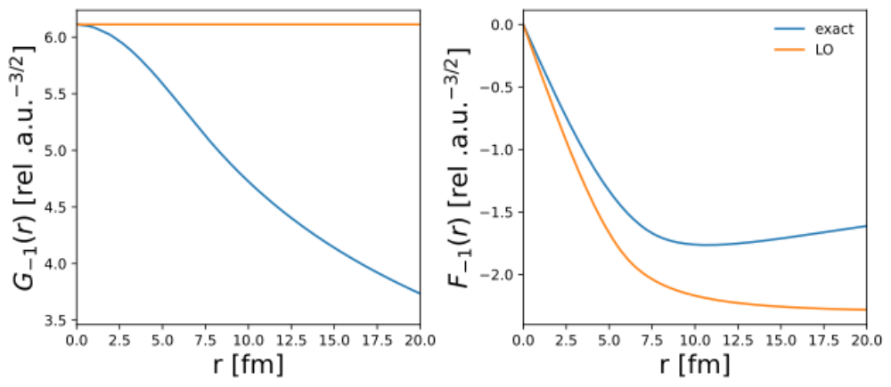
What about leptons?
For electron: Solve the Dirac equation with nuclear charge distribution
It is challenging to take full spatial distribution of lepton wave functions into account
Parametrize atomic physics by Coulomb amplitudes (β_{x})
For neutrino: expand into multipoles, spherical Bessel functions
Single-particle orbital

Slide 8

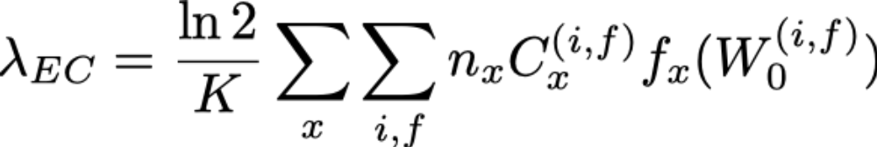
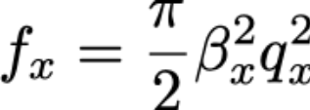
LO expression for EC
[F. Salvat, et al., Comput. Phys. Commun. 90, 151 (1995).]
Coulomb amplitudes (RADIAL solver)
phase-space factor:
neutrino transfer
Nuclear physics is contained in shape-factor $C_{x}^{(i,f)}$ with the form:
[W. Bambynek, H. Behrens, et al., Rev. Mod. Phys. 49, 77 (1977). ]

Slide 9
Superheavy nuclei

Slide 10


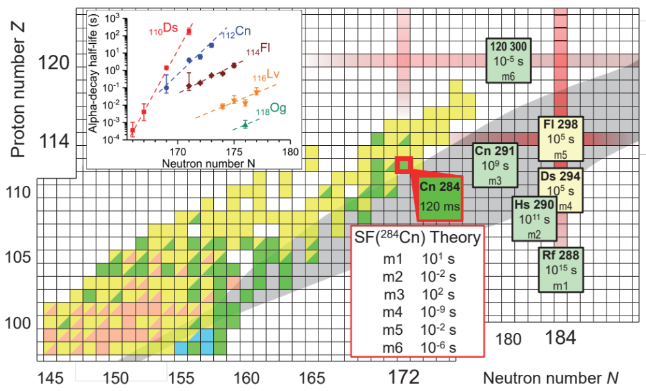
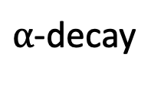
Superheavy nuclei
$α$-decay
strong force
fission
Electron capture
weak force
large uncertainties
SHE and superfast
EC ?
[O. Smits et al., Nat. Rev. Phys. 6, 86 (2024).]

Slide 11
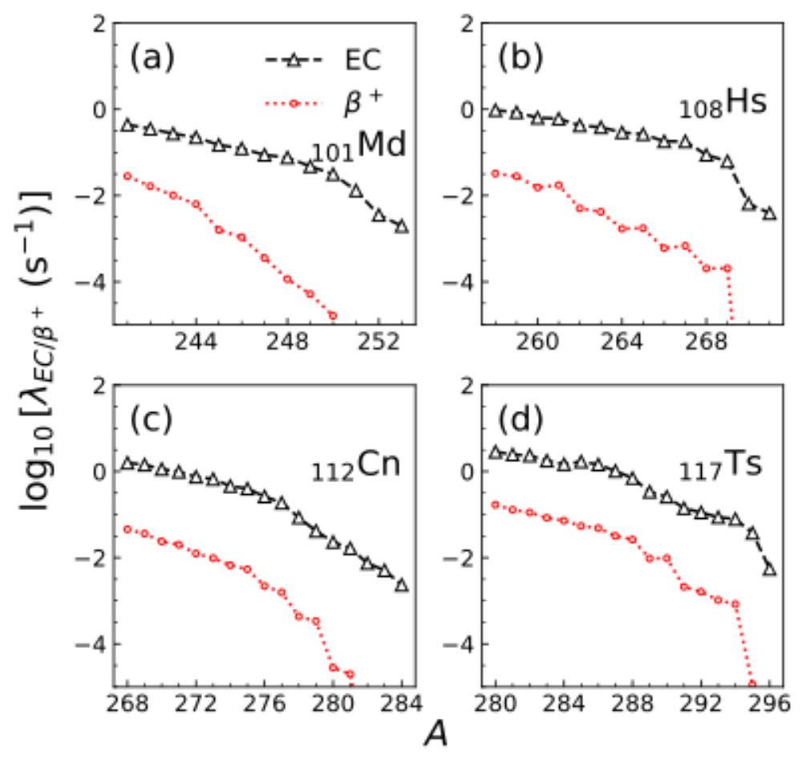
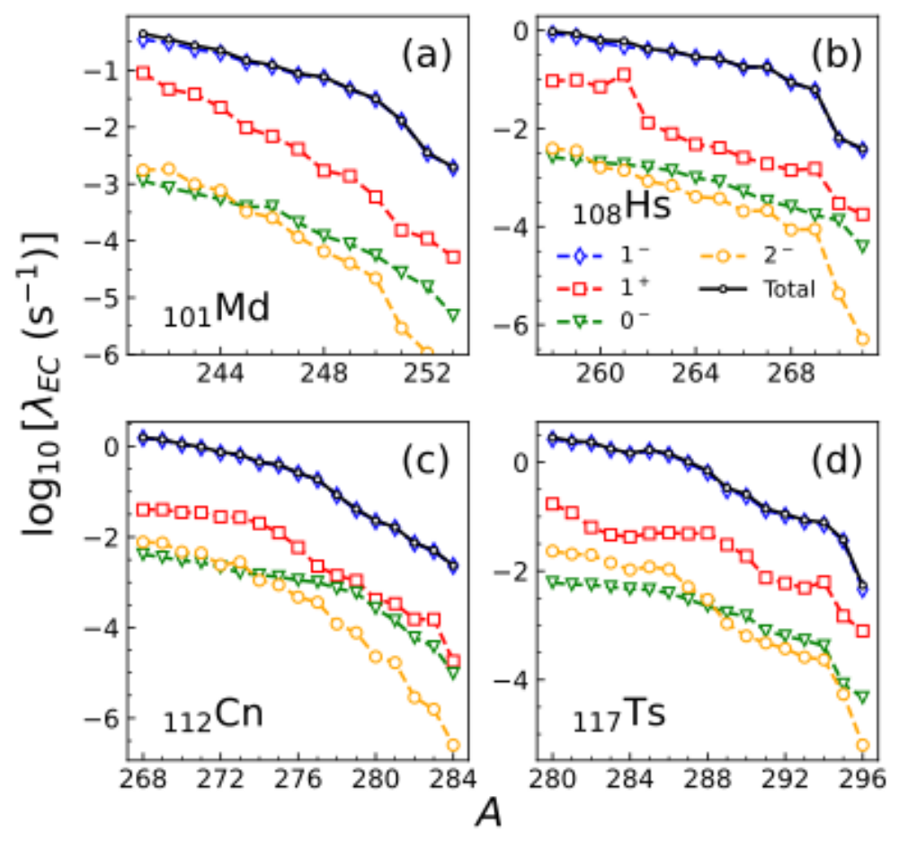

[A. Ravlic and W. Nazarewicz, PRC 111, L051305 (2025).]
Goal: find candidates where EC could compete with fission and ⍺-decay:
First-forbidden transitions dominate over allowed:
EC dominates over $β^{+}$-decay:

Slide 12
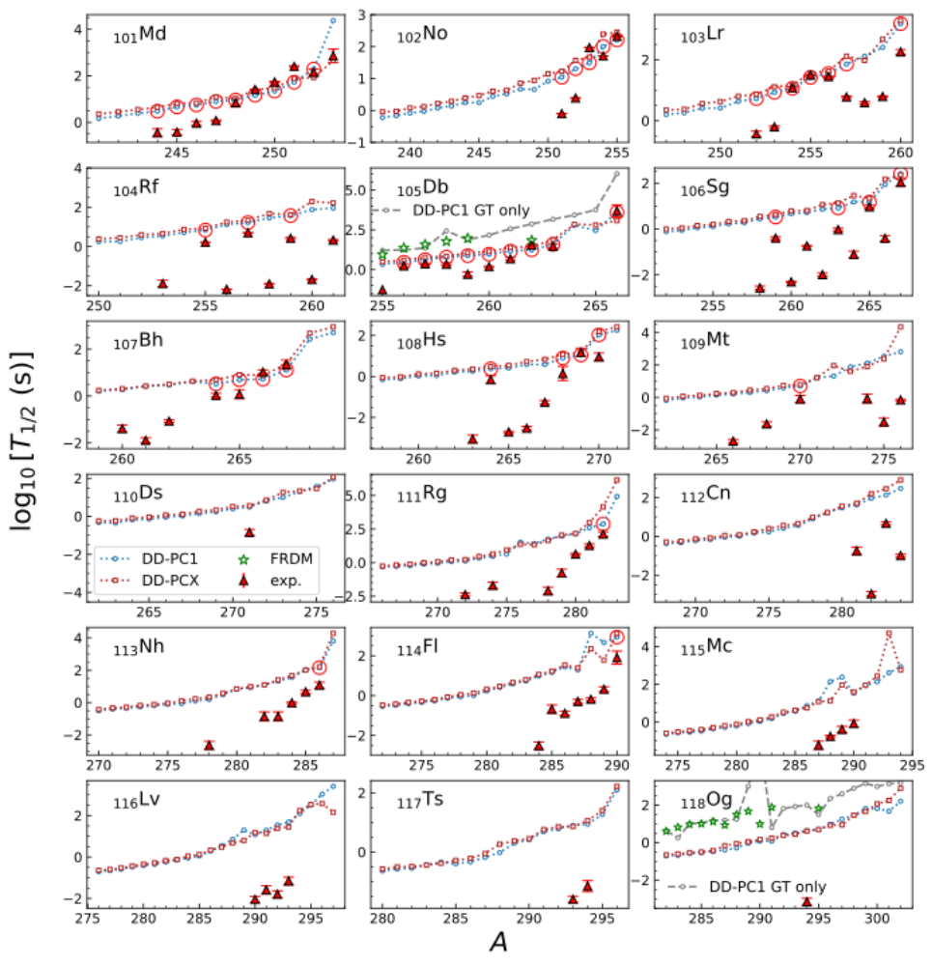
identify candidate where EC can compete with ⍺-decay and fission
we consider
two EDFs: DD-PC1 and DD-PCX
Found candidates
where EC could have
branching > 5%
previous calculations miss
important contribution of
FF transitions
[A. Ravlic and W. Nazarewicz, PRC 111, L051305 (2025).]

Slide 13
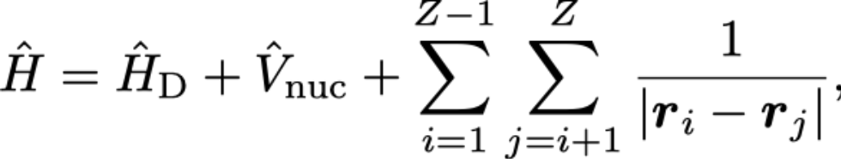
What if we take full radial dependence of lepton wavefunctions into account ?
Solve the many-body problem
nucleus-electron Coulomb interaction
interaction between electrons
Multiple electrons in the cloud

Slide 14
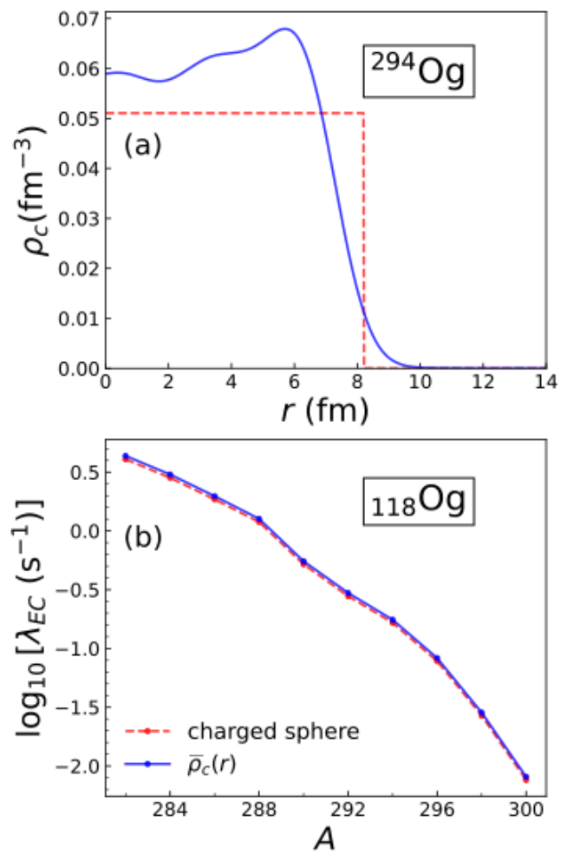
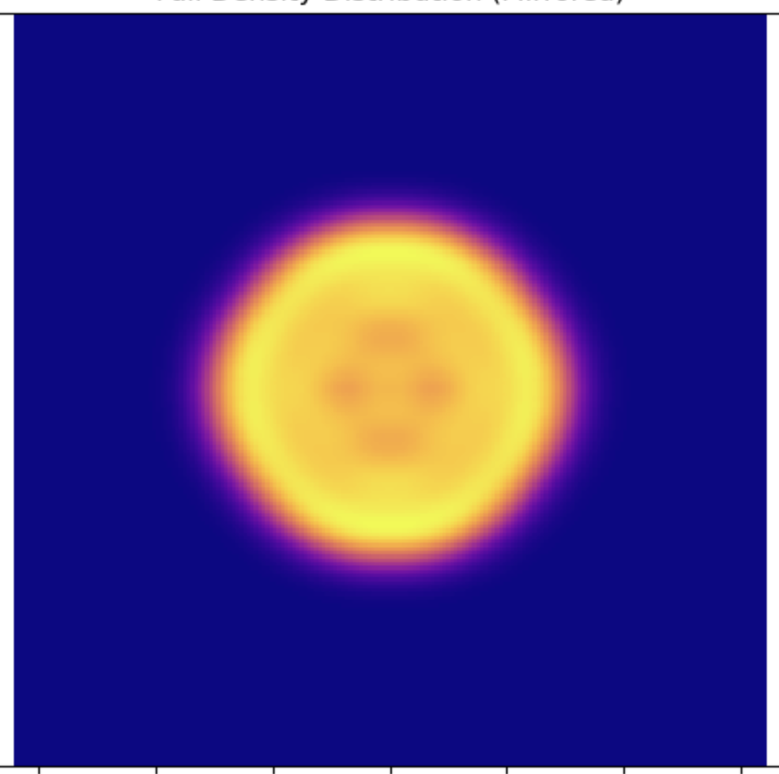
What if we take full radial dependence of lepton wavefunctions into account ?
Solve the many-body problem
nucleus-electron Coulomb interaction
interaction between electrons
Multiple electrons in the cloud

Slide 15
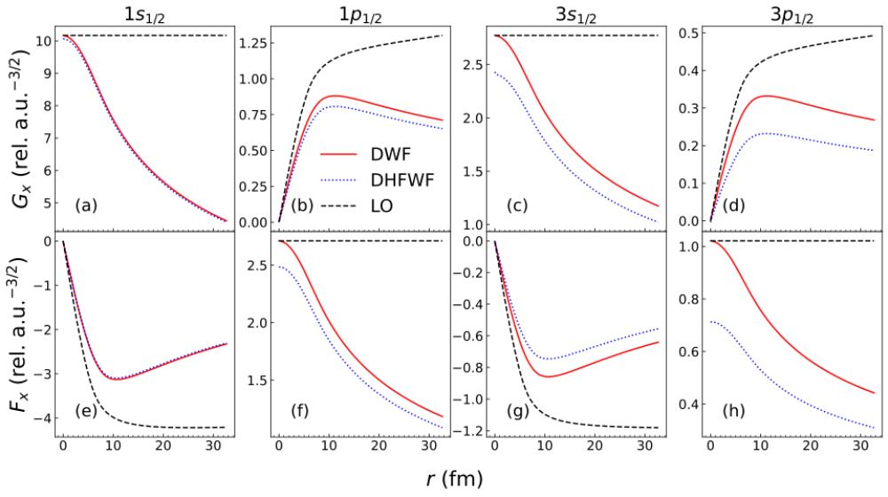
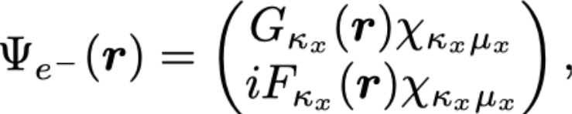
What if we take full radial dependence of lepton wavefunctions into account ?
DWF – Dirac single-particle
DHFWF – Dirac Hartree-Fock
LO – lowest order calculation
[A. Ravlic, P. Schwerdtfeger and W. Nazarewicz, PRC 111, 064323 (2025).]

Slide 16
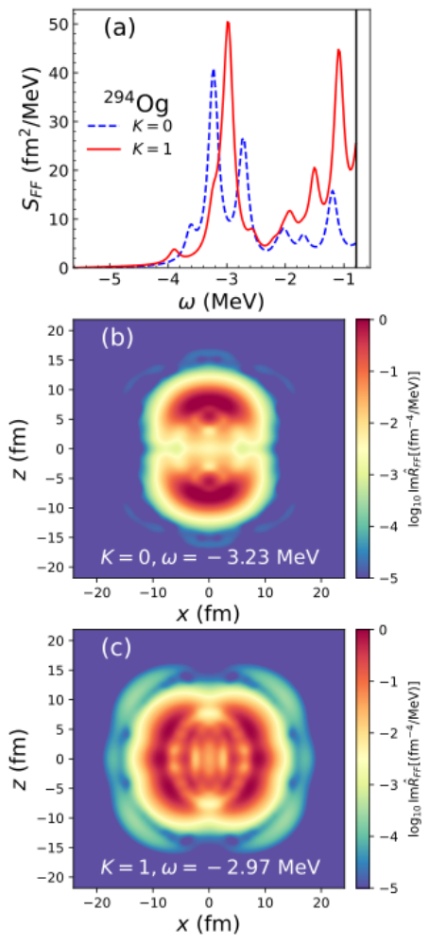
What if we take full radial dependence of lepton wavefunctions into account ?
DWF – Dirac single-particle
DHFWF – Dirac Hartree-Fock
LO – lowest order calculation
[A. Ravlic, P. Schwerdtfeger and W. Nazarewicz, PRC 111, 064323 (2025).]

Slide 17
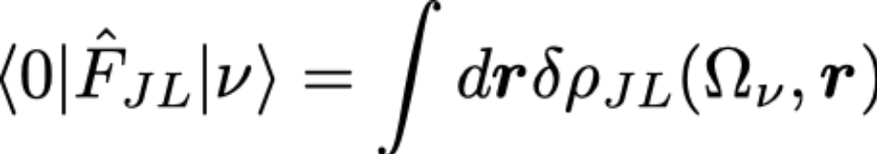
What if we take full radial dependence of lepton wavefunctions into account ?
We can introduce transition density
in the coordinate-space:
DWF – Dirac single-particle
DHFWF – Dirac Hartree-Fock
LO – lowest order calculation
[A. Ravlic, P. Schwerdtfeger and W. Nazarewicz, PRC 111, 064323 (2025).]

Slide 18
What if we take full radial dependence of lepton wavefunctions into account ?
DWF – Dirac single-particle
DHFWF – Dirac Hartree-Fock
LO – lowest order calculation
[A. Ravlic, P. Schwerdtfeger and W. Nazarewicz, PRC 111, 064323 (2025).]

Slide 19
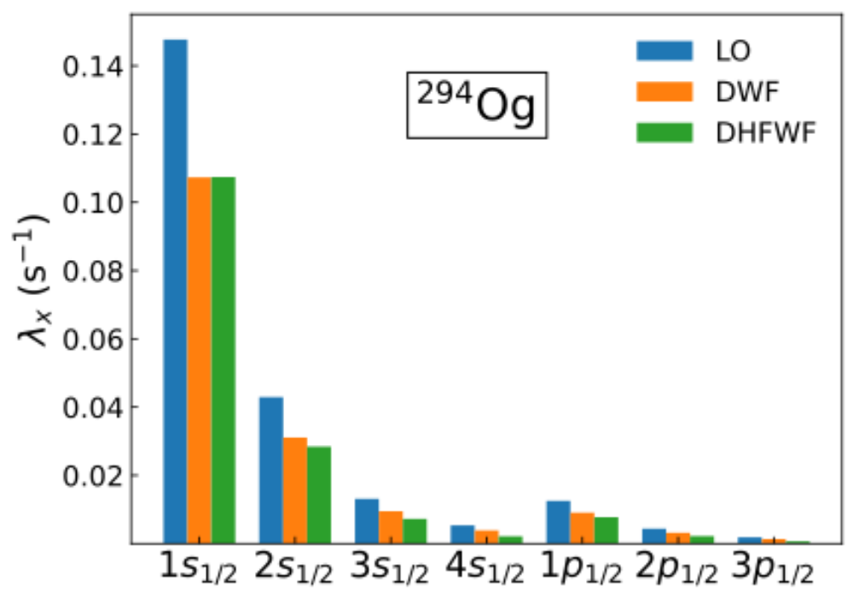
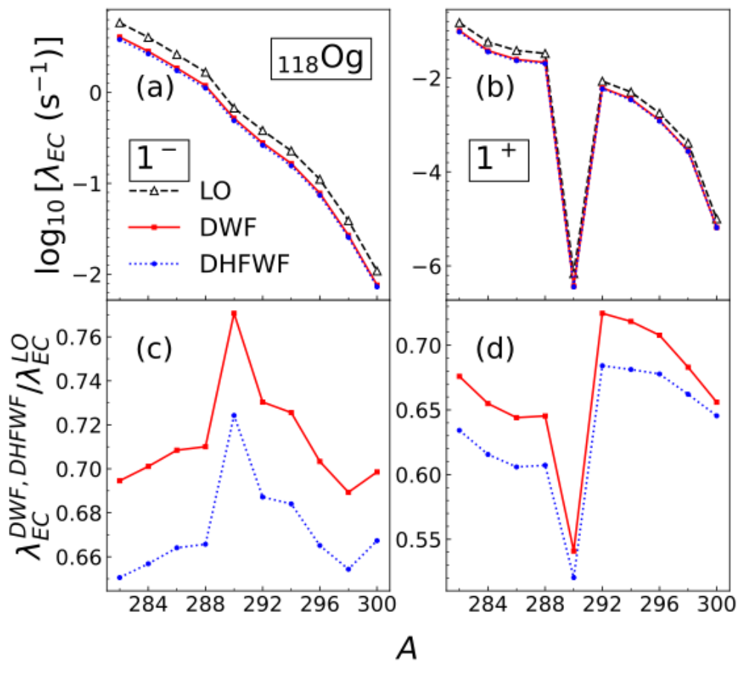
s_{1/2} electron ”shielded” by strong nuclear charge in SHE
[A. Ravlic, P. Schwerdtfeger and W. Nazarewicz, PRC 111, 064323 (2025).]

Slide 20
Global calculations of β-decay rates

Slide 21
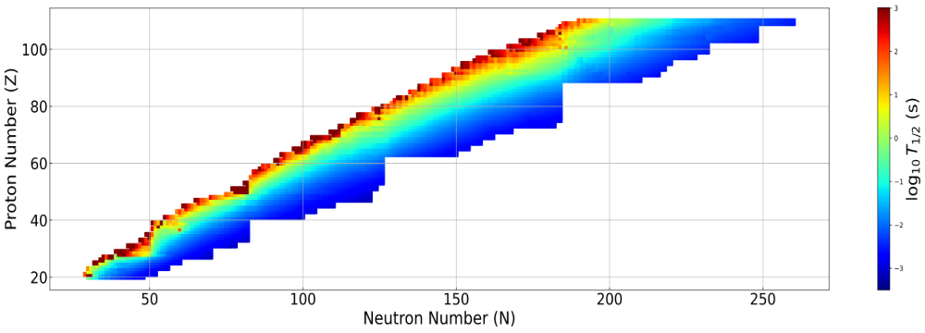

DD-PC1(X) + optimized time-odd terms
GT(1⁺) + first forbidden (0⁻,1⁻,2⁻)
See Yukiya Saito’s talk on Thursday !
[A. Ravlic, Y. Saito and W. Nazarewicz, in preparation (2025)]

Slide 22


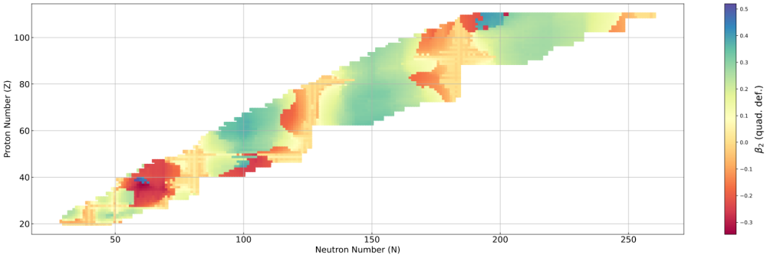
axially-deformed RHB state with reflection symmetry
Equal Filling Approximation blocking RHB+QRPA for odd-A and odd-odd nuclei
built on top of
even-even vacuum
odd q.p. state

Slide 23
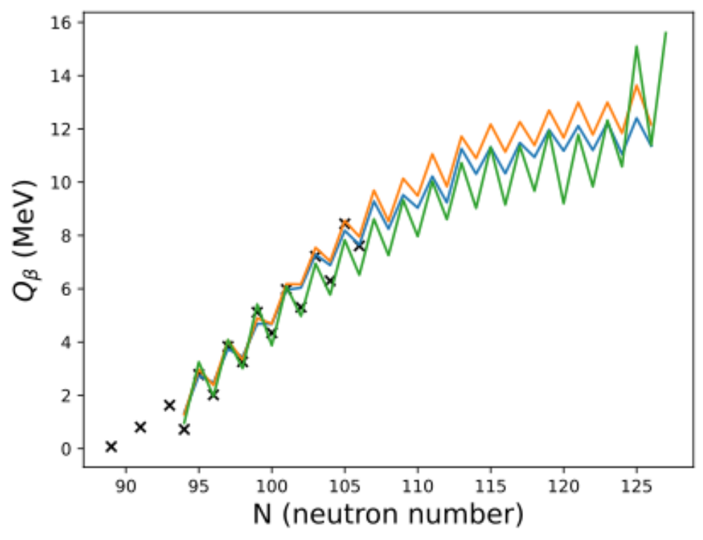
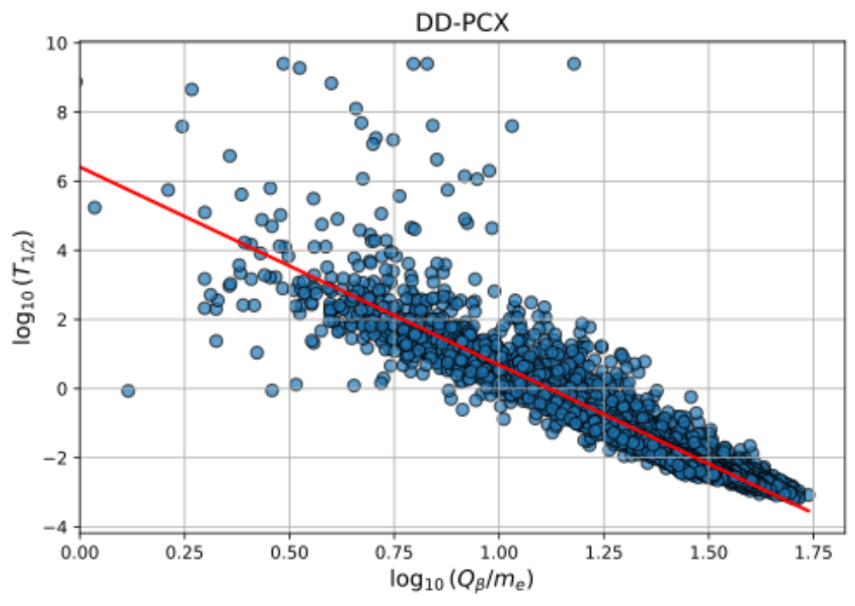
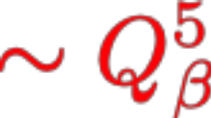
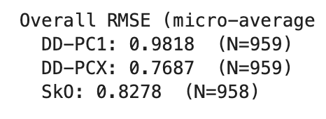
Q-values calculated self-consistently within the model:
Half-lives vs Q-values:
Z = 62
in MeV
See discussion in:
[E. M. Ney, J. Engel, T. Li, N. Schunck, Phys. Rev. C 102, 034326 (2020)]

Slide 24
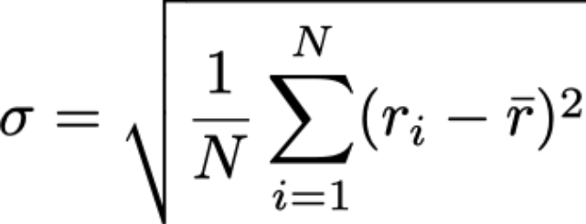
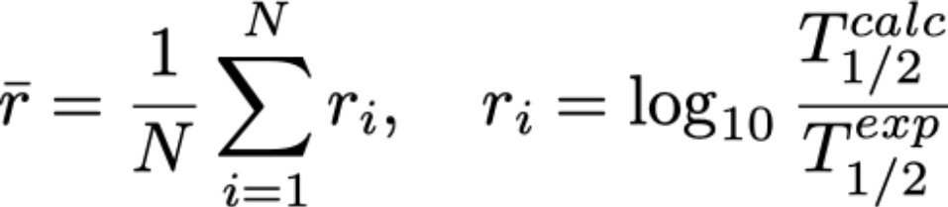
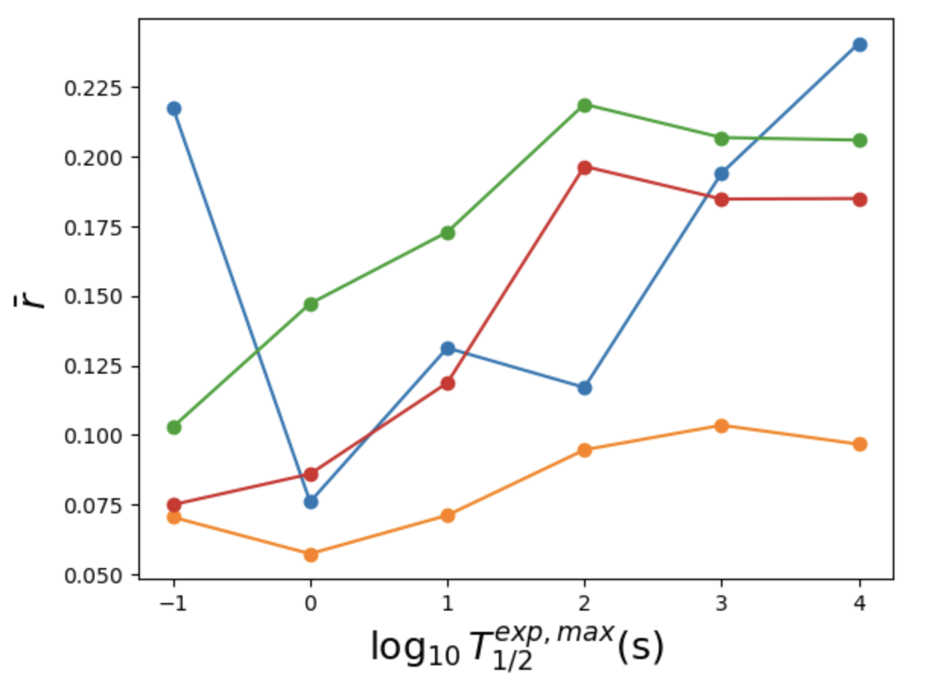
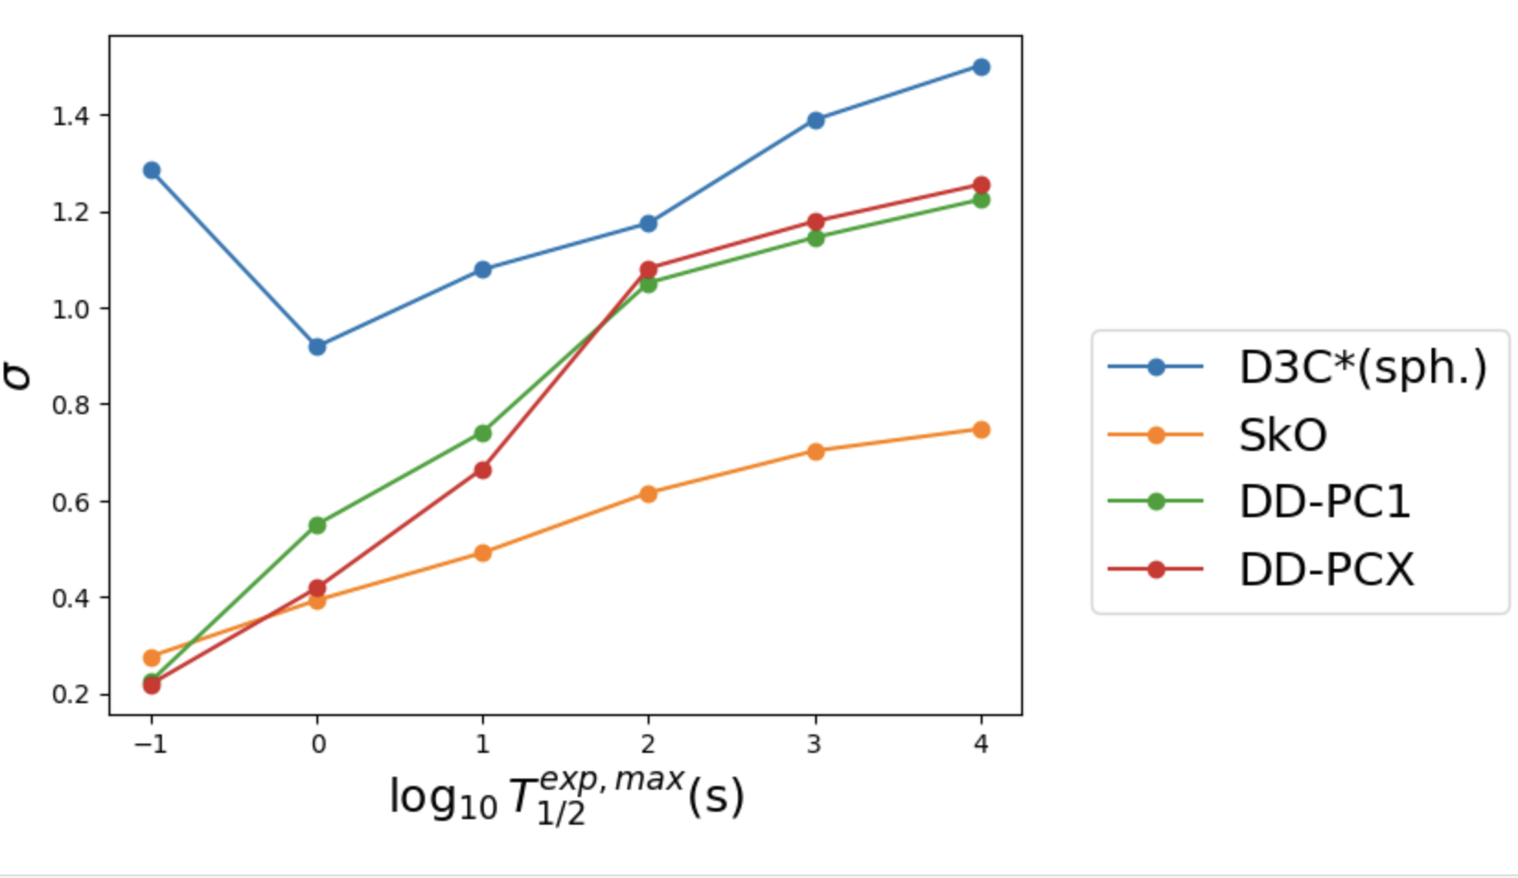
Performance on experimental data (NUBASE2020):
Preliminary

Slide 25
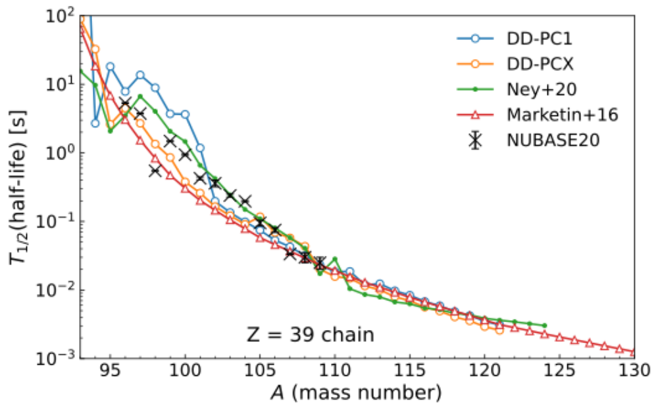
Global β-decay calculations
Half-life is just the moment of distribution, it hides a lot of underlying structure
DD-PC1(X)
[A. Ravlic, Y. Saito and W. Nazarewicz, in preparation (2025)]
[T. Marketin, L. Huther, G. Martinez-Pinedo, PRC 93, 025805 (2016)]
[E. M. Ney, J. Engel, T. Li, N. Schunck, Phys. Rev. C 102, 034326 (2020)]
[A. Ravlic, Y. Saito and W. Nazarewicz, in preparation (2025)]

Slide 26
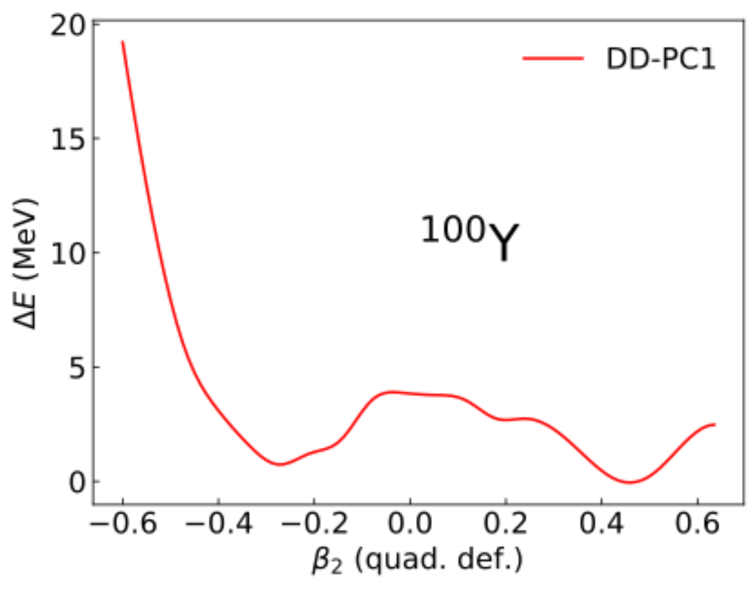
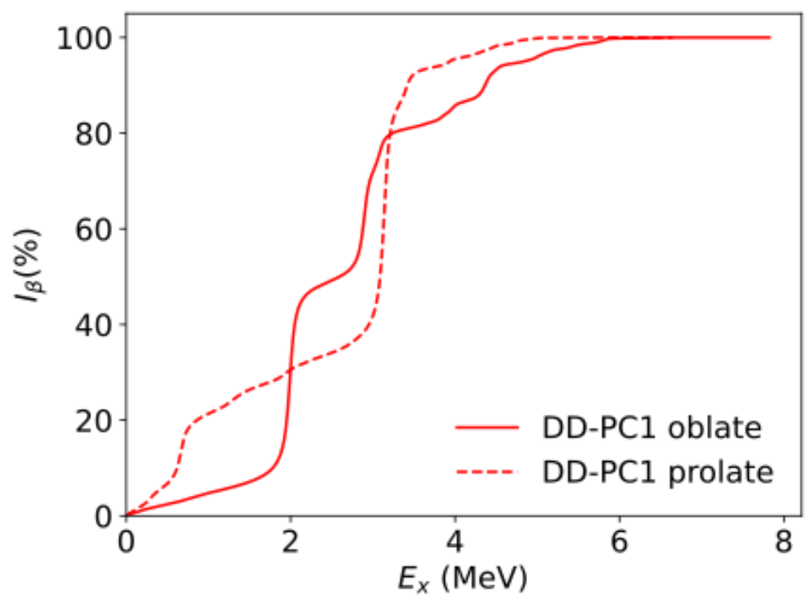
[A. Ravlic, Y. Saito and W. Nazarewicz, in preparation (2025)]

Slide 27
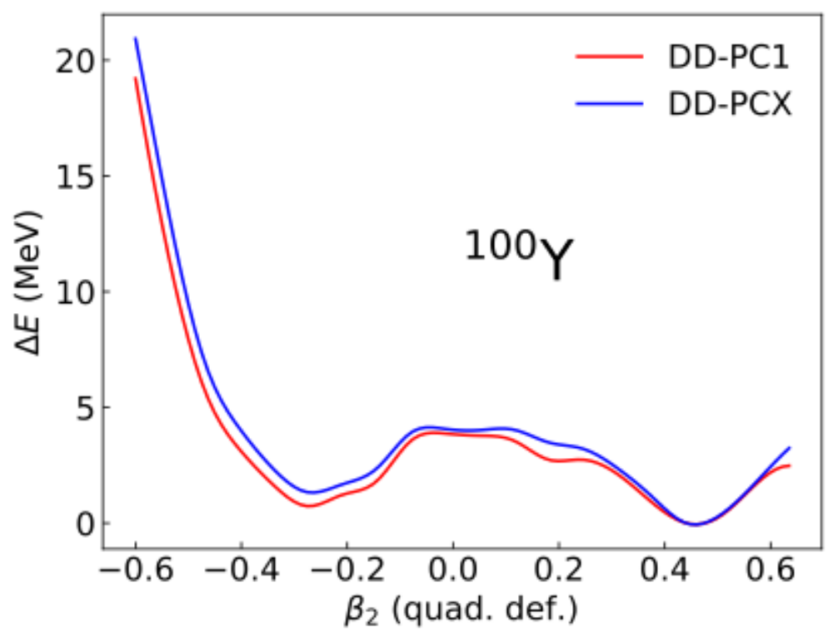
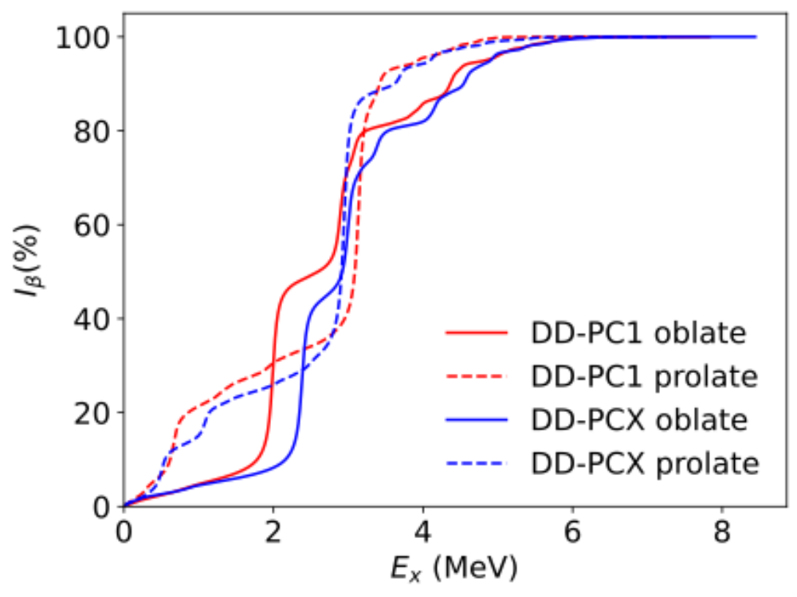
[A. Ravlic, Y. Saito and W. Nazarewicz, in preparation (2025)]

Slide 28
Costly calculations, intrinsic dimension of the QRPA matrix ≅ 10⁵
How to systematically assess uncertainty?
[A. Ravlic, Y. Saito and W. Nazarewicz, in preparation (2025)]

Slide 29
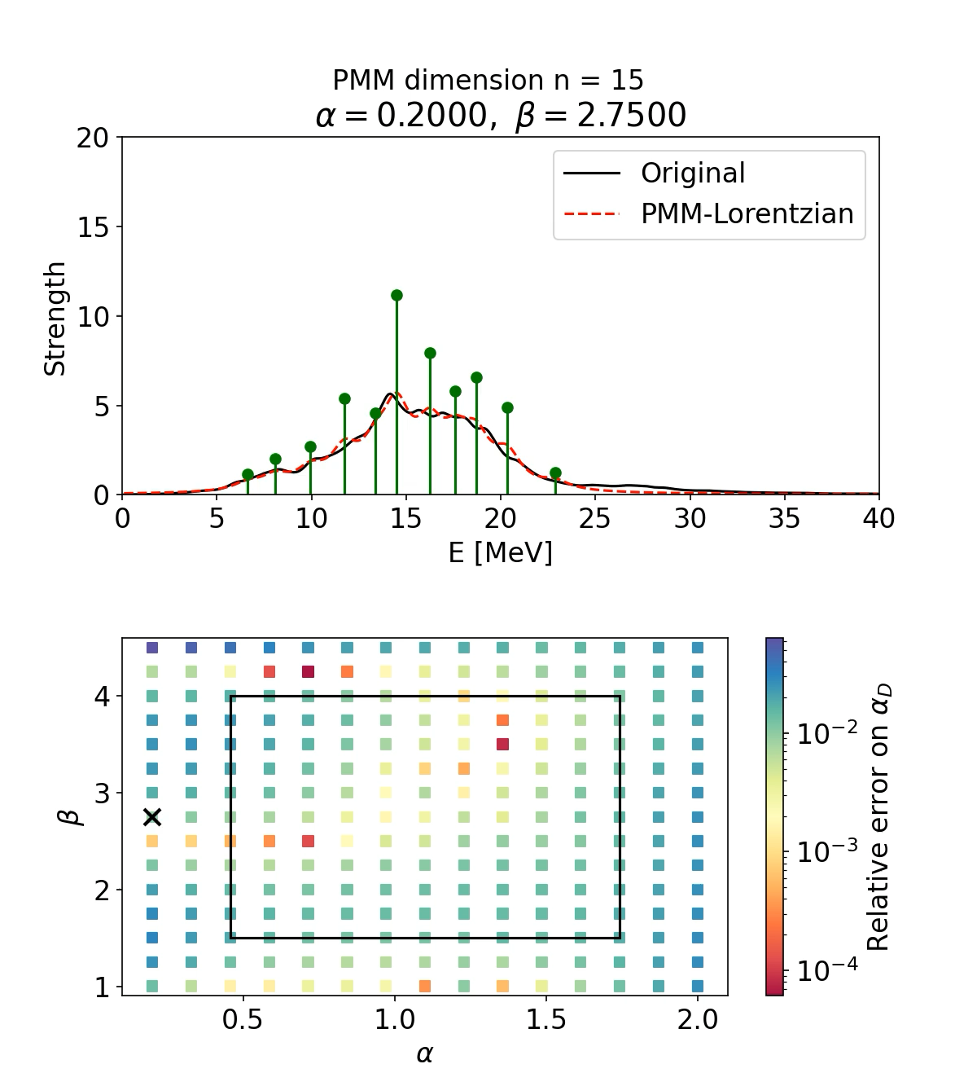

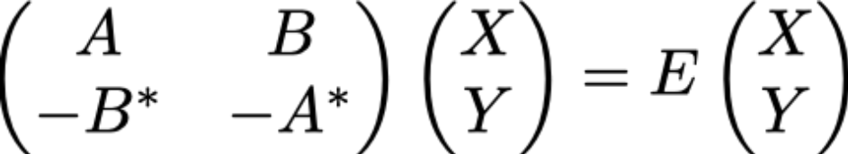
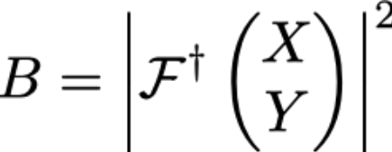

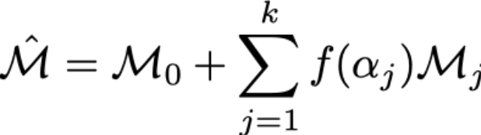


Full-order model:
¹⁸⁰Yb
Emulator:
Work by Lauren Jin @ MSU
[P. Cook, D. Jammooa, M. Hjorth-Jensen, D. D. Lee, D. Lee, Nat. Commun. 16 5929 (2025).]
[L. Jin, A. Ravlic, P. Giuliani, K. Godbey and W. Nazarewicz, in prep (2025)]

Slide 30
Weak decays in stellar conditions

Slide 31







Expression for electron capture rate in stellar environment:
Requires knowledge on nuclear matrix elements at finite-temperature
→ Calculated using finite-temperature QRPA (FT-QRPA)
Fermi-Dirac factor – takes into account density dependence of rates
[A. Ravlic, E. M. Ney, J. Engel, and N. Paar, Eur. Phys. J A 61(2) 37 (2025).]
[A. Ravlic, E. Yüksel et al. PRC 102, 065804 (2020).]

Slide 32

Different microscopic EC calculations (based on shell-model):
Our first study: include nuclei in the “diamond” region around N = 50
[C. Sullivan, E. O’Connor, R. Zegers et al. ApJ 816(1), 44 (2016).]

Slide 33



We employed 3 theoretical models:
non-relativistic FT-QRPA (SkO’)
relativistic FT-PNRQRPA (D3C*)
shell-model for ⁸⁶Kr
FT-QRPA
/
FT-PNRQRPA
Allowed + FF / Allowed
cold
hot
FT-QRPA
FT-PNRQRPA
shell-model
[S. Giraud, E.M. Ney, A. Ravlic et al. PRC 105, 055801 (2022).]

Slide 34






We employed 3 theoretical models:
non-relativistic FT-QRPA (SkO’)
relativistic FT-PNRQRPA (D3C*)
shell-model for ⁸⁶Kr
Results for main CCSNe observables:
FT-QRPA
/
FT-PNRQRPA
Allowed + FF / Allowed
cold
hot
FT-QRPA
FT-PNRQRPA
shell-model
[S. Giraud, E.M. Ney, A. Ravlic et al. PRC 105, 055801 (2022).]

Slide 35

Let’s consider “all” nuclei within the FT-PNRQRPA:
[www.remcozegers.com/weak-rate-library]

Slide 36

GT(EDF) – FT-PNRQRPA with Gamow-Teller only
GT+FF(EDF) – FT-PNRQRPA with Gamow-Teller + first-forbidden
GT(SM+EDF) – FT-PNRQRPA with Gamow-Teller + shell-model where available
[A. Ravlic, S. Giraud, R. Zegers and N. Paar, PRC 112, L032801 (2025).]

Slide 37




What about stellar β-decay rates ?
Work by Troy Dasher @ MSU
NuLib + GR1D framework
[CQG 27(11), 114103 (2010), Astrophys. J. Suppl. Ser. 219, 24 (2015).]
yes β
(anti)
1)
2)
3)
no β
4)
5)
6)
yes β
no β
[T. Dasher, A. Ravlic, S. Lalit, E. O’Connor, in preparation]

Slide 38

Conclusion
We performed calculations of weak decays in SHEs using quantified relativistic DFT
EC can compete with $α$-decay and fission for $Z<109$
First-forbidden transitions dominate weak decay rates → more sensitive to details of nuclear structure
Considering detailed electronic structure leads to visible effects in the decay rates for SHEs
Global calculations of β-decay rates for r-process simulations
Developed emulators for the efficient calculation of QRPA observables
Application to stellar collapse → extension of QRPA at finite-temp

Slide 39
Thank you for your attention!
Collaborators: Witek Nazarewicz (FRIB/MSU)
Kyle Godbey (FRIB/MSU)
Pablo Giuliani (FRIB/MSU)
Lauren Jin (FRIB/MSU)
Yukiya Saito (NP3M)
Peter Schwerdtfeger (Massey Univ., NZ)
Troy Dasher (FRIB/MSU)
Sudhanva Lalit (FRIB/MSU)
Remco Zegers (FRIB/MSU)
This work was supported by the U.S. Department of Energy under Award Number DE-NA0004074 (NNSA, the Stewardship Science Academic Alliances program)

