Slide 1
β-decay constraints at FRIB using
Total Absorption Spectroscopy
Artemis Spyrou

Slide 2
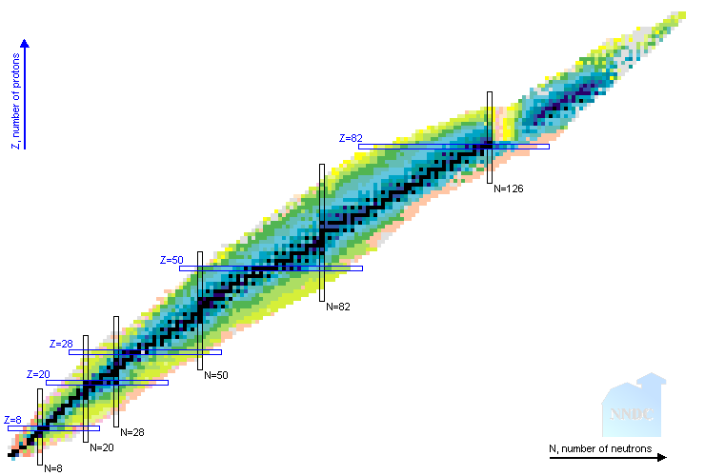
Synthesis of Elements in the Universe
Most astrophysical processes extend into nuclei far from stability
Nuclear input needs different for each process
Sensitivity studies help to identify critical properties
Z=82
s process
r process
N=126
p process
proton
Z=50
rp,νp process
i process
N=82
Z=28
Weak r process
Disentangling contributions from the various processes requires coordinated efforts from all Nuclear Astrophysics sub-fields.
Z=20
Fe
nova
N=50
Z=8
stellar fusion
N=28
neutron
N=20
N=8

Slide 3
Synthesis of Elements in the Universe
Most astrophysical processes extend into nuclei far from stability
Nuclear input needs different for each process
Sensitivity studies help to identify critical properties
Masses
Decay properties
(n,γ) reaction rates
(α,n) reactions
Fission
Isomers
(n,γ) reaction rates
Neutron sources
Z=82
(p,γ), (α,γ) reaction rates
Neutron sources
s process
r process
N=126
p process
(p,γ), (n,p) reaction rates
Masses
proton
Z=50
(n,γ) reaction rates
Neutron sources
rp,νp process
i process
N=82
Z=28
Weak r process
Disentangling contributions from the various processes requires coordinated efforts from all Nuclear Astrophysics sub-fields.
Z=20
Fe
nova
N=50
(n,γ) reaction rates
(α,n) reaction rates
Decay properties
Z=8
stellar fusion
N=28
neutron
N=20
N=8

Slide 4
β decay as a tool to study neutron-capture reactions
Direct measurement of (n,γ) reactions on short-lived isotopes: challenging
Indirect techniques to provide constraints
β-Oslo method:
Use β decay to populate compound nucleus
Extract Nuclear Level Density and γ-ray strength function
Use them to constrain neutron-capture
¹³⁹Ba
¹⁴⁰Ba
β⁻
(n,γ)
¹⁴⁰Cs
(n,γ)
β⁻
(A, Z-1)
(A-1, Z)
γ
Needs
Radioactive Ion Beam
Device to measure:
  Excitation energy
  γ-ray energy
Larsen et al, PPNP 107 (2019) 69
Spyrou, Liddick, et. al., PRL 2014
(A, Z)
Spyrou, Liddick et al., PRL 2014
Liddick, Spyrou, et al., PRL 2016

Slide 5
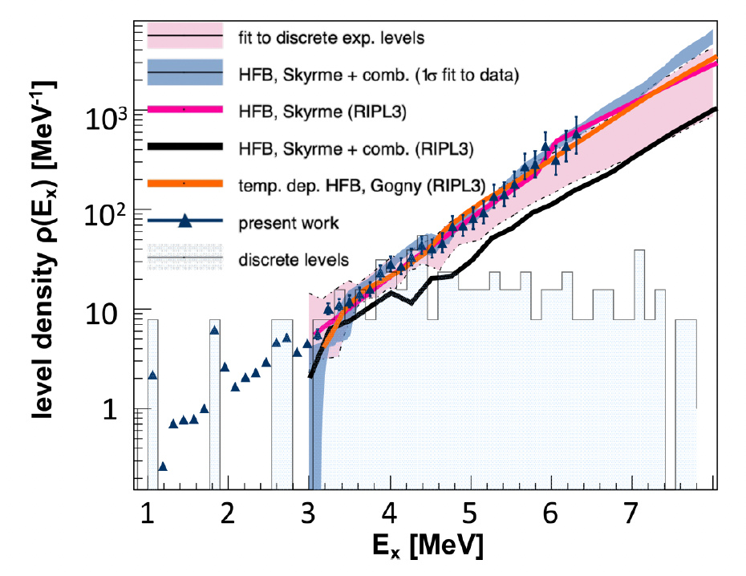
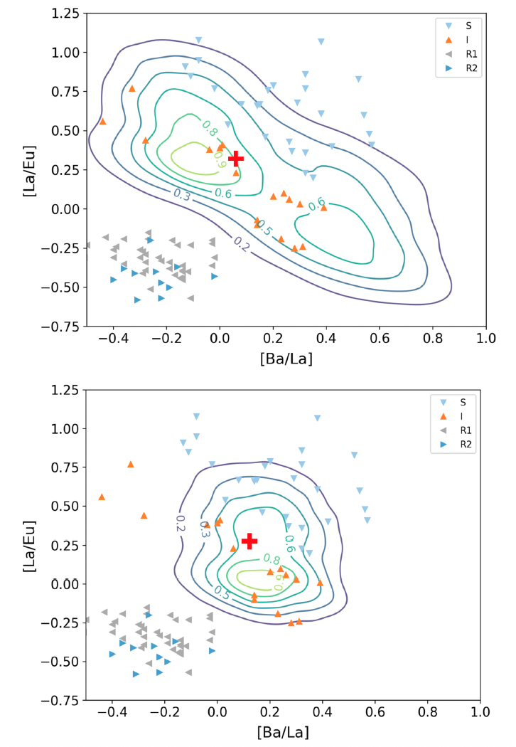
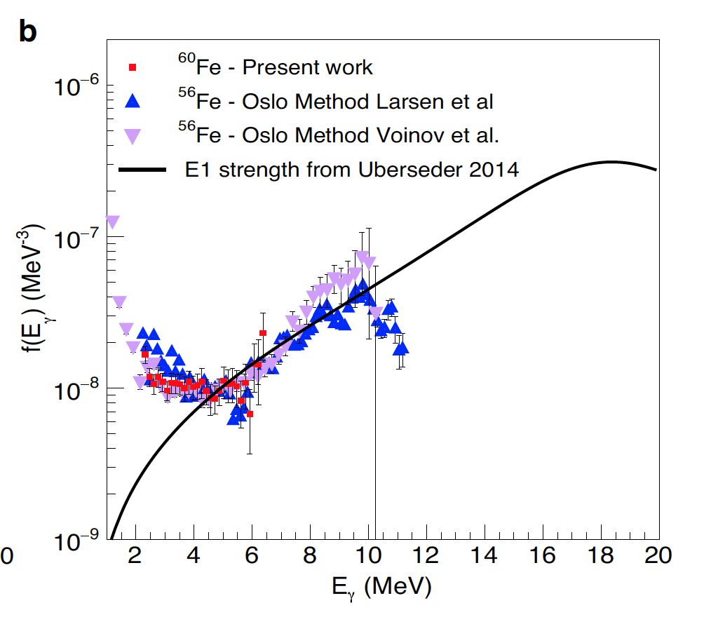
β decay as a tool to study neutron-capture reactions - results
Muecher et al PRC Lett.2023
Wiedeking et al PRC 2021
Combined with the Shape Method we can get model independent partial NLDs far from stability
⁸⁸Kr
Identified a strong upbend in the γSF of ⁶⁰Fe, resulting in enhanced production of ⁶⁰Fe in massive stars
⁶⁰Fe
Impact of ¹³⁹Ba(n,γ)¹⁴⁰Ba reaction on i-process calculations
Spyrou et al Nature Comms 2024
Spyrou et al PRL 2024

Slide 6
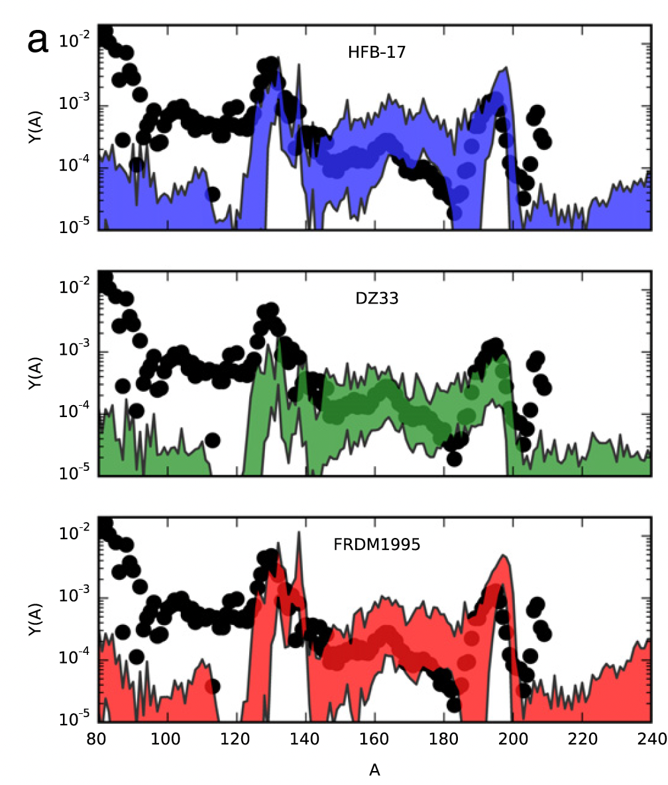
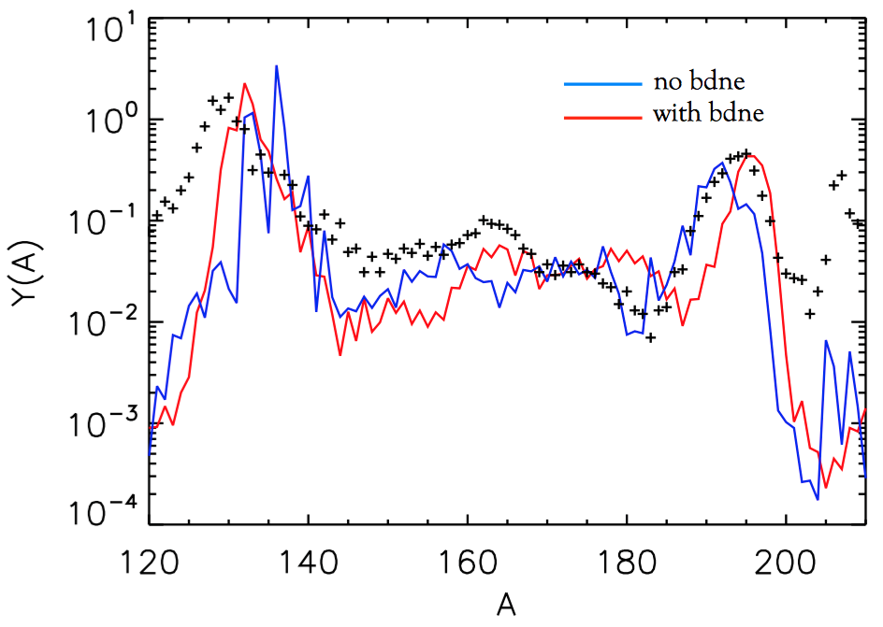
Sensitivity to β-decay properties
Mumpower, Surman, Aprahamian (2015)
T_{1/2}
P_{n}
β⁻
Impact on r-process calculations
(A, Z-1)
S_{n}
γ
(A, Z)
T_{1/2} and P_{n} values are both integral quantities
Measure as many as we can – theory for the rest
Constrain models via the β-decay intensity distribution

Slide 7
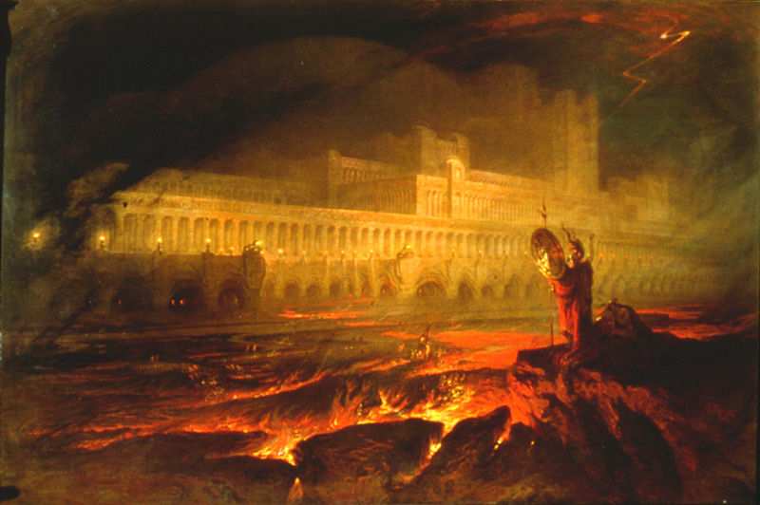
The pandemonium effect
β⁻
(A, Z-1)
γ
John Milton’s "Paradise Lost
(A, Z)
Small size – low efficiency detector
I_{γ}(in)
I_{β}
I_{β}= I_{γ}(out) - I_{γ}(in)
I_{γ}(out)
J.C. Hardy et al., Phys. Lett. B 71 (1977) 307.

Slide 8
The pandemonium effect: solution
β⁻
(A, Z-1)
γ
John Milton’s "Paradise Lost
(A, Z)
Small size – low efficiency detector
Large size - high efficiency detector
I_{γ}(in)
I_{β}
γ
beam
I_{β}= I_{γ}(out) - I_{γ}(in)
I_{γ}(out)
E_{x}= E_{γ1} + E_{γ2} + E_{γ3} + E_{γ4} + ...
J.C. Hardy et al., Phys. Lett. B 71 (1977) 307.
Total Absorption Spectroscopy - TAS

Slide 9
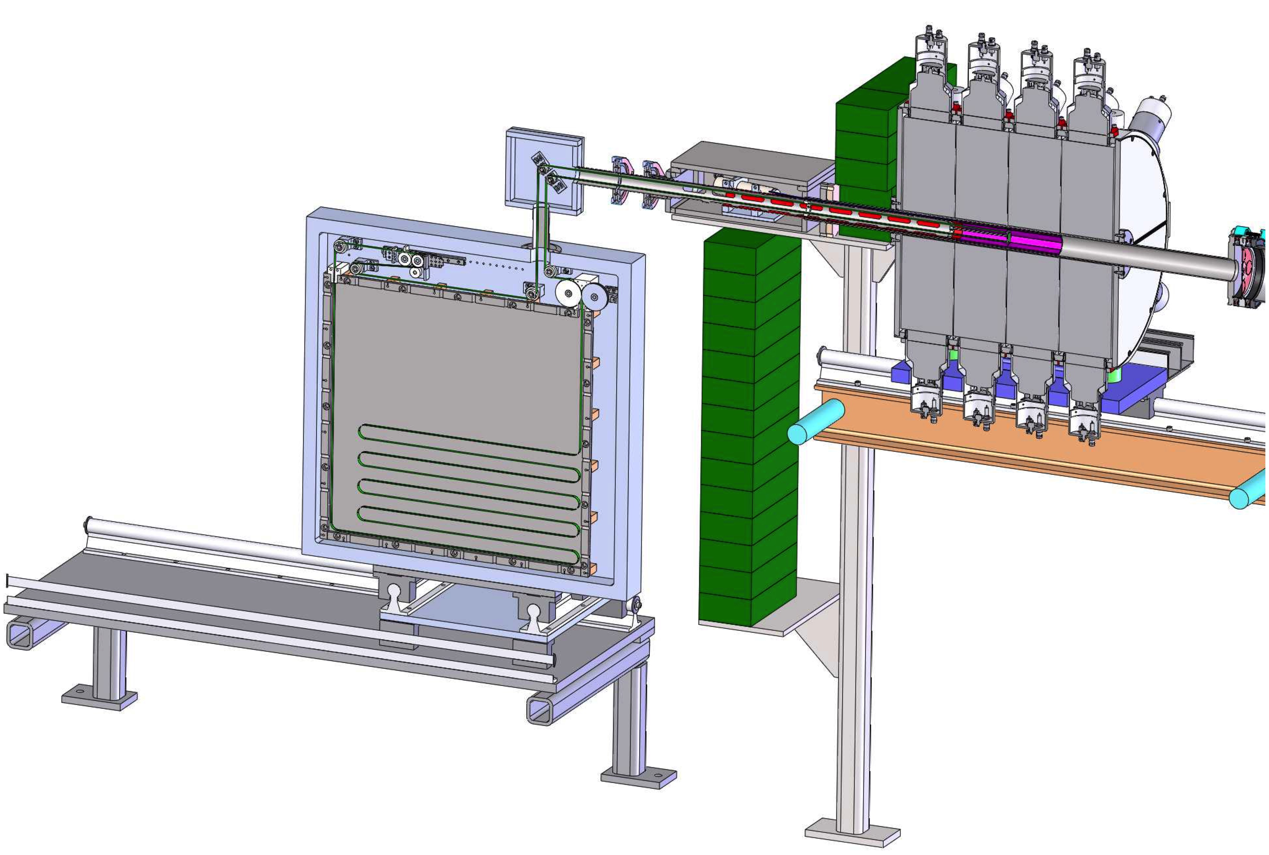
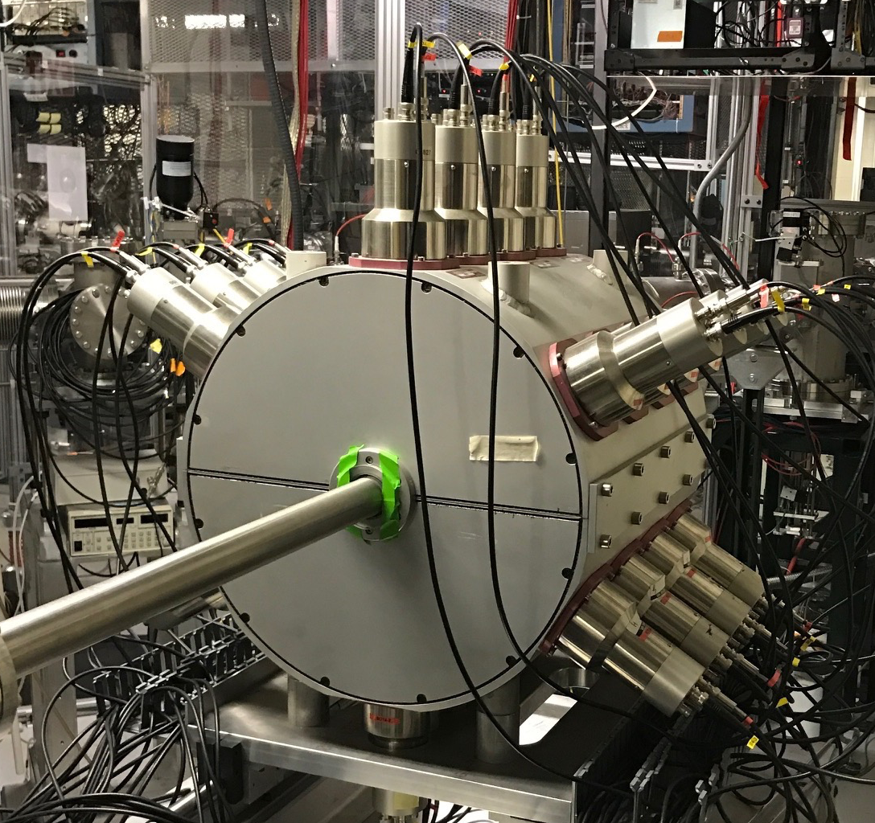
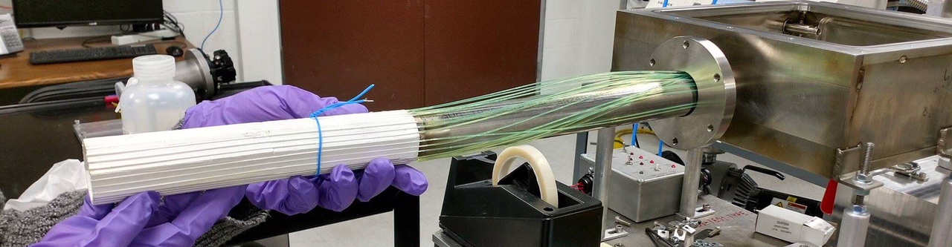
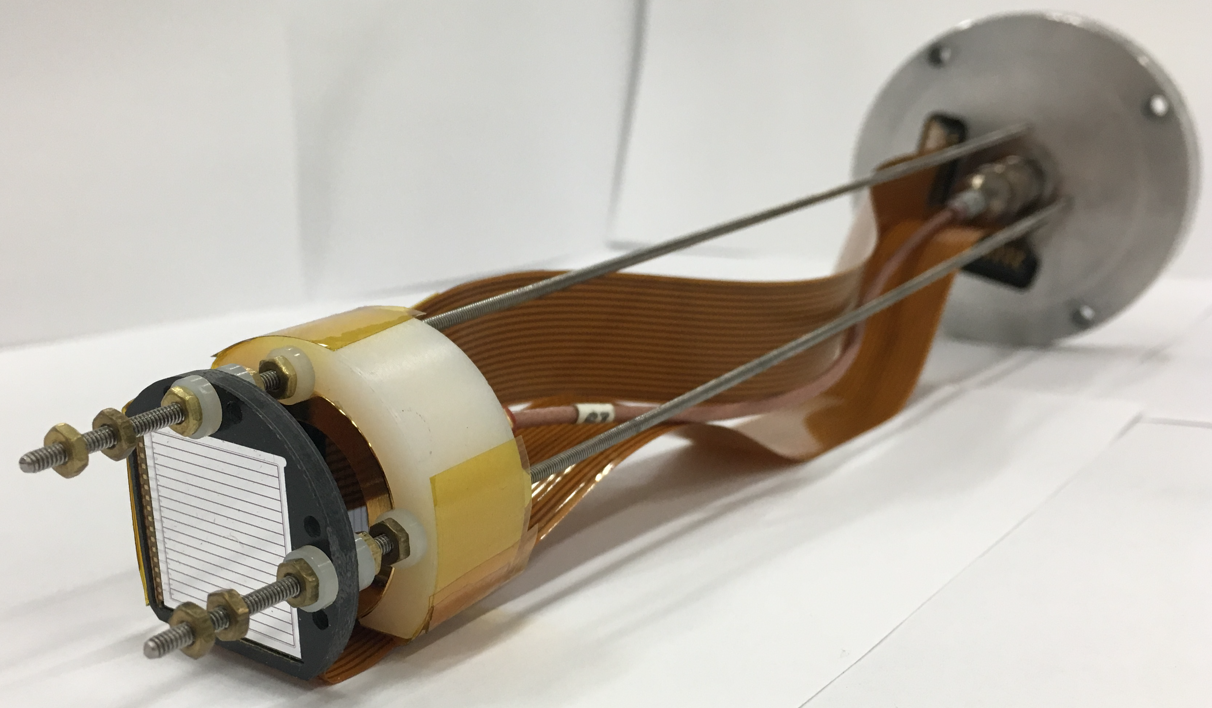
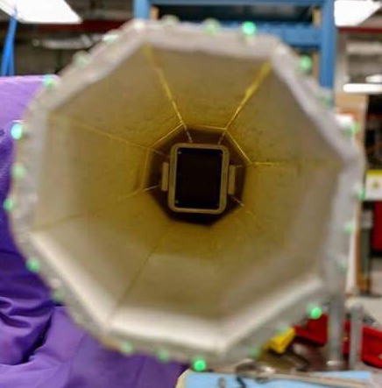
Summing NaI – SuN and friends
SuN
γ-Total Absorption Spectrometer
SuNTAN
Tape Transport System
Design by LSU and ANL
Fiber Detector
β-detection
Hope College
DSSD
Implantation-decay correlation
A. Simon, S.J. Quinn, A.S., et al., Nucl. Instr. Meth A 703, 16 (2013)

Slide 10
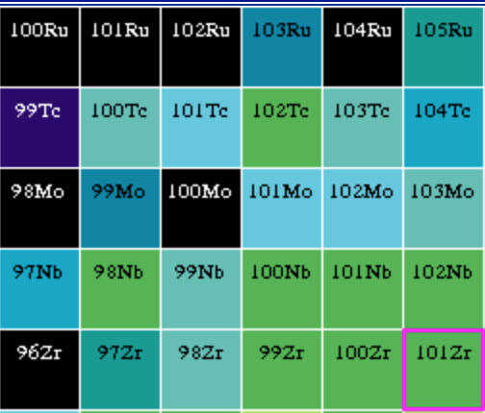
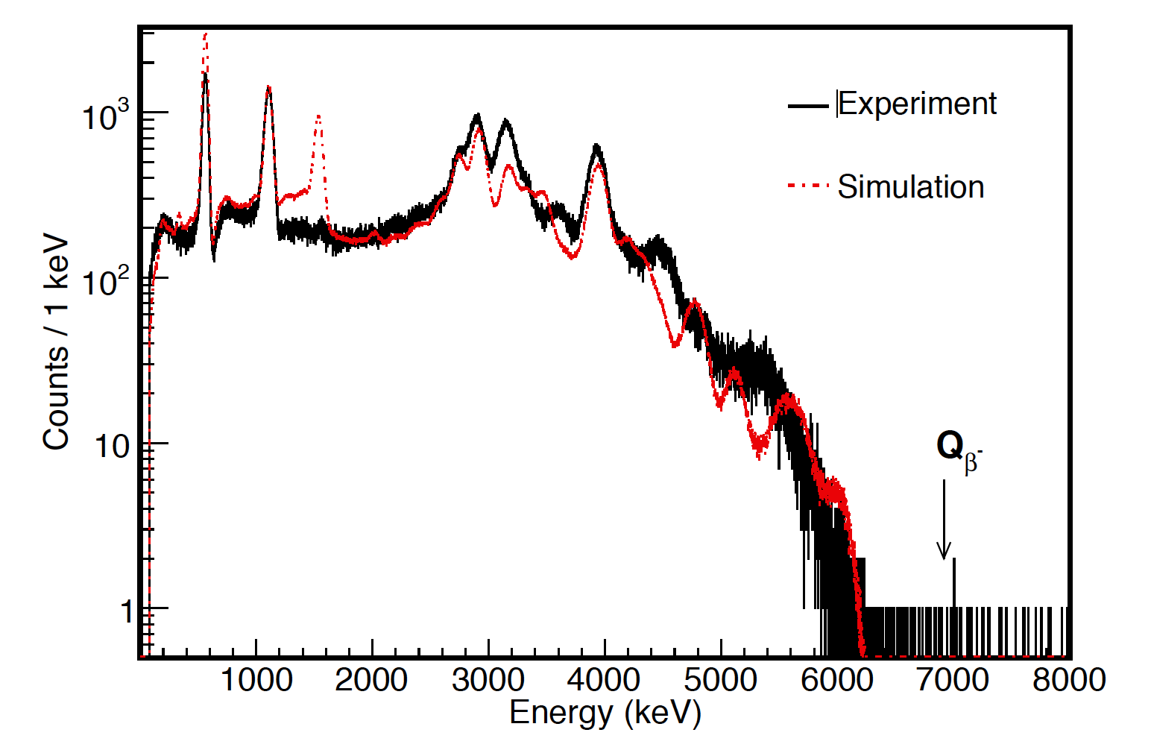
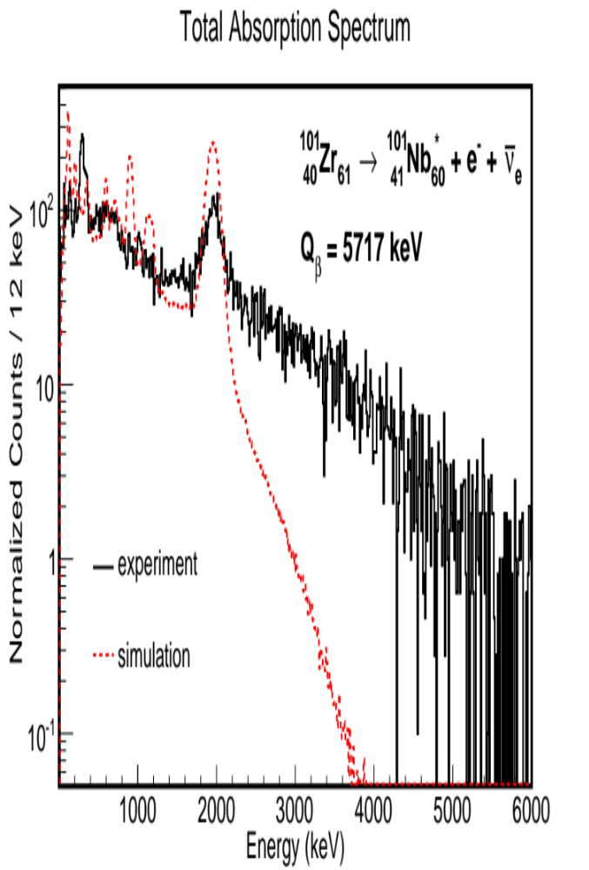
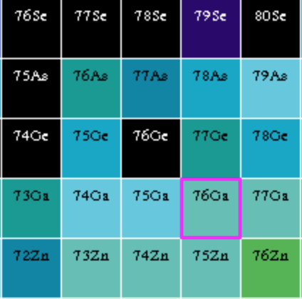
The pandemonium effect in action
⁷⁶Ga β decay
TAS - SuN
NNDC
¹⁰¹Zr β decay
TAS - SuN
NNDC

Slide 11
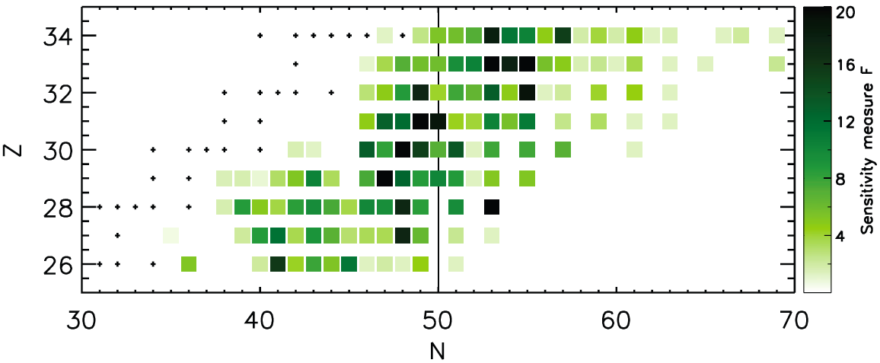
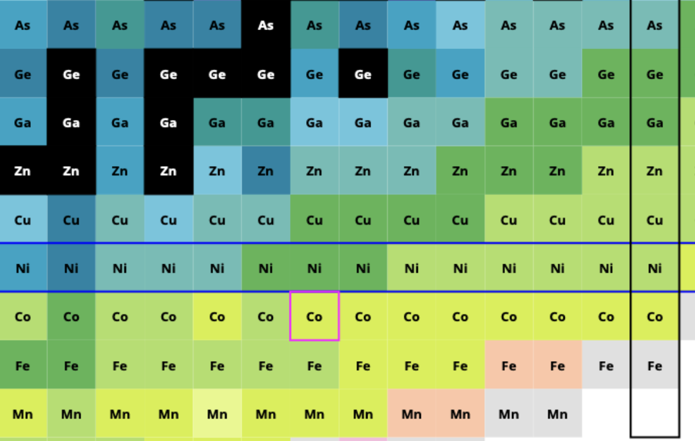
First measurements: weak r process region
R. Surman, et al., , AIP Advances 4, 041008 (2014)
N=50
Z=28

Slide 12
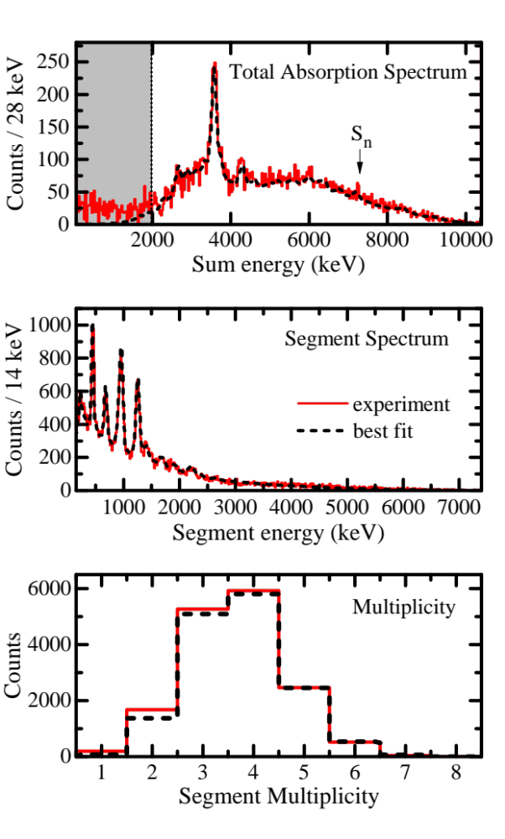
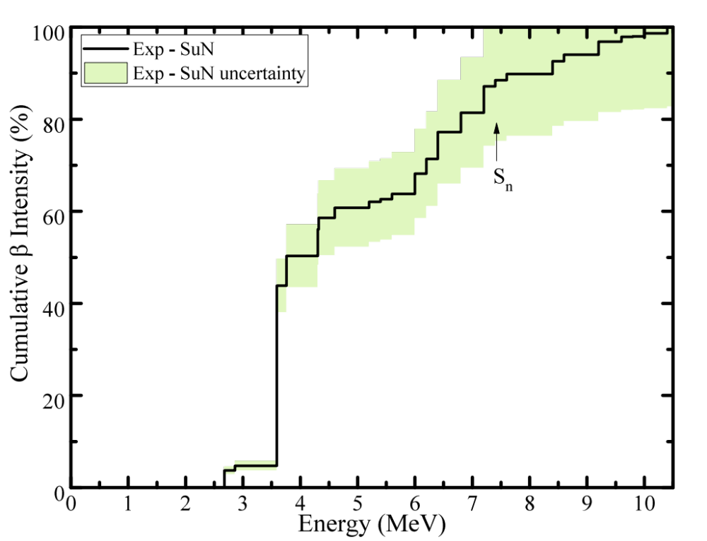
Results – ⁷⁰Co decay
A. Spyrou, S.N. Liddick, et al. Phys. Rev. Lett. 2016
Zn
72
73
74
75
76
77
78
Cu
71
72
73
74
75
76
77
Ni
70
71
72
73
74
75
76
Z=28
Co
69
70
71
72
73
74
75

Slide 13
⁷⁰Co β-decay Intensity
A. Spyrou, S.N. Liddick, et al. Phys. Rev. Lett. 2016

Slide 14
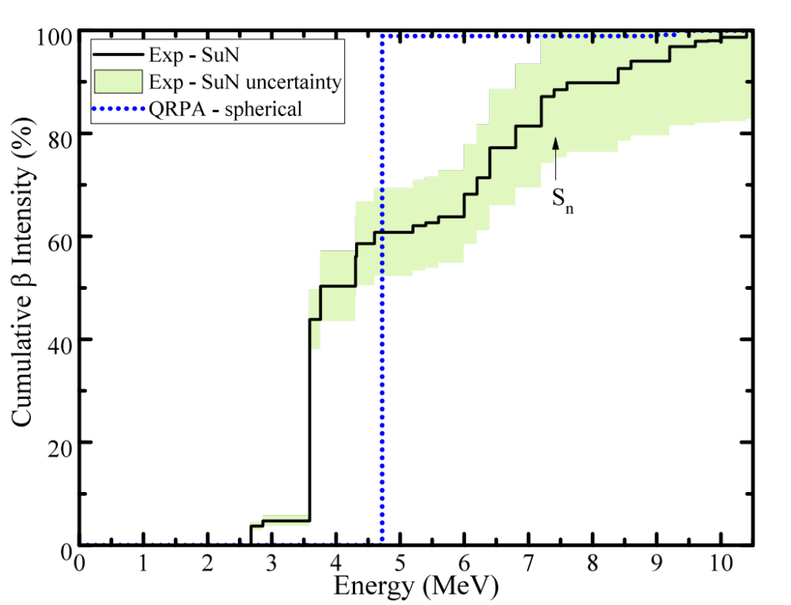
⁷⁰Co β-decay Intensity
T_{1/2} (QRPA) = 103.5 ms
T_{1/2} (Exp.) = ~110 ms
QRPA – P. Moller
A. Spyrou, S.N. Liddick, et al. Phys. Rev. Lett. 2016

Slide 15
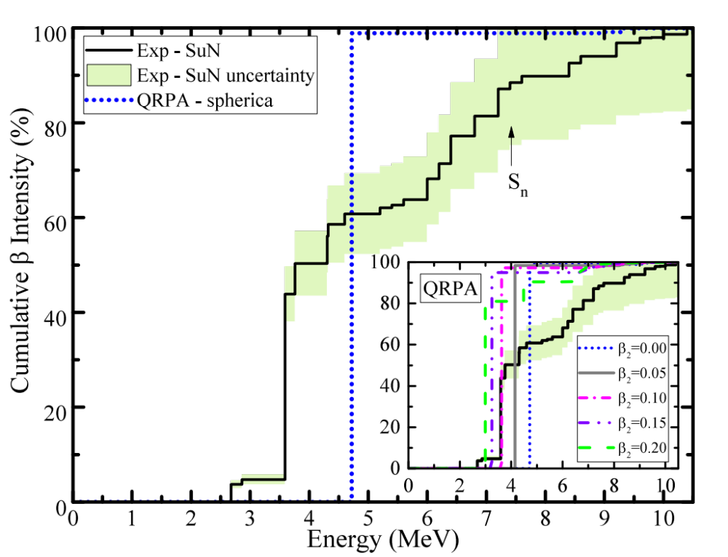
⁷⁰Co β-decay Intensity
QRPA – P. Moller
A. Spyrou, S.N. Liddick, et al. Phys. Rev. Lett. 2016

Slide 16
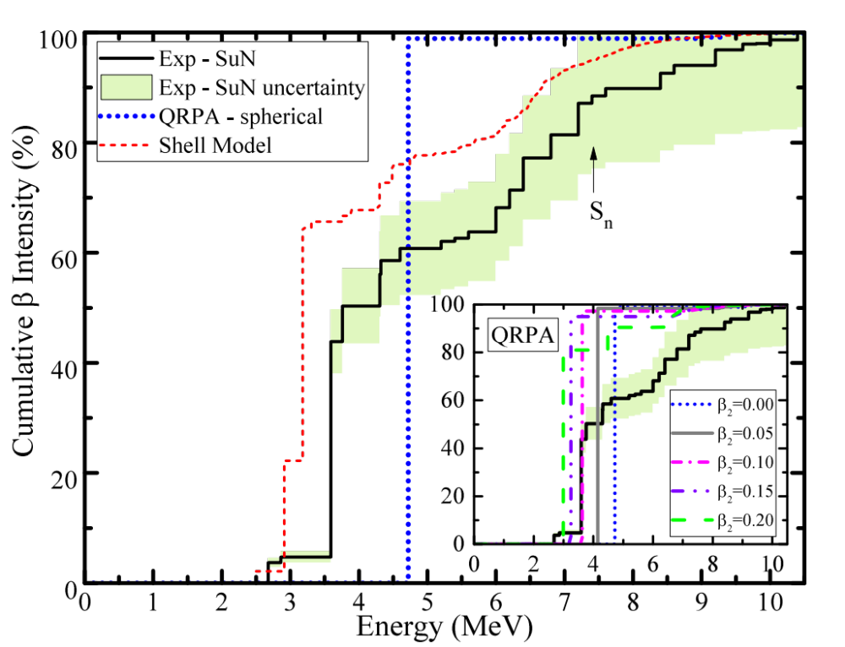
⁷⁰Co β-decay Intensity
QRPA – P. Moller
Shell Model – Alex Brown
A. Spyrou, S.N. Liddick, et al. Phys. Rev. Lett. 2016

Slide 17
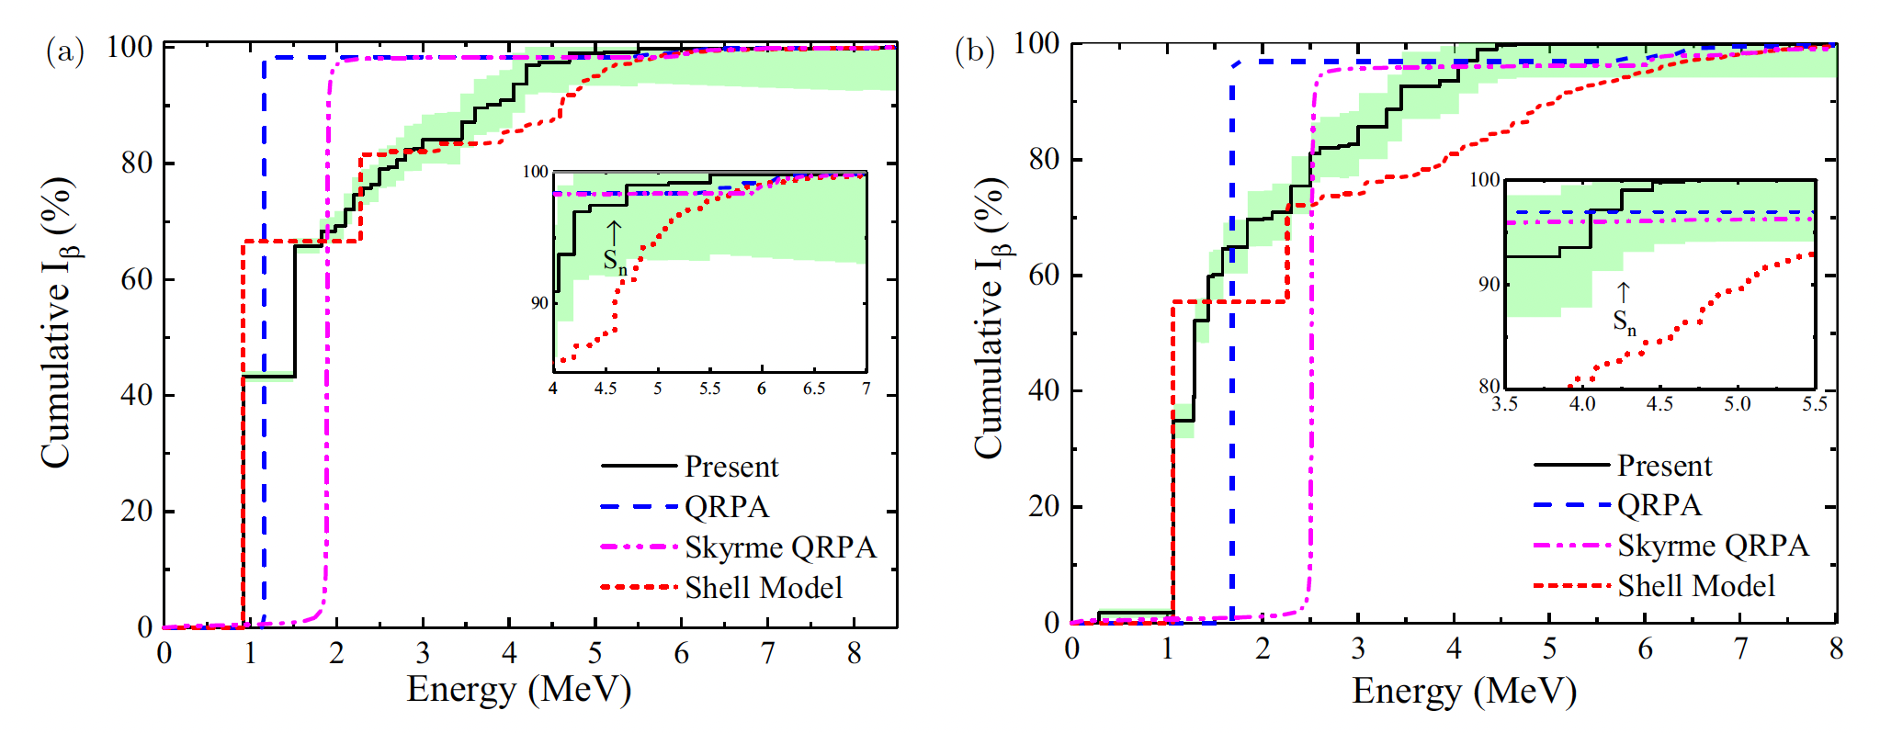
New results: ^{69,71}Co
⁶⁹Co
⁷¹Co
QRPA – P. Moller
Skyrme QRPA -J. Engel
Shell Model – Alex Brown
Lyons et al. , PRC 2019

Slide 18

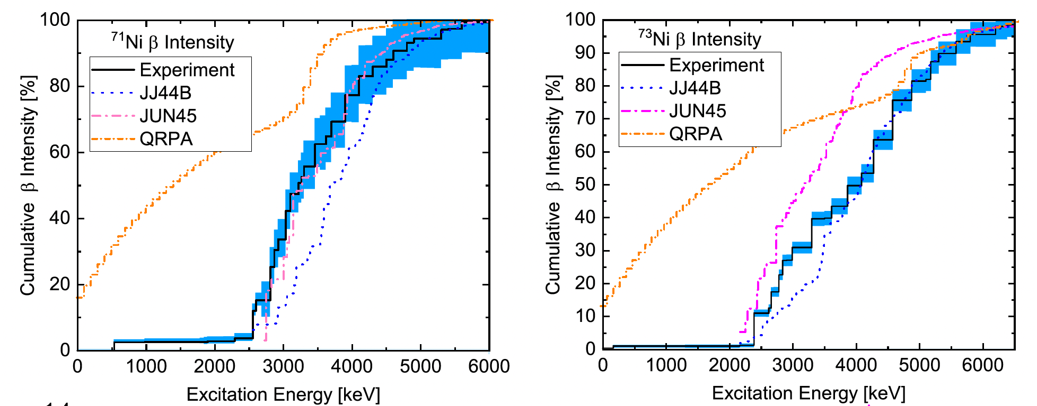
New results : ^{71,73}Ni
QRPA -J. Engel
Shell Model – Sofia Karabagia, Alex Brown
Persch et al. , PRC 2021

Slide 19
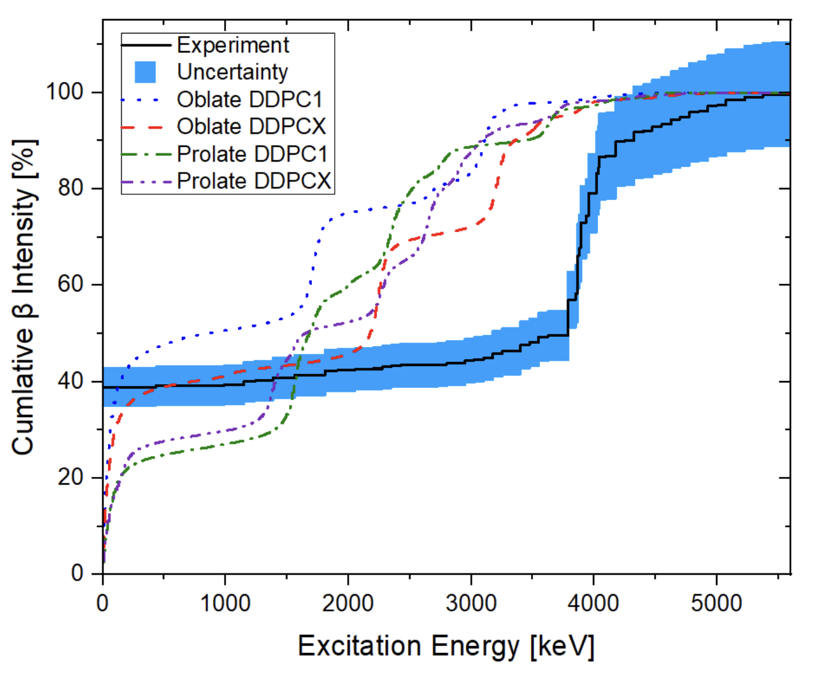
New results : ⁹³Rb
QRPA – Ante Ravlic (talk on Friday)

Slide 20
Competitions between β-decay channels
A. Spyrou, S.N. Liddick, et al. Phys. Rev. Lett. 2016
S_{2n}
β⁻
S_{n}
(A, Z-1)
β-n
γ

Slide 21
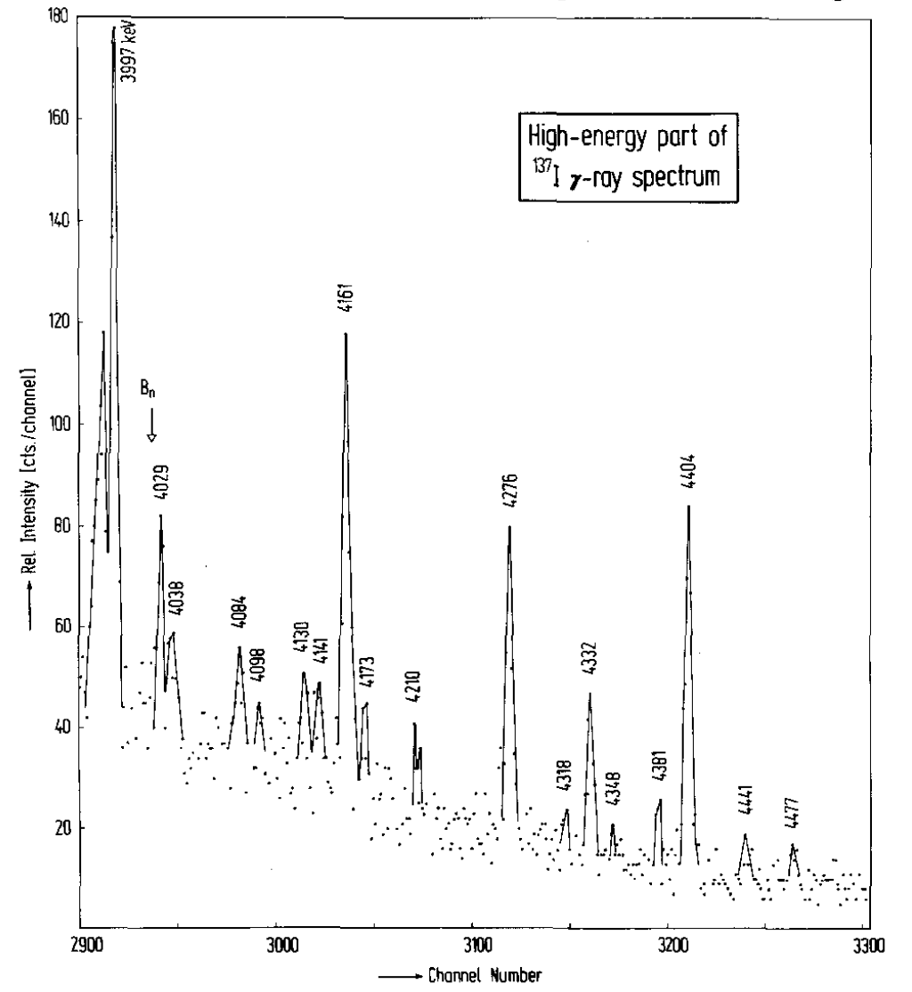
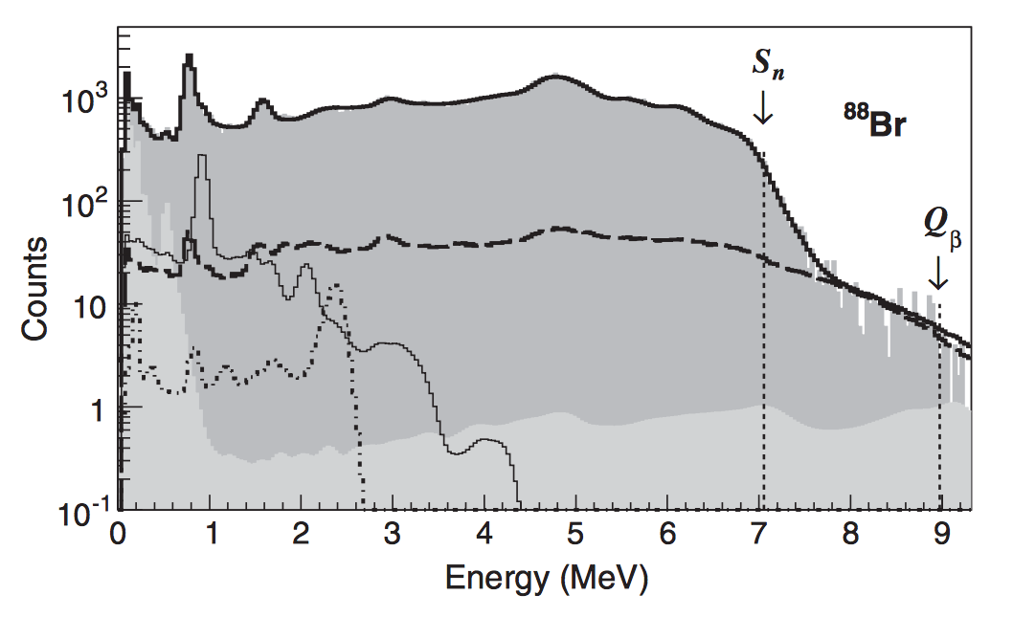
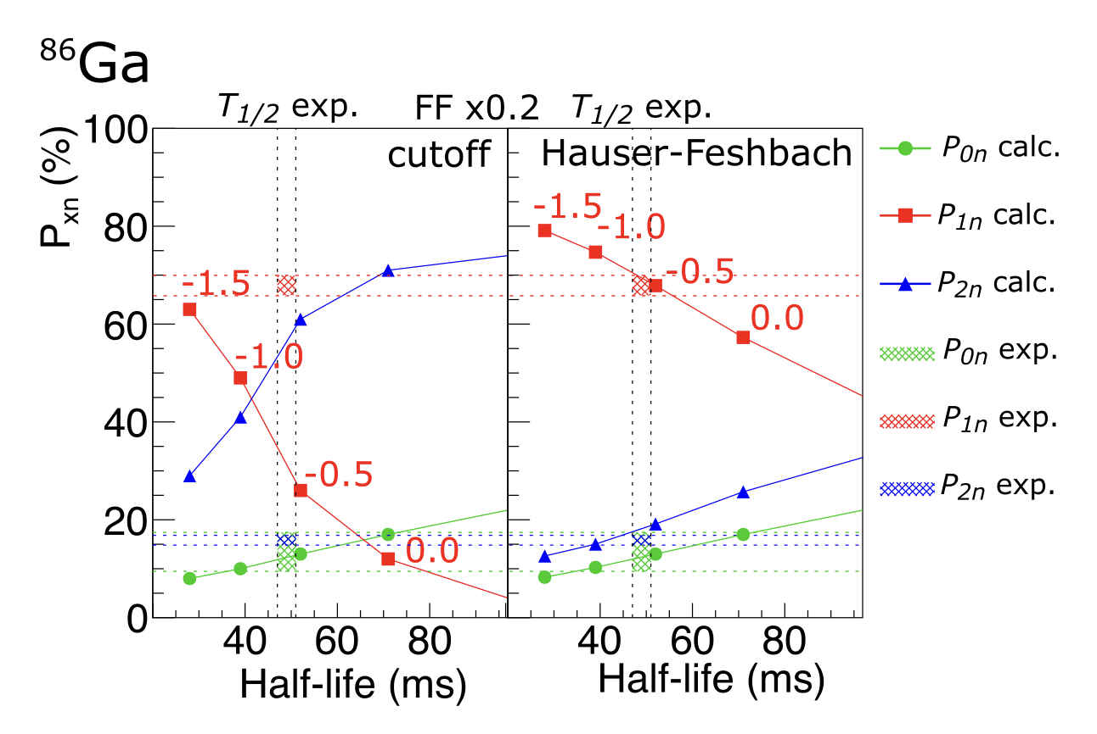
Competitions between β-decay channels
¹³⁷I β-decay
Tain et al, PRL 115, 062502 (2015)
Reasons
High angular momentum barrier for neutron emission
Nuclear structure effects
Statistical processes
S_{n}
Yokoyama, Grzywacz et al, PRC (R) 2019
H. Ohm, et al.,,Physik A - Atoms and Nuclei 296, 23 (1980).

Slide 22
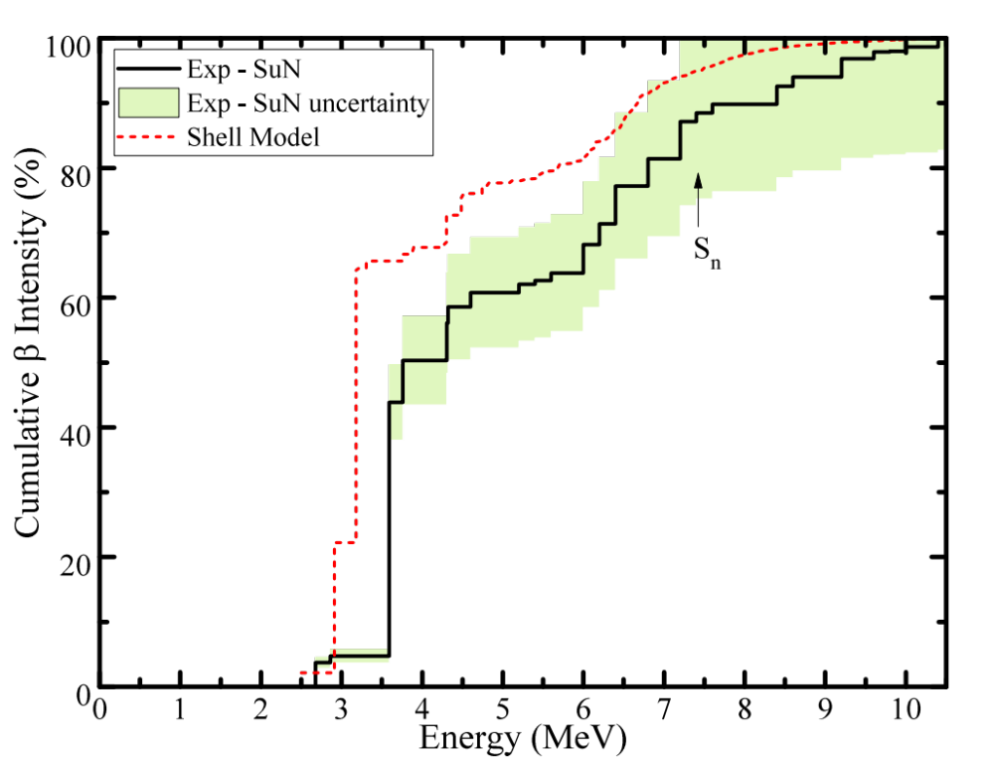
Neutron – γ competition in ⁷⁰Co
58
0g_{7/2}
50
0g_{9/2}
40
1p_{1/2}
38
0f_{5/2}
32
1p_{3/2}
28
0f_{7/2}
20
s-p-sd
s-p-sd
Z=27
N=43
⁷⁰Co
A. Spyrou, S.N. Liddick, et al. Phys. Rev. Lett. 2016

Slide 23
Neutron – γ competition in ⁷⁰Co
58
0g_{7/2}
50
0g_{9/2}
40
1p_{1/2}
38
0f_{5/2}
32
1p_{3/2}
28
0f_{7/2}
20
s-p-sd
s-p-sd
Z=27
N=43
ν(0g_{9/2}) π(0f_{7/2})
6⁻ 0⁺
Fifth forbidden
⁷⁰Co ⁷⁰Ni
A. Spyrou, S.N. Liddick, et al. Phys. Rev. Lett. 2016

Slide 24
Neutron – γ competition in ⁷⁰Co
58
0g_{7/2}
50
0g_{9/2}
40
1p_{1/2}
38
0f_{5/2}
32
1p_{3/2}
28
0f_{7/2}
20
s-p-sd
s-p-sd
Z=27
N=43
ν(0f_{5/2}) π(0f_{7/2})
6⁻ 5,6,7⁻
Allowed
⁷⁰Co ⁷⁰Ni
A. Spyrou, S.N. Liddick, et al. Phys. Rev. Lett. 2016

Slide 25
Neutron – γ competition in ⁷⁰Co
58
0g_{7/2}
50
0g_{9/2}
40
1p_{1/2}
38
0f_{5/2}
32
1p_{3/2}
28
0f_{7/2}
20
s-p-sd
s-p-sd
Z=27
N=43
Proton excited across Z=28
6⁻ 5,6,7⁻
Allowed
⁷⁰Co ⁷⁰Ni
A. Spyrou, S.N. Liddick, et al. Phys. Rev. Lett. 2016

Slide 26
Neutron – γ competition in ⁷⁰Co
58
0g_{7/2}
58
0g_{7/2}
50
0g_{9/2}
50
0g_{9/2}
40
1p_{1/2}
40
1p_{1/2}
38
0f_{5/2}
38
0f_{5/2}
32
1p_{3/2}
32
1p_{3/2}
28
0f_{7/2}
28
0f_{7/2}
20
20
s-p-sd
s-p-sd
s-p-sd
s-p-sd
Z=28
N=42
Z=28
N=41
⁷⁰Ni
⁶⁹Ni
A. Spyrou, S.N. Liddick, et al. Phys. Rev. Lett. 2016

Slide 27

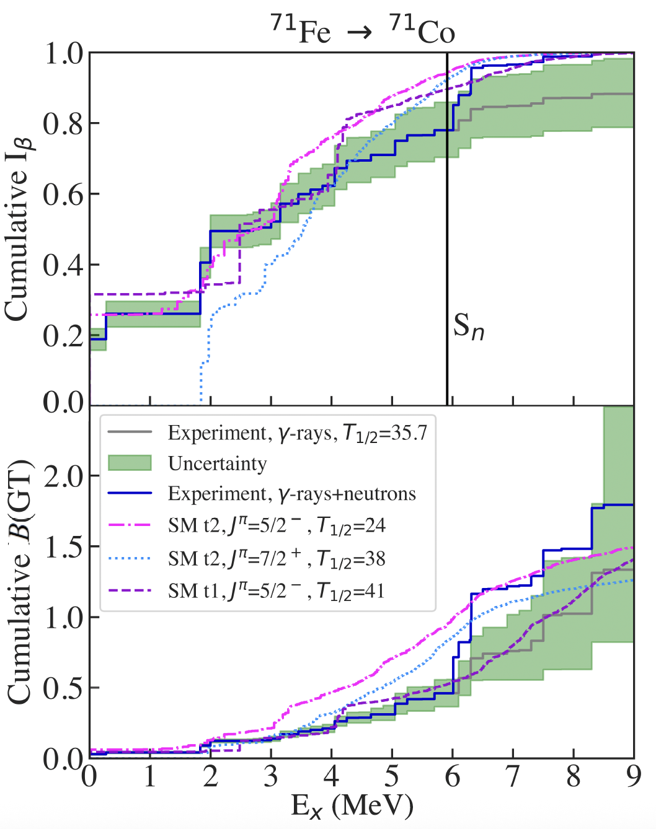
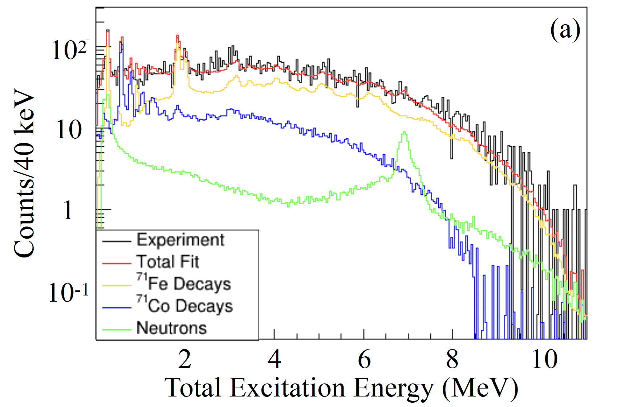
New results: ⁷¹Fe
Cade
Dembski
MSU/ND
Neutron-γ competition observed in ⁷¹Fe
Exploring the reasons behind it
Shell Model – Alex Brown
Dembski et al. In prep.

Slide 28
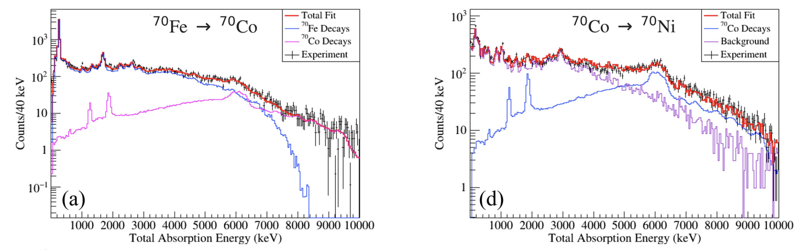
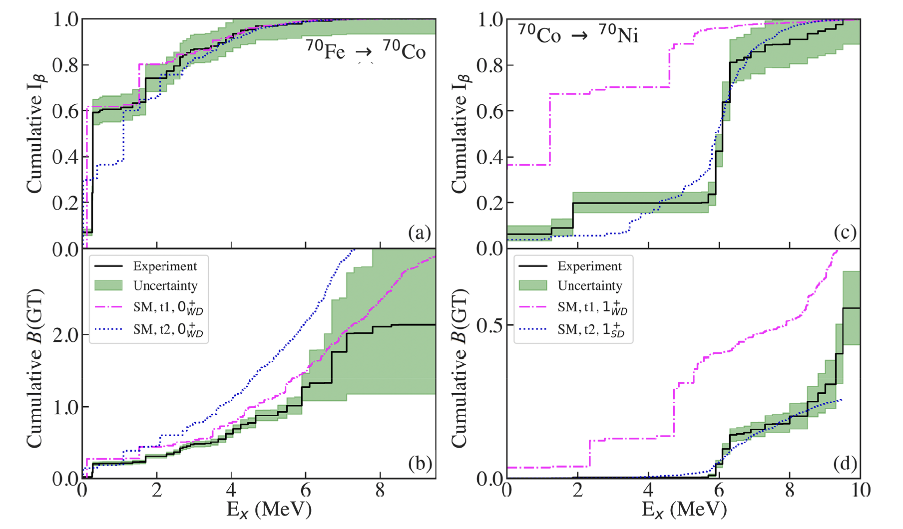
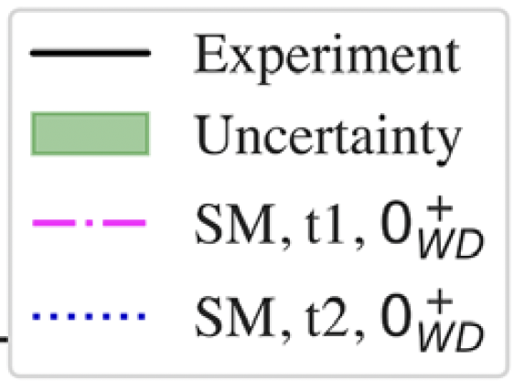
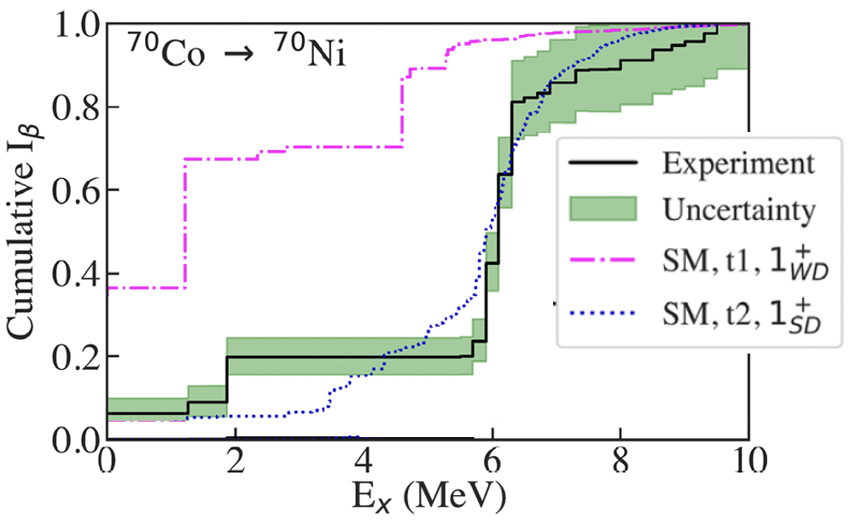
Extreme Shape Coexistence in ⁷⁰Co
Cade
Dembski
MSU/ND
Shell Model – Alex Brown
Dembski et al., Physics Communications 2025

Slide 29
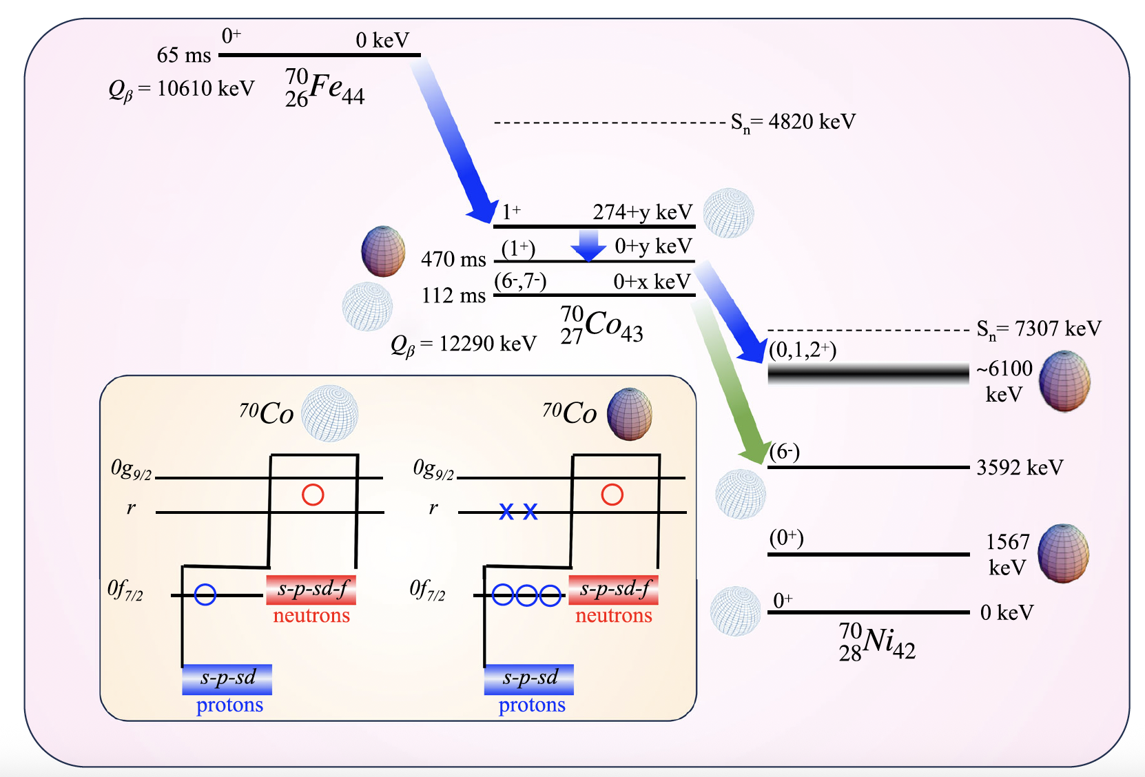
Extreme Shape Coexistence in ⁷⁰Co
Cade
Dembski
MSU/ND
Shell Model – Alex Brown

Slide 30
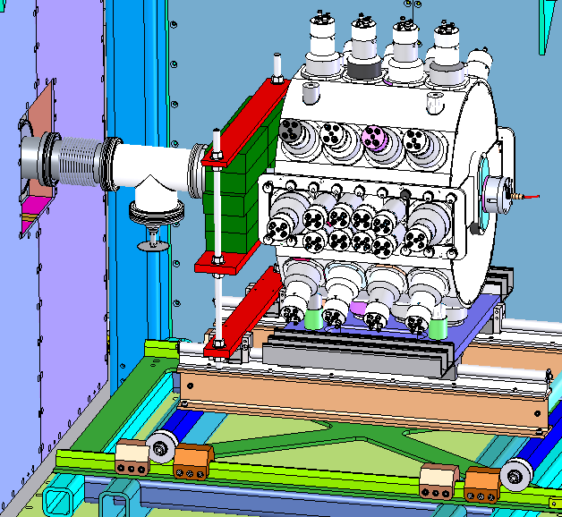
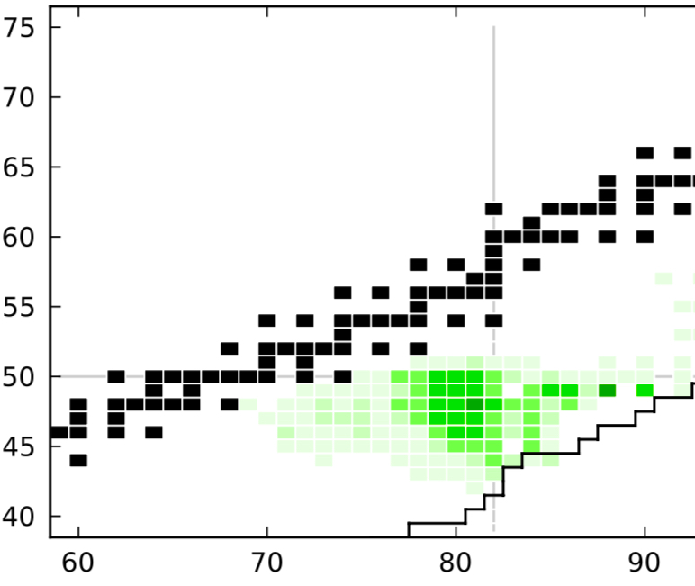
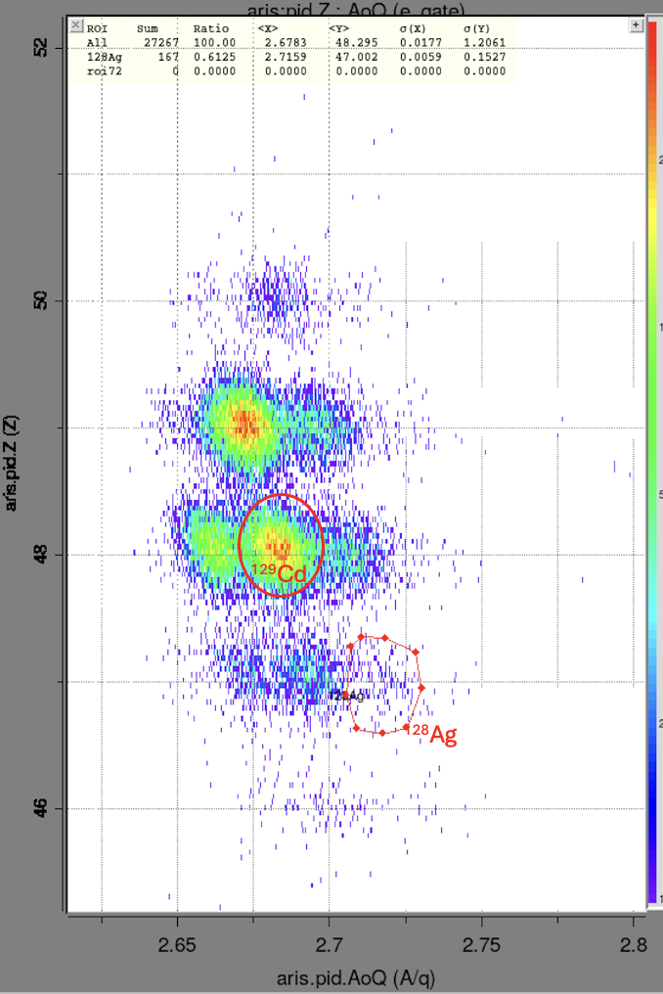
Future plans- Analysis of first SuN decay experiment at FRIB
Adapted from M. Mumpower et al.,
Prog. Part. Nucl. Phys. 86 (2016)
PID (online quality)
1h of data
50
49
PRELIMINARY
Z
48
Setup
SuN++ @ FRIB
Hosted inside MTAS frame
E21073, June 2025
47
46
All proposed nuclei populated + 1 extra setting
Sufficient statistics to constrain (n,γ) rate for many key r-process nuclei in the vicinity of ¹³²Sn
2.65 2.7 2.75
A/Q
A. Spyrou (FRIB), D. Muecher (Univ. Cologne), S. Liddick(FRIB), et. al.

Slide 31



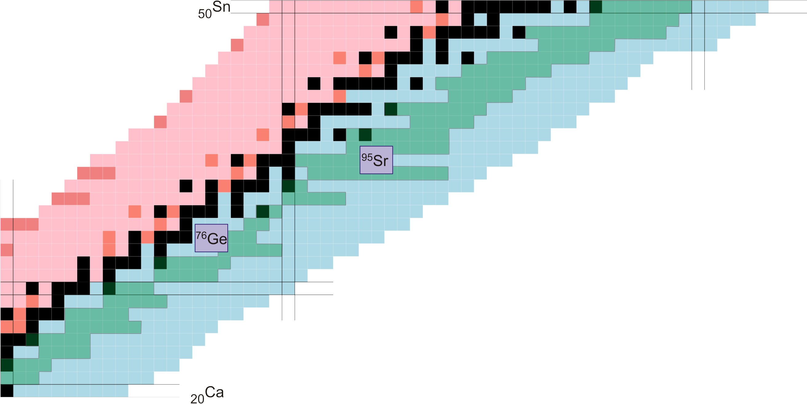





Total Absorption Spectroscopy with SuN
Jordan Owens-Fryar
MSU
Alex
Dombos MSU
Stephanie Lyons, PNNL
Kyle
Taft
MSU/ND
Mejdi Mogannam
MSU
Nick
Tubaro
MSU/ND
Cade
Dembski
MSU/ND
A=136
Lighter nuclei (Schatz group)
Wei-Jia Ong (LLNL)
Rahul Jain (LLNL)
Kirby Hermansen
Hannah
Berg,
MSU
Farheen
Naqvi
Texas A&M

Slide 32
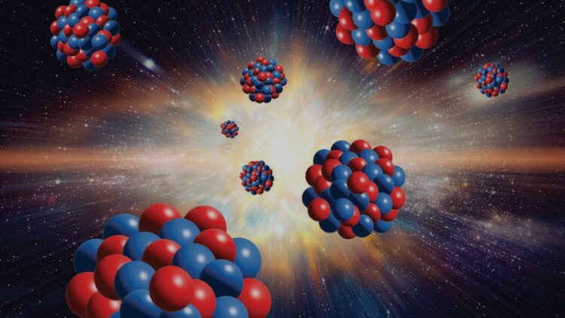
Summary
Measurements of β-decay intensity distributions
Information about the structure of the nucleus
Theory guidance for more accurate predictions of astrophysical calculations
Competitions between different β-decay channels
Stay tuned for new results

