Slide 1
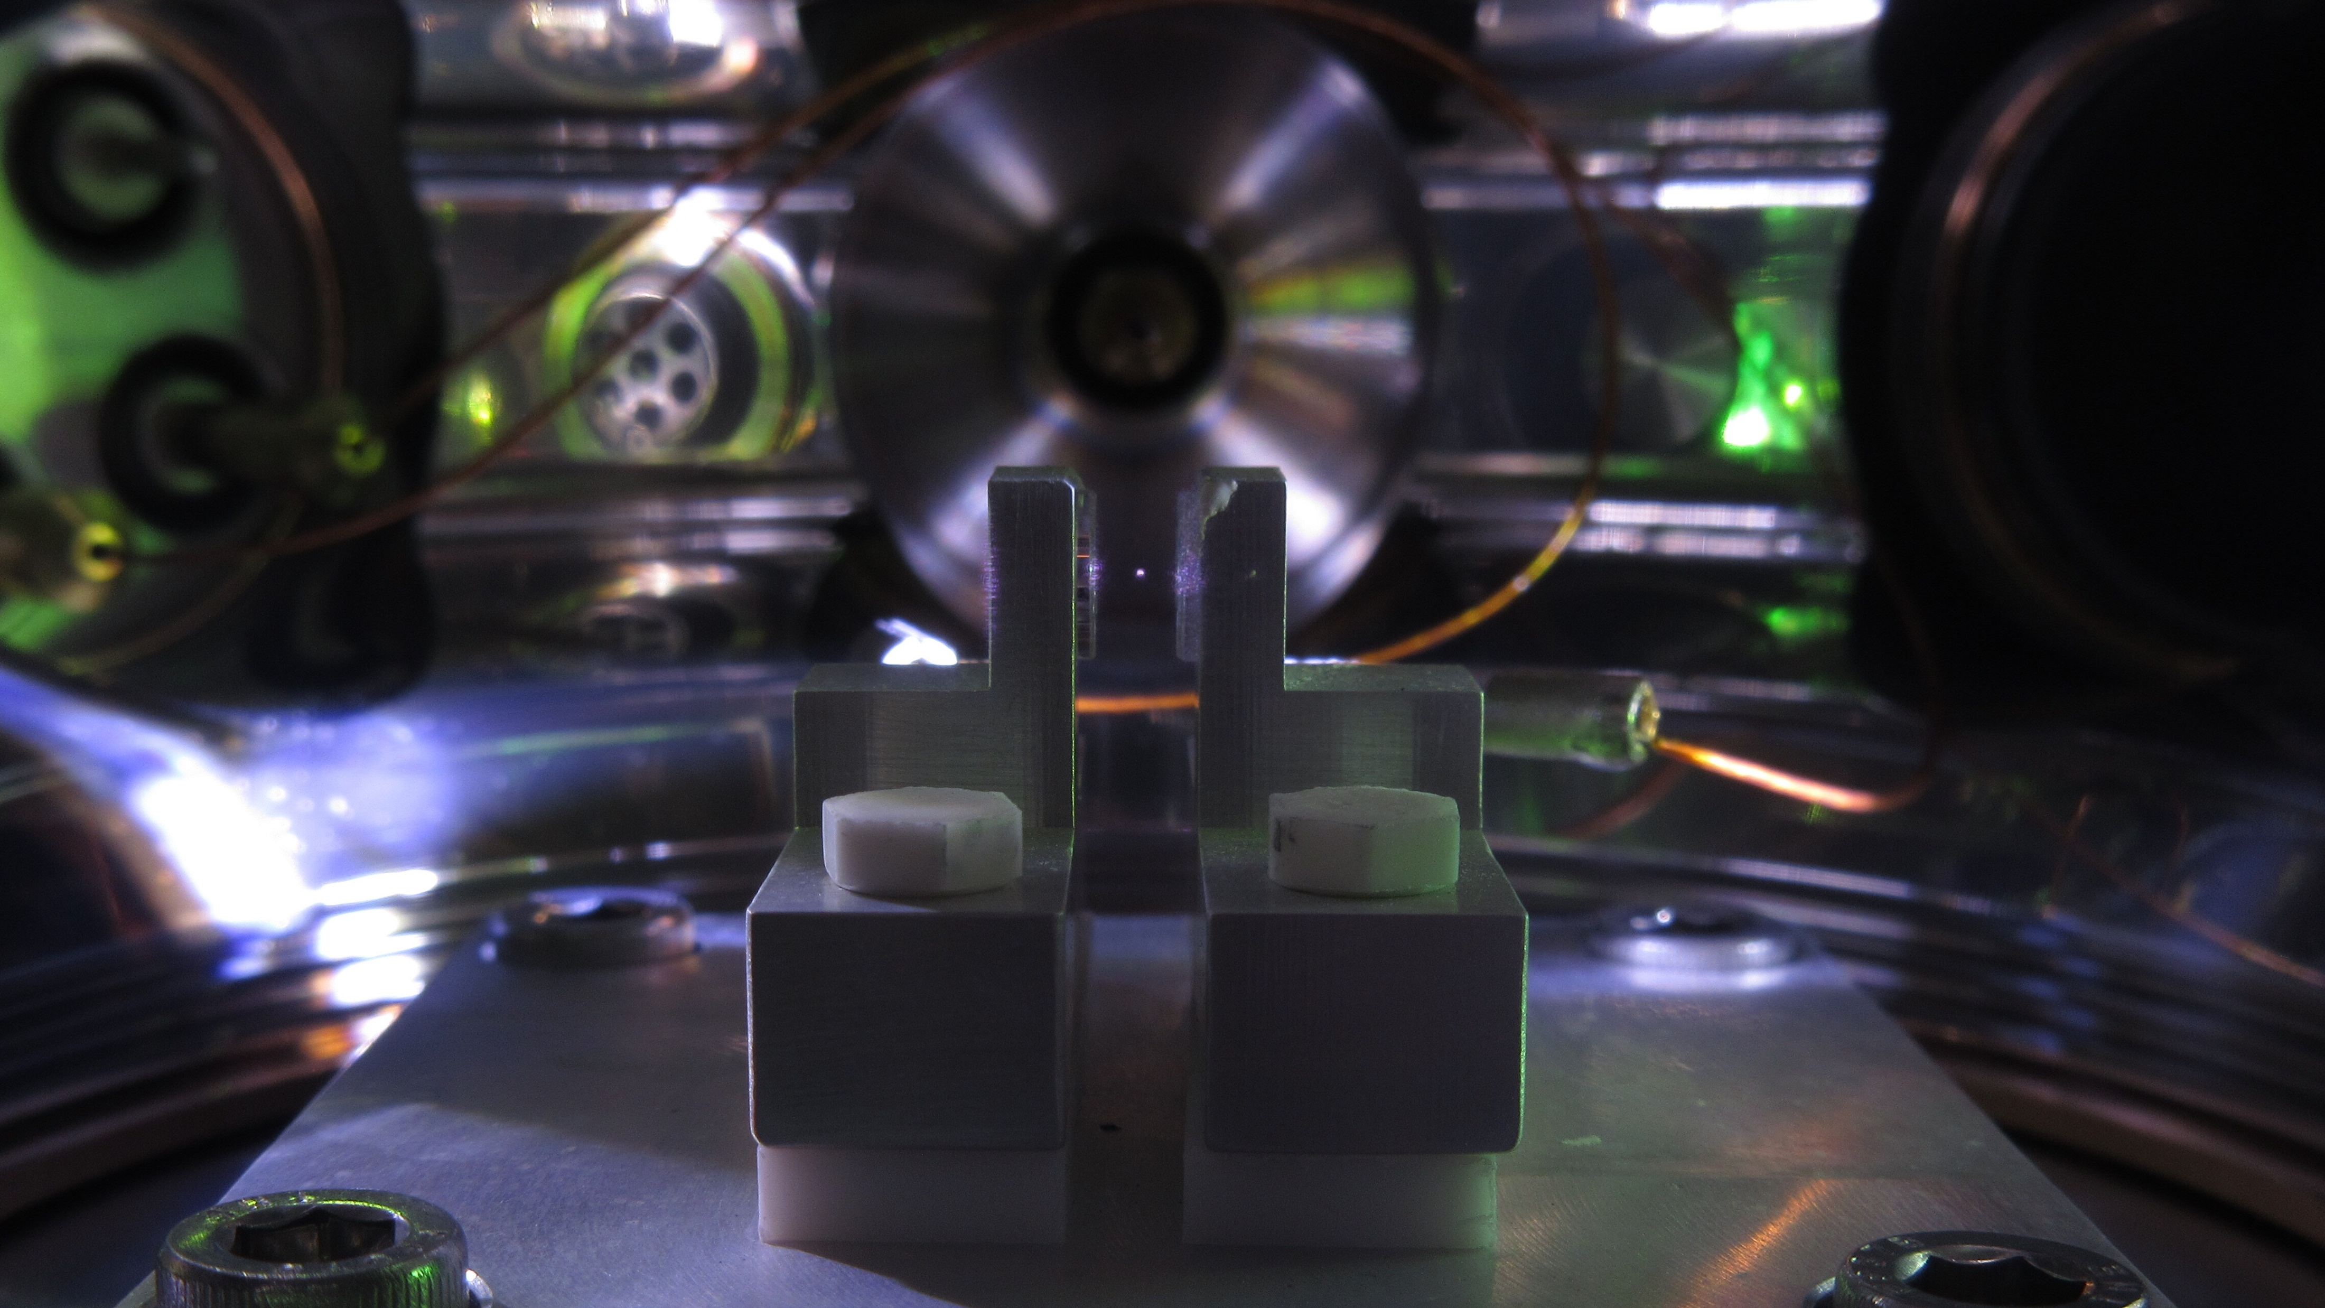


Searches for BSM physics using nuclear recoils in optically levitated nanoparticles
David Moore, Yale
FRIB-TA: Topical program on future directions in beta decay
September 12, 2025

Slide 2
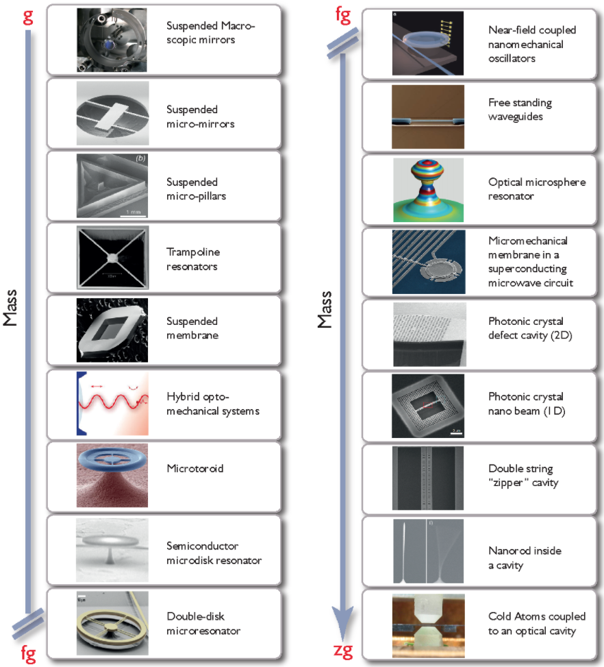
LIGO, VIRGO, KAGRA
Optomechanical systems
Optomechanical systems are revolutionizing how we measure tiny forces
  Pioneering work by the gravitational wave community
  A wide range of “optomechanical” sensors are now reaching quantum measurement limits
These sensors are extremely sensitive to tiny forces or accelerations
  In the sub-ng range, reaching sensitivity to the forces imparted by single sub-atomic particles!
For more details see, e.g.:
  “Snowmass 2021: Quantum Sensors for HEP Science,” arXiv:2203.07250.
  "Mechanical Quantum Sensing in the Search for Dark Matter,” Quant. Sci. Tech. 6 024002 (2021), arXiv:2008.06074
  “Searching for new physics using optically levitated sensors,” Quant. Sci. Tech. 6 014008 (2021), arXiv:2008.13197
  “Quantum sensing for particle physics,” Nature Reviews Physics 6, 329 (2024)
  …
Levitated objects ~fg to mg
Aspelmeyer et al., Rev. Mod. Phys. 86, 1391 (2014)
D. Moore, Yale

Slide 3
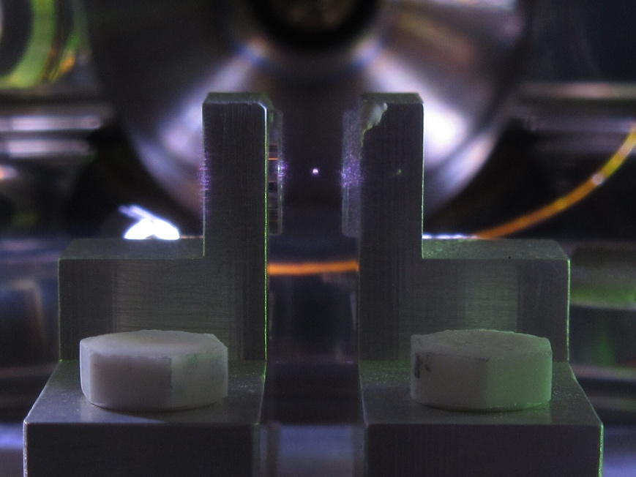
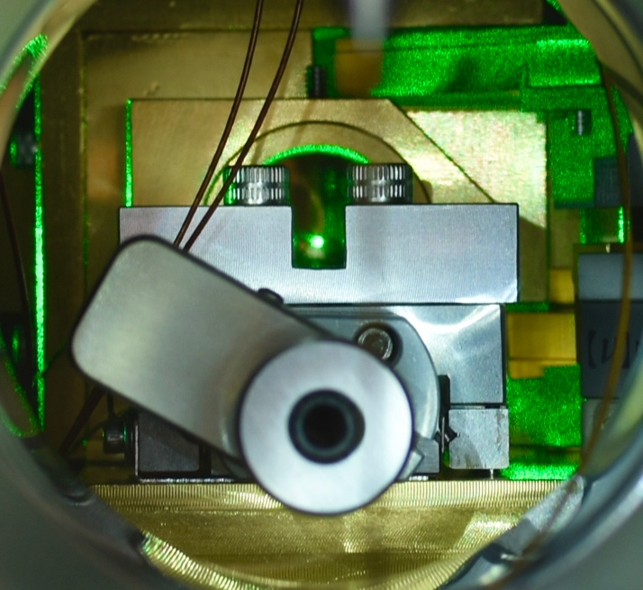
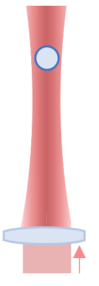
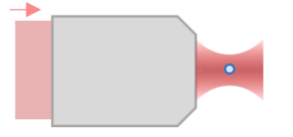
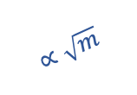

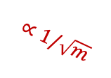


Photographs of trapped nano/micro particles at Yale:
Levitated optomechanics
Nano- to micro-sized dielectric masses can be optically trapped with ~100 mW of laser power
Levitated masses are isolated both electrically and thermally
  Ultra-low decoherence allows quantum control of motional degrees of freedom
  Force sensitivities at the zN level, with acceleration sensitivities near a nano-g
Levitation trap
(~1 – 30 𝜇m):
Highly focused tweezers (~0.1 – 1𝜇m):
~1 pg – 30 ng
~1 fg – 1 pg
Force and acceleration sensitivity vs particle mass:
10⁻¹⁹
$$∝\sqrt{m}$$
10⁻⁶
Force sensitivity [N/$\sqrt{Hz}$]
Accel. sensitivity [g/$\sqrt{Hz}$]
10⁻²⁰
10⁻⁷
$$∝1/\sqrt{m}$$
10⁻²¹
10⁻⁸
$$\vec{g}$$
fg
pg
ng
Particle mass
D. Moore, Yale

Slide 4
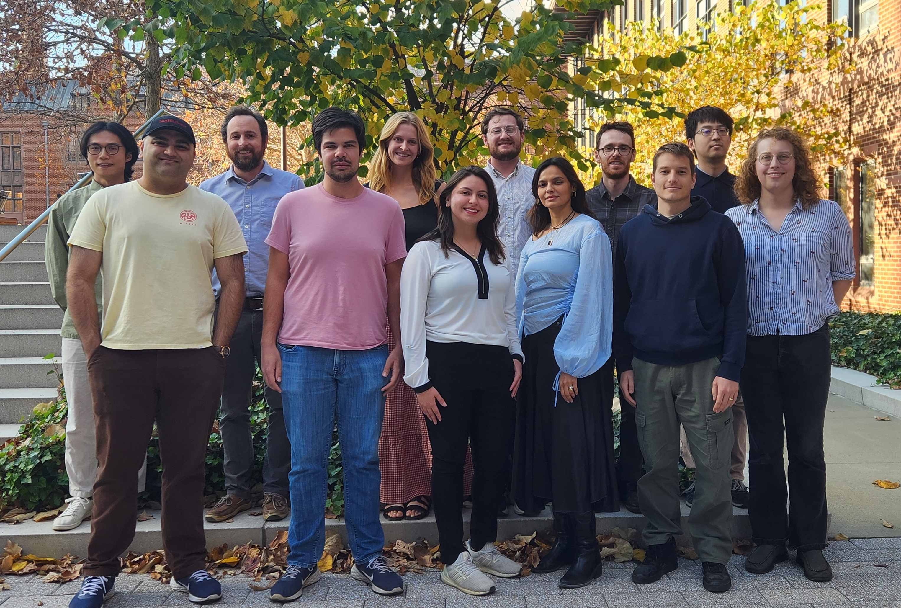













(Search for new Interactions in a Microsphere Precision Levitation Experiment)
Jackie Baeza-Rubio
Lucas Darroch
Cecily Lowe
Aaron Markowitz
Siddhant Mehrotra
David Moore
Isabelle Ong
Tom Penny
Ben Siegel
Yu-Han Tseng
Jiaxiang Wang
Molly Watts
With collaborators:
QuIPs:
MAST-QG:
(Quantum Invisible Particle Search)
(Macroscopic Superpositions Towards Witnessing the Quantum nature of Gravity)
D. Moore, Yale

Slide 5
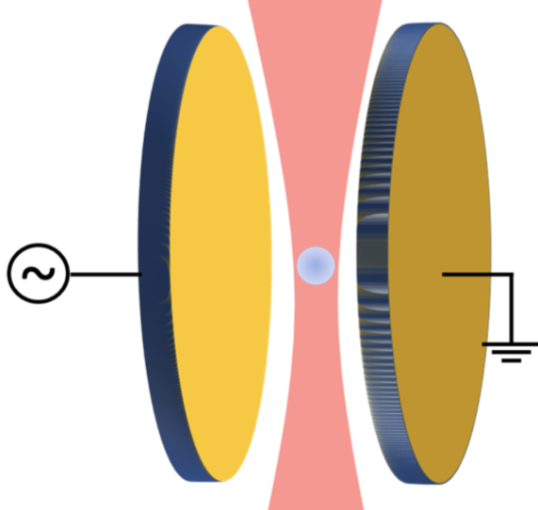
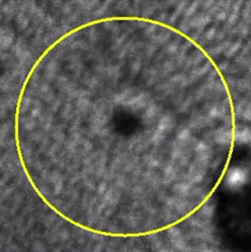
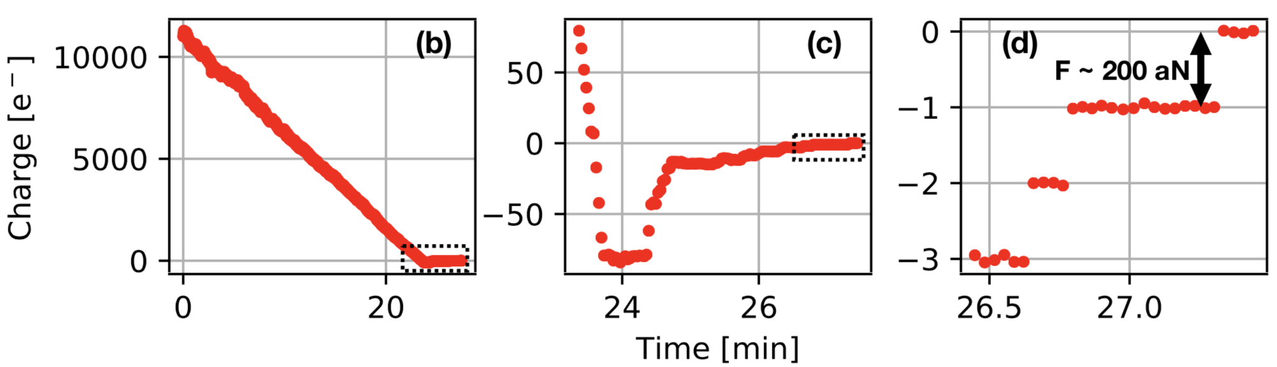
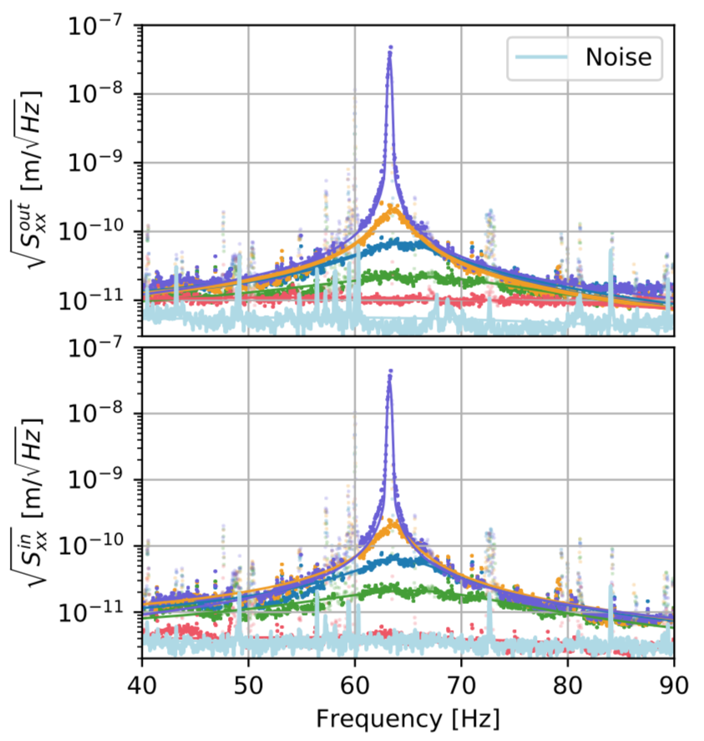
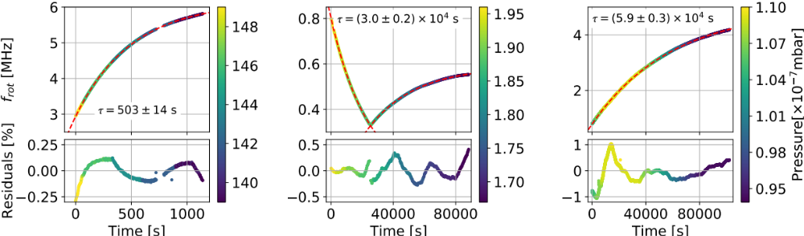
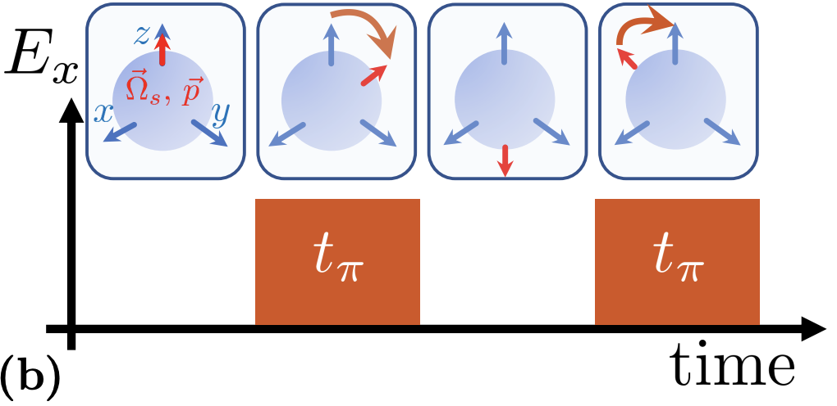

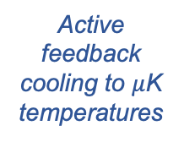


Experimental sequence (>ng spheres)
25 mm
Step 1: Trap sphere (~1 mbar)
Step 2: Electrically neutralize
q_{init} >10⁴ e⁻
~1-10 mm
Pump to $≲$10⁻⁷ mbar
E ~ 1 V/mm
Piezo stack
Monteiro et al., PRA 101, 053835, arXiv:2001.10931(2020)
Monteiro et al., PRA 101, 053835, arXiv:2001.10931(2020)
Step 4: Cool center-of-mass mode
Step 5: Orient electric dipole moment
Step 3: Stabilize spin
Optically spin to >MHz frequency
$$ω\sim MHz$$
Active feedback cooling to $μ$K temperatures
Out-of-loop sensor
Apply electric field (if desired)
$50±22 μ$K
p₀
Afek et al., PRA 104, 053512, arXiv:2108.04406 (2021)
Monteiro et al., PRA 97, 051802(R), arXiv:1803.04297 (2018)
Monteiro et al., PRA 101, 053835, arXiv:2001.10931(2020)
Monteiro et al., PRA 96, 063841, arXiv:1711.04675 (2017)

Slide 6

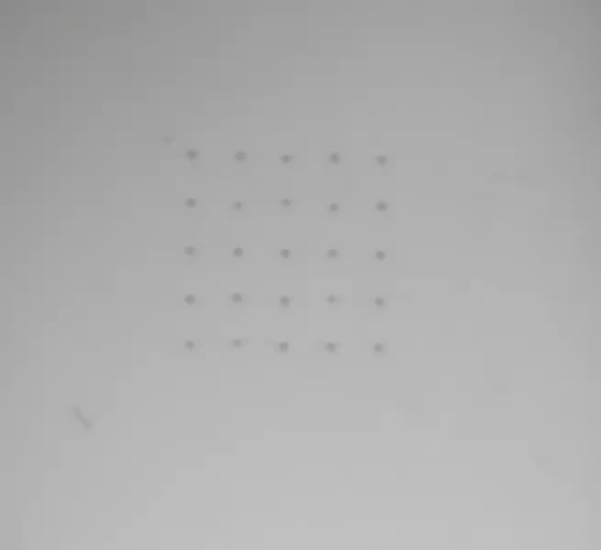
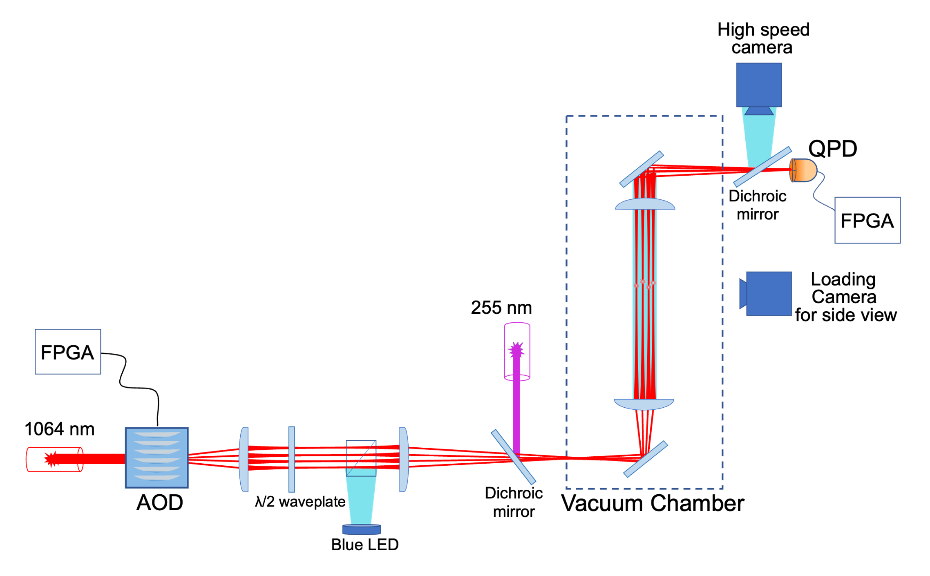
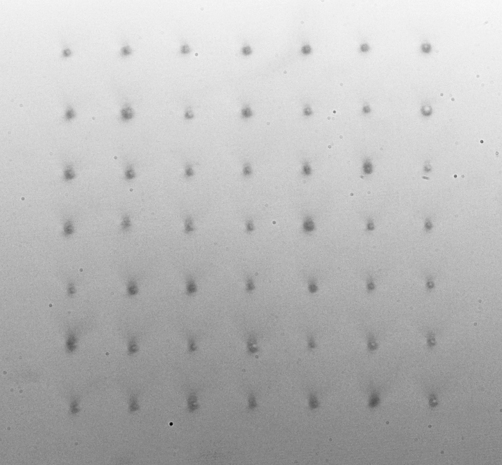

Microsphere arrays
Microsphere trap has been upgraded with high power laser (100 W) to allow up to ~10 x 10 arrays
Similar technology to tweezer arrays for neutral atom quantum computing
  Real time control over trap positions
25 spheres = 10¹⁵ atoms!
Ben Siegel
7x7 array of spheres in vacuum:
Simplified schematic:
100 $μ$m
~500 $μ$m
Played at 8x speed
D. Moore, Yale
Siegel et al. PRA 111, 033514 (2025)

Slide 7
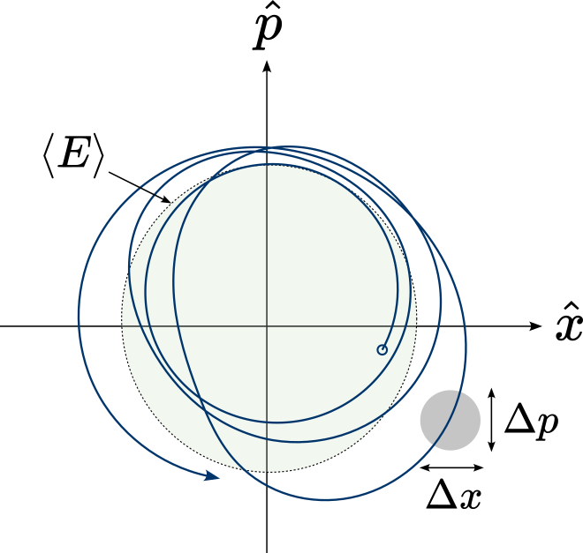
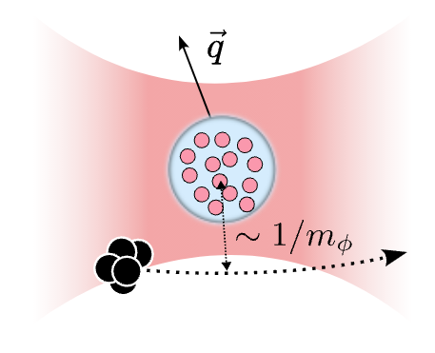



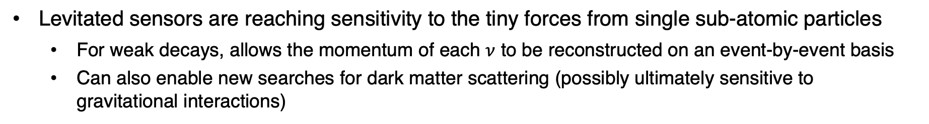
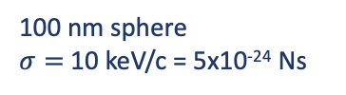
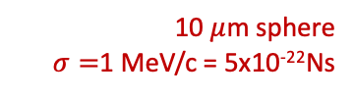
Forces from sub-atomic particles
Levitated sensors are reaching sensitivity to the tiny forces from single sub-atomic particles
  For weak decays, allows the momentum of each $ν$ to be reconstructed on an event-by-event basis
  Can also enable new searches for dark matter scattering (possibly ultimately sensitive to gravitational interactions)
Phase space trajectory:
Example force measurements relevant for fundamental physics:
Weak nuclear decays
Dark matter scattering
$$\vec{p}sph$$
Auger e⁻
x-rays
$$\vec{p}ν$$
$$ν_{e}$$
100 nm sphere
$σ=$10 keV/c = 5x10⁻²⁴ Ns
10 $μ$m sphere
$σ=$1 MeV/c = 5x10⁻²²Ns
PRL133, 023602 (2024), arXiv:2402.13257
PRX Q 4, 010315 (2023), arXiv:2207.05883
PRL 128, 101301 (2022), arXiv:2111.03597
PRL 127, 061804 (2021), arXiv:2104.05737
PRL 125, 181102 (2020), arXiv:2007.12067
See, also, e.g.:
Magrini et al., Nature 595, 373 (2021)
D. Moore, Yale
Tebbenjohanns et al., Nature 595, 378 (2021)

Slide 8
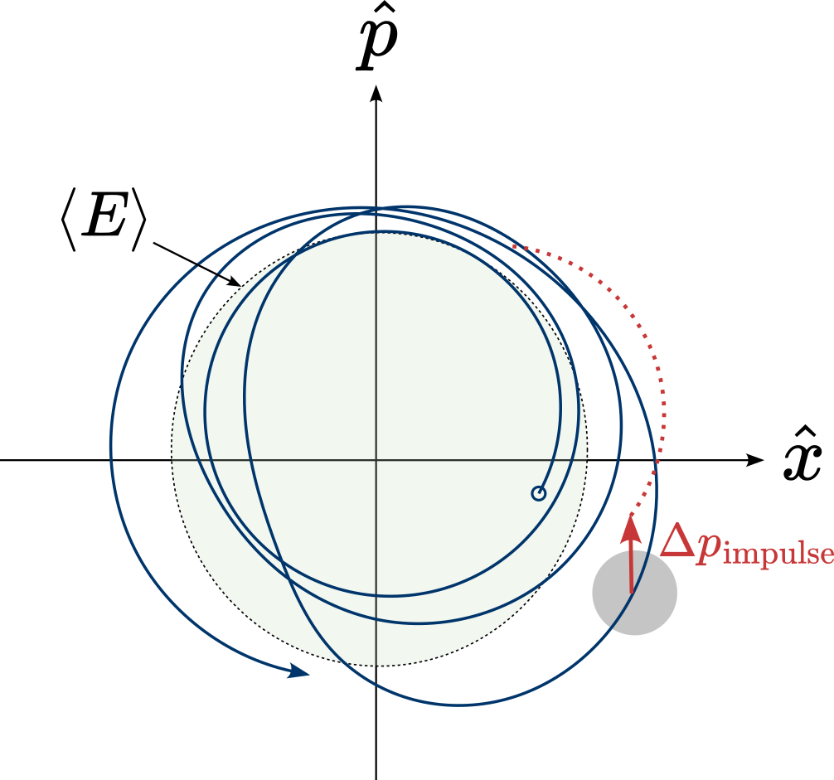
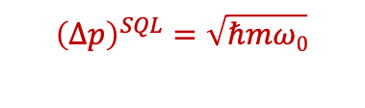
Forces from sub-atomic particles
Levitated sensors are reaching sensitivity to the tiny forces from single sub-atomic particles
  For weak decays, allows the momentum of each $ν$ to be reconstructed on an event-by-event basis
  Can also enable new searches for dark matter scattering (possibly ultimately sensitive to gravitational interactions)
Phase space trajectory:
Example force measurements relevant for fundamental physics:
Weak nuclear decays
Dark matter scattering
$$\vec{p}sph$$
Auger e⁻
x-rays
$$\vec{p}ν$$
$$ν_{e}$$
100 nm sphere
$σ=$10 keV/c = 5x10⁻²⁴ Ns
10 $μ$m sphere
$σ=$1 MeV/c = 5x10⁻²²Ns
PRL133, 023602 (2024), arXiv:2402.13257
PRX Q 4, 010315 (2023), arXiv:2207.05883
PRL 128, 101301 (2022), arXiv:2111.03597
PRL 127, 061804 (2021), arXiv:2104.05737
PRL 125, 181102 (2020), arXiv:2007.12067
$${\left(Δp\right)}^{SQL}=\sqrt{ℏmω0}$$
See, also, e.g.:
Magrini et al., Nature 595, 373 (2021)
D. Moore, Yale
Tebbenjohanns et al., Nature 595, 378 (2021)

Slide 9
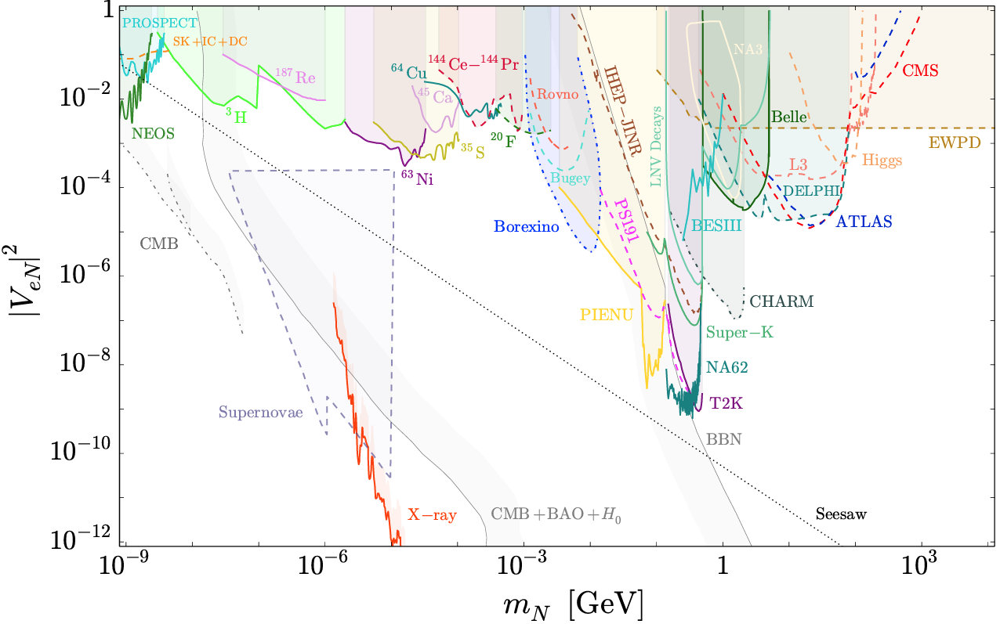

Sterile 𝜈
From oscillation experiments we know 𝜈 have mass
However, we’ve never detected a right-handed 𝜈 (or a left-handed $\overline{ν}$)
Right-handed 𝜈 likely “sterile”, i.e. would not directly interact with other particles*
In the keV-MeV mass range, they could make up some (or all) of dark matter
  Look for “wrong” $\overline{ν}$momentum in a weak decay
Experimental limits on sterile 𝜈 mixing with 𝜈_{e}:
Mixing with $ν_{e}$, $|U_{e4}|2$
?
“Minimal” DM candidate?
Nanospheres
Masses:
m₁
m₂
m₃
m₄
Sterile $ν$ mass, $m4$ [GeV]
Bolton et al., JHEP 2020, 170 (2020), arXiv:1912.03058
D. Moore, Yale
*except via gravity

Slide 10
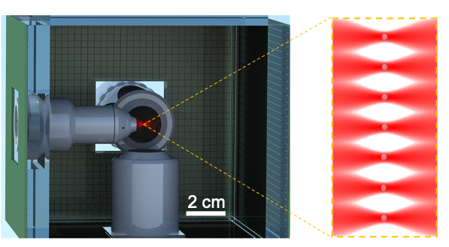
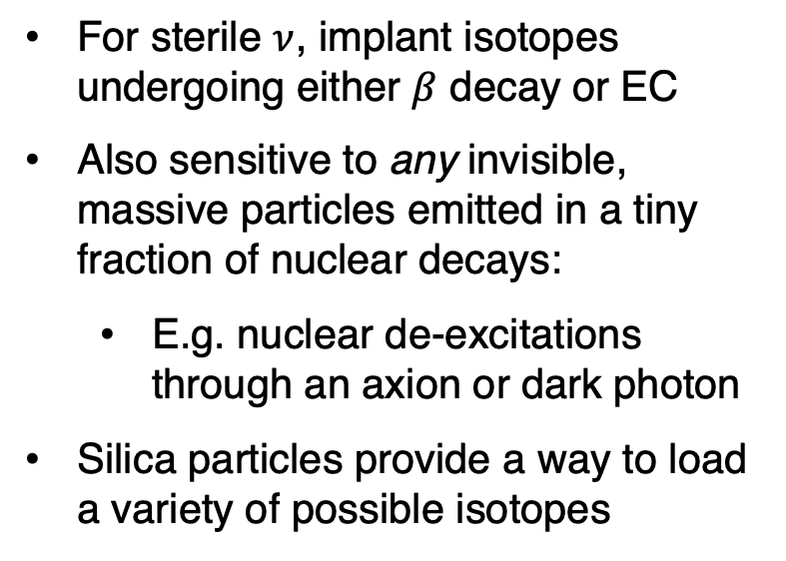
Detector concept
Surround optical trap by conventional particle detectors, to reconstruct the 3-momentum of any “missing momentum” in the decay
For sterile $ν$, implant isotopes undergoing either $β$ decay or EC
Also sensitive to any invisible, massive particles emitted in a tiny fraction of nuclear decays:
  E.g. nuclear de-excitations through an axion or dark photon
Silica particles provide a way to load a variety of possible isotopes
Detector concept:
Nanosphere array
Scintillator + SiPM arrays
D. Moore, Yale
PRX Q 4, 010315 (2023), arXiv:2207.05883

Slide 11
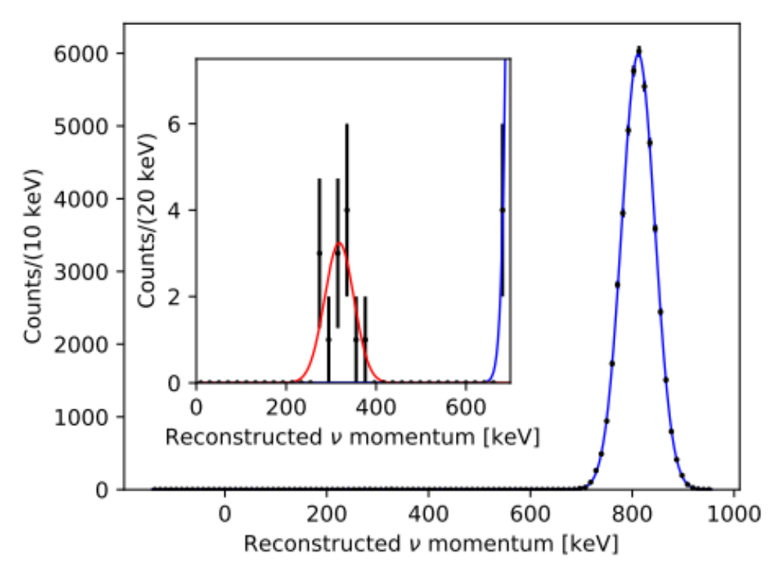
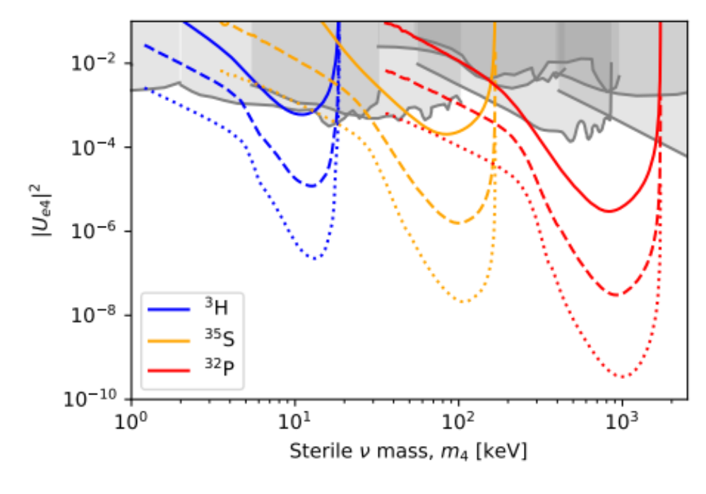
Projected sensitivity
If a keV – MeV mass sterile 𝜈 mixes with the light 𝜈, then expect small fraction of decays to emit a heavy 𝜈
Possibility to probe many orders of magnitude beyond best existing experiments with mechanical sensors
Example electron capture decay (³⁷Ar):
Projected sensitivity versus livetime:
100 nm sphere
1 month
$m_{4}$ = 750 keV
1 sphere month
10 sphere years
1000 sphere years
D. Moore, Yale
PRX Q 4, 010315 (2023) arXiv:2207.05883

Slide 12

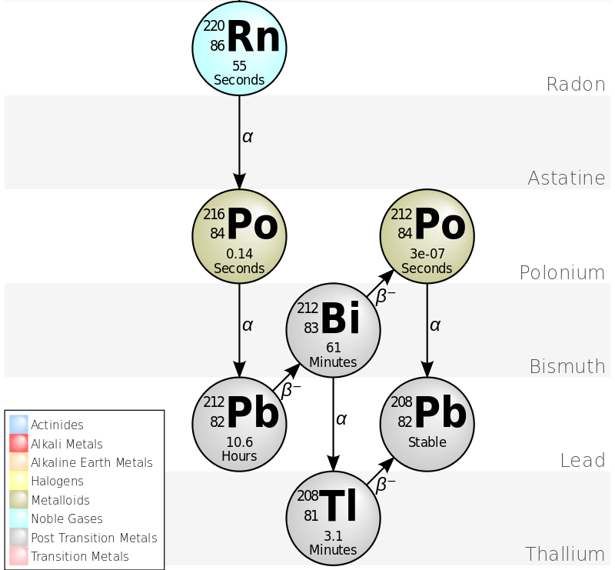

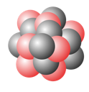


Proof of principle ($α$ decays)
As a proof-of-principle, we have detected single 𝛼 decays with >$μ$m sized spheres
  Momentum is ~200 MeV/c (compared to 0.1-1 MeV/c for typical $ν, γ$)
Have demonstrated loading of small quantities of ²¹²Pb into trapped microspheres
Jiaxiang Wang
Rn-220 decay chain:
Schematic of loading scheme:
²²⁰Rn
²¹⁶Po⁺
Drift in E-field
~100 nm
²¹²Pb
T_{1/2} = 56 s
T_{1/2} = 0.14 s
T_{1/2} = 10.6 h
3 $μ$m diameter SiO₂ sphere
J. Wang et al, PRL133, 023602 (2024), arXiv:2402.13257
D. Moore, Yale

Slide 13
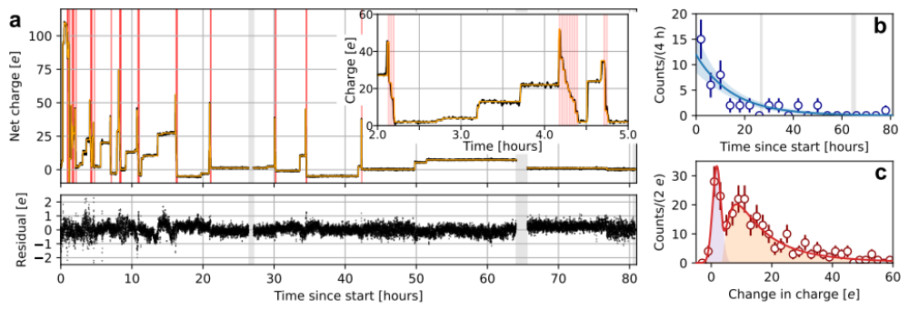

Detection of single nuclear decays (charge)
Can detect single nuclear decays through the change in net charge of the particle
Example of measured charge changes vs. time:
Auto-discharge
$α/β$ decays
PRL133, 023602 (2024), arXiv:2402.13257

Slide 14
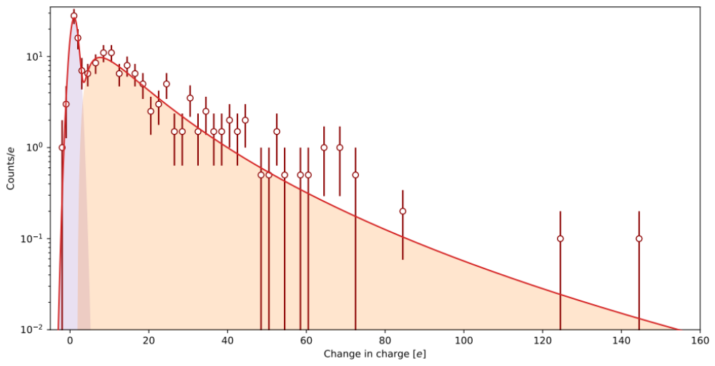
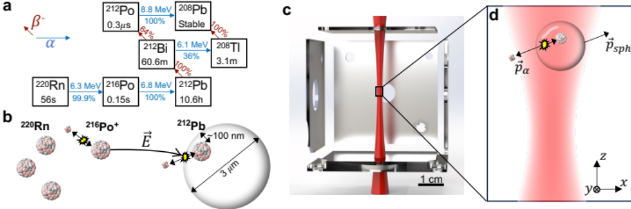
Distribution of measured charge changes
Single $α$ and $β$ decays nearly always kick out extra electrons, with changes >>1 e⁻ observed
Distribution of charge changes (6 spheres):
Counts
“Background free” tag of a decay within the particle!
PRL133, 023602 (2024), arXiv:2402.13257
Change in charge [e]

Slide 15
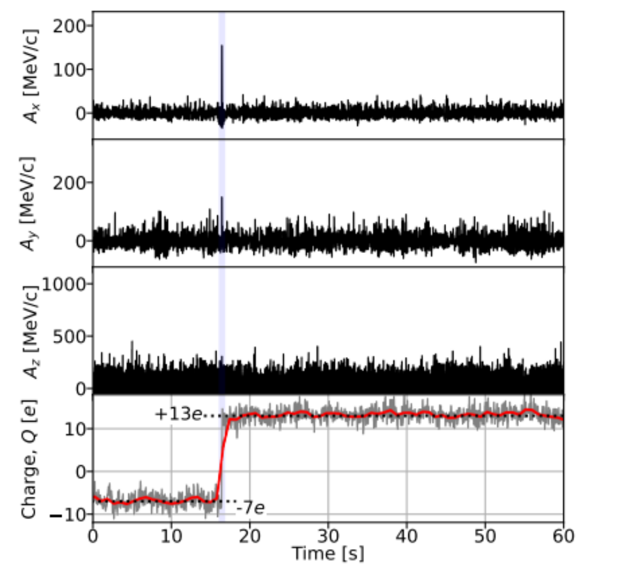
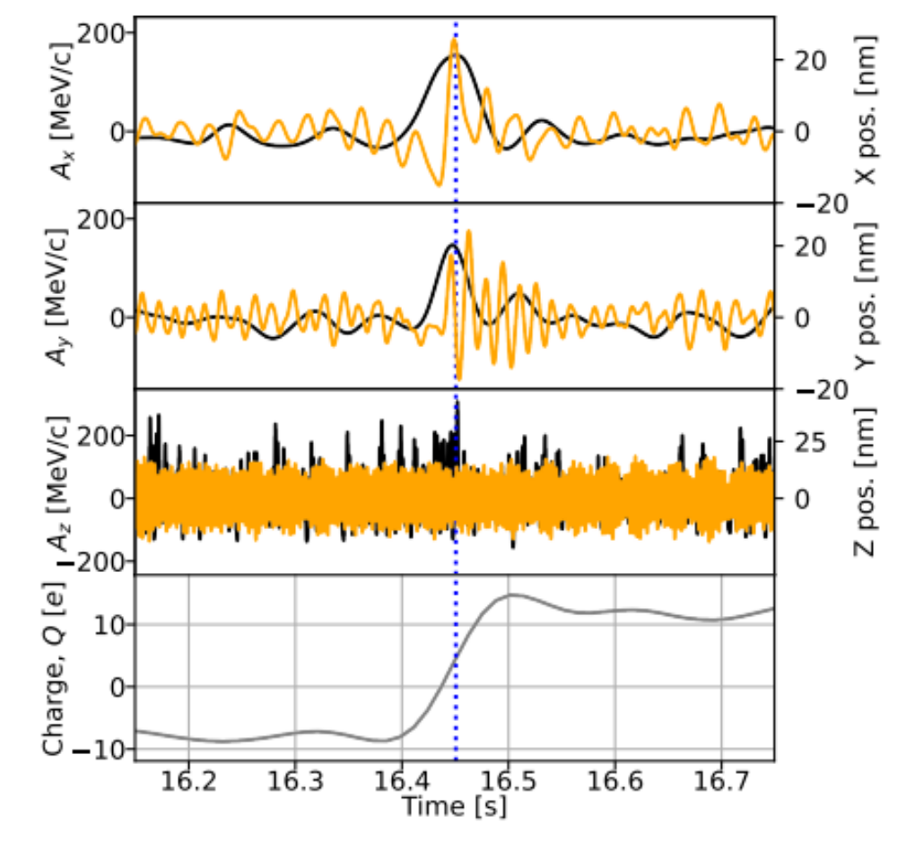
Detection of single nuclear decays (recoil)
Reconstruct recoil of the entire particle correlated with the decay time
Recoil coincident with charge change:
Zoom to decay time:
Signal to noise = 13
PRL133, 023602 (2024), arXiv:2402.13257

Slide 16
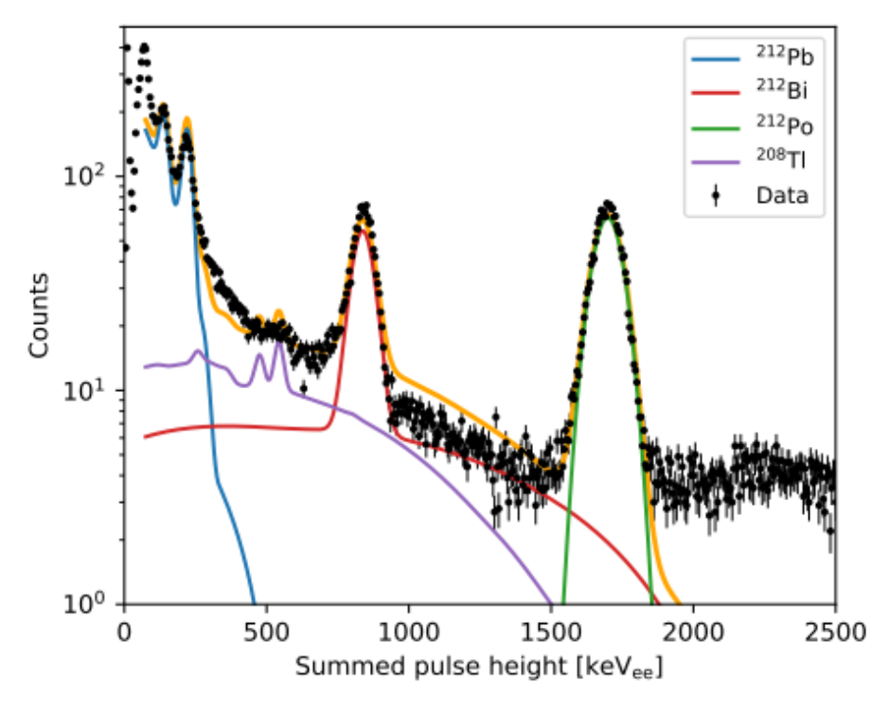

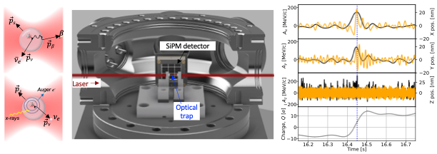

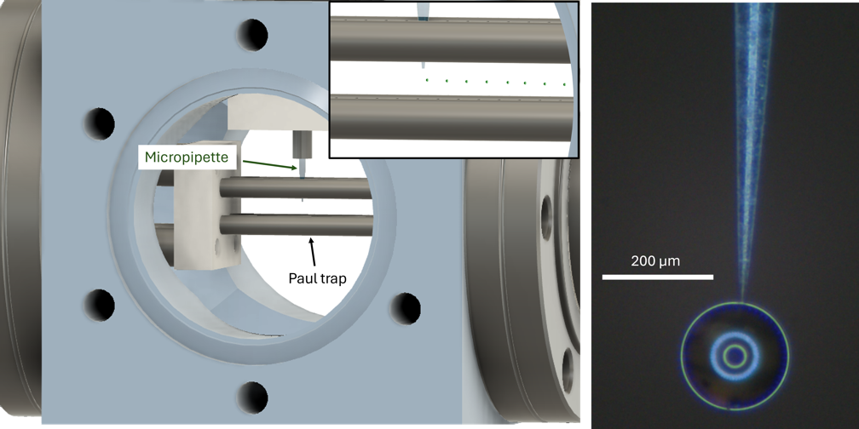

SiPM detector measured ²¹²Pb spectrum
Next steps
This proof-of-principle may find applications in nuclear safeguards/forensics:
  E.g. 10 um diameter ²³⁵U₂O₅ particle -> 400 $μ$Bq activity (~1 decay/hr)
Next steps are:
  Develop methods to load other isotopes of interest into ~100 nm particles
  Incorporate conventional $α, β,$ and $γ$ detectors
  Measure momenta of single $γ$, $ν$
Lucas Darroch
Jiaxiang Wang
Particle detector surrounding trap:
Droplet on micropipette:
Microdroplet loading concept:
Tom Penny
Jackie Baeza-Rubio
D. Moore, Yale

Slide 17
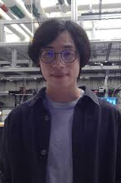
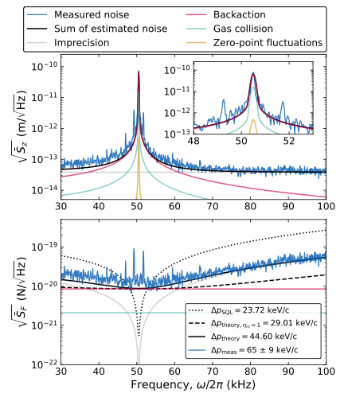
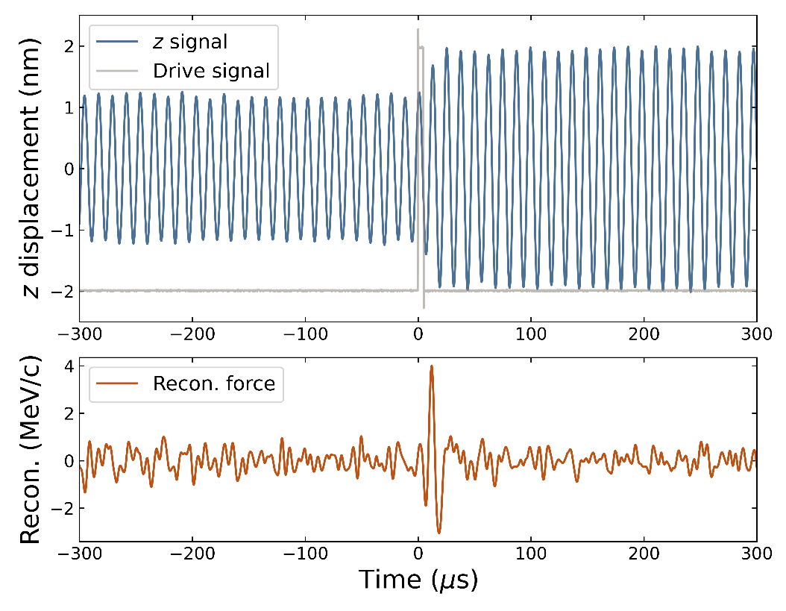


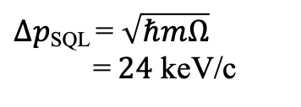
Smaller spheres (fg mass)
In parallel, have reached required sensitivity to detect neutrinos with high signal-to-noise with ~150 nm diameter spheres
Resolution within <3x of “Standard Quantum Limit” (SQL)
Yu-Han Tseng
Tom Penny
Measured force noise, 5 fg particle:
Calibrated response, 5 fg particle (4 MeV/c):
Preliminary
Backaction
$Δpmeas \text{= 65}±9$ keV/c
$Δp\text{SQL}\text{ = }\sqrt{ℏmΩ} \text{=} 24$ keV/c
Imprecision
S/N>10 for ²⁰⁸Tl $ν$
D. Moore, Yale

Slide 18
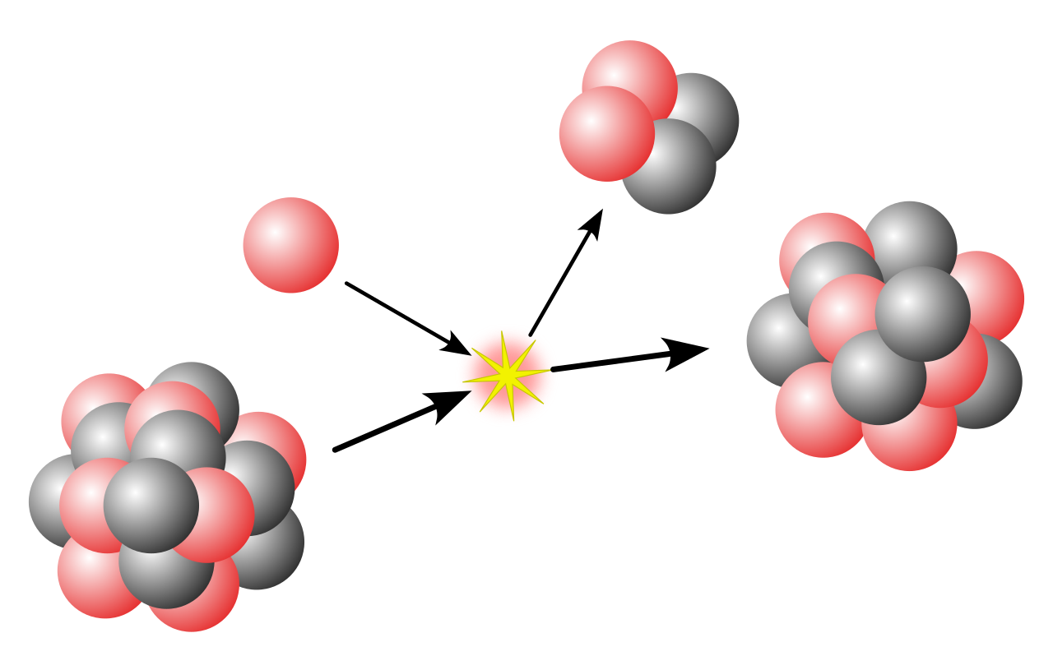


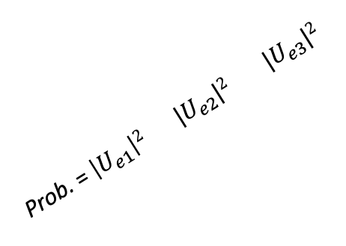
Future extensions
Sensitivity is already relevant for applications in neutrino physics and dark matter searches
  Searching for heavy, right-handed neutrinos
  Searches for dark matter coupled through a “fifth force”
Reaching the ultimate potential for fundamental physics will require measurements deep in the quantum regime:
  Can we projectively measure the momentum of the different neutrino mass states?
  Can we search for dark matter through its gravitational interactions alone?
In parallel, working to extend techniques to new materials relevant for fundamental physics applications
Projective measurement of $ν$ mass states:
$$\vec{p}sph$$
Prob. = $\left|U_{e1}\right|2$ $|U_{e2}|2$ $|U_{e3}|2$
Cartoon of impulse measurement with mechanical squeezing:
(a)
P
(b)
P
X
X
Solid xenon, solid tritium, …
See, e.g.,: Rossi et al, “Quantum Delocalization of a Levitated Nanoparticle,” arXiv:2408.01264 (2024)
D. Moore, Yale

Slide 19
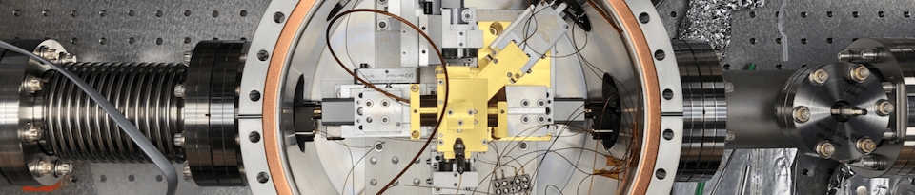
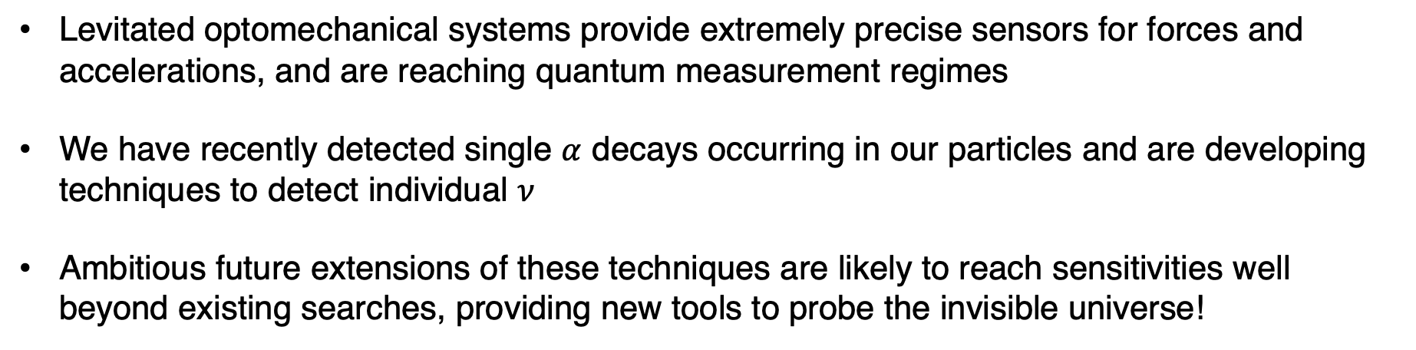
Summary
Levitated optomechanical systems provide extremely precise sensors for forces and accelerations, and are reaching quantum measurement regimes
We have recently detected single $α$ decays occurring in our particles and are developing techniques to detect individual $ν$
Ambitious future extensions of these techniques are likely to reach sensitivities well beyond existing searches, providing new tools to probe the invisible universe!
D. Moore, Yale

Slide 20
D. Moore, Yale

Slide 21
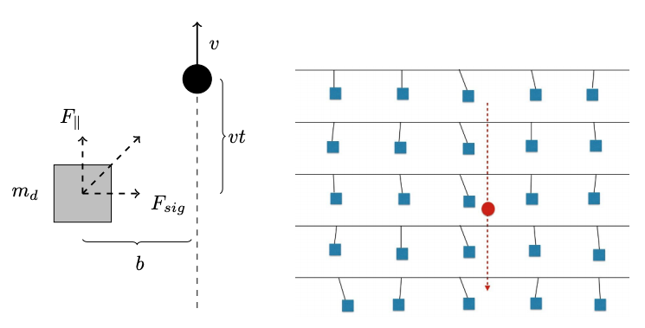



Model independent search
Thinking big, one can at least imagine what a model-independent terrestrial search for dark matter might look like
Gravitational impulse:
Array of sensors:
Thermal noise (levitated sensor @ 10⁻¹² mbar):
Dark matter mass
Sensor mass
Dark Matter rate:
Planck mass $\sim 20 μ$g
Array of d = 1 mm → 10⁹ sensors!
Carney et al., "Proposal for gravitational direct detection of dark matter,” PRD 102, 072003 (2020), arXiv:1903.00492
  For sufficiently heavy dark matter ($m_{χ} \sim m_{Pl}$) this might be possible, at least in principle
    Measurement limits are a key issue → need at least 30 dB beyond the “standard quantum limit”!!!
D. Moore, Yale

Slide 22




Dark matter candidates
There is astrophysical evidence for dark matter spanning from galactic to cosmological length scales
  WIMPs and Axions are compelling candidates for this DM
Dark matter mass:
GUT scale
zeV
aeV
feV
peV
neV
$μ$eV
meV
eV
keV
MeV
GeV
TeV
PeV
EeV
ZeV
M_{pl}
30M$⨀$
Axions
WIMPs
Wave-like ($n/λ3≫1)$
Particle-like ($n/λ3≪1)$
Adapted from US Cosmic Visions: New Ideas in Dark Matter 2017: Community Report, arXiv:1707.04591
D. Moore, Yale

Slide 23

Dark matter candidates
There is astrophysical evidence for dark matter spanning from galactic to cosmological length scales
  WIMPs and Axions are compelling candidates for this DM… but a much larger set of models is consistent with astrophysical observations
Dark matter mass:
GUT scale
zeV
aeV
feV
peV
neV
$μ$eV
meV
eV
keV
MeV
GeV
TeV
PeV
EeV
ZeV
M_{pl}
30M$⨀$
Compton wavelength fits in smallest galaxies
Pre-inflation
Post-inflation
Mostly ruled out by “micro”-lensing surveys
Axions
WIMPs
Composite/macroscopic DM
Axion-like particles
Sterile $ν$
Q-balls
Hidden sector DM
Ultra-light scalar fields
WIMPzillas
Black holes(?)
Dark photons
+ many more…
Wave-like ($n/λ3≫1)$
Particle-like ($n/λ3≪1)$
Adapted from US Cosmic Visions: New Ideas in Dark Matter 2017: Community Report, arXiv:1707.04591
D. Moore, Yale

Slide 24




Kinematic detection of (particle) dark matter
While the momentum sensitivity is sufficient to detect dark matter scatters, the rate of scatters can be very small
Most sensitive to dark matter models that primarily interact coherently with entire objects
Ton-scale WIMP detectors (e.g. LZ, DarkSide, …):
fg-ng scale trapped objects:
Long range force:
Low momentum transfer:
Xe (A~100)
$$χ$$
$$χ$$
q⁻¹ ~ 10 nm
q⁻¹ ~ 1 pm
Monteiro et al., PRL 125, 181102 (2020), arXiv:2007.12067
Afek et al., PRL 128, 101301 (2022), arXiv:2111.03597
Coherence over an entire nano- or micro-sized object:
Coherence only over a single nucleus:
Rate $∝$ (N_{T})²$σn$
Rate $∝$ N_{T} A² $σn$
Can rival Avogadro’s number!
~ (10⁹)² to (10¹⁴)²
D. Moore, Yale
$≫$10²³
~10⁴

Slide 25


Dark matter search (long range force)
Acquired 5 days of dark matter search data in June 2020, four candidate events remain in non-Gaussian tail of distribution after all cuts
Conservatively set limits on neutron coupling assuming candidates could arise from DM
Measured spectrum of impulses:
Limits on generic DM-neutron coupling:
Observed data
Predicted DM signal:
All reconstructed events
New results with 100 nm spheres (1000x lower threshold) coming soon!
After all cuts
Mediator mass:
After accelerometer, "lab-entry” cuts
Monteiro et al., PRL 125, 181102 (2020), arXiv:2007.12067
D. Moore, Yale

Slide 26




Future sensitivity
Natural directionality → any detection would be definitive!
This first proof-of-principle search for DM with mechanical detectors can already explore well beyond existing searches for certain classes of models
Next steps:
  Continue to push towards SQL (and beyond?)
  Develop large arrays of sensors, and longer exposures
Future projections vs array size:
Tweezer arrays:
Atoms:
$μ$spheres (vacuum):
>6000 atoms!
Manetsch et al., arXiv:2403.12021 (2024)
B. Siegel (Yale)
D. Moore, Yale
DCM and A. Geraci, Quantum Sci. Tech. 6 014008 (2021), arXiv:2008.13197

