Slide 1
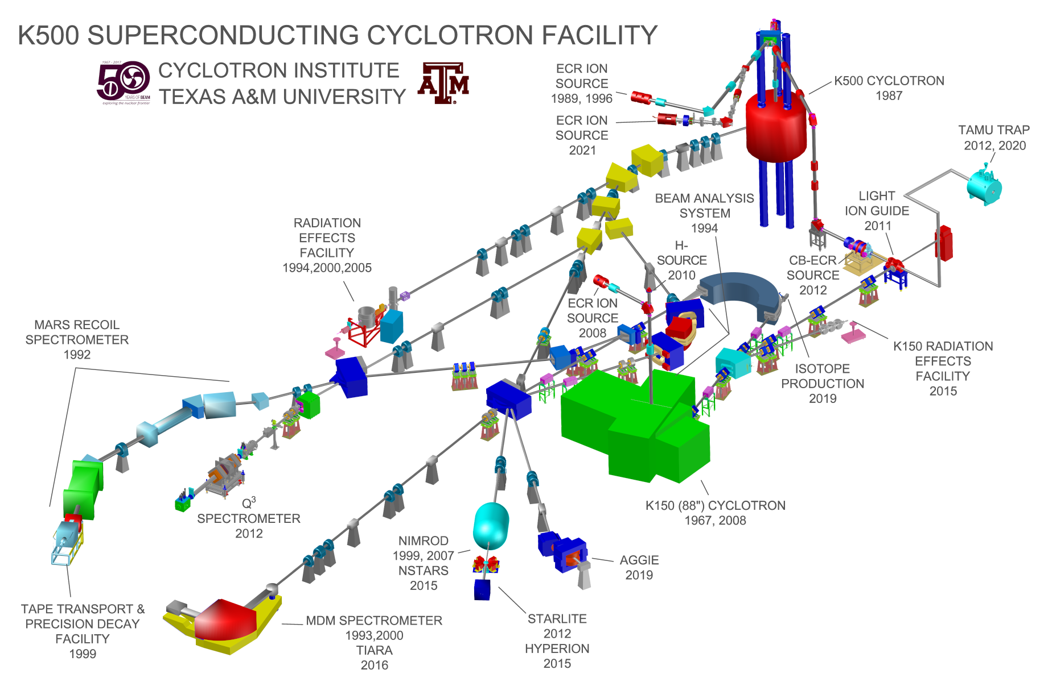

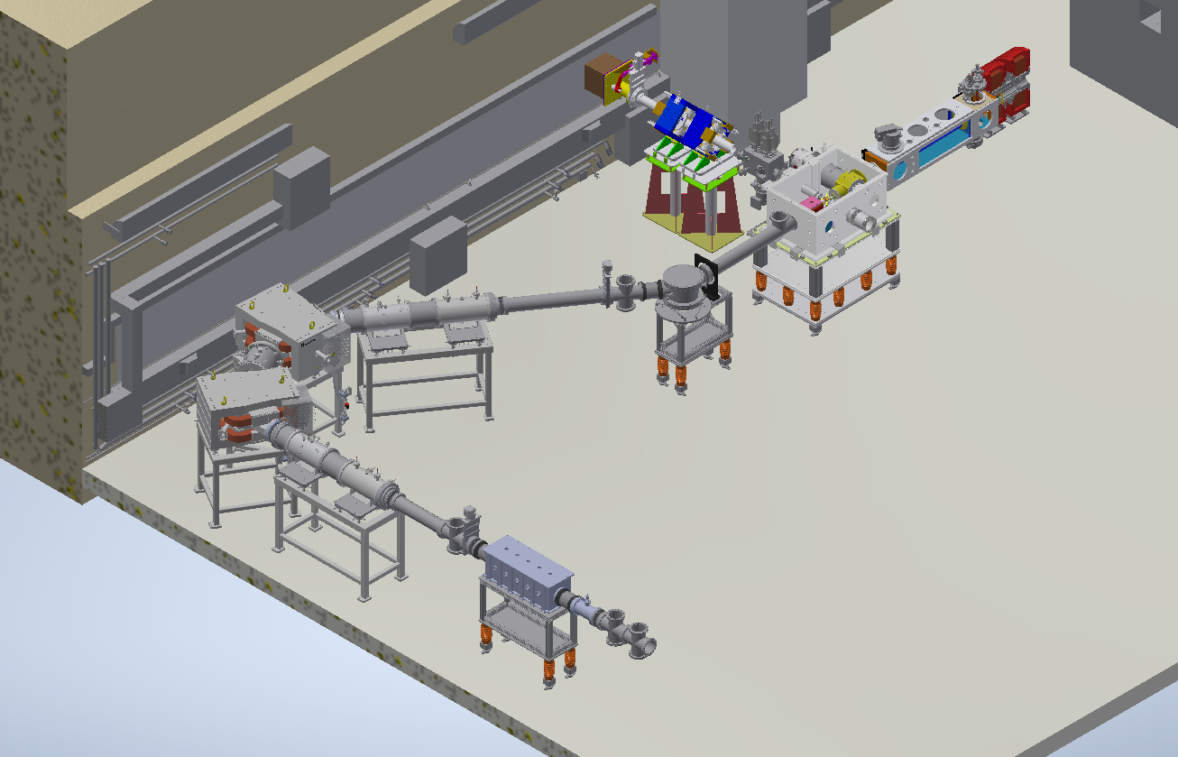
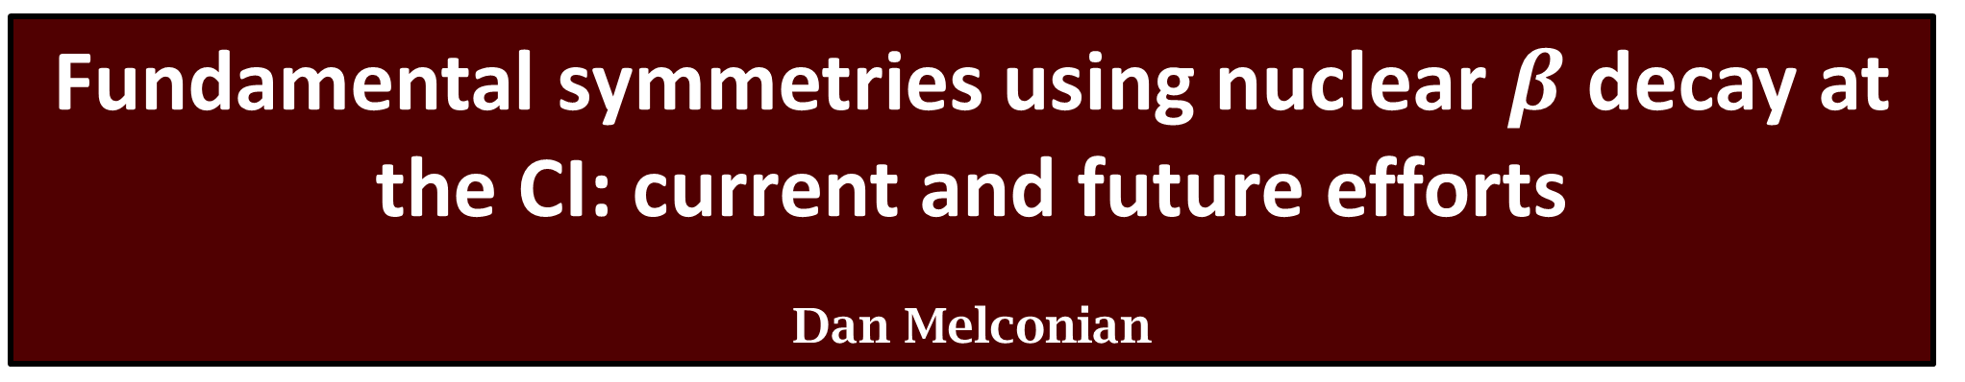
Fundamental symmetries using nuclear $β$ decay at the CI: current and future efforts
Dan Melconian
and FRIB…?

Slide 2
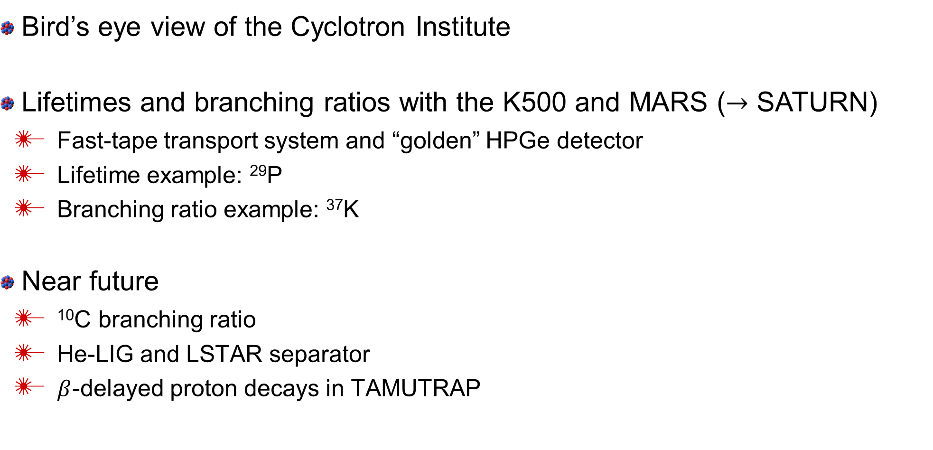
Overview
Bird’s eye view of the Cyclotron Institute
Lifetimes and branching ratios with the K500 and MARS ($→$ SATURN)
  Fast-tape transport system and “golden” HPGe detector
  Lifetime example: ²⁹P
  Branching ratio example: ³⁷K
Near future
  ¹⁰C branching ratio
  He-LIG and LSTAR separator
  $β$-delayed proton decays in TAMUTRAP

Slide 3
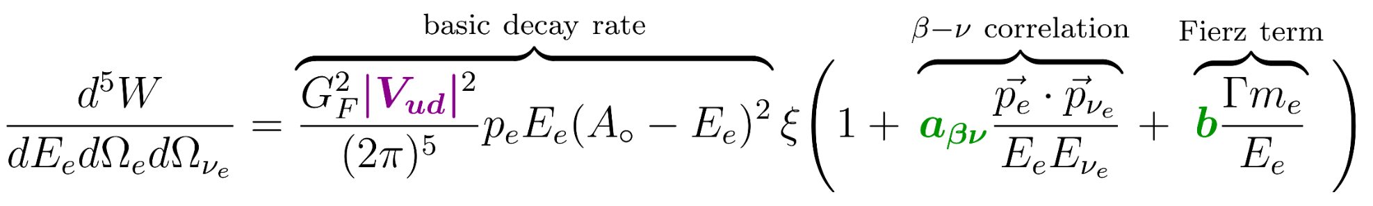
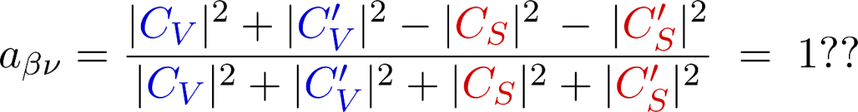
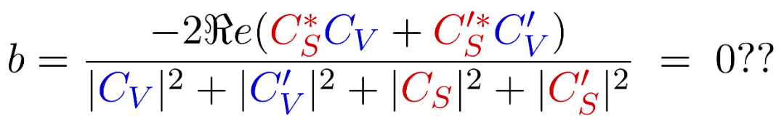
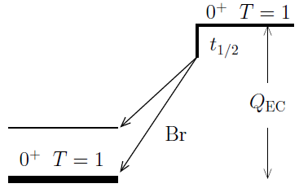
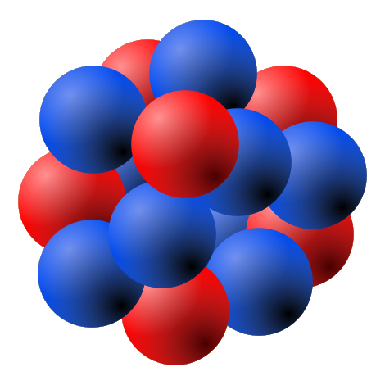
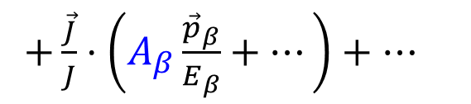
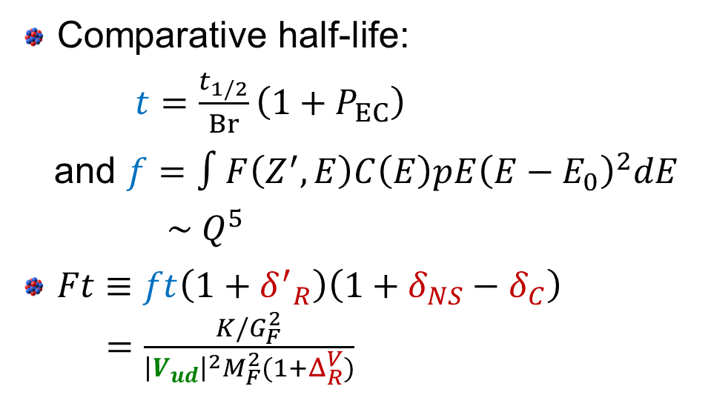



A primer on $β$ decay and fundamental physics
Expand to the often-quoted angular distribution of the decay
(Jackson, Treiman and Wyld, Phys Rev 106 and Nucl Phys 4, 1957)
$+\frac{\vec{J}}{J}⋅\left(A_{β}\frac{{\vec{p}}_{β}}{E_{β}}+…\right)+…$
Comparative half-life:
$t=\frac{t_{1/2}}{Br}\left(1+P_{EC}\right)$
and $f=∫F\left(Z^{′},E\right)C\left(E\right)pE{\left(E−E_{0}\right)}^{2}dE$
$\sim Q^{5}$
$Ft≡ft\left(1+{δ^{′}}_{R}\right)\left(1+δ_{NS}−δ_{C}\right)$
$=\frac{K/G_{F}^{2}}{{\left|V_{ud}\right|}^{2}M_{F}^{2}(1+Δ_{R}^{V})}$

Slide 4
The Cyclotron Institute
not a user facility

Slide 5
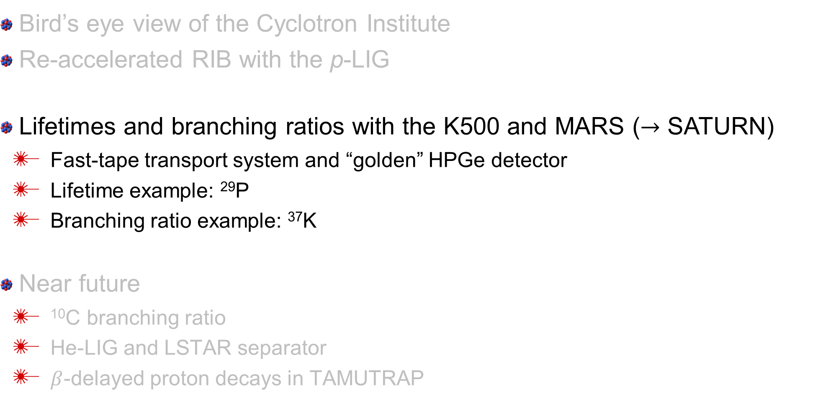
Overview
Bird’s eye view of the Cyclotron Institute
Re-accelerated RIB with the p-LIG
Lifetimes and branching ratios with the K500 and MARS ($→$ SATURN)
  Fast-tape transport system and “golden” HPGe detector
  Lifetime example: ²⁹P
  Branching ratio example: ³⁷K
Near future
  ¹⁰C branching ratio
  He-LIG and LSTAR separator
  $β$-delayed proton decays in TAMUTRAP

Slide 6
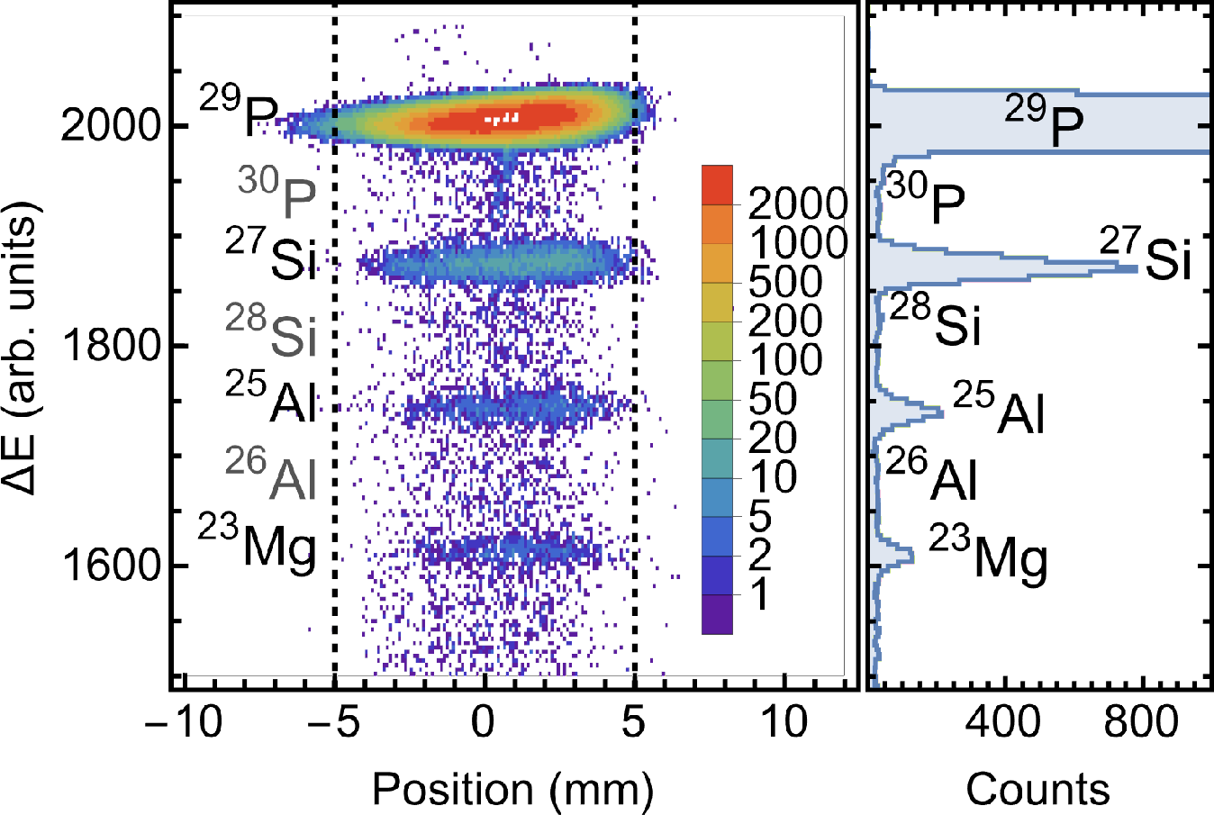
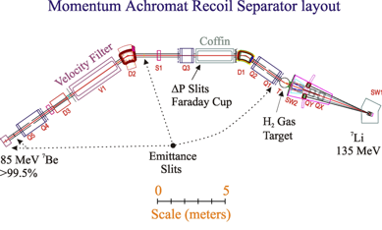
MARS: a heavily utilized spectrometer
Follows a LN₂-cooled H₂ target for inverse kinematic reactions.
Very pure beams!

Slide 7
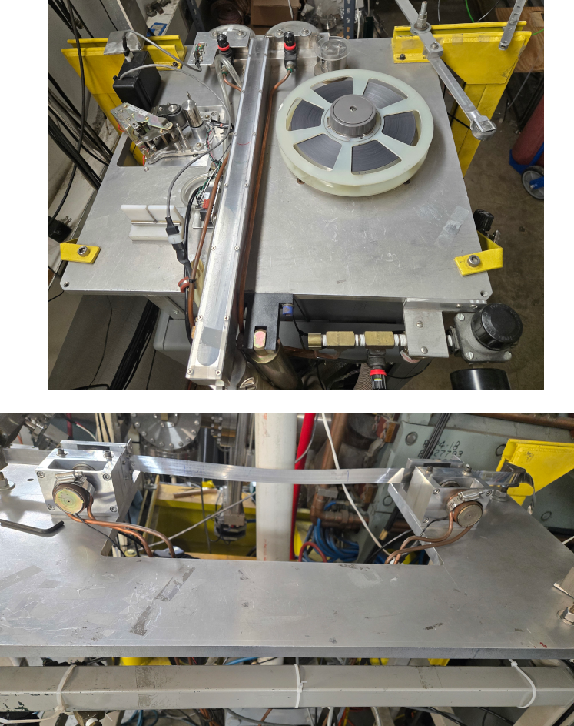
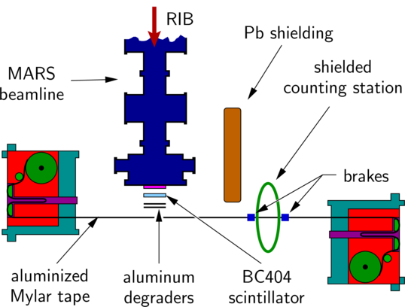
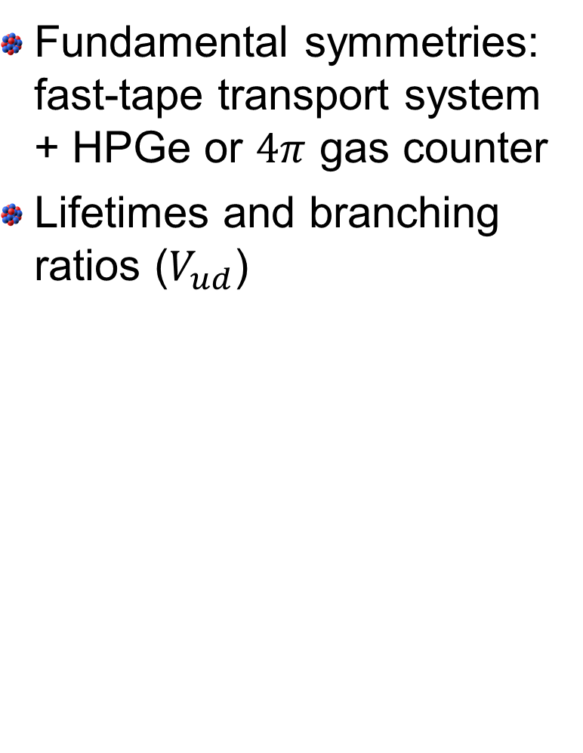
Fast-tape transport system (Hardy and Iacob)
Fundamental symmetries: fast-tape transport system + HPGe or $4π$ gas counter
Lifetimes and branching ratios ($V_{ud}$)

Slide 8
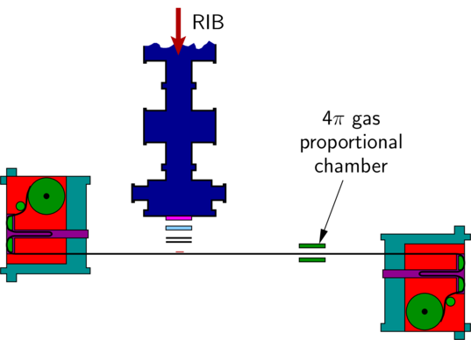
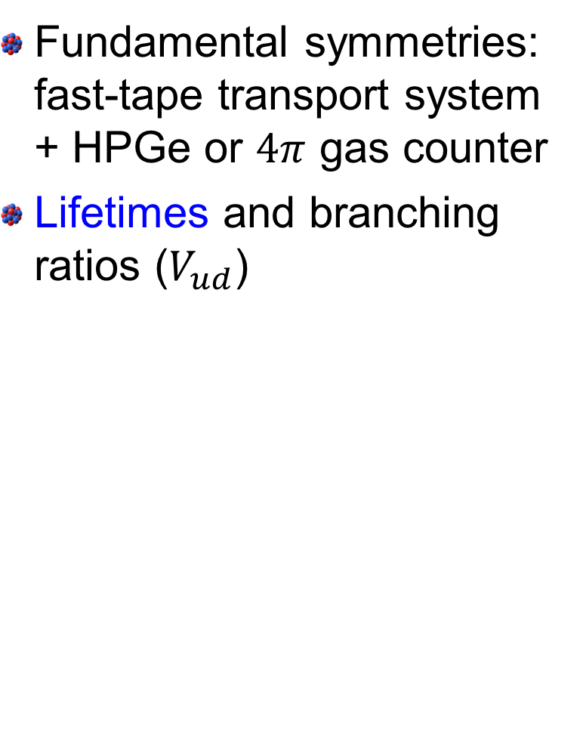
Fast-tape transport system (Hardy and Iacob)
Fundamental symmetries: fast-tape transport system + HPGe or $4π$ gas counter
Lifetimes and branching ratios ($V_{ud}$)

Slide 9
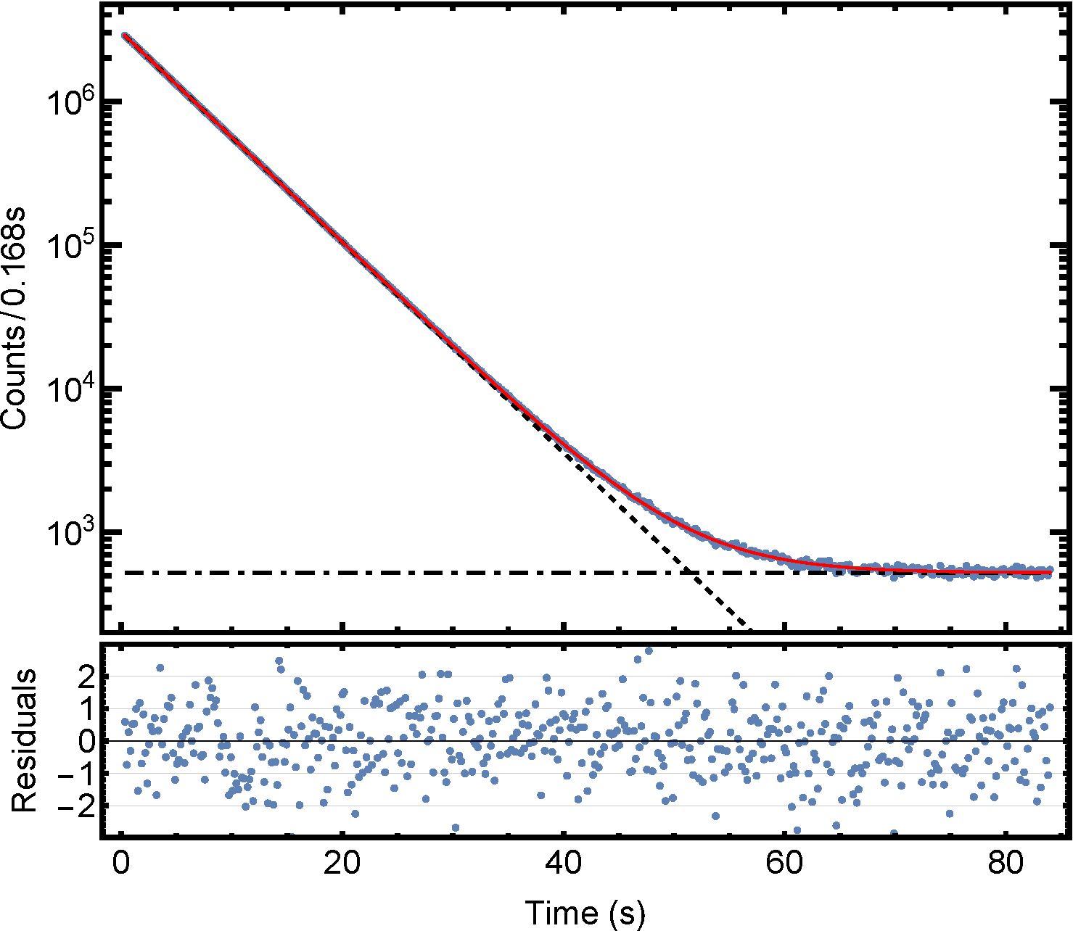
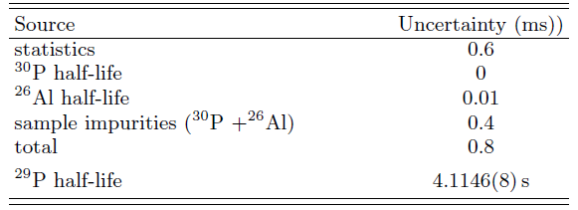
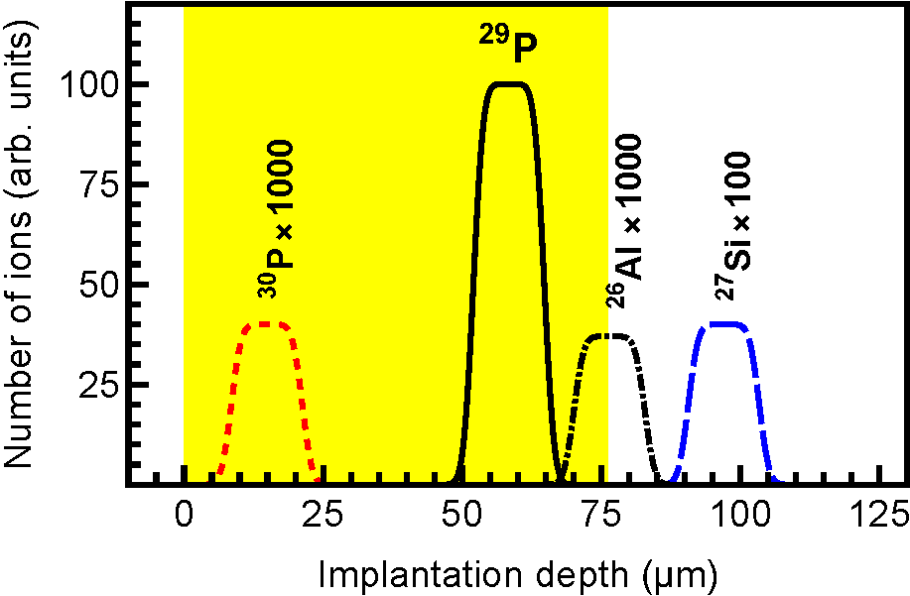
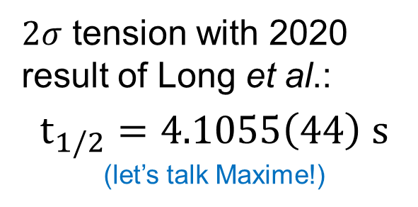
Lifetime example: ²⁹P
Degraders let us tune where activity is implanted in the tape and further purify the beam out of MARS
$2σ$ tension with 2020 result of Long et al.:
$$t_{1/2}=4.1055\left(44\right) s$$
(let’s talk Maxime!)

Slide 10
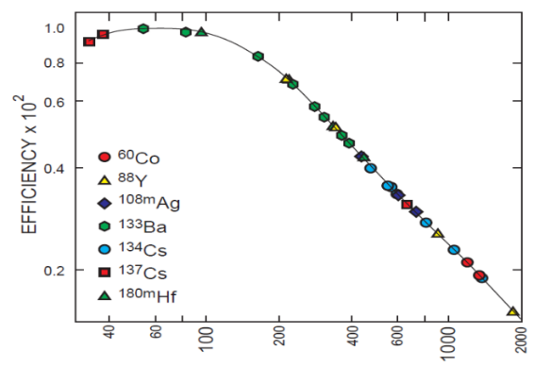
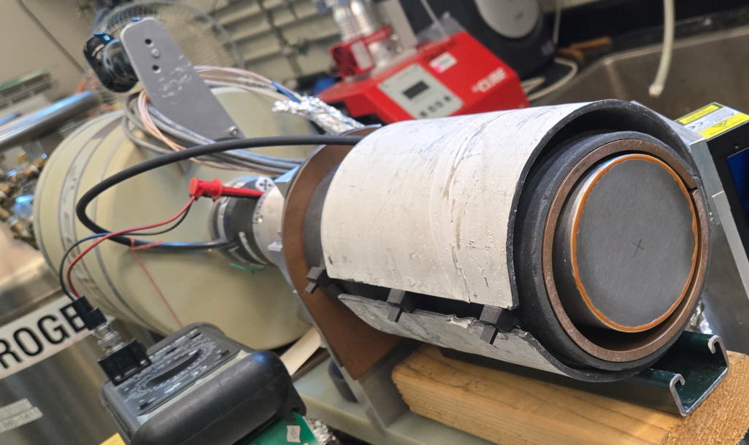
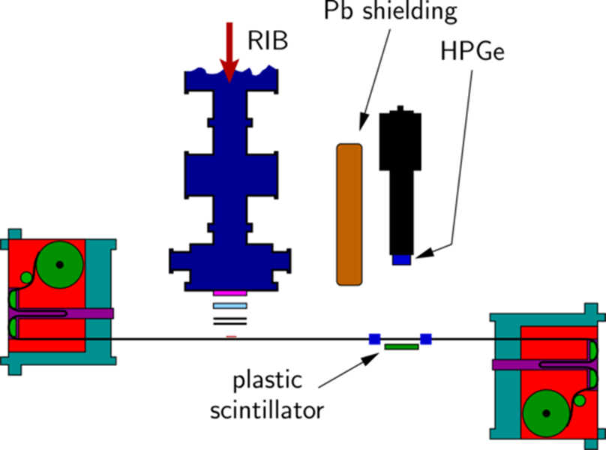
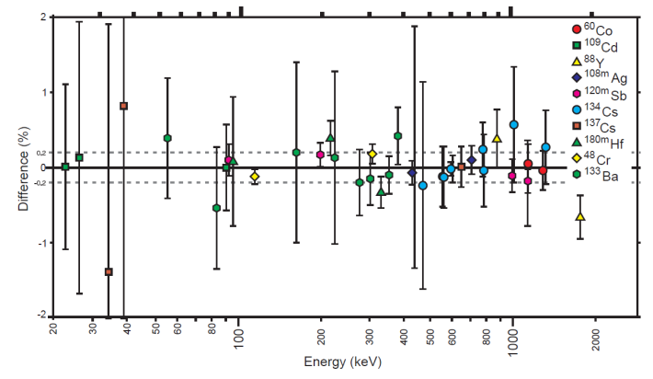
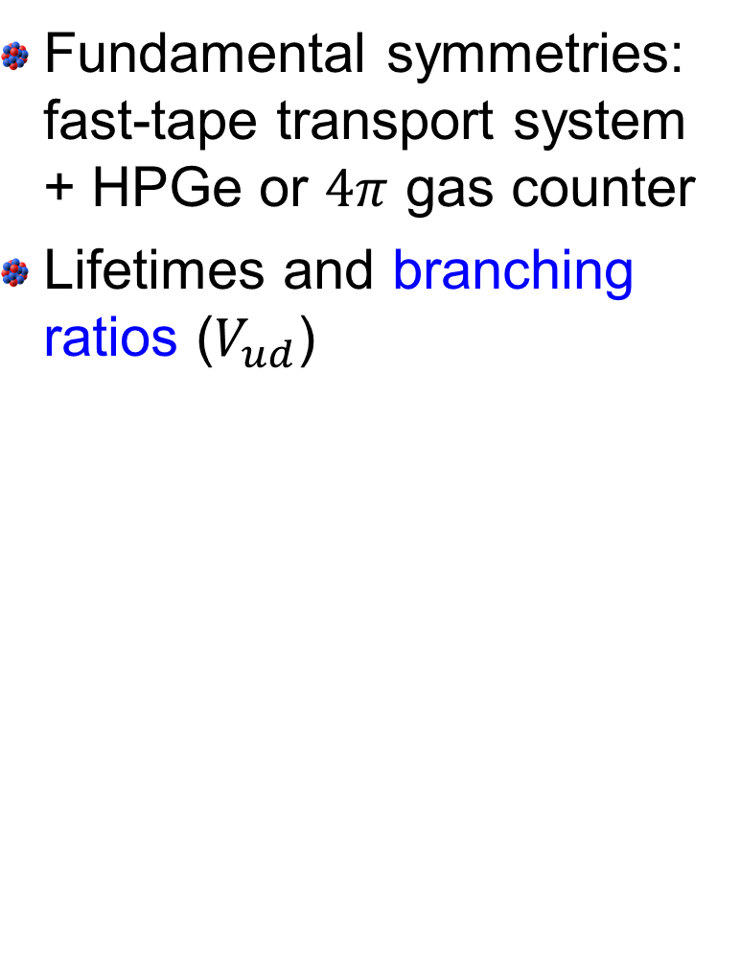
Fast-tape transport system (Hardy and Iacob)
Fundamental symmetries: fast-tape transport system + HPGe or $4π$ gas counter
Lifetimes and branching ratios ($V_{ud}$)
Absolute efficiency
±0.2%

Slide 11
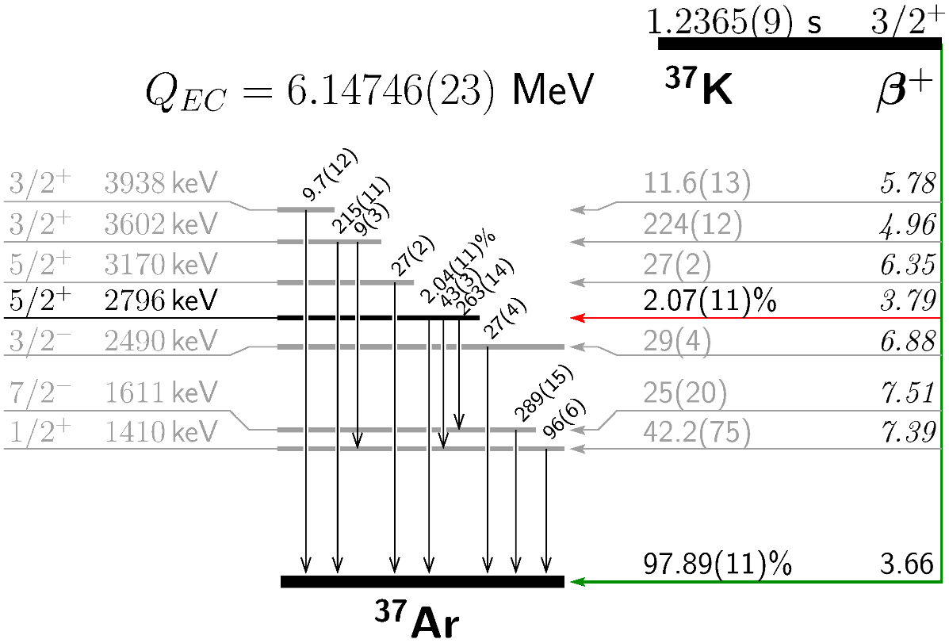
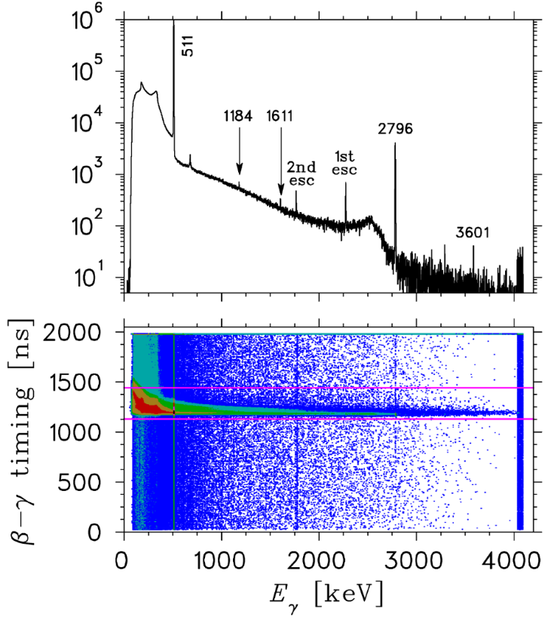
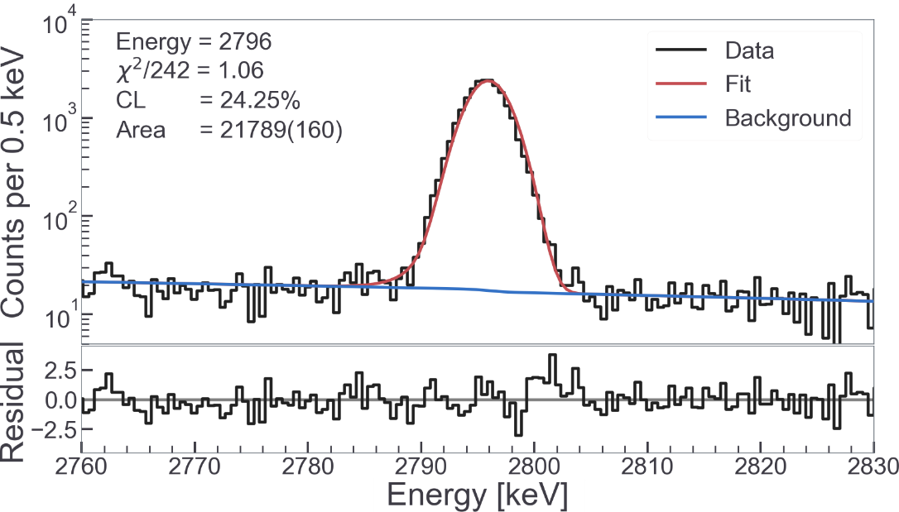
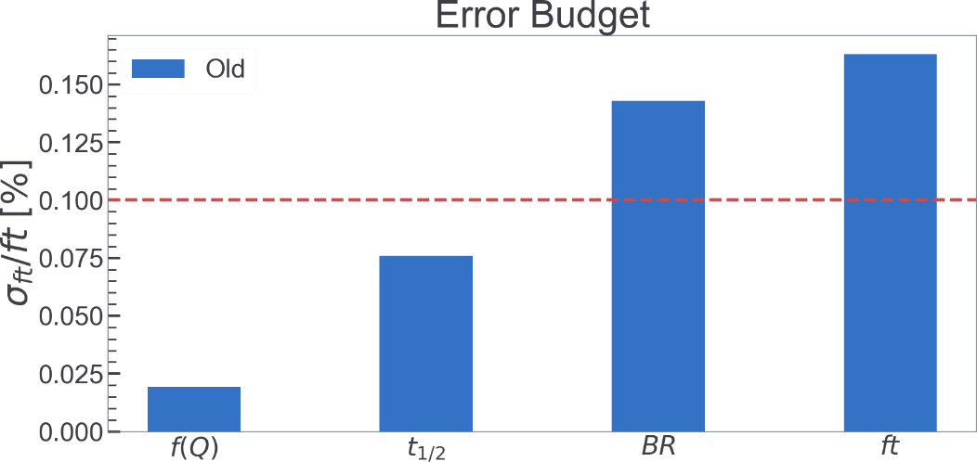
Branching ratio example: ³⁷K
d

Slide 12
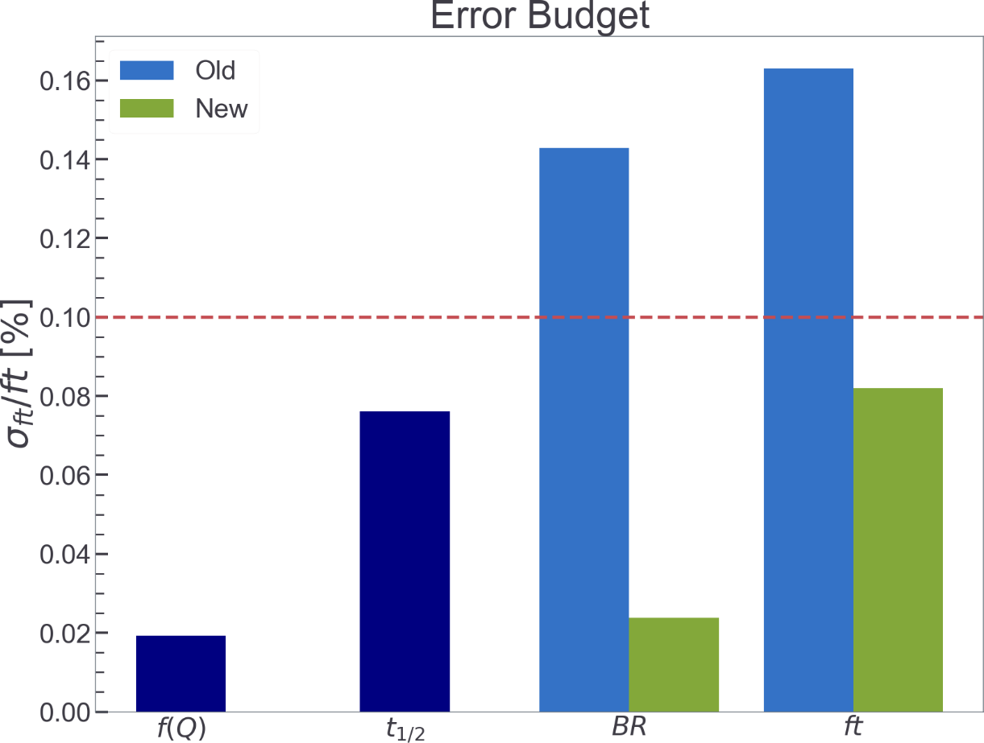
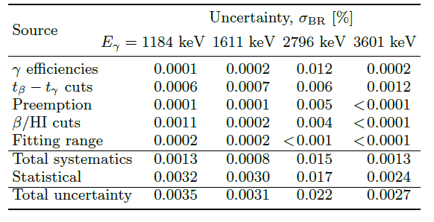
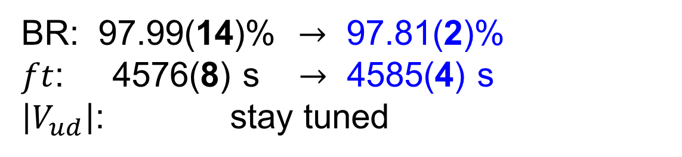
Branching ratio example: ³⁷K
BR: 97.99(14)% $→$ 97.81(2)%
$ft$: 4576(8) s $→$ 4585(4) s
$\left|V_{ud}\right|$: stay tuned

Slide 13
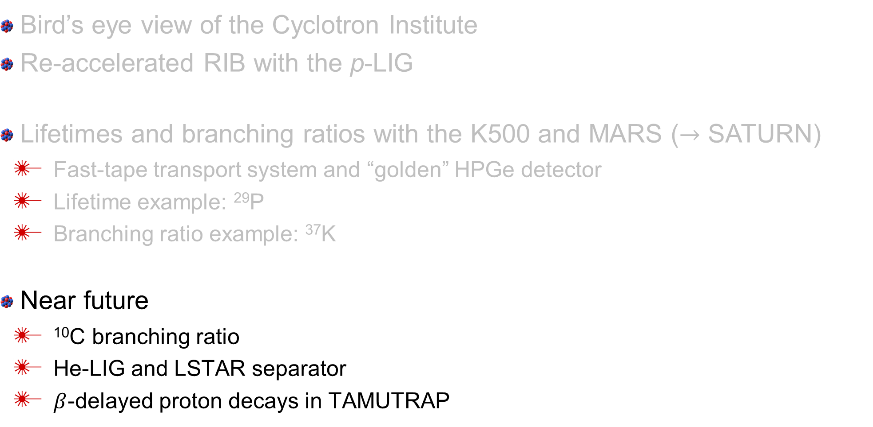
Overview
Bird’s eye view of the Cyclotron Institute
Re-accelerated RIB with the p-LIG
Lifetimes and branching ratios with the K500 and MARS ($→$ SATURN)
  Fast-tape transport system and “golden” HPGe detector
  Lifetime example: ²⁹P
  Branching ratio example: ³⁷K
Near future
  ¹⁰C branching ratio
  He-LIG and LSTAR separator
  $β$-delayed proton decays in TAMUTRAP

Slide 14
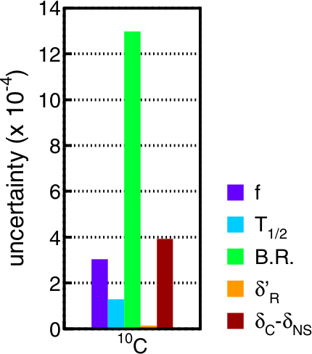
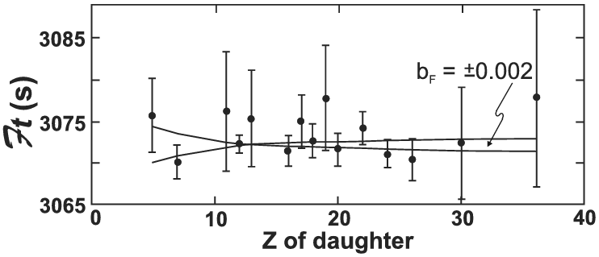
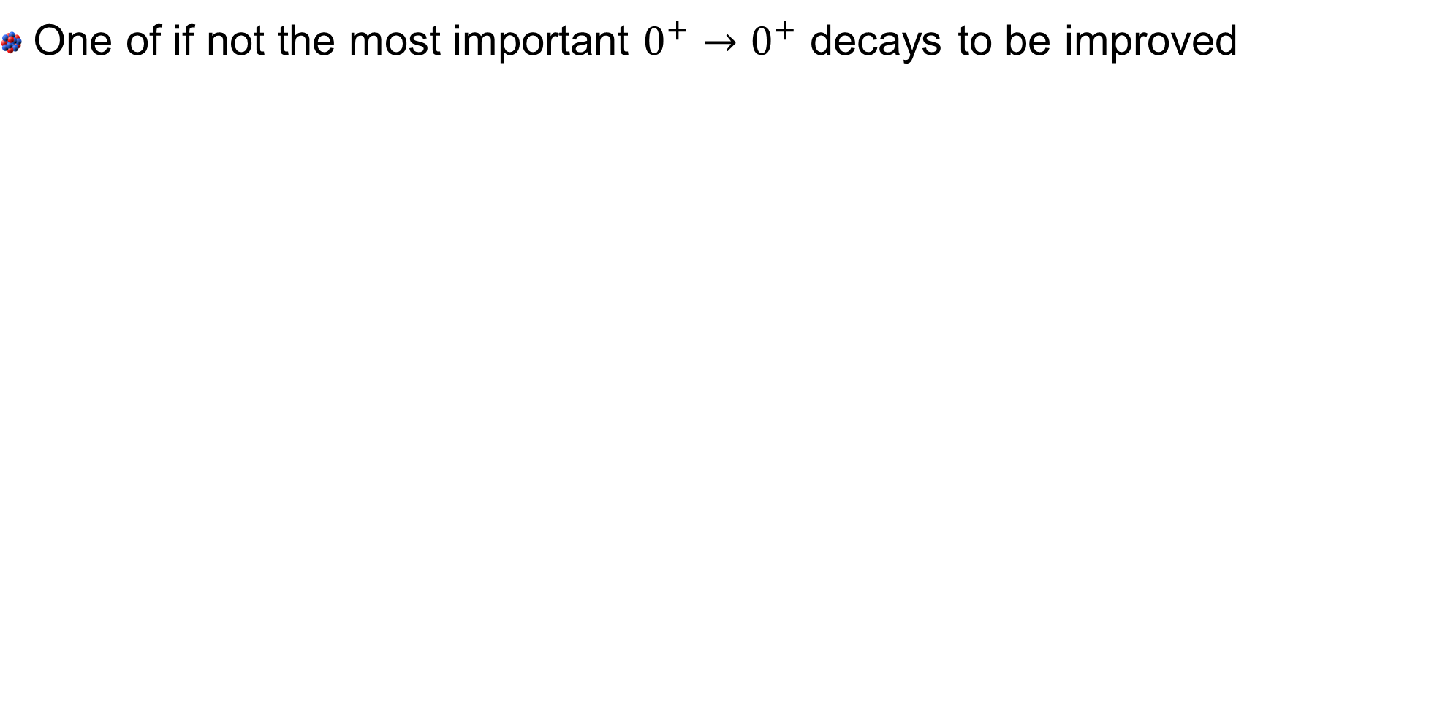
Another branching ratio – ¹⁰C
One of if not the most important $0^{+}→0^{+}$ decays to be improved

Slide 15
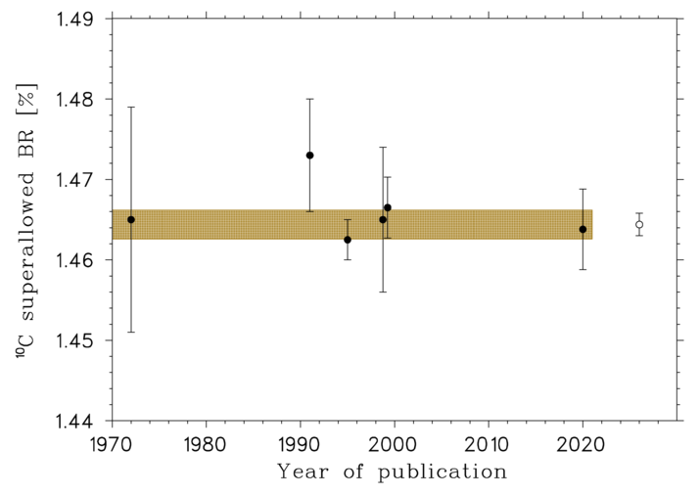
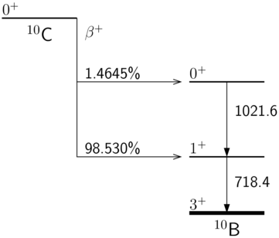
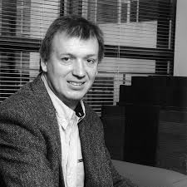
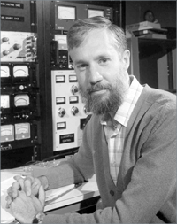
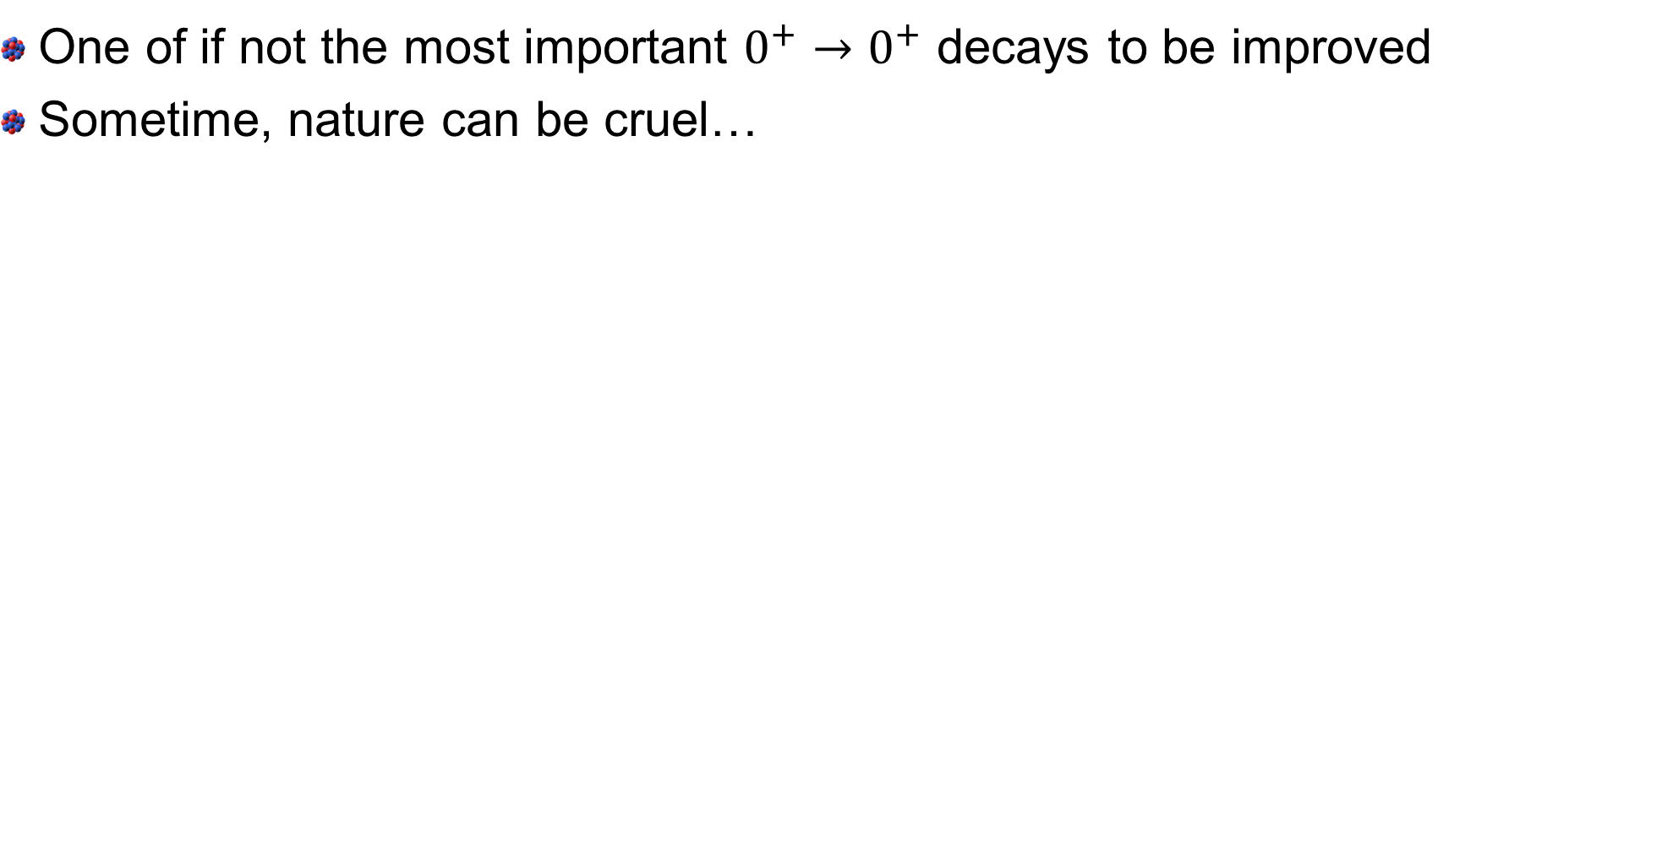
Another branching ratio – ¹⁰C
One of if not the most important $0^{+}→0^{+}$ decays to be improved
Sometime, nature can be cruel…

Slide 16
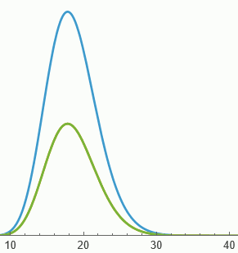

Victor’s idea
If you can know how many 511+511s are in your peak, you can still make a precision measurement
Model summing with HPGe response
  Normalize to times prior to coincidence window
  Subtract random summing from true 1022-keV peak
time diff
pulse height
pulse height
time diff [$μs$]

Slide 17
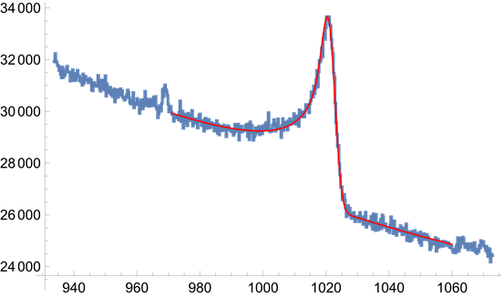
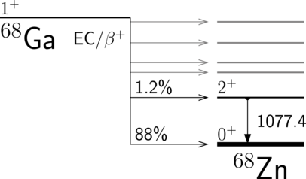
Victor’s idea
If you can know how many 511+511s are in your peak, you can still make a precision measurement
Model summing with HPGe response
  Normalize to times prior to coincidence window
  Subtract random summing from true 1022-keV peak
Tested with ⁶⁸Ge/Ga
time diff
pulse height

Slide 18
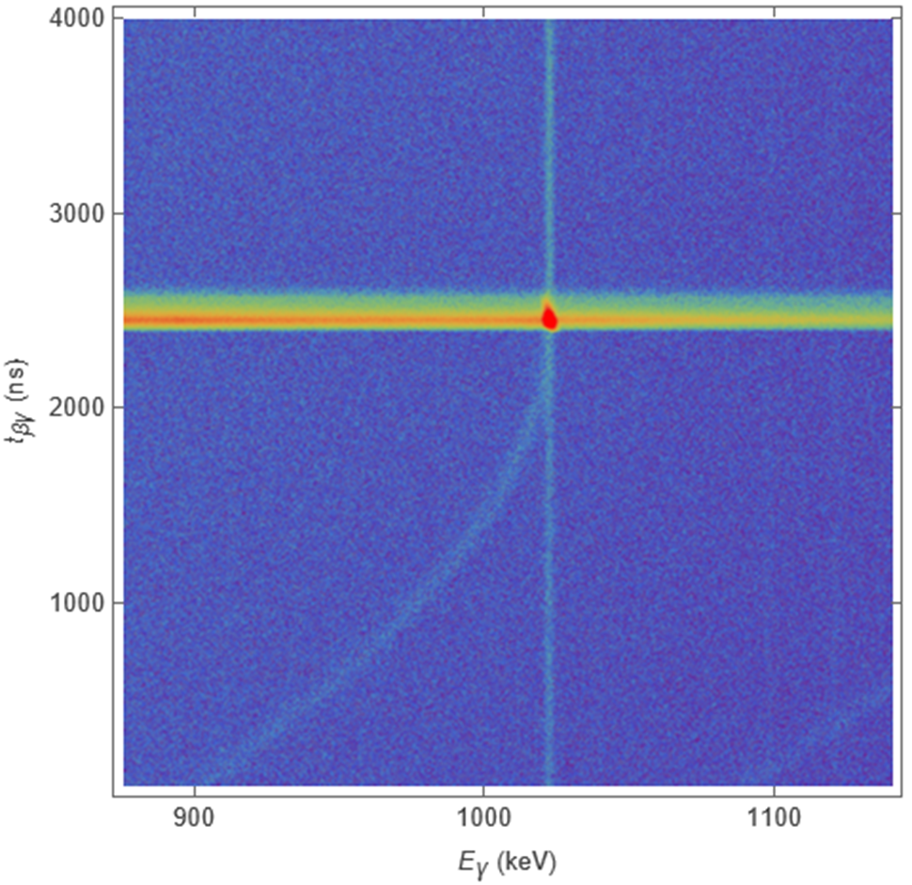
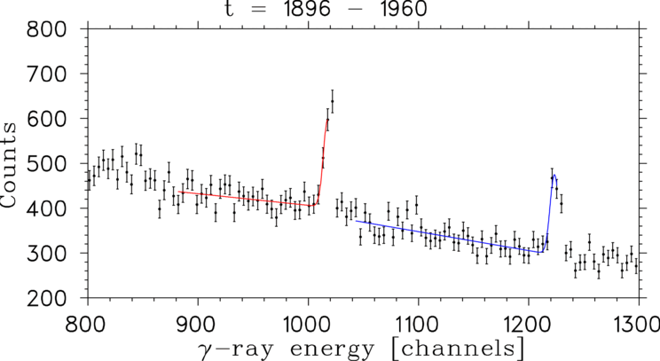
We got 2 weeks of beamtime and some good data!
Better than expected, really

Slide 19
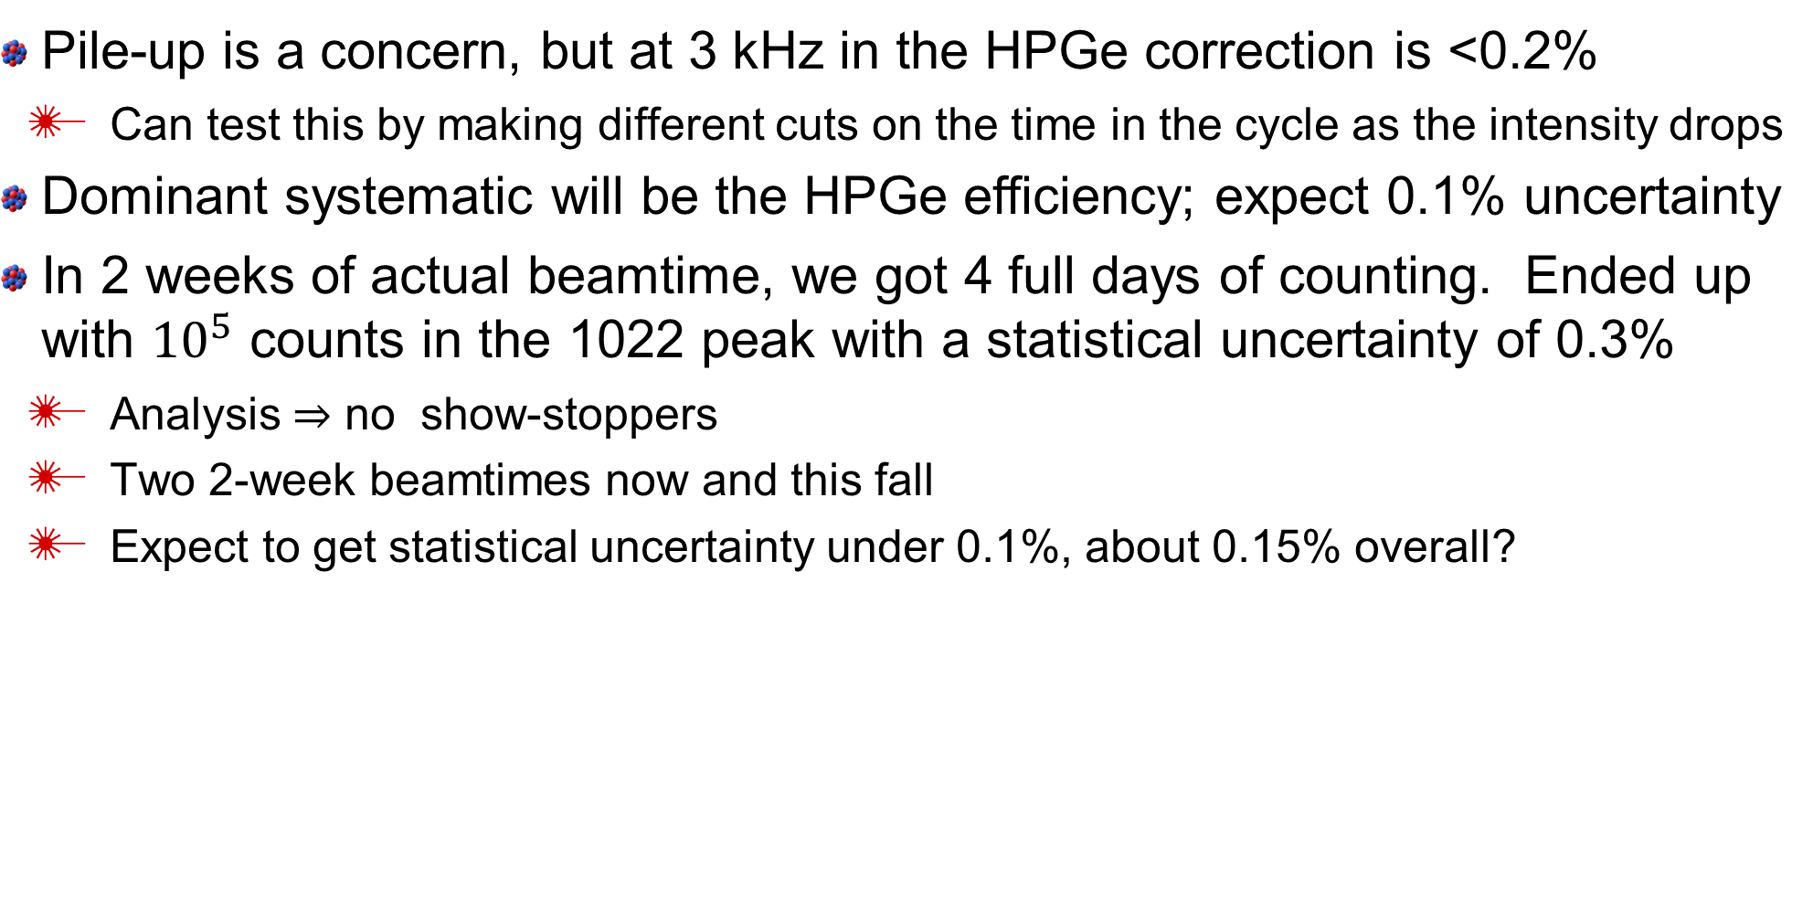

Recent ¹⁰C – first test run (more data this fall)
Pile-up is a concern, but at 3 kHz in the HPGe correction is <0.2%
  Can test this by making different cuts on the time in the cycle as the intensity drops
Dominant systematic will be the HPGe efficiency; expect 0.1% uncertainty
In 2 weeks of actual beamtime, we got 4 full days of counting. Ended up with ${10}^{5}$ counts in the 1022 peak with a statistical uncertainty of 0.3%
  Analysis $⇒$ no show-stoppers
  Two 2-week beamtimes now and this fall
  Expect to get statistical uncertainty under 0.1%, about 0.15% overall?
Best: $B=1.4625\left(25\right)\%$ $±0.17\%$
Average: $B=1.4644\left(18\right)\%$ $±0.12\%$

Slide 20












Eventually we will trap radioactive ions at the CI!
Motivation: $V_{ud}$ (corrections) and structure near the proton dripline
$$J^{+};T,T_{Z}$$
$$β^{+}$$
$$J^{+};T,T_{Z+1}$$
$$p$$
vector (SM)
scalar (BSM)
Doppler shape of proton energy depends on ${\vec{p}}_{β}⋅{\vec{p}}_{ν}$!

Slide 21


TAMUTRAP: a “new” Penning trap
180 mm in diameter with endcaps
Find resonant frequencies for
²³Na, ^{85,87}Rb, ¹³³Cs and ³⁹K (ref).
Precisions obtained (2020):
    ²³Na: 400 ppb
    ⁸⁵Rb: 500 ppb
    ⁸⁷Rb: 500 ppb
    ¹³³Cs: 800 ppb
TOF ICR, 200 ms excitation time
³⁹K⁺
¹³³Cs ⁺
All agree with AME
P.Shidling et al., Hyperfine Interact. 240, 40 (2019)
P.Shidling et al., Int. J. Mass Spectr. 468, 116636 (2021)

Slide 22






³He-LIG and LSTAR for TAMUTRAP
Primarily for $β$-$ν$ correlation studies using $β$-delayed proton decays in a Penning trap
p/He-LIG chamber ready to be installed, inside parts about to be ordered
Target | Product | Production rate
²⁰Ne | ²⁰Mg ²¹Mg | $$4×{10}^{3}$$ $$3×{10}^{5}$$
²⁴Mg | ²⁴Si ²⁵Si | $$3×{10}^{3}$$ $$2×{10}^{5}$$
²⁸Si | ²⁸S ²⁹S | $$3×{10}^{3}$$ $$8×{10}^{4}$$
³²S | ³²Ar ³³Ar | $$0.9×{10}^{3}$$ $$0.9×{10}^{5}$$
³⁶Ar | ³⁶Ca ³⁷Ca | $$0.2×{10}^{3}$$ $$0.2×{10}^{5}$$
$$A\left(3He,xn\right)B$$

Slide 23





LSTAR: purify and transport up to TAMUTRAP
In collaboration with Notre Dame (Berg, Couder, Brodeur), design based on $2×{60}^{∘}$ separator at CARIBU.
GPA Berg, D Melconian, M Couder, M Brodeur, VE Iacob, J Klimo, PD Shidling, NIMA 1069, 169944 (2024)

Slide 24




LSTAR: purify and transport up to TAMUTRAP
In collaboration with Notre Dame (Berg, Couder, Brodeur), design based on $2×{60}^{∘}$ separator at CARIBU.
$$ΔM/M=3000$$
GPA Berg, D Melconian, M Couder, M Brodeur, VE Iacob, J Klimo, PD Shidling, NIMA 1069, 169944 (2024)

Slide 25





⁶He-CRES $→$ 6He CRES
Wall effect may be our limiting systematic
If we can confine the decays to occur just in the centre, we remove this source of uncertainty!
Can we upgrade to use a Penning trap…?

Slide 26


Need large bunch sizes

Slide 27

Need large bunch sizes

Slide 28




GOLIATH seems to work for heavier masses
Hot off the presses, get’s $0.8×{10}^{6}$ per bunch, more possible with a “simple” re-alignment

Slide 29
MARS: a heavily utilized spectrometer
Follows a LN₂-cooled H₂ target for inverse kinematic reactions.
Very pure beams!
SATURN is on the horizon
Limitations:
Rigidity (<2 Tm)
Acceptance
No room for instrumentation
Aging components

Slide 30



SATURN concept
Separator and Analyzer at TAMU for Understanding Reactions of Nuclei
Unique opportunity:
  CI Building extension for radiation effects
  “Energy gap” with current facilities in the US (15-50 MeV/u)
Features:
  3.5 Tm rigidity
  Large acceptance
  Room for Phase II and instru-
  mentation
  RIBs intensities 10x – 100x
  more than MARS

Slide 31








Why would I care about SATURN?
Mirror $0^{+}→0^{+}$ transitions
  Good (best?) way to check the
  model dependence
$\frac{ft^{a}}{ft^{b}}=1+\left(δ_{R}^{′b}−δ_{R}^{′a}\right)+\left(δ_{NS}^{b}−δ_{NS}^{a}\right)−(δ_{C}^{b}−δ_{C}^{a})$
²⁶Si
$→$^{26m}Al
$→$²⁶Mg
³⁸Ca
$→$^{38m}K
$→$³⁸Ar
Missing:
⁴²Ti $→$ ⁴²Sc $→$ ⁴²Ca
³⁴Ar
$→$³⁴Cl
$→$³⁴S

Slide 32


Moving forward in nuclear $β$ decay
If there’s a compelling case, could consider driving HPGe to other facilities if we can’t make it at the CI
  This is the best I could do to tie into the future directions
If ⁶He–CRES works at CENPA, opens up possibilities at other labs
Stay tuned for ²⁹P lifetime, ³⁷K branch, and ¹⁰C branch
  Feel free to explicitly tell me how to get from $ft$ to $ℱt_{0}$ to $V_{ud}$ for ²⁹P and ³⁷K!
In general, I’ll second Brenden’s call for an “updated Holstein”
  Preferably typo-free
  Open-source code for recoil and radiatively-corrected decays for all $J$ and in terms of ${\tilde{a}}_{βν}$, $b_{Fierz}$,… or $C_{i}$ and ${C′}_{i}$
One day I’ll want a generator for $β$-delayed proton decays
  That’s years away…just keep it in mind, please
at FRIB
and FRIB

Slide 33








Final thoughts, collaborators and thanks
MARS ($→$ SATURN) + Fast-tape transport + HPGe = precise $τ$ + BR
TAMUTRAP: commissioned, just need radioactive ions…
p/He-LIG + LSTAR: (near?) future is bright!
B.M. Vargas-Calderon
M. Holloway
D. Melconian
P.D. Shidling
V.E. Iacob
N. Morgan
A. Ozmetin
D. McClain
V. Kolhinen
G. Morgan
G. Berg
M. Brodeur
M. Couder
+ several REUs, a few ENISCAEN
interns, and TAMU undergrads

Slide 34


Some tools we’re developing
(I left this to the end to spare the theorists if I ran out of time)
MWPC with pre-amps built in

Slide 35


Some tools we’re developing
(I left this to the end to spare the theorists if I ran out of time)
MWPC with pre-amps built in
Pepper-pot to measure emittance

Slide 36

Once He-LIG and LSTAR running
There will be room on the highbay for stations to utilize RIB from the He-LIG
Available space
NEPTUNE
General decay station
Charge-breeding/re-acceleration
Other…?

Slide 37


SATURN concept
Separator and Analyzer at TAMU for Understanding Reactions of Nuclei
Features:
  3.5 Tm rigidity (not superconducting)
  Large acceptance
  Room for Phase II and instrumentation
  RIBs intensities 10x – 100x more than
  MARS
Configuration
  Phase 1: D-Wedge-D (initial design
  completed, but evolving – ask Oleg!)
  Phase 2: RF kicker – absorber/RF
  buncher – D spectrometer (not yet
  designed)

Slide 38



Two slices of $t_{βγ}$

