Slide 1

Indirect methods to directly explore threshold energies
M. La Cognata
Laboratori Nazionali del Sud - INFN, Catania, Italy

Slide 2
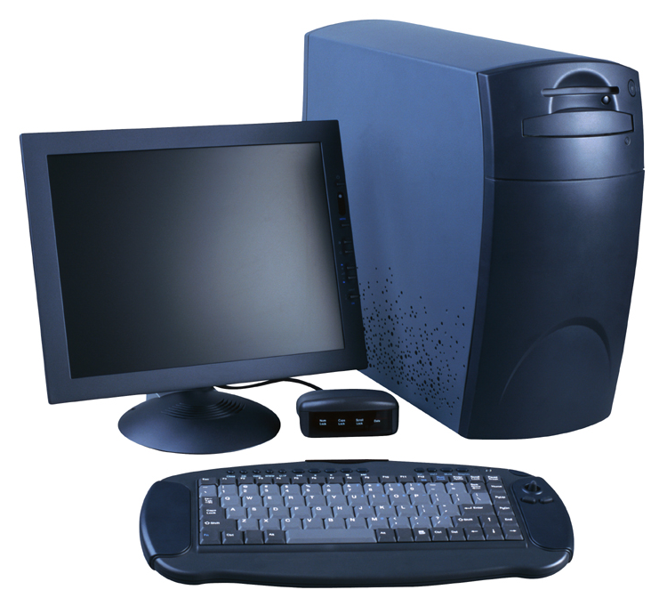
Nuclear astrophysics: from the laboratory to the cosmos
Nuclear parameters (cross sections, …)
Elemental yield → comparison with abundances observed in stars and meteorites to validate models
The purpose of nuclear astrophysics is to provide reliable nuclear physics input for astrophysical models
Astrophysical models: how a star works
PROBLEM: cross sections are needed at energy of 10-100 keV
Model input parameters: magnetic field, metallicity, …
Change the model until observables are matched by predictions
Astrophysical models are very complex: assumptions on stellar structure and on stellar parameters (age, mass…) → need of multiple independent constrain

Slide 3
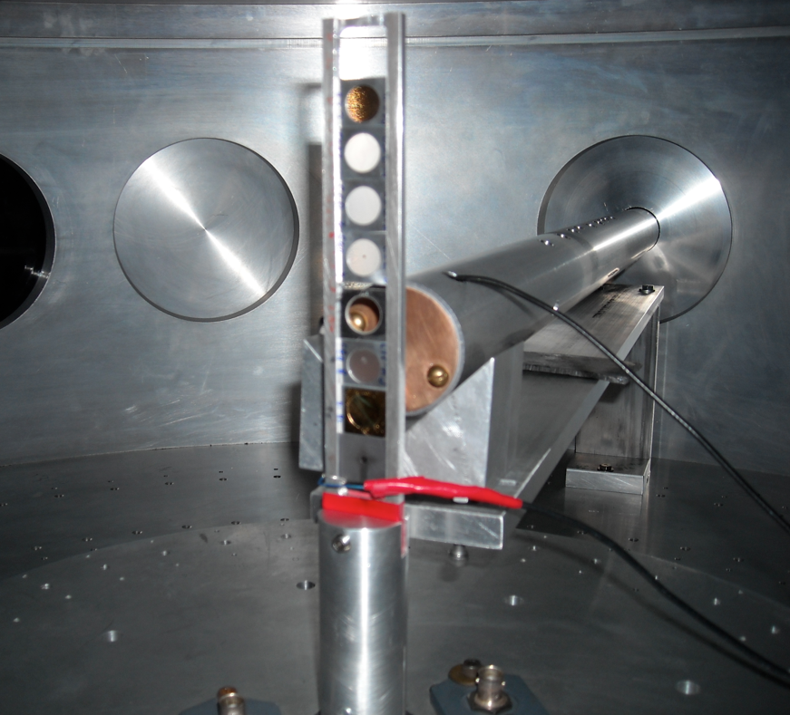
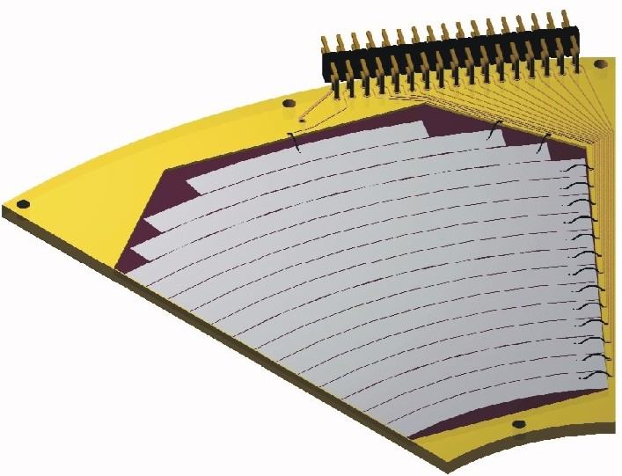
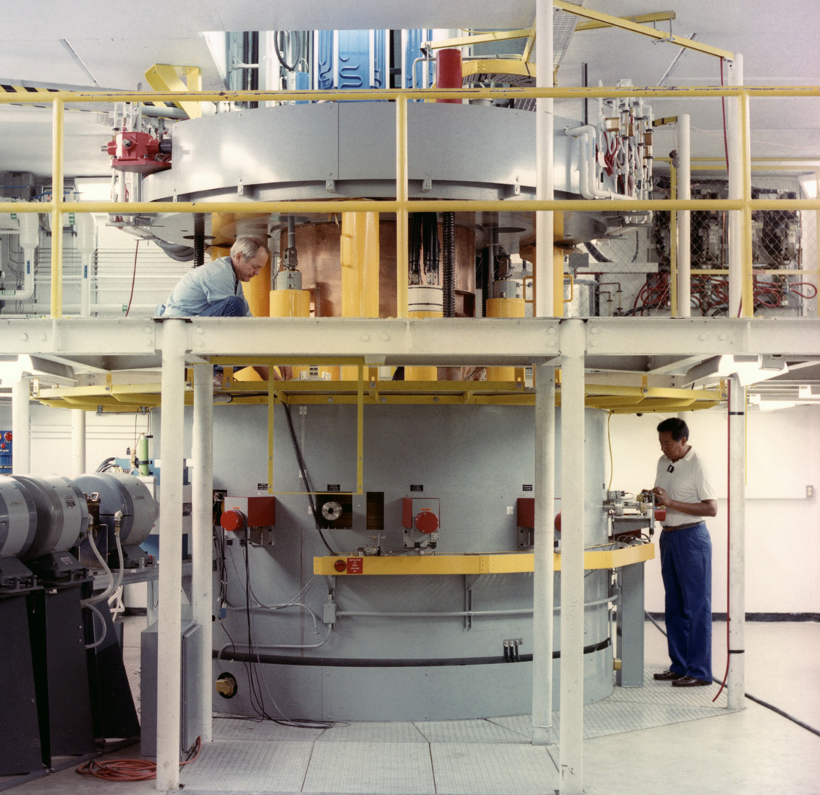
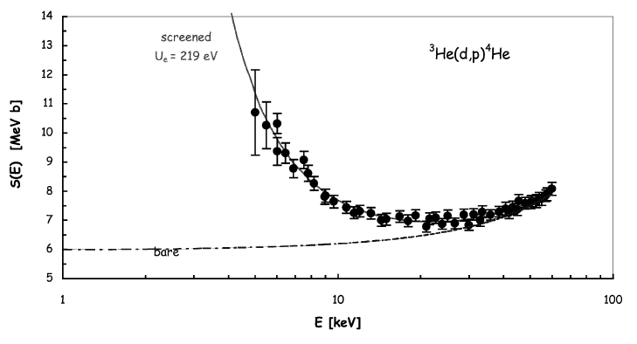

The need of indirect methods: direct vs. indirect methods
How to measure the A+x→c+C reaction in a direct way?
However, several reasons make the low-energy region of astrophysical interest difficult to access
Coulomb barrier suppression of the cross section
Cosmic background and systematic errors due to, e.g., straggling in the target
Electron screening hiding the nuclear cross section
Detector →
kinematic observables
- Energy
- Emission angle
& Particle identification
Target (A)
Beam (x)
Reaction
product (c)
It looks quite simple!

Slide 4
The need of indirect methods: direct vs. indirect methods
Nuclear reaction theory required
→ cross checks of the methods needed
→ possible spurious contribution
→ additional systematic errors (is the result model independent?)
Several reaction mechanisms link the two channels
Entrance channel:
A+a
Reaction products
C+c+…
Advantages include no need of low energies → no straggling, no Coulomb suppression, no electron screening
Possibility to access astrophysical energies with high accuracy
To recall the previous sketch:
Indirect methods are especially useful in the case of reactions involving radioactive nuclei
Higher cross sections
Possibility to study reactions induced by neutrons on radioactive nuclei
Reactions among unstable nuclei
Easier experimental procedures
Nuclear reaction theory
R. Tribble et al., Rep. Prog. Phys. 77 (2014) 106901

Slide 5
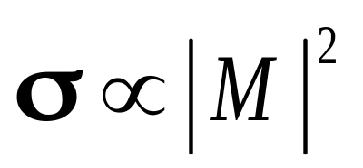
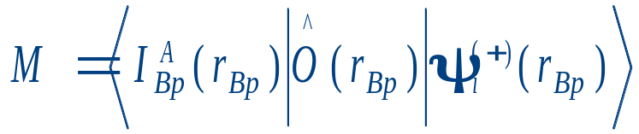

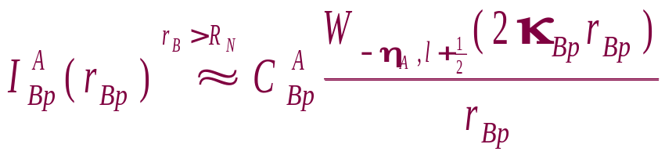





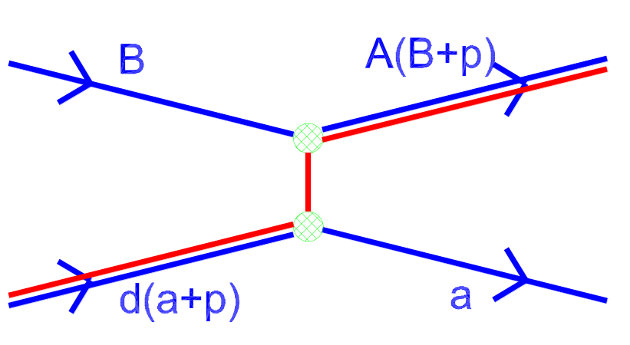
About the ANC (Asymptotic Normalization Coefficient) method
Radiative p (α) capture at stellar energies
Classical barrier penetration problem
Direct radiative capture
Low B.E.:
Outside the nuclear radius
Peripheral reaction
Find:
low energies ⇒ capture at large radii
very small cross sections
The cross section is determined by ANCs
ANC ⇒ amplitude for tail of overlap function → can be deduced from transfer reaction XS

Slide 6
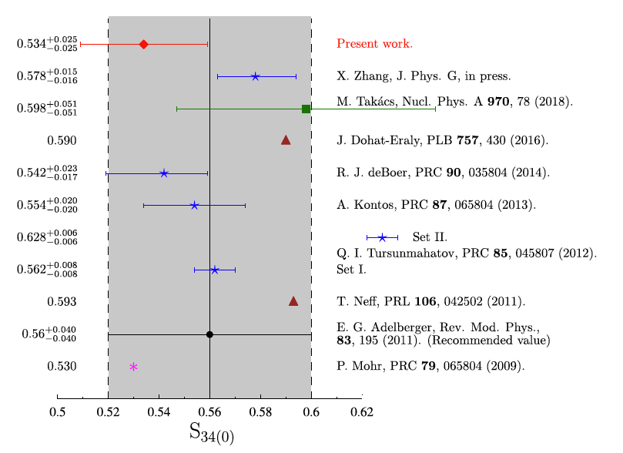
The ³He(α,γ)⁷Be and the ⁶Li(p,γ)⁷Be scientific cases
The detection of the neutrinos coming directly from the core of the Sun became more and more precise after the construction of larger and more efficient neutrino detectors
Neutrinos are released in the β decay of the ⁷Be, ⁸B, ¹³N, ¹⁵O isotopes produced in the p−p chain and in the CNO cycle.
The flux of the p−p neutrinos was measured with a precision of about 3.4% by the BOREXINO, SNO and Super-Kamiokande collaborations
The precise neutrino flux measurements can constrain the Standard Solar Model (SSM)
However, at present the uncertainties on cross sections are far too high, typically of the order of 5-8% contrary to the 3% precision required
The ANC approach has the opportunity
The zero-energy astrophysical factor of the ³He(α,γ)⁷Be shows a very large scatter. There is no general agreement between measurement (prompt vs activation) and calculations → NEED OF NEW INDEPENDENT DATA

Slide 7
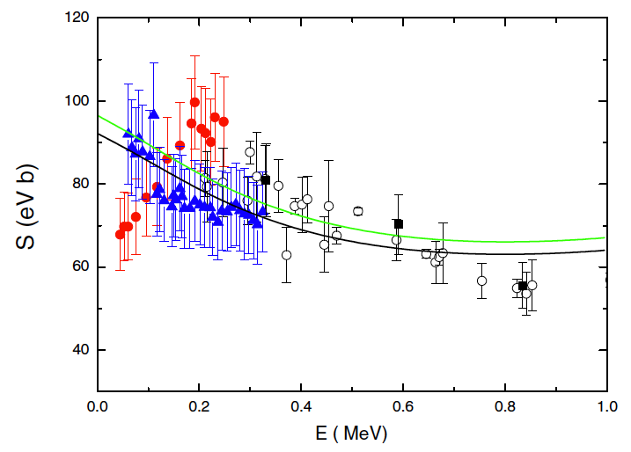
The ³He(α,γ)⁷Be and the ⁶Li(p,γ)⁷Be scientific cases
⁶Li(p,γ)⁷Be total S-factor
Lithium is a key elements in astrophysics as big bang nucleosynthesis models coupled to chemical evolution models fail to find an agreement between predictions and observations.
⁷Li is the most abundant isotope, produced in the BBN and in stars
⁶Li is almost exclusively produced by cosmic rays and the possibility of a primordial ⁶Li plateau, like the one for ⁷Li, is not presently confirmed
Since the production mechanism of ⁶Li and ⁷Li are completely different, the ⁶Li/⁷Li isotopic ratio can be used either to constrain the lithium production mechanisms and/or the galactic enrichment processes
→ an accurate determination of the ⁶Li(p,γ) ⁷Be astrophysical S factor is needed.
Blue solid triangles → D. Piatti et al., Phys. Rev. C 102, 052802(R) (2020) (including systematic error)
Red filled circles → J. J.He et al., Phys. Lett. B 725, 287
(2013)
Direct measurements show a totally different low energy trend

Slide 8
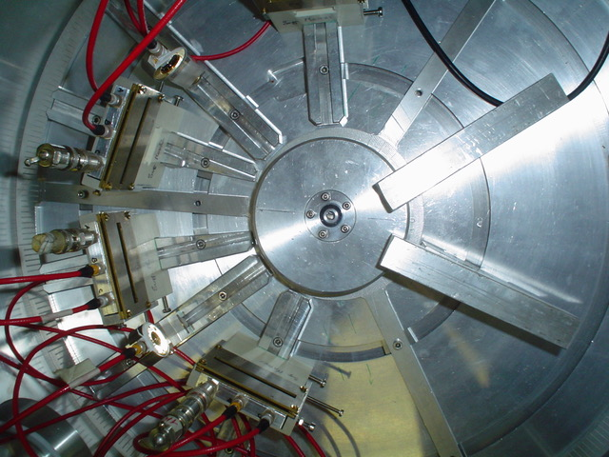
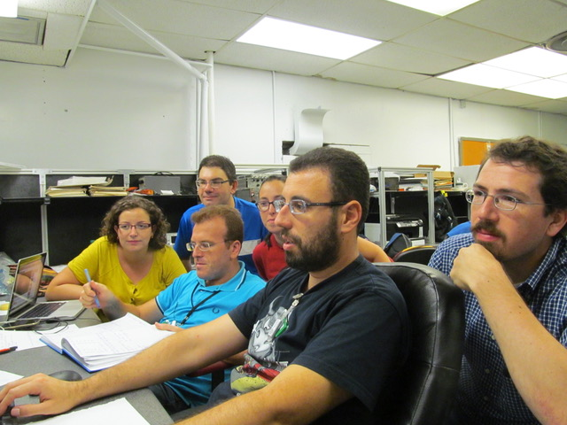
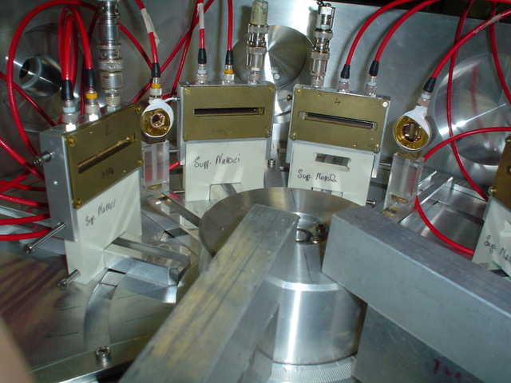

The ⁶Li(³He,d)⁷Be measurement
Experimental setup
³He beams by: singletron accelerator @ Department of Physics and Astronomy (DFA) of the University of Catania (Italy) and FN tandem accelerator @ John D. Fox Superconducting Accelerator Laboratory at Florida State University (FSU), Tallahassee (FL), USA
Angular distributions were measured at E_{lab} = 3 MeV and E_{lab} =5 MeV using silicon DE-E telescopes on a turntable. Additional monitor detectors were placed at symmetric angles with respect to the beam axis to check target thickness and for normalization.
⁶LiF (enriched in ⁶Li by 95%) and pure ⁶Li targets (enriched in ⁶Li by 98%) were used
³He beam
The experimental team
The ASFIN collaboration

Slide 9
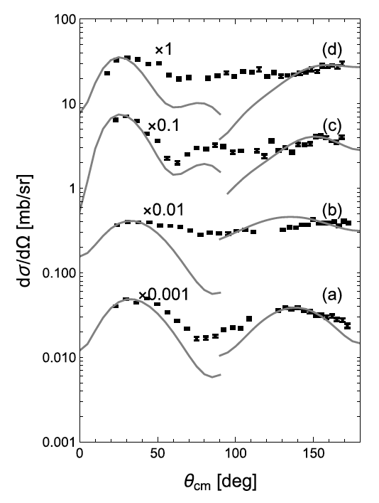
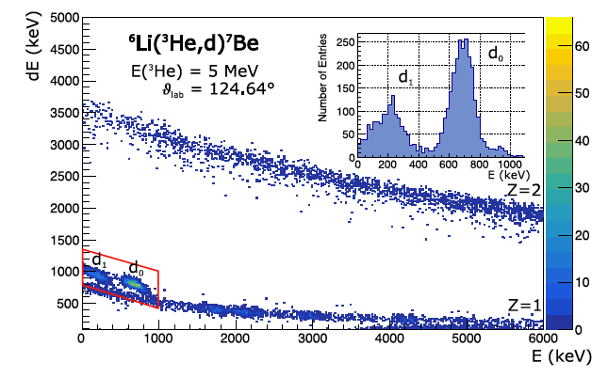
Experimental spectra
G.G. Kiss et al. Physics Letters B 807 (2020) 135606
G.G. Kiss et al. Physical Review C 104 (2021) 015807
DE−E spectrum measured with a silicon telescope
The peaks: d₀ and d₁
Very clean d ID
Observation of both ⁷Be gs and 1st excited state
Angular distributions of the ⁶Li(³He,d)⁷Be reaction populating the ground ((a) and (c)) and first (0.429 MeV) excited ((b) and (d)) states of ⁷Be at the projectile ³He energies of 3 ((a) and (b)) and 5 ((c) and (d)) MeV.
Gray lines are the calculated angular distributions, for p−and α−transfer (forward and backward hemisphere, respectively) → possibility to deduce the ANC’s for both channels (no interference at the peaks)

Slide 10
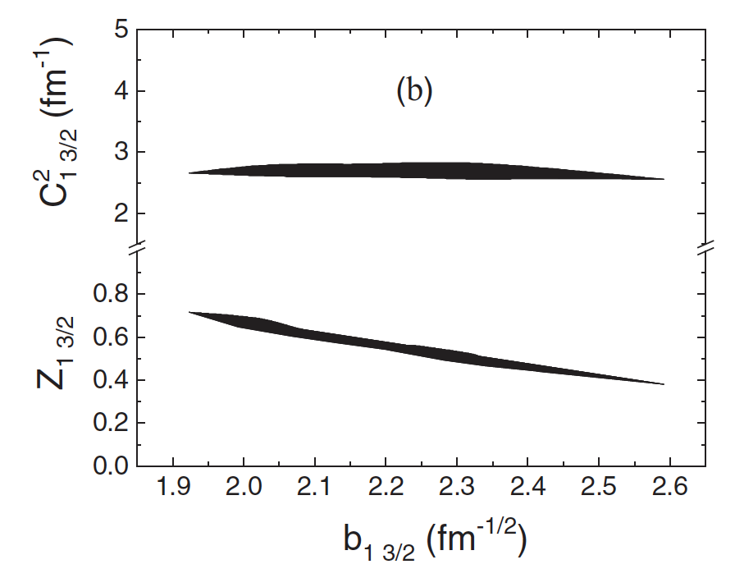
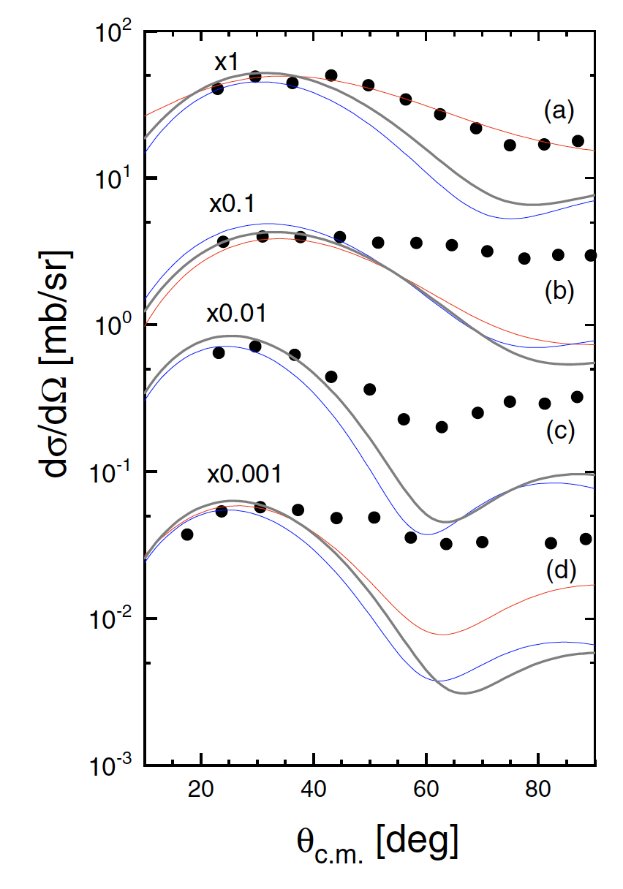
Test of the model dependence
Nuclear reaction theory in indirect approaches may introduce systematic errors
The gray lines indicate the calculated angular distributions including coupled-channel effects for p transfer off 3He. The red and blue curves are the same calculations, but with other optical potentials
While the spectroscopic factor Z depends on the choice of the optical model potential parameters (lower band), the ANC C² is almost independent (upper band). The dependence is given by the width of the band

Slide 11

The ³He(α,γ)⁷Be S₃₄(0) using ANC
The post-form DWBA calculation contains:
s-wave ANC values for the d+p →³He and the d+α→⁶Li channels
Test of the dependence on the choice of the optical potentials
Test of the peripheral nature of the reaction
channels coupling effects (CCE)
Further improvements to be implemented:
Test one-step process in modelling the transfer
Test the coupling between ground and excited states of ⁶Li and ⁷Be
Perform full coupled-channel analysis to derive the ³He+⁴He and the p+⁶Li ANCs
Lower S₃₄(0) values favored, with a total uncertainty equal to 4.7%.
More than 50% of the error budget is due to the non-peripherality of the transfer process
³He(α,γ)⁷Be
PLB 807 (2020) 135606

Slide 12

The ⁶Li(p,γ)⁷Be astrophysical factor
Two approaches:
the weighted means of the ANCs from the analysis of the ⁶Li(³He,d)7Be transfer were used to calculate the total astrophysical S factor for the ⁶Li(p,γ)⁷Be reaction using the modified two-body potential method [Igamov and R. Yarmukhamedov (2019)]. In the calculation M1 and E2 are neglected as their contribution is lower than 1% at these energies
the ANCs for the ⁶Li+p→ ⁷Be(g.s.) and ⁶Li+p→ 7Be(0.429 MeV) channels were derived from the experimental total astrophysical S factor and the branching ratios of Piatti et al. (2020) and then (after checking the actual agreement), we also calculated the astrophysical factor of the ⁶Li(p,γ)7Be reaction within the MTBPM
Green line: astrophysical S factor obtained by using the weighted average ANC values from the near-barrier proton transfer ⁶Li(³He,d)⁷Be reaction at E_{beam} = 3 and 5 MeV
Black line: astrophysical S factor obtained from the analysis of the ⁶Li(p,γ )⁷Be S-factor of Piatti et al. (2020)
Our result strongly disfavors the resonant trend claimed by He et al. (2014)
⁶Li(p,γ)⁷Be
PRC 104 (2021) 015807

Slide 13
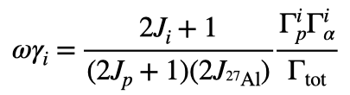
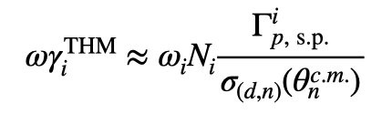
The Trojan Horse Method -THM (see, e.g., PRL 101, 152501 (2008))
²H
n
When narrow resonances dominate the S-factor the reaction rate can be calculated by means of the resonance strengths and resonance energies only. Both can be deduced from the THM cross section.
Let’s focus on resonance strengths
p
⁴He
²⁷Al
The strengths are calculated from resonance partial widths
In the THM approach we determine the strength in arb.units. Normalization to a known resonance is necessary
²⁴Mg
What is its physical meaning?
Area of the Breit-Wigner describing the resonance
Advantage:
no need to know the resonance shape (moderate resolution necessary)

Slide 14
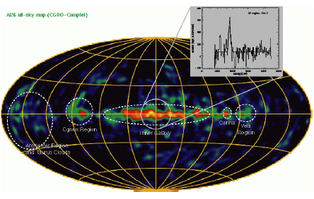
²⁷Al: an ingredient in multimessenger astronomy
MgAl cycle in massive stars
²⁶Al/²⁷Al abundance ratio
It is ignited at temperatures > 0.03 GK and it is important to determine the abundances of medium mass nuclei
²⁶Al abundance is used to estimate the number of Galactic neutron stars and, therefore, of neutron star mergers (sources of GW)
The ²⁶Al/²⁷Al is generally
estimated, so it is
influenced by ²⁷Al
abundance predictions

Slide 15
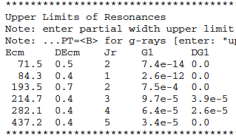
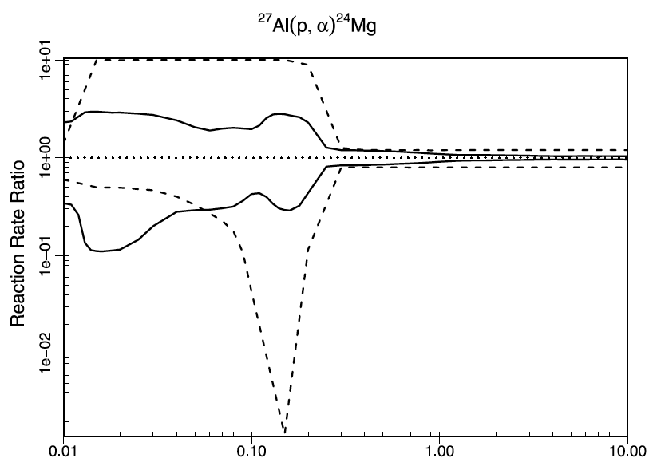
²⁷Al(p,α)²⁴Mg status of the art
The most recent review [Iliadis et al. (2010)] shows that for most low-energy resonances only an upper limit is known
→ These resonances are the most influent for astrophysics
Up to one order of magnitude uncertainty

Slide 16
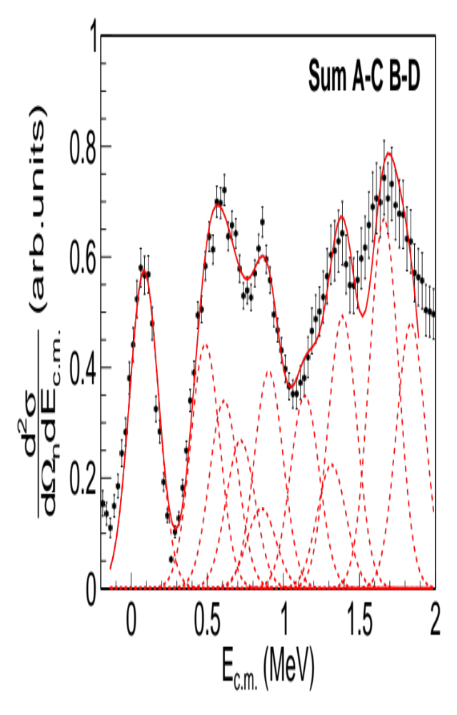
Extraction of the resonance strengths
Gamow window for 50 MK
Black dots: sum over the two spectra for A-C and B-D
Following discussion in APJ 708 (2010) 796 the red line is a fit with a sum of Gaussian functions, with fixed energies and fixed widths (from MC). Heights are proportional to strengths
The most intense resonances in STARLIB were all included in the fit down to about 200 keV
Tails of higher energy resonances affects the region above 1.5 MeV

Slide 17
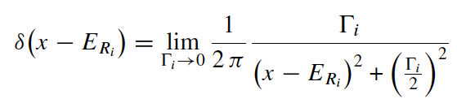
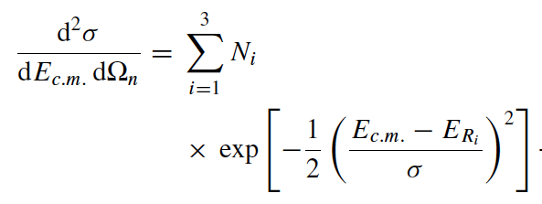
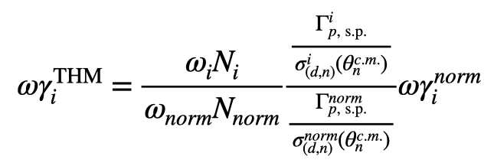
A bit of theory (from APJ 708 (2010) 796)
For narrow resonances:
The THM cross section can be fitted using the equation:
𝞒_{s.p.} is calculated using the potential model
𝞼(𝞱) is calculated in PW using the same well & w.f.
n
The double ratio ensures an extra small model dependence (6%)

Slide 18
Average values
Energy in cm (keV) [from STARLIB] | Jpi | Strength (eV) [from STARLIB] | error (eV) | Strength (eV) [from THM] | error (eV)
71.5 | 2+ | 2.47E-14 | up lim | 8.23E-15 | up lim
84.3 | 1- | 2.60E-13 | up lim | 1.67E-14 | 3.2E-15
193.5 | 2+ | 3.74E-07 | up lim | 2.50E-07 | up lim
214.7 | 3- | 1.13E-07 | up lim | 4.36E-08 | up lim
486.74 | 2+ | 0.11 | 0.05 | 0.107 | 0.021
609.49 | 3- | 0.275 | 0.069 | 0.245 | 0.054
705.08 | 1- | 0.52 | 0.13 | 0.261 | 0.065
855.85 | 3- | 0.83 | 0.21 | 0.61 | 0.35
903.54 | 3- | 4.3 | 0.4 | 4.20 | 0.38
1140.88 | 2+ | 79 | 27 | 73 | 14
1316.7 | 2+ | 137 | 47 | 124 | 28
1388.8 | 1- | 54 | 15 | 61 | 12
We take the weighted average of the strengths obtained from the two normalizations procedure to reduce systematics errors

Slide 19
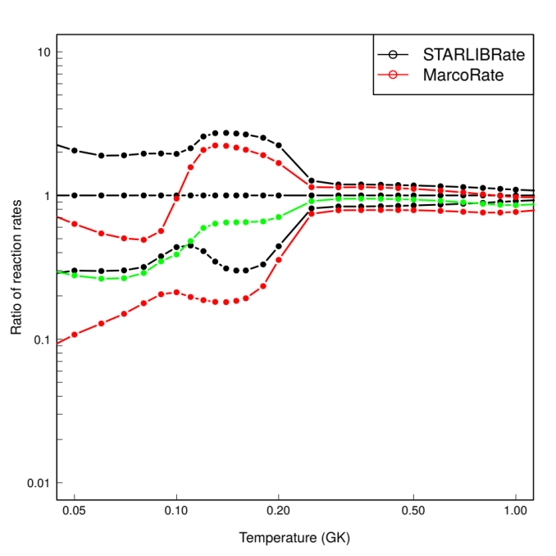
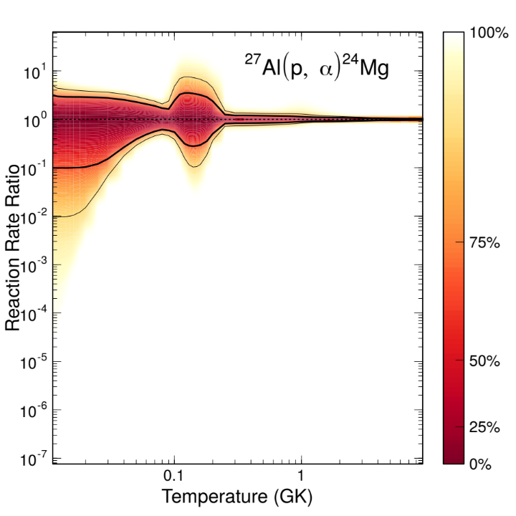
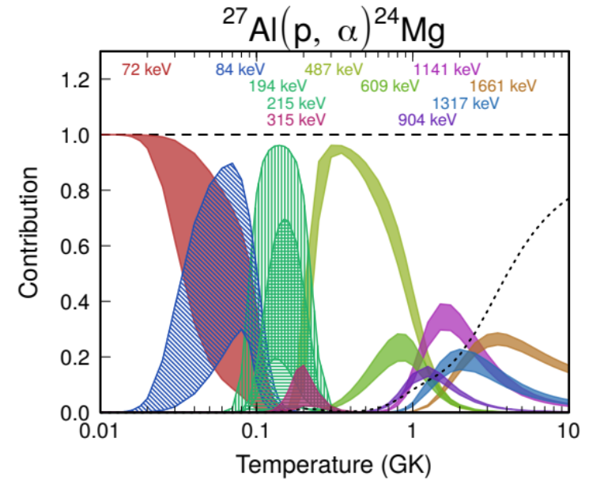
The full calculation using STARLIB (by Philip Adsley)
The green line is the THM recommended rate
We run the full code (for STARLIB and STARLIB+THM replacing our results in the standard input)
Is the upper limit for the resonance at about 200 keV overestimated?

Slide 20
Thank you for your attention

