Slide 1

Thermal and atomic effects on coupled-channels heavy ion fusion
Iain Lee, University of Surrey
In collaboration with Alexis Diaz-Torres (Surrey) and Gilbert Gosselin (CEA, Fr)
Lee, Gosselin & Diaz-Torres, Physical Review C 107 (2023) 054609

Slide 2
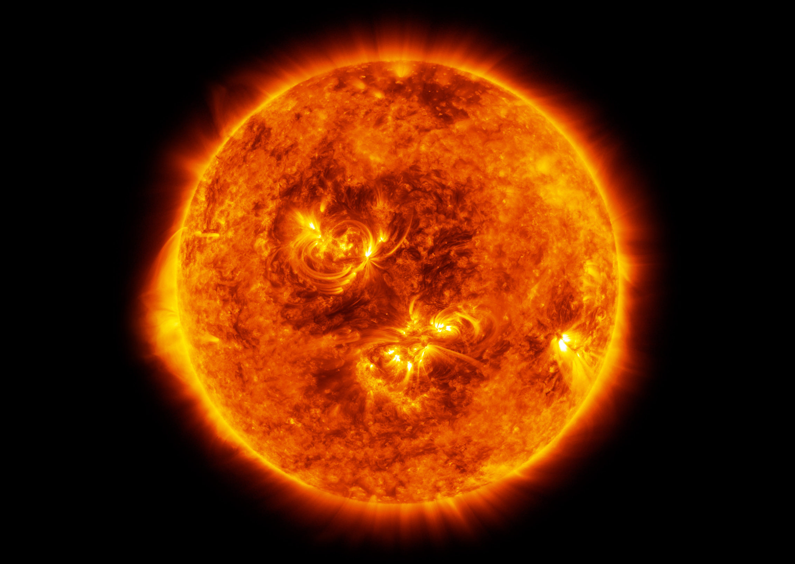
Presentation outline
Aims of the study
Using the Coupled Channels Density Matrix (CCDM) method
How atomic and thermal effects influence nuclear excited states
Fusion probability results using 16O + 188Os
Conclusions and outlook

Slide 3
Aims of the study
Implement atomic and thermal effects into a quantum dynamical model
  These effects arise due to environments such as plasma
Investigate the effect of low-lying collective states on fusion probabilities
  Low-lying excited states are expected to have the most effect in high energy density plasmas (HEDPs)

Slide 4
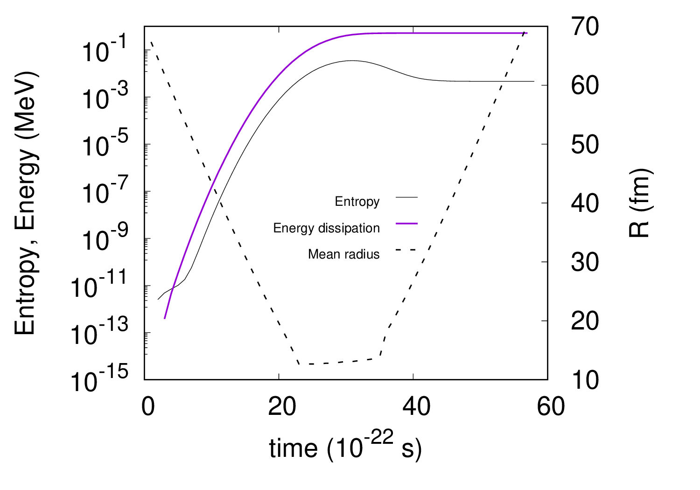
The CCDM method
Fully quantum dynamical model
Using a density matrix allows mixed state calculations
Liouville von-Neumann equation, Lindblad Master equation for open quantum system dynamics
Results agreed with calculations from TISE calculations for a head on collision using 16O+144Sm
Able to calculate the evolution of entropy, energy dissipation and purity
Iain Lee and Alexis Diaz-Torres. Coherence dynamics in low-energy nuclear fusion. Physics Letters B, 827:136970, 2022

Slide 5
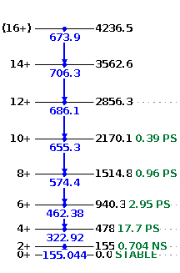
A note on projectile and target choice
The effects discussed above are most effective for low-lying nuclear excited states (< 1 MeV).
A promising even-even test target identified was 188Os. This target has a 2⁺ , 155 keV first excited state. For simplicity, we ignore the higher level states.
A 16O projectile was used because of its 3⁻, 6.13 MeV first excited state, hence it can be assumed inert.
The basic 188Os level scheme.

Slide 6
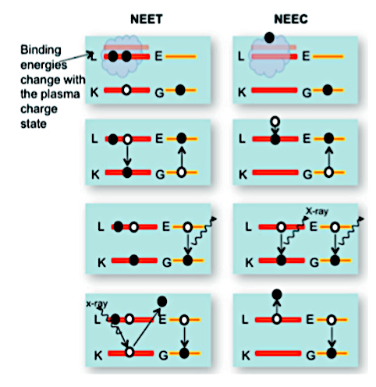
Atomic effects
Calculated using the ISOMEX code, and includes atomic effects such as Nuclear Excitation by Electron Capture or Transmission (NEEC or NEET).
The code produces excitation and de-excitation rates that are included in our calculations using Lindblad operators. These rates change the population of the low-lying excited state (155 keV) of 188Os.
Although promising, even with our low-lying excited state, the reaction rates were far too low to have a noticeable effect on fusion probability
G. Gosselin and P. Morel. Enhanced nuclear level decay in hot dense plasmas. Phys. Rev. C, 70:064603, Dec 2004.
D. L. Bleuel et al. Method for Detection of Nuclear-Plasma Interactions in a 134Xe-Doped Exploding Pusher at the National Ignition Facility. Plasma and Fusion Research, 11:3401075, 2016

Slide 7


Thermal effects
The thermal effects in this work refers to the thermal excitation of collective excited states
Hot environments populate low-lying excited states, and therefore fusion reactions may initiate from a mixed state
A Boltzmann equation is used to initialise the density matrix, using temperature (MeV)
Nuclei in collective excited states are deformed i.e. 2+ (quadrupole) and have different Coulomb barriers relative to the bare potential
Initial density matrix and the Boltzmann factors

Slide 8
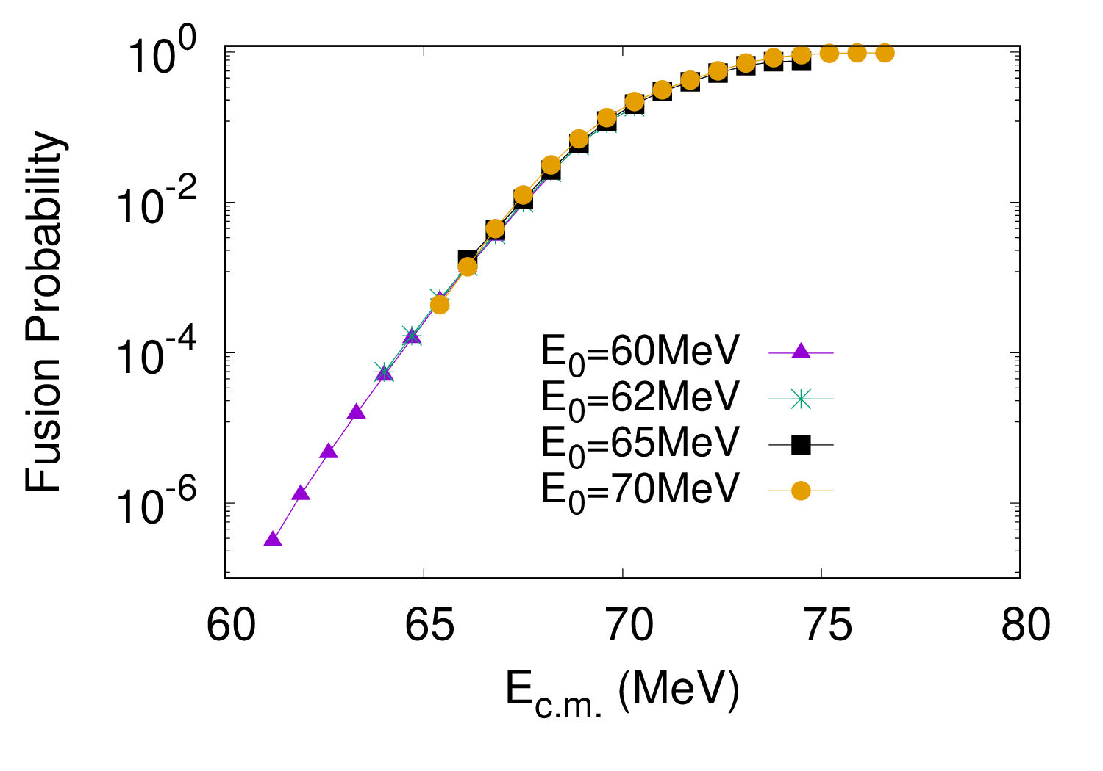
Baseline figure
J=0, 188Os + 16O without environment
Using a range of initial mean energies provides
convergent fusion probability values

Slide 9
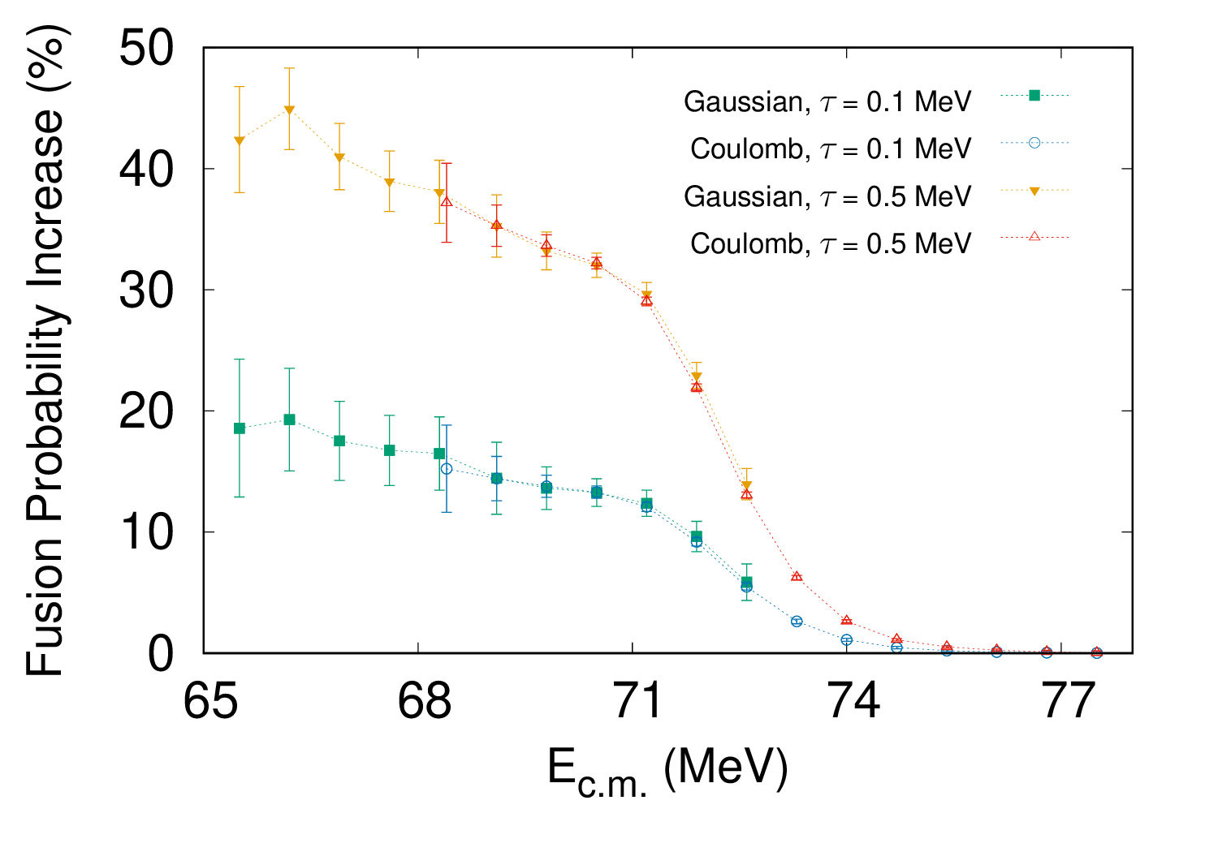
Increase in fusion probability for 16O+188Os
Notes:
How did we get this figure?
We used different initial conditions for the collision partners. By changing the initial mean energy and shape of the wavepacket, we calculated the fusion probabilities with the thermal environment on and off. To account for slight fluctuations in the calculations, we took an average

Slide 10
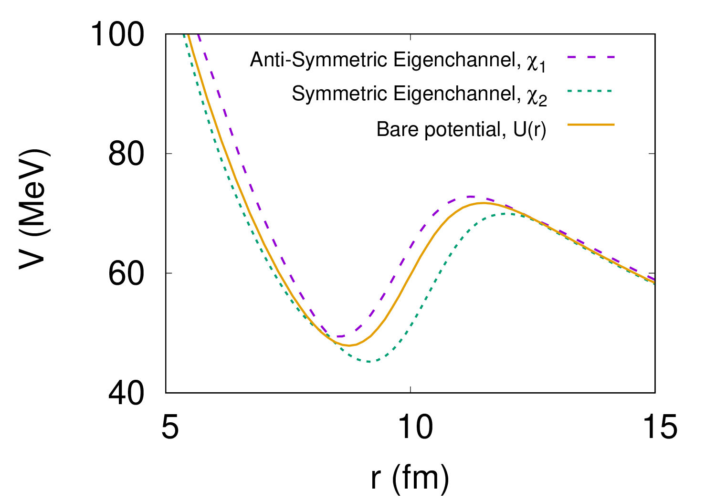
Coulomb barriers of the decoupled eigenchannels

Slide 11
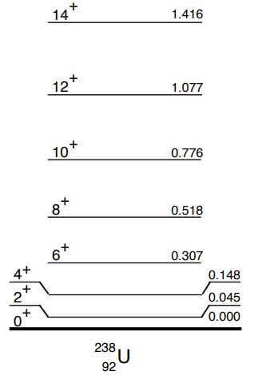
Conclusions and Outlook
The study has shown that the thermal population of low-lying nuclear excited states in HEDPs can significantly enhance fusion probability.
It is hoped that the CCDM method will be a useful theoretical model for experimental studies using lasers to prepare targets in excited states.
A large investigation of different projectiles and targets would be required to estimate the overall contribution due to thermal excitation effects.
Atomic effects with very low excited state(238U, ~50 keV 2+)
A basis for multinucleon transfer reactions?

Slide 12



Thank you for listening!
Any questions?

Slide 13




Equations for decoupled eigenchannels
Entrance channel configuration
Decoupled eigenchannels
In the final equation, it is clear that the excited state eigenchannel, with the lower barrier, is more populated in the entrance channel configuration.

Slide 14

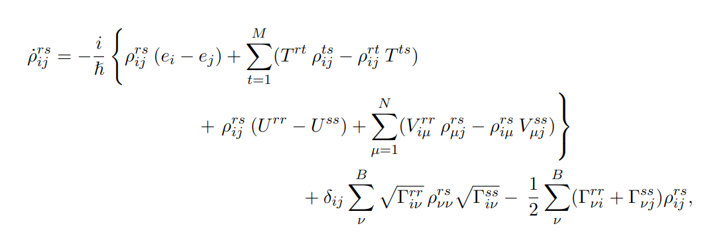

Slide 15
