Slide 1
Low Energy User Meeting
August 11, 2023
Dr. Timothy J. Hallman
Associate Director, Office of Science, for Nuclear Physics
Office of Science (SC)
U.S. Department of Energy (DOE)

Slide 2
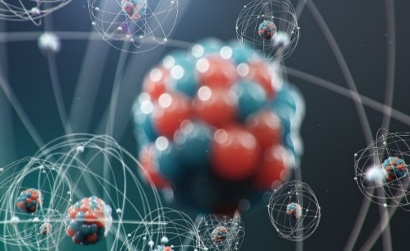
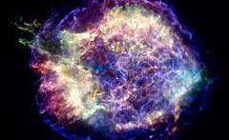
A Prime Deliverable: Basic Nuclear Physics R&D
Discovering and understanding new forms of nuclear matter
        Quark-Gluon Plasma at RHIC
        Four new Super-Heavy Nuclei
New discoveries
        Natural radiation frustrates quantum coherence times
        World’s best tensor limit via ⁸Li β — anti-neutrino correlation measurement
        Abundance of carbon in stellar environment via neutron up-scattering
        Observation of super radiance in mirror nuclei
        Direct production of matter from an electro-magnetic field (e⁺e⁻ pairs)
        Neutron skins exist on heavy nuclei
New technology important for national needs
        First ever demonstration of accelerator bunched-beam cooling
        FEL ERL development for the Navy using LERF
Nuclear data & knowledge for a suite of applications
        Space exploration
        Reactor design
        Nuclear forensics / Nonproliferation
The Structure of the Atomic Nucleus
The Birth of Nuclei in Astronomical Processes
Probing Universal Laws in Nuclear Decays

Slide 3
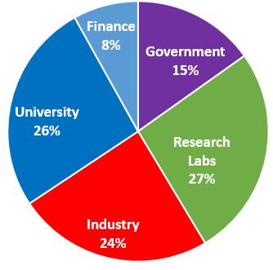
A Second Very High priority: Training in Nuclear Science
Highly Specialized Technical skills
Creative problem analysis/solving ability
Scientific communication skills
Resilience/perseverance despite set-backs
Self confidence
Time management ability
Project planning skills
Ability to work within a large collaboration
Leadership development
The result is an essential national core competency useful not only for “things nuclear”, but for a variety of other challenging pursuits as well
Where NP PhDs go
U.S. science, commerce, medicine, defense —all benefit, in part, from a stable level of sustained competence, capability, capacity, and leadership in nuclear physics;

Slide 4
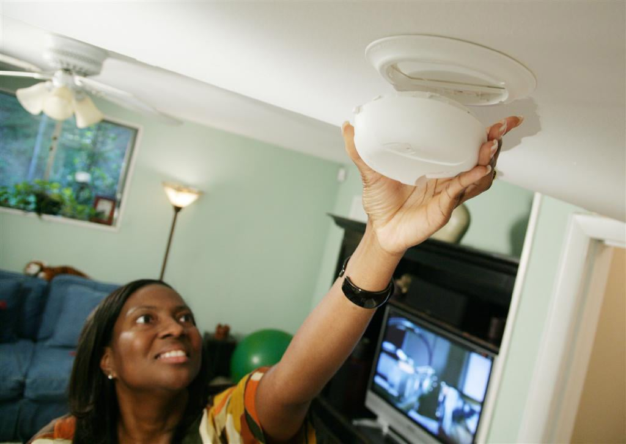
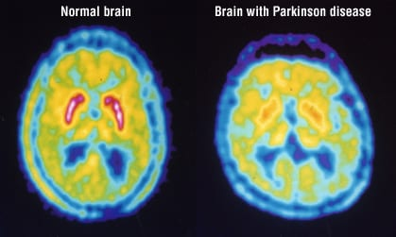
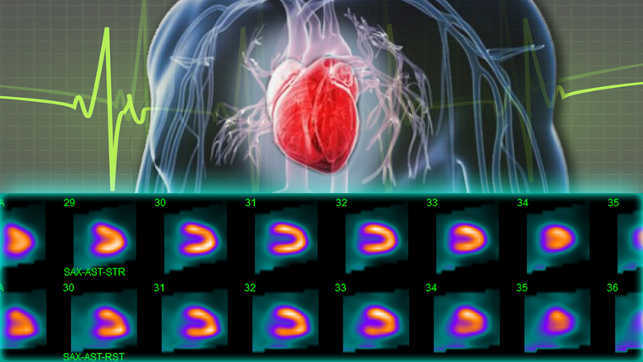
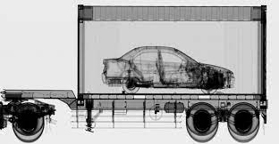
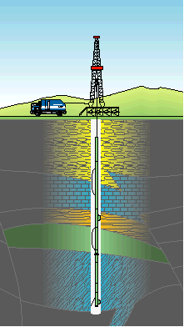
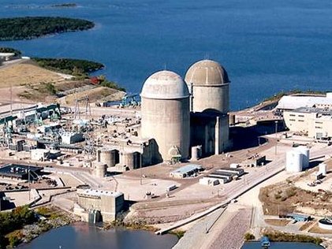
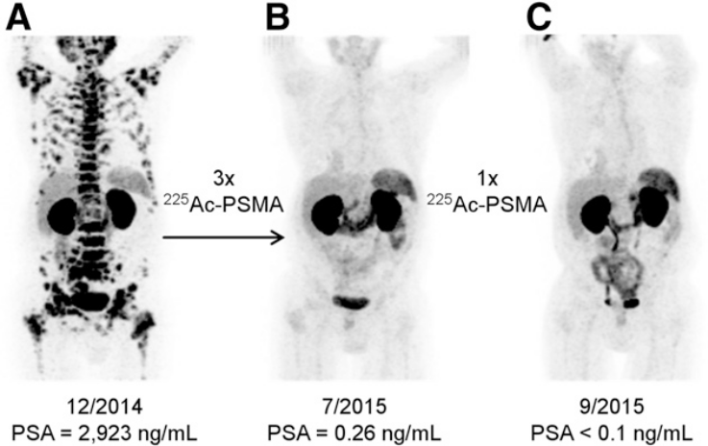
A Third Priority: Better Living Through Apps of Nuclear Physics
Fire safety in your house
Heart Health
Food safety
Medical Diagnosis
Carbon free electricity generation
Port of entry security
Metastasized cancer treatment
Oil and gas prospecting
Deep space exploration
Lasting joint replacements
National Security

Slide 5
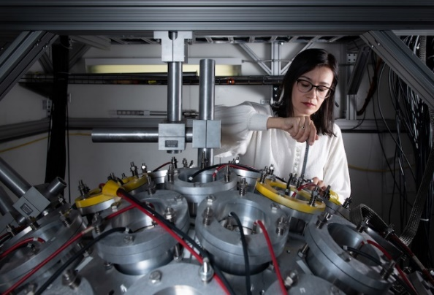
Beyond Assertion: How An NP Trained Workforce Benefits the Nation
Sample of Non-Defense Roles Based on Recent Breakthrough Prize Questionnaire
Sr. Chemist at a mining company
Sr. Research Scientist at a Fotune-100 conglomerate
Head of bioinformatics at a molecular therapy company
Director of Radiological Product Development of a global healthcare technology company
Vice President of Engineering of a software application development company
Chief Researcher at an international industrial research lab
Director of Innovation at a popular data science platform company
Senior Manager at an EU-listed company providing micro structuring equipment to the semiconductor industry.
Accelerator and materials technical lead at the radiation effects laboratory of a major Fortune-50 aerospace company.
Owner of a private technology/consulting company
President of a high-tech company that provides geotechnical monitoring solutions and instrumentation to mining and industry
CTO of a web design and software design company
Principal Scientist (Global Research and Technology) of a major international healthcare company
CEO of an international water purification technology company
Director of Information Systems of an international insurance company
Principal Scientist (electronics and software development) at a company that provides radiation and explosive solutions to homeland security and industry
Owner of a nuclear electronics, instrumentation and data analysis company
Manager of the R&D department of a FTSE-100 detection and screening technology company
Sr. Radiation Physicist, health science company that provides gamma technologies and medical isotopes
Sr. Scientific Director (R&D) at a radiation analytic company
President & CEO of an arboriculture company

Slide 6
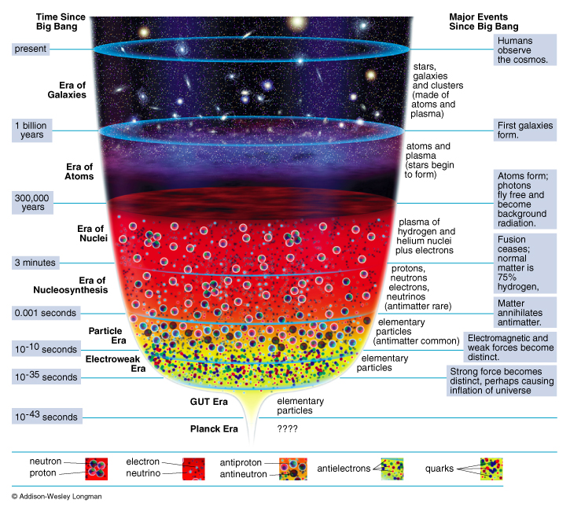
The Reach of NP Scientific Research
Present Day
Evolution of the Universe
Present
Galaxies
NP
Discovery
Horizon
Atoms
Nuclei
Nucleo-Synthesis
Particles
The vast range of time (μsec to 13.8B years) and physical scales (quarks to galaxies) requires “microscopes” of varying, complementary resolving “powers”

Slide 7
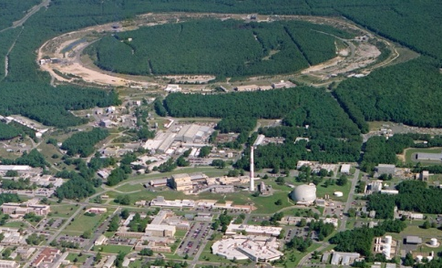
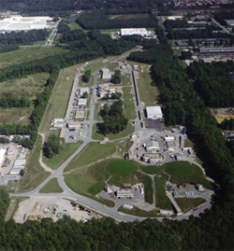
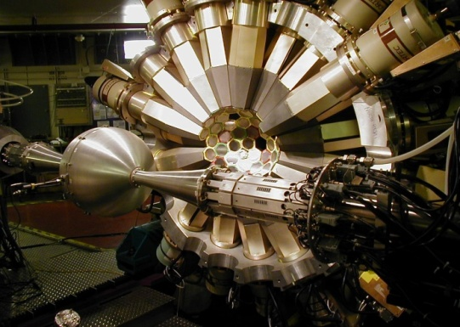
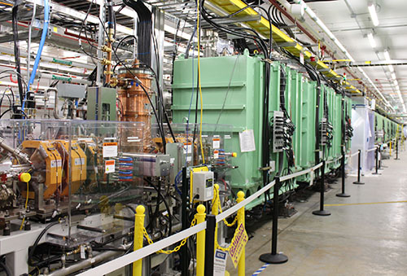
The Four World-Leading National User Facilities That Help Drive Advances
ALS 1993
Relativistic Heavy Ion Collider
Continuous Electron Beam Accelerator Facility
CEBAF
Argonne Tandem Linac System
Facility for Rare Isotope Beams
Are “Microscopes” with Complementary Resolving Power

Slide 8
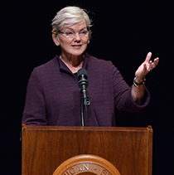
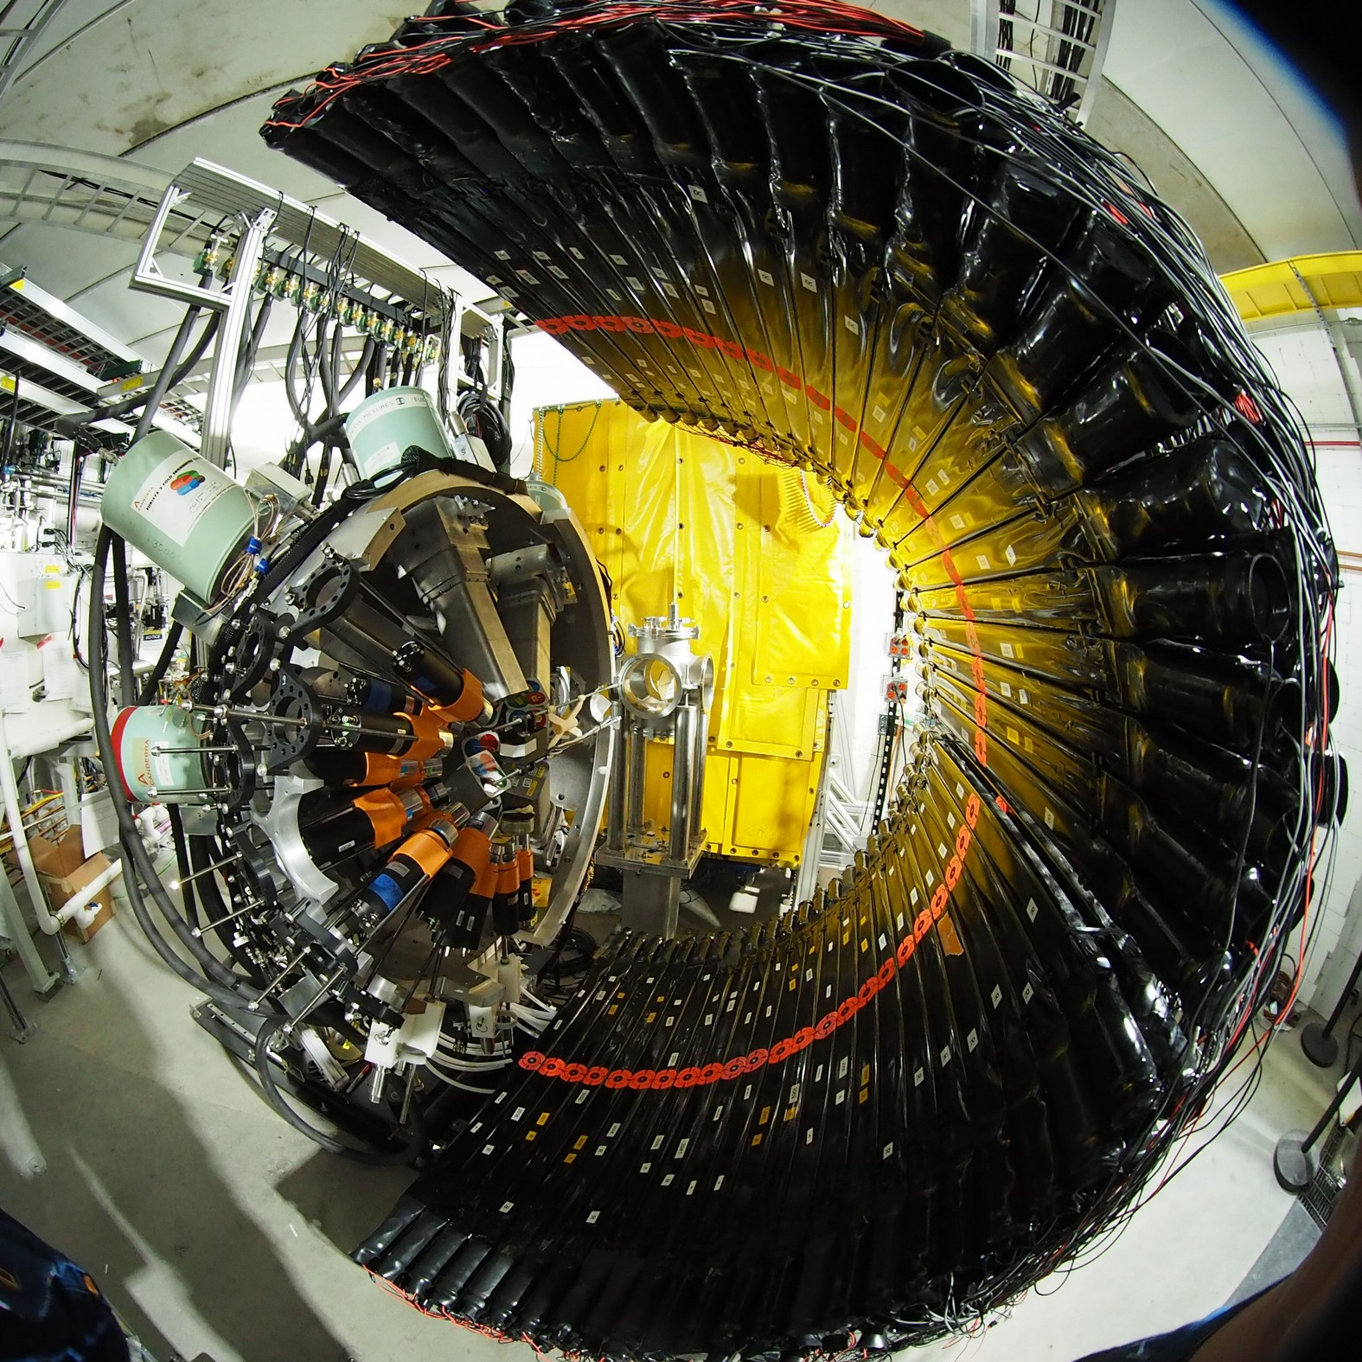
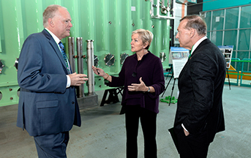
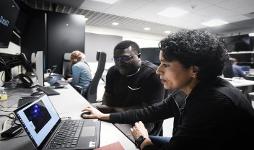
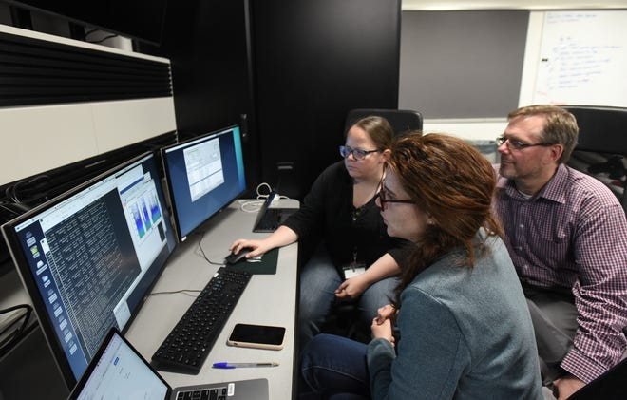
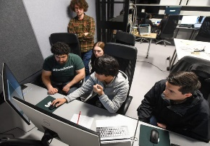
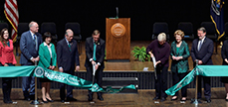
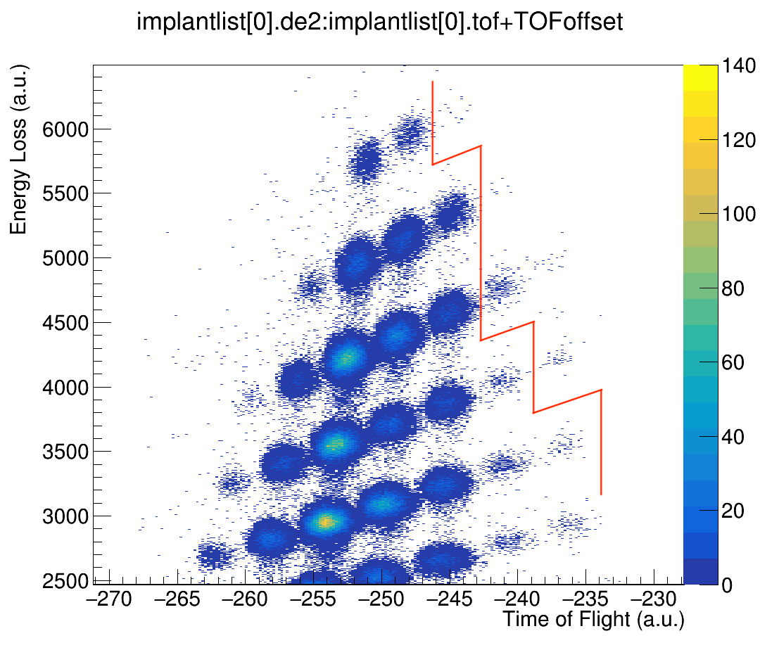
The Opening of a New Horizon for Scientific Discovery
Secretary Granholm at the FRIB Ribbon Cutting
FRIB Experiment E21062
Spokespersons: J. Allmond (ORNL), H. Crawford (LBNL), B. Crider (Mississippi State University), R. Grzywacz (University of Tennessee Knoxville) and V. Tripathi (Florida State University)
May 2, 2022
May 19, 2022
The “never-been-done–before” line.: isotopes to the right of this line have never before been available for study
Multiple papers with first FRIB science now published

Slide 9
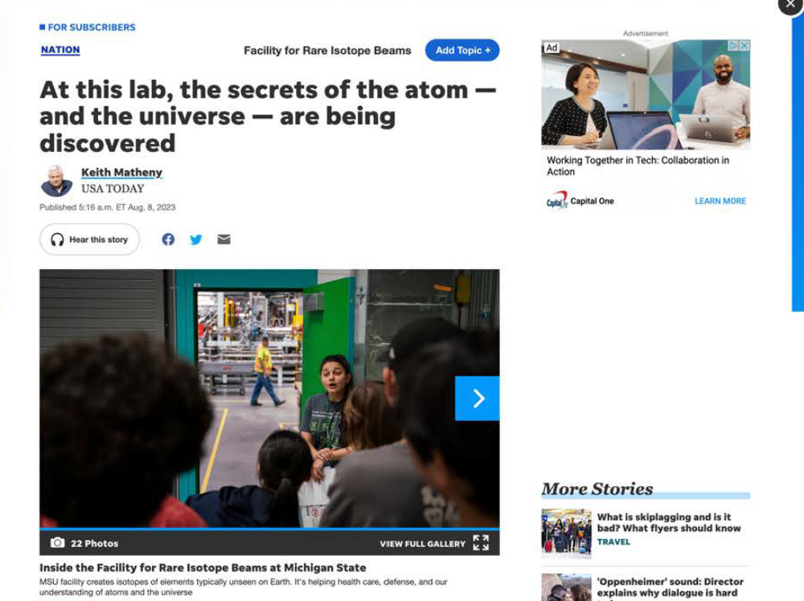
The Newest SC User Facility: the Facility for Rare Isotope Beams
ALS 1993
Facility for Rare Isotope Beams
FRIB construction started in 2013 and finished in 2022, on cost and ahead of schedule
FRIB was constructed by DOE ($635M) and Michigan State University ($94.5M) under a unique Cooperative Agreement
Now complete, FRIB provides access to 80% of all isotopes predicted to exist in nature
CEBAF

Slide 10
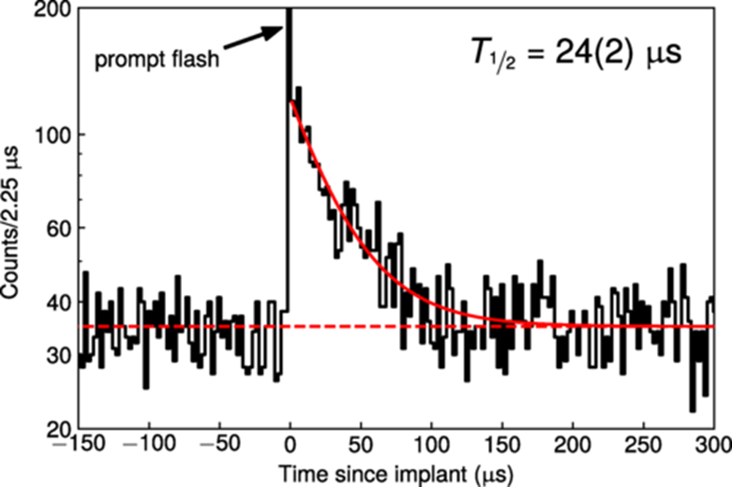
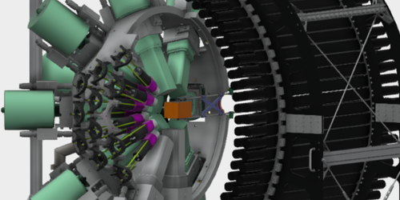
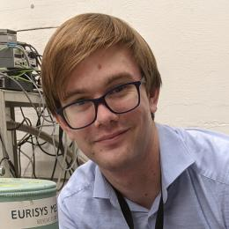

















Excited Na-32 With a Spherical Wave Function
Microsecond Isomer at the N=20 Island of Shape Inversion Observed at FRIB
T. J. Gray et al. Phys. Rev. Lett. 130, 242501 – Published 13 June 2023
Notes:
Results from the first FRIB experiment continue to come in – this work is from a PRL that came out this summer. A microsecond isomer at the N=20 Island of Shape Inversion was observed at FRIB. (Figure shows isometric half-life for 32Na). In principle, the energy of an excited deformed state can drop below a spherical ground state. This appears to be happening for some exotic nuclei when the natural ratio of neutrons to protons becomes unbalanced. The phenomenon is known as “the island of inversion” and it may be pervasive for n-rich nuclei along the classical shell closures. Yet, the excited spherical states are never found as if everything has gone deformed. One possibility is that the deformed 2p-2h and 4p-4h states are strongly mixed with the spherical 0p-0h states near the crossing. A long-lived 24-μs isomer was discovered in ³²Na (diagonal to ³²Mg) and it is the longest-lived isomer in the region that decays by γ-ray emission. One of the explanations for the new isomer is that the excited state is spherical (J^{π}=6⁻), resulting in a shape isomer. However, it could also be a deformed (J^{π}=0⁺) spin-parity isomer. The next clue in the riddle of the missing spherical states will be addressed after the next FRIB power upgrade when it will be possible to perform γ-γ angular correlations and spin assignments.

Slide 11
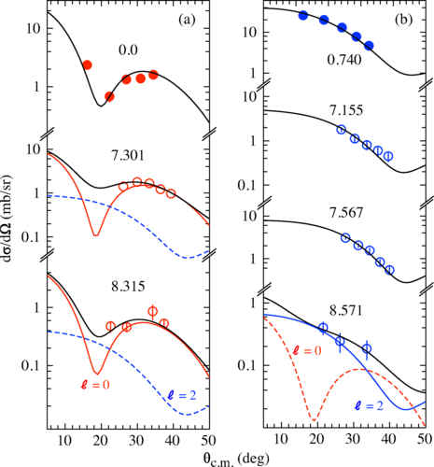



HELIOS @ ATLAS: (d,p) Reactions
Quenching of Single-Particle Strength in A=15 Nuclei, B. P. Kay, et al. Phys. Rev. Lett. 129, 152501 – Published 3 October 2022
Notes:
Measurement using HELIOS at ATLAS, capitalizes on cocktail beam of 14C and 14N for (d,p) reactions. Absolute differential cross sections, labeled by excitation energy in MeV, with fits (solid black lines) determined from a DWBA analysis (see text). The solid data points are for the 14C(d,p)15C reaction and empty symbols for 14N(d,p)15N. (a) States populated via (in the case of 15N, dominantly) ℓ=0 transfer (red) and (b) for ℓ=2 (blue). The colored solid (dashed) curves denote the dominant (subdominant) ℓ transfer where relevant.In a measurement where many systematic errors are absent because of the ratio method, we show that, for two different nuclei separated by ≈28 MeV in ΔS, a similar degree of quenching of the single-particle strength is observed for both the s and d excitations. This contrasts with the factor-of-two difference observed in HI-knockout over the same range in ΔS. This Letter provides the first assessment of neutron-adding (d,p)-reaction data at extreme ΔS, complementing a very limited number of datasets from nucleon-removing knockout and transfer reactions, adding to the growing evidence of a discrepancy between HI knockout and results using other probes.
There is an expectation that more data will become available as radioactive beams at energies above the Coulomb barrier become more widely available for transfer-reaction studies, for example, at the Facility for Rare Isotope Beams. With many of these facilities likely to provide isobarically impure beams, the simultaneous beams technique discussed in this Letter could be a convenient and useful approach for future studies. Developing a body of transfer-reaction data, using both adding and removing reactions, comparable in magnitude to that of the HI-knockout data is likely essential to guide theoretical insights into this discrepancy.

Slide 12
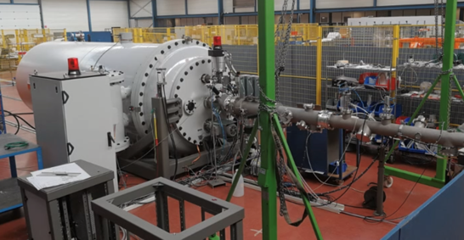
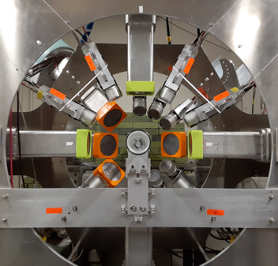
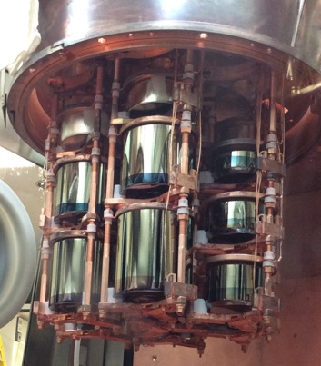
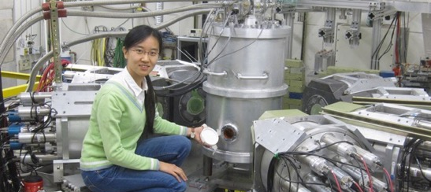
TUNL’s Decadal Vision: Strong Research Programs at the Frontiers of the Field
Nuclear Structure: New γ-ray Array at HIγS:
Identify in stable nuclei new excitation modes found in n-rich systems
Properties of states important for nucleosynthesis
Strength functions
Comissioning summer 2023
Nuclear Astrophysics: LENA Upgrade, New 2-MV single-tron accelerator with terminal ECR source and chopper/buncher for research on globular clusters, classical novae, astrophysical s-process, grains
Fundamental Symmetries: 0νββ
Analysis of Majorana Demonstrator data
Commission LEGEND-200
Prepare for LEGEND-1000
Neutron EDM
Systematics with polarized UCN and ³He
Neutron cell development and UCN storage time determination
Medium Energy: Low-Energy QCD research at HIγS on Compton scattering on H, D and ^{3,4}He to determine nucleon polarizabilities with high precision; develop HIγS beams t toward pion threshold

Slide 13
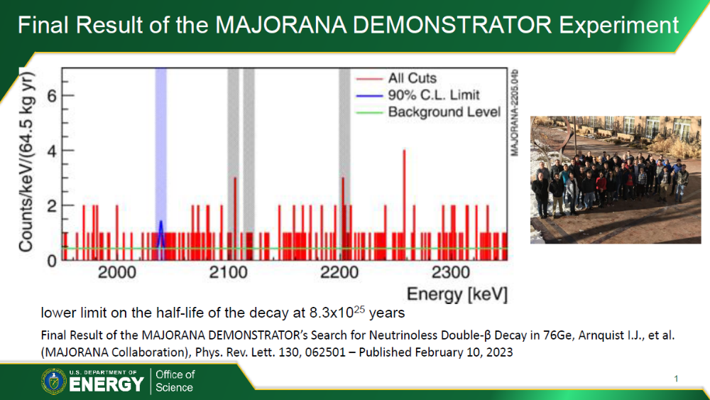
13

Slide 14
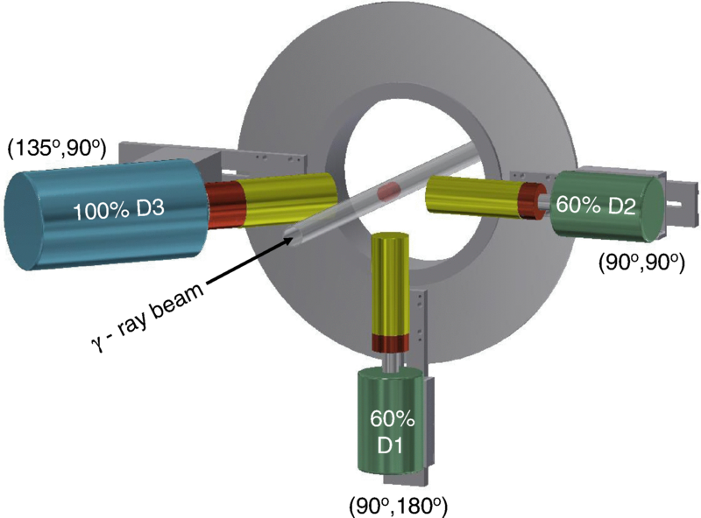

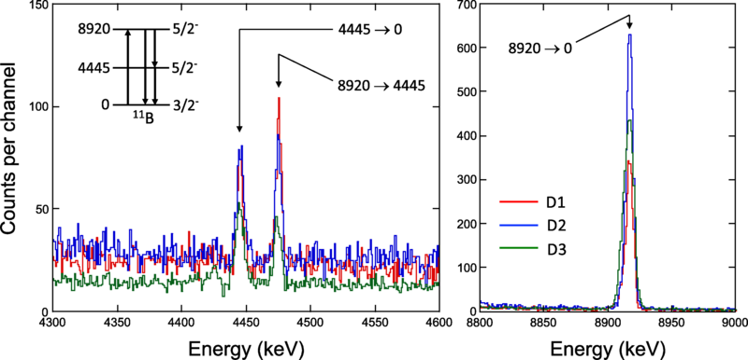
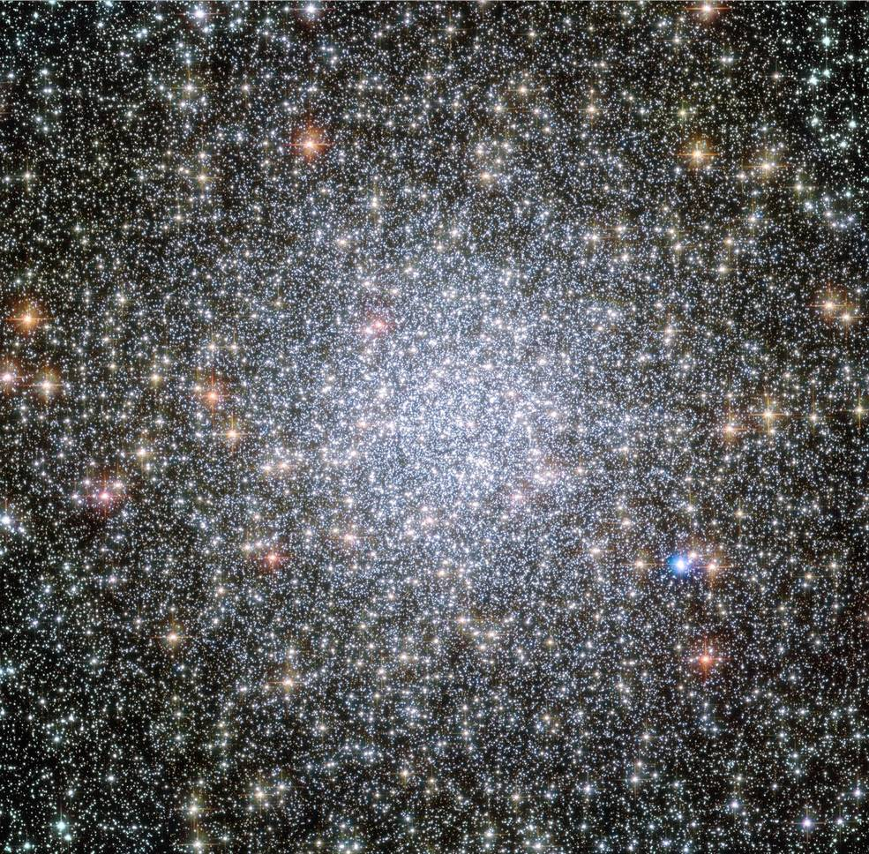
Nuclear Resonance Fluorescence @ HIγS
Globular Cluster Tuc 47 image courtesy of NASA/Hubble
Investigation of 11B and 40Ca levels at 8–9 MeV by nuclear resonance fluorescence, D. Gribble, C. Iliadis, R. V. F. Janssens, U. Friman-Gayer, Krishichayan, and S. Finch, Phys. Rev. C 106, 014308 – Published 14 July 2022

Slide 15
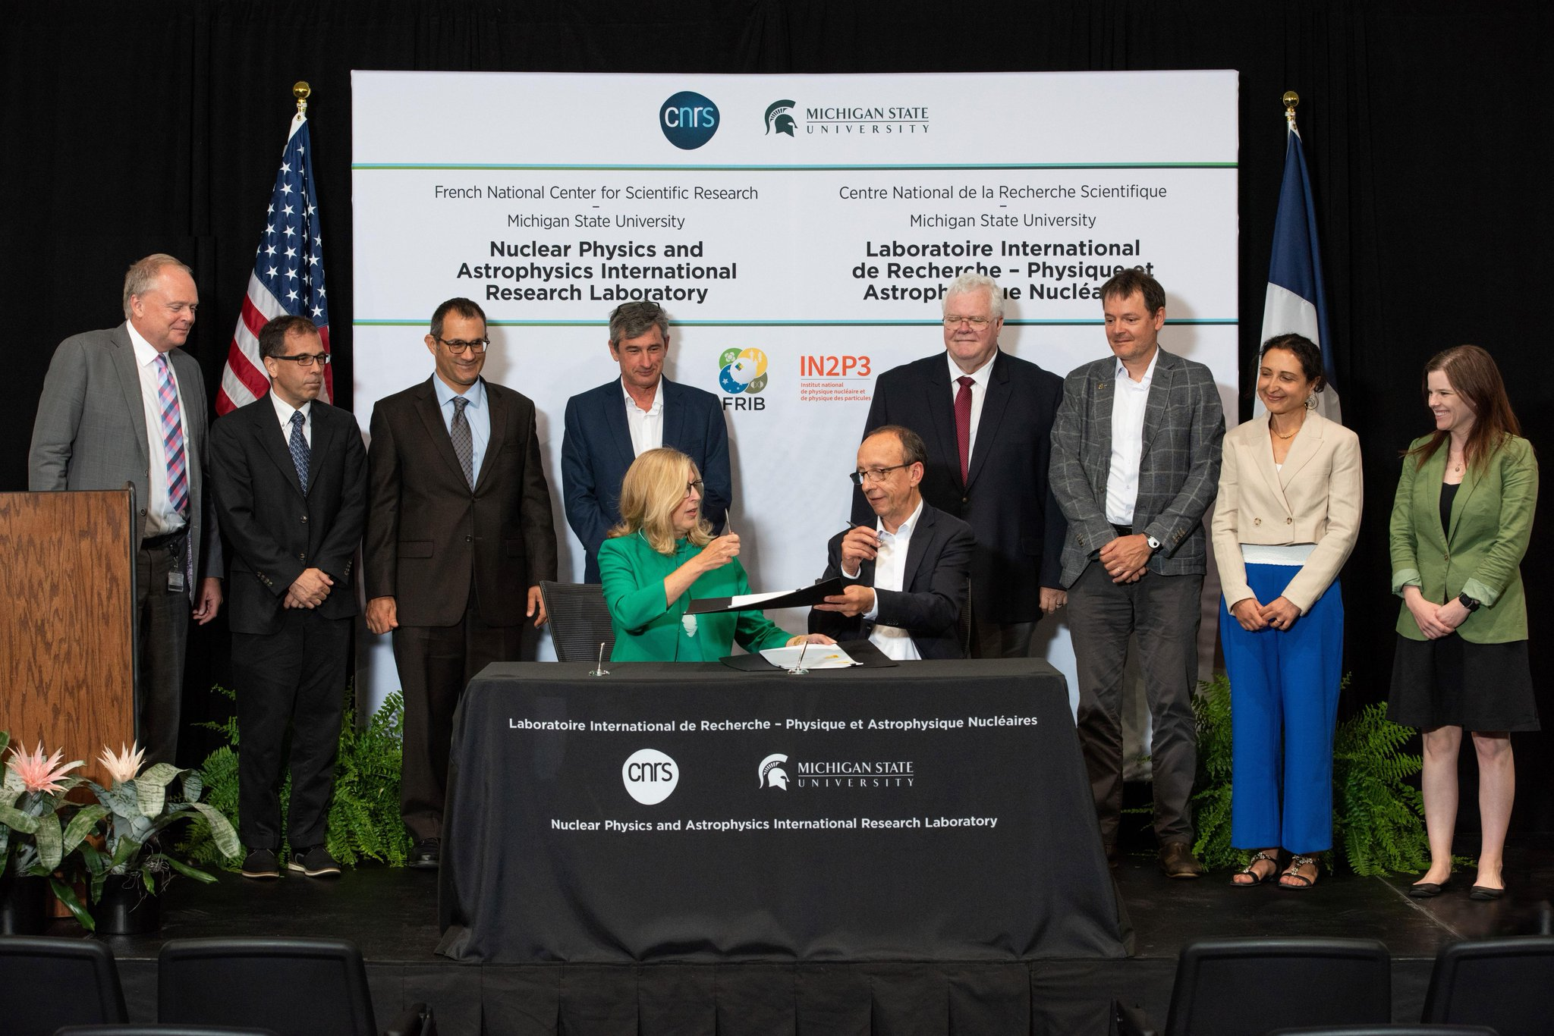
Opening a New “Hands-Across-the-Pond” Engagement with France for Collaboration on FRIB
July 18,2023

Slide 16
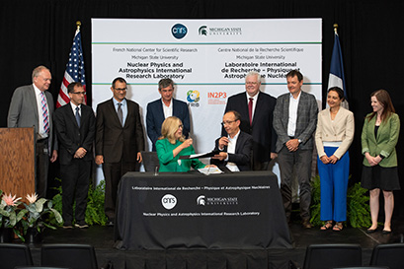
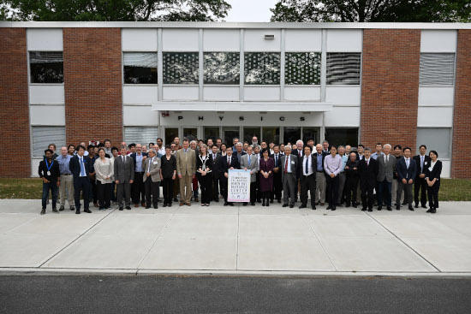
In Fact, Two International Success Stories in July 2023
FRIB-CNRS International Research Laboratory
  Collaborative effort in nuclear physics
  MoU signed July 18, 2023.
RIKEN-BNL 25th Anniversary
  Japanese collaboration enables scientific collaboration
  Celebration on June 22, 2023

Slide 17
Other Important NP Campaigns

Slide 18
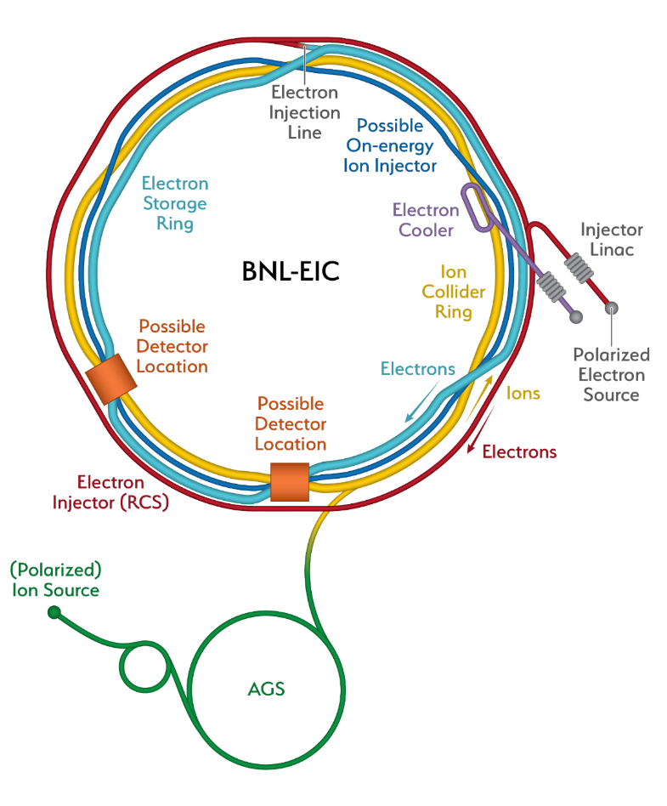
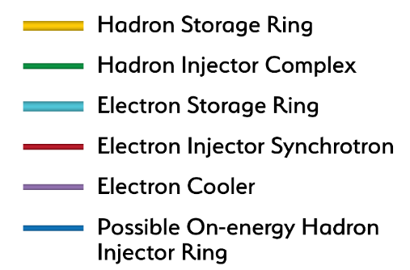
Constructing Capability to Maintain World Leadership Throughout The Century: the Future Electron-Ion Collider
Recent Progress
Successful OPA Progress Review 1/ 2023
Significant Project staffing increases via IRA
Pursuing Long Lead (CD3a) followed by CD-2
Project Detector Location
The EIC will be the most advanced accelerator in the world and the only new collider built for decades. It will keep US capability in accelerators physics number one

Slide 19
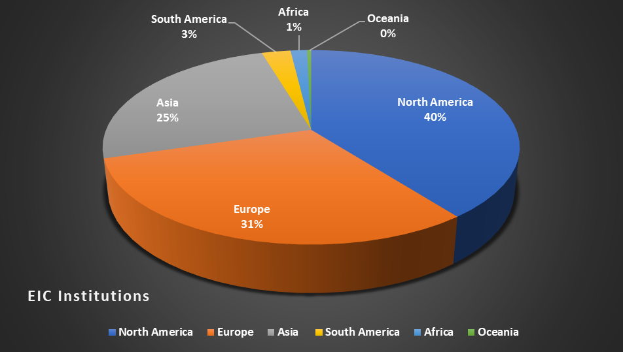
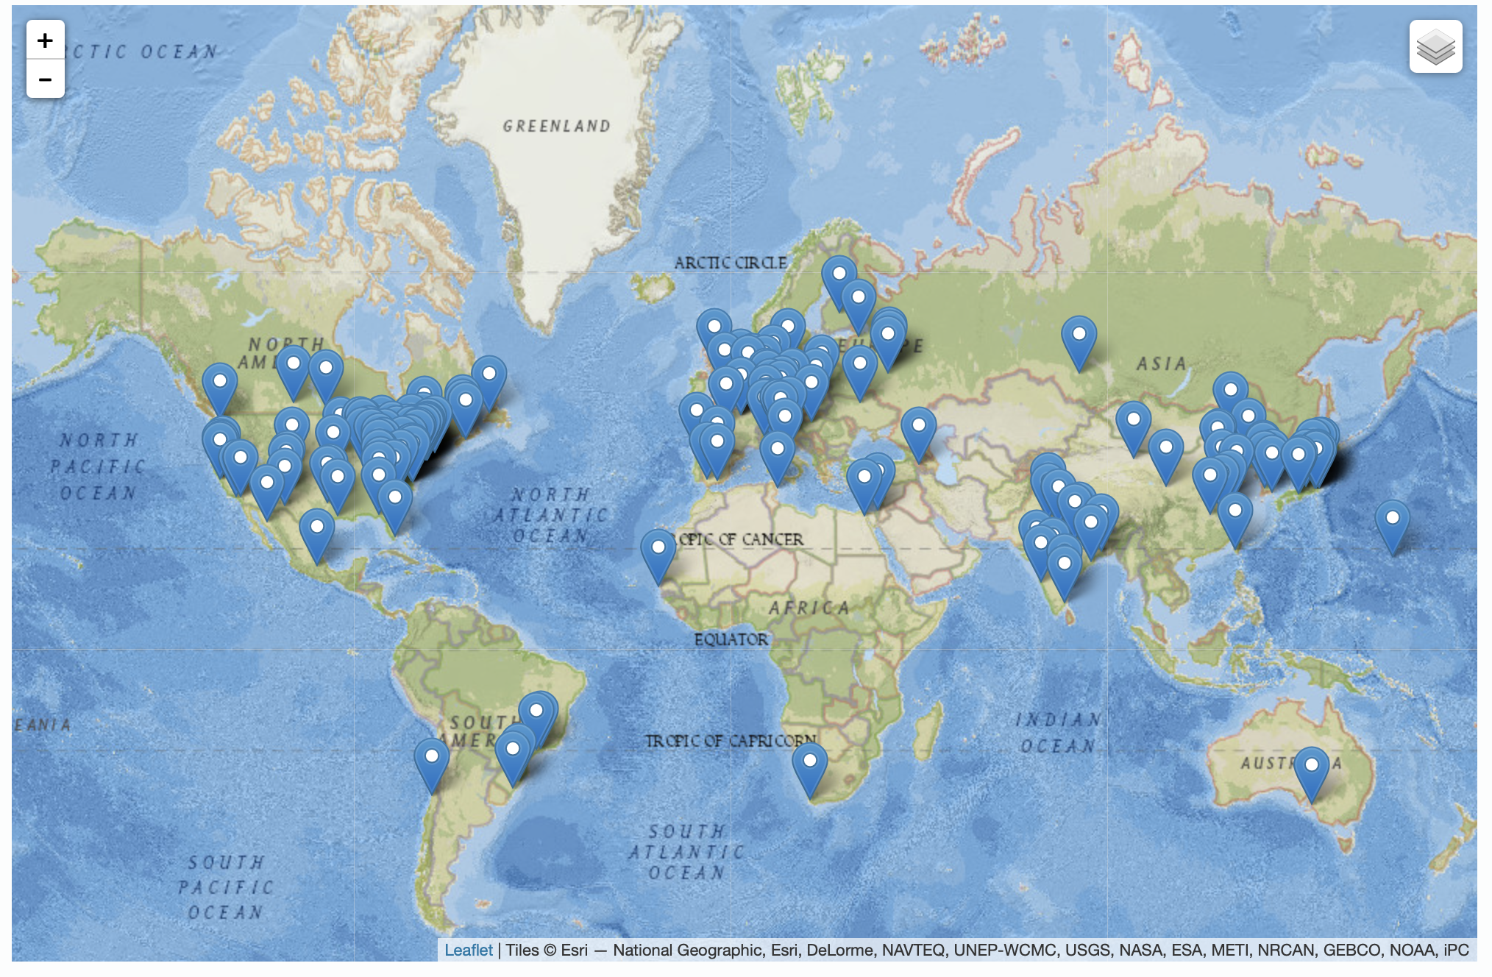
19
The EIC is International At Its Core
EIC Users Group Formed in 2016
EICUG.ORG
Status January 2023:
Collaborators 1391
Institutions 270
Countries 36

Slide 20
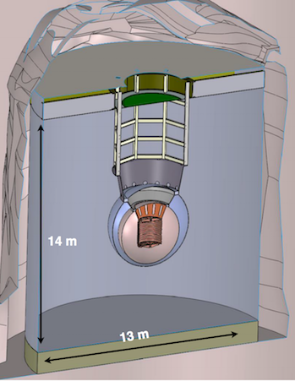
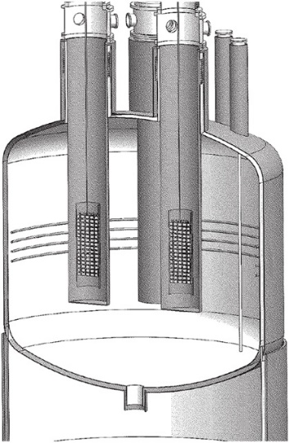
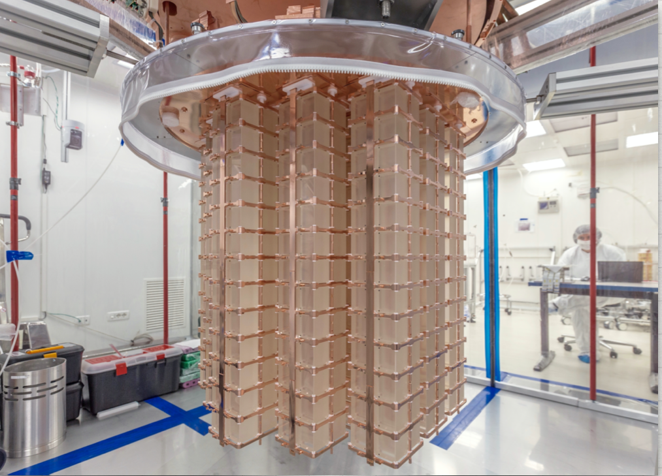
The Other Priority of the 2015 Long Range Plan for Nuclear Science: Neutrinoless Double Beta Decay
Between IRA funding and NP Program Funding, approximately $12.8 M allocated to the three technologies being explored LEGEND 1000, nEXO, and CUPID since FY 2020.
Additional resources provided by international partners
Inability to procure isotopes from Russia is having a severe, existential impact
The next DBD international occurred on April 27, 2023 at SNOLab in Canada. A Virtual Global DBD Observatory is being established.
NP is thinking about options to demonstrate a proof-of-principle isotope procurement test
Three Proposed Technologies
  Scintillating bolometry (CUPID, ¹⁰⁰Mo enriched Li₂Mo₄ crystals)
  Enriched ⁷⁶Ge crystals (LEGEND-1000, drifted charge, point contact detectors)
  Liquid Xenon TPC (nEXO, light via SiPM, drifted ionization)
TeO₂ Crystals from CUORE
Potential Partners:
Italy, Canada, and Germany

Slide 21
Snapshot of the Status of NP Projects
Project | Location | Status | Cost | CPI | SPI | CD-4 | Operation cost plan
Construction Projects
Facility for Rare Isotope Beams (FRIB) * | MSU | CD-4 | $730M | 1.00 | 1.00 | 6/2022 | Included in NP budget formulation
Electron-Ion Collider (EIC) | BNL | CD-1 | $1.7B to $2.8B |  |  | Q4 FY33 | RHIC operations funds redirected to EIC project recovered for EIC operations
Major Items of Equipment
Gamma Ray Energy Tracking Array (GRETA) ^{FF} | LBNL | CD-2/3 | $58.3M | 0.96 | 0.93 | 4/2028 | Mostly covered by host laboratory operations experimental support
Super Pioneering High Energy Nuclear Interaction Experiment (sPHENIX) * | BNL | PD-4 | $26.5M | 1.00 | 1.00 | 12/2022 | Covered by RHIC operations experimental support
Measurement of Lepton-Lepton Electroweak Reactions (MOLLER) ^{FF} | TJNAF | CD-3A | $45.8M to $56.6M |  |  | Q4 FY27 | Covered by TJNAF operations experimental support
High Rigidity Spectrometer (HRS) | MSU | CD-1 | $85.0M to $111.4M |  |  | Q2 FY29 | Covered by FRIB operations experimental support
Ton Scale Neutrinoless Double Beta Decay (TS-NLDBD) | TBD | CD-0 | $215M to $250M |  |  | TBD | TBD
Blue (*) indicates “Completed”, green (^{FF}) “Fully Funded”, and purple italic “Substantially Funded”
Smaller NP Projects are being “cleared off the books”

Slide 22
Planned NP Research Horizons in FY24 and Beyond
Search for anomalous atomic electric-dipole moments at FRIB as a signal of new physics using laser trapped isotopes
Search for anomalous parity violation in electron scattering as a signal of new physics using MOLLER at JLAB
Search for the next superheavy nucleus (Z = 120) at the LBNL 88 inch cyclotron
Understanding the equation of state of the quark-gluon plasma using sPHENIX at RHIC
Expanding the boundary of present knowledge of how heavy elements are produced in the cosmos via never-before-produced heavy neutron-rich nuclei at FRIB
Discovering ways to suppress the effects of natural radiation on quantum coherence times
Quantum step improvement in rare search capability via AI/ML pattern recognition software
Significantly advancing imaging technology for the physical sciences.
Comprehensive tomography of the proton

Slide 23
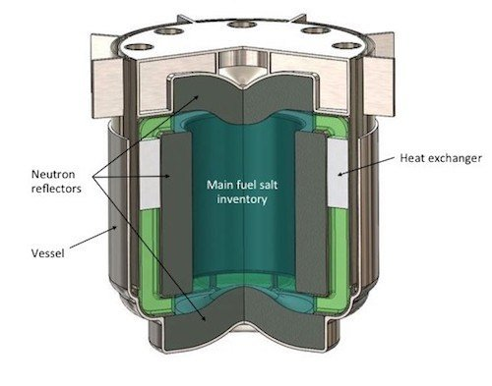


NP Broader Impacts & Applications For Other Missions:
Nuclear Data
NP is providing new and updated nuclear data to existing customers
  Working to identify impactful nuclear data needs and leverage resources
    Ex: Data for next generation molten salt reactors with DOE/NE, ARPA-E
NP is reaching out to new nuclear data application customers
  Electronics protection (NASA, Missile Defense Agency, Federal Aviation Administration)
  Human safety (NASA [spaceflight], NIH [ion beam therapy])
  Advanced reactors (ARPA-E, NASA)

Slide 24
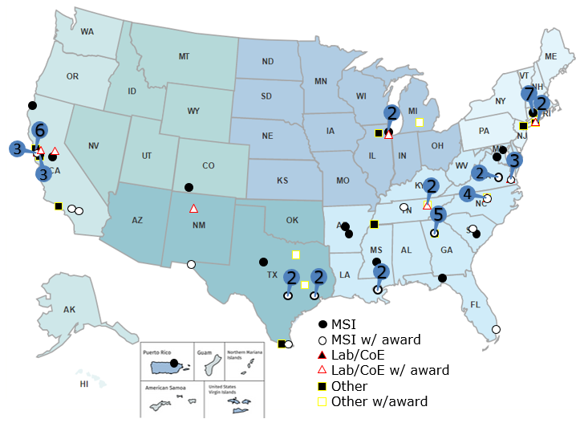
NP Helped Pioneer An Early Initiative As Part of SC’s Development of RENEW
110 NP traineeship award recipients include:
  18 MSIs,
  10 other colleges/universities,
  5 DOE laboratories
MSI award recipients include:
  9 Hispanic Serving Institutions (HSIs),
  8 HBCUs,
  5 Asian/Native American, and Pacific Islander Serving Institutions (AANAPISI),
  1 Predominantly Black Institution (PBI)
Other institutions on the map are involved in the traineeship program as recruitment sites (38), Co-Is (9), and/or hosts (7).
Of the funds awarded, ∼ 70% went to MSIs, MSI faculty, or MSI students. About 50% of trainees awarded continued on to Graduate Programs in Science or Engineering

Slide 25
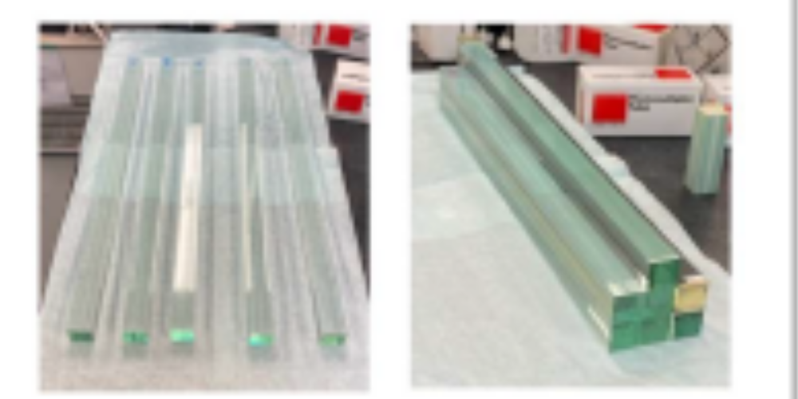
SBIR Value Added: NP Phase II Example:
Lead-glass Scintillator for Nuclear Physics Detectors
STTR award to Scintilex/Catholic University of America
New material is being developed due to the expense and difficulty in obtaining the PbWO₄ often used in electromagnetic calorimeters, a component of current and future NP detectors
Currently crystals come from the Czech Republic; LHC is buying up all material for next few years
“SciGlass” will be ~ 5x cheaper in volume than PbWO_{4.} This development is essential for the Electron-Ion Collider (EIC)
The Company received a Phase IIA award to finish R&D and scale up production.
2×2×40 cm³ bars – full scale PbWO₄ replacements

Slide 26




March 15, 2023 to March 17, 2023 at the Thomas Jefferson National Accelerator Facility
89 participants from DOE, NCI, NIBIB, universities, clinics
Second workshop (this time focused on radiation detection) in an ongoing series
Unmet goals: Small pixels, less noise, good spectral information
Unmet need: Address both charge sharing and pulse pileup

Slide 27
Ideas From the Joint Workshop to Stimulate Thought
Ultra-low Temperature Calorimetry Sensors for Discovery Science Ultra-low temperature, superconducting sensors promise a critical, inherent, physics-based signal-to-noise advantage that may promote both high precision nuclear science as well as new biological discovery with medical implications.
The 10 ps Challenge: Needed for high rate (such as the luminosity frontier at JLab) and high volume (such as the EIC) nuclear science experiments, the continued development of these techniques may also directly pave the path for addressing the 10 ps challenge in time-of-flight (TOF) PET.
Enabling Multi‑institutional, Multi-agency Collaborations with Scalable Federated Learning: Federated learning (FL) is a distributed machine learning method that allows a network of participants to collaboratively train a shared model without exchanging their data
Non-imaging and Imaging Detector Technologies for Enabling Nuclear Science and Customized Dosimetry-based Cancer Treatment Planning: The goal of this topic is to develop and validate cost-effective, potentially small cross-section, detector technologies that will enable radiation monitoring for personnel, equipment, and/or personalization of radiation therapy treatment planning. It could be achieved by combining high-resolution, hyper-sensitive radiation detectors
Compton Scattering-based Detectors and Systems: Compton scattering-based detectors can resolve much lower radiation emissions than standard sensors, and can do so more rapidly, as compared for example to PET or other sources and therefore offer great promise in medical and other applications

Slide 28
NP - FY 2024 President's Request
 |  | FY 2022 |  |  | FY 2023 |  | FY 2024 |  | FY 2024 |  | FY 2024 Senate Mark vs FY 2024 Request |  | FY 2024 Senate Mark vs FY 2023 Enacted
 |  | Enacted |  |  | Enacted |  | Request |  | House Mark | Senate Mark
 |  | Regular | IRA Supp. |  | Regular |  | Regular |  | Regular
Nuclear Physics
Medium Energy, Research |  | 53,404 | ... |  | 59,083 |  | 55,555 |  | 51,724 | 55,555 | ... | ... | -3,528 | -5.97%
Medium Energy, Operations |  | 142,709 | ... |  | 149,834 |  | 141,930 |  | 150,000 | 143,430 | 1,500 | 1.06% | -6,404 | -4.27%
Medium Energy Physics |  | 196,113 | ... |  | 208,917 |  | 197,485 |  | 201,724 | 198,985 | 1,500 | 0.76% | -9,932 | -4.75%
Heavy Ion, Research |  | 46,505 | ... |  | 46,149 |  | 47,454 |  | 46,704 | 47,454 | ... | ... | 1,305 | 2.83%
Heavy Ion, Operations |  | 183,943 | ... |  | 182,087 |  | 176,195 |  | 166,684 | 178,695 | 2,500 | 1.42% | -3,392 | -1.86%
Heavy Ion, Projects |  | 25,013 | 10,000 |  | 20,000 |  | 2,850 |  | 2,850 | 2,850 | ... | ... | -17,150 | -85.75%
Heavy Ion Physics |  | 255,461 | 10,000 |  | 248,236 |  | 226,499 |  | 216,238 | 228,999 | 2,500 | 1.10% | -19,237 | -7.75%
Low Energy, Research |  | 73,935 | ... |  | 77,651 |  | 78,409 |  | 76,909 | 78,409 | ... | ... | 758 | 0.98%
Low Energy, Operations |  | 107,831 | ... |  | 128,579 |  | 127,624 |  | 132,487 | 130,624 | 3,000 | 2.35% | 2,045 | 1.59%
Low Energy, Projects |  | 17,400 | 78,760 |  | 23,940 |  | 9,259 |  | 18,000 | 9,259 | ... | ... | -14,681 | -61.32%
Low Energy Physics |  | 199,166 | 78,760 |  | 230,170 |  | 215,292 |  | 227,396 | 218,292 | 3,000 | 1.39% | -11,878 | -5.16%
Theory, Research |  | 57,260 | ... |  | 67,873 |  | 77,142 |  | 59,642 | 77,142 | ... | ... | 9,269 | 13.66%
Nuclear Theory |  | 57,260 | ... |  | 67,873 |  | 77,142 |  | 59,642 | 77,142 | ... | ... | 9,269 | 13.66%
Program Subtotal |  | 708,000 | 88,760 |  | 755,196 |  | 716,418 |  | 705,000 | 723,418 | 7,000 | 0.98% | -31,778 | -4.21%
20-SC-52, Electron Ion Collider EIC, BNL |  | 20,000 | 128,240 |  | 50,000 |  | 95,000 |  | 95,000 | 95,000 | ... | ... | 45,000 | 90.00%
Construction Subtotal |  | 20,000 | 128,240 |  | 50,000 |  | 95,000 |  | 95,000 | 95,000 | ... | ... | 45,000 | 90.00%
Total Nuclear Physics |  | 728,000 | 217,000 |  | 805,196 |  | 811,418 |  | 800,000 | 818,418 | 7,000 | 0.86% | 13,222 | 1.64%
The FY 2024 Request for $811.4 million supports high priority efforts and capabilities in fundamental nuclear physics research; operations, maintenance, and upgrades of scientific user facilities; and projects

Slide 29

NP - Research Initiatives
Effort on initiatives tends to be primarily non-collaborative internationally and focused within the U.S. thus far

Slide 30
House Mark: General Provisions Potentially Affecting NP
The FY24 HEWD mark is $8.1B, which is flat at FY23 enacted funding levels.
SC’s program direction was held flat at FY23 levels. If this funding level were enacted it may require SC implementing a hiring freeze and doing a reprogramming.
Section 308 creates limitations by requiring that new university awards $5M or under be fully funded before being awarded. SC currently fully funds awards $1M or less. To implement the new requirement, SC would have to reduce number of research awards.

Slide 31
NP Outlook
In FY 2024, NP continues stewardship of a world-leading program in nuclear physics that delivers new science, operates unique leadership user facilities, supports and enhances a diverse workforce, and delivers impactful applications
The EIC Project is making steady progress, towards CD3a (Long Lead Procurement), and the next DOE gateway CD-2 (Approve Performance Baseline). Although not yet baselined, increased support from annual appropriations is essential to enable timely progress and a smooth transition of workforce from the Relativistic Heavy Ion Collider in FY 2025.
The FY 2024 Request is greatly appreciated, allowing NP National User Facilities to operate at or above 90% of optimal funding. That said, this level is not sufficient for adequate RHIC running
NP Research funding allows for a compelling program of science but continues to be constrained due to the priority of increased funding for FRIB Operations and EIC construction

Slide 32

What To Do Now?
Key Points:
In turbulent, challenging times it is crucial to Keep One’s Eye On The Ball—keep delivering the knowledge, discoveries and training that are valued outcomes for the U.S.
Articulate the value of Nuclear Physics
Mutual Respect among scientific sub-disciplines
Commitment To The Greater Good of nuclear science as a discipline
Meticulously Level Playing Field leading to respect for process and outcomes
The community MUST REMAIN UNIFIED
Staying united we can accomplish great things together
Division will setback the entire field and is the last thing needed right now

Slide 33
Additional Information

Slide 34

The High-Level NP Work Plan
Operate and get science out from the Relativistic Heavy Ion Collider (RHIC),the Continuous Electron Beam Accelerator Facility (CEBAF), the Argonne Tandem Linac Accelerator System (ATLAS) and the Facility for Rare Isotope Beams (FRIB)
Make progress on a U.S.-led ton-scale neutrino-less double beta decay experiment.
Start construction of a high-energy high-luminosity polarized electron-ion collider (EIC)
Implement smaller scale instrumentation to take advantage of facility capabilities
The work plan centers on NP’s mission to understand all forms of nuclear matter to benefit energy, commerce, medicine, and national security. A new Long Range Plan is in development by NSAC.

Slide 35



Recent Impactful Accomplishments
Discovery that ionizing radiation reduces coherence time for entangled quantum states
  Need new quantum materials or/and underground Quantum Computing
First known observation of the Breit-Wheeler two-photon process at RHIC
  Confirmation of Quantum Electro-Dynamic (QED) process; possibility of e⁺e⁻ pair production via lasers
Discovery that heavy nuclei have a neutron skin (CEBAF)
  New constraints on neutron star radii and their equation of state
Implementation of dynamical fermions and the real pion mass in Lattice QCD
  Major advance in fidelity of Lattice Quantum Chromodynamics calculations
Initiation of the FRIB science program
  Opening a new frontier to understand heavy element
  production in cosmos
Integration of AI technology at CEBAF to make it more fault tolerant
  Test-bed for use of Artificial Intelligence in accelerator control and optimization

Slide 36
FY 2024 President's Request Highlights - NP
FRIB begins its third year of science research studying atomic number nuclei near the limit for nuclear existence, and initiating a world leading campaign of fundamental symmetries measurements
NP User Facilities (RHIC, CEBAF, ATLAS, and FRIB) are all at or above 90% optimal budget
The Electron-Ion Collider vets a list of CD3a long lead procurements and makes finalizes preparations for CD-2 Review, Approve Performance Baseline. EIC A/E design is begun subject to funding.
sPHENIX continues science research at RHIC to determine the novel properties of the quark-gluon plasma
LEGEND-200 continues initial search for new physics via the slowest rare decay ever attempted
A ton-scale neutrino-less double beta decay experiment finalizes preparation for a CD-1 review, “Approve Alternatives Selection and Cost Range”
The Gamma Ray Energy Tracking Array (GRETA) MIE and MOLLER are fully funded at the FY 2023 Request, and construction continues in accordance with their technically driven schedules
The High Rigidity Spectrometer for FRIB continues construction
NP investment in the AI/ML cross-cutting research continues and RENEW and EPSCOR investment increases
NP makes highly impactful awards in the new cross-cutting initiatives in Funding for Accelerated Inclusive Research (FAIR) and Accelerate Innovations in Emerging Technologies (Accelerate)

Slide 37






Nuclear Physics
Discovering, exploring, and understanding all forms of nuclear matter
      Understanding why matter takes on the specific forms observed in nature and how that knowledge can benefit energy, commerce, medicine, and national security, by:
  Mapping the quantum cosmos inside the proton using the future Electron-Ion Collider
  Discovering the properties of the novel quark-gluon plasma RHIC, LHC
  Exploring the mechanism underlying the confinement of quarks and gluons via CEBAF and RHIC
  Searching for new exotic particles and violations of nature’s symmetries at CEBAF, FRIB, ATLAS
  Determining the limits of nuclear existence and how are heavy elements made via FRIB and ATLAS
  Searching for lepton number violation and other sources of time-reversal asymmetry via Neutrino-less Double Beta Decay and Electric Dipole Moments.
  Exploring the strong force in many-body systems via SciDAC, Core Research, QIS/QC, AI/ML
  Advancing Nuclear Data for Space, Energy, and Research through Nuclear Data and AI/ML

Slide 38
Summary of 2024 PR Changes Relative to FY 2023 Enacted
Research
FY 2022 Enacted | FY 2023 Enacted | FY 2024 PR
Core research in Medium Energy, Heavy Ions, and Theory is increased by 7.5% from FY21 Enacted. The Fundamental Symmetries and Nuclear Structure and Nuclear Astrophysics portfolios are increased by 10.5% over FY21 Enacted. | Core Research in Medium Energy, Heavy Ions, Nuclear Theory, Fundamental Symmetries and Nuclear Structure and Nuclear Astrophysics is ~6.1% above the FY22 Enacted Level. | Core Research in Medium Energy, Heavy Ions, Nuclear Theory, Fundamental Symmetries and Nuclear Structure and Nuclear Astrophysics is ~flat with the FY23 Enacted Level.
LHC M&O commitments are met. | LHC M&O commitments are met. | LHC M&O commitments are met.
FRIB Research is increased. | FRIB Research is increased. | FRIB Research is increased.
nEDM supported significantly below planned profile. | nEDM is supported below the planned profile at $1M for the GPP effort for minor construction. | nEDM is supported below the planned profile at $1M for the GPP effort for minor construction.
SciDAC funding is increased to support SciDAC-5 (+$600k). | SciDAC is modestly reduced by from the FY22 Enacted. | SciDAC is modestly increased from the FY23 Request to support SciDAC-5 activities.
Nuclear Data increased $2.8M from FY21 Enacted to support the expansion of experimental efforts. | Nuclear Data is flat with the FY22 Enacted level. | Nuclear Data is modestly increased above the FY23 Enacted level.
Accelerator R&D held flat with the FY21 Enacted level. | Accelerator R&D is reduced by 4.5% from the FY22 Enacted. | Accelerator R&D is flat with the FY23 Enacted.

Slide 39
Summary of 2024 PR Changes Relative to FY 2023 Enacted
Initiatives
FY 2022 Enacted | FY 2023 Enacted | FY 2024 PR
QIS increased to $10.9M. | QIS is flat with FY22 Enacted. | QIS is flat with FY23 Enacted ($10.9M).
AI/ML Initiative support flat with FY21 Enacted ($4M). | AI/ML is increased to $8M (+$4M) | AI/ML is flat with the FY23 Enacted ($8M).
Three new initiatives are supported: Reaching a New Energy Sciences Workforce (RENEW) - $3M Accelerator Science and Technology - $1M Microelectronics - $518k | Two of the FY22 Enacted new initiatives are supported in FY 2023: Reaching a New Energy Sciences Workforce (RENEW) - $6M (+$3M) Microelectronics - $518k Accelerator Science and Technology Initiative is paused | Initiatives are continued in FY 2024: Accelerate Innovations in Emerging Technologies - $4M Microelectronics - $518k Accelerator Science and Technology Initiative is paused
 | Two new cross cutting initiatives are supported: Funding to Accelerated, Inclusive Research (FAIR) - $2M Accelerate Innovations in Emerging Technologies - $4M | The FAIR and RENEW initiatives are increased: Reaching a New Energy Sciences Workforce (RENEW) - $11.5M (+$5.5M) Funding to Accelerated, Inclusive Research (FAIR) - $5M (+$3M)

Slide 40
Summary of 2024 PR Changes Relative to FY 2023 Enacted
Facility Operations and Projects
FY 2022 Enacted | FY 2023 Enacted | FY 2024 PR
Facility operations supported at >90% of optimal. RHIC operates 20 weeks (90 % maximum) CEBAF operates 31 weeks (90 % optimal) ATLAS operates 39 weeks (93 % optimal) FRIB operates 12 weeks (100% of optimal) | All NP user facilities operate at >90% of optimal in FY 2023. RHIC operates 25 weeks (96 % optimal) CEBAF operates 33 weeks (96 % optimal) ATLAS operates 40 weeks (96 % optimal) FRIB operates 26 weeks (99% of optimal) | All NP user facilities operate at roughly 90% of optimal funding in FY 2024. RHIC operates 20 weeks (94 % optimal funding) CEBAF operates 27 weeks (88 % optimal funding) ATLAS operates 39 weeks (94 % optimal funding) FRIB operates 24 weeks (91% of optimal funding)
FRIB Operations increased, but still slightly below planned levels ($77M in PR vs $82M planned) | FRIB Operations increased to near optimal level. | FRIB Operations slightly reduced, and below optimal levels ($96.2M in Request vs $102.4M optimal)
EIC construction at TEC of $20M and OPC of $24.8M in annual appropriation, and TEC of $128.24M and OPC of $10M in the Inflation Reduction Act. | EIC construction at TEC of $50M and OPC of $20M | EIC construction at TEC of $95M and OPC of $2.9M
Ongoing Major Items of Equipment are supported with both the annual appropriation and Inflation Reduction Act funds: GRETA above baseline level ($16.7M) sPHENIX at baseline level in final year ($0.2M) MOLLER above planned level ($36.2M) TSNLDBD at $8.4M HRS at $34.84M | Ongoing Major Items of Equipment: GRETA at optimal level, providing the project with the final year of funding ($15.5M) MOLLER receives the final $4M of planned TEC funding TSNLDBD at $1.44M TEC HRS at $3M TEC | Ongoing Major Items of Equipment: GRETA and MOLLER at received full TPC amount in FY 23 Request. Progress continues, but no new funding requested in FY24. TSNLDBD at $3M TEC HRS at $6.3M TEC

