Slide 1
Building Respectful, Welcoming, Equitable, and Inclusive Collaborations: DOE-NP Perspectives
Low Energy Community Meeting
August 11, 2023

Slide 2
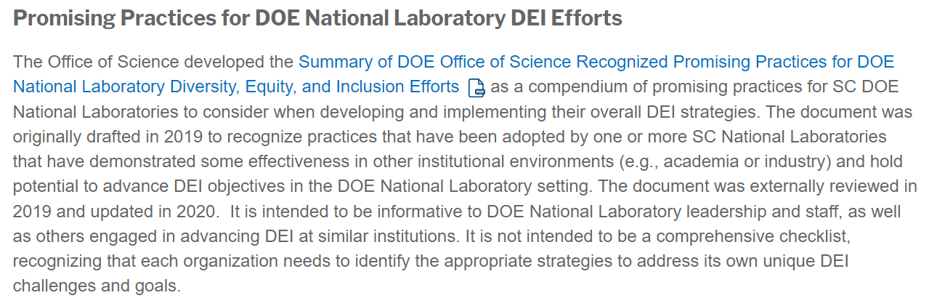
How does DOE-NP help build respectful, welcoming, equitable, and inclusive collaborations?
https://science.osti.gov/-/media/SW-DEI/pdf/Summary-of-SC-DOE-Laboratory-DEI-Promising-Practices-2020---vpublic.pdf
SW-DEI Community DEI Information... | U.S. DOE Office of Science(SC) (osti.gov)

Slide 3
How does DOE-NP help build respectful, welcoming, equitable, and inclusive collaborations?
How does DOE-NP support creating and maintaining respectful, welcoming, equitable, and inclusive collaborations?
  FAIR ($2M) RENEW ($6M), prioritize creating

Slide 4
How does DOE-NP help build respectful, welcoming, equitable, and inclusive collaborations?
How does DOE-NP support creating and maintaining respectful, welcoming, equitable, and inclusive collaborations?
  FAIR ($2M) RENEW ($6M), prioritize creating
  Base funding to labs and universities encourages creating and maintaining -- PIER Plans can include funding requests

Slide 5
How does DOE-NP help build respectful, welcoming, equitable, and inclusive collaborations?
Promoting Inclusive, Equitable Research (PIER) Plan
  Common characteristics of strong PIER Plans (my view):
  Informed
  Context includes a personal presence
  Motivation
  Flexibility, especially around mentoring
  Veracity
  GRANTS Information about PIER Pl... | U.S. DOE Office of Science(SC) (osti.gov)

Slide 6
How does DOE-NP help build respectful, welcoming, equitable, and inclusive collaborations?
Promoting Inclusive, Equitable Research (PIER) Plan
  Common characteristics of strong PIER Plans (my view):
  Informed
  Context includes a personal presence
  Motivation
  Flexibility, especially around mentoring
  Veracity
  GRANTS Information about PIER Pl... | U.S. DOE Office of Science(SC) (osti.gov)

Slide 7
How does DOE-NP help build respectful, welcoming, equitable, and inclusive collaborations?
Promoting Inclusive, Equitable Research (PIER) Plan
  Common characteristics of strong PIER Plans (my view):
  Informed
  Context includes a personal presence
  Motivation
  Flexibility, especially around mentoring
  Veracity
  GRANTS Information about PIER Pl... | U.S. DOE Office of Science(SC) (osti.gov)

Slide 8
How does DOE-NP help build respectful, welcoming, equitable, and inclusive collaborations?
Promoting Inclusive, Equitable Research (PIER) Plan
  Common characteristics of strong PIER Plans (my view):
  Informed
  Context includes a personal presence
  Motivation
  Flexibility, especially around mentoring
  Veracity
  GRANTS Information about PIER Pl... | U.S. DOE Office of Science(SC) (osti.gov)

Slide 9
How does DOE-NP help build respectful, welcoming, equitable, and inclusive collaborations?
Promoting Inclusive, Equitable Research (PIER) Plan
  Common characteristics of strong PIER Plans (my view):
  Informed
  Context includes a personal presence
  Motivation
  Flexibility, especially around mentoring
  Veracity
  GRANTS Information about PIER Pl... | U.S. DOE Office of Science(SC) (osti.gov)

Slide 10
How does DOE-NP help build respectful, welcoming, equitable, and inclusive collaborations?
Promoting Inclusive, Equitable Research (PIER) Plan
  Common characteristics of strong PIER Plans (my view):
  Informed
  Context includes a personal presence
  Motivation
  Flexibility, especially around mentoring
  Veracity
  GRANTS Information about PIER Pl... | U.S. DOE Office of Science(SC) (osti.gov)

