Slide 1

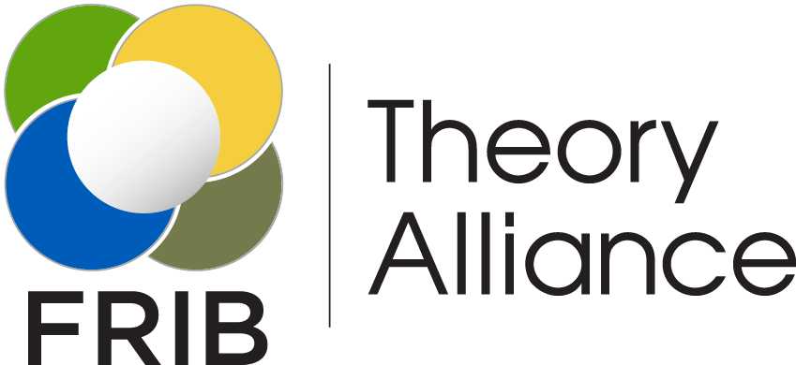

FRIB Theory Alliance
2023 LECM
Daniel Phillips *
Ohio University
* for the FRIB-TA Executive Board
This work is supported by the U.S. Department of Energy, Office of Science, Office of Nuclear Physics, under the FRIB Theory Alliance award DE-SC0013617

Slide 2

FRIB Theory Alliance
The FRIB-TA is a coalition of scientists from universities and national laboratories whose mission is to:
foster advancements in theory related to FRIB science;
optimize the coupling between theory and experiment;
create permanent theory bridge positions;
attract young talent through the FRIB Theory Fellow Program;
coordinate educational programs through Topical Programs & Schools;
foster interdisciplinary collaborations, and shepherd international initiatives.
FRIB Theory Alliance - link

Slide 3
    Theory that we do
Nuclear forces
Nuclear structure
Nuclear reactions
Nuclear equation of state
Fundamental symmetries in nuclei
Nucleosynthesis in stars
Ab initio methods
Shell-model calculations (both large-basis and effective-space)
Structure embedded in the continuum
Density Functional Theory
β-decay
Clustering in nuclei
Collective models
Direct knockout, transfer, … reactions
Development of optical potentials
Three-body models
Statistical approach to nuclear reactions
Central collisions
Theory of fission & fusion
Exotic decay modes
FRIB-TA has people who can compute implications of your measurements for BSM physics or nucleosynthesis or ….
AND

Slide 4
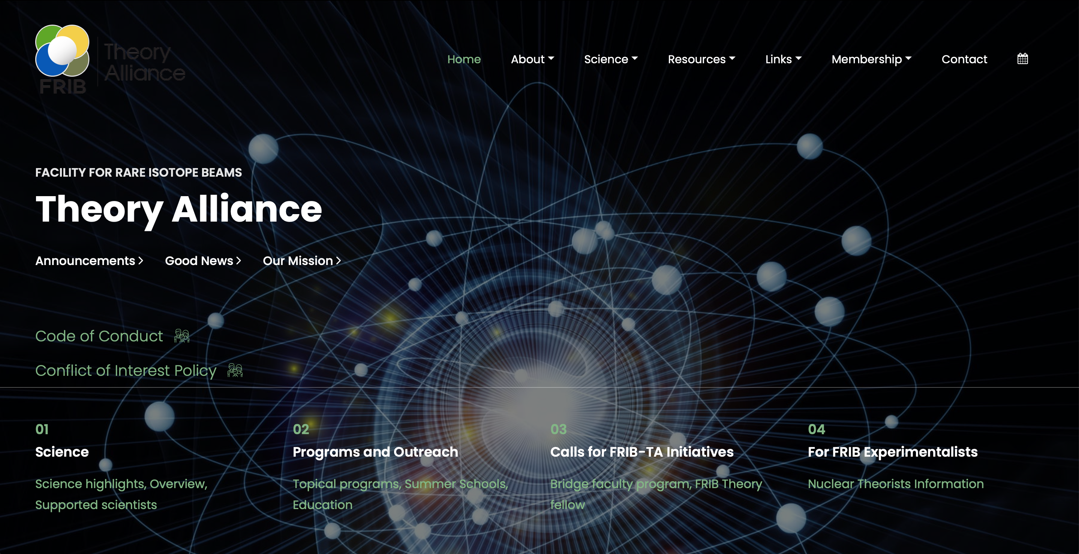
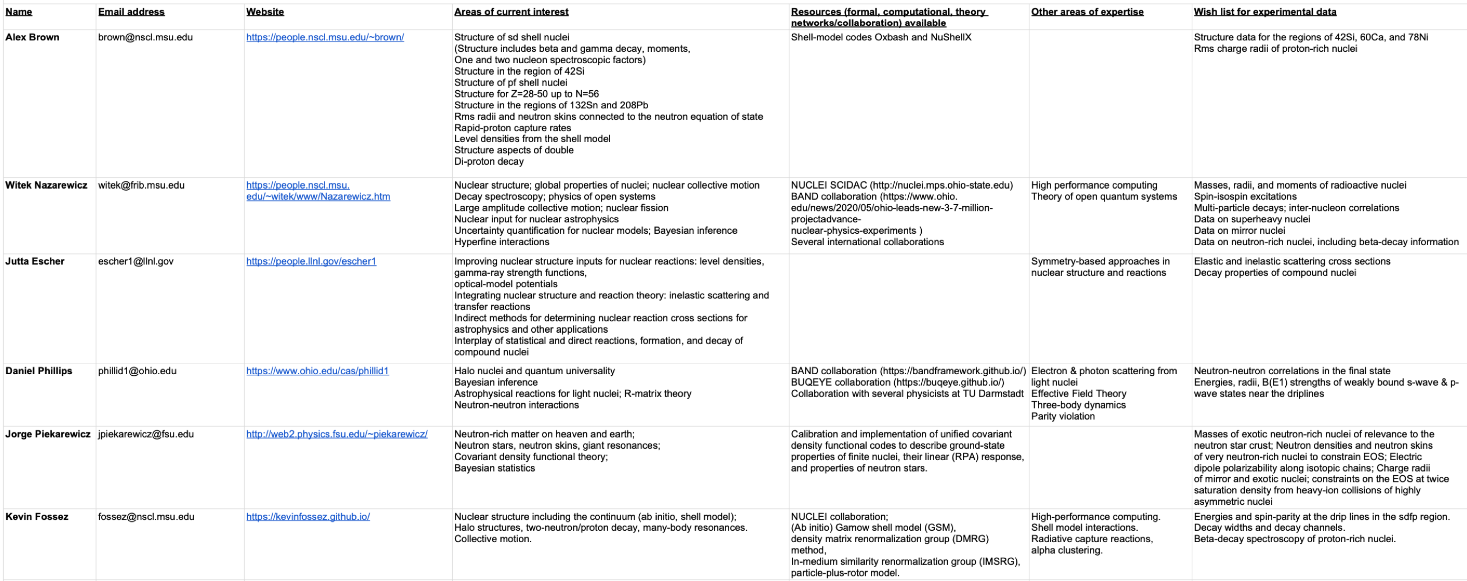
1-88T-HEORIST
We have put together a list of theorists who can provide input/calculations on various topics connected to experiment
Lists name, email address, website, interests, computer codes/resources, wish list for experiments

Slide 5
We are here to help!
At least 14 different theorists involved in more than 35 PAC-1 proposals*
To recruit a theorist collaborator you can start by going to http://fribtheoryalliance.org and consulting the list of theorists there
If that fails consult Scott Bogner (bogner@frib.msu.edu), or myself (phillid1@ohio.edu). Between us we know a large fraction of the FRIB-TA membership and we love to connect theorists who want their approaches tested or applied with experimental efforts that will make use of that work
The earlier you contact us the better we’ll be able to help you
*Based on survey data

Slide 6
FRIB-TA Bridge Faculty

Slide 7
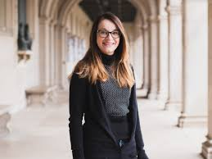
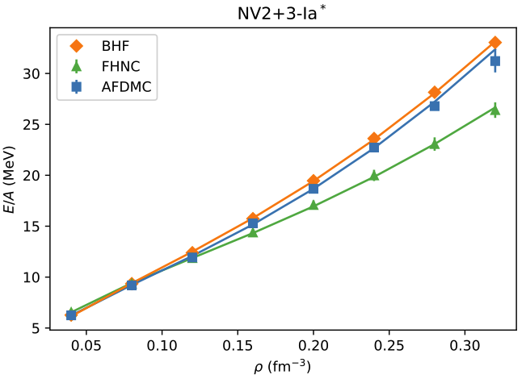
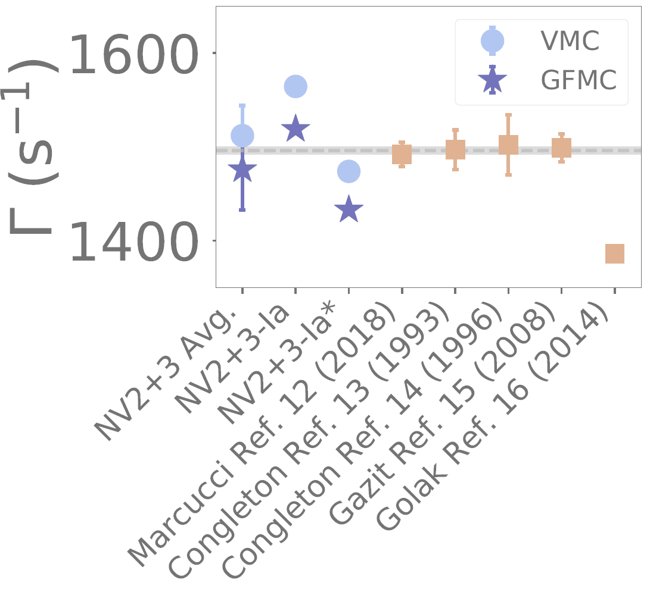
Maria Piarulli (2018 WashU) DOE Early Career Award
Research Focus
Quantum Monte Carlo calculations of many-body systems
Many-body interactions from Chiral Effective Field Theory
Bayesian Methods and UQ
PRC 105 (2022) 055808
PRC 105 (2022), L042501

Slide 8
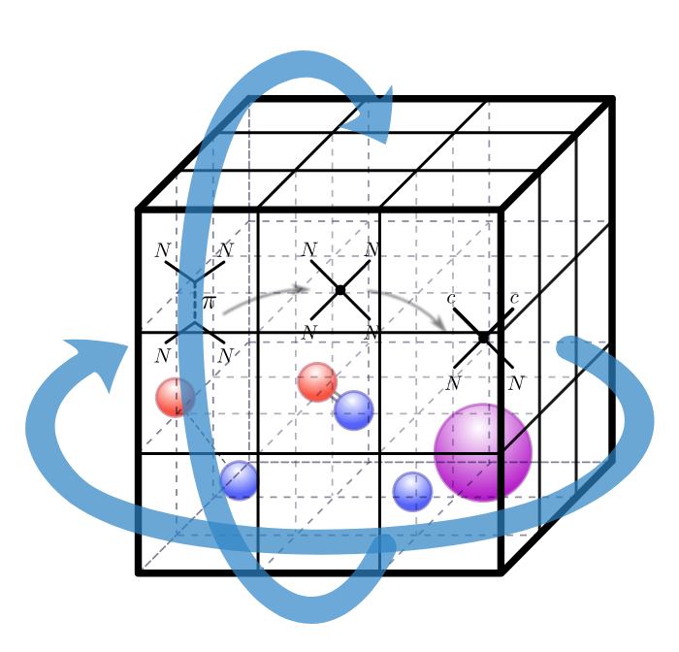
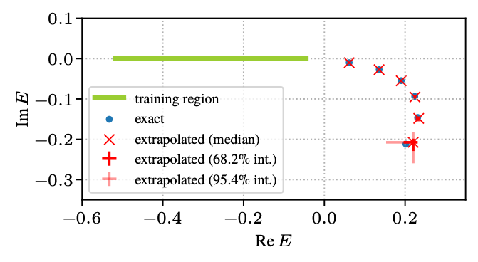
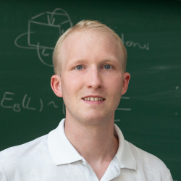
Sebastian König (2020 NCSU) NSF Early Career Award
Research Focus
Nuclear Effective Field Theories
Few-body systems in finite volume
Emulators and extrapolations
PRC 107, 064316 (2023); Eigenvector continuation for emulating and extrapolating two-body resonances
Nuwan Yapa, Kévin Fossez, Sebastian König

Slide 9
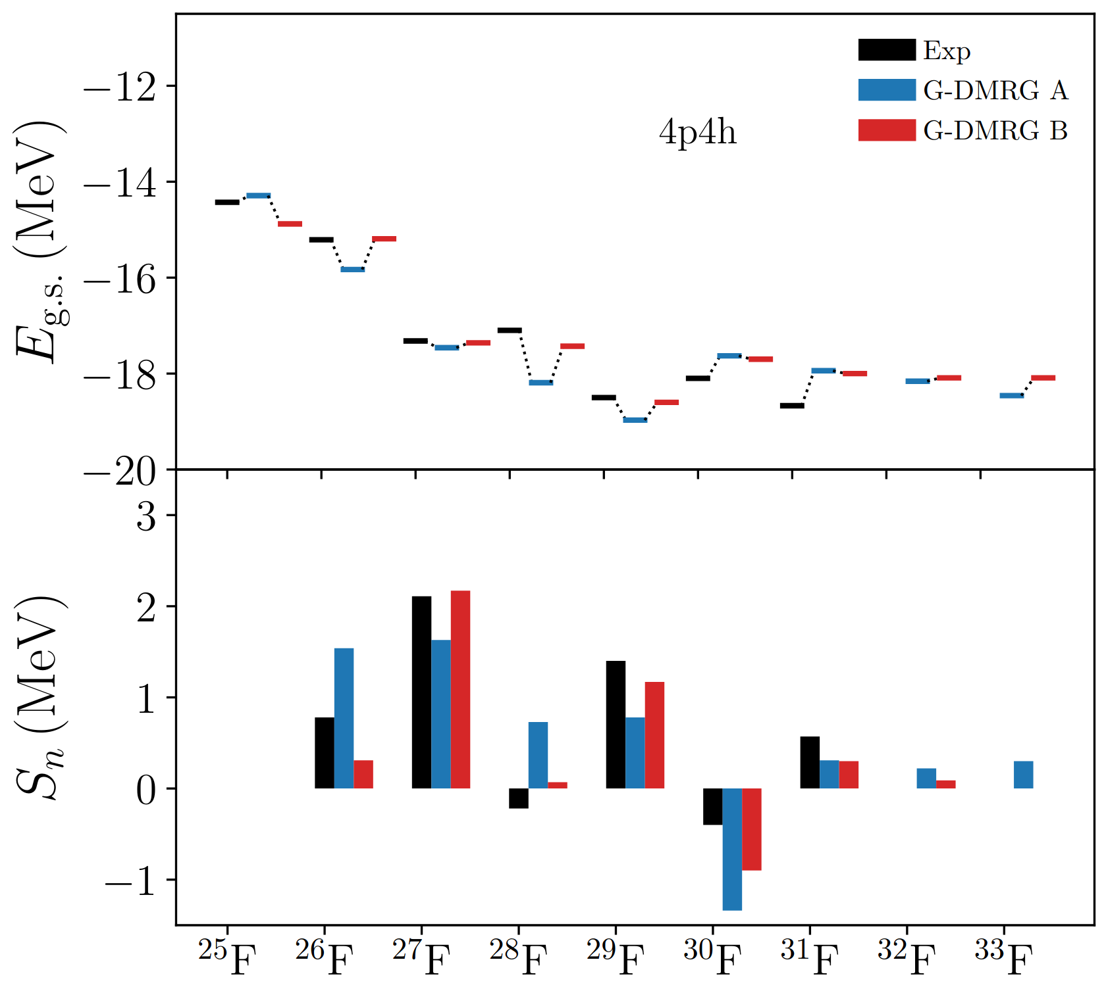
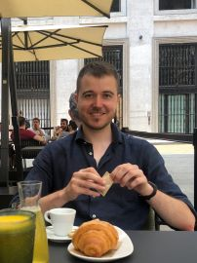
Kevin Fossez (2021 FSU)
Research Focus
Gamow Shell Model
Density matrix renormalization group
In-medium similarity renormalization group

Slide 10
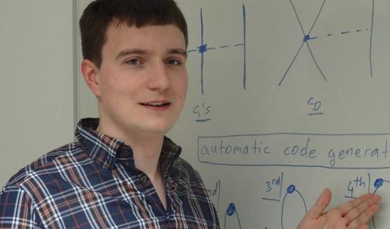
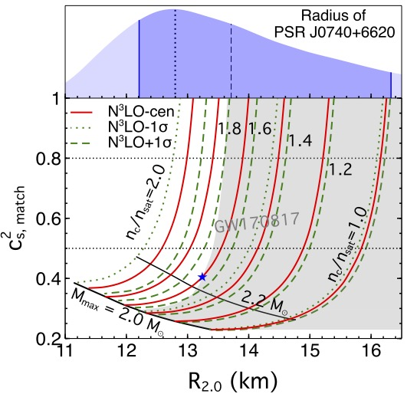
Christian Drischler (2022 Ohio U)
Research Focus
Neutron Stars and EoS
Nuclear Emulators
Bayesian Methods
Nuclear effective field theories
PRC 105, 035808

Slide 11
FRIB Theory Fellows

Slide 12
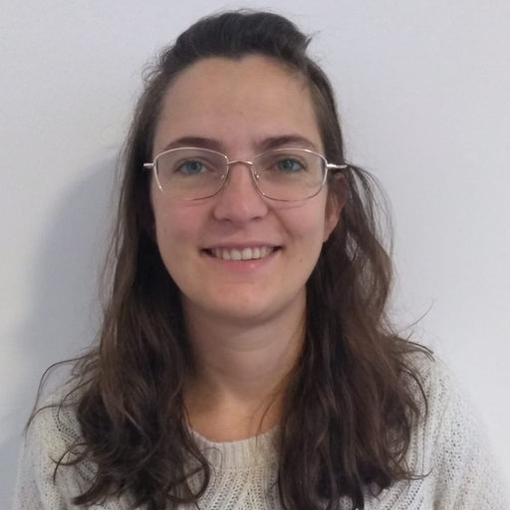
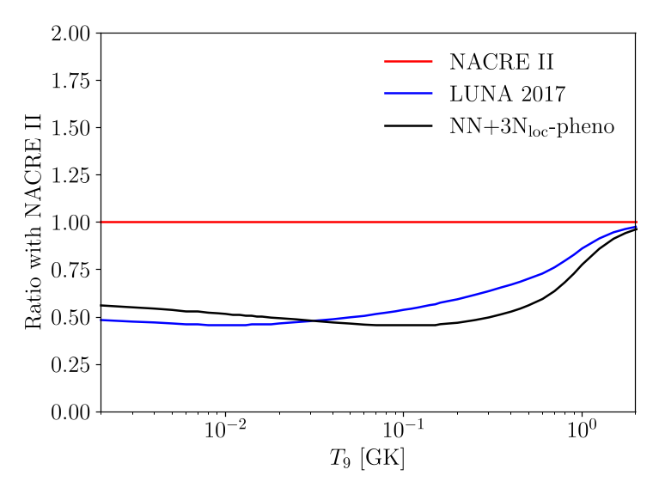
Chloe Hebborn (2020 LLNL | 2023 FRIB Assistant Prof)
PRL 129 (2022) 4
Research Focus
Knockout reactions
Ab initio description of reactions
Integrated structure and reaction theories for accurate predictions

Slide 13
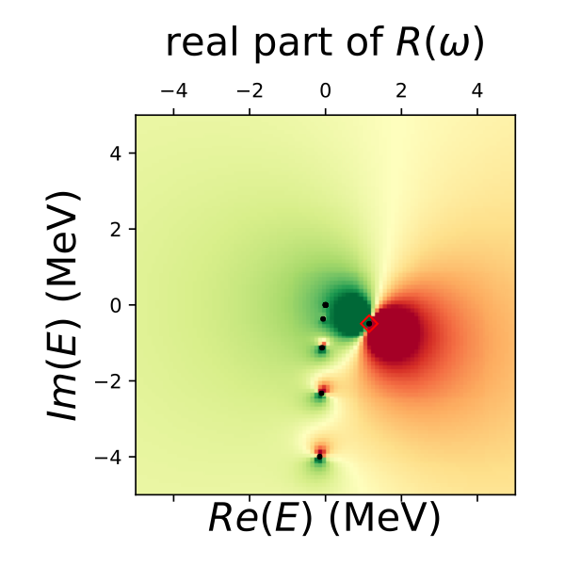
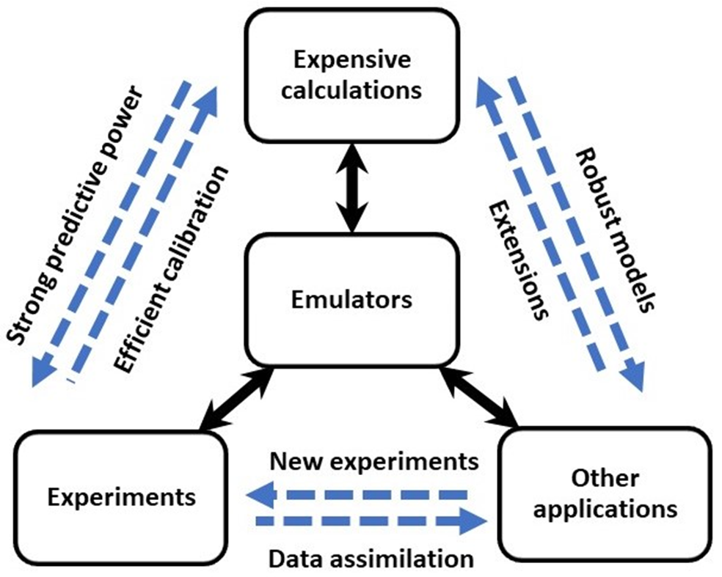
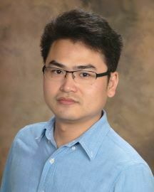
Xilin Zhang (2021 MSU)
Research Focus
Fast and accurate emulators for quantum continuum states
Interpolations/extrapolations in model parameter space
Applications to astrophysics, accelerator physics, dispersion relations, neutrinoless double beta decay…
XZ and R.J. Furnstahl (2022)

Slide 14
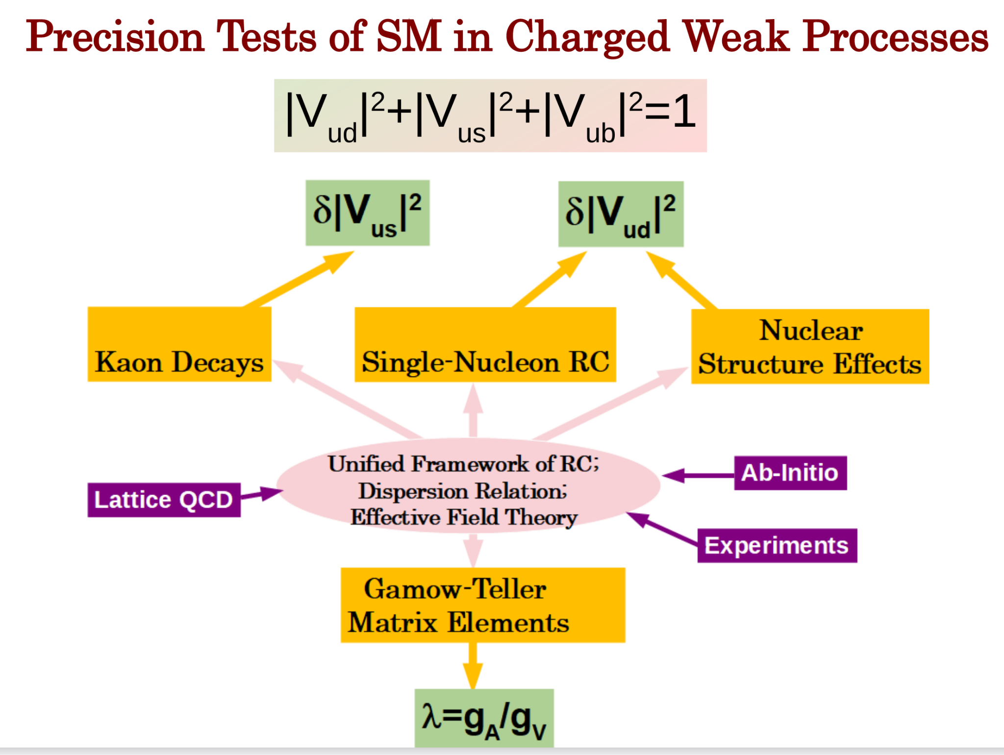
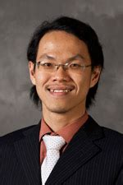
Chien Yeah Seng (2022 UW)
Research Focus
Precision test of the SM
EFTs

Slide 15
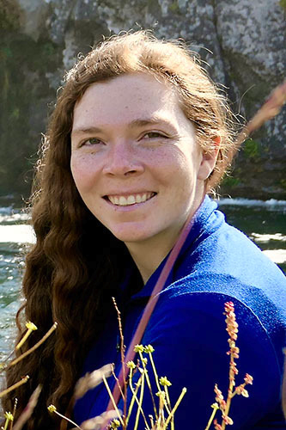
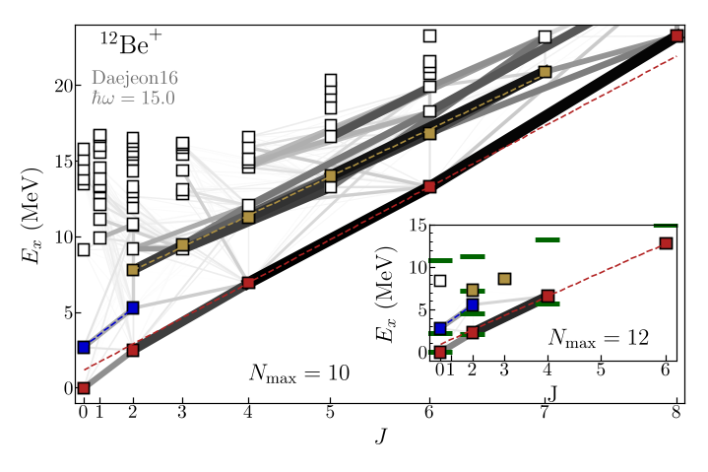
Anna McCoy (2022 WashU | 2023 Staff Scientist ANL)
Research Focus
Ab initio methods
No-core shell model
Symplectic no-core configuration interaction

Slide 16
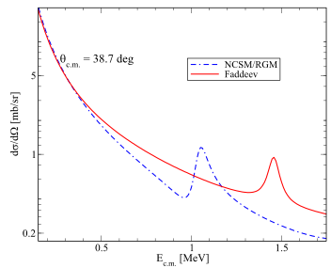
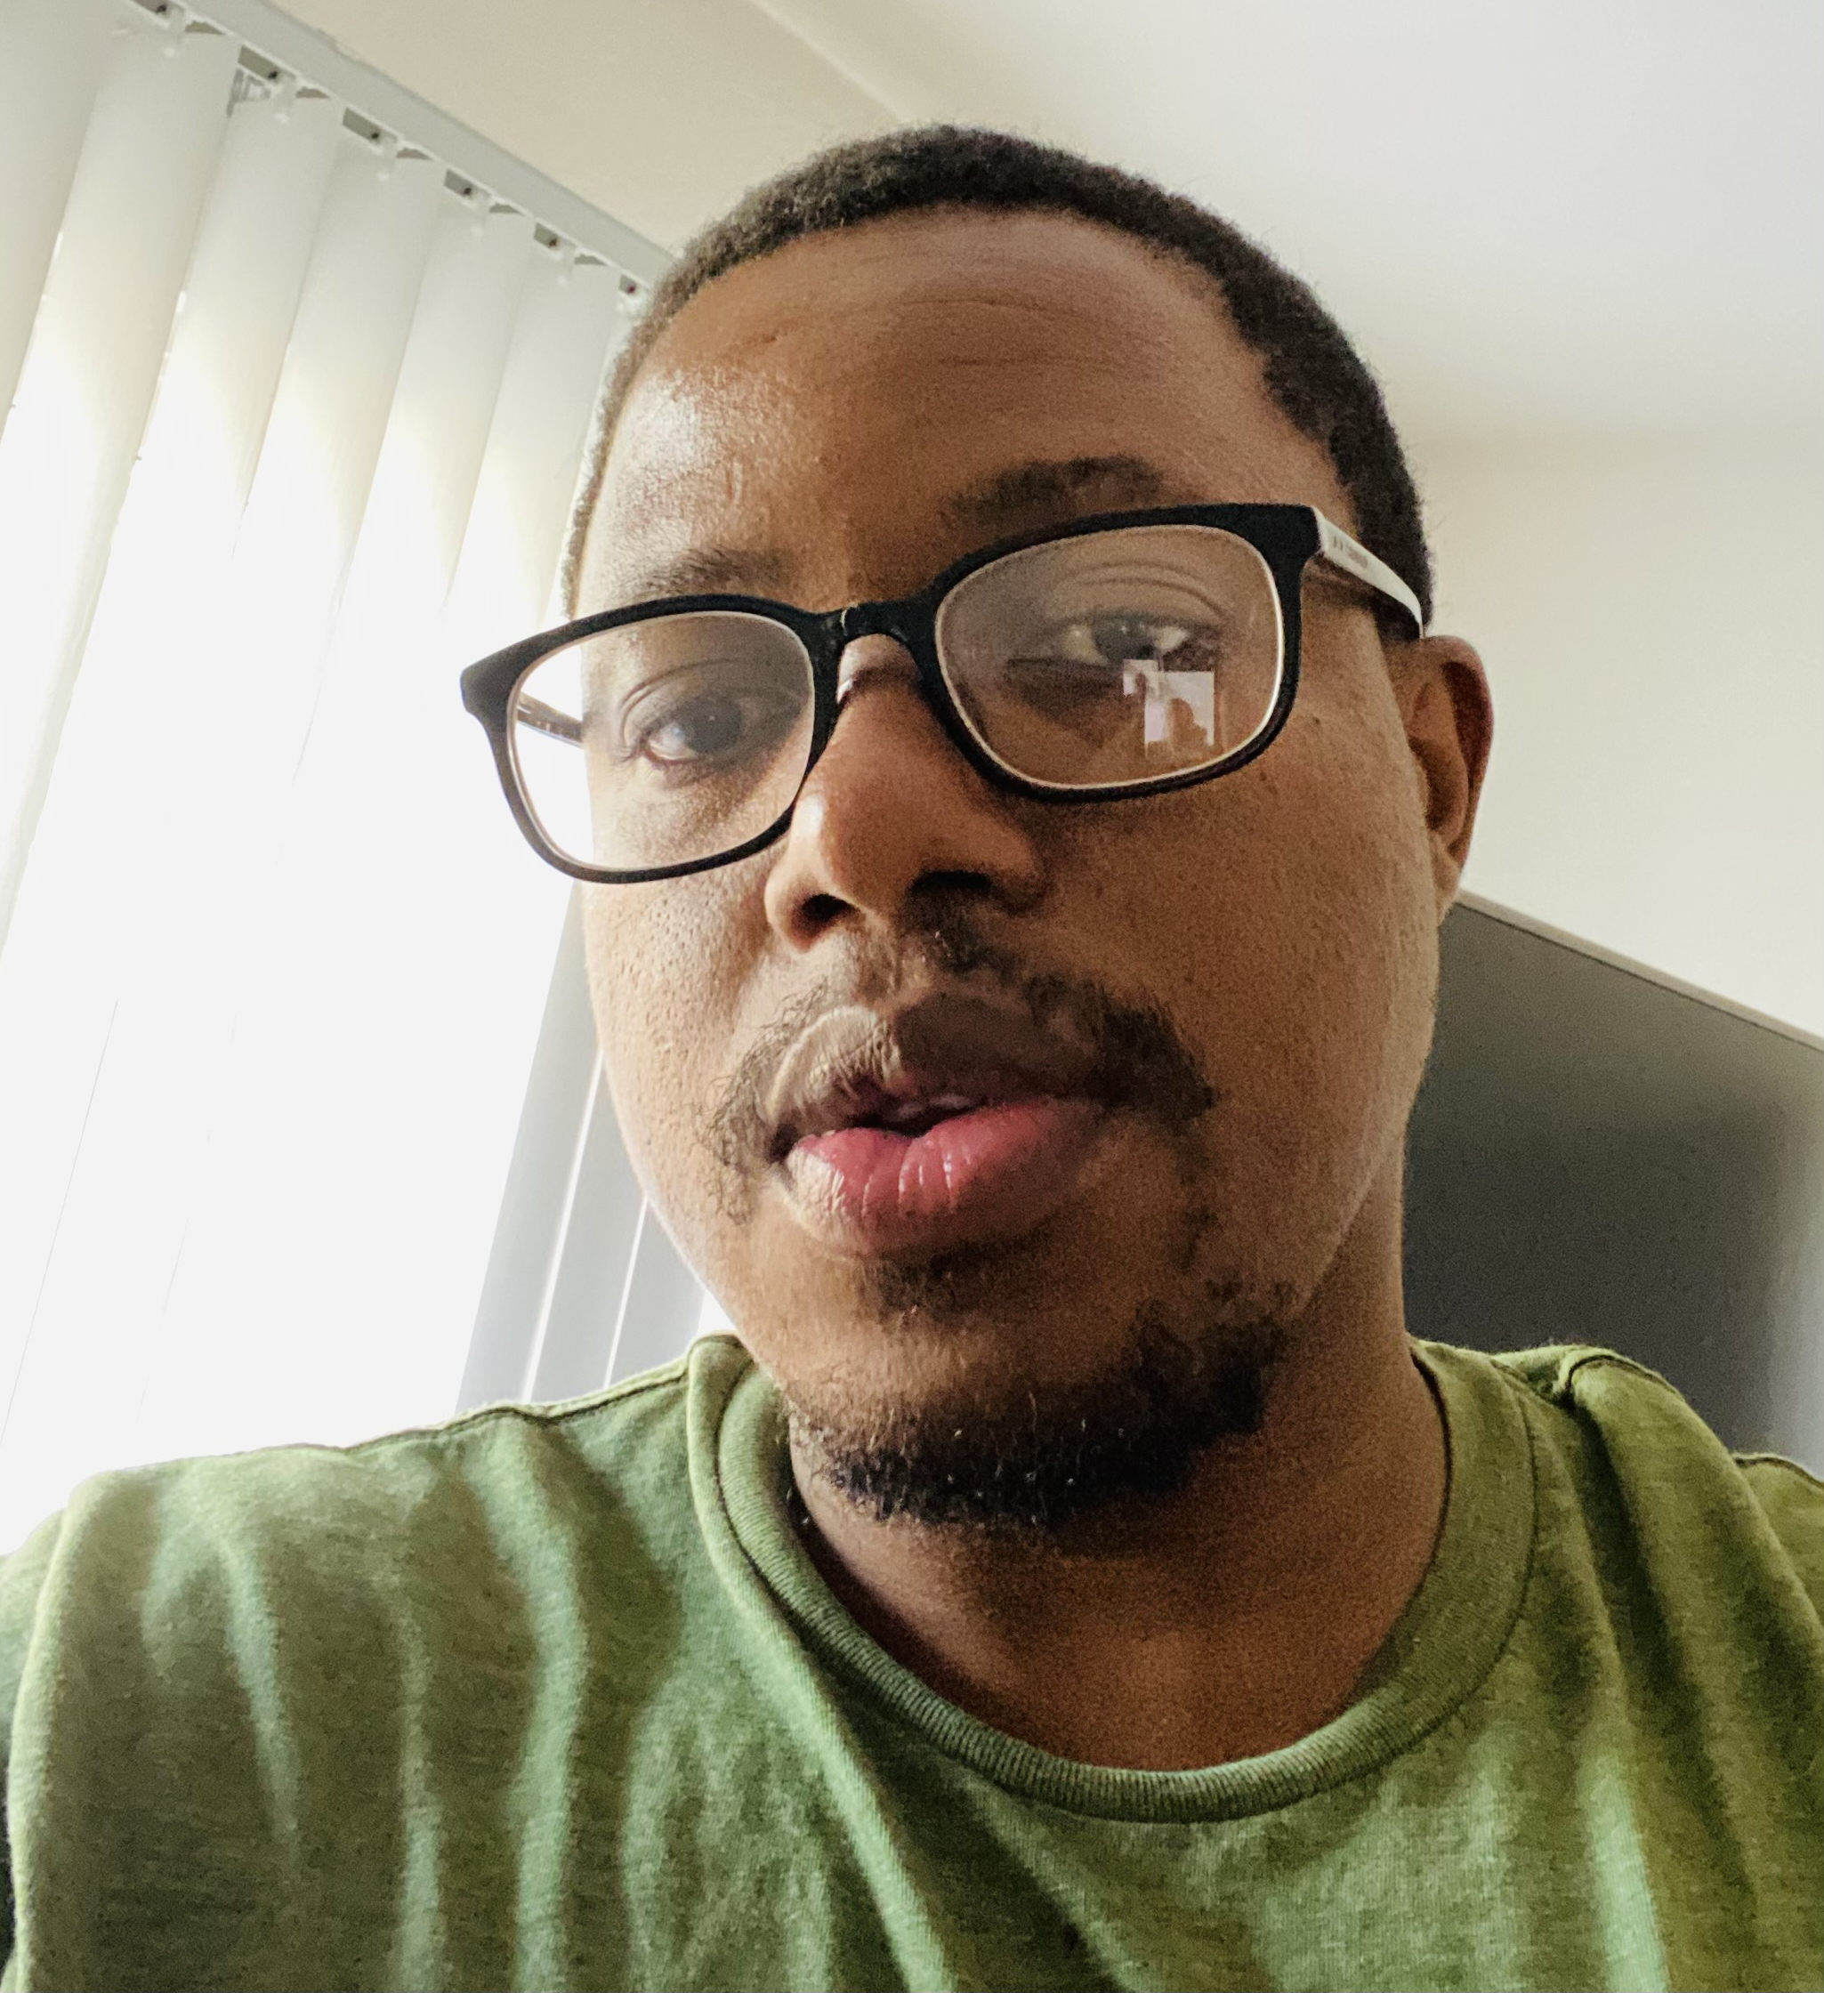
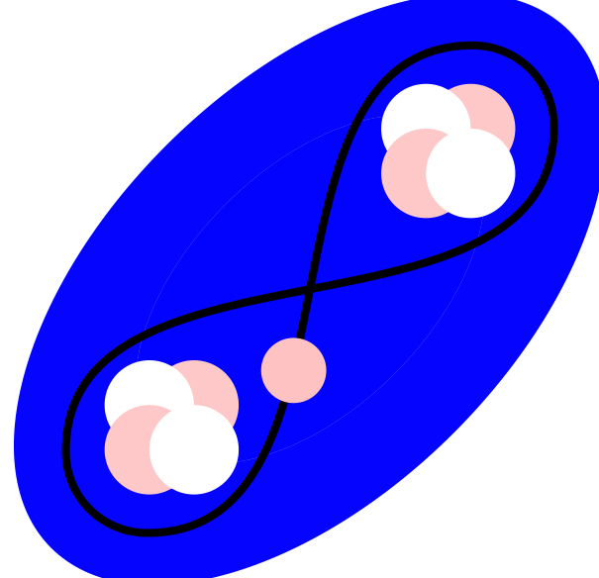

Linda Hlophe (2023 LANL)
d+α system
Research Focus
Advancing few-body techniques for direct nuclear reactions
Grounding three-body problem on underlying many-body dynamics
Ab initio description of ternary reactions
PRC 107 014315 (2023)
$$α$$
$$α$$
$$n$$

Slide 17
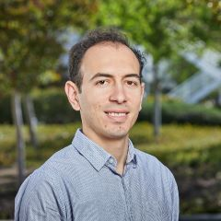
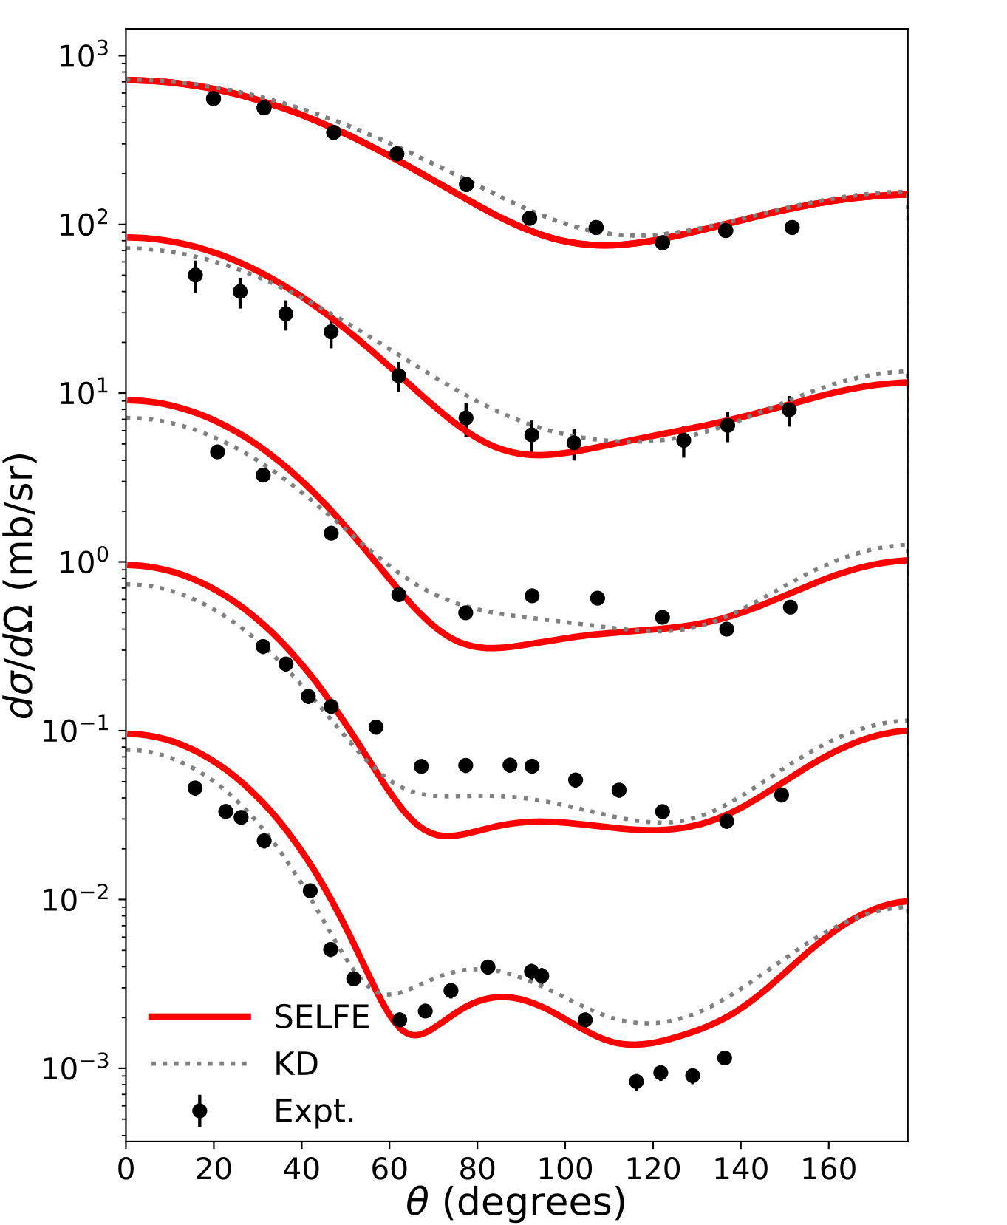
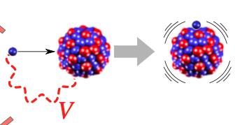
Grigor Sargsyan (coming to MSU/FRIB in 2023)
n+²⁴Mg elastic scattering
Construction of optical potentials from microscopic nuclear structure input
Predictive calculations of structure and reactions for neutron-rich nuclei
Ab initio calculations of higher-multipole beta-decay effects for Standard Model tests
1.9 MeV
3.4 MeV
Research Focus
4.8 MeV
6.1 MeV
7.6 MeV

Slide 18
Opportunities: FRIB-TA Fellows
FRIB-TA Fellow program
New search for up to one fellow: Fall 2023
Partner institution identification by August 14
Info Calvin Johnson (cjohnson@sdsu.edu)
The fellow job ad will be posted on August 21
Deadline: October 15th

Slide 19
Opportunities: FRIB-TA Bridge positions
FRIB-TA Bridge program
Info Jon Engel (engelj@physics.unc.edu)
New call imminent:
deadline for bridge faculty host institutions will be February-March 2024
Search in Fall 2024-Winter 2025
new position to start in Fall 2025

Slide 20
Opportunities: Summer Schools and Topical programs
Summer Schools:
Practical Uncertainty Quantification and Emulator Development in Nuclear Physics, June 26-28, 2023 Edgard Bonilla, Pablo Giuliani, Kyle Godbey, Morten Hjorth-Jensen, Rahul Jain, Fernando Montes, Alexandra Semposki, and Frederi Viens.
Topical programs:
Few-Body Clusters in Exotic Nuclei and Their Role in FRIB Experiments, August 15 - 26, 2022: Sebastian Konig, Kevin Fossez, Chloe Hebborn, Lucas Platter
Theoretical Justifications and Motivations for Early High-Profile FRIB,May 16-26, 2023: Alex Brown, Alex Gade, Ragnar Stroberg
Applications typically due mid-late January

Slide 21
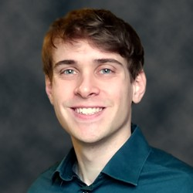
FRIB Achievement Award for Early Career Researchers
The FRIB Achievement Award for Early Career Researchers recognizes outstanding original contributions to the field of nuclear physics through work at or relating to FRIB, performed by scientists early in their careers.
Nominate young researchers!
Ask your supervisors to nominate you!
Nominations typically due March/April
point of contact: Elena Litvinova (Western Michigan)
2023 Theory recipient: Kyle Godbey (MSU/FRIB)

Slide 22
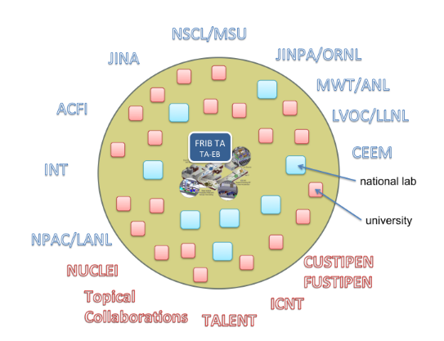
FRIB Theory Alliance
Total Members = 279 (188 from USA)
Faculty = 120 (75 from USA)
Lab staff = 38 (31 from USA)
Postdocs = 55 (39 from USA)
Fellows = 5 (3 from USA)
Students = 61 (40 from USA)
Programs:
FRIB theory fellow (Five years)
FRIB theory bridge (Faculty)
FRIB topical programs (Workshops)
FRIB-TA summer schools
EUSTIPEN (Travel grants to ECT*)

Slide 23
FRIB TA Executive Board
Sonia Bacca (University of Mainz, Germany)
Jonathan Engel (University of North Carolina at Chapel Hill) [Director Elect]
Kevin Fossez (Florida State University)
Alexandra Gade (NSCL, Michigan State University)
Gaute Hagen (Oak Ridge National Laboratory)
Calvin Johnson (San Diego State University)
Ben Kay (Argonne National Laboratory)
Sebastian Koenig (North Carolina State University)
Elena Litvinova (Western Michigan University)
Saori Pastore (Washington University in St. Louis) [Director]
Gregory Potel (Lawrence Livermore National Laboratory)
Daniel Phillips (Ohio University) [Past Director]
Nicole Vassh (TRIUMF)
Scott Bogner (NSCL, Michigan State University) [Managing Director]
Gillian Olson (MSU) [Administrative Support]
Special thanks to:
Jutta Escher,
Kate Jones,
Amy Lovell

Slide 24
Resolutions: FRIB TA
FRIB Theory Alliance is an essential component of our field and helps to grow its capabilities. FRIB-TA theorists are an integral part of the interpretation of FRIB experiments.
Resolution:
We strongly endorse continued support of the FRIB-TA and all of its activities. In particular, FRIB-TA Bridge
Positions, Fellows, and Topical programs ensure intellectual vitality in our field.
https://fribtheoryalliance.org

Slide 25
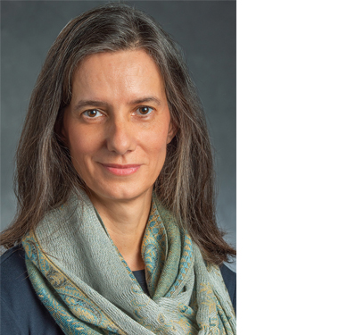
Our inaugural Managing Director
Managing Director from FRIB-TA inauguration in 2015 until May 2023
FRIB-TA now in its third funding cycle
Thank you Filomena!

Slide 26
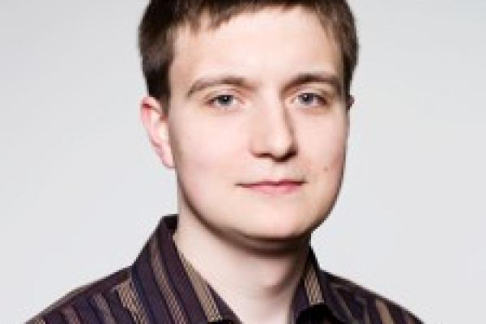
FRIB Theory Alliance

