Slide 1
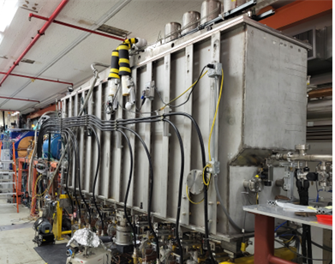
ATLAS facility Status
2023 Low-Energy Community Meeting
East Lansing, Michigan
erhtjhtyhy
Guy Savard
Director of ATLAS
August 11, 2023

Slide 2
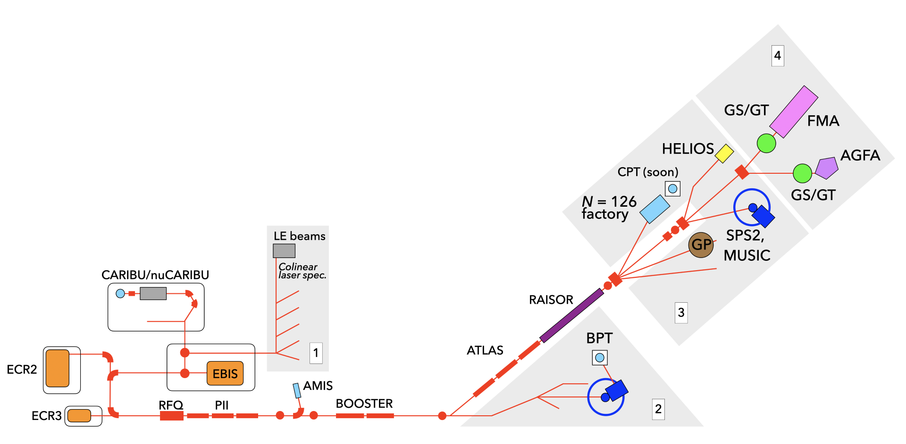
ATLAS/CARIBU facility
ATLAS is the DOE nuclear physics stable beam national user facility
Stable beams at high intensity and energy up to 10-20 MeV/u
Light in-flight radioactive beams with RAISOR
  light beams, no chemical limitations, close to stability, acceptable beam properties
CARIBU beams
  heavy n-rich from Cf fission, no chemical limitations, low intensity, ATLAS beam quality, energies up to 15 MeV/u
State-of-the-art instrumentation for Coulomb barrier and low-energy experiments
Operating ~6000 hrs/yr (+ 2000 hrs/yr CARIBU stand alone) at > 90% efficiency
  Common PAC for ATLAS and CARIBU
  300-400 “single users” per year performing experiments at ATLAS
2

Slide 3
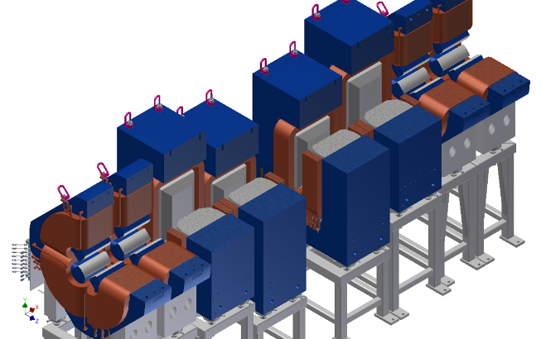
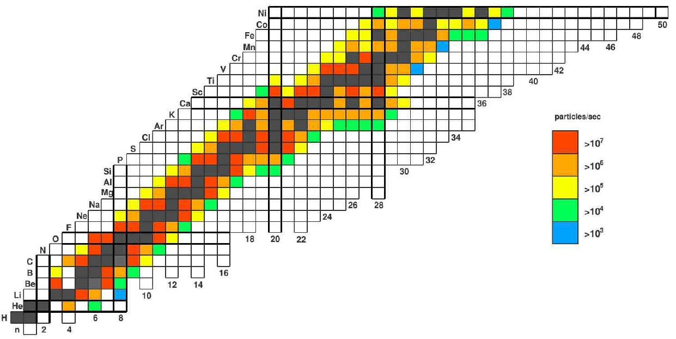
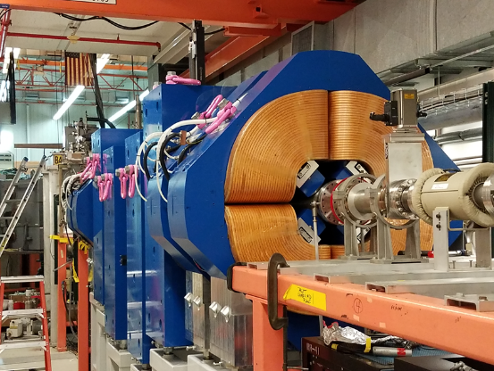
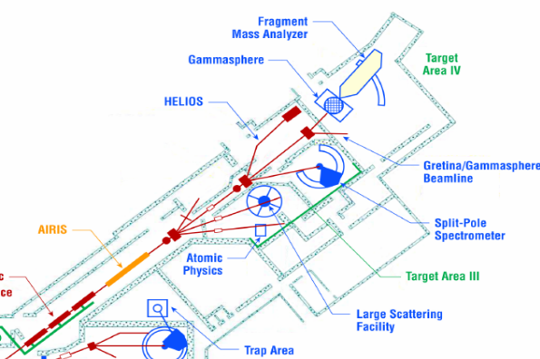

Light In-flight radioactive beams with raisor
Collective Nuclei
Pairing in Nuclei
Single-Particle Structure
Nuclear Reactions
Nuclear Astrophysics
Fundamental Symmetries
Uncertainties up to one order of magnitude
Increased intensities, purities, & reach for ATLAS in-flight beams
Momentum selection (magnetic chicane) followed by velocity selection (RF sweeper) → A/q selection
Accessibility to more experimental areas
Multi-Purpose
RAISOR

Slide 4
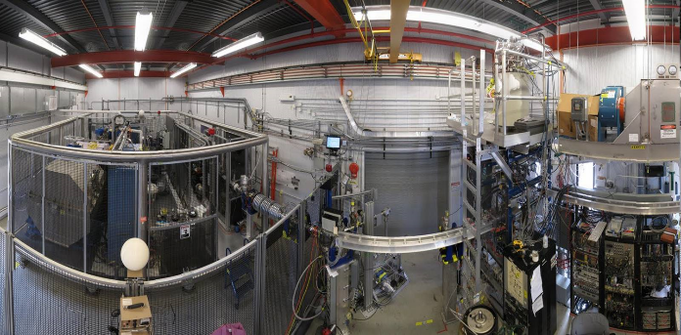
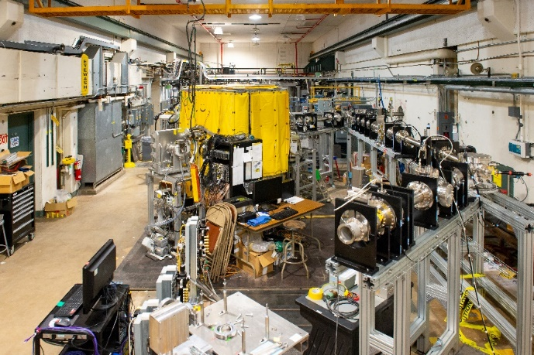
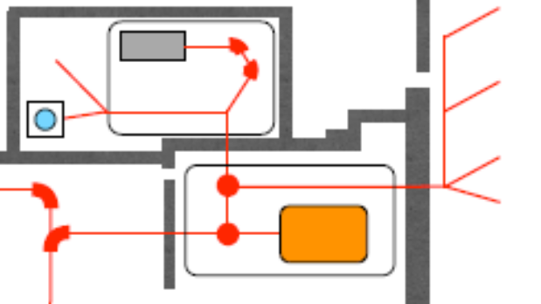
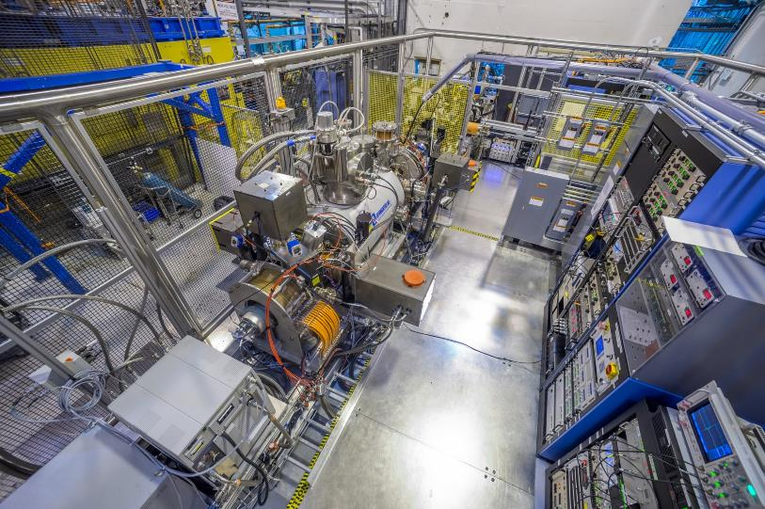
Neutron-rich beam source for ATLAS: CARIBU “front end” layout
Main components of CARIBU
PRODUCTION: “ion source” is ²⁵²Cf source inside gas catcher
    Thermalizes fission fragments
    Extracts all species quickly
    Forms low emittance beam
SELECTION: Isobar separator and MR-TOF
    Purifies beam
DELIVERY: beamlines and preparation
    Low-energy buncher and beamlines
    Charge breeder to Increase charge state for post-acceleration
    Post-accelerator ATLAS and weak-beam diagnostics
Commissioned in 2012
Commissioned in 2020
Commissioned in 2017

Slide 5

Layout of ATLAS facility
ATLAS + CARIBU + RAISOR beams 2-15 MeV/u
CARIBU beams 3-400 keV
Experimental area 1
Old CARIBU exp area
Experimental areas 3 - 4
Experimental area 2
ATLAS + CARIBU beams 2-7 MeV/u

Slide 6
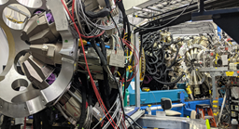
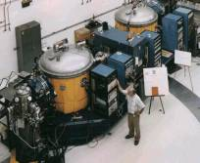
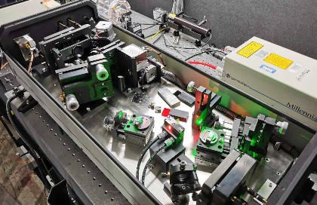
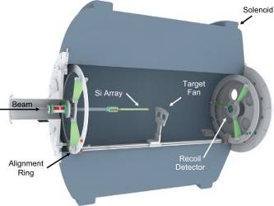
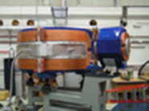
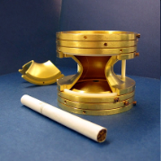
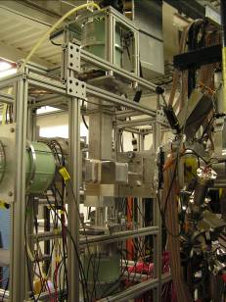
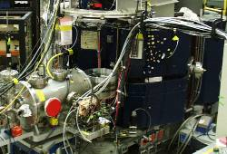
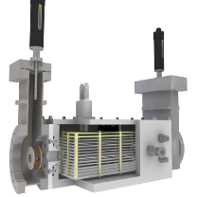
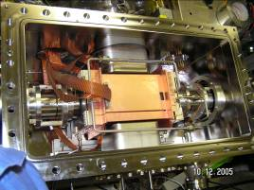
Distribution of experimental equipment
GAMMASPHERE/GRETINA
FMA
Laser spectroscopy
HELIOS spectrometer
CPT mass spectrometer
Laser Lab
X-array
Si-array (Ludwig) and Enge spectrometer
MUSIC
+ outside instruments playing an increasingly important role: GRETINA, CHICO-II, HERCULES, GODDESS, VANDLE, MTAS, SUN, AT-TPC ….
Beta decay Paul trap

Slide 7
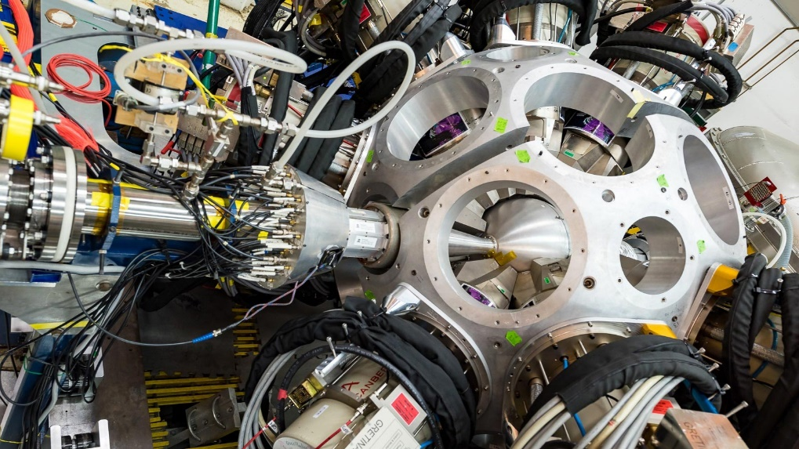
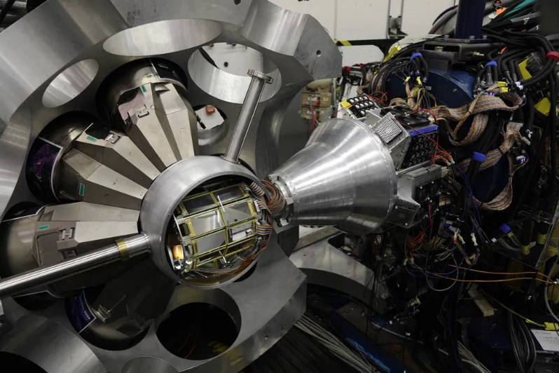
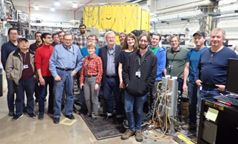
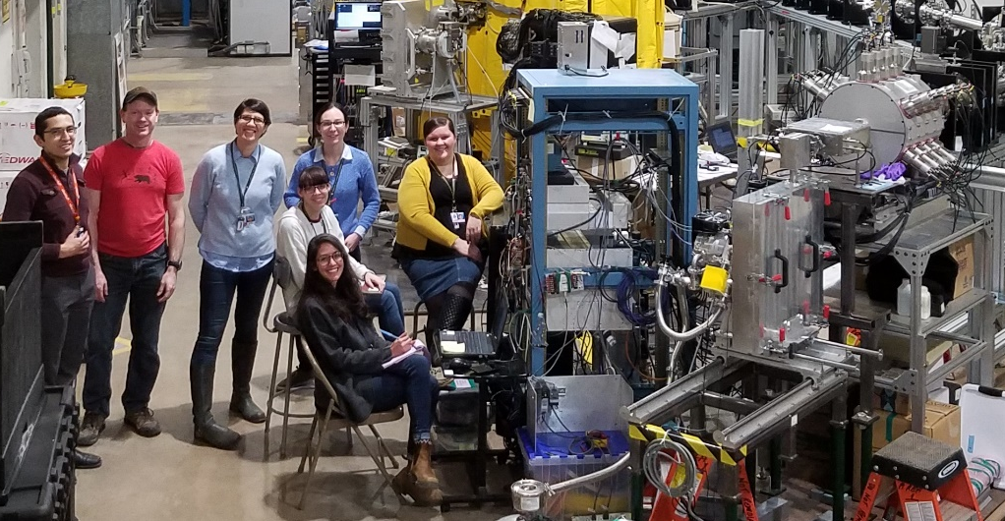
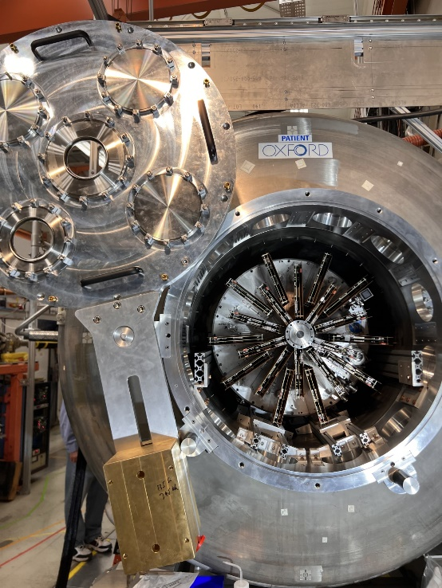
New and improved equipment capabilities
Significant impact of community devices
Local equipment continually improved for higher efficiency and rate capability
Extended stays by state-of-the-art community devices for focused physics campaigns
Versatile DAQ infrastructure to merge signals from visiting devices with local equipment
ORRUBA/GODDESS + GRETINA
CHICO2 + GRETINA
AT-TPC + HELIOS
SUN
MTAS

Slide 8
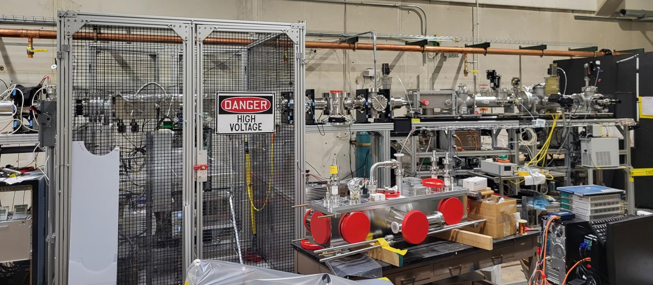
Adding new experimental stations in area 1
New capabilities for study of n-rich isotopes
Moving towards the full complement of 7 experimental stations in area 1:
  New buncher that will feed two stations
    Laser spectroscopy setup
    BEARtrap
  Services in place for last two stations (Gammasphere + open station)

Slide 9

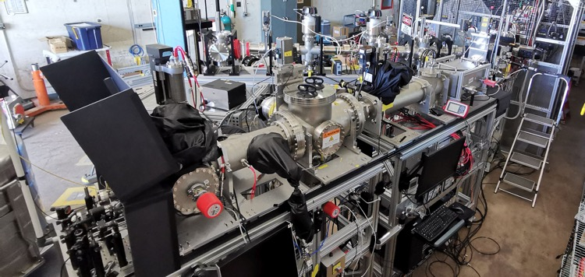
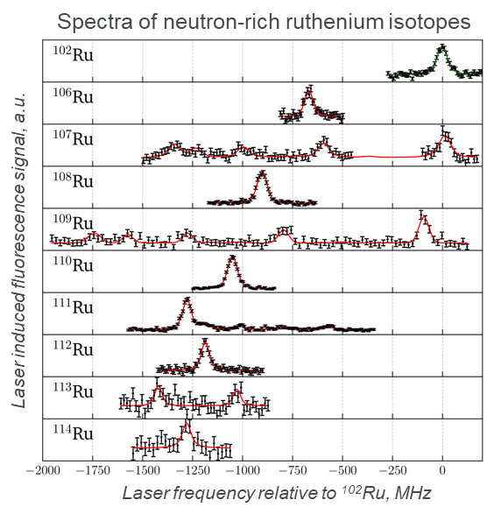
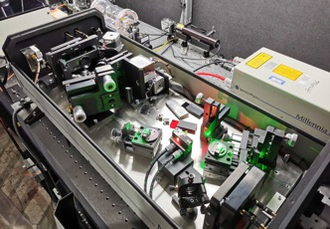
New Experimental Capabilities at ATLAS -
Bunched-Beam Collinear Laser Spectroscopy
ATLANTIS – New collinear laser spectroscopy setup installed in ATLAS Area I
Time-resolved, high-resolution laser induced fluorescence detection
Commissioned in Oct. 2022 stable Zr⁺ and Pd (neutral)
First CARIBU experiment completed in Nov. 2022 & March 2023: neutron-rich Pd + Ru
Bernhard Maass
Postdoc PHY/LEP
Collinear laser spectroscopy beamline
Laser system
(cw Ti:Sa + frequency doubler)

Slide 10
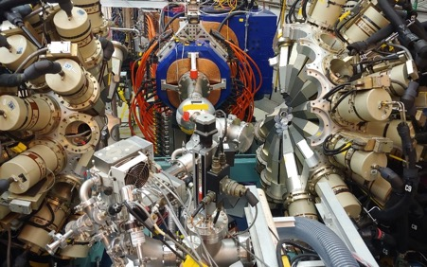
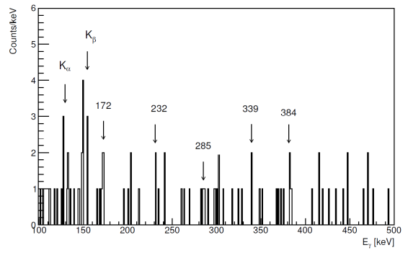
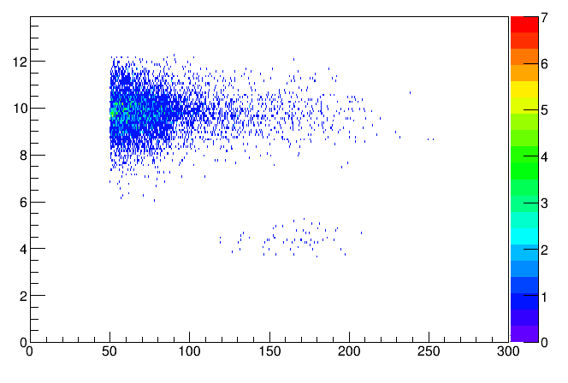
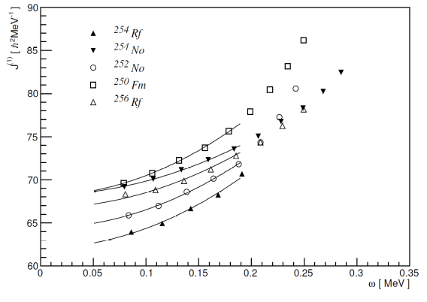
²⁵⁴Rf ground-state rotational band rotation at the fission limit with Gammasphere and AGFA
6⁺→4⁺
14⁺→12⁺
8⁺→6⁺
12⁺→10⁺
10⁺→8⁺
log₁₀t_{dec}(ns)
²⁵⁴Rf gs SF
T_{1/2}=25 μs
σ~2.5 nb
Lower moment of inertia
E_{dec} (1MeV/ch)
D. Seweryniak, T. Huang et al., Phys. Rev. C 107, L061302 (2023)

Slide 11
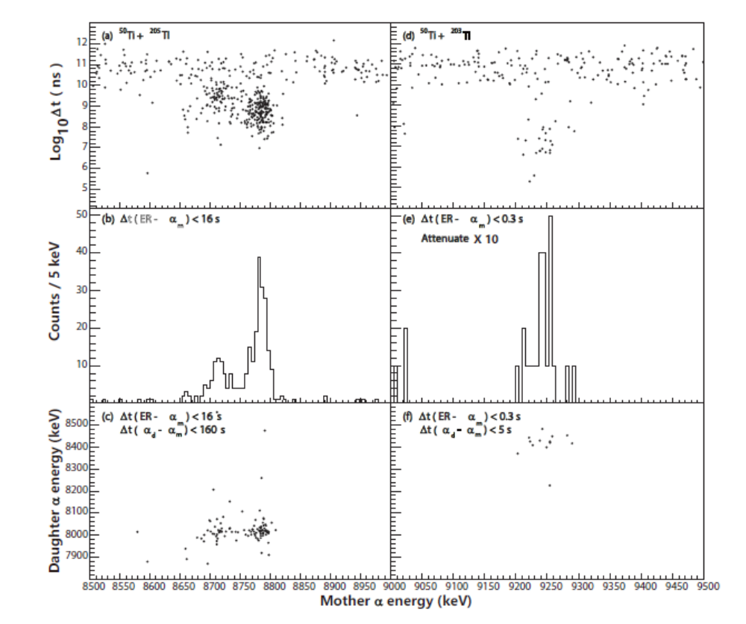
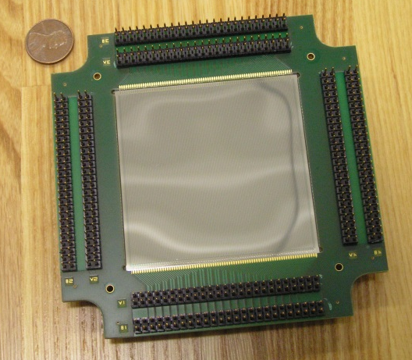
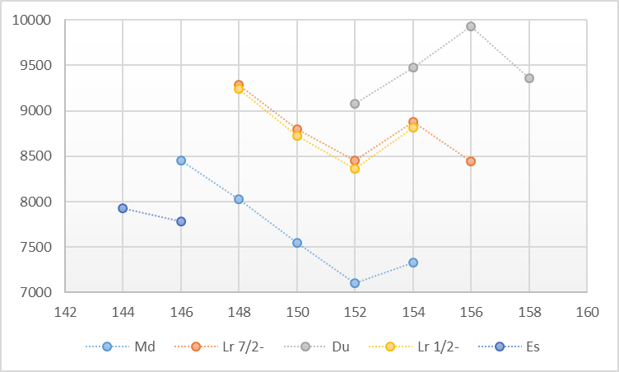
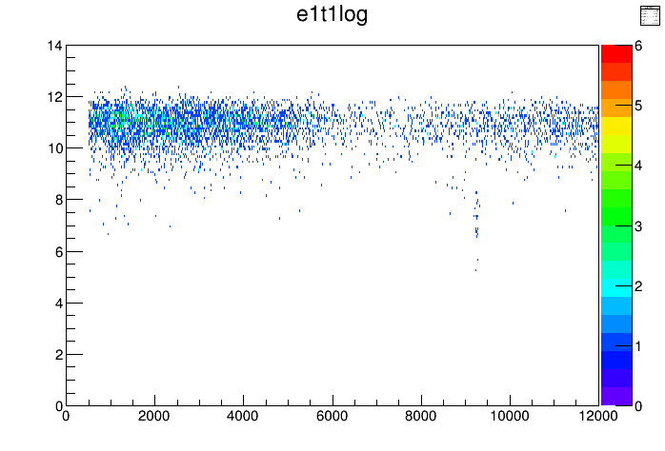
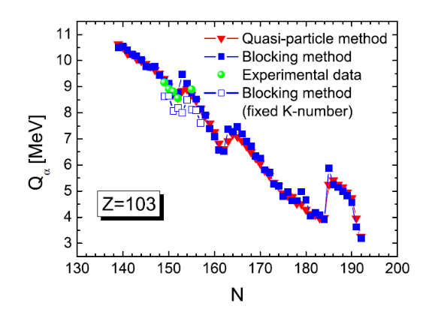
New isotope ²⁵¹Lr
T. Huang, D. Seweryniak et al., Phys. Rev. C 106, L061301 (2022)
Q_{α}
²⁵¹Lr
α1
α2
α1
²⁵¹Lr
²⁴⁷Md
α3
α2
α1
N
²⁴³Es
α3
7/2⁻
160x160 DSSD
2nd peak
½⁻
log(t_{dec}[ns])
α2
Q_{α}~9.44 MeV
T_{1/2}~25 ms
²⁵¹Lr-²⁴⁷Md
E_{α1}[keV]
Mother α energy

Slide 12
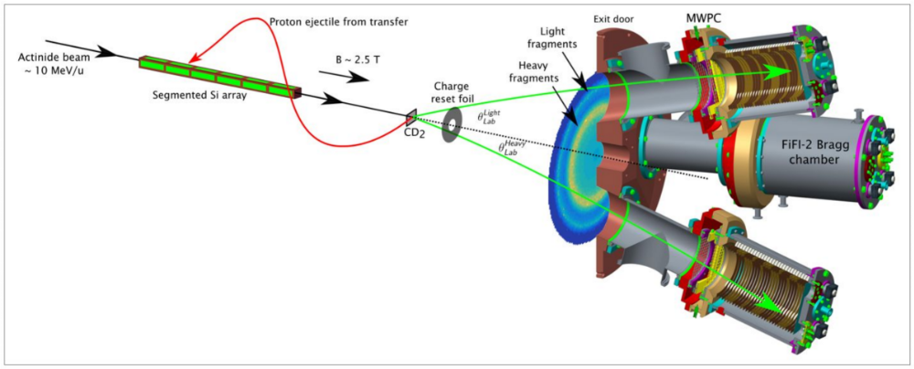
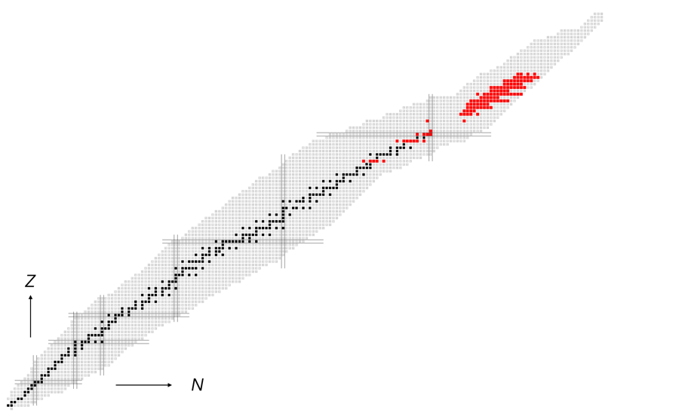
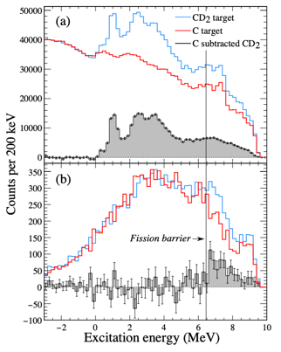
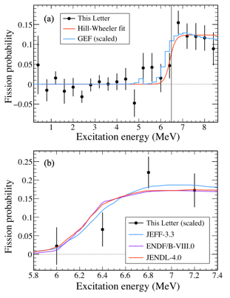

HELIOS: New technique – (d,pF) studies
Demonstration using ²³⁸U beam. Move towards multi-modal fission observables
S. Bennett et al., Phys. Rev. Lett. 130, 202501 (2023)

Slide 13
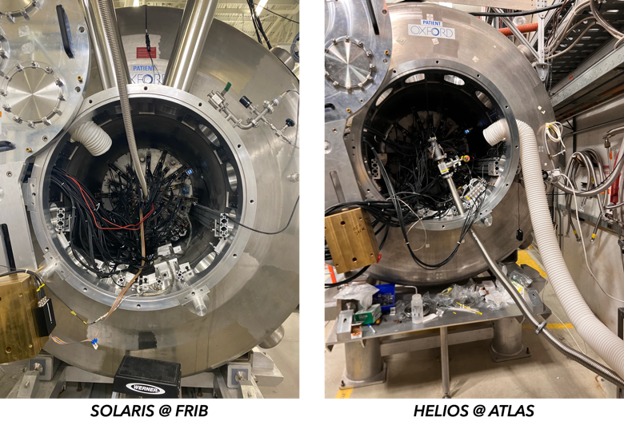
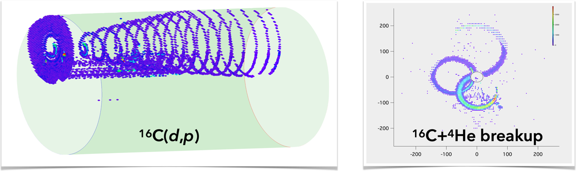
First AT-TPC campaign at ATLAS
Bringing HELIOS and SOLARIS under a common mechanical infrastructure to take advantage of the AT-TPC and other auxiliary detectors at both ATLAS and FRIB
Argonne-FRIB-University of Santiago de Compostela collaboration

Slide 14
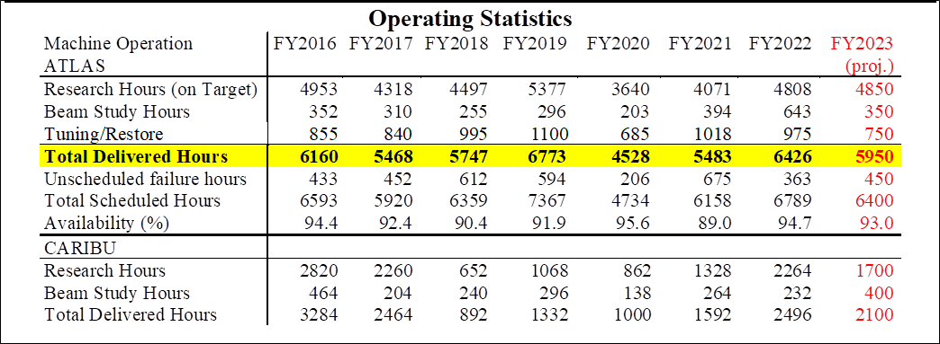
ATLAS Facility performance
ATLAS+CARIBU delivered hours 8980 7728 6399 7841 5390 6811 8690
FY20: operating hours reduced due to COVID-19 shutdown for 3 months followed by restart at 5 days/wk without outside users
FY21: targeted 5350 hours for ATLAS due to budget reduction and to allow removal of 109 MHz cryostat
FY22: targeted 5800 hours for ATLAS due to reduced budget and to allow reinstallation of 109 MHz cryostat
FY23 – FY28 : planned for 5950 delivered hours for ATLAS in FY23, will be returning to > 6000 hours/year starting in FY24

Slide 15
PAC Statistics
PAC Statistics:
Trends persist, i.e., high number of proposals & oversubscription
Continue to operate with priority I & II modes to optimize efficiency of program
keep enough backlog to allow additional needed flexibility in scheduling

Slide 16
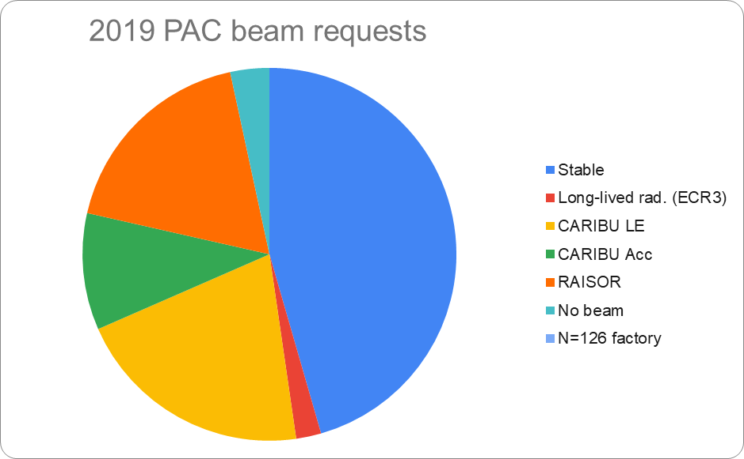
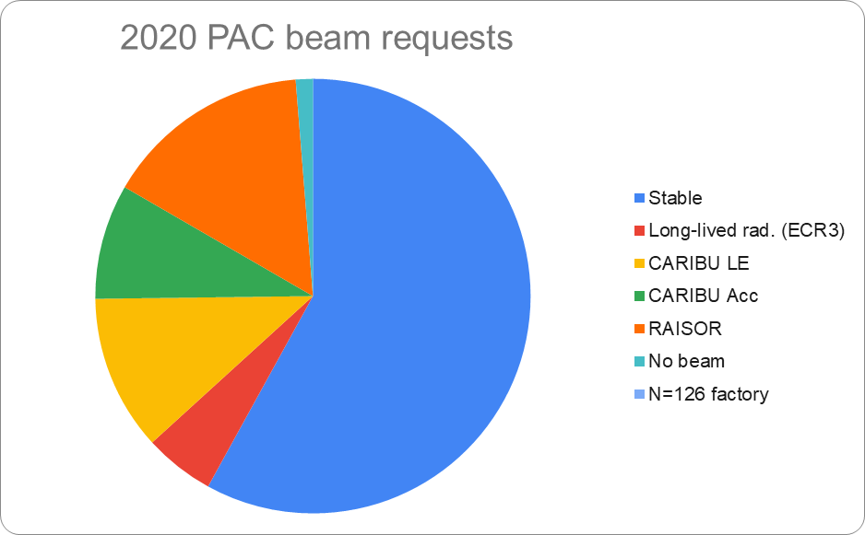
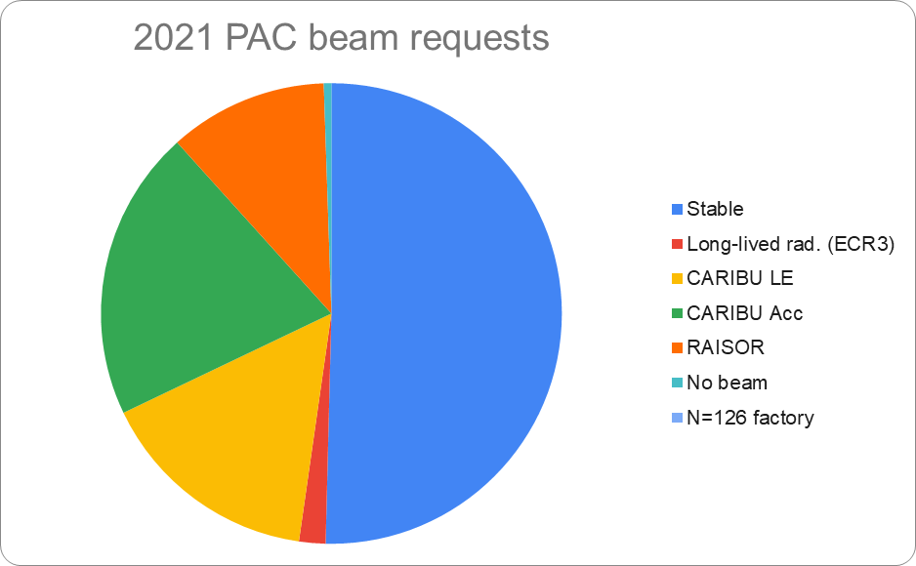
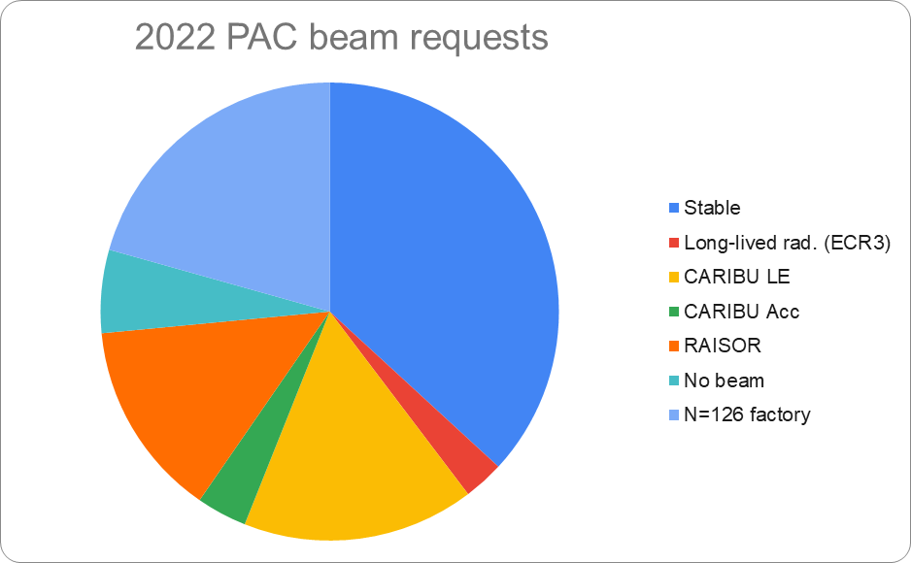
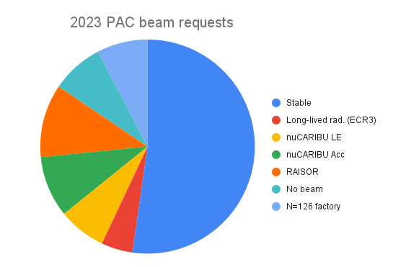
Type of Beams requested by users

Slide 17

ATLAS upgrades overview
Radiation interlock system (ARIS)
ECR3
Low intensity beam diagnostics
Irradiation target line (AMIS)
N=126
109 MHz Upgrade
High current ECR
nuCARIBU
Cryogenic upgrades
Solid state RFQ amplifiers
Vacuum control upgrade
Multi-user upgrade

Slide 18


Accelerator Upgrades
New solid-state amplifier for ATLAS RFQ
  96 1 kW transistors coupled by coaxial combiners
  Design brings redundancy that eliminates single point of failure
  Operational and used for all beams since April 2022
  Essentially no downtime due to RFQ since
109 MHz refurbishment and new hardware
  Cryostat removed during the May 2021 shutdown
  Mods performed over the following 6 months
  Cryostat reinstalled in June 2022
  First used for experiments in February 2023
  Initial problems with circulators now resolved
  Will provide an increase of 8MV, 12MV → 20MV
Cryostat accelerating gradient
Status | Voltage [MV]
Current (de-rate) | 10-12
After cleaning | 14.5
Additional resonator | 16.5
Overcoming VCX limit | 20
Net gain of roughly 1.4 MeV/u for mid to heavy mass beams

Slide 19




Gammasphere Upgrade
Re-established detector repair pipeline with ORTEC/AMETEC
  Have received two repairs back from vendor
  Eight detectors are at vendor for repair
  Working with ORTEC on a repair pipeline
Developed new electronics from Ge preamp to digitizer
  J. Anderson, M. Oberling, E. Boron (AES)
  New preamp for Ge
  Slope Box Extension (SBX) Module – signal prep
  Collector Box – routes singles to digitizers
All upgraded electronics has been installed and is in operation e.g., preamps, SBX, collector box
All electronics located at support structure
Working on outstanding issues
Beam test held – April 13-15, 2023
First experiment June 2023
Preamp
SBX
Collector Box

Slide 20

CARIBU Status
Source needs to be changed roughly every 3 years and it has proven very challenging to obtain a good thin ²⁵²Cf source
The current plate was deposited in 2017 and
installed in May 2018
  Originally 0.52 Ci with 40-50% release
Next ~5 attempts yielded no usable deposits
Current yield: ~2 x 10⁷ fissions/sec
Solution: nuCARIBU, a neutron-generator-based source of fission fragments to obtain more reliable and higher intensity access to fission products

Slide 21




CARIBU → nuCARIBU
nuCARIBU
Replace the ²⁵²Cf source and infrastructure with proton cyclotron, transport, and targets
p-⁷Li reaction for neutron production to induce fission on actinide foils
Increase yield by over an order-of-magnitude
Make facility easier to operate and maintain
Provide access to neutron-induced fission process

Slide 22

Changes in fission distribution
Significant gain
Significant loss

Slide 23




Preparing for Beta Decay Factory in Area 1 (FY24)
Gammasphere Decay Station
Saturn/X-Array Upgrades
Beta Decay Factory
β−γ coincidences for proper feeding intensities
γ−γ, γ−γ−γ for level structure determination and spin assignments from angular correlations
Reduced summing and crystal to crystal scattering (in contrast to X-Array)
Calorimetry provides information on excitation energy on event-by-event basis (Ge + BGO)
Gammasphere electronics upgrade provides 3 copies of Ge central contact @ 4, 8 and 20 MeV full range
Gammasphere upgrade project allows for relocation of device to Area 1.
Using nuCARIBU, we estimate 2 orders of magnitude increase in implanted ions.
Gammasphere gives multi-fold coincidences, total gamma-ray energy, angular correlations, for spin, parity, mixing rations.
X-Array – lifetimes (LaBr₃), low-energy gamma detections (BEGe), conversion electron measurement (LACES).
Campaign of six months to measure 30-50 parent decays – FY23 (Q2)
LaBr₃ to measure lifetimes – 2 rings, 15 1”x1” crystals each ring.
Conversion electron measurements utilizing Laces (LSU)
1-2 BEGe detectors for low-energy gamma-ray and x-ray detection
Si(Li) detector system to couple with
X-Array decay station
Area 1
γ ray angular correlations following
¹⁰⁰Y beta decay with Gammasphere
1 LaBr3 Ring @
X-Array
X-Array
GS

Slide 24






Weak r-process studies with MUSIC
(𝛂,n) reactions in neutrino-driven winds after CCSN
Measured the ¹⁰⁰Mo(⍺,n) reaction
W. J. Ong et al., PRC 105, 055803 (2022)
Recent measurement of the ⁸⁸Sr(⍺,n) reaction
(α,n) reaction affecting the nucleosynthesis of lighter heavy nuclei in r-process (weak r-process) were identified.
J. Bliss et al., Phys Rev C 101, 055807 (2020)
A. Psaltis et al., ApJ 935 (2022)
C. Fougères et al., manuscript in preparation

Slide 25

Next big step at ATLAS: Multi-User Upgrade
EBIS beams represents 1-3% duty factor
Combine pulsed EBIS beam with stable ECR beam
  Address high demand on facility
  Enable long duration experiments
  Maximize efficient accelerator usage
ECR stable beam, ~90% duty cycle
EBIS pulse, ~1 ms @ 10 - 30Hz
t
Combine beams
4-15 MeV/u
Separate beams
4-7 MeV/u
Great flexibility (2 different beams at different energies) to increase beam hour delivered by ~3000 hours per year

Slide 26





New capability: N=126 factory … multi-nucleon transfer versus fragmentation for neutron-rich heavy isotopes
Fragmentation
Fragmentation
MNT reactions
(measurement)
Isotopes available, mass separated, at > 1/s for mass measurements or decay studies
MNT reactions
(calculation)
Hirayama et al., EPJ Web Conferences 109, 08001 (2016)
N=126 and much more … slide from our users
²⁰⁸Pb + ⁹Be at 1 GeV/u (best fragmentation reaction cross-sections for N = 126)
^{versus}
¹³⁶Xe + ¹⁹⁸Pt at 10 MeV/u (best multi-nucleon transfer (MNT) reaction)

Slide 27

Initial Expected mass separated yield of the N=126 factory ( at 10% of full power)
²²⁶Pb
²⁰²Ta
¹⁷³Sm
10⁻³ – 10⁻² /s
10⁻² – 10⁻¹ /s
10⁻¹ – 10⁰ /s
10⁰ – 10¹ /s
10¹ – 10² /s
10² – 10³ /s
10³ – 10⁴ /s
10⁴ – 10⁵ /s
> 10⁵ /s
¹⁴¹Sn
¹⁴¹Sn
⁸²Ni
Courtesy of Biying Liu
For more information, contact savard@anl.gov

Slide 28
Outlook
ATLAS is the DOE nuclear physics stable beam national user facility
  Running reliably and logging in a large number of operating hours
  Accomplishing its current science goals
  Demand for beamtime remains high and is increasing
ATLAS, with the help of the community, has developed a coherent upgrade program to add accelerator and experimental capabilities that build on each other to provide new capabilities to better address the community’s evolving science goals
  The new equipment and capabilities are seeing a lot of use and producing the science they were designed for
ATLAS is working to put in place the remaining elements of this plan while continuing to provide operating hours and world leading capabilities to its users. This plan allows for the construction of nuCARIBU, the N=126 factory and the AMUU, uniquely positioning ATLAS to serve the nuclear physics community in the coming decade.

Slide 30



Instruments requested by users

Slide 31

Physics reach of ATLAS

Slide 32
PAC membership
PAC members selected based on many criteria
  Established and recognized experts in the field with broad physics background
  Distribution of expertise of the group should
    roughly match subfield distribution of the requests and represent main user institutions
    include useful knowledge of activities at other facilities in the field … in the US and abroad
    be diverse
Selected based on suggestions from informal polling of the community and retiring PAC members … and availability
The current PAC membership is composed of Focus Area # of PACs
  Kelly Chipps (ORNL) Astro 4
  Roderick Clark (LBNL) Structure 4
  Aaron Couture (LANL) Applications* 3
  Alejandro Garcia (U of Washington) Fund. Sym. 1
  Rituparna Kanungo (Saint Mary’s U) Reaction 1
  Alison Laird (U of York) Astro 5
  Sean Liddick (FRIB) Decay 1
  Darek Seweryniak (ANL) Structure 5
  Alexander Volya (FSU) Theory 2
  Kay Kolos (LLNL) as Chair of the ATLAS UEC Applications* 2

Slide 33
ATLAS beams
Stable beams (protons to Uranium) + some long-lived beams
  up to 5 pμA, limited by ion source performance and radiation safety
  Pulse separation of 82 ns or n X 82 ns with n=1, 2, 3, …
  Pulse timing down to ~100 ps
  Energy range from ~ 0.5 MeV/u up to 10-20 MeV/u depending on mass
CARIBU beams have similar properties …. but much lower intensity
  All species, even the most refractory, are extracted efficiently
  Reaccelerated CARIBU beam up to ~ 10 MeV/u, essentially free of stable beam contamination
In-flight radioactive beams from RAISOR: all light species, close to stability, energy up to 10-20 MeV/u, but some compromises between beam properties, intensity and purity
Unique capabilities worldwide + coupled to unique instruments
Most of the CARIBU beams (species and energy) are not available anywhere else.
No other facilities worldwide can produce a number of these beams at these energies and they are perfectly suited to the ATLAS experimental equipment suite (e.g. HELIOS)

Slide 34



Quenching at extreme ΔS
Part of an ongoing experimental effort to bring some clarity to our understanding of quenching in exotic nuclei following distinctive (but puzzling) trends seen in 20 years of knockout data from NSCL
B. P. Kay et al., Phys. Rev. Lett. 129, 152501 (2022)

Slide 35






⁸Li beta-neutrino correlation measurement
Two recent PRL publications.
M. T. Burkey et al., PRL 128 202502 (2022).
Beta-decay Paul Trap at ANL, measured triple decay product correlation of ⁸Li. Consistent w/ Standard Model.
G. H. Sargsyan, K. D. Launey, et al., PRL 128 202503 (2022).
Theory improvements to radiative and recoil order corrections – reduce theory uncertainties by factor of 2!
Possible intruder state in ⁸Be?
Beta-Decay Paul Trap

Slide 36



⁸B beta-neutrino correlation measurement
A. T. Gallant et al. PRL 130 (2023) 192502
B. Longfellow et al. to be submitted to PRL
new measurement of ⁸B with some improved systematics
Statistics similar to our best ⁸Li case
New symmetry-adapted no-core shell-model calculations for recoil order corrections
Assuming right-handed tensor coupling:
  a_{βν} = -0.3341 ± 0.0019_{stat} ± 0.0022_{syst}
Preliminary

Slide 37




Single-proton orbital order vs hexacontetrapole deformation
½⁻ and 7/2- orbitals change order between ²⁵¹Lr and ²⁵⁵Lr!
β₂
β₄
β₆
β₂~0.24 plateau
β₄, β₆, β₈ vary!
Inclusion of hexacontetrapole deformation β₆
reproduced the order change
Particle Number Conserving Cranked Shell Model

Slide 38

Search for heavy proton emitters
¹⁸⁵Bi (FMA/AGFA, D. Doherty et al.)

Slide 39


New isotope ¹⁹⁰At
Observed 4 α-α correlations for ¹⁹⁰At-¹⁸⁶Bi
Possibly two α lines from one or two levels
Proton emission unlikely to compete
A. Andreiev. D. Seweryniak et al., accepted at Phys. Rev. C
Search for proton emission in ¹⁸⁹At on-going!

