Slide 1

MC1 – Colliders
Invited Talks Proposals
Wolfram Fischer (BNL) and Mei Bai (GSI)
SPCC2 Meeting, MSU, 16-17 January 2019

Slide 2
MC1: Colliders
4 invited talks (+8 contributed)
33 Proposals in SPMS
Votes received: 22 (1st priority) and 60 (2nd)
23 Proposals in spreadsheet (have at least 1 secondary)
14 Proposals after eliminating:
  Double proposals
  IPAC17 talks
  Talks that should go into other MCs

Slide 3
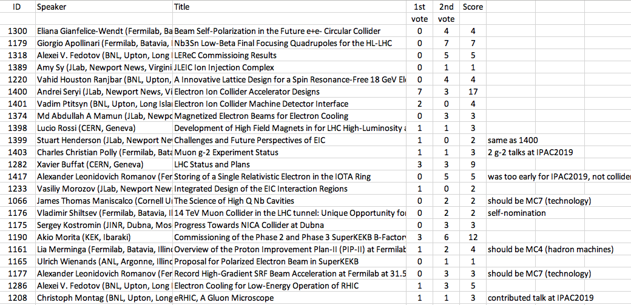
All proposals with votes

Slide 4
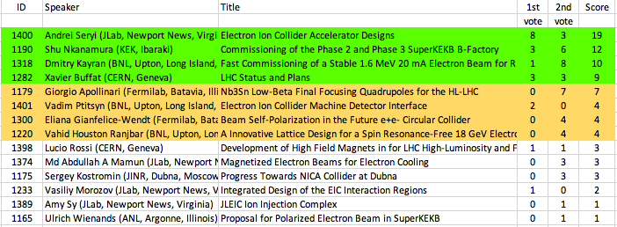
Green: 4 proposal
Yellow: 4 back-ups
Blue : 0 plenary
2nd iteration
Balances:
2x America, 1x Asia, 1x Europe
4x M, 0x F
3x EC
MC1: Wolfram Fischer (BNL) and Mei Bai (GSI)

Slide 5
MC-1 comments
Have covered operating colliders (LHC, KEKB),
proposal for new American collider (EIC),
and electron cooling for colliders (Budker’s original idea)
SuperKEKB speaker changed to Shu Nkanamura (EC)
EIC talk by JLab is balanced with IPAC2019 contributed
talk on eRHIC
LEReC talk to be given by Dmitry Kayran (EC),
changed title to “Fast Commissioning of a Stable 1.6 MeV 20 mA Electron Beam for RHIC Low-Energy Cooling” (ID: 1172)
Hope that CERN will support junior scientist for LHC talk
despite stated policy of not supporting NAPAC

