Slide 1
MC 5
Ideally, we should have talk on general beam dynamics topics and/or on EM field.
Most of the identified tentative speakers within the highest-ranked talks are not junior (all are PhD+>15 yr).
It would have been nice to have some talk on simulations, algorithm (this is the main session for such a topic but not a lot of abstract on the topic)

Slide 2
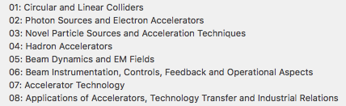
MC5: Beam dynamics and EM field
There are 42 abstracts.
Storage ring Single Particle dynamics 1337,1191, 1354,1407,1420,1235,1168, 1345
Diagnostics 1428=1351, 1311,1312 (some could go to MC6)
Ring instability 1348, 1304, 1257, 1074
Beam-beam 1077, 1166,1296
Space charge 1279=1420, 1181
Egun 1237 (this should probably go to MC2)
LINAC 1371, 1248,1085,1094
FEL 1383 (EEHG this should probably go to MC2)
Cooling 1229, 1167
New Acceleration 1438 (PWFA this should probably go to MC3)
Simulation 1378, 1367. 1173
Commissioning 1390,1246.1290,1080,1068

Slide 3
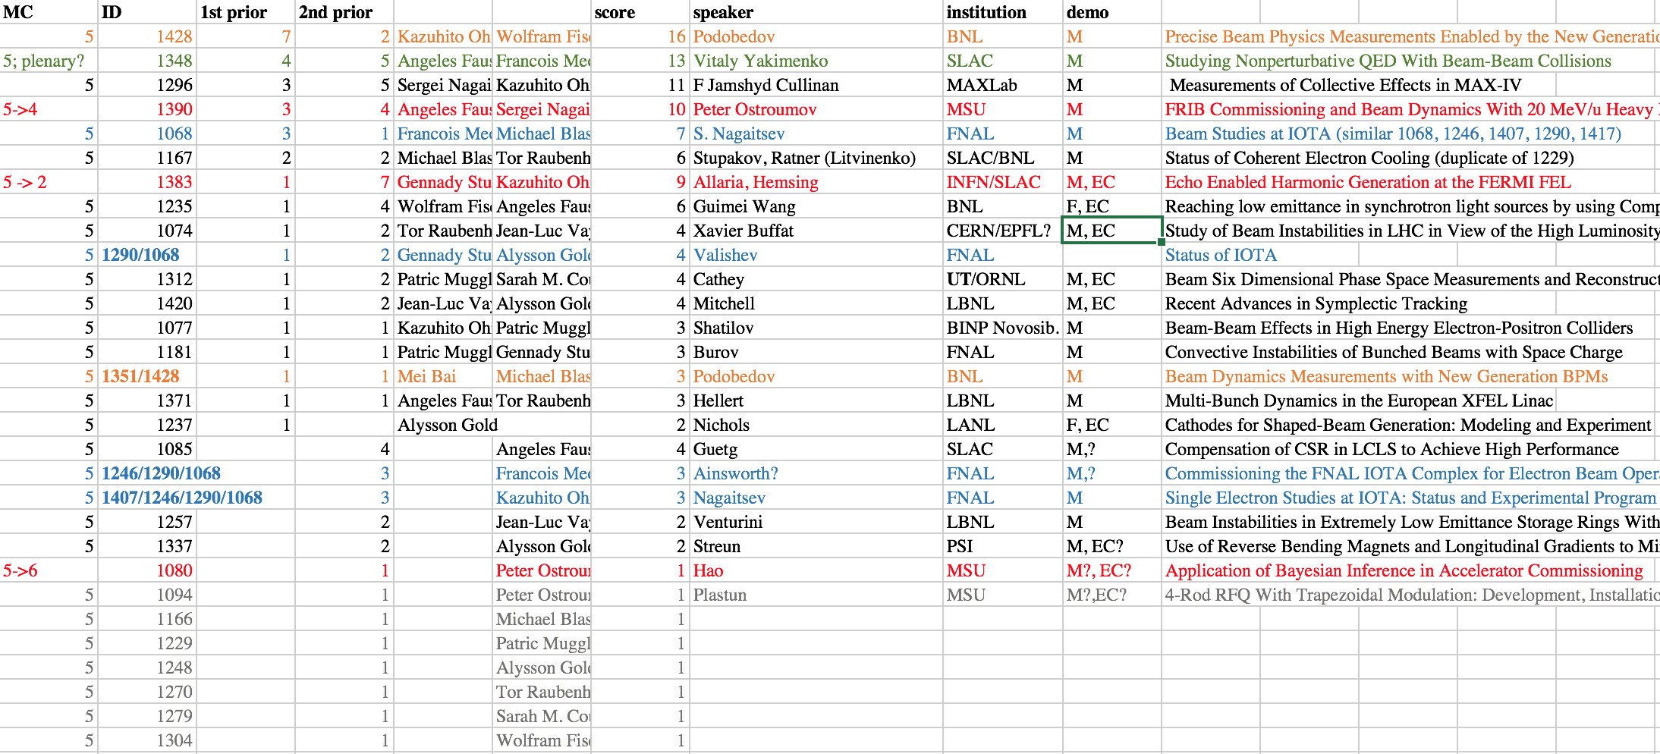
SPC voting
IPAC18
NPAC16,IPAC18)

Slide 4
Remarks I
1351/1428(1st) :“Precise Beam Physics Measurements Enabled by the New Generation of BPMs” (2 abstracts on the topics) -- interesting how new beam physics measurements are performed New generation BPM -- tentative speaker Podobedov (M, BNL)
1348 (2nd): Collective effect in MAX-IV Abstract lacks details on what is new/interesting. LHC instability (1074) seems similar and alternative choice – tentative speaker: Cullinan (M, MaxLab)
1296 (3rd): Talk on QED studies enabled by exotic electron beams ; not sure it fit under MC5 but if the emphasis is put on beam dynamics associated on needed electron probe (MAmps peak current) that could be an interesting topic – tentative speaker: Yakimenko (M/SLAC)
1407/1246/1290/1068: IOTA abstracts(commissioning, single-e-, experiments, integrable optics) new -- should be presented -- tentative speakers: Nagaitsev (NP16,IP18), Valishev (NP16) or Romanov (M,EC/FNAL)

Slide 5
Remarks II
1167: Coherent electron cooling -- tentative speaker Litvinenko, Ratner (EC), Stupakov (M,BNL/SLAC)
1235: Reaching low emittance in synchrotron light sources by using Complex Bends (non MBA)--tentative speakers: Guimei Wang (F, EC/BNL) main author on corresponding PRAB
1074: Study of Beam Instabilities in LHC in View of the High Luminosity LHC Upgrade – tentative speaker: Xavier Buffat (M, EC/CERN/EPFL)
1312: 6-D phase space measurement of a – tentative speaker: Bendon Cathey (M, EC/UT+ORNL)

Slide 6
Suggestion (but ring-centric + non Asian rep.)
Podobedov (M/BNL) – beam dynamics studies enabled by precise beam position monitor
Romanov? (M, EC/FNAL) – the IOTA complex
Yakimenko (M, SLAC) – exotic beam as QED probes (plenary?)
Buffat (M, EC, CERN/EPFL) –(now MC1?) instabilities in LHC or Cullilnan (M, MaxLab) – collective effect in Max-IV
Cathey (M, EC, UT/ORNL) – 6D phase space characterization of an ion beam
Wang (F, EC/BNL) – complex-bend lattice design to reach ultra-low emittances in storage rings
Ratner (M, EC?/SLAC) or Stupakov? (M/SLAC) or – review of coherent electron cooling (results?) and options

