Slide 1
NAPAC 2019
Student Program
Student Tutorials & Short Courses
Alysson Gold, Steve Lund
June 14th, 2019
NAPAC 2019 SPCC Meeting #3
Notes:
SL: Will use this title but strip logos rather than putting bunches.

Slide 2
Tutorials: Brief Review
Held in parallel with first morning session
  8:30am – 10:00am
Objectives
  Provide necessary background (fundamental physics + context) for participants to engage in material presented at NAPAC
  Enable and motivate students and new members to the field to participate broadly in the conference
Strong connection between plenary lectures and tutorials
Notes:
I’ll add to this slide tomorrow morning
SML: See merged set. Have from Torr.

Slide 3
Proposed Tutorial Topics
Tutorial | Brief Description | Potential Speakers
Applications of Accelerator SRF Research to New Technologies | A primer for Romanenko's plenary on SRF for quantum computing. Ideally, it would provide context into qubits (or whatever type of quantum computing is being addressed in the plenary), how they work and why SRF is important to their operation. The talk should provide students with a basic understanding of the specific SRF concepts relevant to the plenary, including how they are applied in accelerators today. | Romanenko (FNAL)
Compact Light Sources | Overview of the physics of compact light sources (inverse Compton scattering, etc.) and the unique design and engineering challenges, including developing products which can be used in academic and industry labs. | Graves (ASU) Ruth (SLAC)
Cryo-Engineering | Introduction to how the cryogenic systems work and specific challenges of cryo-engineering for accelerators (cryogenics, vacuum, mechanical vibrations, controls, etc.). | Peterson (SLAC) Wu (FNAL) Daly (JLAB) Prebble (JLAB)
Feedback Systems | Brief review of basic controls and how a feedback system works, followed by overview of how they are used in stabilizing beam dynamics. Ideally would also discuss the beam physics involved including the time-scales and how they result in challenging requirements on the control system. Recent progress and potential applications in stabilizing future, higher intensity beams (including technical challenges which would need to be overcome). | Teytelman (Dimtel) Fox (Stanford)
Notes:
I’ll add to this slide tomorrow morning
SML: See merged set. Have from Torr.

Slide 4
Proposed Tutorial Topics
Tutorial | Brief Description | Potential Speakers
Future Colliders: Physics and Applications | Physics case for a collider, mapping the physics to specific requirements of the accelerator, perhaps highlighting unmet challenges that the future generation of accelerator physicists will need to address. | Seryi (JLAB) Arkani-Hamed (Princeton)
Future of FELs | Recent advances in FEL physics, including attosecond pulses and TW power levels. Discussion of both the accelerator physics and experimental methods which enabled these advances and potential applications. | A. Marinelli (SLAC) S. Li (SLAC) J. MacArthur (SLAC)
LLRF Systems | Introduction to low-level RF systems: why we need them, how they work and recent advances in the field. | Doolittle (LBNL)
Machine Learning and Accelerators | Introduction to machine learning concepts with examples from accelerator physics demonstrating the impact of these techniques in recent years. | Tomin (XFEL) Neveu (SLAC) Edelen (SLAC)
MBA Light Sources | Physics and engineering of MBA lattices | Lindberg (ANL) Wang (BNL) Liu (LNLS)
Plasma Accelerators | Discussion of what is required for plasma accelerator to meet the demands of their potential applications, where we are in meeting these requirements today and potential solutions to be explore in the future. | Gessner (CERN)
Notes:
I’ll add to this slide tomorrow morning
SML: See merged set. Have from Torr.

Slide 5
Proposed Tutorial Topics
Tutorial | Brief Description | Potential Speakers
Precise Beam Physics Through Diagnostics | Motivation for sophisticated beam measurements (diffraction-limited light sources and operation above collective instability thresholds), recent developments in diagnostics and novel concepts for the future. | Podobedov (BNL)
Rare Ion Beams and Accelerator Applications in Nuclear Physics | Brief introduction to nuclear physics and motivation for accelerators in enabling basic research in nuclear science. Discussion of the challenges in accelerating rare ion beams compared to electron and proton beams. Possibly a brief discussion of industry applications in nuclear physics as well, including radio-isotope production and accelerator driven fission? | T. Glashmacher (MSU)
Notes:
I’ll add to this slide tomorrow morning
SML: See merged set. Have from Torr.

Slide 6
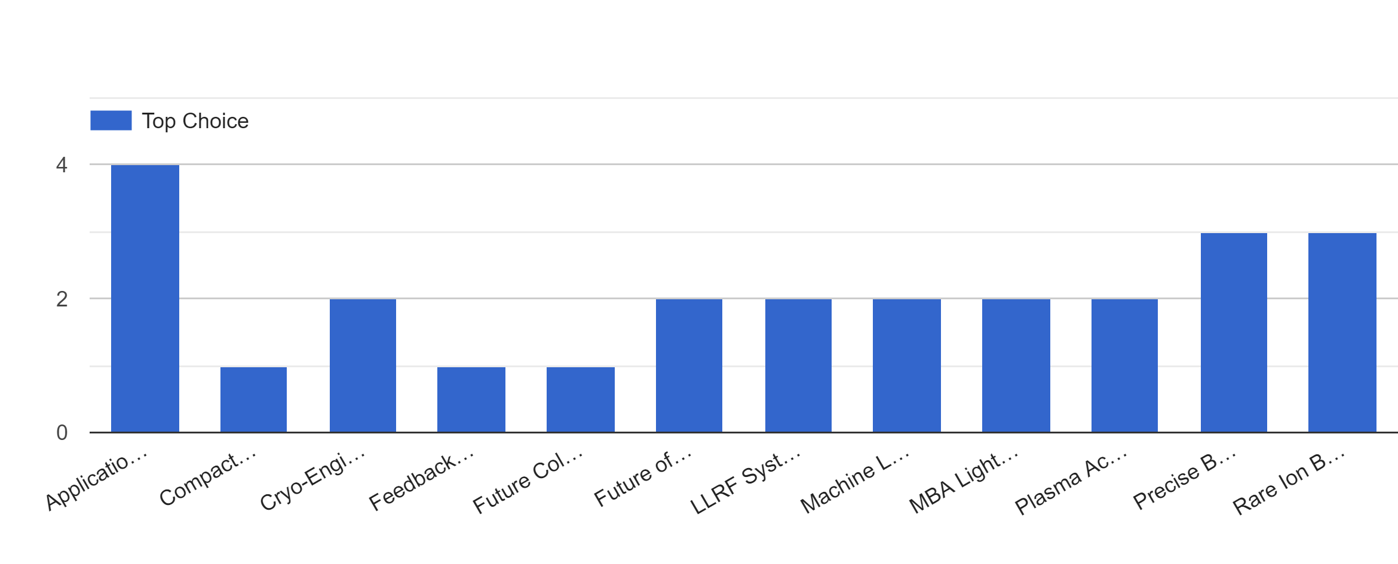
Feedback on Proposed Topics
5 responses to request a few weeks ago:
Notes:
I’ll add to this slide tomorrow morning
SML: See merged set. Have from Torr.

Slide 7
Proposed Tutorials Based on Feedback
Top Choices (4 tutorials total):
  Applications of Accelerator SRF Research to New Technologies
    Romanenko, FNAL
  Precise Beam Physics Through Diagnostics
    Podobedov, BNL
  Rare Ion Beams and Accelerator Applications in Nuclear Physics
    Glashmacher, MSU
  Machine Learning and Accelerators
    Edelen, SLAC
I will invite the top choices first. If suggested speaker can’t give the tutorial, will ask for a designee.
Back-up:
  Cryo-Engineering
    Wu, FNAL
  Future of FELs
    Marinelli, SLAC
If I can’t find anyone suitable, I’ll move to one of the back-up topics.
Notes:
I’ll add to this slide tomorrow morning
SML: See merged set. Have from Torr.

Slide 8
Your Feedback?
Feel free to discuss / revise the proposed plan (topics + speakers).
Top Choices (4 tutorials total):
  Applications of Accelerator SRF Research to New Technologies
    Romanenko, FNAL
  Precise Beam Physics Through Diagnostics
    Podobedov, BNL
  Rare Ion Beams and Accelerator Applications in Nuclear Physics
    Glashmacher, MSU
  Machine Learning and Accelerators
    Edelen, SLAC
Back-up:
  Cryo-Engineering
    Wu, FNAL
  Future of FELs
    Marinelli, SLAC
Notes:
I’ll add to this slide tomorrow morning
SML: See merged set. Have from Torr.

Slide 9
Timeline
Invite speakers (June 17th)
Deadline for speakers to respond (June 24th )
Second round of invites if needed (June 26th)
Deadline for second round responses (July 3rd)
Finalize tutorial program and get abstracts from speakers (July 8th)
Make web-page for tutorials and poster for putting up during NAPAC (July 15th)
Notes:
I’ll add to this slide tomorrow morning
SML: See merged set. Have from Torr.

Slide 10
IEEE Short Courses: Summary Status
All scheduled and confirmed
Sunday: 9:00 am – 12:30 pm (1/2 hour break in middle)
22 registered (as of 6/14): 19 student status, 3 other
Box lunch provided before student poster session starting at 2:00 pm
Cost $50 (includes lunch), reimbursable
IEEE Paul Phelps awards supplement travel up to $150 to fund extra night (IEEE NPSS member for eligibility)
USPAS projectors borrowed to reduce cost
Lectures stream will be recorded (Zoom) and posted on conference and USPAS tutorials web site
3 Short Courses: 2 Physics, 1 Engineering. All linked to upcoming USPAS courses

Slide 11
IEEE Short Courses
Science: Beam Cooling
Instructor: Sergei Nagaitsev (FNAL)
Linked USPAS Class: 2021 Tentative
Science: High Brightness Electron Injectors
Instructors: Jared Maxson (Cornell) and Pietro Musumeci (UCLA)
Linked USPAS Class: January 2020, San Diego
Engineering:Engineering for Superconducting RF Linear Accelerators
Instructor: Vyacheslav Yakovlev (FNAL)
Linked USPAS Class: January 2020, San Diego

Slide 12
IEEE Short Courses: Needs
Enrollment: 22
  44 students supported by NAPAC … should have more
  Email students supported and request they participate?
Only one student requested travel support to date via IEEE Paul Phelps
Prudent to remind all speakers and verify schedule
  Yakovlev, Eng for SRF Linacs, recently discussed prep
  Maxson & Musumeci, High Brightness e- Injectors, recently reconfirmed
  Nagaitsev, Beam Cooling, not reconfirmed
  Event of a late cancel little consequence outside of student disappointment: students can shift to other

