Slide 1
Experiment Preparation at the ReAccelerator
Ana Henriques
October, 1st 2020

Slide 2
Outline
ReA
  The facility
  Present configuration
  Challenges
  Ongoing upgrades
Beam delivery
  Charge state selection
  Linac tuning
  Documentation
Summary

Slide 3
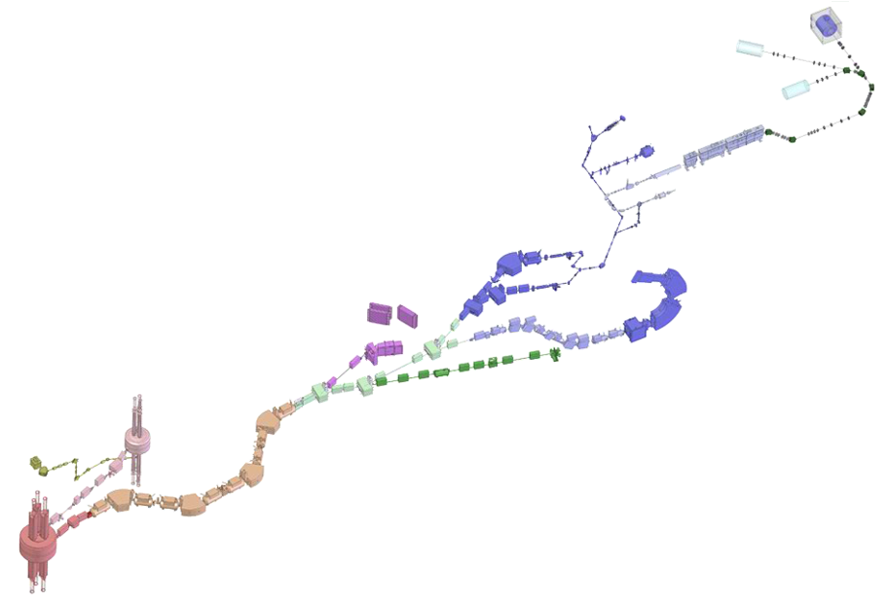

ReAccelerator @ NSCL/FRIB
NSCL: National Superconducting Cyclotron Lab. @ MSU
  User facility producing rare-isotope beams by projectile fragmentation.
ReA @ NSCL
  Post-accelerator built for reacceleration of rare-isotope beams to several MeV/u.
“Low” Energy Beam Area
(~ several MeV/u)
Thermalized Beam Area
ReA, post-accelerator
High Energy Beam Area
Acceleration (>150 MeV/u):
ECR ion source
+ coupled cyclotrons
Production (>80 MeV/u):
Projectile fragmentation & in-flight separation
Production target
NSCL rates ≤ 10⁹ pps

Slide 4



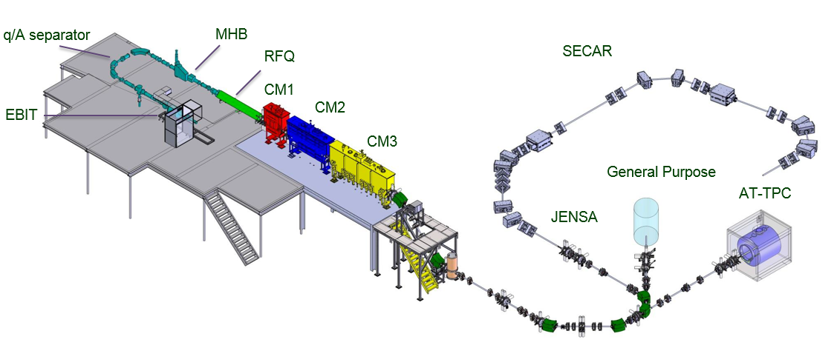
ReA – Research Topics
Properties of nuclei
  Develop a predictive model of nuclei and their interactions
  Many-body quantum problem
Astrophysical processes
  Origin of the elements in the cosmos
  Explosive environments: novae, supernovae, X-ray bursts…
Societal applications and benefits
  Bio-medicine, energy, material sciences, national security
Reaccelerator ReA at NSCL
National Superconducting Cyclotron Laboratory
- 2010: RFQ commissioning started
- 2011: CM1 first beam acceleration
- 2011: CM2 first beam acceleration
- 2013: First experimental hall beam line
- 2013: First rare isotope experiment
- 2013 EBIT coil fails
- 2014: ReA3 Beam Lines complete
- 2014: EBIT magnet returns
- 2015: CM3 full energy acceleration
- 2015: ReA RIB program starts

Slide 5
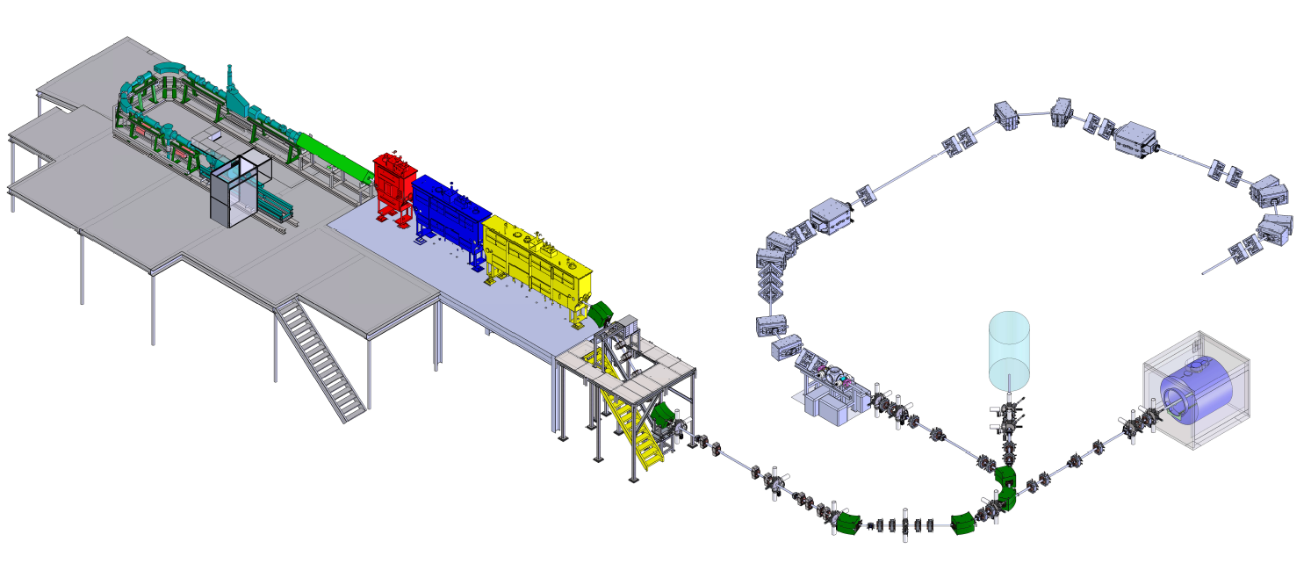
ReA – Present Configuration
Q/A separator
SECAR
RFQ
SC-LINAC
EBIT
Charge Breeder
General Purpose Lines
JENSA
Beam from Thermalized area or local sources
Current configuration of ReA
Light ions: 0.3 - 6 MeV/u (M/q=2)
Heavy ions: 0.3 - 3 MeV/u (M/q=3)

Slide 6
ReA – Present configuration
Present configuration
  1 rebuncher + 14 resonators
  E_{max} = 12 ∙ q/M (MeV/u)
  Energy spread better than 0.5% (FWHM)
  Emittance usually better than 10 pi.mm.mrad
Total : 33 beams (15 radioactive and 18 stable beams)
Radioactive beams are challenging
  Efficiency
  Purity (“contaminants”)
  Rapidity (“Lifetime of rare ions”)
Complete available ReA beam list with 121 isotopes can be found in: http://www.nscl.msu.edu/users/beams.html

Slide 7
ReA – Challenges
Efficiency
Step | Efficiency
Separation | 20-80%
Stop in gas | 30-90%
Extract from gas, cool, and mass separate | 1-30%
Transport and inject in buncher | 50-80%
Bunch and extract | 95%
Charge breed | 10-25%
Accelerate, transport | 50-60%
Total (best) | 2.5%
Gas and solid stoppers
Charge Breeder

Slide 8
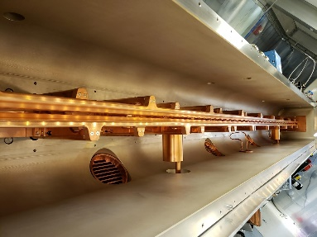
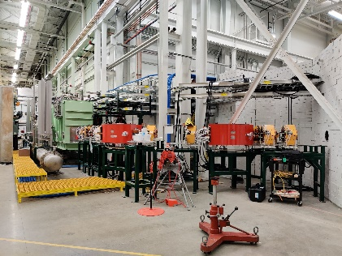
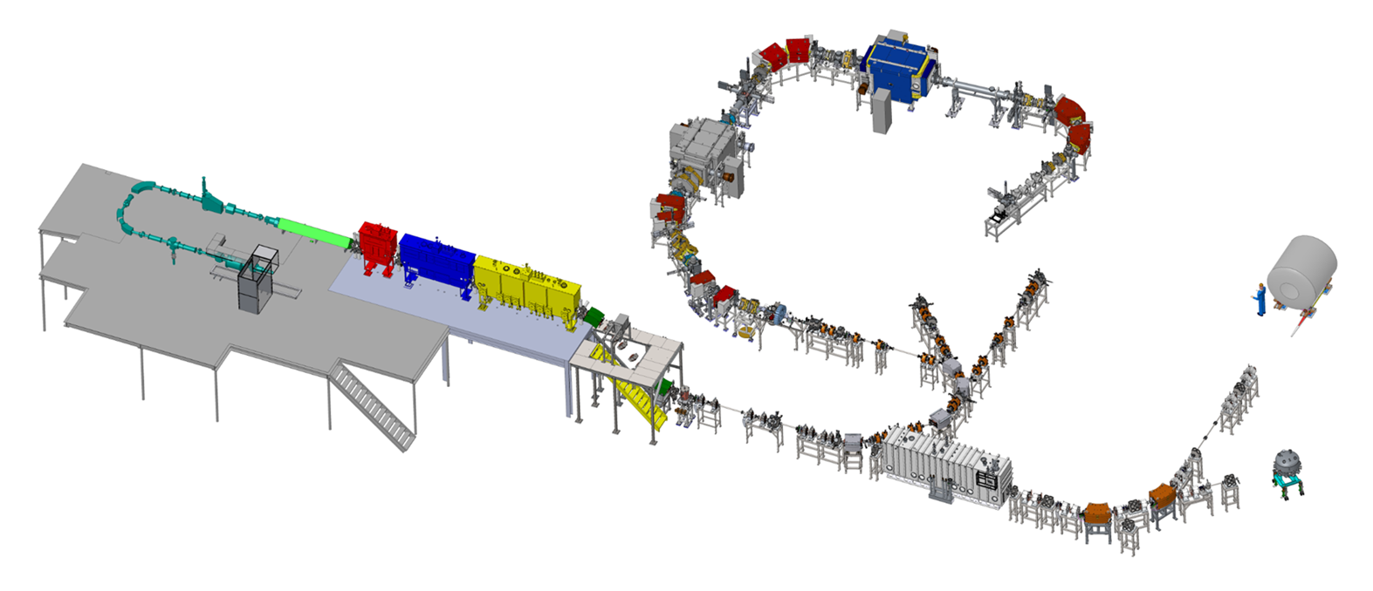
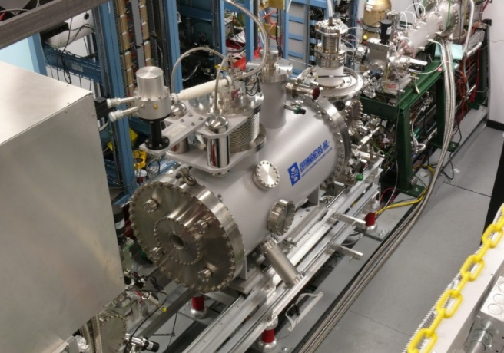
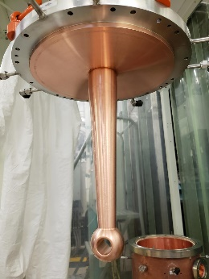
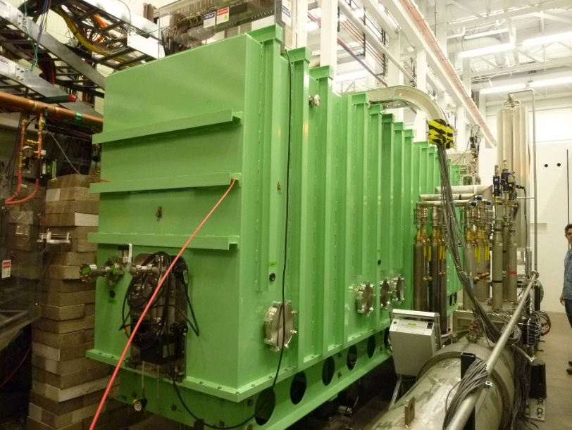
ReA – Ongoing upgrades
RFQ
ReA3
ReA6
HCEBIS
(see Hyock-Jun)
Rebuncher

Slide 9

ReA – ReA6
  Accelerate and transport beams within 2<M/q<5
  Beam energy 6 MeV/u for M/q = 2
  Beam intensities up to 1 x 10¹¹ pps
  Beam emittance of < 0.15 π.mm.mrad (norm.)
SOLARIS
ReA6
General
Purpose
Line
  Beam energy spread at 80 MHz of < 0.2 %
  Beam size in the targets down to 2 mm
  Commission in March 2021

Slide 10
ReA – Beam delivery
The process
Proposal
Technical
review
Contaminants, energy, intensity
Review
  ERR
R&D
Source development
ReA discussion
  Selection of pilot beam, possible contaminants, linac settings
Schedule
  Beam
  tuning
  Pilot and beam development
Documentation
Experiment
Evaluation

Slide 11
ReA - Charge state selection
The charge state determines the possible energy achievable
E_{max} = 12 ∙ q/M (MeV/u)
It can avoid undesirable contamination
Nevertheless, a contaminant can be selected as pilot beam !
Example: ¹¹⁶Sn

Slide 12
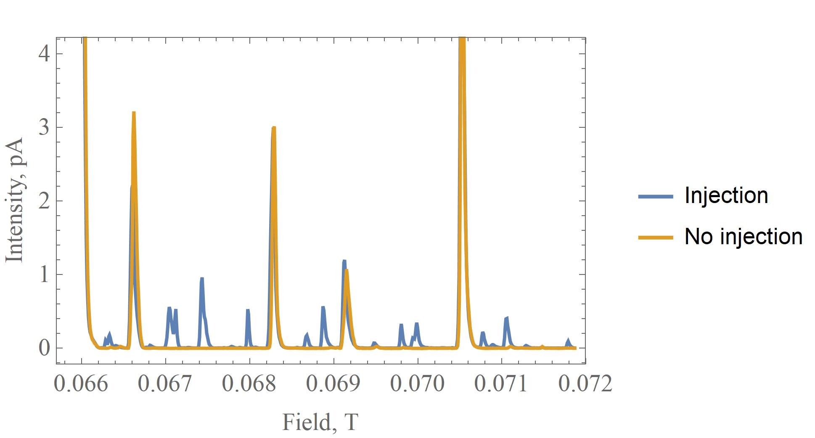
ReA – Charge state selection
R&D information – ¹¹⁶Sn
Possible charge states:
  38+,39+ and 40+
Possible maximum energy :
  38+ : 3.53 MeV/u
  39+ : 3.61 MeV/u
  40+ : 3.70 MeV/u
Required energy: 3.7 MeV/u
Definition of pilot
  M/q within 5%
  Future experiments
¹¹⁶Sn⁴¹⁺
⁴¹K¹⁴⁺
¹¹⁶Sn³⁷⁺
¹¹⁶Sn³⁸⁺
¹¹⁶Sn⁴⁰⁺
¹¹⁶Sn³⁹⁺
¹¹⁶Sn³⁸⁺
⁴¹K¹³⁺
¹¹⁶Sn³⁸⁺

Slide 13
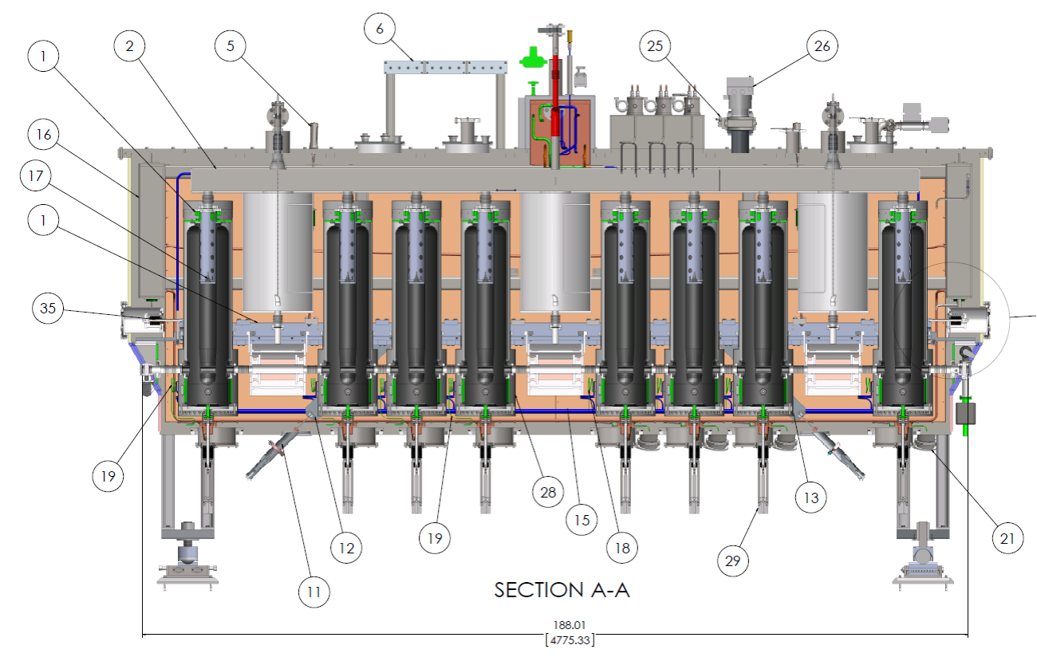
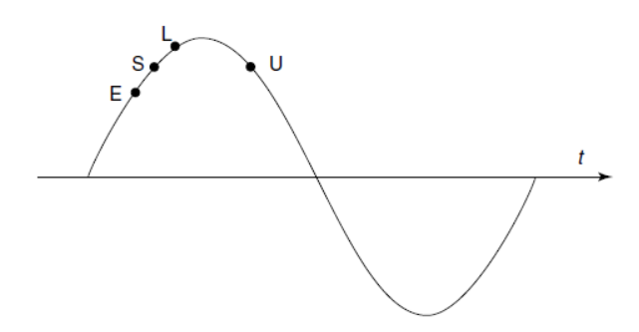

ReA – Linac phasing
  Before experiment:
    Calculator to determine the energy gain for each cavity
      Amplitude
      Phase
  During the experiment:
    Si detector at the end of the linac section
    Low intensity
    For each cavity:
      Determine zero-crossing
      Determine phase delay
      Apply phase delay
  Can take up to 15 minutes per cavity
S - Synchronous
E - Early
L - Late
U - Unstable
Ф = -20°

Slide 14
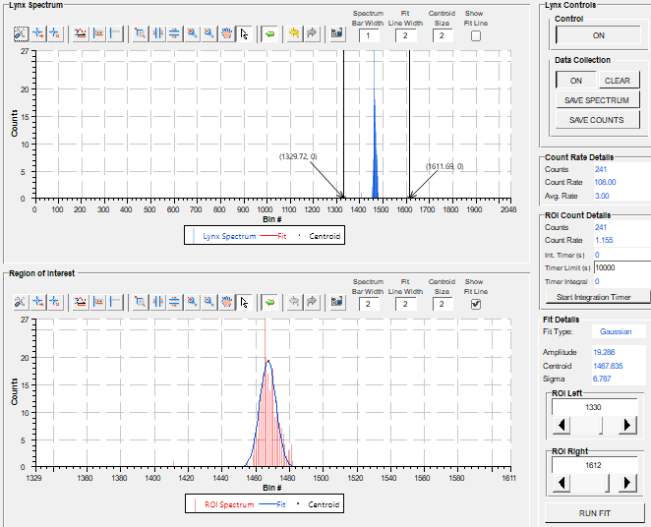
ReA – Linac phasing
  Optimization of phasing:
    Rely on theoretical modeling
    Optimize the procedure in place (ongoing)
Cavities off
Beam on Si detector
  Obtain mean value of distribution
Turn on cavity (low amplitude)
Change the cavity phase (delay)
  Check where is the peak
  Change phase until phase crossing is reached
  +90° - fixed delay ->Synchronous phase
  If beam lost, tune
  Goal: have it in the control system
    Identifying the key steps

Slide 15
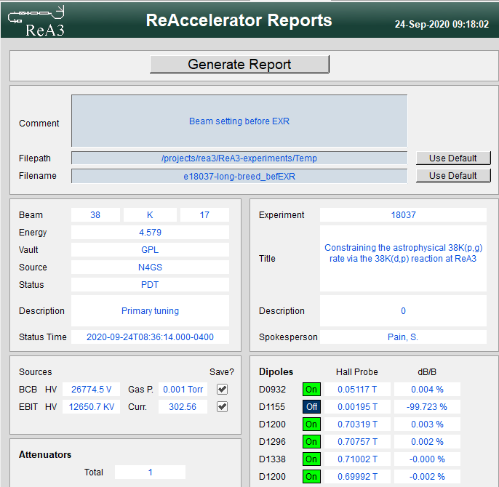
  ReA – Documentation & After Action Review
We learn from experience
Documentation:
  Hourlog – electronic logbook for operations
  Save-sets
  Experiment directory – all documents, viewer images, tuning checklists
  Experiment journal - notes on key points of experiment (unexpected contaminants, preparation, beam measurements)
  Setup journal – notes on details of particular setups as procedures to tune beam on target
In development:
    Automatic report

Slide 16
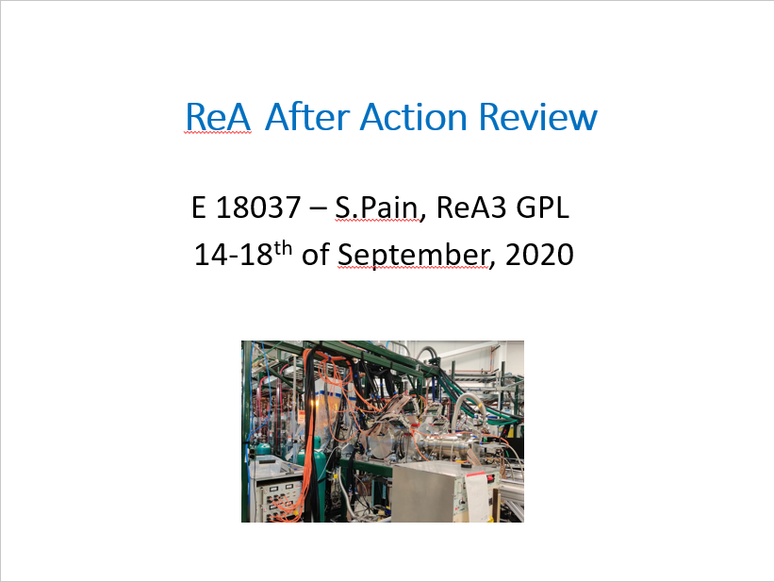
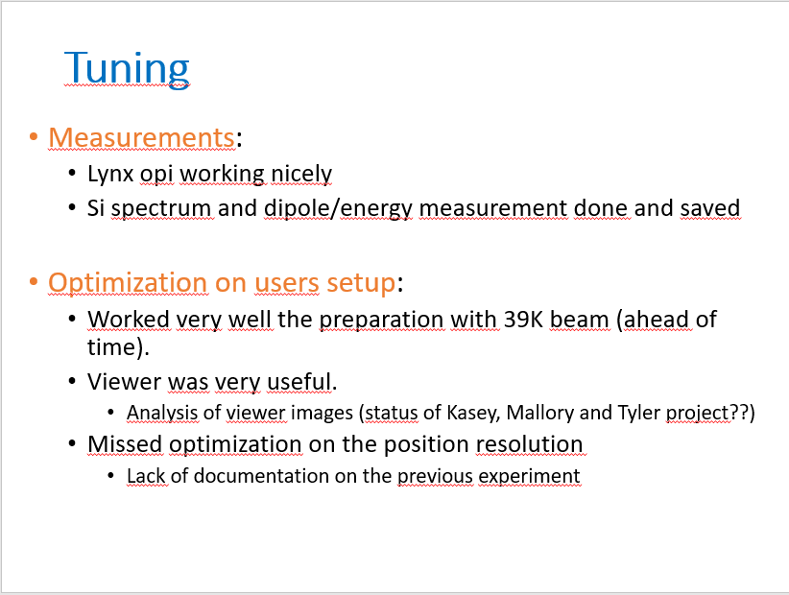
ReA – Documentation & After Action Review
  After Action Review
  How was the beam time ?
    Good actions and actions to be improved
  Topics:
    Numbers - tuning hours and efficiencies
    Before experiment – cables, set-up of diagnostics, meetings
    During beam tuning – procedures, measurements done
    During experiment – requests from users, measurements

Slide 17
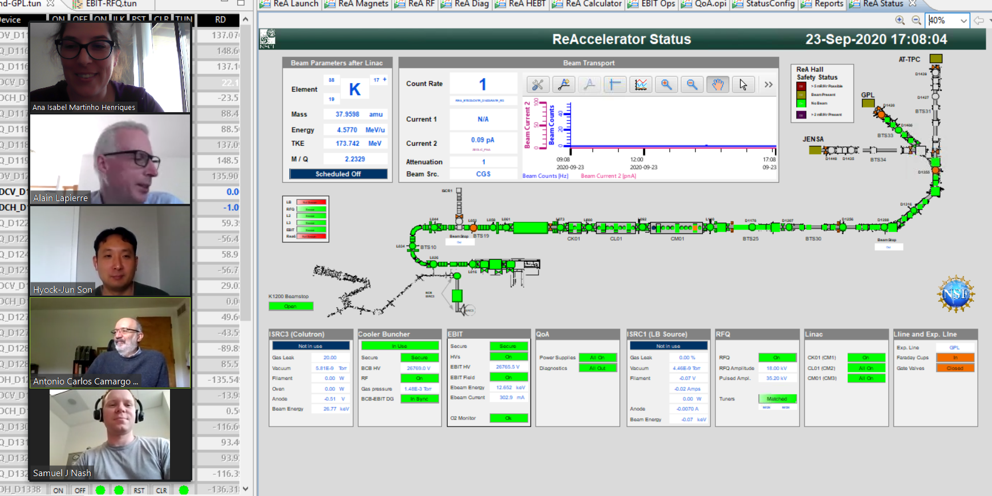
ReA – Beam delivery & COViD
    Currently we are operating from home

Slide 18
Summary
ReA accelerates rare isotope beams successfully producing science since 2015. It provides beams from 300 keV/u up to 6 MeV/u
It works in stand-alone mode or receives rare isotopes from high energy line
Optimization and upgrades are ongoing.
ReA6 commission foreseen in March 2021<
Selection of the charge state has a great impact on the efficiency, contaminants and beam energy
Beam delivery process behind the scenes and operation from home.

Slide 19
Thank you
Special thanks to the ReA group
  Antonio Villari
  Daniel Crisp
  Alain Lapierre
  Samuel Nash
  Hyock-Jun Son

Slide 20
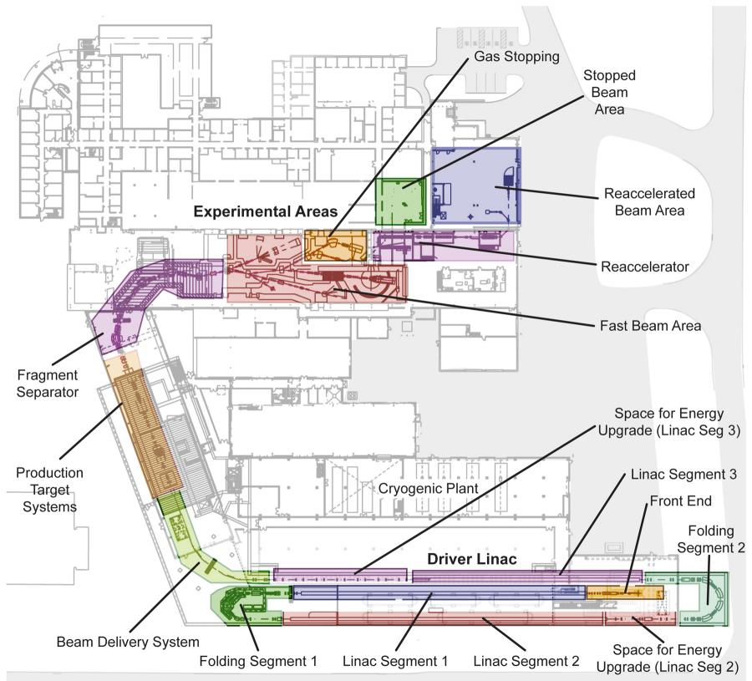
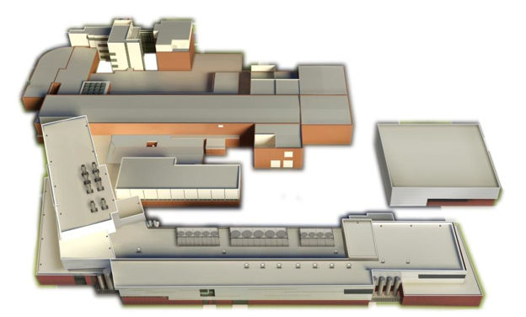
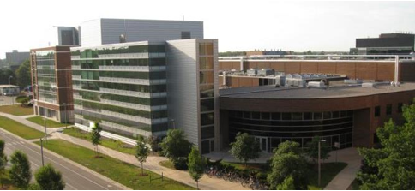
Facility for Rare Isotope Beams (FRIB)
FRIB will increase the current production rates of rare isotopes by up to 2-3 orders of magnitude, up to 10¹² pps
Coupled cyclotrons

Slide 21
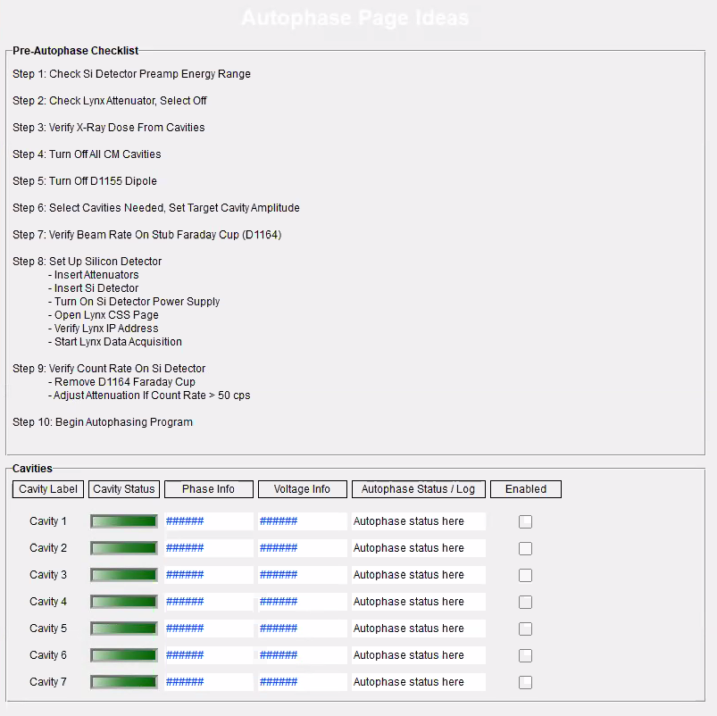
ReA - Linac phasing
  Beam
  tuning
  Si detector in control system
  Start of control system pages

